Slide 1

Flight Manager
Group #1
Hiba ALAMI
Djagou DONKO
Raid GUEDOUDJ
André KENY
Lydia KHEMSINE
Jean-Yves LONDONIO
Remzi VUKOVIC

Slide 2
2
2
System Overview
The system to be developed is a flight management system in response to airline companies need to organize and planify upcoming flights.
The main purpose of the system is to establish a clear and detailed calendar defining each upcoming flight in a unique and usefull way.
Flight Manager will be used by both CCOs and crew members through a website and mobile application.

Slide 3
3
3
3
Users
CCO Group
Crew Members
As for the CCO group, advanced privileges and flight modification access are granted through a website version of the system.
On the other hand, crew members only have a reading access in order to stay informed and accomplish their check-in in the best way.

Slide 4
Business Objects
In addition to some supplementary entities such as OFP, meteorology, NOTAM and advertising, our system has 3 major business objects detailed further more, which are flights, planes and employees.

Slide 5
4
2
Business Objects
Plane
Flight
Employee
- ATC_number
- departure_airport
- arrival_airport
- departure_time
- arrival_time
- OFP
- NOTAM_list
- ad_list
- meteo_card
- crew_list
- employee_id
- first_name
- last_name
- job_title
- model
- ATC_number
- commercial_number

Slide 6


5
5
2
Technical Diagram
Database
OFP
System
OFP
Import
Advertising
System
Advertising
Import
Alert
System
Meteorology
Import
Meteorology
System
Server
NOTAM
Import
NOTAM
System
Website
Mobile app

Slide 7
Mobile App Outline
The mobile version of Flight Manager is destined to crew members as mentionned before.
It will provide appropriate information display accordingly to each member’s job title.

Slide 8
6
2
Mobile App Navigation Schema
Home Page
Flights list
Flight Details
The amount of information displayed in both the flights list and each flight details will be adapted to the job title of the person authentified in the current session.

Slide 9
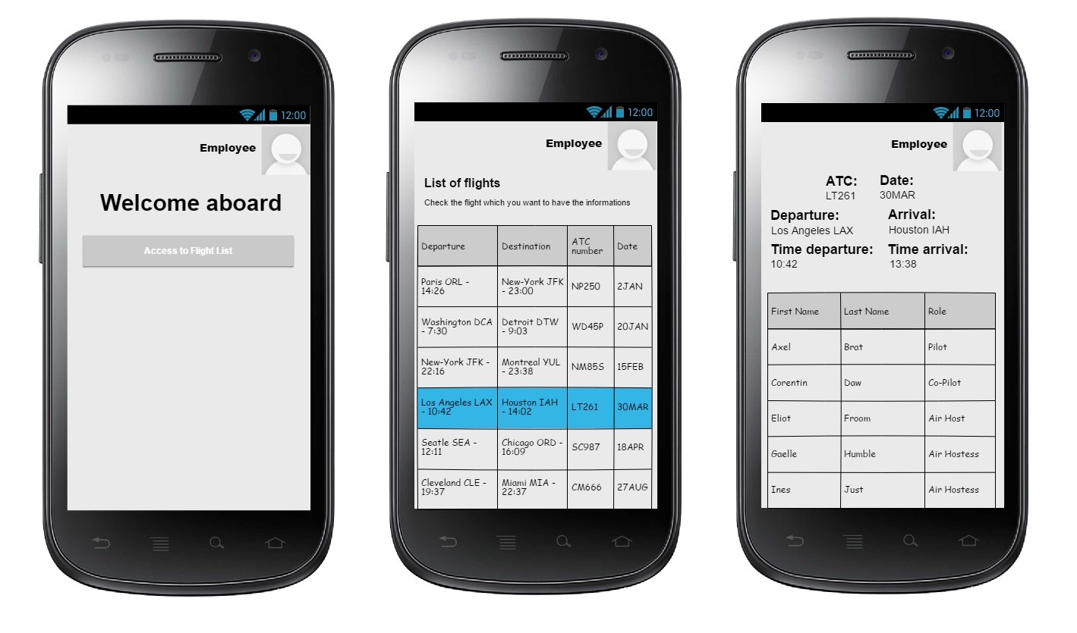
8
2
Mobile App Mock-ups

Slide 10
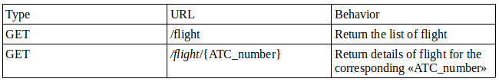
8
2
Webviews

Slide 11
Website Outline
The website version of Flight Manager
Is intended for CCO members as it will provide data modification interfaces.

Slide 12
7
2
Website Navigation Schema
Manual add
Add Flight
Excel Import
Home Page
Flights list
Flight Details
Update Flight
An authentification interface will be developped futher more before granting access to the home page as the update privilege is a serious matter.

Slide 13
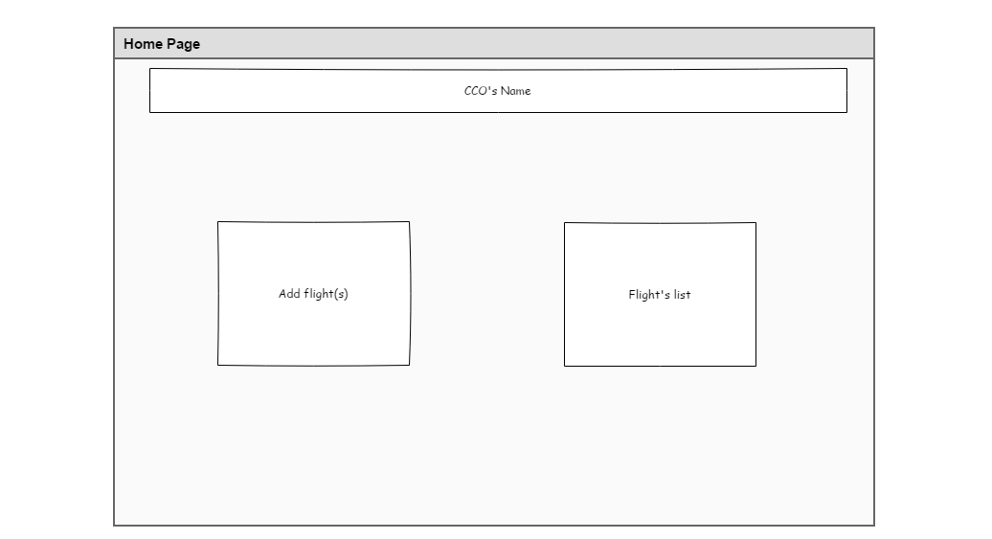
8
2
Website Mock-ups : Home page

Slide 14
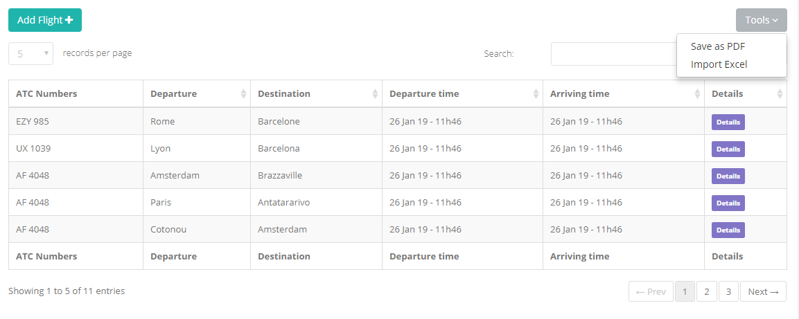
8
2
Website Mock-ups : Flights list

Slide 15
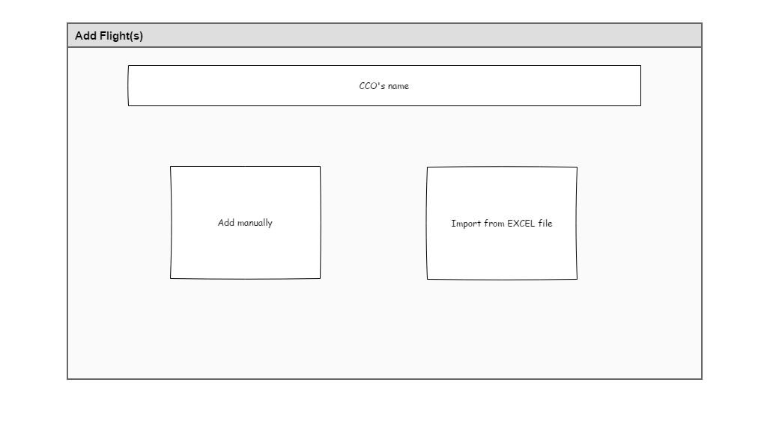
8
2
Website Mock-ups : Add Flight

Slide 16
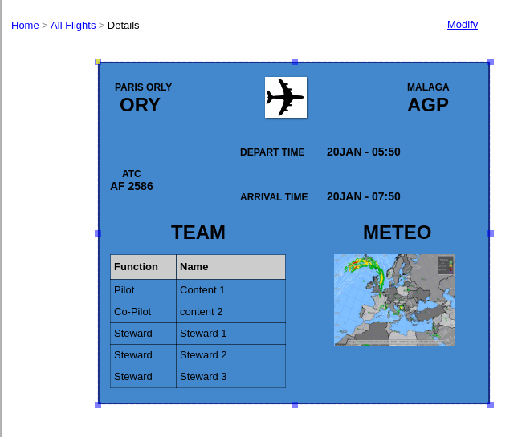
8
2
Website Mock-ups : Flight Details

Slide 17
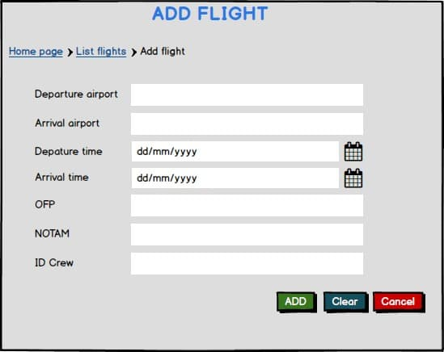
8
2
Website Mock-ups : Add Form

Slide 18
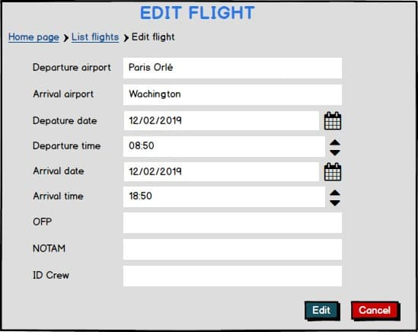
8
2
Website Mock-ups : Update Form
Paris Orly
Washington

Slide 19
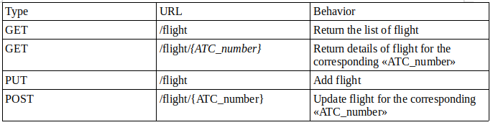
8
2
Webviews

Slide 20
Workspace Structure

Slide 21
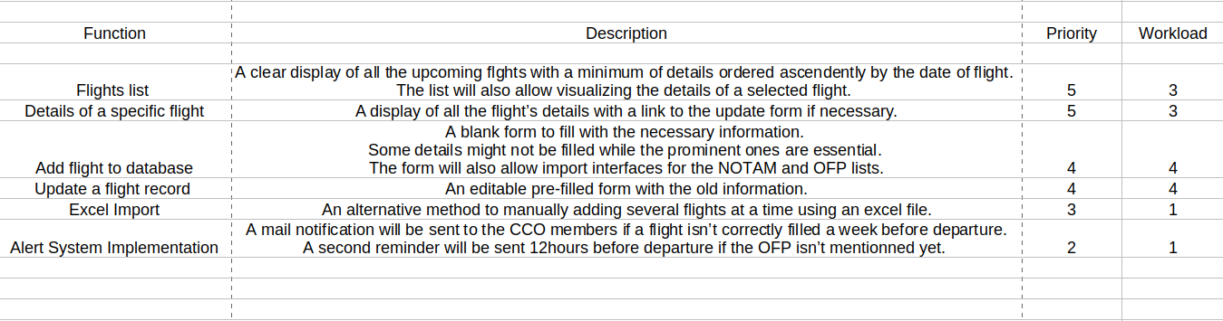
8
2
Backlog

Slide 22
8
2
Git Repository
Link to our git repository : https://github.com/andressito/ProjetGLA2019
As for the persistence layer, our classes are the followings :
- ActionFlight.java
- Ads.java
- DAOException.java
- Employee.java
- EmployeeDao.java
- Flight.java
- FlightDao.java
- Interface_plane.java
All the implemented classes are in the link above.
Same goes for the stub.

