Slide 1
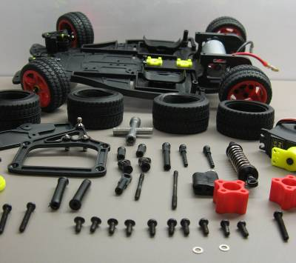


Slide 2
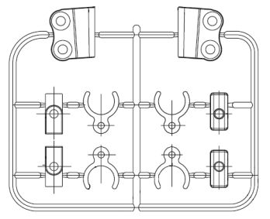
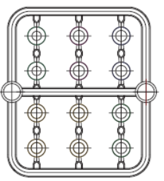
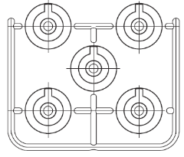
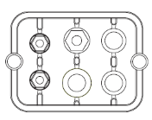
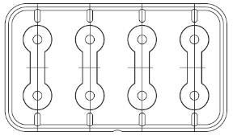
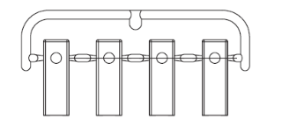
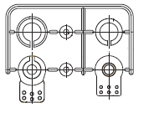
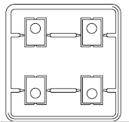
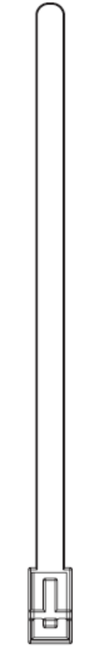
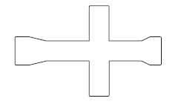



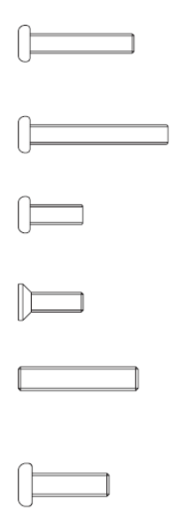
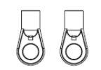
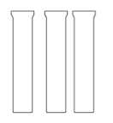

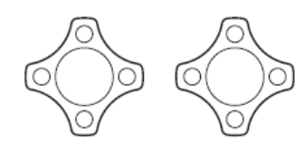
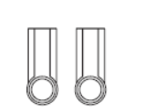

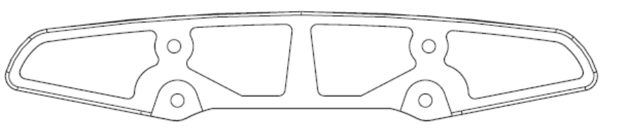
Spare Parts List (not to scale)
Servo Joints
Front Wheel-height adjustment blocks
Servo orientation poles
Spring Adjustments
Assorted Nuts and Gaskets
Allen Wrench
Lug Wrench
Servo Gaskets and Mount
Rear Wheel Height Adjustment Blocks
4.8mm ball
M3x16
Shafts
5.8mm ball
M3x22
Ball Drawbar
Spacers
M3x8
M3 nut
M3x8 sink
Rear Wheel Regulators
Half-Ball Drawbar
Connecting Rod
Front Fender
3.1mm gasket
M3x15 bolt
M2.6x10
Adjustable Tie Down

Slide 3

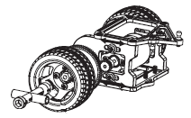
Tire Construction
Foam
Rim
Finished Tire
Rubber
Attach the tire with the lug wrench.

Slide 4
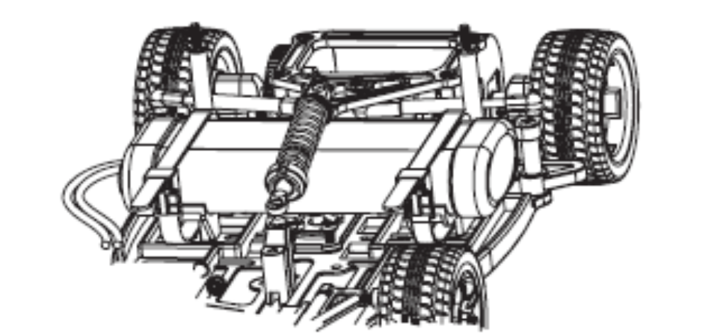
Drivetrain Assembly

Slide 5
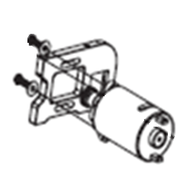
Motor Mount

Slide 6
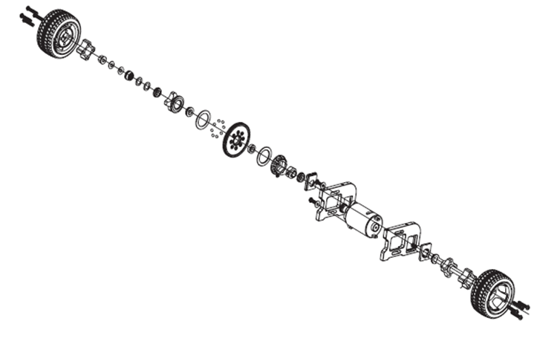

Slide 7
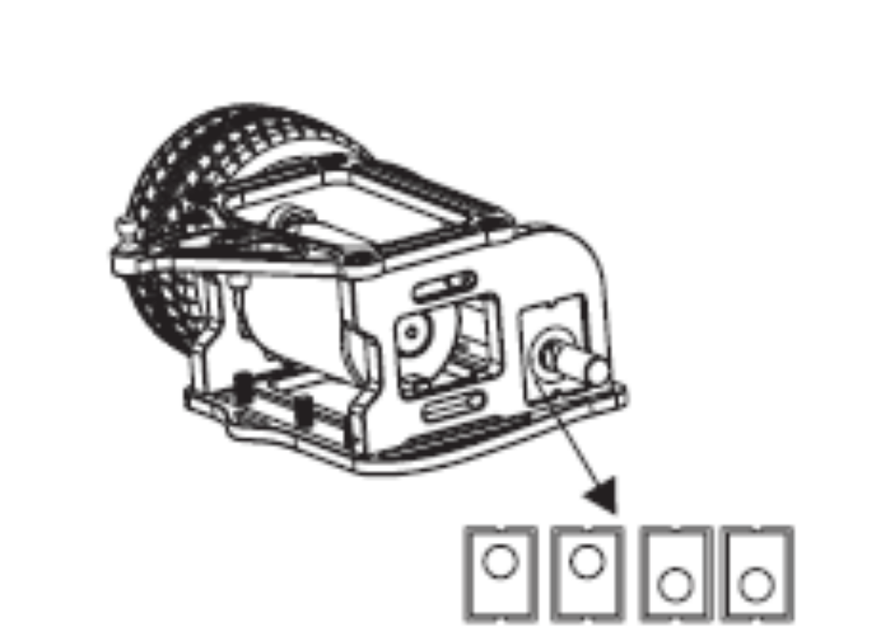
Motor Height Adjustment
Rear wheel height adjustment spacers elevate the rear axle.

Slide 8
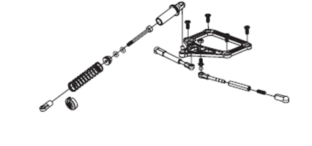
Rear Shock Assembly

Slide 9
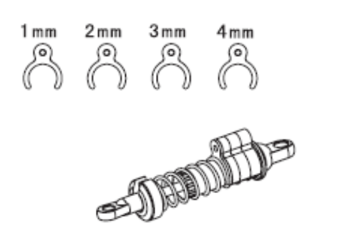
Shock Spacers
To mount the Tower System you will need to move the rear shock absorber.

Slide 10
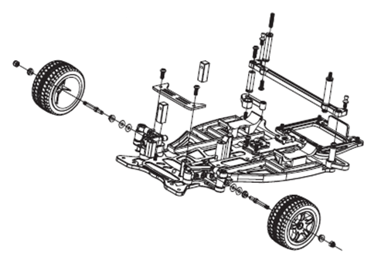
Steering Assembly

Slide 11
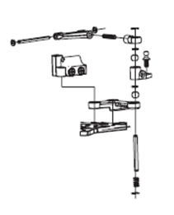
Front Strut Assembly

Slide 12
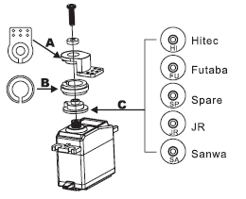
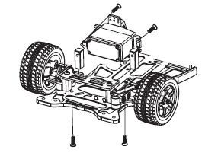
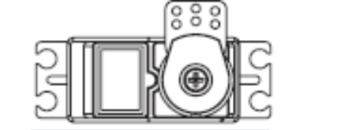
Servo Mounting
Power the servo and put it in the center (0 degree) state before tightening screws.

Slide 13
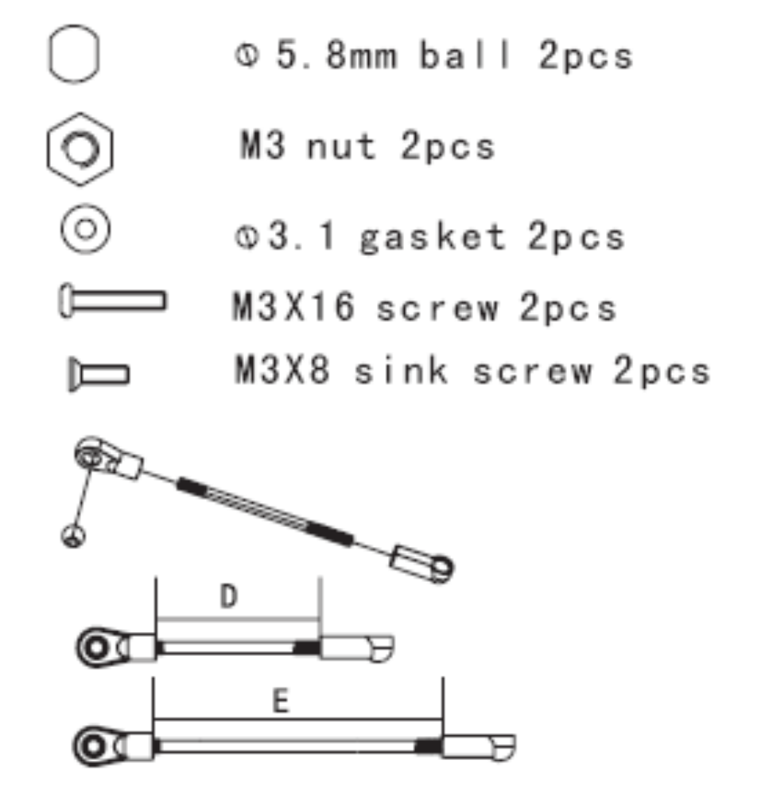
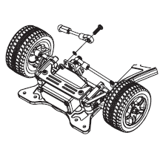
Drawbars
Adjust D and E to proper length

Slide 14
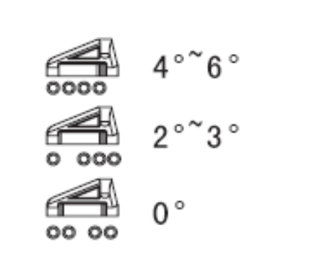
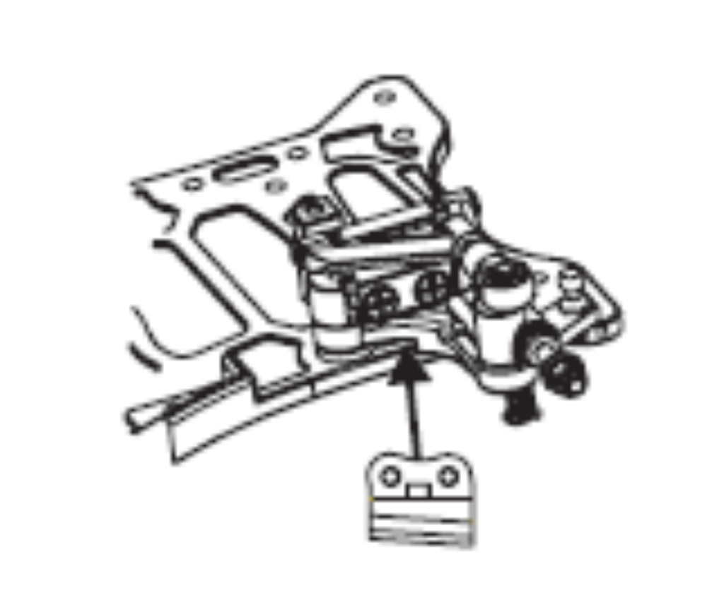
Rocker Arm Adjustments
Rocker arm pieces allow for wheel angle adjustment

Slide 15
To mount the control board you will need to move the rear shock absorber.
Rocker arm pieces allow for wheel angle adjustment
Rear wheel height adjustment spacers elevate the rear axle.
Tire Construction
Finished Tire
Rubber
Foam
Rim
Attach the tire with the lug wrench.

Slide 16
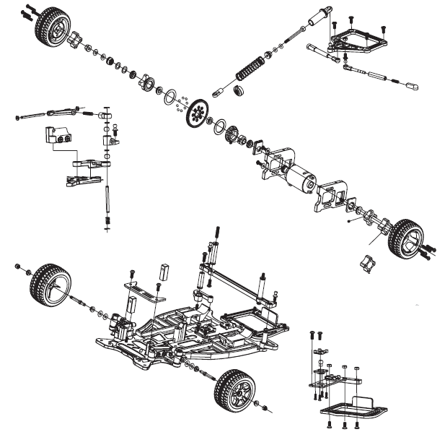
Customize by adding different rear wheel spacers

