Slide 1

Google Play Store Apps
Andres Viloria
Aarushi Dhyani
Diana Ortiz
Sameeksha Mendon

Slide 2
AGENDA
Questions of Interest
Data Set overview
Data Quality
Conclusion
Q&A

Slide 3
Step1
Data overview

Slide 4
“While many public datasets (on Kaggle and other sources) provide Apple App Store data, there are not many counterpart datasets available for Google Play Store apps anywhere on the web. On digging deeper, I found out that iTunes App Store page deploys a nicely indexed appendix-like structure to allow for simple and easy web scraping. On the other hand, Google Play Store uses sophisticated modern-day techniques (like dynamic page load) using JQuery making scraping more challenging.” -Lavanya CS Grad (Language Technologies) at Carnegie Mellon University
Google Play Store Apps

Slide 5
Variables:
Categorical:
Genres: An app can belong to multiple genres (apart from its main category). For e.g., a musical family game will belong to.
Category: Category the app belongs to
Type: Paid or Free
Content Rating: Age group the app is targeted at - Children / Mature 21+ / Adults.
Numerical:
Price: Price of the app (as when scraped)
Size: Size of the app (as when scraped)
Rating: Overall user rating of the app (as when scraped)
Installs: Number of user downloads/installs for the app (as when scraped)

Slide 6
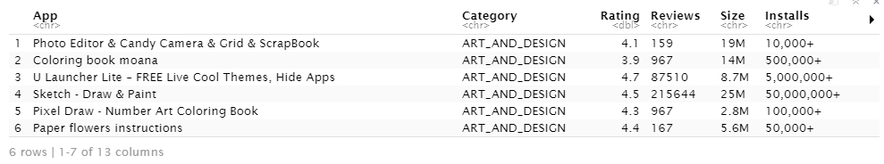
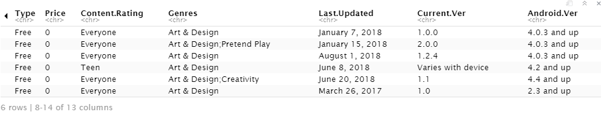

Slide 7
Data Quality

Slide 8
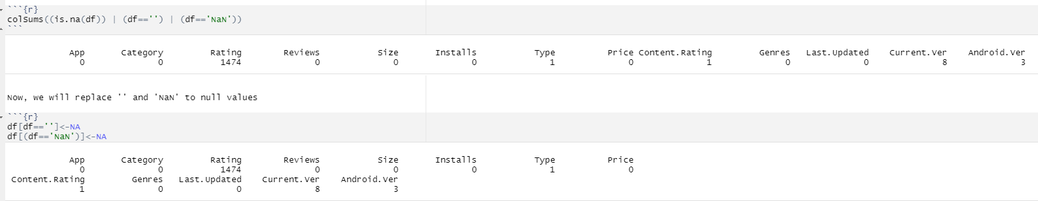
Remove NULL Values

Slide 9
Replace the missing values
Notes:
NULL TREATMENT
since the null values of the attribute rating are higher than 10% of the sample. We cannot rid of these observations. So those values will be filled in.
let's check the rating distribution by plotting box plot.

Slide 10
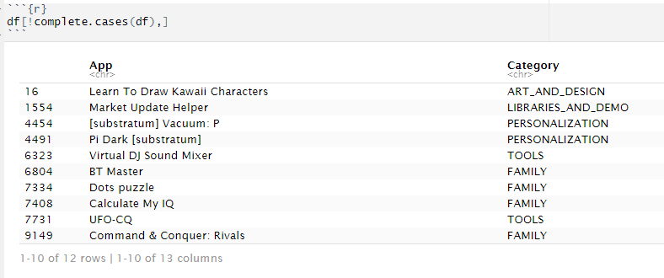
Eliminate NA Listwise

Slide 11
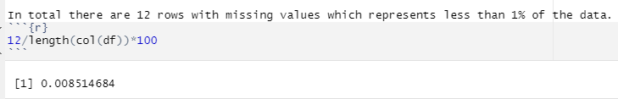
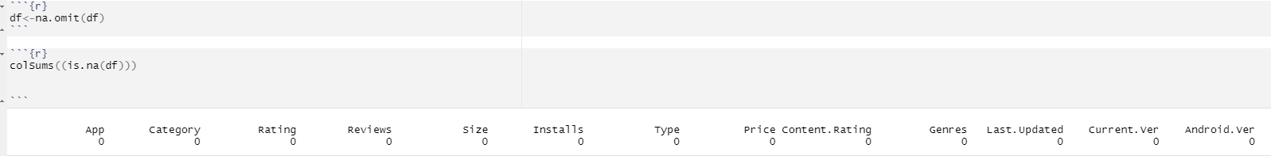
Eliminate NA Listwise

Slide 12
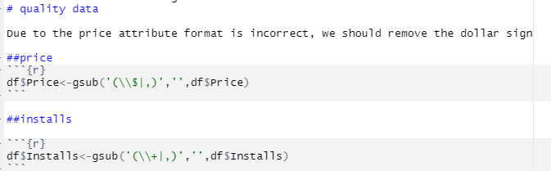
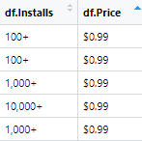
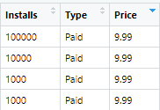
Data quality

Slide 13
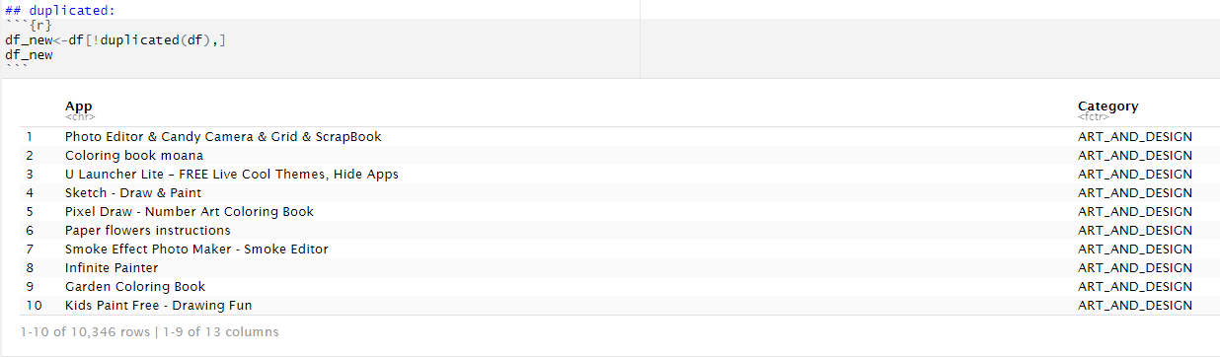
Eliminate Duplicates

Slide 14
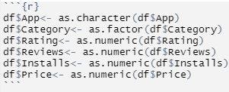
Setting Data Type

Slide 15
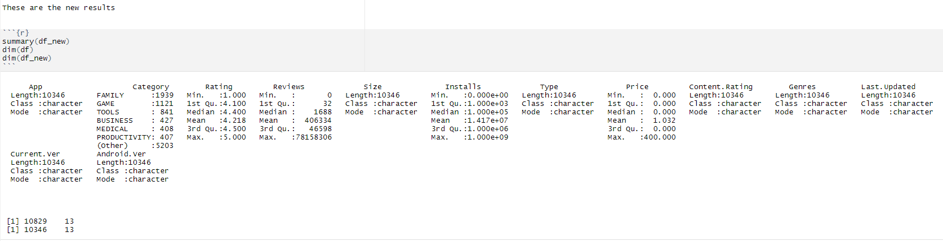
Summary New Data Set

Slide 16
Hypothesis
How is the distribution of Rating? Can it be considered Normal distribution?
How is the distribution of prices? Can it be considered Normal distribution?
What are the 5 most expensive apps in the play store dataset?
What is the correlation between Installs and Reviews?
Can we consider Type and Content Rating are strongly associated?

Slide 17
Q1
How is the distribution of Rating? Can it be considered Normal distribution?

Slide 18
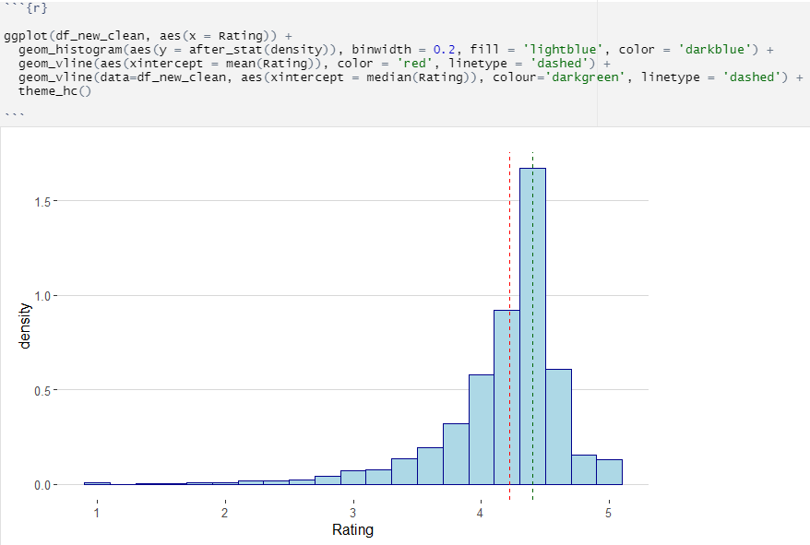
Distribution of Rating
Looking at the histogram above, we can see that majority of ratings fall between roughly 3.8 and 4.6.
The Average rating of the apps is around 4.3.
The mean is plotted as a red dashed line, and we can see that the highest density of ratings is just above the mean.
The dashed green line signifies the median.
The distribution of the Rating variable is Left-Skewed.

Slide 19


Distribution of Rating
From our analysis, we found that the average volume of ratings across all app categories is 4.3.
The histogram plot is skewed to the right indicating that the majority of the apps are highly rated with only a few exceptions in the low-rated apps.
Mean: 4.218
Median: 4.4

Slide 20
Q2
How is the distribution of prices? Can it be considered Normal distribution?

Slide 21
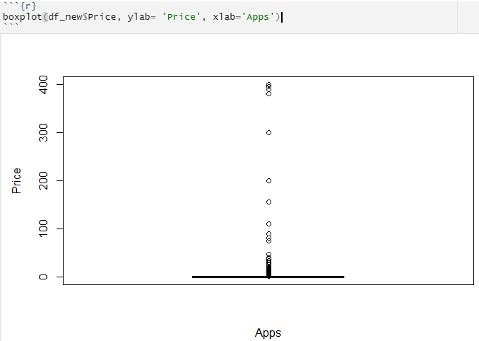
Distribution of Price
From the boxplot we can get a general view to describe the data. It shows the distribution of price for all the Apps in Google Play store:
As price is a numerical variable, we can describe the data by its central tendency:
1. Quartiles
2. Variation
3. Shape
In this distribution we can see various outliers.

Slide 22
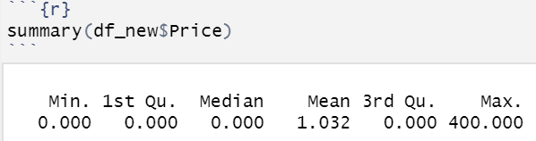
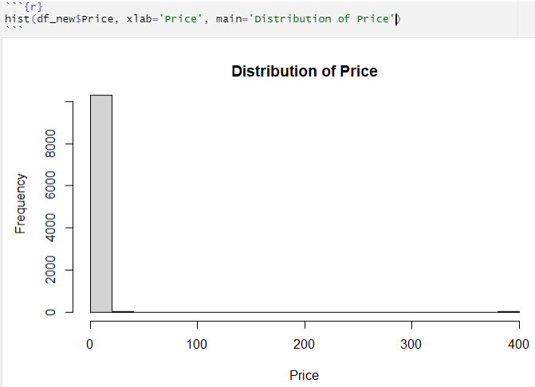
Looking at the summary we can say that this distribution is Right-skewed.
But we will do further detailed analysis for this distribution because there are too many outliers.

Slide 23
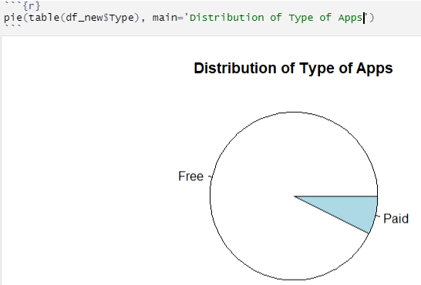
From the histogram we can see that on the X-axis which depicts the Price of Apps, zero has the highest frequency which comes from the free apps.
The pie chart depicts that the majority of apps in the Play Store are Free as compared to Paid Apps, adding to the high frequency of zero for the Price variable.
Therefore, we can say that the Price variable should be analyzed only for apps that are Paid considering that for Free Apps it will always be Zero.

Slide 24
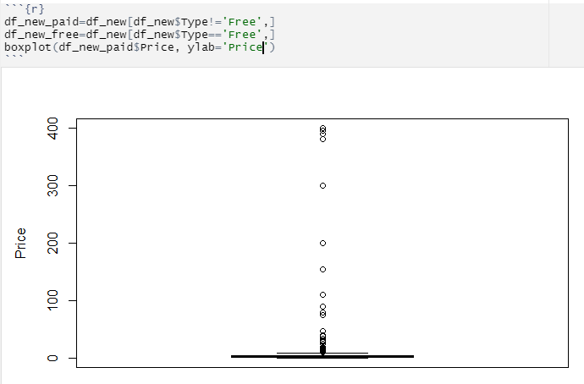
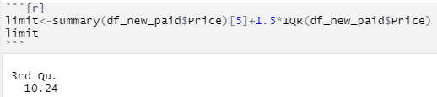
Analyzing the Distribution for Paid Apps
In order to analyze the distribution for Paid Apps the Data frame was split into two parts – Paid apps and Free apps.
We used the Data frame for only Paid Apps and plotted a bar plot which depicts the distribution of price for Paid Apps only.
Even though the distribution is better, the presence of outliers are really high.
We checked the threshold to consider a value to analyze the outliers.
Threshold Value: 10.24

Slide 25

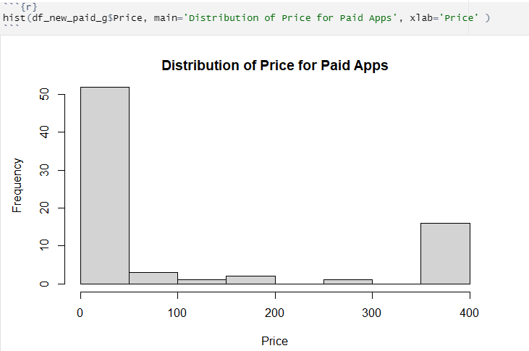
After finding the threshold value we further divide the Paid Apps data frame as:
df_new_paid_l : containing all the apps within the price range of 0 to 10
df_new_paid_g : containing all the apps within the price range of 10 to 400
This histogram depicts the Price distribution for df_new_paid_g containing apps within the price range of 10 to 400.
Apart from the values considered outliers from the distribution of paid apps, we can see that there are some extreme values around 400.

Slide 26
In order to further analyze the distribution we will follow this flowchart.
We split the Price variable into Free & Paid and created two separate data frames for each.
Then we further divided the Paid apps based on the threshold value 10.24 for the outliers.
We get 2 ranges for Paid App Price: 0 to 10 and 10 to 400.
As there were some extreme values around 400 as seen in the histogram, we further split the Range 10 to 400 in order to analyze it.
It was split into: Price range 10 to 89 and 200 to 400.
We found that Price range 200 to 400 contains most of the fake apps with the same name ‘Rich’
For getting the correct distribution of Price variable we used the Price range: 0 to 10 and 10 to 89
We’ll be explaining the code for these steps in the next question
Price
Free Apps
Paid Apps
Price Range 0 to 10
Price Range 10 to 400
Price Range 10 to 89
Price Range 200 to 400

Slide 27
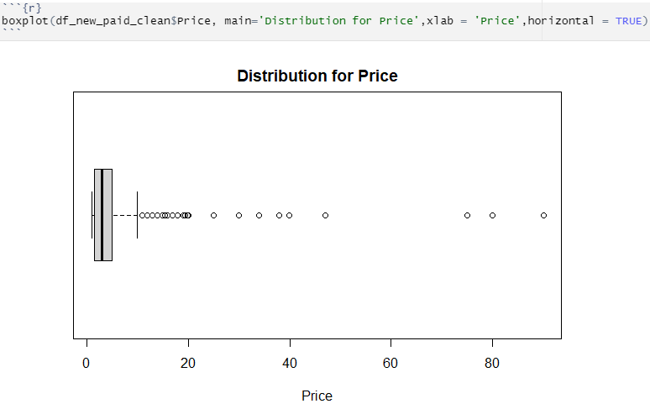
This is the final Distribution of Price and it is Right Skewed.
For getting the correct distribution of Price variable we combined the Price range: 0 to 10 and 10 to 89.
Price range 200 to 400 contains most of the fake apps so it was removed from the distribution.

Slide 28
Q3
Which are the 5 most expensive apps in the play store dataset?

Slide 29
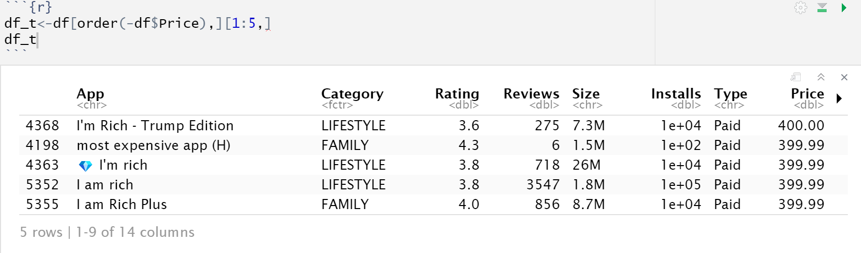
The most expensive apps shows a pattern with the keyword “rich” in their names. Hence these apps aren’t real and should not be considered in the analysis.
The apps with word “rich ” in their names are more expensive and the prices are more than $200.
We have excluded the “rich” apps for this analysis and all the further analysis

Slide 30

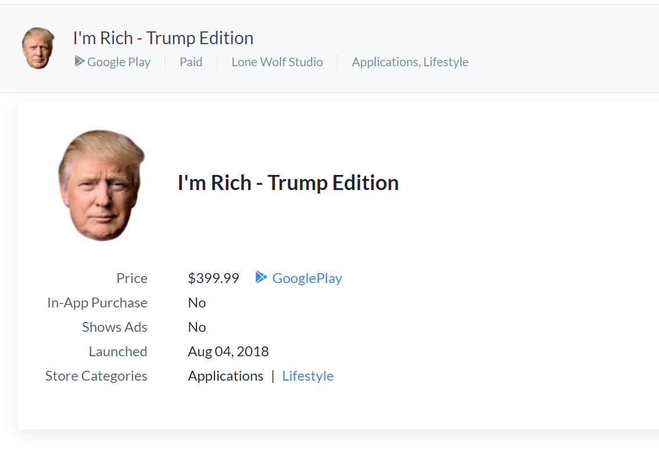
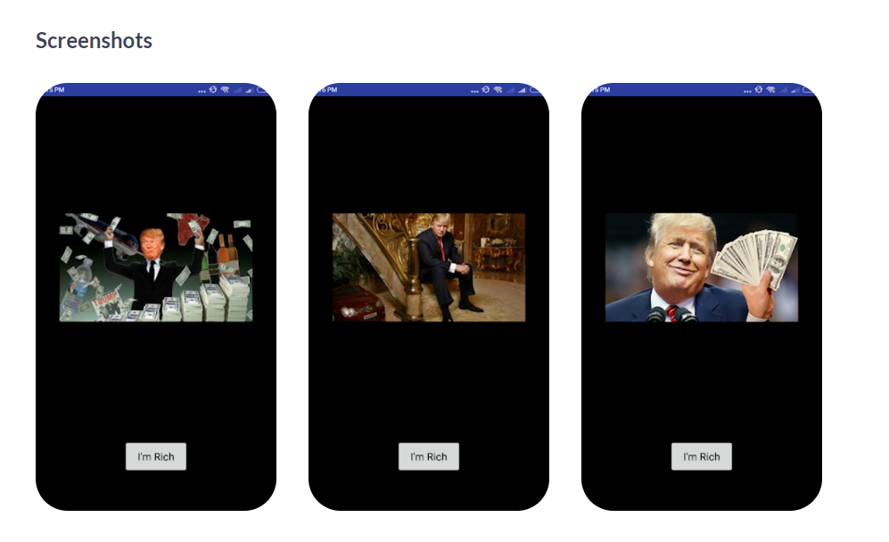
A PICTURE IS WORTH A THOUSAND WORDS

Slide 31
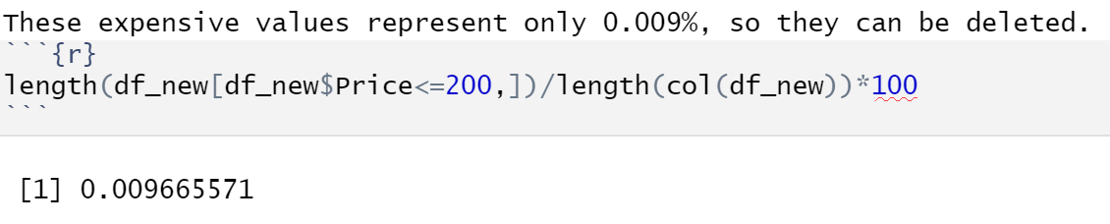
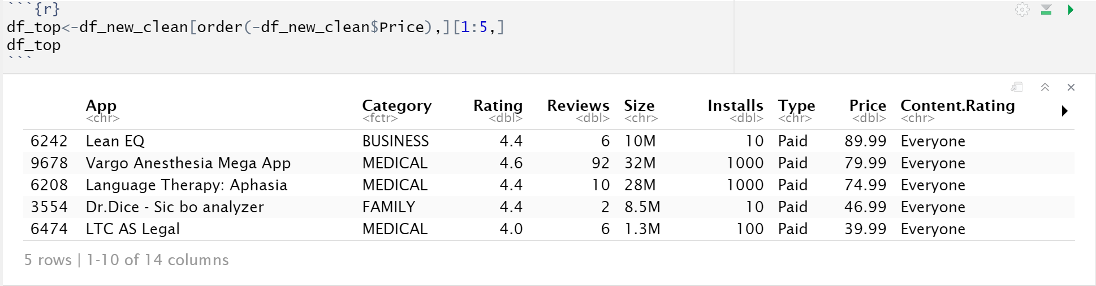
Filtering the apps with prices less than or equal to $200 and finding the 5 most expensive apps .

Slide 32
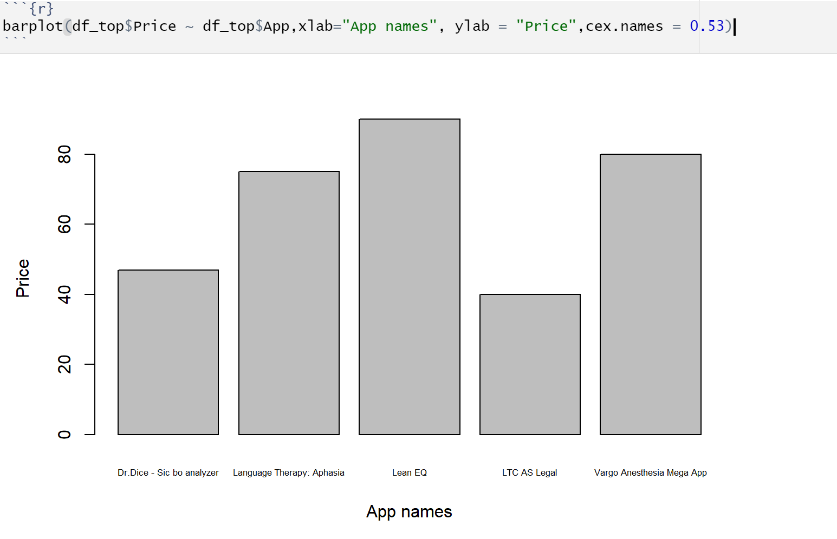
5 Top most expensive apps with their prices

Slide 33
Q4
What is the correlation between Installs and Reviews?

Slide 34
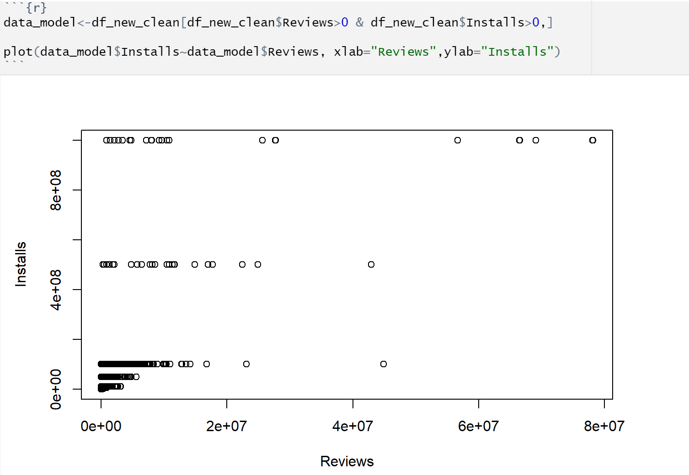
Correlation between Installs and Reviews using raw data

Slide 35
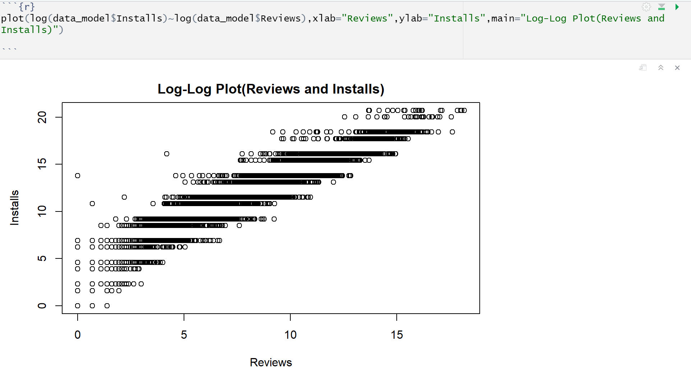
After a lot of analysis on the data we found that the data had linear correlation when both the variables are in a logarithmic format.
After transforming the data to logarithmic scale and plotting the log-log plot.

Slide 36
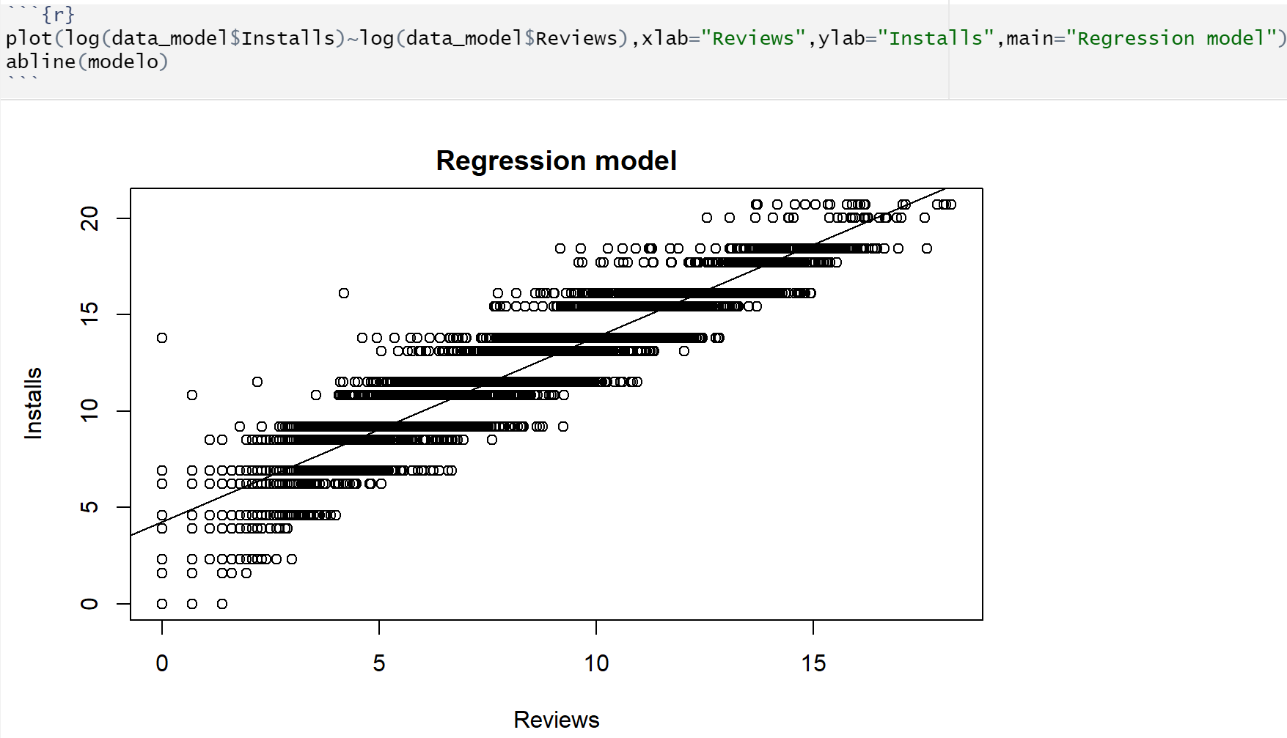
Fitting a linear regression line in a log-log plot

Slide 37
Q5
Can we consider Type and Content Rating are strongly correlated?

Slide 38
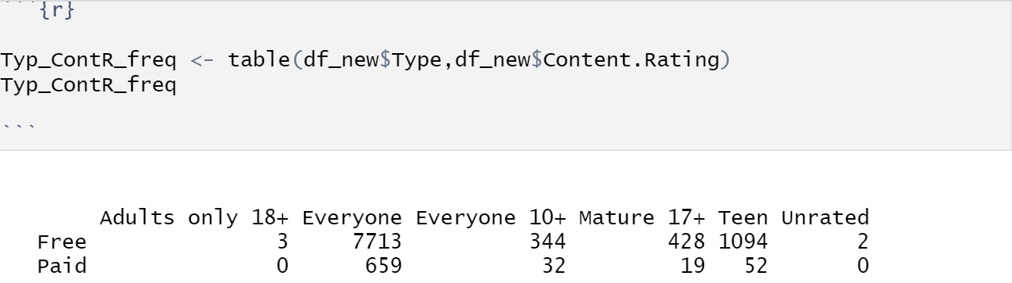
Proportions of Type and Content Rating
The reason why the adults only 18+ and unrated will be removed is because there are not representative enough.

Slide 39
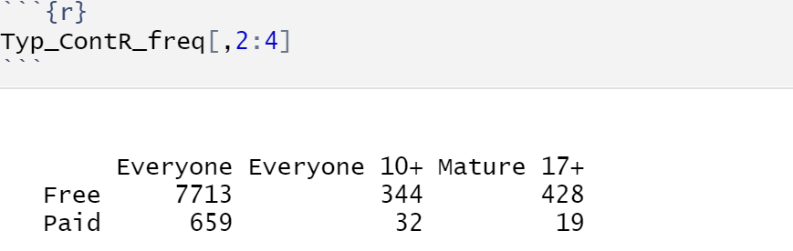
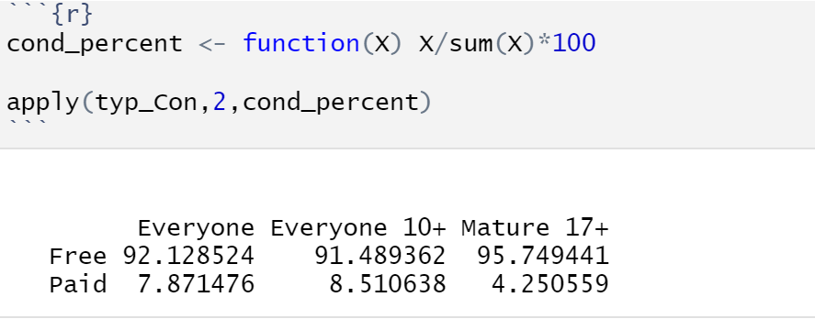
Excluding the insignificant categories
Finding the conditional percentages of the two way table

Slide 40
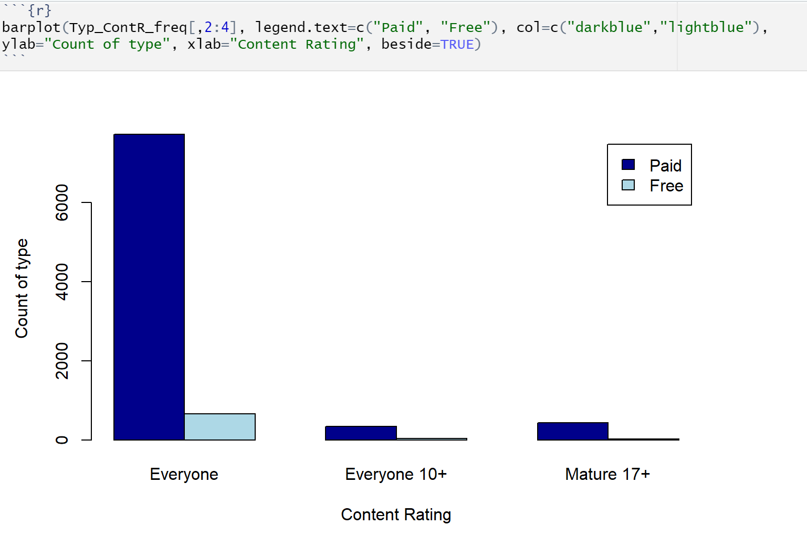
Side by side bar plot of Type variable based on Content Rating

Slide 41
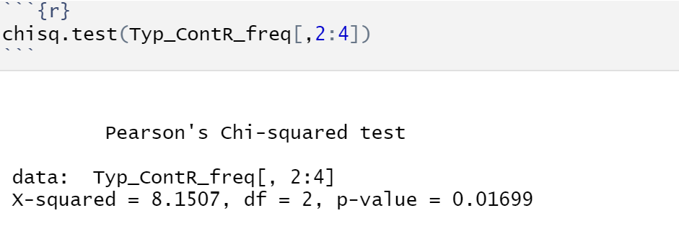
Chi Square test
Hypothesis :
H0 = The content rating and type are independent
H1 = The content rating and type are not independent (dependent)
After computing the chi-square, we can reject the null hypothesis as the value of X2 is 8.1507 which is greater than the decision point 5.99 with degree of freedom 2 and level of confidence 0.05 .We can conclude the variables are not independent. Also, as the content rating changes the type variable could change.
Also, as the content rating changes the type variable could change.

Slide 42
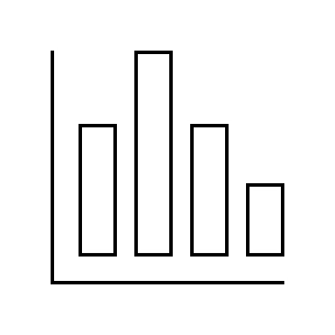
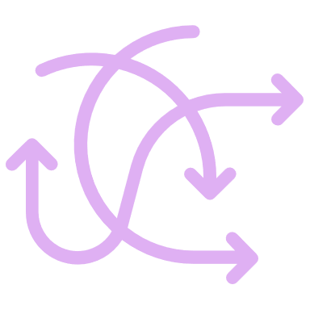
Conclusions
Population
Data access
Selection Bias
Jquery making scraping
More challenging
Sample size
Region

Slide 43
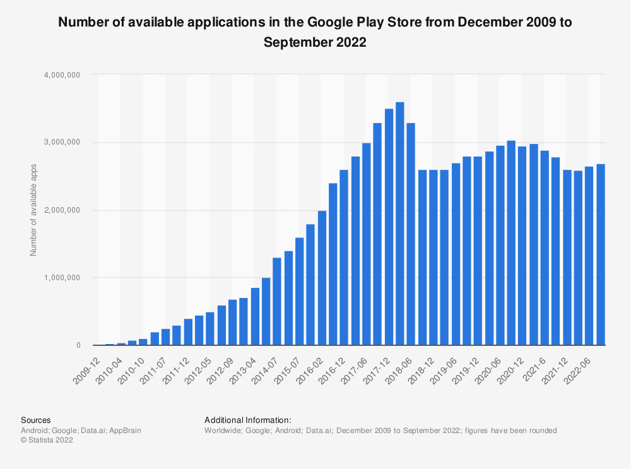
Conclusions
Conclusions
Not random sampling
Sample
10829rows
Sample Size
0.4% of population

Slide 44
Conclusions
Sample
Data Quality (null, empty and data transformation)
Identify Data not representative enough (new apps and meme apps)
Distribution of Rating is left-skewed
Distribution of Price is right-skewed
Positive correlation between Installs and reviews
Type app and content rating are statistically associated

Slide 45
Conclusions
Conclusions
<>
Population
App store
Sample
Sample Size
Selection Bias

Slide 46
THANK YOU

