Slide 1
Predicting peptides immunogenicity
(Immuno)genomics Group
Andre Tadeu de Carvalho
Brian Chaplin
Hernán Martínez-Foffani
Martin Skarzynski
Yixing Han
Wenjing Yang
Zaheer Valivullah

Slide 2
Introductions
Questions
Why are certain peptides immunogenic?
How do amino acid positions and properties affect immunogenicity?
Challenges
Data search and consolidation
Human dataset only has one non-immunogenic peptide

Slide 3
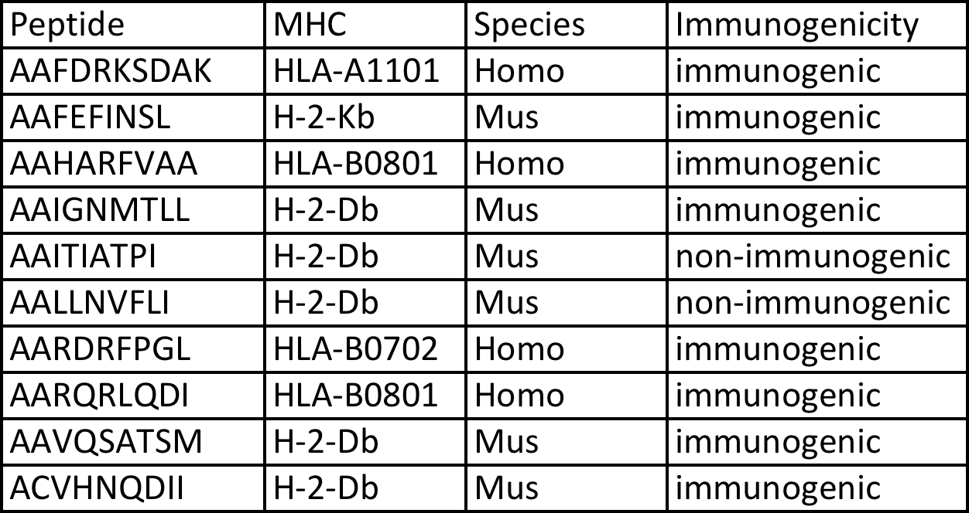
OUR DATASET

Slide 4
Which amino acid position iS the most important IN PREDICTING IMMUNOGENICITY?

Slide 5
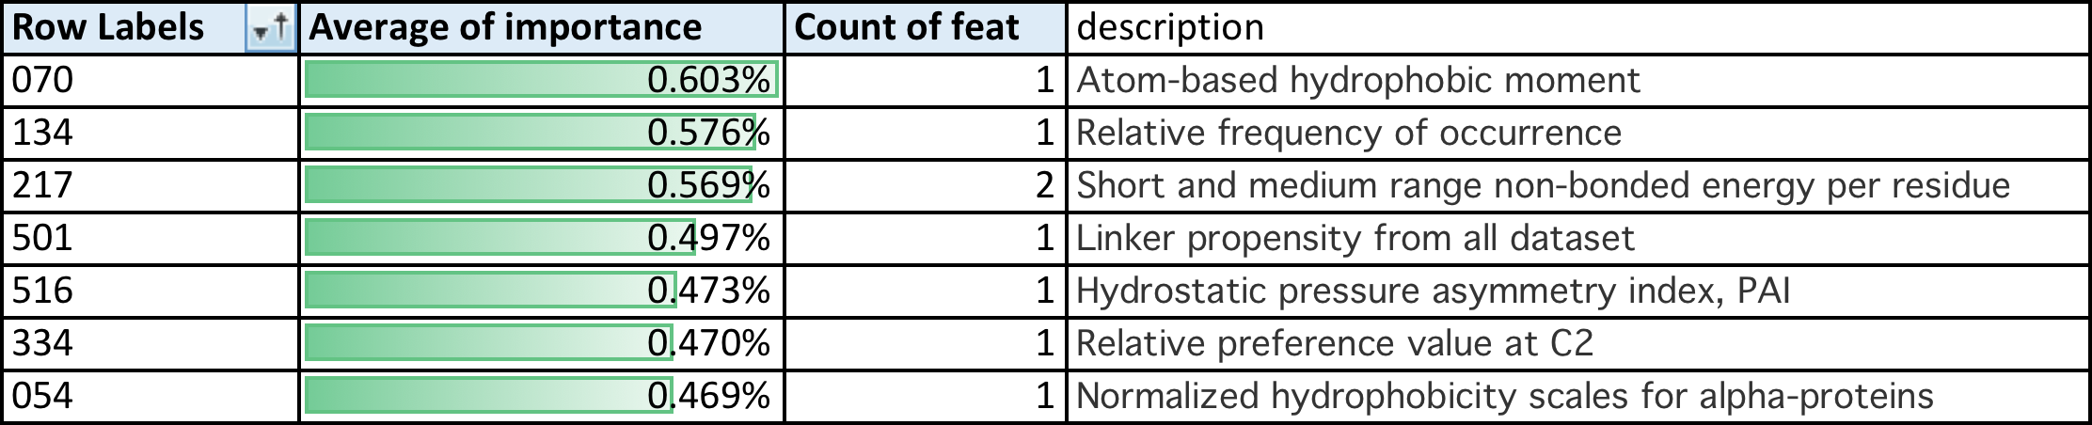
THE MOST IMPORTANT AMINO ACID PROPERTIES IN PREDICTING IMMUNOGENICITY

Slide 6
THANK YOU FOR LISTENING AND FOR MAKING THIS SUCH A WONDERFUL EVENT!

