Slide 1
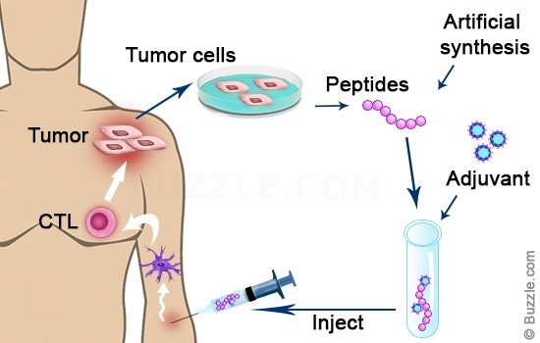
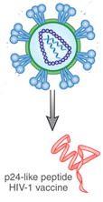
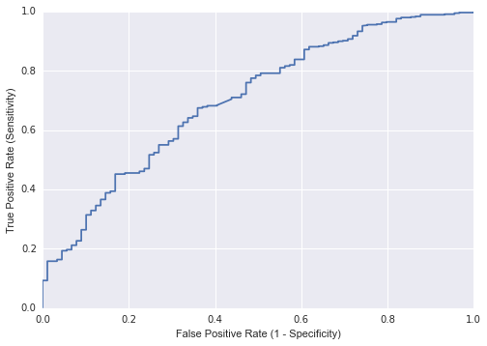
Which peptides will be the best vaccines (for cancer and infectious disease)?
Create property matrix for each peptide in dataset
Perform PCA to determine most important aa properties in each aa position
Use Machine Learning to predict which position-property pairs (P3s)
are most likely to cause an immune response
Receiver Operating Characteristic (ROC)
Principal Component Analysis
Area under the ROC curve = 0.7

