Slide 1
Andre’s Notes

Slide 2
Human Vitals – Respiratory Rate
Breathing is a vital physiological function of the human body.
As such, Respiratory Rate is one of the most fundamental vital signs [3] of the human body reflects strongly on the state of body health.
Applications such as sleep studies, sport training, patient monitoring, or health at work [1][2] rely upon Respiratory Rate.

Slide 3
Introduction to Respiratory Rate
Respiratory rate is defined as the number of breaths per minute.
Respiratory Rate is a critical indicator of physiological health, as alterations in RR can help diagnose respiratory diseases, such as asthma, sleep apnea, and chronic obstructive pulmonary diseases (chronic bronchitis, emphysema, and non-reversible asthma) [4]
Non-contact sensing technologies, such as radar systems, have gained attention for continuous monitoring without patient discomfort or motion constraints.

Slide 4
Non-Contact RR Monitoring
Erik Vanegas et al. reviews respiration sensing systems comprehensively.
It analyses 198 relevant studies in respiratory monitoring
Key summaries:
Non-contact radar methods are increasingly preferred for respiratory monitoring due to their ability to measure vital signs without physical contact, thus enhancing user comfort and compliance.
Of all non-contact methods studied, 60% utilize radar technology to detect chest wall movements and respiratory patterns from a distance.
Radar systems are typically small, low-cost, and easy to install, less susceptible to electromagnetic interference, all which contributes to their practicality in real-world application.
Despite their advantages, challenges remain in accurately interpreting the data due to potential noise and the need for sophisticated algorithms to process the signals effectively

Slide 5
Problem Formulation
To extract human vitals (heart rate and breathing rate), we need to detect micro-movements of the human body.
Measurable signals are in the table below.
Challenges
Magnitude of movement is tiny, especially for Heart Rate.
Interference – Internal leakage, static reflections, multi-path interference, respiration might overshadow heart rate
Need to find a way to separate respiration and heart rate
 | Frequency | Amplitude
Heart Rate | 0.1Hz – 0.5Hz | ~1-12mm
Breathing Rate | 0.8Hz – 2Hz | ~0.1 – 0.5mm

Slide 6


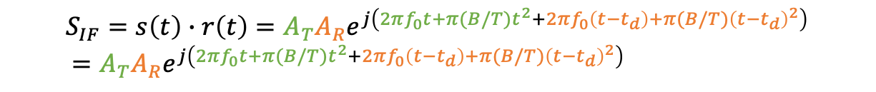
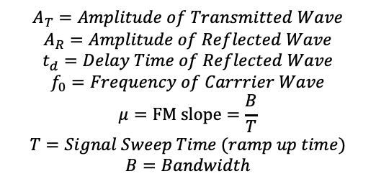

Difference between mmWave Radar and SDR
Carrier Wave f_{C}
Synthesizer generates a chirp
Chirp is transmitted by tx antenna
Reflected chirp (echo) is captured by rx antenna
Local oscillator is used as mixer to combine rx and tx signals to produce an Intermediate Frequency (IF) signal using downconversion.
$$s\left(t\right)=A_{T}e^{j\left(2πf_{0}t+πμt^{2}\right)}$$
Frequency Synthesizer
VCO
Tx
Power Amplifier
LO
$$A_{T}=Amplitude of Transmitted Wave$$
$$A_{R}=Amplitude of Reflected Wave$$
$$t_{d}=Delay Time of Reflected Wave$$
$$f_{0}=Frequency of Carrrier Wave$$
$$μ=FM slope=\frac{B}{T}$$
$$T=Signal Sweep Time (ramp up time)$$
$$B=Bandwidth$$
Rx
Mixer
$$r\left(t\right)=A_{R}e^{j\left(2πf_{0}(t−t_{d})+πμ{(t−t_{d})}^{2}\right)}$$
LNA
ADC
$$S_{IF}=s\left(t\right)∙r\left(t\right)={A_{T}A}_{R}e^{j\left(2πf_{0}t+π(B/T)t^{2}+2πf_{0}\left(t−t_{d}\right)+π(B/T){\left(t−t_{d}\right)}^{2}\right)} \\ ={A_{T}A}_{R}e^{j\left(2πf_{0}t+π(B/T)t^{2}+2πf_{0}\left(t−t_{d}\right)+π(B/T){\left(t−t_{d}\right)}^{2}\right)}$$

Slide 7
https://www.ti.com/lit/an/swra553a/swra553a.pdf?ts=1742626781023&ref_url=https%253A%252F%252Fwww.google.com%252F
In linear FMCW radars, the transmit (TX) signal is a single tone with its frequency changing linearly with time. This sweep in frequency is commonly referred to as a “chirp”. A set of these chirps form a “Frame” and this can be used as the observation window for the radar processing. The various parameters of the chirp ramp (like frequency slope, sweep bandwidth, and so forth) impact the system performance.

Slide 8
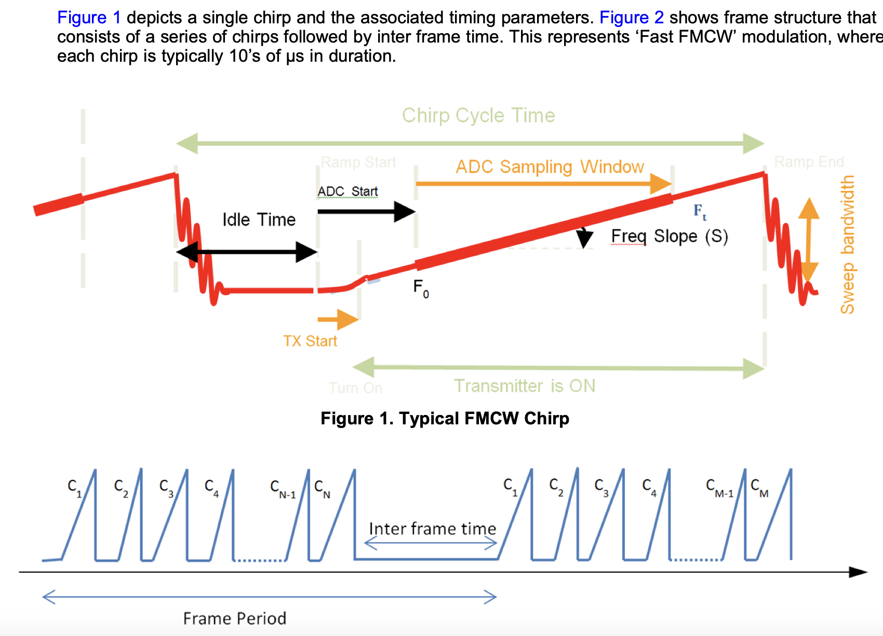

Slide 9
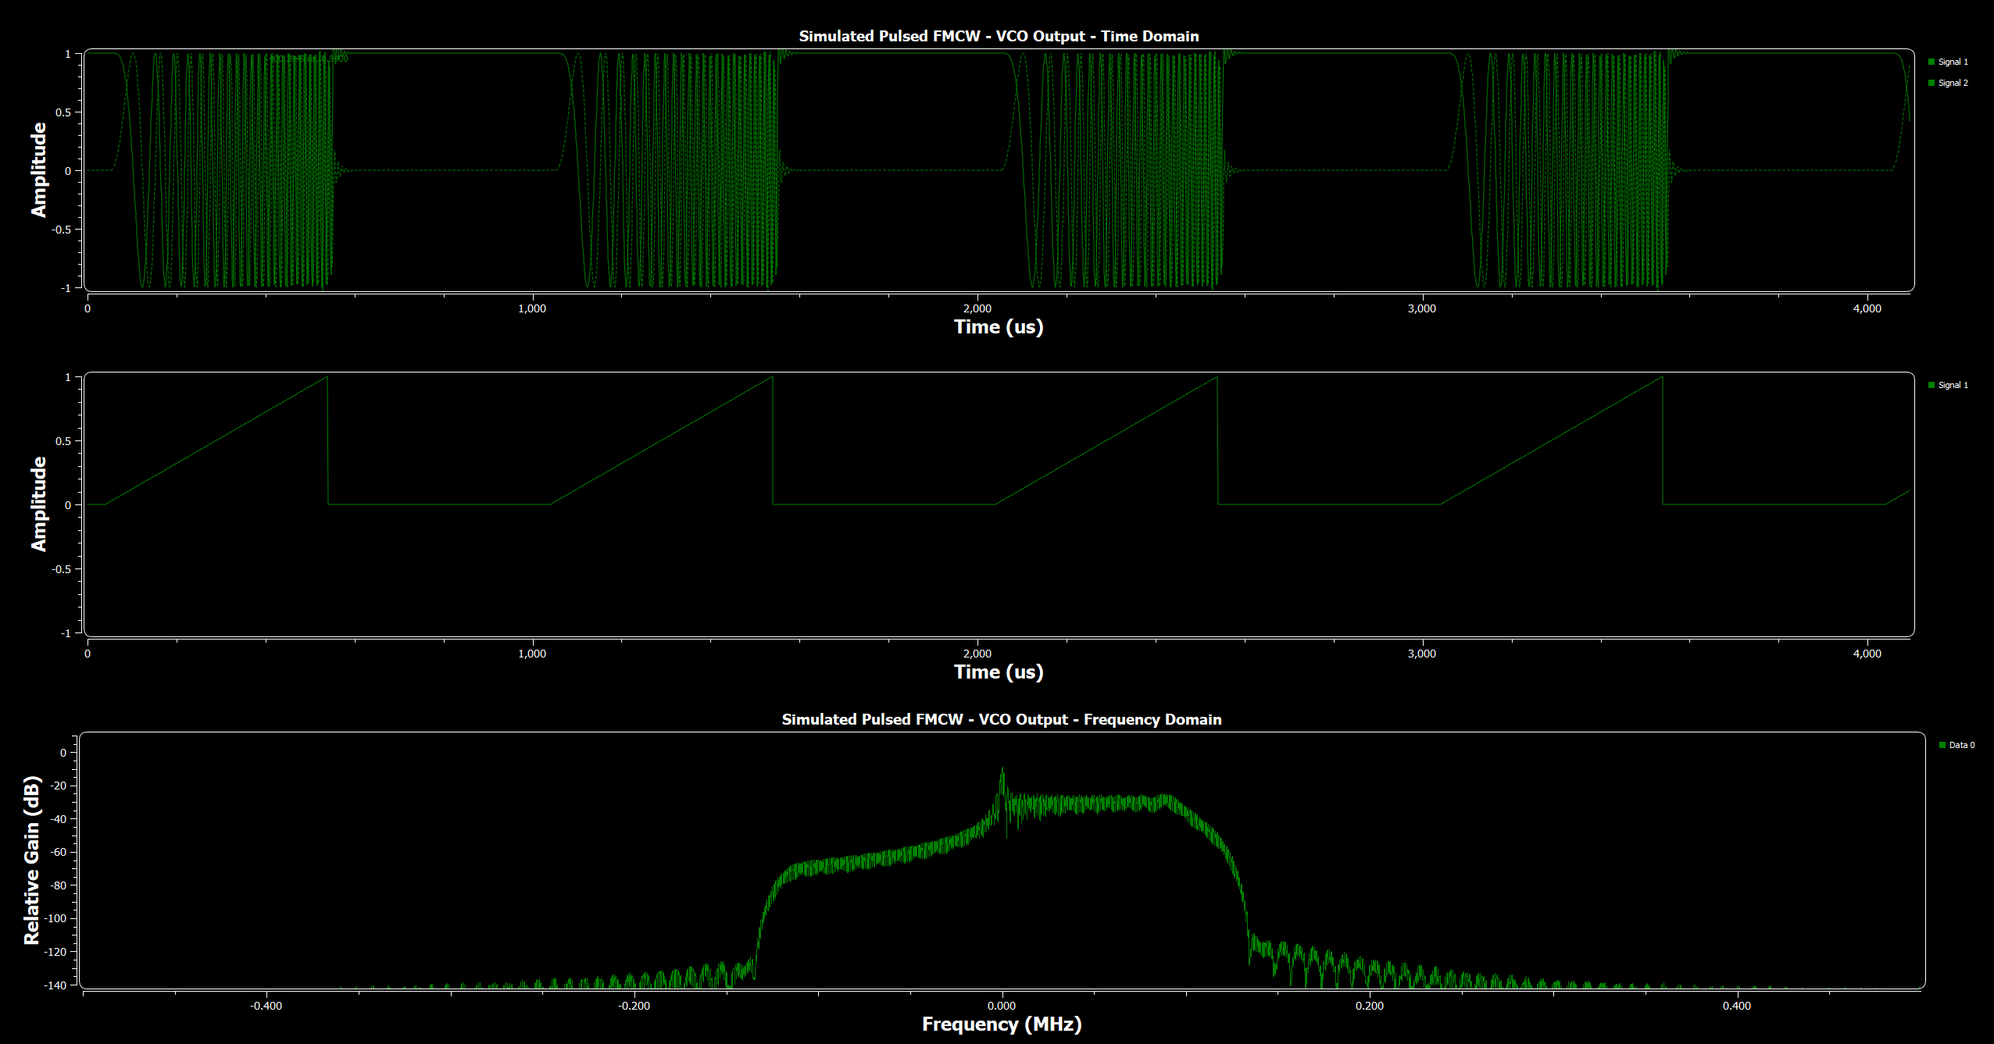
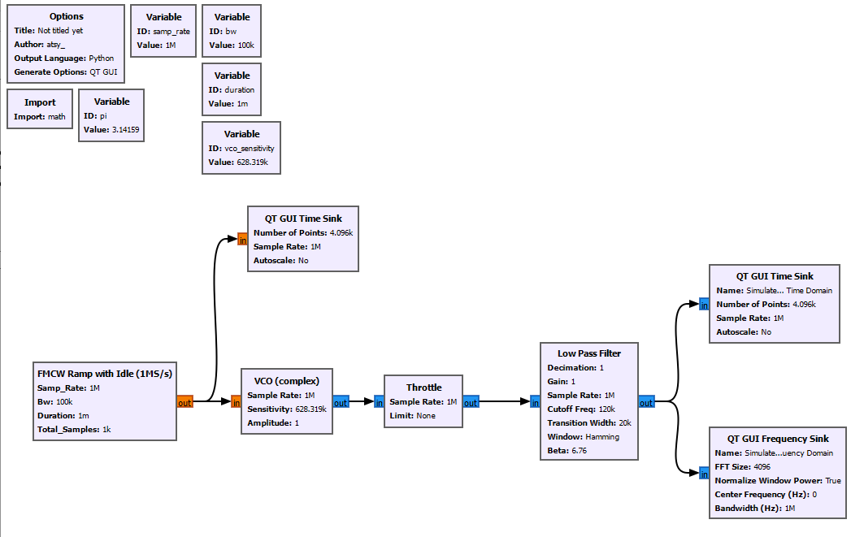

Slide 10
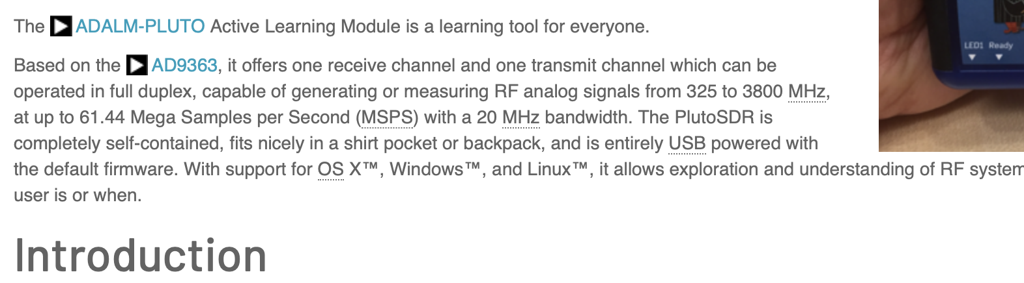
ADALM-Pluto Detail Specifications https://wiki.analog.com/university/tools/pluto/devs/specs

Slide 11
Variables
Sample rate
Sets sample duration, limits range resolution
Chirp length
Sets Pulse Repetition Frequency (PRF), limits unambiguous range
Speed of light
Time of one sample
Large distance
Increased sample rate
Better range resolution
N range (FFT) bins (each one sample duration)
Energy in each = reflected energy at that time
N-1 | 0 | 1 | 2 | 3 | 4 | … | N-2 | N-1
Time

Slide 12
Variables
Hidden Returns
Multiple targets end up in same range bin
Target echo is too weak, swamped by local TX/clutter/spectral leakage
Any other information we can use to disambiguate? Yes, doppler effect

Slide 13

Doppler Processing
Collect multiple return periods (requires Integration Time)
FFT across each range bin
Velocity information for targets (w.r.t SDR)
Changing phase over integration period
Get phase information from each FFT bin for each range transform
Tx
Q
Rx
I

Slide 14
Doppler Processing
Row: Range Bins
Column One Range Bin Over Many Chirps
0 | 1 | 2 | 3 | 4 | 5 | 6 | 7 | 8 | 9
0 | 1 | 2 | 3 | 4 | 5 | 6 | 7 | 8 | 9
0 | 1 | 2 | 3 | 4 | 5 | 6 | 7 | 8 | 9
0 | 1 | 2 | 3 | 4 | 5 | 6 | 7 | 8 | 9
0 | 1 | 2 | 3 | 4 | 5 | 6 | 7 | 8 | 9
0 | 1 | 2 | 3 | 4 | 5 | 6 | 7 | 8 | 9
0 | 1 | 2 | 3 | 4 | 5 | 6 | 7 | 8 | 9
0 | 1 | 2 | 3 | 4 | 5 | 6 | 7 | 8 | 9
Doppler Bins
Taking FFT column-wise, to look at the phase changes of the return signals at each range bin. Which means the doppler shift information is captured and we can calculate the velocity of the targets
Range Bins

Slide 15
FMCW Signal Flow
Chirp Generation
Tx
Rx
Mixer
De-chirped Signal
FFT

Slide 16
Appendix
[1] Nicolò, A., Massaroni, C., Schena, E., & Sacchetti, M. (2020). The importance of respiratory rate monitoring: From healthcare to sport and exercise. In Sensors (Switzerland) (Vol. 20, Issue 21, pp. 1–45). MDPI AG. https://doi.org/10.3390/s20216396
[2] Xie, W., Gan, L., Huang, L., Shi, C., Liu, B., Wu, C. H., Lee, Y. T., Chen, J., & Zhang, R. (2023). A Real-Time Respiration Monitoring System Using WiFi Sensing Based on the Concentric Circle Model. IEEE Transactions on Biomedical Circuits and Systems, 17(2), 157–168. https://doi.org/10.1109/TBCAS.2022.3229435
[3] Massaroni, C., Nicolò, A., Schena, E., & Sacchetti, M. (2020). Remote Respiratory Monitoring in the Time of COVID-19. Frontiers in Physiology, 11. https://doi.org/10.3389/fphys.2020.00635
[4] Vanegas, E., Igual, R., & Plaza, I. (2020). Sensing systems for respiration monitoring: A technical systematic review. In Sensors (Switzerland) (Vol. 20, Issue 18, pp. 1–84). MDPI AG. https://doi.org/10.3390/s20185446

