Slide 1

Chapter 9
Testing the System
Shari L. Pfleeger
Joann M. Atlee
4th Edition
4th Edition

Slide 2
Contents
9.1 Principles of system testing
9.2 Function testing
9.3 Performance testing
9.4 Reliability, availability, and maintainability
9.5 Acceptance testing
9.6 Installation testing
9.7 Automated system testing
9.8 Test documentation
9.9 Testing safety-critical systems
9.10 Information systems example
9.11 Real-time example
9.12 What this chapter means for you

Slide 3
Chapter 9 Objectives
Function testing
Performance testing
Acceptance testing
Software reliability, availability, and maintainability
Installation testing
Test documentation
Testing safety-critical systems

Slide 4
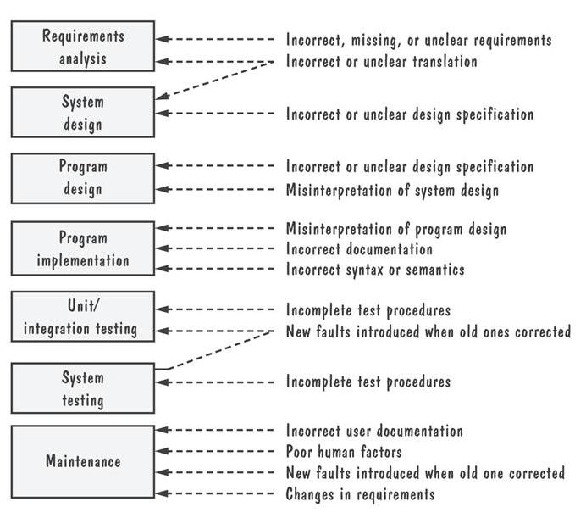
9.1 Principles of System Testing
Source of Software Faults During Development

Slide 5
9.1 Principles of System Testing System Testing Process
Function testing: does the integrated system perform as promised by the requirements specification?
Performance testing: are the non-functional requirements met?
Acceptance testing: is the system what the customer expects?
Installation testing: does the system run at the customer site(s)?

Slide 6
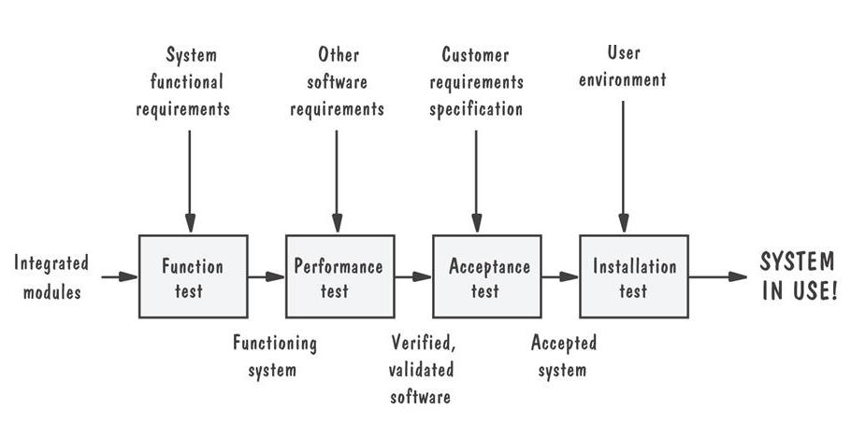
9.1 Principles of System Testing
System Testing Process (continued)
Pictorial representation of steps in testing process

Slide 7
9.1 Principles of System Testing
Techniques Used in System Testing
Build or integration plan
Regression testing
Configuration management
  versions and releases
  production system vs. development system
  deltas, separate files and conditional compilation
  change control

Slide 8
9.1 Principles of System Testing
Build or Integration Plan
Define the subsystems (spins) to be tested
Describe how, where, when, and by whom the tests will be conducted

Slide 9
9.1 Principles of System Testing
Example of Build Plan for Telecommunication System
Spin | Functions | Test Start | Test End
O | Exchange | 1 September | 15 September
1 | Area code | 30 September | 15 October
2 | State/province/district | 25 October | 5 November
3 | Country | 10 November | 20 November
4 | International | 1 December | 15 December

Slide 10
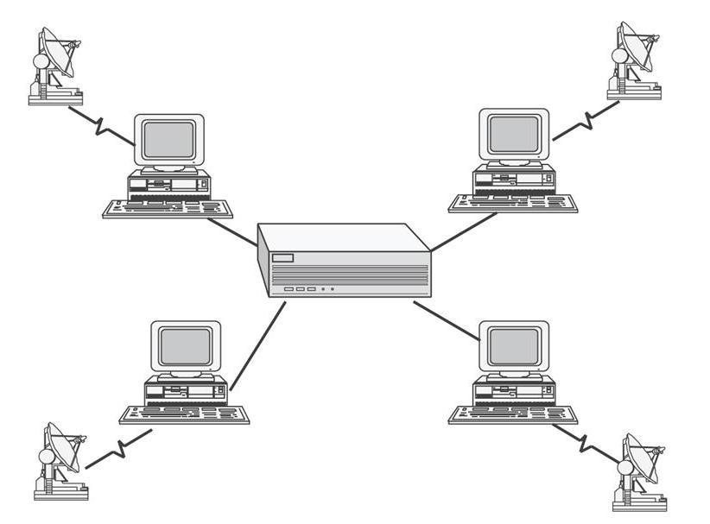
9.1 Principles of System Testing
Example Number of Spins for Star Network
Spin 0: test the central computer’s general functions
Spin 1: test the central computer’s message-translation function
Spin 2: test the central computer’s message-assimilation function
Spin 3: test each outlying computer in the stand alone mode
Spin 4: test the outlying computer’s message-sending function
Spin 5: test the central computer’s message-receiving function

Slide 11
9.1 Principles of System Testing
Regression Testing
Identifies new faults that may have been introduced as current one are being corrected
Verifies a new version or release still performs the same functions in the same manner as an older version or release

Slide 12
9.1 Principles of System Testing
Regression Testing Steps
Inserting the new code
Testing functions known to be affected by the new code
Testing essential function of m to verify that they still work properly
Continuing function testing m + 1

Slide 13
9.1 Principles of System Testing
Sidebar 9.1 The Consequences of Not Doing Regression Testing
A fault in software upgrade to the DMS-100 telecom switch
  167,000 customers improperly billed $667,000

Slide 14
9.1 Principles of System Testing
Configuration Management
Versions and releases
Production system vs. development system
Deltas, separate files and conditional compilation
Change control

Slide 15
9.1 Principles of System Testing
Sidebar 9.2 Deltas and Separate Files
The Source Code Control System (SCCS)
  uses delta approach
  allows multiple versions and releases
Ada Language System (ALS)
  stores revision as separate, distinct files
  freezes all versions and releases except for the current one

Slide 16
9.1 Principles of System Testing
Sidebar 9.3 Microsoft’s Build Control
The developer checks out a private copy
The developer modifies the private copy
A private build with the new or changed features is tested
The code for the new or changed features is placed in master version
Regression test is performed

Slide 17
9.1 Principles of System Testing
Test Team
Professional testers: organize and run the tests
Analysts: who created requirements
System designers: understand the proposed solution
Configuration management specialists: to help control fixes
Users: to evaluate issues that arise

Slide 18
9.2 Function Testing
Purpose and Roles
Compares the system’s actual performance with its requirements
Develops test cases based on the requirements document

Slide 19
9.2 Function Testing
Cause-and-Effect Graph
A Boolean graph reflecting logical relationships between inputs (causes), and the outputs (effects) or transformations (effects)

Slide 20
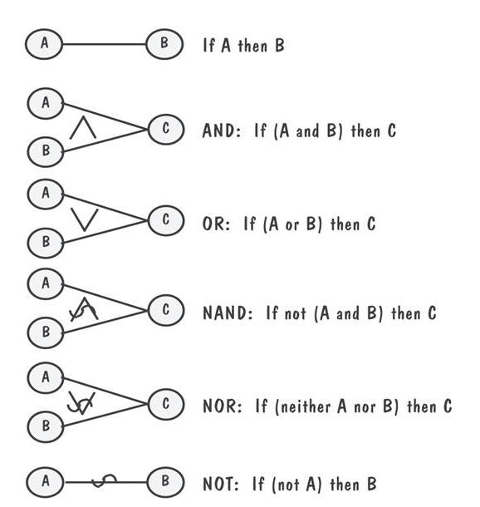
9.2 Function Testing
Notation for Cause-and-Effect Graph

Slide 21
9.2 Function Testing
Cause-and-Effect Graphs Example
INPUT: The syntax of the function is LEVEL(A,B) where A is the height in meters of the water behind the dam, and B is the number of centimeters of rain in the last 24-hour period
PROCESSING: The function calculates whether the water level is within a safe range, is too high, or is too low
OUTPUT: The screen shows one of the following messages
  1. “LEVEL = SAFE” when the result is safe or low
  2. “LEVEL = HIGH” when the result is high
  3. “INVALID SYNTAX”
depending on the result of the calculation

Slide 22
9.2 Function Testing
Cause-and-Effect Graphs Example (Continued)
Causes
  The first five characters of the command “LEVEL”
  The command contains exactly two parameters separated by a comma and enclosed in parentheses
  The parameters A and B are real numbers such that the water level is calculated to be LOW
  The parameters A and B are real numbers such that the water level is calculated to be SAFE
  The parameters A and B are real numbers such that the water level is calculated to be HIGH

Slide 23
9.2 Function Testing
Cause-and-Effect Graphs Example (Continued)
Effects
  1. The message “LEVEL = SAFE” is displayed on the screen
  2. The message “LEVEL = HIGH” is displayed on the screen
  The message “INVALID SYNTAX” is printed out
Intermediate nodes
  1. The command is syntactically valid
  2. The operands are syntactically valid

Slide 24
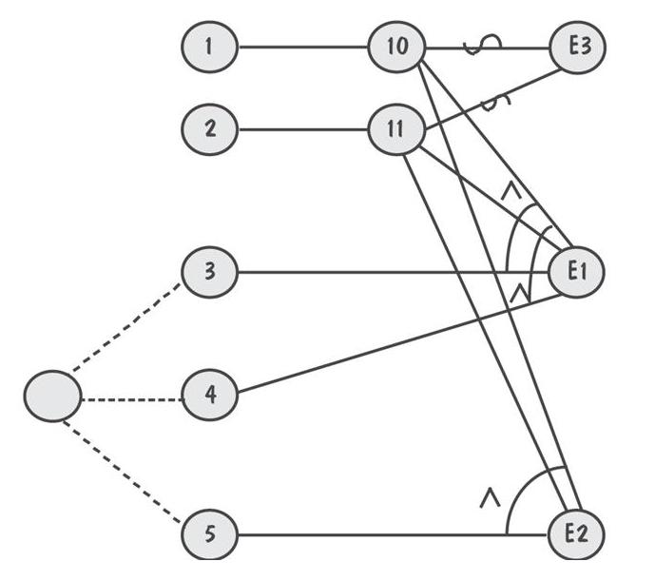
9.2 Function Testing
Cause-and-Effect Graphs of LEVEL Function Example
Exactly one of a set of conditions can be invoked
At most one of a set of conditions can be invoked
At least one of a set of condition can be invoked
One effects masks the observance of another effect
Invocation of one effect requires the invocation of another

Slide 25
9.2 Function Testing
Decision Table for Cause-and-Effect Graph of LEVEL Function
 | Test 1 | Test 2 | Test 3 | Test 4 | Test 5
Cause 1 | I | I | I | S | I
Cause 2 | I | I | I | X | S
Cause 3 | I | S | S | X | X
Cause 4 | S | I | S | X | X
Cause 5 | S | S | I | X | X
Effect 1 | P | P | A | A | A
Effect 2 | A | A | P | A | A
Effect 3 | A | A | A | P | P

Slide 26
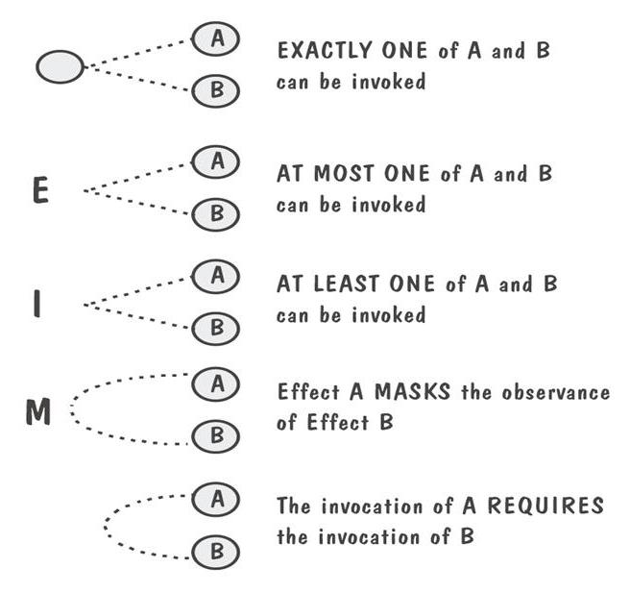
9.2 Function Testing
Additional Notation for Cause-and-Effect Graph

Slide 27
9.3 Performance Tests
Purpose and Roles
Used to examine
  the calculation
  the speed of response
  the accuracy of the result
  the accessibility of the data
Designed and administrated by the test team

Slide 28
9.3 Performance Tests
Types of Performance Tests
Stress tests
Volume tests
Configuration tests
Compatibility tests
Regression tests
Security tests
Timing tests
Environmental tests
Quality tests
Recovery tests
Maintenance tests
Documentation tests
Human factors (usability) tests

Slide 29
9.4 Reliability, Availability, and Maintainability
Definition
Software reliability: operating without failure under given condition for a given time interval
Software availability: operating successfully according to specification at a given point in time
Software maintainability: for a given condition of use, a maintenance activity can be carried out within stated time interval, procedures and resources

Slide 30
9.4 Reliability, Availability, and Maintainability
Different Level of Failure Severity
Catastrophic: causes death or system loss
Critical: causes severe injury or major system damage
Marginal: causes minor injury or minor system damage
Minor: causes no injury or system damage

Slide 31
9.4 Reliability, Availability, and Maintainability
Failure Data
Table of the execution time (in seconds) between successive failures of a command-and-control system
Interfailure Times (Read left to right, in rows)
3 | 30 | 113 | 81 | 115 | 9 | 2 | 91 | 112 | 15
138 | 50 | 77 | 24 | 108 | 88 | 670 | 120 | 26 | 114
325 | 55 | 242 | 68 | 422 | 180 | 10 | 1146 | 600 | 15
36 | 55 | 242 | 68 | 227 | 65 | 176 | 58 | 457 | 300
97 | 263 | 452 | 255 | 197 | 193 | 6 | 79 | 816 | 1351
148 | 21 | 233 | 134 | 357 | 193 | 236 | 31 | 369 | 748
0 | 232 | 330 | 365 | 1222 | 543 | 10 | 16 | 529 | 379
44 | 129 | 810 | 290 | 300 | 529 | 281 | 160 | 828 | 1011
445 | 296 | 1755 | 1064 | 1783 | 860 | 983 | 707 | 33 | 868
724 | 2323 | 2930 | 1461 | 843 | 12 | 261 | 1800 | 865 | 1435
30 | 143 | 108 | 0 | 3110 | 1247 | 943 | 700 | 875 | 245
729 | 1897 | 447 | 386 | 446 | 122 | 990 | 948 | 1082 | 22
75 | 482 | 5509 | 100 | 10 | 1071 | 371 | 790 | 6150 | 3321
1045 | 648 | 5485 | 1160 | 1864 | 4116

Slide 32
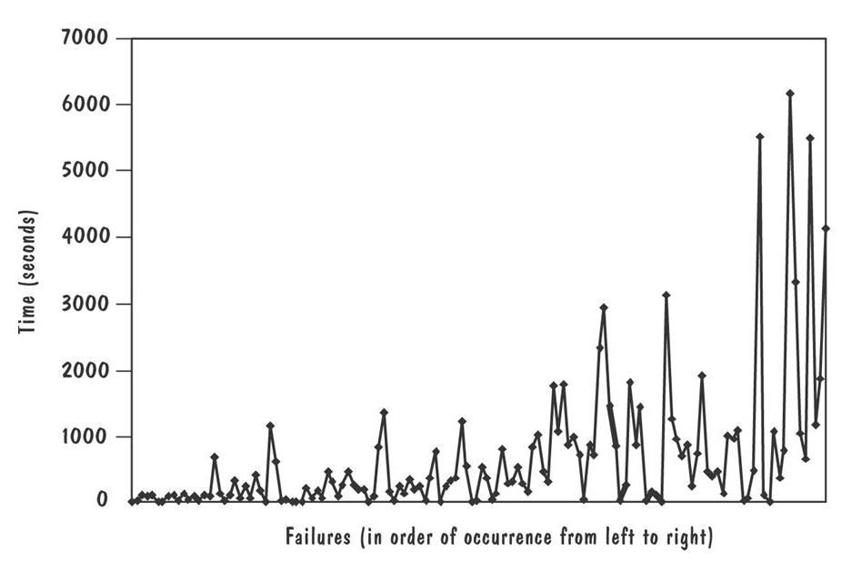
9.4 Reliability, Availability, and Maintainability
Failure Data (Continued)
Graph of failure data from previous table

Slide 33
9.4 Reliability, Availability, and Maintainability
Uncertainty Inherent from Failure Data
Type-1 uncertainty: how the system will be used
Type-2 uncertainty: lack of knowledge about the effect of fault removal

Slide 34
9.4 Reliability, Availability, and Maintainability
Measuring Reliability, Availability, and Maintainability
Mean time to failure (MTTF)
Mean time to repair (MTTR)
Mean time between failures (MTBF)
  MTBF = MTTF + MTTR
Reliability R = MTTF/(1+MTTF)
Availability A = MTBF (1+MTBF)
Maintainability M = 1/(1+MTTR)

Slide 35
9.4 Reliability, Availability, and Maintainability
Reliability Stability and Growth
Probability density function f or time t, f (t): when the software is likely to fail
Distribution function: the probability of failure
  F(t) = ∫ f (t) dt
Reliability Function: the probability that the software will function properly until time t
  R(t) = 1- F(t)

Slide 36
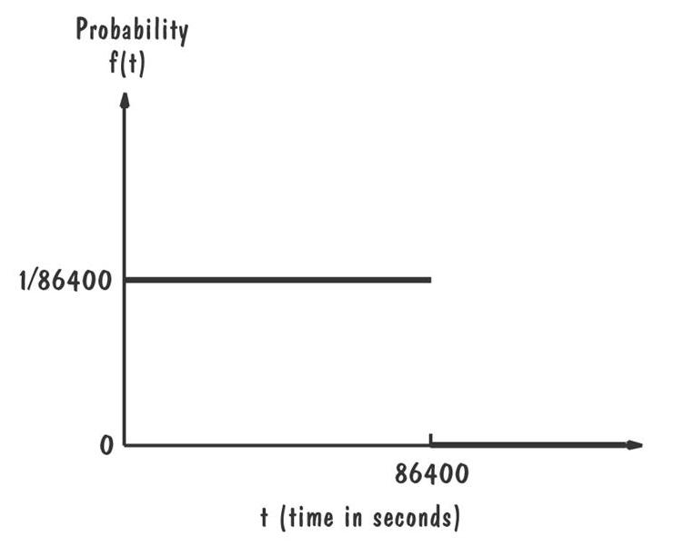
9.4 Reliability, Availability, and Maintainability
Uniformity Density Function
Uniform in the interval from t=0..86,400 because the function takes the same value in that interval

Slide 37
9.4 Reliability, Availability, and Maintainability
Sidebar 9.4 Difference Between Hardware and Software Reliability
Complex hardware fails when a component breaks and no longer functions as specified
Software faults can exist in a product for long time, activated only when certain conditions exist that transform the fault into a failure

Slide 38
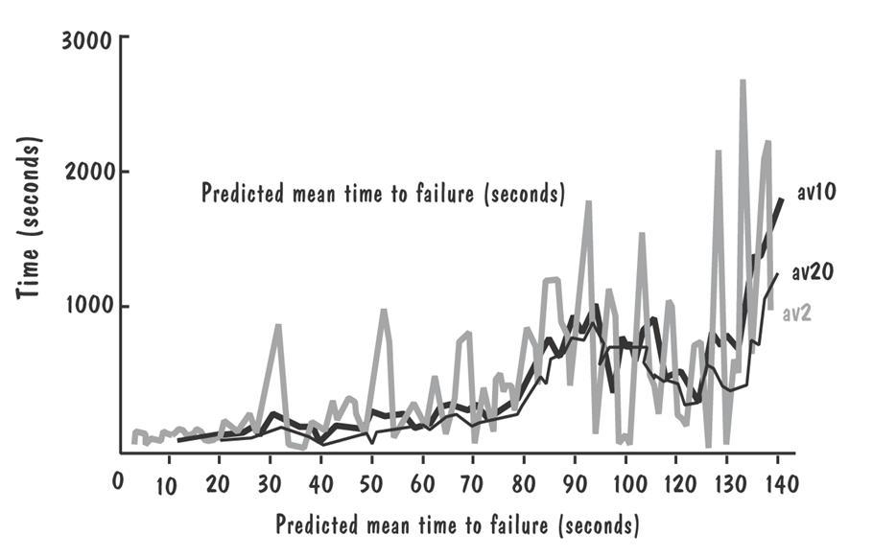
9.4 Reliability, Availability, and Maintainability
Reliability Prediction
Predicting next failure times from past history

Slide 39
9.4 Reliability, Availability, and Maintainability
Elements of a Prediction System
A prediction model: gives a complete probability specification of the stochastic process
An inference procedure: for unknown parameters of the model based on values of t₁, t₂, …, ti-1
A prediction procedure: combines the model and inference procedure to make predictions about future failure behavior

Slide 40
9.4 Reliability, Availability, and Maintainability
Sidebar 9.5 Motorola’s Zero-Failure Testing
The number of failures to time t is equal to
  a e^{-b(t)}
    a and b are constant
Zero-failure test hour
  [ln ( failures/ (0.5 + failures)] X (hours-to-last-failure)
  ln[(0.5 + failures)/(test-failures + failures)

Slide 41
9.4 Reliability, Availability, and Maintainability
Reliability Model
The Jelinski-Moranda model: assumes
  no type-2 uncertainty
  corrections are perfect
  fixing any fault contributes equally to improving the reliability
The Littlewood model
  treats each corrected fault’s contribution to reliability as independent variable
  uses two source of uncertainty

Slide 42
9.4 Reliability, Availability, and Maintainability
Successive Failure Times for Jelinski-Moranda
I | Mean Time to ith failure | Simulated Time to ith Failure
1 | 22 | 11
2 | 24 | 41
3 | 26 | 13
4 | 28 | 4
5 | 30 | 30
6 | 33 | 77
7 | 37 | 11
8 | 42 | 64
9 | 48 | 54
10 | 56 | 34
11 | 67 | 183
12 | 83 | 83
13 | 111 | 17
14 | 167 | 190
15 | 333 | 436

Slide 43
9.5 Acceptance Tests
Purpose and Roles
Enable the customers and users to determine if the built system meets their needs and expectations
Written, conducted and evaluated by the customers

Slide 44
9.5 Acceptance Tests
Types of Acceptance Tests
Pilot test: install on experimental basis
Alpha test: in-house test
Beta test: customer pilot
Parallel testing: new system operates in parallel with old system

Slide 45
9.4 Reliability, Availability, and Maintainability
Sidebar 9.6 Inappropriate Use of A Beta Version
Problem with the Pathfinder’s software
  NASA used VxWorks operating system for PowerPC’s version to the R6000 processor
    A beta version
    Not fully tested

Slide 46
9.4 Reliability, Availability, and Maintainability
Result of Acceptance Tests
List of requirements
  are not satisfied
  must be deleted
  must be revised
  must be added

Slide 47
9.6 Installation Testing
Before the testing
  Configure the system
  Attach proper number and kind of devices
  Establish communication with other system
The testing
  Regression tests: to verify that the system has been installed properly and works

Slide 48
9.7 Automated System Testing
Simulator
Presents to a system all the characteristics of a device or system without actually having the device or system available
Looks like other systems with which the test system must interface
Provides the necessary information for testing without duplication the entire other system

Slide 49
9.7 Automated System Testing
Sidebar 9.7 Automated Testing of A Motor Insurance Quotation System
The system tracks 14 products on 10 insurance systems
The system needs large number of test cases
The testing process takes less than one week to complete by using automated testing

Slide 50
9.8 Test Documentation
Test plan: describes system and plan for exercising all functions and characteristics
Test specification and evaluation: details each test and defines criteria for evaluating each feature
Test description: test data and procedures for each test
Test analysis report: results of each test

Slide 51
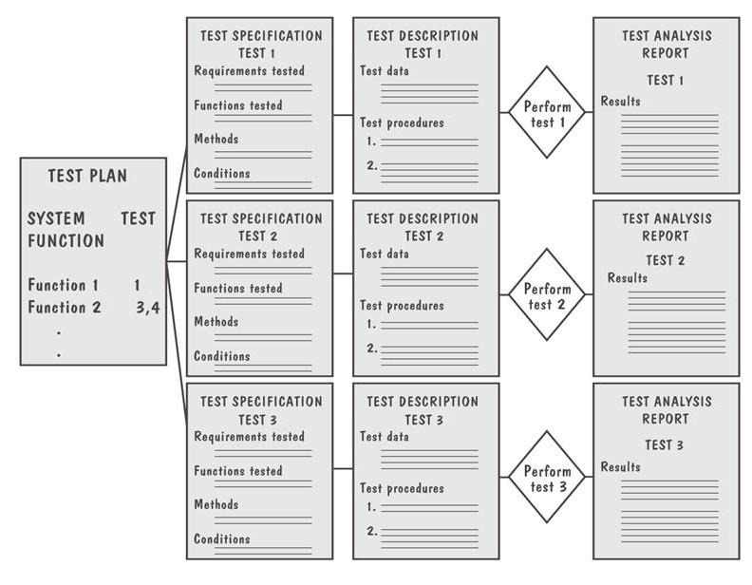
9.8 Test Documentation
Documents Produced During Testing

Slide 52
9.8 Test Documentation
Test Plan
The plan begins by stating its objectives, which should
  guide the management of testing
  guide the technical effort required during testing
  establish test planning and scheduling
  explain the nature and extent of each test
  explain how the test will completely evaluate system function and performance
  document test input, specific test procedures, and expected outcomes

Slide 53
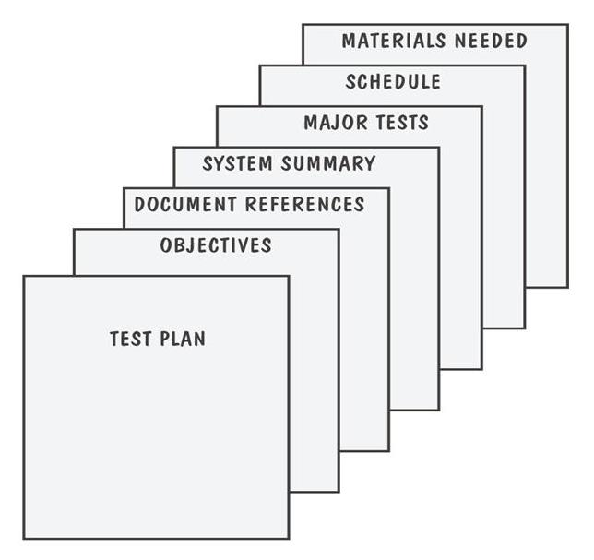
9.8 Test Documentation
Parts of a Test Plan

Slide 54
9.8 Testing Documentation
Test-Requirement Correspondence Chart
Test | Requirement 2.4.1: Generate and Maintain Database | Requirement 2.4.2: Selectively Retrieve Data | Requirement 2.4.3: Produced Specialized Reports
1. Add new record | X
2. Add field | X
3. Change field | X
4. Delete record | X
5. Delete field | X
6. Create index |  | X
Retrieve record with a requested
7. Cell number |  | X
8. Water height |  | X
9. Canopy height |  | X
10. Ground cover |  | X
11, Percolation rate |  | X
12. Print full database |  |  | X
13. Print directory |  |  | X
14. Print keywords |  |  | X
15. Print simulation summary |  |  | X

Slide 55
9.8 Test Documentation
Sidebar 9.8 Measuring Test Effectiveness and Efficiency
Test effectiveness can be measured by dividing the number of faults found in a given test by the total number of faults found
Test efficiency is computed by dividing the number of faults found in testing by the effort needed to perform testing

Slide 56
9.8 Test Documentation
Test Description
Including
  the means of control
  the data
  the procedures

Slide 57
9.8 Test Documentation
Test Description Example
INPUT DATA:
Input data are to be provided by the LIST program. The program generates randomly a list of N words of alphanumeric characters; each word is of length M. The program is invoked by calling
RUN LIST(N,M)
in your test driver. The output is placed in global data area LISTBUF. The test datasets to be used for this test are as follows:
Case 1: Use LIST with N=5, M=5
Case 2: Use LIST with N=10, M=5
Case 3: Use LIST with N=15, M=5
Case 4: Use LIST with N=50, M=10
Case 5: Use LIST with N=100, M=10
Case 6: Use LIST with N=150, M=10
INPUT COMMANDS:
The SORT routine is invoked by using the command
RUN SORT (INBUF,OUTBUF) or
RUN SORT (INBUF)
OUTPUT DATA:
If two parameters are used, the sorted list is placed in OUTBUF. Otherwise, it is placed in INBUF.
SYSTEM MESSAGES:
During the sorting process, the following message is displayed:
“Sorting ... please wait ...”
Upon completion, SORT displays the following message on the screen:
“Sorting completed”
To halt or terminate the test before the completion message is displayed, press CONTROL-C on the keyboard.

Slide 58
9.8 Test Documentation
Test Script for Testing The “change field”
Step N: Press function key 4: Access data file.
Step N+1: Screen will ask for the name of the date file.
Type ‘sys:test.txt’
Step N+2: Menu will appear, reading
* delete file
* modify file
* rename file
Place cursor next to ‘modify file’ and press RETURN key.
Step N+3: Screen will ask for record number. Type ‘4017’.
Step N+4: Screen will fill with data fields for record 4017:
Record number: 4017 X: 0042 Y: 0036
Soil type: clay Percolation: 4 mtrs/hr
Vegetation: kudzu Canopy height: 25 mtrs
Water table: 12 mtrs Construct: outhouse
Maintenance code: 3T/4F/9R
Step N+5: Press function key 9: modify
Step N+6: Entries on screen will be highlighted. Move cursor to VEGETATION field. Type ‘grass’ over ‘kudzu’ and press RETURN key.
Step N+7: Entries on screen will no longer be highlighted.
VEGETATION field should now read ‘grass’.
Step N+8: Press function key 16: Return to previous screen.
Step N+9: Menu will appear, reading
* delete file
* modify file
* rename file
To verify that the modification has been recorded,place cursor next to ‘modify file’ and press RETURN key.
Step N+10: Screen will ask for record number. Type ‘4017’.
Step N+11: Screen will fill with data fields for record 4017:
Record number: 4017 X: 0042 Y: 0036
Soil type: clay Percolation: 4 mtrs/hr
Vegetation: grass Canopy height: 25 mtrs
Water table: 12 mtrs Construct: outhouse
Maintenance code: 3T/4F/9R

Slide 59
9.8 Test Documentation
Test Analysis Report
Documents the result of test
Provides information needed to duplicate the failure and to locate and fix the source of the problem
Provides information necessary to determine if the project is complete
Establish confidence in the system’s performance

Slide 60
9.8 Test Documentation
Problem Report Forms
Location: Where did the problem occur?
Timing: When did it occur?
Symptom: What was observed?
End result: What were the consequences?
Mechanism: How did it occur?
Cause: Why did it occur?
Severity: How much was the user or business affected?
Cost: How much did it cost?

Slide 61
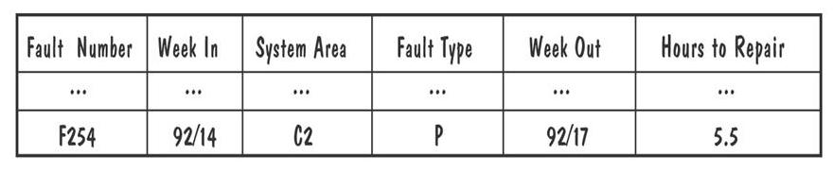
9.8 Test Documentation
Example of Actual Problem Report Forms

Slide 62
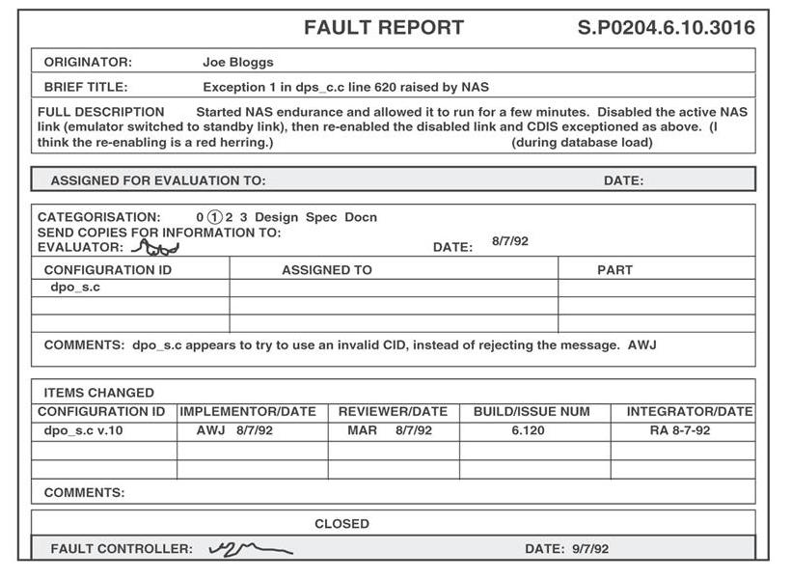
9.8 Test Documentation
Example of Actual Discrepancy Report Forms

Slide 63
9.9 Testing Safety-Critical Systems
Design diversity: use different kinds of designs, designers
Software safety cases: make explicit the ways the software addresses possible problems
  failure modes and effects analysis
  hazard and operability studies (HAZOPS)
Cleanroom: certifying software with respect to the specification

Slide 64
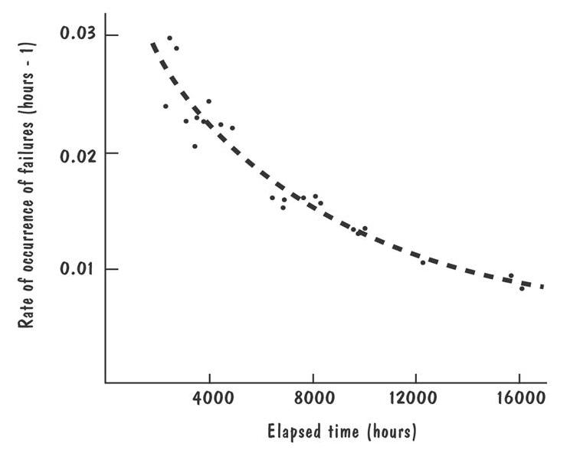
9.9 Testing Safety-Critical Systems
Ultra-High Reliability Problem
Graph of failure data from a system in operational use

Slide 65
9.9 Testing Safety-Critical Systems
Sidebar 9.9 Software Quality Practices at Baltimore Gas and Electric
To ensure high reliability
  checking the requirements definition thoroughly
  performing quality reviews
  testing carefully
  documenting completely
  performing thorough configuration control

Slide 66
9.9 Testing Safety-Critical Systems
Sidebar 9.10 Suggestions for Building Safety-Critical Software
Recognize that testing cannot remove all faults or risks
Do not confuse safety, reliability and security
Tightly link the organization’s software and safety organizations
Build and use a safety information system
Instill a management culture safety
Assume that every mistakes users can make will be made
Do not assume that low-probability, high-impacts event will not happen
Emphasize requirements definition, testing, code and specification reviews, and configuration control
Do not let short-term considerations overshadow long-term risks and cost

Slide 67
9.9 Testing Safety-Critical Systems
Perspective for Safety Analysis
 | Known cause | Unknown cause
Known effect | Description of system behavior | Deductive analysis, including fault tree analysis
Unknown effect | Inductive analysis, including failures modes and effect analysis | Exploratory analysis, including hazard and operability statistics

Slide 68
9.9 Testing Safety-Critical Systems
Sidebar 9.11 Safety and the Therac-25
Atomic Energy of Canada Limited (AECL) performed a safety analysis
  identify single fault using a failure modes and effects analysis
  identify multiple failures and quantify the results by performing a fault tree analysis
  perform detailed code inspections
AECL recommended
  10 changes to the Therac-25 hardware, including interlocks to back up software control energy selection and electron-beam scanning

Slide 69
9.9 Testing Safety-Critical Systems
HAZOP Guide Words
Guide word | Meaning
No | No data or control signal sent or received
More | Data volume is too high or fast
Less | Data volume is too low or slow
Part of | Data or control signal is incomplete
Other than | Data or control signal has additional component
Early | Signal arrives too early for system clock
Late | Signal arrives too late for system clock
Before | Signal arrives earlier in sequence than expected
After | Signal arrives later in sequence than expected

Slide 70
9.9 Testing Safety-Critical Systems
SHARD Guide Words
Flow |  | Provision |  | Failure Categorization Timing |  | Value
Protocol | Type | Omission | Commission | Early | Late | Subtle | Coarse
Pool | Boolean | No update | Unwanted Update | N/A | Old data | Stuck at … | N/A
 | Value | No update | Unwanted Update | N/A | Old data | Wrong tolerance | Out of tolerance
 | Complete | No update | Unwanted Update | N/A | Old data | Incorrect | Inconsistent
Channel | Boolean | No data | Extra data | Early | Late | Stuck at … | N/A
 | Value | No data | Extra data | Early | Late | Wrong tolerance | Out of tolerance
 | Complete | No data | Extra data | Early | Late | Incorrect | inconsistent

Slide 71
9.9 Testing Safety-Critical Systems
Cleanroom Control Structures and Correctness Conditions
Control structures: Correctness conditions:
Sequence For all arguments:
[f]
DO
g: Does g followed by h do f?
h
OD
Ifthenelse
[f]
IF p Whenever p is true
THEN does g do f, and
g whenever p is false
ELSE does h do f?
h
FI
Whiledo
[f] Is termination guaranteed, and
WHILE p whenever p is true
DO does g followed by f do f, and
g whenever p is false
OD does doing nothing do f?

Slide 72
9.9 Testing Safety-Critical Systems
A Program and Its Subproofs
Program: Subproofs:
[f1] f1 = [DO g1;g2;[f2] OD] ?
DO
g1
g2
[f2] f2 = [WHILE p1 DO [f3] OD] ?
WHILE
p1
DO [f3] f3 = [DO g3;[f4];g8 OD]?
g3
[f4] f4 = [IF p2 THEN [f5] ELSE [f6] FI] ?
IF
p2
THEN [f5] f5 = [DO g4;g5 OD] ?
g4
g5
ELSE [f6] f6 = [DO g6;g7 OD] ?
g6
g7
FI
g8
OD
OD

Slide 73
9.9 Testing Safety-Critical Systems
Sidebar 9.12 When Statistical Usage Testing Can Mislead
Consider fault occurs for each
  saturated condition: 79% of the time
  non saturated condition: 20% of the time
  transitional condition: 1% of the time
  probability of failures: 0.001
To have a 50% chance of detecting each fault, we must run
  non saturated: 2500 test cases
  transitional : 500,000 test cases
  saturated: 663 test cases
Thus, testing according to the operational profile will detect the most fault
However, transition situation are often the most complex and failure-prone
Using operational profile would concentrate on testing the saturated mode, when in fact we should be concentrating on the transitional fault

Slide 74
9.10 Information Systems Example
The Piccadilly System
Many variables, many different test cases to consider
  An automated testing tool may be useful

Slide 75
9.10 Information Systems Example
Things to Consider in Selecting a Test Tool
Capability
Reliability
Capacity
Learnability
Operability
Performance
Compatibility
Nonintrusiveness

Slide 76
9.10 Information Systems Example
Sidebar 9.13 Why Six-Sigma Efforts Do Not Apply to Software
A six-sigma quality constraint says that in a billion parts, we can expect only 3.4 to be outside the acceptable range
It is not apply to software because
  People are variable, the software process inherently contains a large degree of uncontrollable variation
  Software either conforms or it does not, there are no degree of conformance
  Software is not the result of a mass-production process

Slide 77
9.11 Real-Time Example
Ariane-5 Failure
Simulation might help preventing the failure
  Could have generated signals related to predicted flight parameters while turntable provided angular movement

Slide 78
9.12 What This Chapter Means for You
Should anticipate testing from the very beginning of the system life cycle
Should think about system functions during requirement analysis
Should use fault-tree analysis, failure modes and effect analysis during design
Should build safety case during design and code reviews
Should consider all possible test cases during testing

