Slide 1
UNIVERSITY OF MASSACHUSETTS
Dept. of Electrical & Computer Engineering
Computer Architecture
ECE 668
Dynamic Branch Prediction
Csaba Andras Moritz
Notes:
Review today, not so fast in future

Slide 2
Static Branch Prediction
Simplest: Predict taken
  average misprediction rate = untaken branch frequency, which for the SPEC programs is 34%
  Unfortunately, the correct prediction rate ranges from not very accurate (41%) to highly accurate (91%)
Predict on the basis of branch direction?
  choosing backward-going branches to be taken (loop)
  forward-going branches to be not taken (if)
  SPEC programs, however, most forward-going branches are taken => predict taken is better
Predict branches on the basis of profile information collected from earlier runs
  Misprediction varies from 5% to 22%

Slide 3
Eight Branch Prediction Schemes
1-bit Branch-Prediction
2-bit Branch-Prediction
Correlating Branch Prediction
Gshare
Tournament Branch Predictor
Branch Target Buffer
Conditionally Executed Instructions
Return Address Predictors
- Branch Prediction even more important when N instructions per cycle are issued
- Amdahl’s Law => relative impact of the control stalls will be larger with the lower potential CPI in an n-issue processor

Slide 4
Dynamic Branch Prediction
Performance = ƒ(accuracy, cost of misprediction)
Branch History Table (BHT): Lower bits of PC address index table of 1-bit values
  Says whether or not branch taken last time ( T-Taken, N )
  No full address check (saves HW, but may be wrong)
Problem: in a loop, 1-bit BHT will cause
2 mispredictions (avg is 9 iterations before exit):
  End of loop case, when it exits instead of looping as before
  First time through loop on next time through code, when it predicts exit instead of looping
  Only 77.8% accuracy if 9 iterations per loop on average
. . . TTT T
N N
T TT . . .

Slide 5
2-bit Branch Prediction - Scheme 1
Better Solution: 2-bit scheme:
Red: stop, not taken
Green: go, taken
T
N
Predict Taken
T*
T*N
Predict Taken
T
T
N
N
Predict Not
Taken
N*T
N*
Predict Not
Taken
T
N
(Jim Smith, 1981)

Slide 6
Branch History Table (BHT)
Predictor 0
Predictor 1
T
T*
N
T*N
Branch PC
T
•
T
N
N*T
N
N*
•
T
•
N
Predictor 127
BHT is a table of “Predictors”
  2-bit, saturating counters indexed by PC address of Branch
In Fetch phase of branch:
  Predictor from BHT used to make prediction
When branch completes:
  Update corresponding Predictor

Slide 7
2-bit Branch Prediction - Scheme 2
Another Solution: 2-bit scheme where change prediction (in either direction) only if get misprediction twice:
Red: stop, not taken
Green: go, taken
T
N
Predict Taken
T*
T*N
Predict Taken
T
T
N
N
Predict Not
Taken
N*T
N*
Predict Not
Taken
T
N
Lee & A. Smith, IEEE Computer, Jan 1984
Notes:
In previous a single misprediction led to oscillating between TN and NT.

Slide 8
2
T
1
T*
N
T*N
T
Comparison
T
T
N
T*
N
T*N
N
T
N*T
N*
T
N
T
N
N*T
N
N*
T
N
Actual: T N T T T N T
}
State: T* T* T*N T* T* T* T*N T*
Predicted: T T T T T T T
For both schemes
Actual: N N T N N T N N
State: N* N* N* N*T N* N* N*T N*
Predicted: N N N N N N N N
Actual: N N T T N N T T
State: N* N* N* N*T T*N N*T N* N*T
Scheme 1
Predicted: N N N N T N N N
Actual: N N T T N N T T
State: N* N* N* N*T T* T*N N* N*T
Predicted: N N N N ? ? ? ?
Scheme 2

Slide 9
2
1
T
T
Further
Comparison
T*
N
T*N
N
T*
T*N
T
T
N
T
N
T
N
N*T
N*
N*T
N
N*
T
N
T
N
Alternating taken / not-taken
Your worst-case prediction scenario
Both schemes achieve 80-95% accuracy with only a small difference in behavior

Slide 10
Correlating Branches
Idea: taken/not taken of recently executed branches is related to behavior of present branch (as well as the history of that branch behavior)
  Then behavior of recent branches selects between, say, 4 predictions of next branch, updating just that prediction
(2,2) predictor: 2-bit global, 2-bit local
  Branch address (4 bits)
2-bits per branch
local predictors
Prediction
2-bit recent global
branch history
(01 = not taken (0) then taken (1) branches
before reaching this)

Slide 11
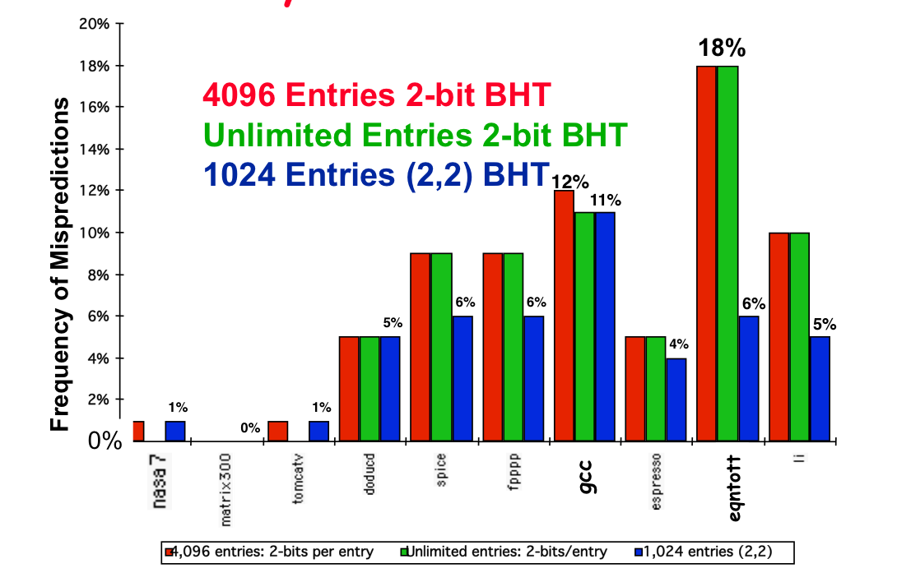
Accuracy of Different Schemes

Slide 12
Re-evaluating Correlation
Several SPEC benchmarks have less than a dozen branches responsible for 90% of taken branches:
  program branch % static # = 90%
  compress 14% 236 13
  eqntott 25% 494 5
  gcc 15% 9531 2020
  mpeg 10% 5598 532
  real gcc 13% 17361 3214
Real programs + OS more like gcc
Small benefits of correlation beyond benchmarks?
Mispredict because either:
  Wrong guess for that branch
  Got branch history of wrong branch when indexing the table
For SPEC92, 4096 about as good as infinite table
  Misprediction mostly due to wrong prediction
Can we improve using global history?

Slide 13
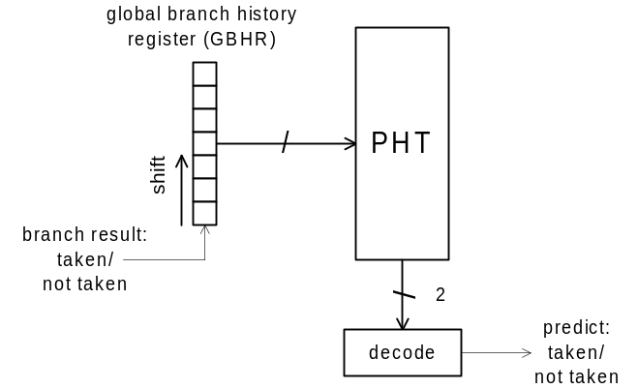
Gselect and Gshare predictors
Keep a global register (GR) with outcome of k branches
Use that in conjunction with PC to index into a table containing 2-bit predictor
Gselect – concatenate
Gshare – XOR (better)
Copyright 2007 CAM

Slide 14
Tournament Predictors
Motivation for correlating branch predictors: 2-bit local predictor failed on important branches; by adding global information, performance improved
Tournament predictors: use two predictors, 1 based on global information and 1 based on local information, and combine with a selector
Hopes to select right predictor for right branch (or right context of branch)

Slide 15
Tournament Predictor in Alpha 21264
4K 2-bit counters to choose from among a global predictor and a local predictor
Global predictor also has 4K entries and is indexed by the history of the last 12 branches; each entry in the global predictor is a standard 2-bit predictor
  12-bit pattern: ith bit is 0 => ith prior branch not taken;
  ith bit is 1 => ith prior branch taken;
00,10,11
00,01,11
1
Use 1
2
4K × 2 bits
Use 2
3
10
01
01
10
.
01
.
Use 2
.
Use 1
10
12
00,11
00,11
Notes:
Global predictor is the green predictor (4Kx2 +12) - 12 bits global (12 branches) select 2 bit predictor
Local predictor – see next slide
4K 2-bit counters to choose from either global or local

Slide 16
Tournament Predictor in Alpha 21264
Local predictor consists of a 2-level predictor:
  Top level a local history table consisting of 1024 10-bit entries; each 10-bit entry corresponds to the most recent 10 branch outcomes for the entry. 10-bit history allows patterns 10 branches to be discovered and predicted
  Next level Selected entry from the local history table is used to index a table of 1K entries consisting a 3-bit saturating counters, which provide the local prediction
Total size: 4K*2 + 4K*2 + 1K*10 + 1K*3 = 29K bits! (~180K transistors)
1K × 10 bits
1K × 3 bits

Slide 17
% of predictions from local predictor in Tournament Prediction Scheme
0%
20%
40%
60%
80%
100%
nasa7
98%
matrix300
100%
tomcatv
94%
doduc
90%
spice
55%
fpppp
76%
gcc
72%
espresso
63%
eqntott
37%
li
69%

Slide 18
Accuracy of Branch Prediction
99%
tomcatv
99%
100%
95%
doduc
84%
97%
86%
fpppp
82%
Profile-based
98%
2-bit counter
88%
Tournament
li
77%
98%
86%
espresso
82%
96%
88%
gcc
70%
94%
fig 3.40
0%
20%
40%
60%
80%
100%
Profile: branch profile from last execution
(static in that is encoded in instruction, but profile)

Slide 19
Accuracy v. Size (SPEC89)
10%
9%
8%
Local - 2 bit counters
7%
6%
Conditional branch misprediction rate
5%
Correlating - (2,2) scheme
4%
3%
Tournament
2%
1%
0%
0
8
16
24
32
40
48
56
64
72
80
88
96
104
112
120
128
Total predictor size (Kbits)

Slide 20
Need Address
at Same Time as Prediction
Branch Target Buffer (BTB): Address of branch used as index to get prediction AND branch address (if taken)
  Note: must check for branch match now, since can’t use wrong branch address
Branch PC
Predicted PC
PC of instruction
FETCH
Yes: instruction is branch; use predicted PC as next PC (if predict Taken)
=?
Prediction state
bits
No: branch not predicted; proceed normally (PC+4)

Slide 21
Branch Target “Cache”
Branch Target cache - Only predicted taken branches
“Cache” - Content Addressable Memory (CAM) or Associative Memory (see figure)
Use a big Branch History Table & a small Branch Target Cache
Branch PC
Predicted PC
PC
=?
Yes: predicted taken branch found
Prediction state
bits (optional)
No: not found

Slide 22
Steps with Branch target Buffer
for the 5-stage MIPS
Send PC to memory and branch-target buffer
IF
Entry found in branch-target buffer?
No
Yes
Branch_CPI_Penalty = [Buffer_hit_rate x P{Incorrect_prediction}] x Penalty_Cycles + [(1-Buffer_hit_rate) x P{Branch_taken}] x Penalty_Cycles = .91x.1x2 + .09x.6x2 = .29
Is instruction a taken branch?
Send out predicted PC
No
Yes
ID
Taken
Branch?
No
Yes
Normal instruction execution
Mispredicted branch, kill fetched instruction; restart fetch at other target; delete entry from target buffer
Enter branch instruction address and next PC into branch-target buffer
Branch correctly predicted; continue execution with no stalls
EX

Slide 23
Predicated Execution
Avoid branch prediction by turning branches into conditionally executed instructions:
if (x) then A = B op C else NOP
  If false, then neither store result nor cause interference
  Expanded ISA of Alpha, MIPS, PowerPC, SPARC have conditional move; PA-RISC can annul any following instruction
Drawbacks to conditional instructions
  Still takes a clock even if “annulled”
  Stall if condition evaluated late: Complex conditions reduce effectiveness since condition becomes known late in pipeline
x
A =
B op C

Slide 24
Special Case: Return Addresses
Register Indirect branch - hard to predict address
SPEC89 85% such branches for procedure return
Since stack discipline for procedures, save return address in small buffer that acts like a stack: 8 to 16 entries has small miss rate

Slide 25
How to Reduce Power
Reduce load capacitances switched
  Smaller BTAC
  Smaller local, global predictors
  Less associativity
  How do you know which branches?
    Use static information
    Combine runtime and compile time information
    Add hints to be used at runtime
  Also, predict statically
  Branch folding
    Runtime
    Compile-time
Copyright 2007 CAM & BlueRISC

Slide 26
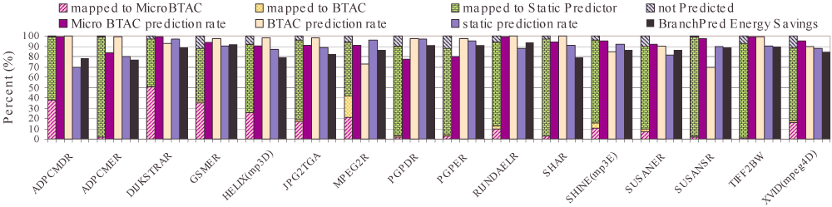
Power Consumption
BlueRISC’s Compiler-driven Power-Aware Branch Prediction
Comparison with 512 entry BTAC bimodal (patent-issued)
Copyright 2007 CAM & BlueRISC

Slide 27
Pitfall: Sometimes dumber is better
Alpha 21264 uses tournament predictor (29 Kbits)
Earlier 21164 uses a simple 2-bit predictor with 2K entries (or a total of 4 Kbits)
SPEC95 benchmarks, 21264 outperforms
  21264 avg. 11.5 mispredictions per 1000 instructions
  21164 avg. 16.5 mispredictions per 1000 instructions
Reversed for transaction processing (TP) !
  21264 avg. 17 mispredictions per 1000 instructions
  21164 avg. 15 mispredictions per 1000 instructions
TP code much larger & 21164 hold 2X branch predictions based on local behavior (2K vs. 1K local predictor in the 21264)
What about power?
  Large predictors give some increase in prediction rate but for a large power cost

