Slide 1
tide gauge
satellite
altimeter
sea level
bottom pressure sensor
land movement
geodetic reference

Slide 2
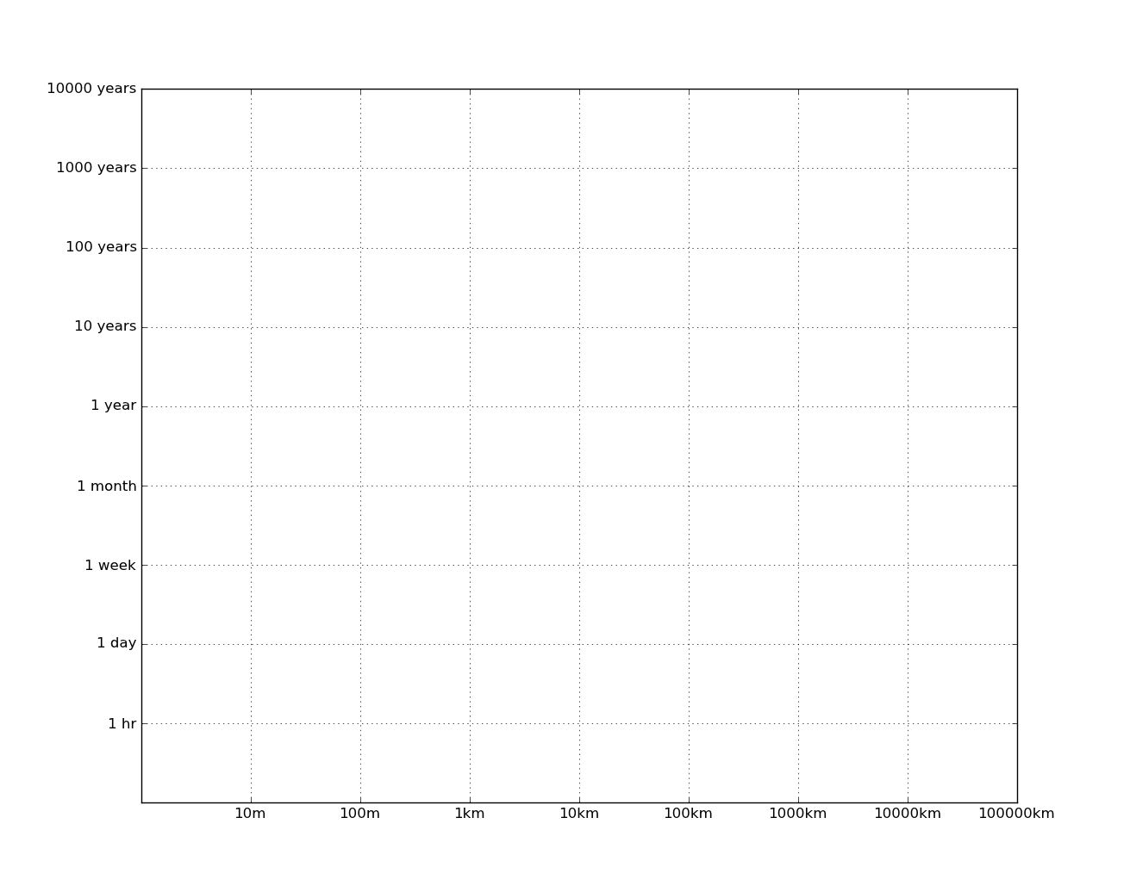
bathymetry/geology
climate change
ENSO, PDO
seasonal
long period tides
eddies &
fronts
coastally trapped waves
internal tides
[semi] diurnal
surface tides
internal waves & inertial motions
surface waves

Slide 3
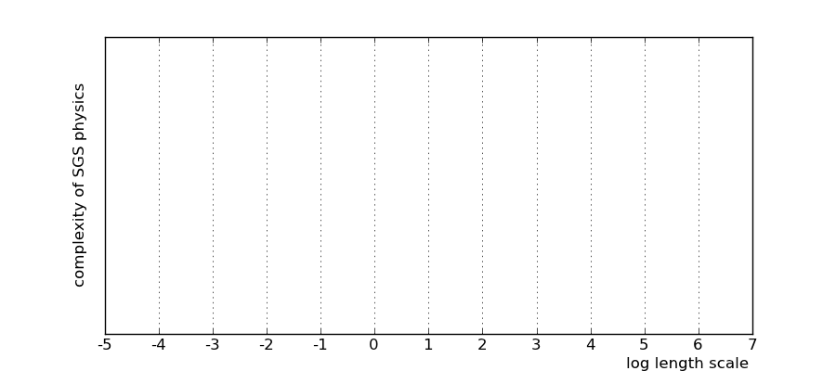
1D balance
OGCMs
eddy averaging
eddy resolving
tide resolving?
LES
DNS
increasing aggregation

Slide 4
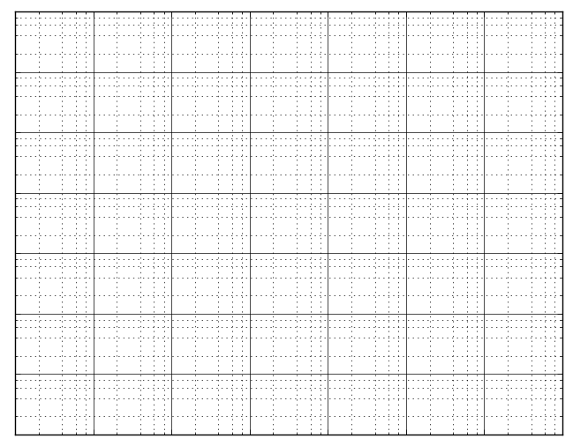

Slide 6
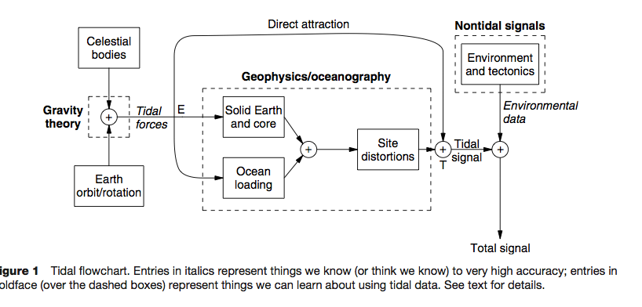
Positional Astronomy & Gravity
Geophysics/Oceanography
Non-Tidal Forces
Ocean Self Attraction
Ocean Loading
Earth orbit & rotation
Non-Tidal Ocean
SAL
Moon orbit
ATGF
Solid Earth & Core
Nett Tidal Force
Tidal Ocean
Sun orbit
Ocean Observation

Slide 7
Response method
Noise
Radiation
potential
Gravitational potential η_{eq}
LTI
admittances
Tide
interaction inputs
I²⁻²,I²⁻¹,…
linear tide
Ocean Observation

