Slide 1
Movie Recommender Systems
Advanced Topics in Data Science
Leg 1 - Interaction models: AR, CF, MFPQ, BPR, NCF
Leg 2 - RAG: LLM summarisation + FAISS retrieval + explanations
Made by: André Vieira (up202107341), Ricardo Ribeiro (up202104806), Miguel Silva (up202105204)

Slide 2
PART ONE
Leg 1
Interaction-based recommenders, tuned and evaluated under CRISP-DM

Slide 3
1. BUSINESS UNDERSTANDING
Problem, Success Criteria & ML Framing
The business problem
Two ML framings
A streaming platform wants to increase engagement by recommending films each user will enjoy.
Without personalisation, users face choice overload across thousands of titles -> fatigue and lower watch rates.
Binary : implicit feedback
Did the user interact at all? Any rating is positive. Rank items by predicted interaction.
Success criteria
Non-binary : explicit feedback
Item relevant only if rating >= 3.5. Closer to true preference but stricter and sparser.
Beat a non-personalised popularity baseline
Measure ranking with Precision@3 & Recall@3
Remain viable under operational limits (sparsity, cold-start)
2

Slide 4
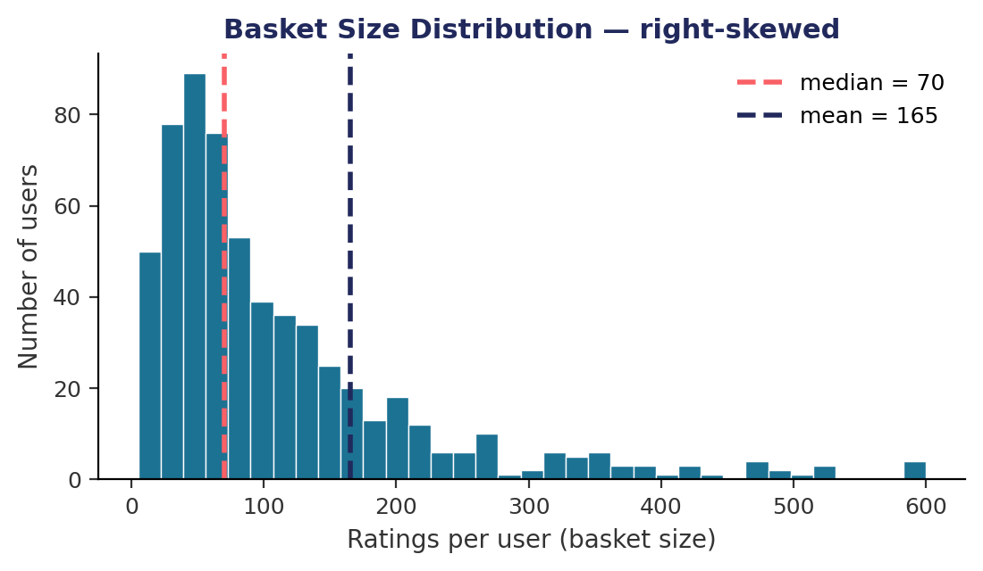
2. DATA UNDERSTANDING
MovieLens ml-latest-small
100,836
610
9,742
98.3%
ratings
users
movies
sparsity
Reading the distribution
Basket size follows a power law. A few power-users rate thousands; most rate few. Median 70 vs mean 165.
Why it matters:
98.3% sparsity makes similarity noisy -> filter entities with < 20 ratings.
The long tail makes even the popularity baseline non-trivial.
3

Slide 5
3. DATA TRANSFORMATION
Preparing the Data for Each Model
1
Filter sparse entities
2
20% user subsample
3
Chronological split
Remove users & movies with < 20 ratings to stabilise similarity.
Probe all five families fast before full data.
70/15/15 per user by timestamp. No leakage.
4
Explicit matrix
5
Implicit conversion
6
Negative sampling
User x movie rating pivot. It feeds CF and MFPQ.
rating >= 4 -> positive; keep positives for AR, BPR, NCF.
Sample unobserved movies (1:1) from training items for BPR/NCF.
4

Slide 6
4. MODELLING
The Five Models & How We Tuned Them
AR
Association Rules -> movies that co-occur in baskets. Interpretable, non-personalised.
support / confidence
CF
Collaborative Filtering -> recommend what similar users liked (cosine).
best K = 20
MFPQ
Matrix Factorisation -> latent factors u.v + biases, L2 reg.
factors=10, λ=0.1
BPR
Bayesian Personalised Ranking -> pairwise ranking loss on implicit data.
factors=10, λ=0.01
NCF
Neural CF -> embeddings through an MLP for non-linear patterns.
lr=1e-3, reg=1e-4
5

Slide 7
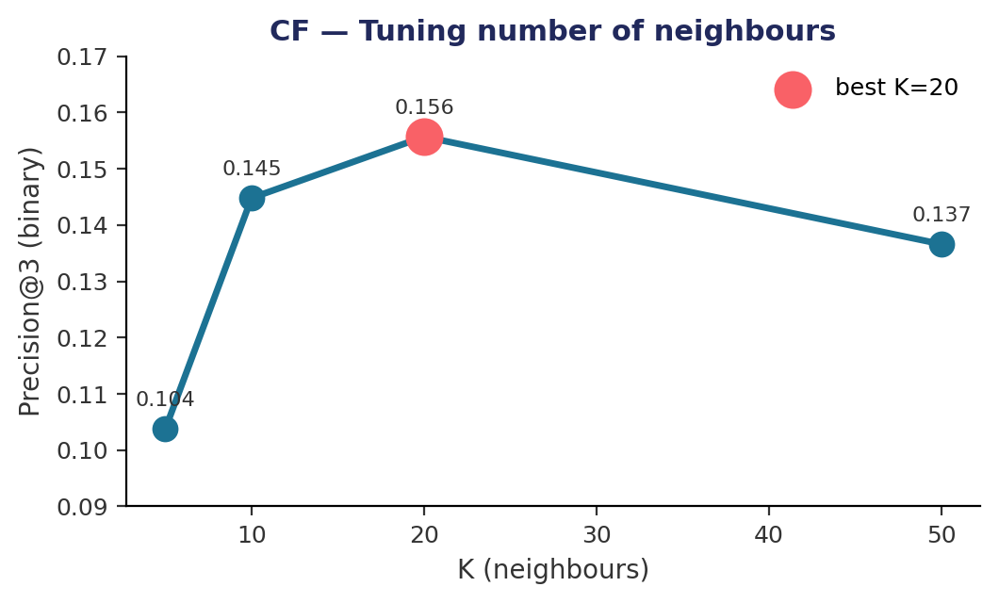
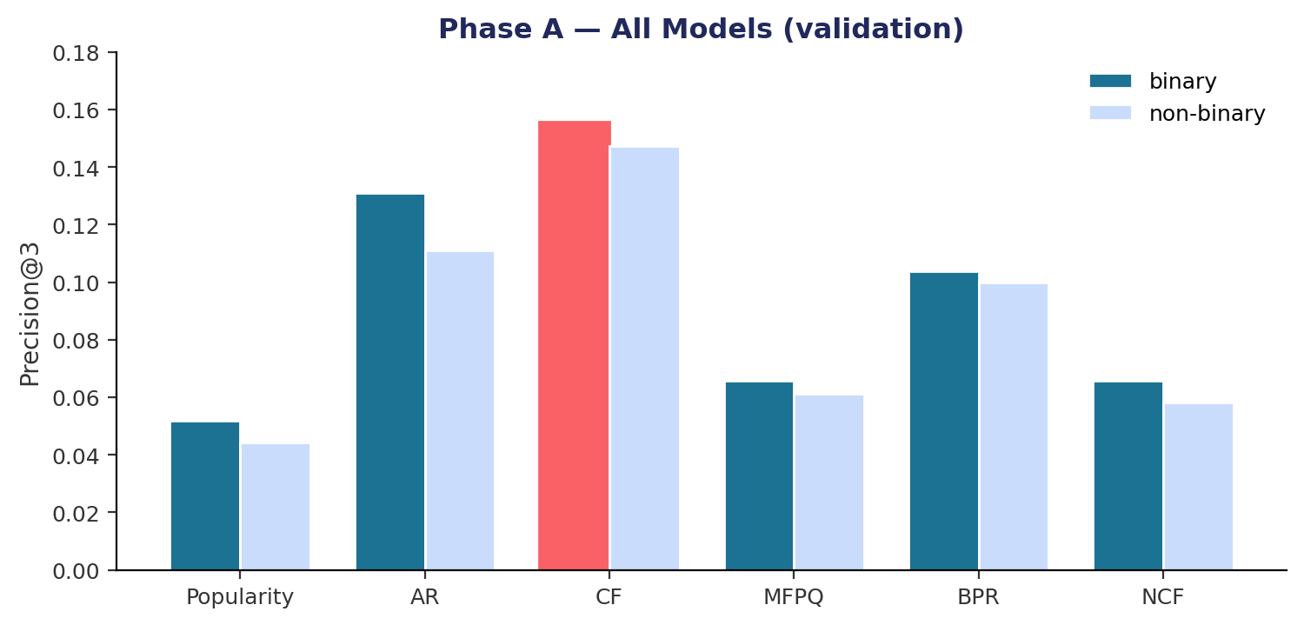
4a. PHASE A : SUBSAMPLE
Tuning & Which Model Wins
CF peaks at K=20. Too few neighbours = noise; too many = over-smoothing.
CF wins (val P@3 = 0.156). Held-out TEST (once): P@3 = 0.1175 R@3 = 0.0293 (binary) - 0.1083 / 0.0365 (non-binary)
6

Slide 8
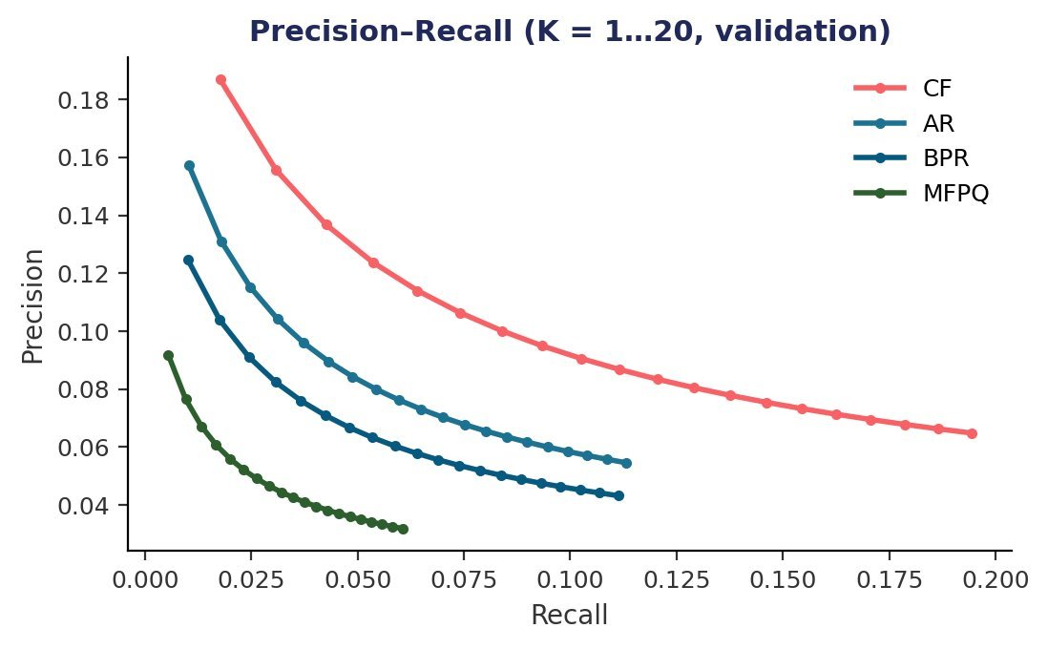
4b. PHASE B : FULL DATA
Scaling, Sanity Checks & PR Curves
Tuned vs 3 arbitrary configs (full data)
CF, K=2 neighbours
P@3 0.0874
MFPQ, 5 factors, λ=0
P@3 0.0104
MFPQ, 150 factors, λ=0
P@3 0.0104
PR curves: CF and AR dominate the upper-left -> higher precision at comparable recall, robust to K.
Scaling: absolute P@3 falls for all methods on full data (sparser per-user target), but the tuned config still beats arbitrary ones.
Precision–Recall computed across K = 1…20 on the test set.
Leg 1 verdict: CF is the best interaction model; sparsity caps NCF; honest validation/test split throughout.
7

Slide 9
PART TWO
Leg 2
Retrieval-Augmented Generation: can semantic search compete with interactions?

Slide 10
5. LEG 2 : MOTIVATION
Why Retrieval-Augmented Generation?
Leg 1 models learn only from who watched what. They cannot reason about what a film is about.
Content-based signal
Cold-start friendly
Interpretable
Uses titles, genres and tags - semantic meaning, not co-occurrence.
New movies with no ratings can still be retrieved via their metadata.
Every recommendation comes with a natural-language explanation.
The pipeline: LLM summarises a user's session into a preference query -> FAISS retrieves semantically similar movies -> LLM explains each pick.
9

Slide 11
5. LEG 2 : ARCHITECTURE
The RAG Pipeline
User session
watched movies
LLM (IAEdu)
summarise taste
FAISS DB
MiniLM embeddings
Retriever
+ Re-ranker
top-K candidates
Recs +
Explanations
ranked + grounded
Design decisions
Metadata text: title + genres + aggregated tags -> one embedding per film (all-MiniLM-L6-v2)
Cosine via FAISS: L2-normalised vectors, inner-product index for fast top-K search
Prompt strategies: tested 3 : detailed / keywords / simple
Re-ranker: cross-encoder ms-marco re-scores the retrieved candidates
10

Slide 12
5. LEG 2 : SUMMARISATION
LLM Session Summary & Prompt Comparison
How it works
Three prompt strategies tested
The user's highly-rated movies are sent to IAEdu, which returns a 2-3 sentence preference profile used as the retrieval query.
Large sessions are capped at the top-rated films to respect the context window.
Detailed : full descriptive paragraph
P@3 (bin): 0.0111
Keywords : 5-8 taste keywords
Example output
P@3 (bin): 0.0111
"This user enjoys gritty, action-packed films from the late 20th century, often set in dystopian or isolated environments -> sci-fi, post-apocalyptic and horror with a raw edge."
Simple : one-sentence summary
P@3 (bin): 0.0111
All three tied (P@3 = 0.0111) -> the bottleneck is retrieval, not prompt wording.
11

Slide 13
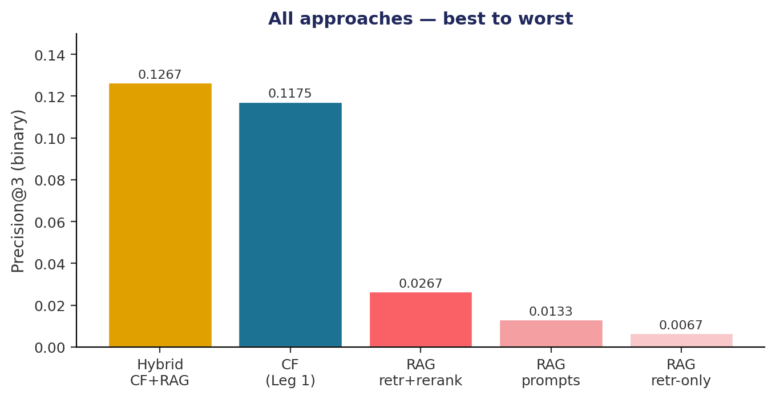
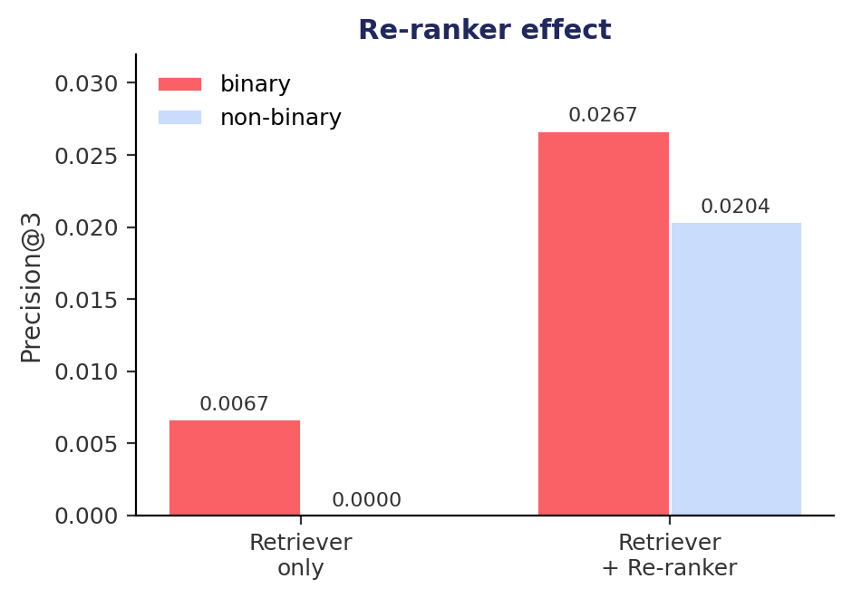
6. LEG 2 : RESULTS
RAG vs Leg 1, and the Re-ranker Effect
Pure RAG trails CF by ~18x : semantic similarity alone is noisier than interaction data and tags are sparse.
The re-ranker quadruples precision (0.0067 -> 0.0267) and rescues the non-binary case from zero. But the real win comes next...
12

Slide 14
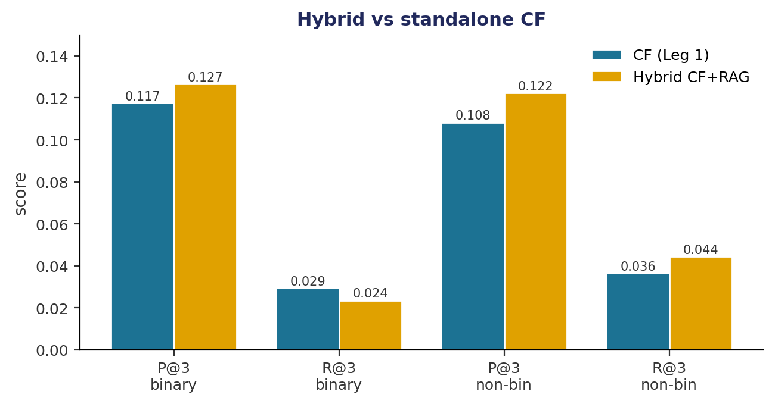
6. LEG 2 : HYBRID MODEL
Hybrid CF + RAG: Best of Both Worlds
How it works
1
CF generates candidates
User-based CF (cosine) scores all unseen movies, keeps a pool of 50.
2
RAG re-scores
A cross-encoder re-scores them with the user's LLM summary.
3
Blend the signals
Both scores min-max normalised, then combined.
hybrid(u,i) = a . CF_norm + (1-a) . RAG_norm
a = 0.7 -> 70% personalisation, 30% semantics
Hybrid beats standalone CF. P@3 0.1267 vs 0.1175 (binary) and 0.1224 vs 0.1083 (non-binary). Neither signal alone reaches this.
13

Slide 15
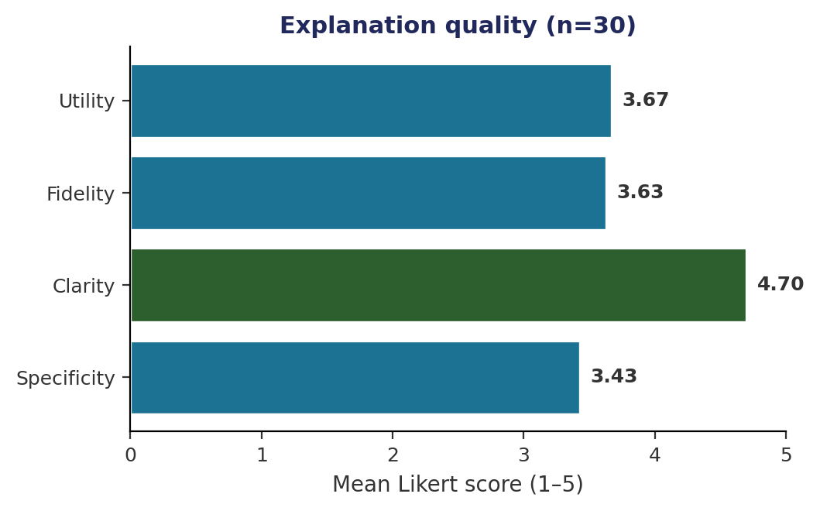
7. LEG 2 : EXPLANATIONS
Automatic Explanations & Human Evaluation
Method
An LLM explains each recommendation, grounded in the user's session. A sample of 30 explanations was rated 1-5 on four criteria.
Clarity is excellent (4.70) -> explanations read naturally;
Utility & fidelity solid (~3.6);
Specificity lowest (3.43) -> sometimes too generic.
.
The real win of RAG. Even with lower ranking accuracy, the explanations add interpretability that interaction models cannot offer.
14

Slide 16
Conclusions
1
The hybrid CF+RAG wins overall
Blending CF (α=0.7) with RAG re-ranking beats standalone CF on Precision@3 -> 0.1267 vs 0.1175 (binary), 0.1224 vs 0.1083 (non-binary).
2
CF is the strongest single model
On its own, CF gives the best Leg 1 Precision@3 (0.118 on test); pure RAG trails it by ~18x -> interactions carry more signal than metadata alone.
3
Sparsity & tuning shape Leg 1
98.3% sparsity caps AR and starves NCF; CF@K=20, MFPQ@λ=0.1 and BPR@λ=0.01 beat all arbitrary configurations.
4
RAG adds what CF lacks
Cold-start coverage and explanations -> the cross-encoder re-ranker quadrupled RAG precision; prompt choice barely mattered.
5
Explanations are interpretable
LLM explanations score 4.7/5 on clarity (3.86 overall), giving the transparency interaction models cannot provide.

