Slide 1

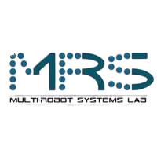
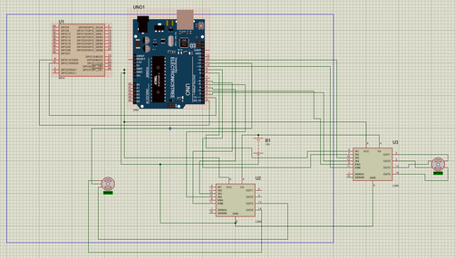
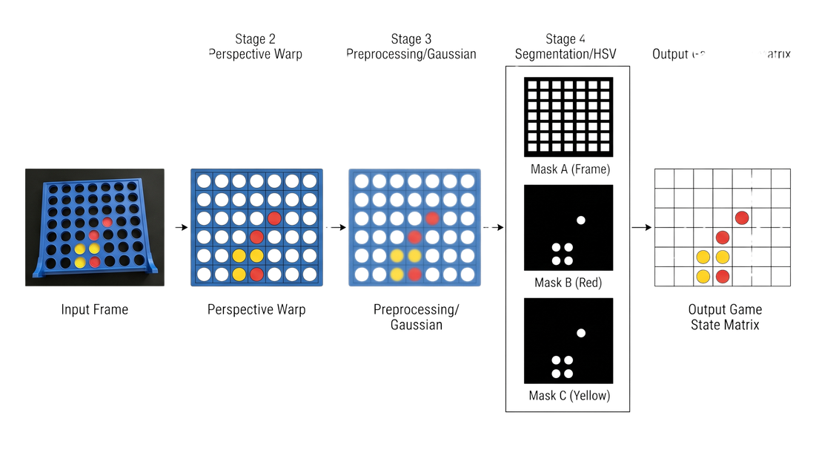
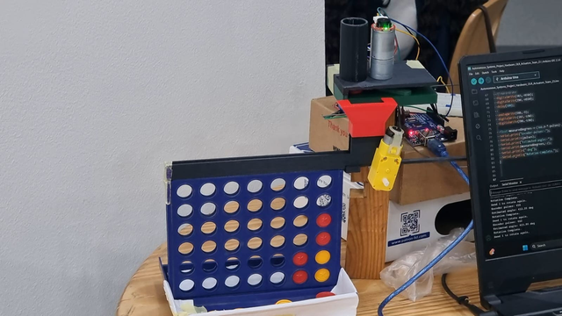
Vision-Based Connect-4 Robot
Image Processing Pipeline for Autonomous Game-State Extraction and Motor Control
German University in Cairo (GUC)
Course
Project Team
Faculty of Engineering & Materials Science | Mechatronics Department
MCTR1010 - Image Processing for Mechatronics | Spring 2026
Andrew Abdelmalak, Kirolous Kirolous, Daniel Boules, Samir Yacoub, David Girgis, Youssef Salama
Abstract & Objectives
System Methodology
Results & Conclusions
Abstract: This project presents a finalized closed-loop Vision-Based Connect-4 Robot that integrates computer vision, minimax decision-making, and robotic actuation. A Raspberry Pi 4 processes overhead frames through an OpenCV pipeline (HSV segmentation and homography) to extract the game state with 98% per-cell accuracy. The system employs a trusted-state validator to reject illegal board transitions, ensuring robustness against environmental noise. Moves are calculated via a depth-5 minimax algorithm and executed by an Arduino-controlled dual-motor assembly. Experimental results confirm an average end-to-end task time of 7.5 seconds and a 95% successful token-placement rate, meeting all milestone objectives for autonomous operation.
Perception & Image Processing:
Closed-Loop Results:
Camera Setup: Overhead Pi Camera V2 captures RGB frames using a fixed black cardboard background to mitigate lighting limitations
Pipeline: Includes affine rotation, perspective warping (homography mapping to an 800x800 square), Gaussian filtering (5x5 kernel), and HSV color thresholding
State Extraction: Morphological opening/closing refines binary masks to generate a verified 6x7 game-state matrix
Execution & Processing Speeds: Vision Pipeline: The Pi 4 handles core operations quickly: Rotation (8.47 ms), Perspective Warp (3.60 ms), and Gaussian Blur (0.76 ms).
Decision Speed: Minimax search at depth 5 typically completes in under 1 second.
End-to-End Task Time: The total cycle—from command issue to verified token placement—averages 7.5 seconds (ranging from a 3s minimum to a 15s maximum in worst-case scenarios).
KPIs: HSV (Rule-based): Achieved the highest reliability at 98% overall accuracy.
Auto (Hybrid): Maintained a high 96% accuracy, successfully integrating machine learning with an HSV fallback.
ML-only: Provided 91% accuracy, demonstrating robustness to hue drift despite lower absolute scores than HSV.
System Robustness in Scenarios: Glare & Lighting: The system successfully recovered from light sweeps within 1–2 frames thanks to the Exponential Moving Average (EMA) smoother and the validator.
Illegal Moves: The Trusted State Validator successfully rejected all injected illegal transitions (e.g., "floating" chips) during mid-game testing.
Error Handling: Post-move verification caught 100% of missed drops, placing the robot in a safe error state rather than continuing with a corrupted board.
Cognition & Actuation:
Project Objectives:
Decision Layer: Raspberry Pi 4 (4 GB) evaluates the matrix using Minimax with alpha-beta pruning
Control Interface: Column selection is serialized and transmitted via USB to an Arduino Uno at 9600 baud
Hardware Assembly: Mechanical frame modeled in SolidWorks. Actuation utilizes NEMA 17 steppers (via L298N drivers) for the pusher and an SG90 micro-servo for the column-selection gate
Implemented a finalized closed-loop hardware system acting as a blackbox (input images/videos → output motor control)
Validated image processing techniques including HSV color segmentation, geometric transformations, and morphological cleanup
Measured target KPIs: action accuracy, operation speed, and detection robustness
System Architecture
OpenCV Transformations
Hardware Testing
Conclusion & Limitations:
Outcome: Successfully built a closed-loop system where the camera serves as both the input sensor and the verification element.
Limitation 1: Time-based carriage movement (instead of encoder-closed) limits accuracy on outer columns.
Limitation 2: High sensitivity to specular highlights on the blue plastic frame.
Project Instructors: Assoc. Prof. Dr. Eng. Omar M. Shehata, Eng. Dalia M. Mahfouz, PhD, Eng. Abdelrahman Hatem, MSc., and Eng. Mohammed Ashraf
Andrew.abdelmalak@student.guc.edu.eg 55-22771; Daniel.boules@student.guc.edu.eg 55-5055; David.girgis@student.guc.edu.eg 55-1481 Kirolous.kirolous@student.guc.edu.eg 55-18081; Samir.yacoub@student.guc.edu.eg 55-25111; youssef.salama@student.guc.edu.eg 55-0540
Notes:
1

