Slide 1
CLUSTERING
Eitan Lifshits
Big Data Processing Seminar
Prof. Amir Averbuch
18.1.2015
Mining of Massive Datasets, Jure Leskovec, Anand Rajaraman, Jeffery D. Ullman

Slide 2
Main Topics
What is Clustering?
Distance measures and spaces.
Algorithmic approaches.
The curse of dimensionality.
Hierarchical clustering.
Point assign clustering.
non-main-memory data clustering.
Summary and other topics.

Slide 3
What is Clustering?
The process of examining a collection of “points” and grouping them into clusters according to some distance measure.
The goal is that points in the same cluster have a small distance from one another, while points in different clusters are at large distance from one another.
Main issues
Data is very large.
High dimensional data space.
Data space is not Euclidean (e.g. NLP problems).

Slide 4
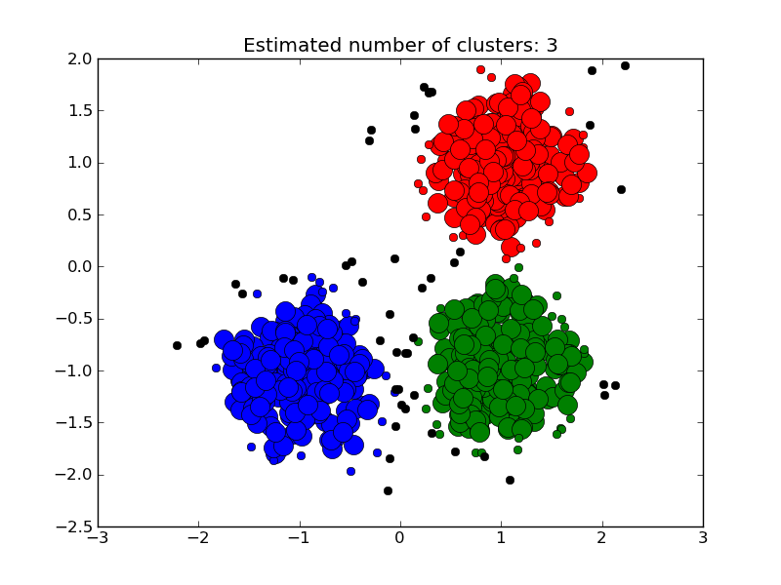
Clustering illustration
Example of data clustered into 3 clusters based on Euclidean space.

Slide 5

Distance measures and spaces
Distance measure requires 3 conditions (was given in previous lectures)
Distances examples:
Euclidean distance (for set of points).
Given by:

Slide 6


Distance measures and spaces
Jaccard distance (for sample sets).
Given by
Cosine distance (for sets of vectors)
Given by
Edit distance (comparing strings)
Given two strings a and b. The edit distance is the minimum number of operations (insertion, deletion, substitution) that transform a into b.
And many more…

Slide 7
Algorithmic Approaches
There are two main approaches:
Hierarchical algorithms:
Agglomerative (bottom-up): Start with each point as a cluster. Clusters are combined based on their “closeness”, using some definition of “close” (will be discussed later).
Divisive (top-down): Start with one cluster including all points and recursively split each cluster based on some criterion.
Will not be discussed in this presentation.
Point assignment algorithms:
Points are considered in some order, and each one is assigned to the cluster into which it best fit.

Slide 8
Algorithmic Approaches
Other clustering algorithms distinctions:
Whether the algorithm assumes a Euclidean space, or whether the algorithm works for arbitrary distance measure (as those mentioned before).
Whether the algorithm assumes that the data is small enough to fit in main memory, or whether data must reside in secondary memory primarily.

Slide 9
The curse of dimensionality
Refers to high dimensional data properties which might make the clustering task much harder or yield bad results.
Properties:
In high dimensional data all points are equally far away from one another.
Consider points where and is large, that were selected uniformly from a dimensional unit cube.
Each point is a random variable chosen uniformly from the range [0,1].

Slide 10
The curse of dimensionality
The Euclidean distance between two points is:
If the dimension is high, we can expect that for some
. That puts a lower bound of between almost any two points. The upper bound is given by
Further calculations gives stronger bounds.
Hence, it should be hard finding clusters among so many pairs that are all in approximately the same distance.
Should be handled by dimensionality reduction methods.

Slide 11
Hierarchical Clustering

Slide 12
Hierarchical Clustering
We first consider Euclidean space.
The algorithm:
-While stop condition is false Do
-Pick the best two clusters to merge.
-Combine them into one cluster.
-End;

Slide 13
Hierarchical Clustering
Three important questions:
How do you represent a cluster with more than one point?
How will you choose which two clusters to merge?
When will we stop combining clusters?

Slide 14
Hierarchical Clustering
Since we assume Euclidean space, we represent a cluster by its centroid or average of points in the cluster. Of course that in clusters with one point, that point is the centroids.
Merging rule: merge the two clusters with the shortest Euclidean distance between their centroids.
Stopping rules: We may know in advance how many clusters there should be and stop where this number reached. Stop merging when minimum distance between any two clusters is greater than some threshold.

Slide 15
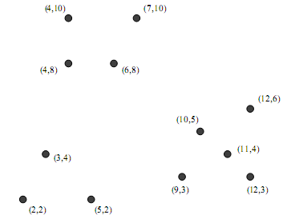
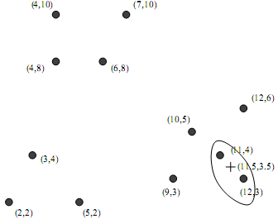
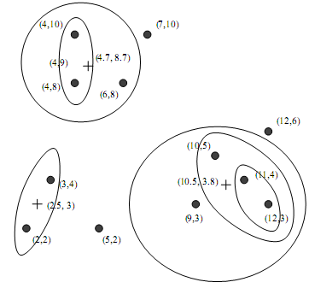
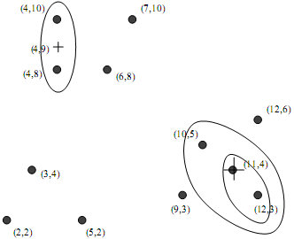
Hierarchical Clustering - Clustering illustration
.

Slide 16
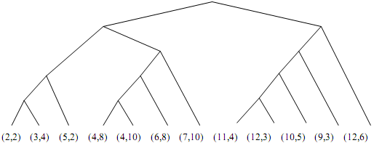
Hierarchical Clustering- Tree representation
The tree representing the way in which all the points were combined.
That may help making conclusions about the data together with how many clusters there should be.

Slide 17
Hierarchical Clustering – Controlling clustering
Alternative rules for controlling hierarchical clustering:
Take the distance between two clusters to be the minimum of the distances between any two points, one chosen from each cluster.
For example in phase 2 we would next combine (10,5) with the two points cluster .
Take the distance between two clusters to be the average distance between all pair of points, one from each cluster.
The Radius of a cluster is the maximum distance between all the points and the centroid. Combine the two clusters whose resulting cluster has the lowest radius. May use also average or sum of squares of distances from the centroid.

Slide 18
Hierarchical Clustering – Controlling clustering
Continuation.
The Diameter of a cluster is the maximum distance between any two points of the cluster. We merge those clusters whose resulting cluster has the lowest diameter.
For example, the centroid of the cluster in step 3 is (11,4), so the radius will be
And the diameter will be

Slide 19
Hierarchical Clustering – Stopping rules
Alternative stopping rules.
Stop if the diameter of cluster results from the best merger exceeds some threshold.
Stop if the density of the cluster that results from the best merger is lower than some threshold. The density may be defined as the number of cluster points per unit volume of the cluster. Volume may be some power of the radius or diameter.
Stop when there is evidence that next pair of clusters to be combined yields bad cluster. For example, if we track the average diameter of all clusters, we will see a sudden jump in that value when a bad merge occurred.

Slide 20
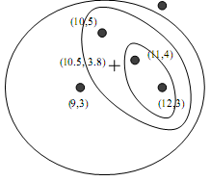
Hierarchical Clustering in Non-Euclidean spaces
Main problem: We use distance measures such as mentioned at the beginning. So we can’t base distances on location of points.
The problem arises when we need to represent a cluster, Because we cannot replace a collection of points by their centroid.
Euclidean space Strings space (edit distance)

Slide 21
Hierarchical Clustering in Non-Euclidean spaces
Example:
Suppose we use edit distance, so
But there is no string represents their average.
Solution:
We pick one of the points in the cluster itself to represent the cluster. This point should be selected as close to all the points in the cluster, so it represent some kind of “center”.
We call the representative point Clustroid.

Slide 22
Hierarchical Clustering in Non-Euclidean spaces
Selecting the clustroid.
There are few ways of selecting the clustroid point:
Select as clustroid the point that minimize:
The sum of the distances to the other points in the cluster.
The maximum distance to another point in the cluster.
The sum of the squares of the distances to the other points in the cluster.

Slide 23

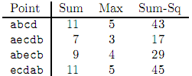
Hierarchical Clustering in Non-Euclidean spaces
Example:
Using edit distance.
Cluster points: abcd, aecdb, abecb, ecdab.
Their distances:
Applying the three clustroid criteria to each of the four points:

Slide 24
Hierarchical Clustering in Non-Euclidean spaces
Results:
For every criteria selected, “aecdb” will be selected as clustroid.
Measuring distance between clusters:
Using clustroid instead of centroid, we can apply all options used for the Euclidean space measure.
That include:
The minimum distance between any pair of points.
Average distance between all pair of points.
Using radius or diameter (the same definition).

Slide 25
Hierarchical Clustering in Non-Euclidean spaces
Stopping criterion:
Uses criterions not directly using centroids, except the radius which is valid also to Non-Euclidean spaces.
So all criterions may be used for Non-Euclidean spaces as well.

Slide 26
Point assign algorithms

Slide 27
K – Means Algorithms
Best known point assignment clustering algorithms.
Works well in practice.
Assume a Euclidean space.
Assume the number of clusters K is known in advanced.

Slide 28
K – Means Algorithm
The algorithm:
Initially choose k points which are likely to be in different clusters;
Make this points the centroids of this clusters;
FOR each remaining point p DO
Find the centroids to which p is closest;
Add p to the cluster of that centroid;
Adjust the centroid of that cluster to account for p;
END;
Optional: Fix the centroids of the clusters and assign each point to the k clusters (usually does not influence).

Slide 29
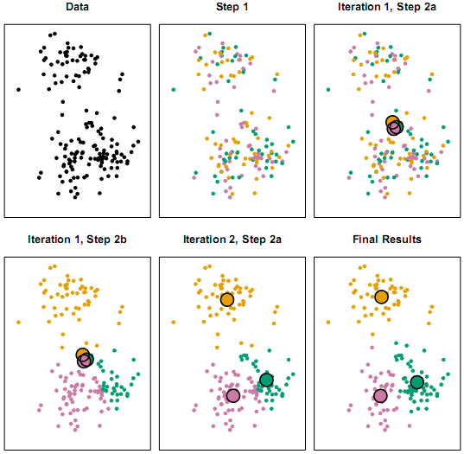
K – Means Algorithm
Illustration (similar to our algorithm):

Slide 30
K – Means Algorithm
Initializing clusters.
Few approaches:
Pick points that are as far away from one other as possible.
Cluster a sample of the data (perhaps hierarchically) so there are k clusters. Pick a point from each cluster (perhaps that point closest to cluster centroid).
Algorithm for the first approach:
Pick the first point at random;
WHILE there are fewer than k points DO
Add the points whose minimum distance from the selected points is as large as possible;
END;

Slide 31
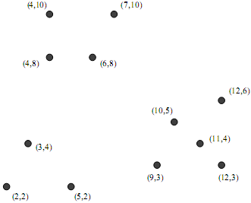
K – Means Algorithm
Example for initializing clusters:
We have the following set:
We first the worst case point, which is (6,8). That’s the first point.
The furthest point from (6,8) is (12,3), so that’s the next point.

Slide 32
K – Means Algorithm
Now, we check the point whose minimum distance to either (6,8) or (12,3) is the maximum.
d((2,2),(6,8)) = 7.21, d((2,2),(12,3)) = 10.05.
So, the score is min(7.21, 10.05)= 7.21.

Slide 33
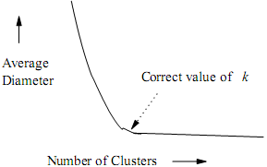
K – Means Algorithm
Picking the right value of k:
Recall measures of appropriateness of clusters , i.e. radius or diameter.
We run k-means on series of numbers, say 1,…,10, and search for significant decreasing in the clusters diameters average, where afterwards it doesn’t change much.

Slide 34
BFR Algorithm

Slide 35
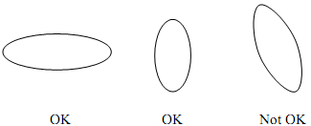
BFR Algorithm
BFR (Bradley – Fayyad – Reina) is a variant of k – means, designed to handle very large (disk resident) data sets.
Assumes that clusters are normally distributed around a centroid in a Euclidean space.
Standard deviation In different dimensions may vary.
For example if d=2, we get an ellipse along with the axes.

Slide 36
BFR Algorithm
Points are read one main-memory-full at a time.
Most points from previous memory loads are summarized by simple statistics.
To begin, from the initial load we select the initial k centroids by some sensible approach.

Slide 37
BFR Algorithm
Initialization:
As similar to k – means:
Take a small random sample and cluster optimally.
Select points which are far from one another as in the k-means algorithm.

Slide 38
BFR Algorithm
The main memory data uses three types of objects:
The Discard Set: Points close enough to a centroid to be summarized (how to summarize will be defined later).
The Compression Set: Groups of points that are close together but are not close to any centroid. They are summarized, but not assigned to a cluster.
The Retained Set: Isolated points.
How to summarize will explained later.

Slide 39
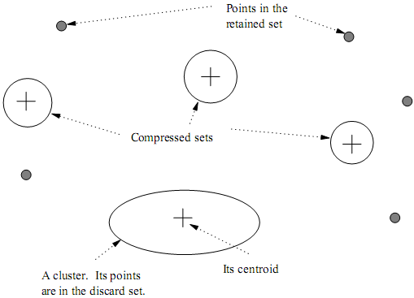
BFR Algorithm
Processed point representation in memory:

Slide 40
BFR Algorithm
Summarizing sets of points:
For the Discard Set, each cluster is summarized by:
The number of points N.
The vector SUM whose i-th component is the sum of coordinates of the points in the i-th dimension.
The vector SUMSQ whose i-th component is the sum of squares of coordinates in the i-th dimension.

Slide 41
BFR Algorithm
Why use such representation?
2d+1 values represent any size cluster, where d is the number of dimensions.
Average of each dimension (centroid) can be calculated as
as defined above.
Variance of each dimension in a cluster may calculated as
for the i-th coordinate.
Standard deviation is the square root of that.
Such representation give us a straightforward way of calculatind the centroid and std. of a cluster for any marginal points addition.

Slide 42
BFR Algorithm
Processing a chunk of points (memory-load) data:
Find those points that are “sufficiently close” to a cluster centroid. Add those points to that cluster and the Discard Set.
Use any main-memory clustering algorithm to cluster the remaining point and the old Retained Set.
Clusters go to Compress Set.
Outlying points go to the Retained Set.
Adjust statistics of the clusters to account for the new points.
Add N’s, SUM’s and SUMSQ’s.
Consider merging compressed sets in the Compressed Set.

Slide 43
BFR Algorithm
Continuation:
If this is the last round, merge all compressed sets in the Compressed Set and all Retained Set points into their nearest cluster.
Comment: In the last round we may treat the Compressed and Retained sets as an outliers and never cluster them at all.

Slide 44

BFR Algorithm
Assigning new point - How Close is close enough?
Mahalanobis Distance:
Normalized Euclidean distance from centroid.
For point and centroid
The Mahalanobis distance between them is

Slide 45
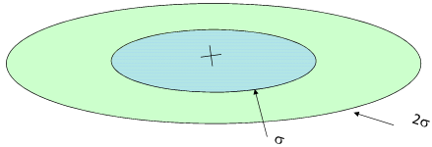
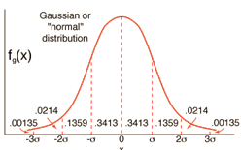
BFR Algorithm
Mahalanobis distance illustration:

Slide 46
BFR Algorithm
Assigning new point using Mahalanobis Distance:
If the clusters are normally dist. In d dimensional, than after transformation one std. equals .
That means that approximately 70% of the points of the cluster will M.D < .
Assigning rule: Assign new point to a cluster if its M.D < threshold.
Threshold may be 4 std.
In normal dist. 3 std. distance include around 99.7% of the points. Thus, with that threshold there is a very small chance to reject a point that truly belong to that cluster.

Slide 47
BFR Algorithm
Merging two compressed sets:
Calculate the variance of the combined cluster.
We can easily do that using the clusters representation mentioned before.
Merge if variance is below some threshold.

Slide 48
Summary and further topics
So far we handled:
Hierarchical clustering, assuming Euclidean space and main-memory-fit data.
Hierarchical clustering using arbitrary distance measure.
Point assign clustering, assuming Euclidean space and main-memory-fit data.
Point assign clustering, assuming Euclidean space and very large data sets (data reside in secondary memory).

Slide 49
Summary and further topics
Further topics may be:
The CURE (Clustering Using Representatives) algorithm: Does similar job as BFR, but without restrictions on the clusters shape.
The GRGPF (named after its authors) algorithm: Also deal with very large data sets and may work with an arbitrary distance measures.
Clustering streams: Assuming sliding window of points, where we have access to a smaller number of last points.
Answering queries: Use stream clustering strategy to answer queries.
Clustering using MapReduce: Divide the data into chunks and cluster each chunk in parallel using a Map task.

Slide 50
Thank you

