Slide 1
One click SaaS Serverless Integration solution using AWS Quick Starts

Slide 2








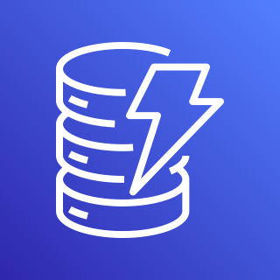
AWS Cloud
Customers
AWS Marketplace
Lambda@Edge
Amazon CloudFront
Amazon S3
Registration page
Amazon API Gateway
AWS Lambda
Amazon DynamoDB

Slide 3
AWS Cloud
Customers
AWS Marketplace
Lambda@Edge
Amazon CloudFront
Registration page
Amazon API Gateway
AWS Lambda
Amazon DynamoDB
Amazon S3

Slide 4
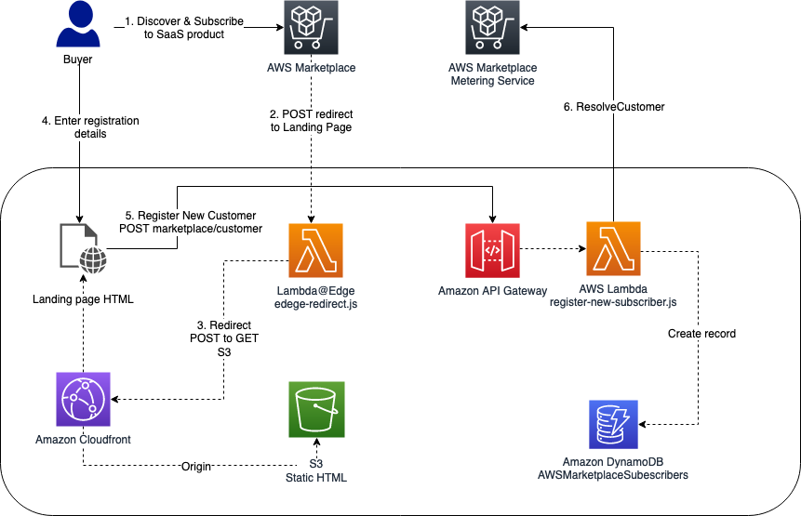
Architecture Diagram

Slide 5
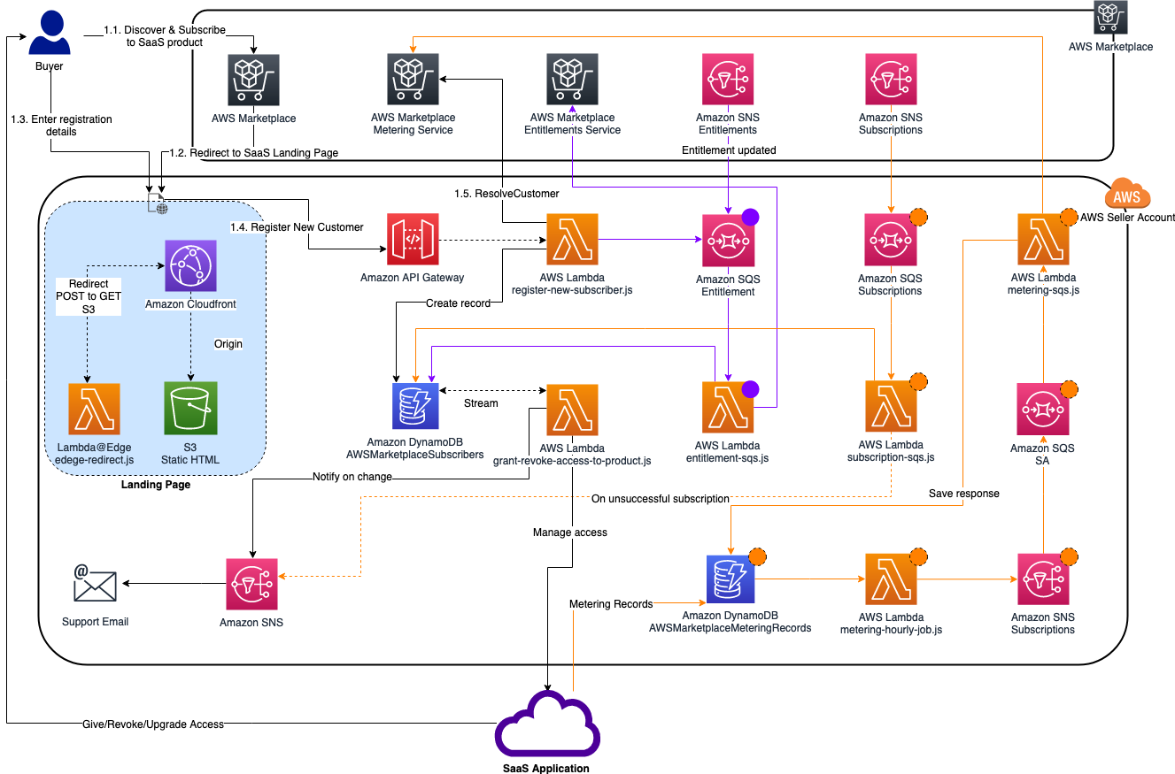
Diagram of created resources

