Slide 1
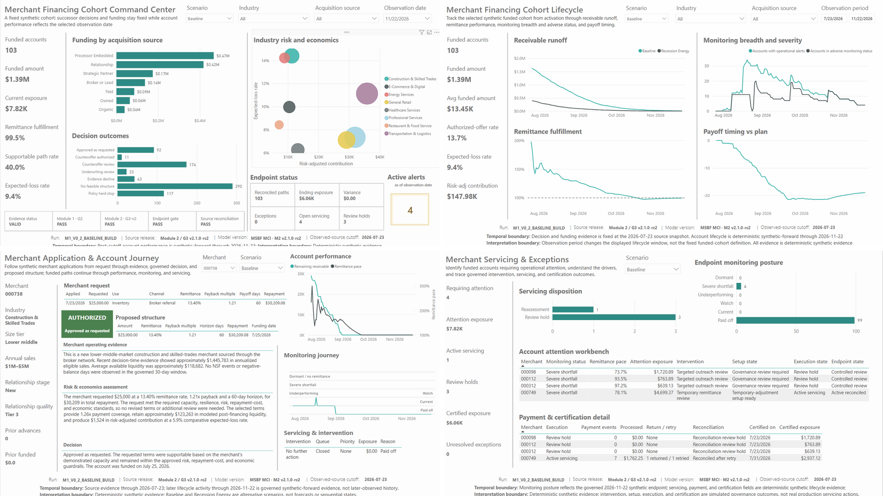
MSBF MERCHANT CREDIT INTELLIGENCE
Initial 750-Merchant
Cohort Overview
Decisioning, Portfolio & Servicing Intelligence
Comprehensive Module 2 analysis supported by governed Power BI evidence
MODULE 2 | v2.1.0-rc2
Observed-source cutoff: 2026-07-23 | Cohort report R3
Synthetic-forward lifecycle: through 2026-11-22

Slide 2
EXECUTIVE OVERVIEW
Baseline supports a broader governed decision frontier; Recession Energy is sharply selective, and funded paths remain operationally controlled at endpoint
Five conclusions capture the full application-to-servicing story.
FIXED COHORT
BASELINE SUPPORTABLE
STRESS SUPPORTABLE
BASELINE FUNDING
OUTCOME DIFFERS IN STRESS
750
40.0%
10.7%
$1.385M
31.5%
1,500 application-scenario paths
300 paths; 103 authorized
80 paths; 27 authorized
103 synthetic funded accounts
236 of 750 matched pairs
Baseline vs. Recession Energy
Decision resilience
Economics under stress
Lifecycle and servicing
Every Recession Energy authorization was retained from the Baseline-authorized population. No merchant became newly authorized under stress. The stress scenario therefore constrains the decision frontier rather than creating artificial upside.
Funded amount contracts 75.2%, supportable rate declines 29.3 percentage points, comparative expected-loss rate rises 2.0 points, and risk-adjusted contribution falls 79.7%.
Baseline ends with 99 of 103 funded paths paid off, four severe-shortfall accounts, $7,823.28 attention exposure, $6,061.03 certified exposure, and zero unresolved exceptions. Stress ends with all 27 paths paid off.
Comparison: final governed decision category for the same merchant/application, Baseline vs. Recession Energy (page 14). Alternative synthetic scenarios—not sequential outcomes, forecasts or a software-version comparison.

Slide 3
EVIDENCE BASE
How source data, analytical figures and Power BI views support this report
750 synthetic merchants, two alternative scenarios: source records supply the calculations; screenshots demonstrate report coverage.
POWER BI SCREENSHOTS
P01 COMMAND CENTER
P02 COHORT LIFECYCLE
P03 APPLICATION JOURNEY
P04 SERVICING
94
32
32
28
2
Retained images—not merchants
Full portfolio + industry + source
Full cohort + industry + source
Decision and narrative branches
Baseline and Recession Energy
What the evidence covers
What the acceptance references mean
Population: 750 matched merchant/application pairs, each with one Baseline and one Recession Energy path (1,500 paths).
Calculations: charts and metrics use source-derived records, not measurements estimated from screenshots.
Coverage: P01/P02 show full portfolios plus industry and acquisition-source slices. P03 examples cover authorization, review and the separate decline reasons.
Controls: P04 scenarios, account selections, tooltips, alt text, tab order and seven-result QA; P03 narrative and monitoring QA are retained.
PBIX is the Power BI report file. R3 identifies its support package; canonical R7 identifies its documented source/reference state.
IA-D-R17-PBI-001 = ACCEPT for Power BI. Cohort-report review is separate.
IA-PBI-PUB-HANDOFF-001 = AUTHORIZED for controlled handoff only—not live publication.
DataModel unchanged; owner-approved capture reuse accepted.
File: MSBF_Merchant_Credit_Intelligence_M2_v2.1.0-rc2.pbix
SHA-256: ca46e8551860...047b5294e4
The private carrier retains source bytes, scripts, keys, hashes and figure identities.
Matched-scenario comparison: “changed” means a different final decision category for the same merchant/application—not a change over time, between software versions or across strategy profiles.

Slide 4
SCOPE AND AUTHORITY
What this cohort overview does - and does not - claim
The analysis is a governed synthetic decisioning and lifecycle evaluation through Module 2.
In scope
Authority and timing
Out of scope
- Fixed 750-merchant population
- Two governed scenarios per merchant
- Application evidence and seven final outcomes
- Requested and proposed structures
- Synthetic funding and 120-day monitoring
- Intervention, setup, servicing execution, reconciliation, and certification
- Industry and acquisition-source segmentation
- R26 is the accepted Module 2 / G3-v2 technical successor baseline; Module 1 / G2 remains accepted
- IA-D-R17-PBI-001 = ACCEPT for the final Power BI candidate
- IA-PBI-PUB-HANDOFF-001 authorizes handoff only
- Public Module 2 / G3 v2.0.0 remains controlling public authority until supersession and GitHub publication are separately authorized and executed
- P01-P04 are frozen; P05/P06 remain excluded
- Source cutoff: 2026-07-23; synthetic endpoint: 2026-11-22
- This overview does not itself execute publication
- No real customers or production servicing
- No causal or treatment-effect claims
- No audited profitability or CECL conclusion
- No forecast of future losses or collections
- No inference that Recession Energy occurs after Baseline
- No public-release authorization implied by this overview
All dollar amounts, dates, outcomes, and account trajectories are deterministic synthetic evidence designed to evaluate architecture, strategy, governance, and analytical consumption.

Slide 5
COHORT ARCHITECTURE
A fixed cohort expands into decision, funding, monitoring, and servicing evidence
ApplicationScenarioKey preserves exact scenario identity through every downstream stage.
APPLICATION
DECISION
FUNDING
MONITORING
SERVICING
750 merchants
1,500 paths
7 outcomes
1,500 final rows
130 funded
scenario paths
15,600 daily rows
120 days each
130 rows per stage
M2.6-M2.10
Profile, request, evidence
Requested/proposed terms
Physical funding date
Status, pace, alerts, runoff
Intervention to certification
Scenario identity control
Reconciliation control
Baseline and Recession Energy stay separated at application-scenario grain; downstream lifecycle evidence exists only when the exact path is authorized and physically funded.
Intervention, setup, execution, certification, and portfolio-performance tables each contain 130 unique keys, matching funded-lifecycle and monitoring membership.
Current QA: 130 unique keys across every M2.6-M2.10 stage; 15,600 monitoring rows; zero P03 operational reconciliation failures.

Slide 6
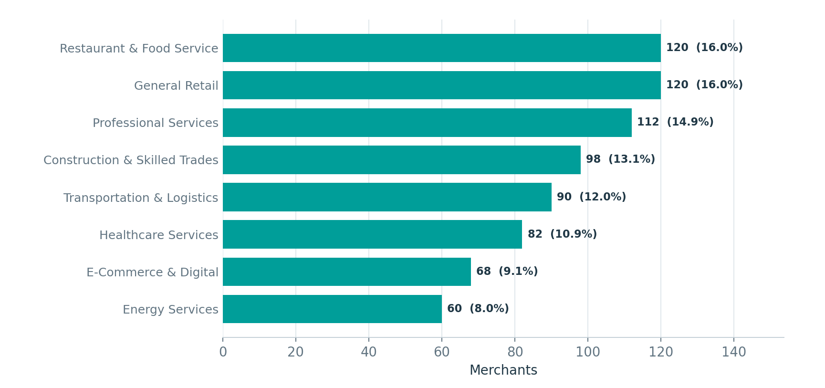
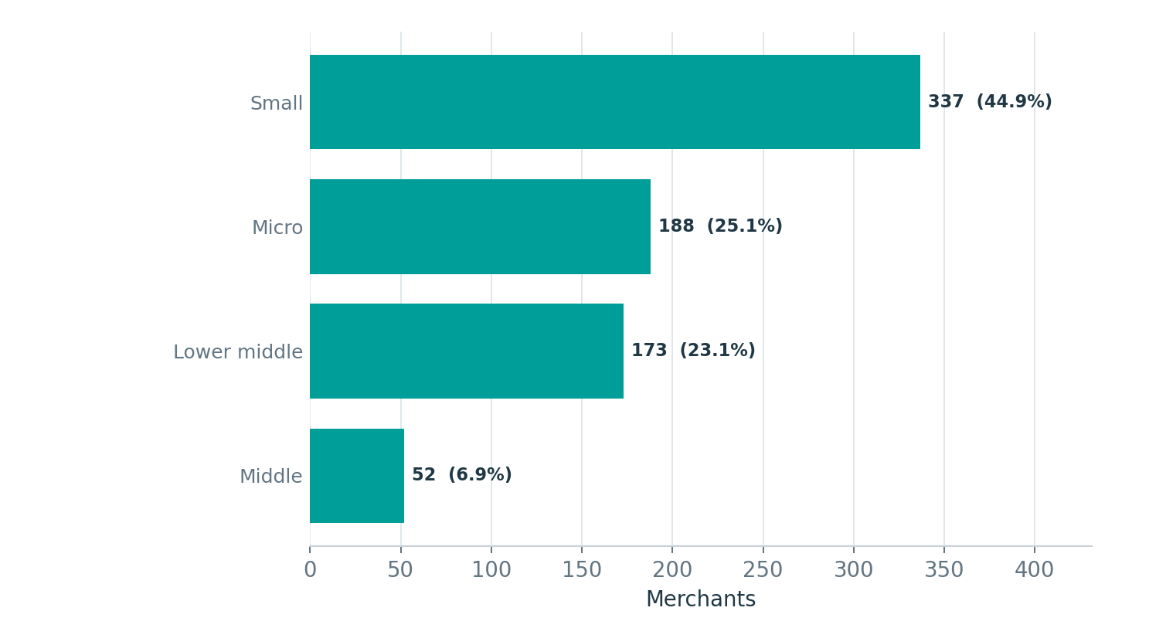
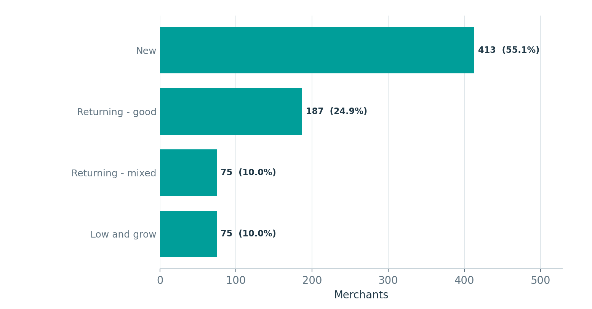
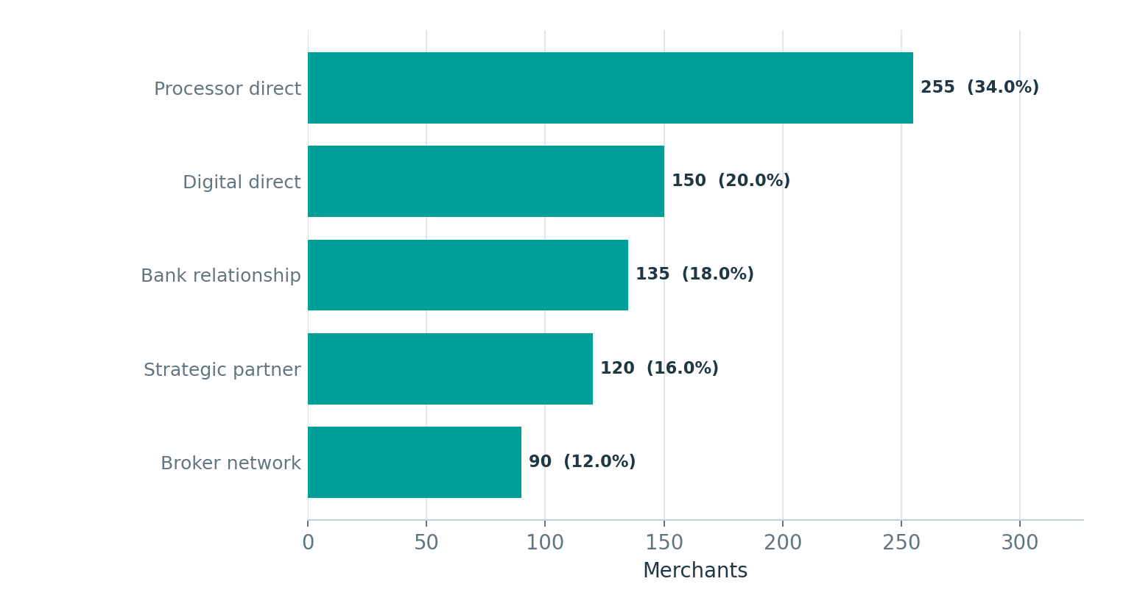
COHORT PROFILE
The 750 merchants span eight industries, multiple size tiers, relationship stages, and sourcing channels
The population is broad enough to expose segment, source, and scenario differences without being dominated by one segment.
Source: R1DimApplicationScenario - fixed cohort composition
Composition readout
- Retail and restaurant are the largest industries at 120 merchants each
- 70.0% of merchants are Micro or Small
- 55.1% are new relationships; 24.9% are returning-good
- Processor direct is the largest channel at 34.0%, followed by digital direct at 20.0% and bank relationship at 18.0%
Parent channel -> normalized source family: Processor Direct -> Processor Embedded; Bank Relationship -> Relationship; Digital Direct -> Paid / Owned / Organic; Strategic Partner -> Strategic Partner; Broker Network -> Broker or Lead.

Slide 7
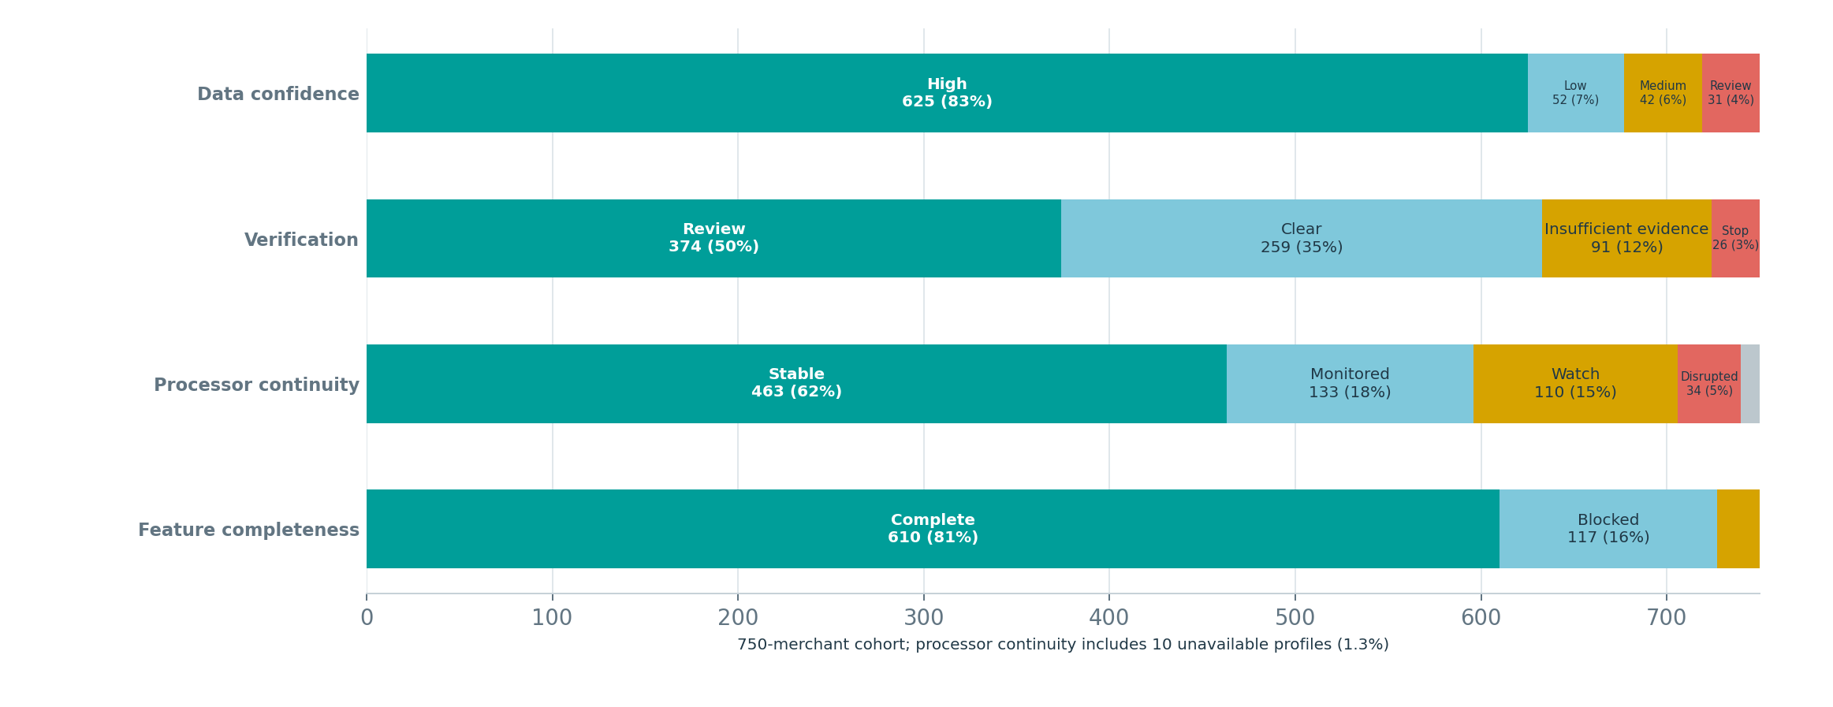
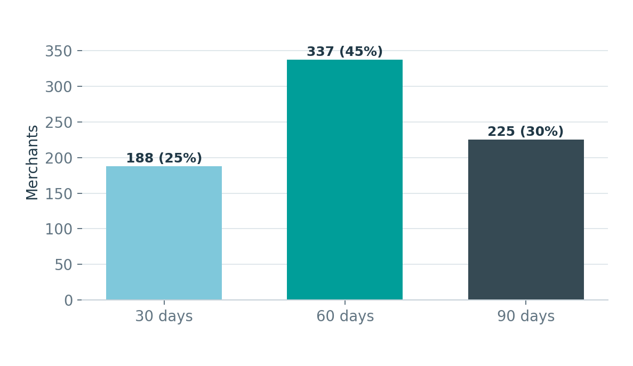
APPLICATION EVIDENCE
Requests are right-skewed, while evidence quality is generally strong but verification friction is common
Evidence availability is a first-order driver of stress outcomes.
Requested horizon mix
Evidence tiers, verification dispositions, processor continuity, and feature completeness
MEDIAN REQUEST
MEDIAN SALES
MEDIAN LIQUIDITY
HIGH CONFIDENCE
VERIFICATION REVIEW
$9.9K
$690K
$33.9K
83.3%
49.9%
Mean $25.4K; max $150K
663 merchant profiles with eligible-sales evidence
675 merchant profiles with balance evidence
625 merchant profiles
374 merchant profiles
The request distribution is skewed: median $9.9K versus mean $25.4K. Evidence confidence is high overall, but nearly half of the cohort requires some verification review.

Slide 8
01
Decisioning and scenario resilience
How evidence, structure search, policy controls, and stress floors shape the final decision frontier.

Slide 9
DECISIONING
Seven outcomes separate authorization, review, and decline reasons
The framework avoids compressing all non-approvals into one undifferentiated rejection population.
AUTHORIZED
REVIEW
DECLINED
Approve as requested
Counteroffer authorized
Downstream effect:
- Physical funding record
- 120-day monitoring path
- Lifecycle, servicing, and certification evidence
Counteroffer review
Manual underwriting review
Downstream effect:
- Proposed/supportable structure may exist
- Specialist judgment required
- No funding or account lifecycle until authorized
Evidence decline
No feasible structure
Policy hard stop
Downstream effect:
- No funding
- No monitoring or servicing evidence
- Distinct reason preserved for interpretation
Supportable path rate = authorized paths + governed review paths. It is broader than the authorized-offer rate and should not be read as an approval rate.

Slide 10
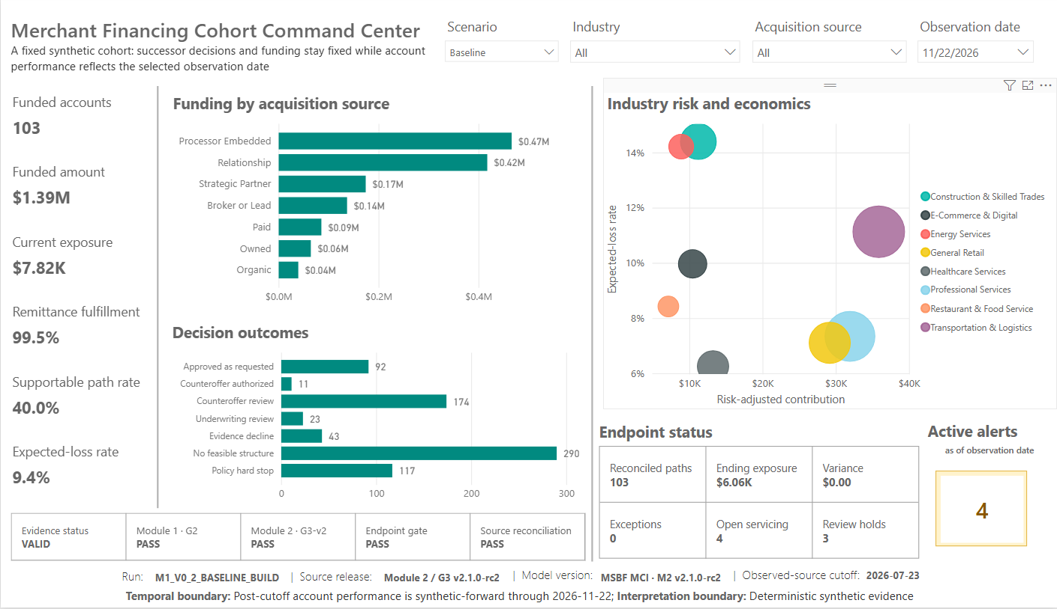
POWER BI EVIDENCE
Baseline command center
The primary portfolio view reconciles decisions, funding, risk-adjusted economics, endpoint state, and active attention.
Power BI P01 - Baseline, observation date 2026-11-22

Slide 11
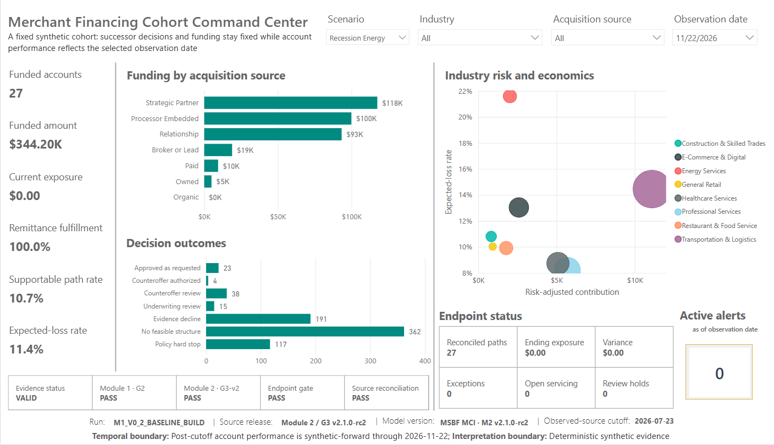
POWER BI EVIDENCE
Recession Energy command center
Stress sharply narrows the supportable frontier while preserving clean endpoint reconciliation.
Power BI P01 - Recession Energy, observation date 2026-11-22

Slide 12
SCENARIO COMPARISON
Stress reduces access and economics without creating false improvements
The same 750 merchants are evaluated under both scenarios.
METRIC | BASELINE | RECESSION ENERGY | CHANGE
Authorized paths | 103 | 27 | -76
Supportable paths | 300 | 80 | -220
Funded amount | $1.385M | $344.2K | -$1.041M
Authorized-offer rate | 13.7% | 3.6% | -10.1 pp
Supportable rate | 40.0% | 10.7% | -29.3 pp
Comparative EL rate | 9.4% | 11.4% | +2.0 pp
Risk-adjusted contribution | $147.98K | $30.03K | -79.7%
Endpoint exposure | $7.82K | $0 | -$7.82K
Access contraction
Authorized paths fall 73.8%; funded dollars fall 75.2%. The supportable frontier contracts even more broadly from 300 to 80 paths.
Economics shift
Expected-loss rate rises while risk-adjusted contribution falls nearly 80%. The smaller stress cohort is economically weaker, not merely smaller.
All 27 stress authorizations were already authorized in Baseline; stress produced zero new authorized paths.

Slide 13
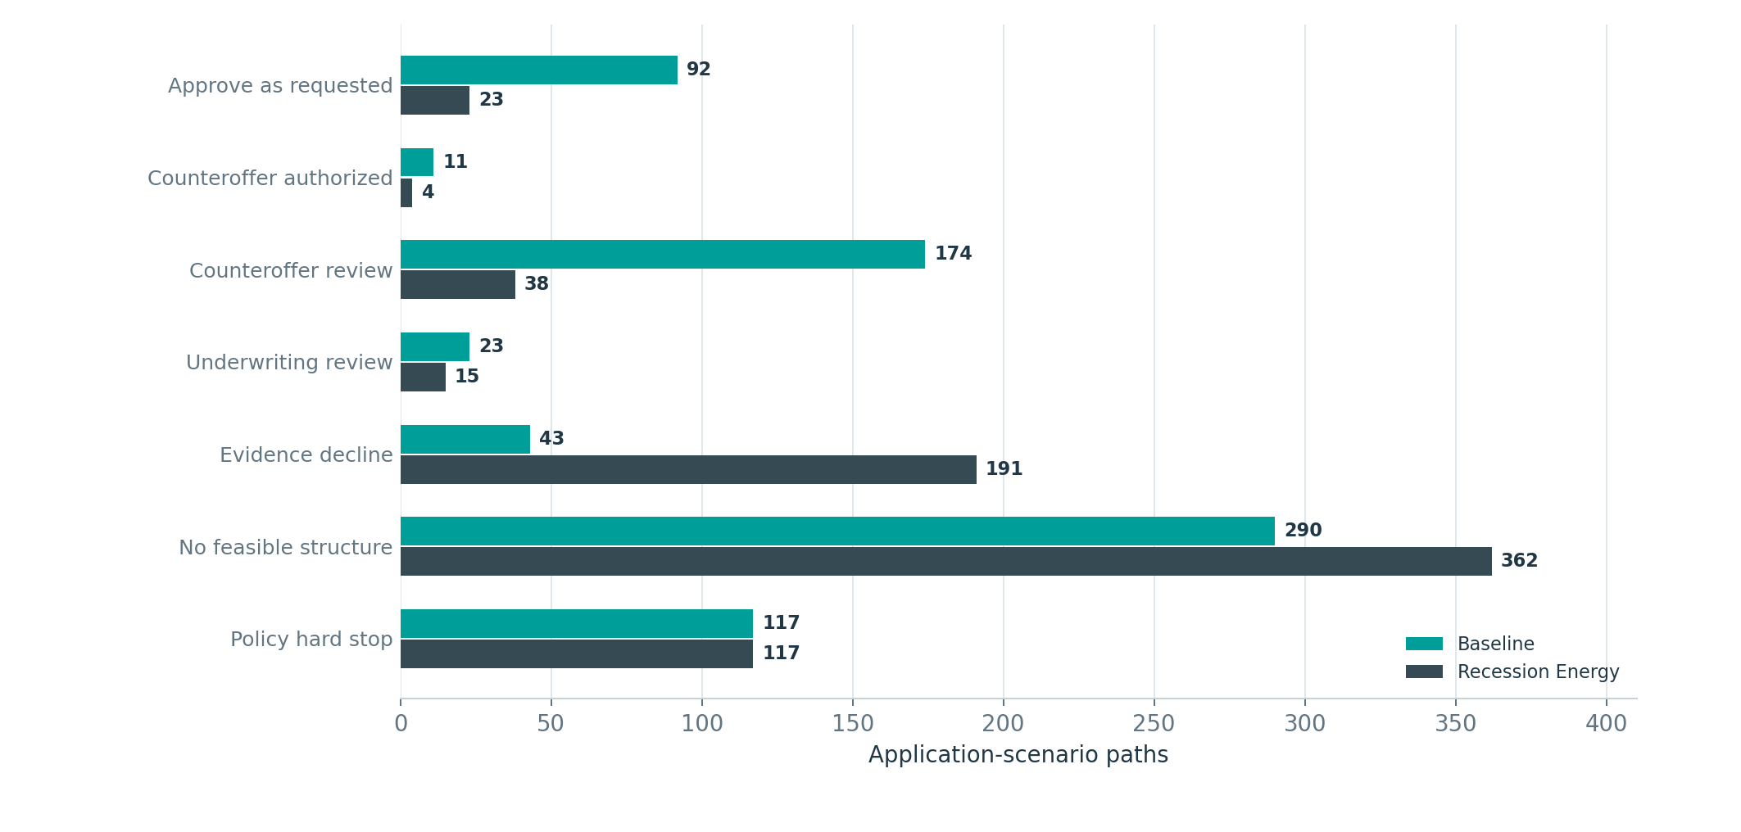
DECISION DISTRIBUTION
Stress shifts the cohort from review and approval toward evidence decline and no-feasible outcomes
Policy hard stops remain invariant at 117 paths.
Largest shift
Evidence declines increase from 43 to 191, a rise of 148 paths.
No-feasible expansion
No-feasible outcomes rise from 290 to 362 as stressed capacity and the non-improvement floor eliminate candidates.
Review population contracts
Counteroffer review falls from 174 to 38 because many Baseline-reviewable paths become evidence declines or no-feasible under stress.
Source: R1FactFinalDecision
The hard-stop population remains 117 in both scenarios, confirming that non-remediable policy boundaries do not soften or worsen merely because scenario assumptions change.

Slide 14
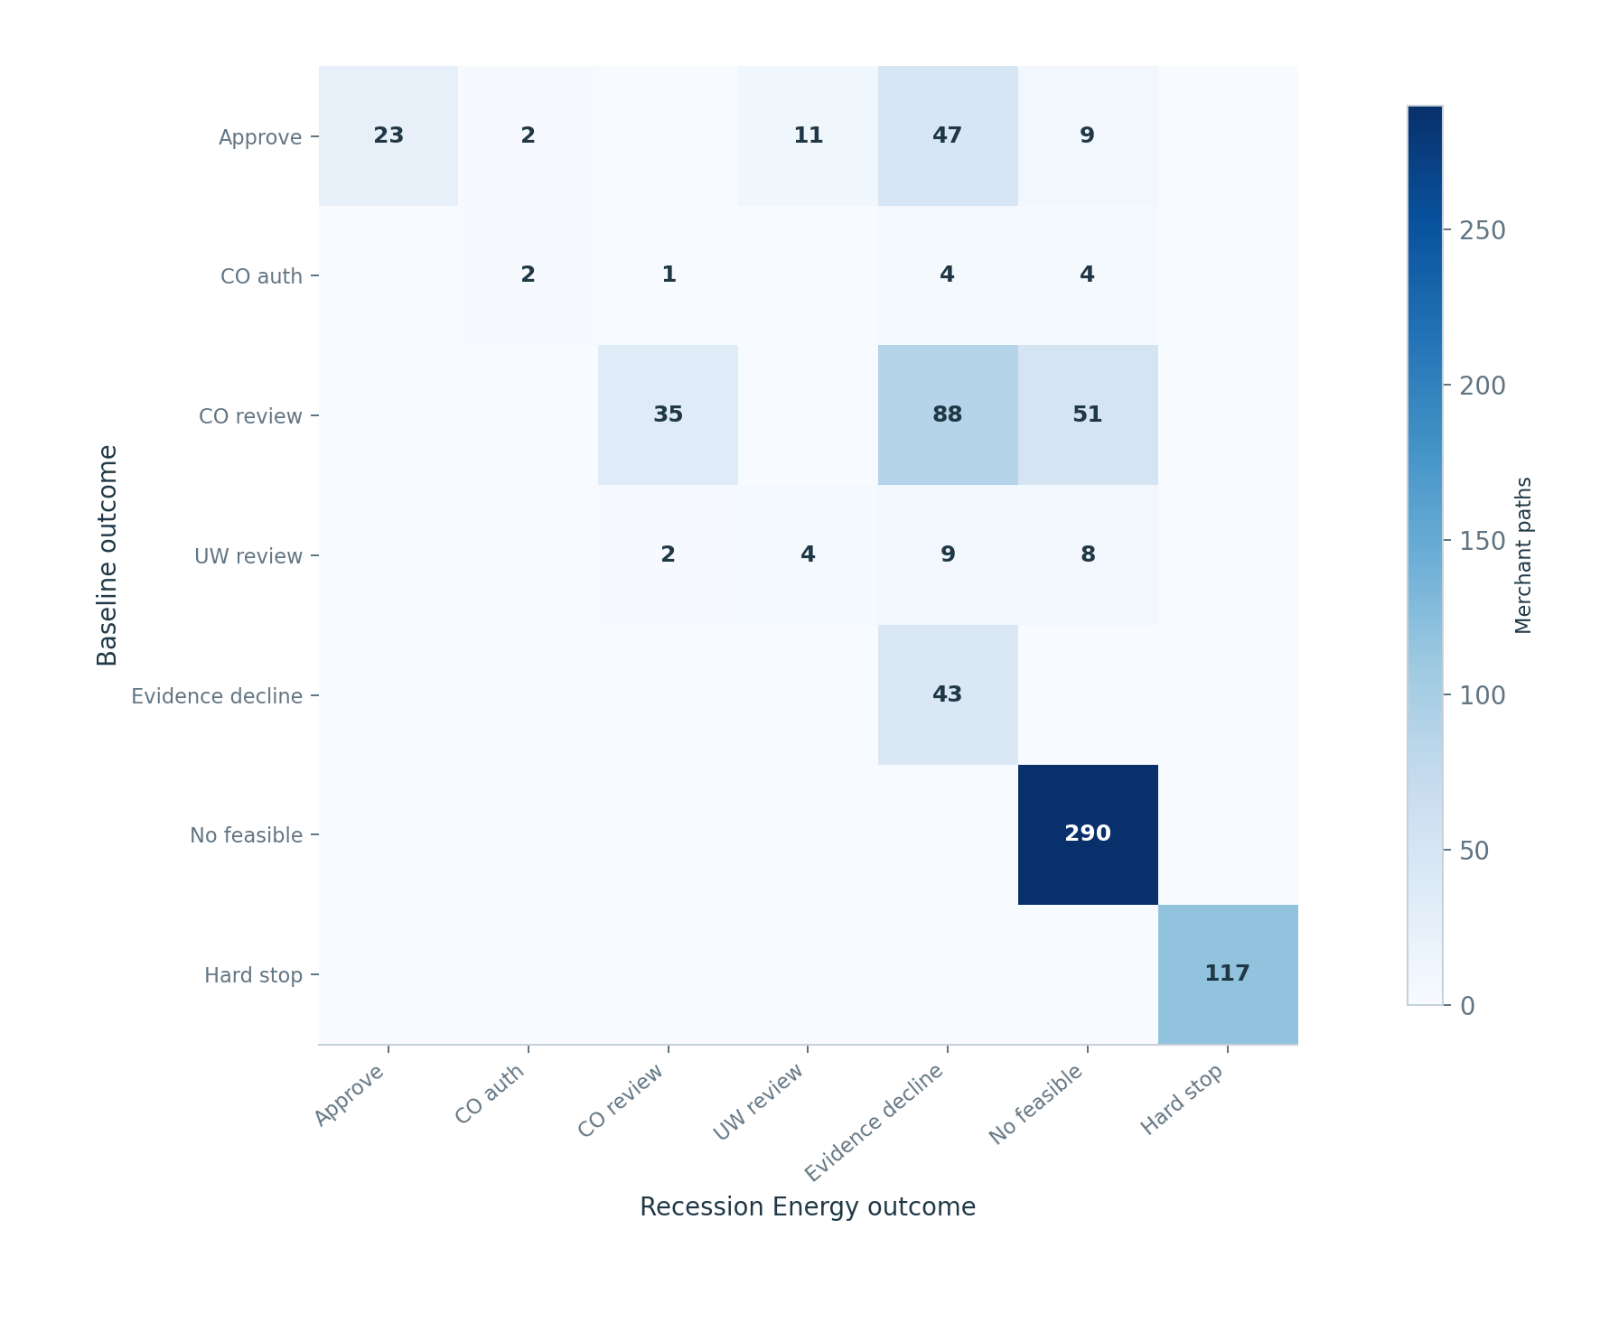
OUTCOME MIGRATION
236 merchants change governed outcome under Recession Energy
The heatmap shows where the fixed Baseline population moves under stress.
UNCHANGED
CHANGED
514
236
68.5% of merchants
31.5% of merchants
Most common migration
88 counteroffer-review paths become evidence declines.
Second-largest migration
51 counteroffer-review paths become no-feasible structures.
Authorized-path sensitivity
47 Baseline approvals become evidence declines; 11 become manual-review paths; 9 become no-feasible.
Rows = Baseline outcome; columns = Recession Energy outcome

Slide 15
GOVERNANCE CONTROL
The stress non-improvement floor prevents artificial scenario improvements
Stress may preserve or worsen a path relative to its matched Baseline route; it cannot manufacture a more favorable decision.
FLOOR APPLIED
OUTCOME CHANGES
CANDIDATE CHANGES
STRESS-ONLY AUTH
RETAINED
169
166
39
0
27
22.5% of merchant paths
Governed result changed
Selected/reselected candidate
No artificial upside
All stress auth
131 paths
Baseline-route non-improvement
28 paths
Term floor - no eligible candidate
10 paths
Term floor - reselection
Control conclusion
The floor is a governance constraint, not a post-hoc reporting adjustment. It operates at matched application-scenario identity and is visible in P03 narratives such as merchant 082.
Outcome-change and candidate-change counts are separate, overlapping control dimensions and are not additive.

Slide 16
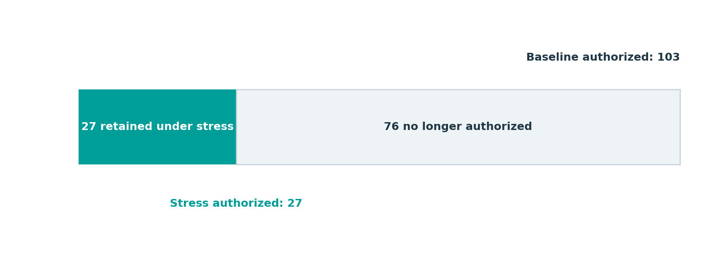
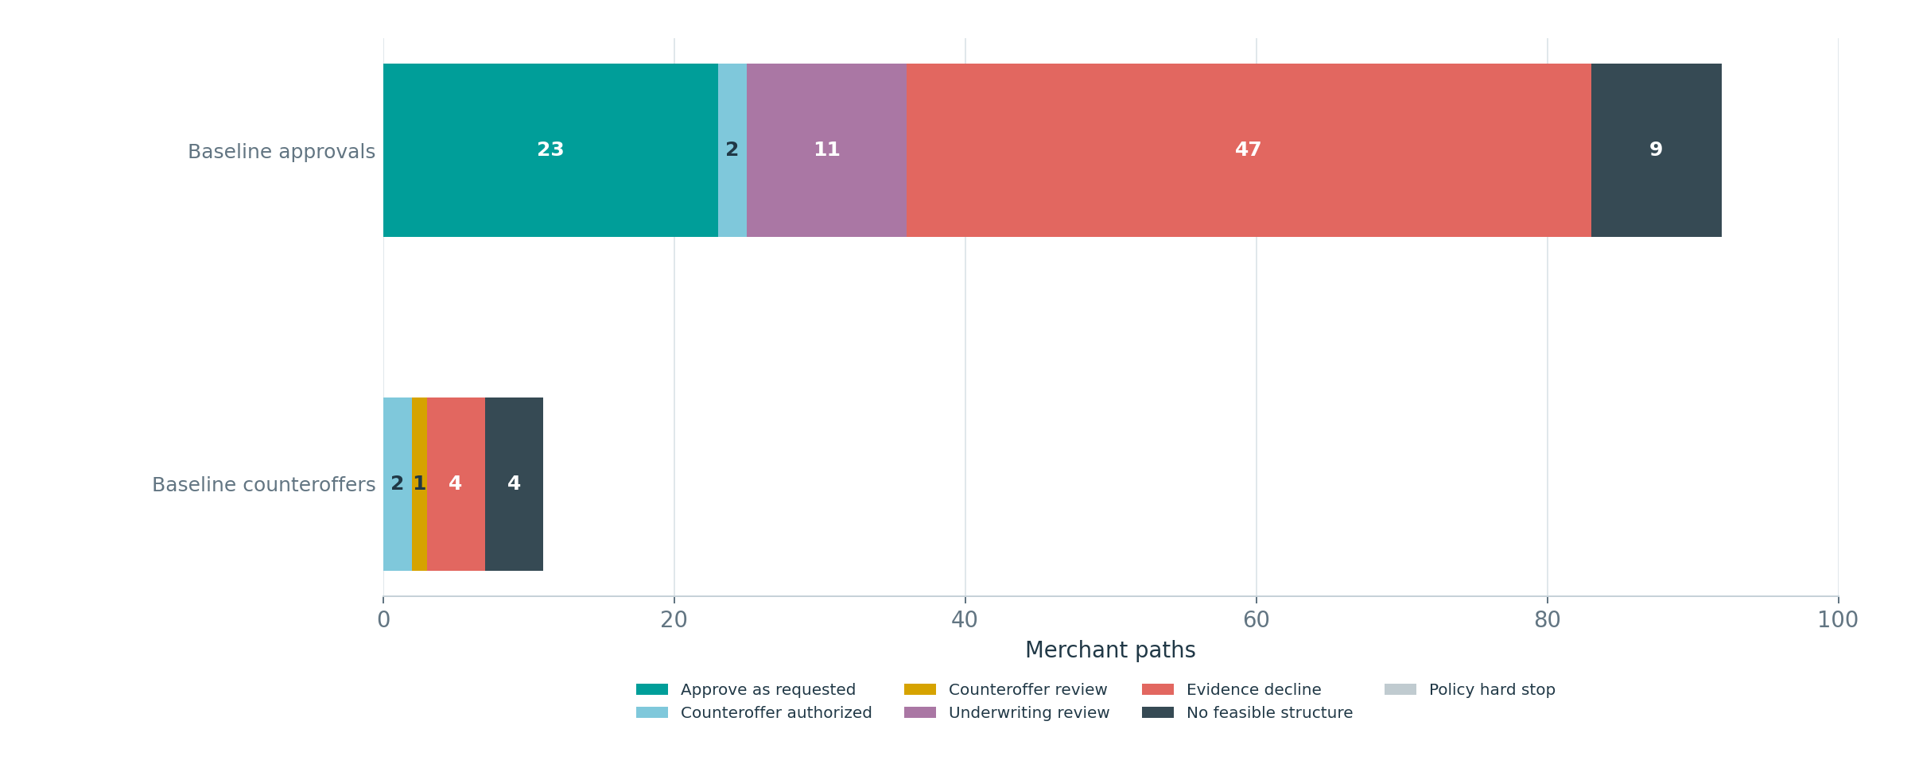
AUTHORIZATION RETENTION
Only 27 of 103 Baseline-authorized paths remain authorized under stress
Stress eliminates 76 authorizations and creates none.
COUNT RETENTION
DOLLAR RETENTION
26.2%
24.8%
27 / 103 paths
$344.2K / $1.385M
Baseline approvals
Only 23 of 92 remain approve-as-requested. Two become counteroffer-authorized; the rest move to review or decline.
Authorization overlap at exact merchant identity
Baseline counteroffers
Only 2 of 11 remain counteroffer-authorized; four become evidence declines and four become no-feasible.
Where Baseline-authorized paths move under stress

Slide 17
STRUCTURE SEARCH
The engine completed every required search and preserved no-feasible proof
Search volume falls under stress, while no-feasible outcomes rise because stress-floor inheritance also governs matched routes.
BASELINE SEARCHES
BASELINE CANDIDATES
STRESS SEARCHES
STRESS CANDIDATES
PROOF
495
4,120
285
2,399
100%
495 attempted and complete
Median 7; max 34
285 attempted and complete
Median 7; max 34
All no-feasible
Baseline search population
Stress search population
495 paths required expanded search. The engine evaluated 4,120 governed alternatives and produced 290 no-feasible outcomes with corresponding proofs.
285 paths required direct stress search, but 362 paths ultimately carry no-feasible proof because approved non-improvement-floor routes can inherit a matched Baseline no-feasible conclusion.
A no-feasible outcome is a governed search conclusion, not a generic decline label: the architecture preserves candidate evaluation and proof availability.

Slide 18
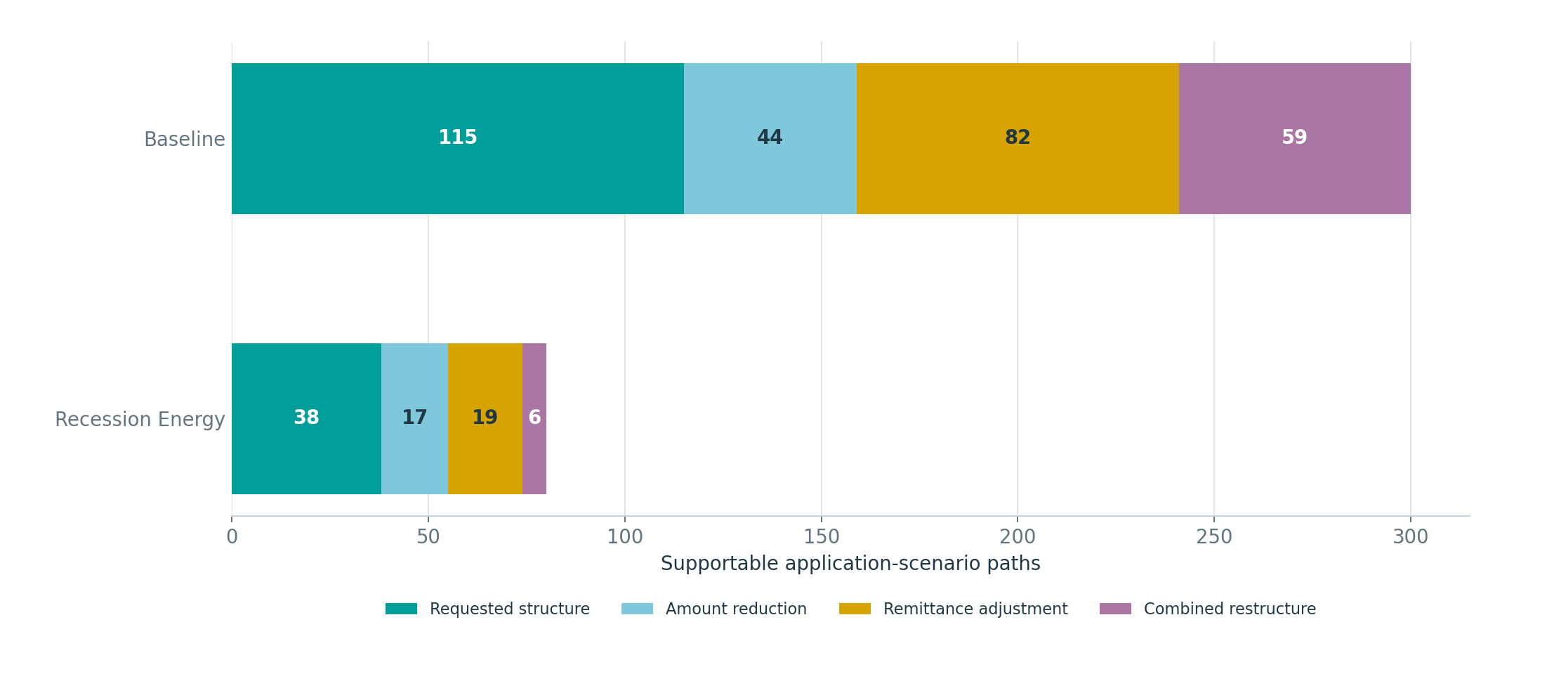
PROPOSED STRUCTURES
Supportable paths use multiple remediation patterns - not only amount cuts
Most selected paths preserve the full requested amount; policy-adjusted terms remain targeted.
BASELINE FULL REQUEST
115 / 300
38.3% of supportable paths
STRESS FULL REQUEST
38 / 80
47.5% of supportable paths
Selected-structure amount ratio
Median selected amount relative to request is 100% in both scenarios. Means are 90.6% in Baseline and 91.5% in Recession Energy. Review-only structures are included; no funding is implied.
Supportable paths by selected-structure treatment
Baseline supportable structure mix: 115 requested, 44 amount reduction, 82 remittance adjustment, 59 combined restructure. Stress: 38, 17, 19, and 6.

Slide 19
02
Segment performance
Where funding, supportability, risk, and contribution concentrate across acquisition sources and industries.

Slide 20
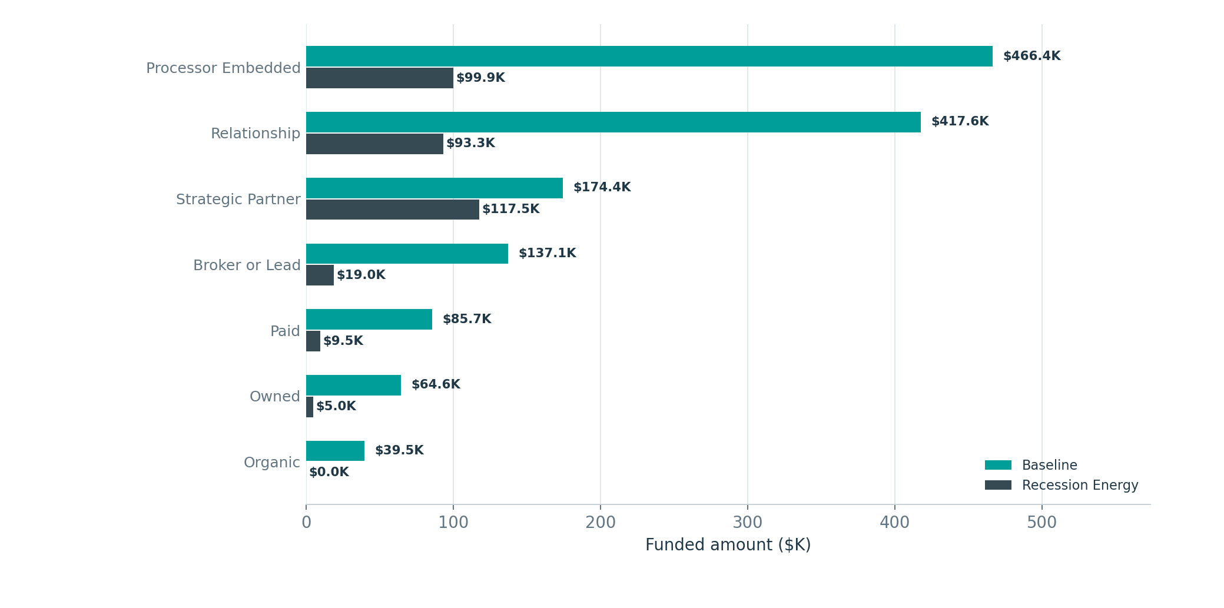
ACQUISITION SOURCE
Funding is concentrated in Processor Embedded and Relationship channels in Baseline
Strategic Partner becomes the largest funded-dollar source under stress.
Baseline concentration
Processor Embedded ($466K) and Relationship ($418K) account for 63.8% of Baseline funded dollars.
Stress leadership
Strategic Partner leads stress funding at $117.5K, followed by Processor Embedded at $99.9K and Relationship at $93.3K.
Organic channel
Organic produces four Baseline funded paths but no stress-funded paths; its supportable rate falls to 4.0%.
Funded amount by source and scenario
Normalized acquisition-source families are shown; the accepted parent-channel crosswalk is on slide 6.

Slide 21
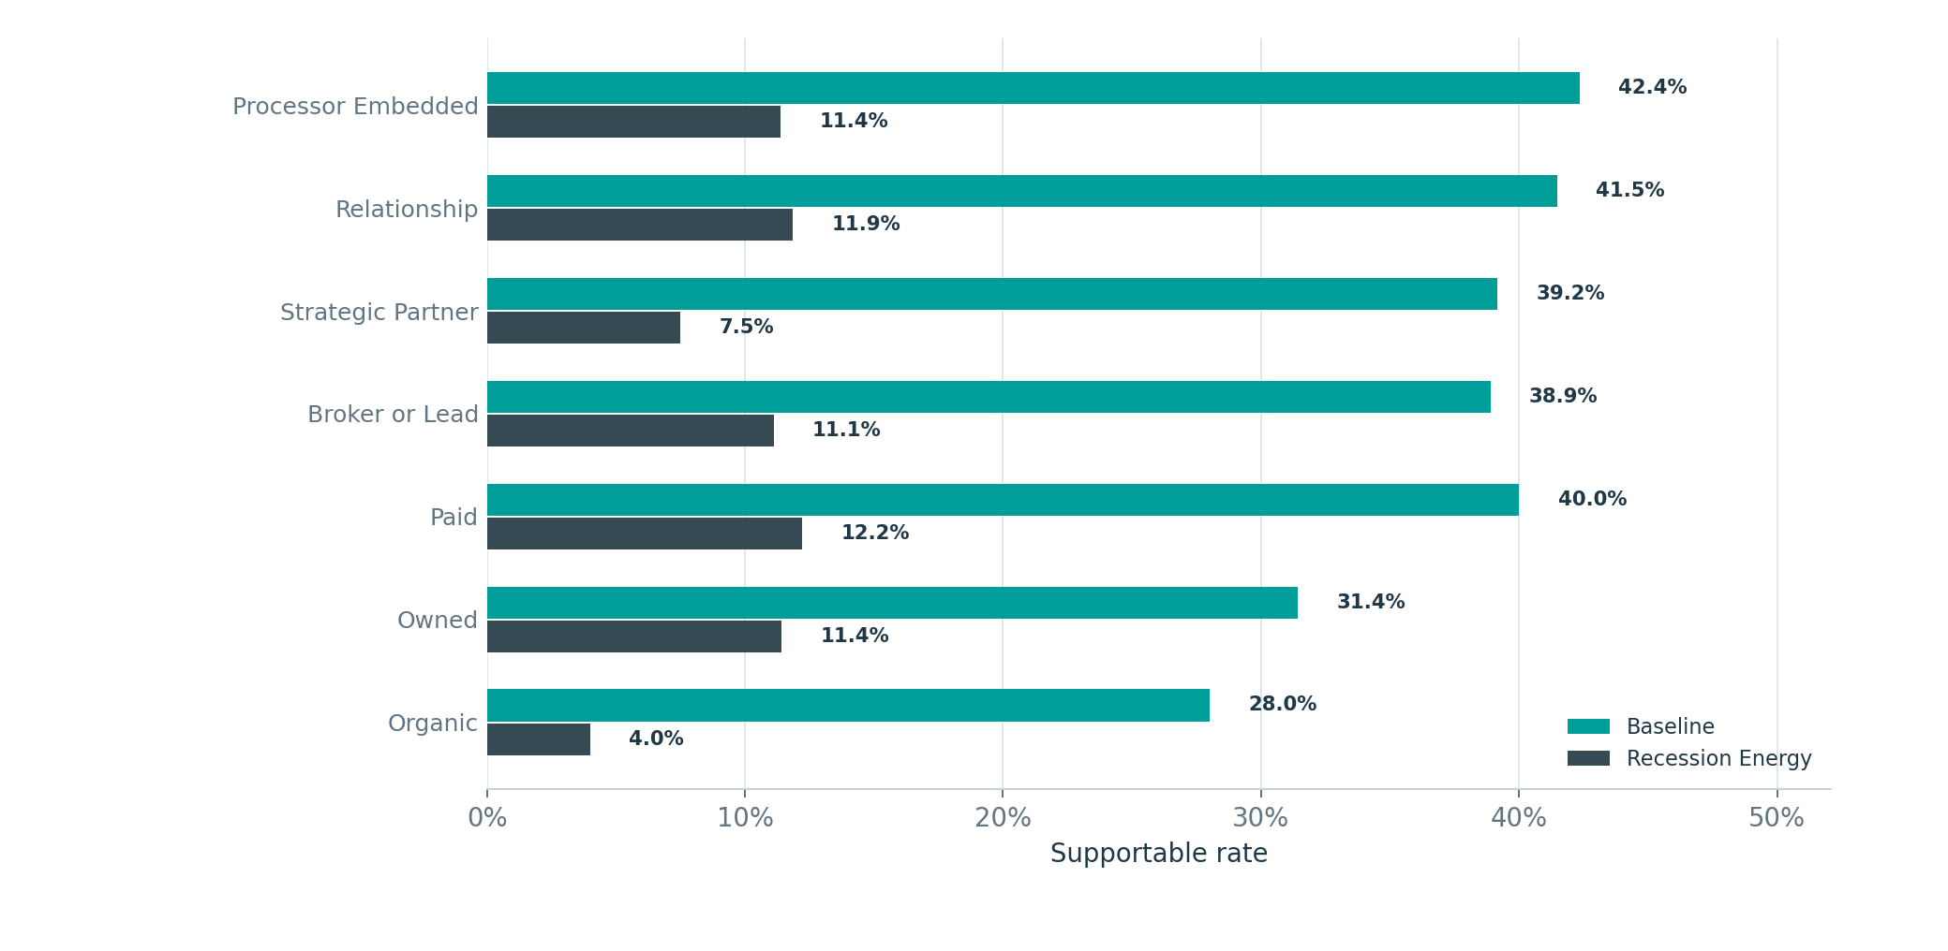
ACQUISITION SOURCE
Every source experiences a lower supportable rate under stress
The size of the decline varies materially by channel.
Highest Baseline rate
Processor Embedded leads at 42.4%, followed by Relationship at 41.5%, Paid at 40.0%, and Strategic Partner at 39.2%.
Highest stress rate
Paid leads at 12.2%, followed by Relationship at 11.9%, Owned at 11.4%, and Processor Embedded at 11.4%.
Retention perspective
Strategic Partner retains 8 of 16 Baseline-funded accounts and 67% of Baseline funded dollars - the strongest dollar retention among major channels.
Supportable path rate by acquisition source
Normalized acquisition-source families are shown; the accepted parent-channel crosswalk is on slide 6.

Slide 22
ACQUISITION SOURCE
Source-level economics show different combinations of volume, resilience, and risk
Normalized source families (crosswalk: slide 6). In this table, Stress = Recession Energy.
SOURCE | BASE FUNDED | STRESS FUNDED | BASE SUPPORT | STRESS SUPPORT | BASE EL | STRESS EL
Processor Embedded | $466K | $100K | 42.4% | 11.4% | 10.7% | 11.7%
Relationship | $418K | $93K | 41.5% | 11.9% | 6.9% | 8.6%
Strategic Partner | $174K | $118K | 39.2% | 7.5% | 9.6% | 13.7%
Broker or Lead | $137K | $19K | 38.9% | 11.1% | 11.5% | 13.7%
Paid | $86K | $10K | 40.0% | 12.2% | 7.3% | 7.2%
Owned | $65K | $5K | 31.4% | 11.4% | 16.2% | 21.3%
Organic | $40K | $0 | 28.0% | 4.0% | 8.4% | N/A
Relationship channel
Combines high Baseline volume with the lowest Baseline expected-loss rate among major sources.
Strategic Partner
Shows the best funded-dollar resilience but a materially higher stress expected-loss rate.
Owned
Small volume but the highest expected-loss rates in both scenarios; selection remains particularly conservative.
Segment expected-loss rates describe scenario-specific selected funded cohorts. A lower aggregate rate under stress may reflect selection/composition, not matched-path improvement; the path-level stress non-improvement floor remains controlling.

Slide 23
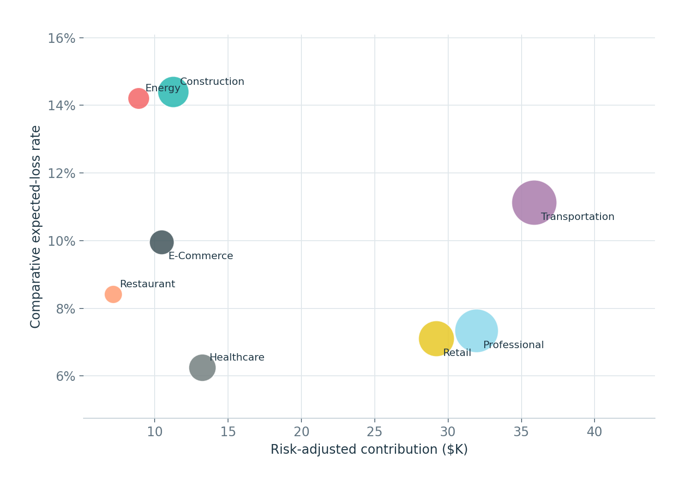
INDUSTRY
Baseline industries occupy distinct risk-contribution positions
Bubble size represents funded amount; axes show risk-adjusted contribution and comparative expected-loss rate.
Transportation & Logistics
Highest Baseline funded amount ($337.4K) and contribution ($35.9K), with 11.1% expected loss.
Professional Services
Highest supportable rate (58.0%) and 30 funded accounts; $314.8K funded with 7.3% expected loss.
Healthcare Services
Lowest Baseline expected-loss rate (6.25%) and a 43.9% supportable rate, though funded dollars are comparatively modest.
Baseline industry risk and economics

Slide 24
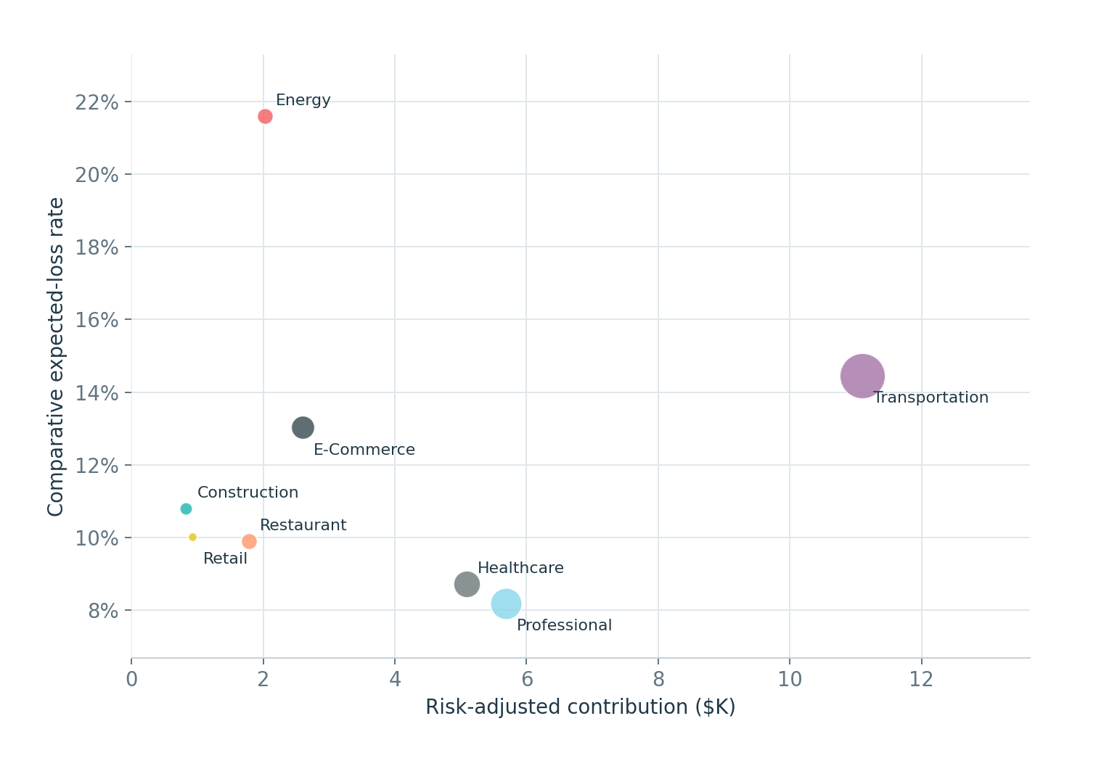
INDUSTRY
Stress preserves a narrow set of sector opportunities and widens risk dispersion
Energy Services reaches the highest stress expected-loss rate; Transportation retains the most funded dollars.
Transportation & Logistics
Retains 7 funded accounts and $139.5K - the largest stress funded amount and contribution ($11.1K).
Professional Services
Highest stress supportable rate at 21.4%, but funded amount falls to $67.1K.
Energy Services
Stress expected-loss rate rises to 21.6%, the highest sector result, while only two paths are funded.
Recession Energy industry risk and economics
Segment expected-loss rates describe scenario-specific selected funded cohorts. A lower aggregate rate under stress may reflect selection/composition, not matched-path improvement; the path-level stress non-improvement floor remains controlling.

Slide 25
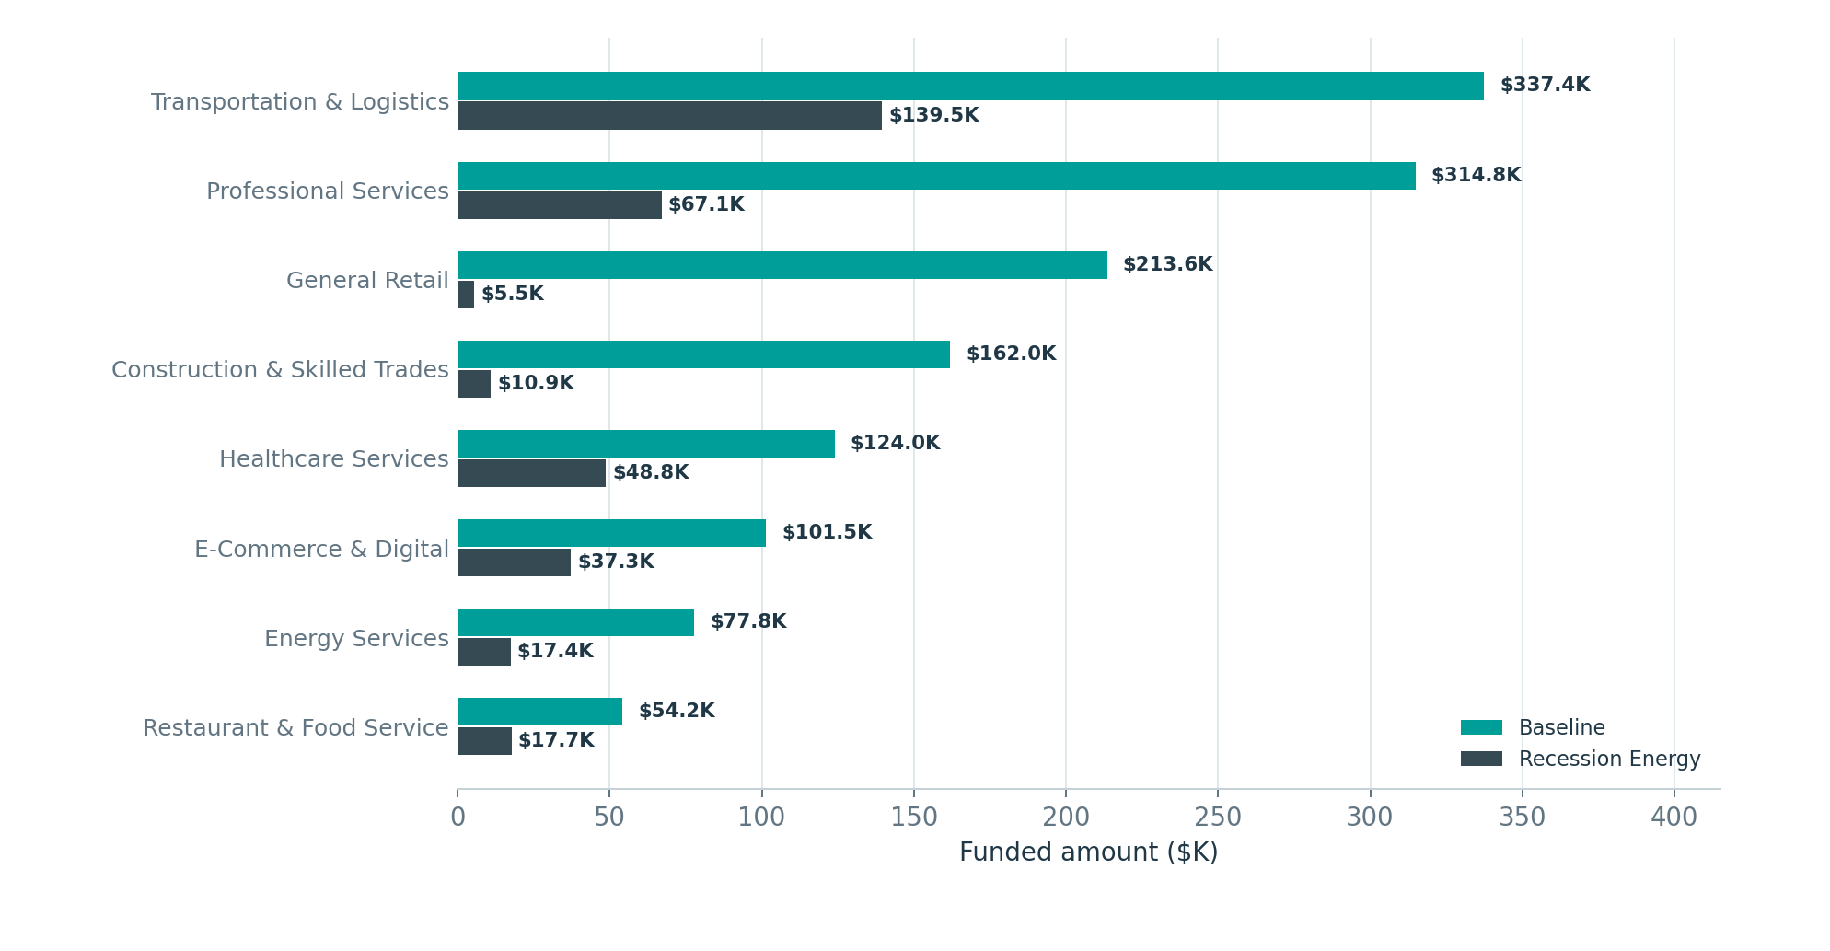
INDUSTRY
Stress funding contraction is broad but uneven
Transportation, Healthcare, and Restaurant retain a larger share of funded dollars than several other sectors.
Largest absolute base
Transportation and Professional Services together represent 47.1% of Baseline funded dollars.
Distinct stress dimensions
Energy carries the highest stress comparative expected-loss rate; Transportation retains the largest stress-funded amount. Interpret these industry dimensions separately.
Portfolio implication
Sector diversification does not remove scenario sensitivity; the most resilient dollar concentrations still contract materially.
Funded amount by industry and scenario

Slide 26
03
Funded-cohort lifecycle
How the authorized cohort runs off, pays against plan, generates alerts, and reaches its governed endpoint.

Slide 27
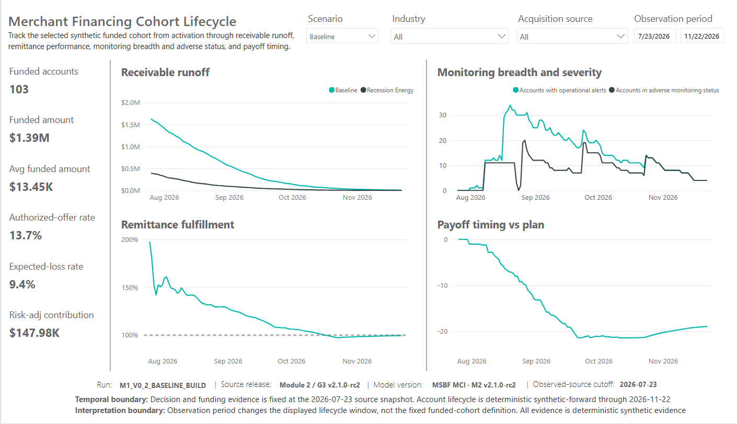
POWER BI EVIDENCE
Baseline cohort lifecycle
The funded cohort runs from activation through receivable runoff, remittance performance, monitoring, and payoff timing.
Power BI P02 - Baseline lifecycle

Slide 28
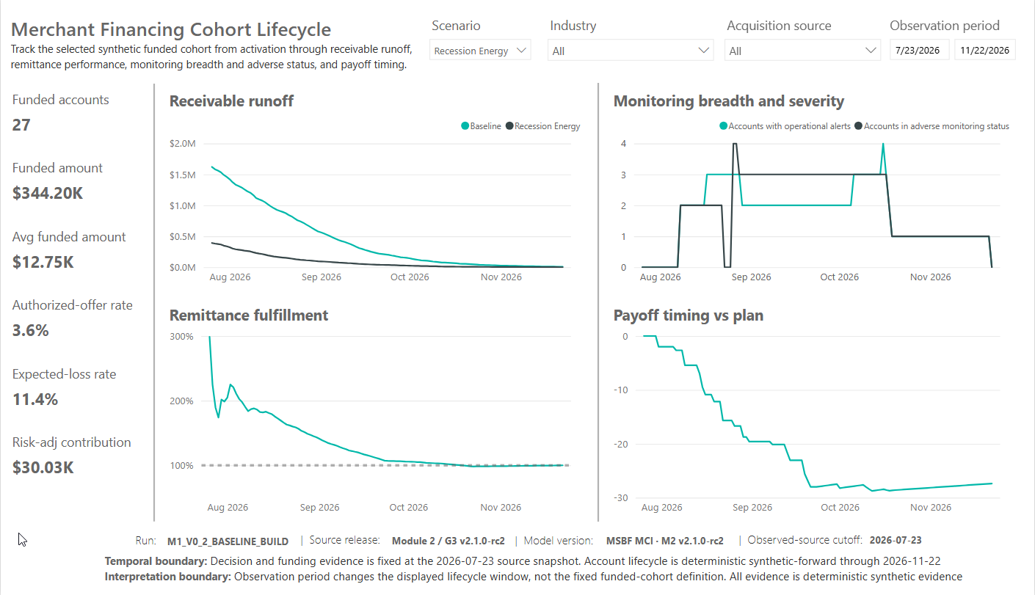
POWER BI EVIDENCE
Recession Energy cohort lifecycle
The smaller stress-funded cohort reaches full payoff with no endpoint exposure or operational servicing population.
Power BI P02 - Recession Energy lifecycle

Slide 29
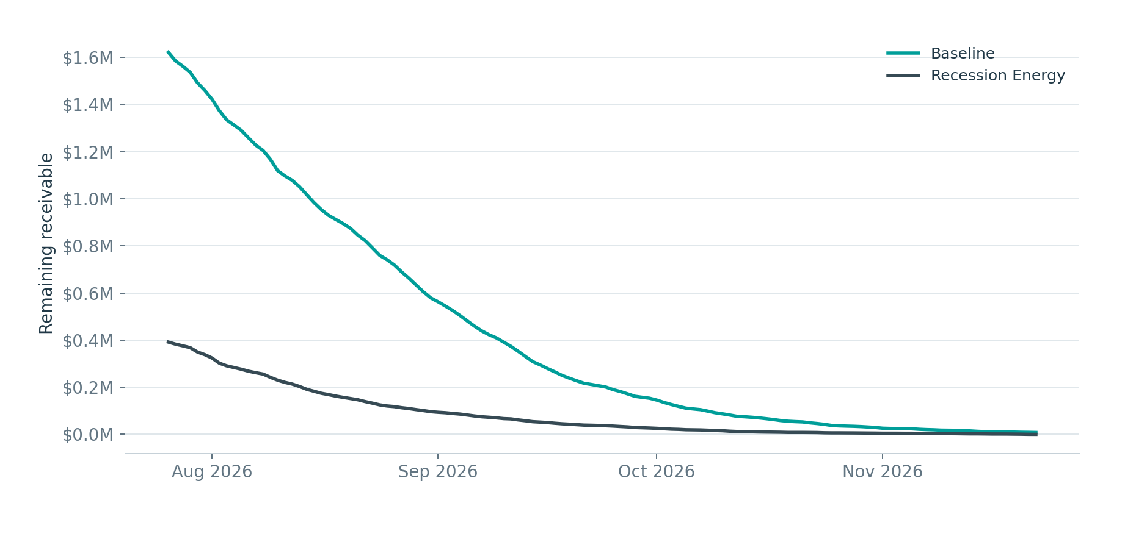
LIFECYCLE
Receivable runoff is steep in both funded cohorts
Baseline starts with a much larger repayment receivable and ends with four residual-exposure accounts.
BASELINE ENDPOINT
$7,823
4 adverse accounts
STRESS ENDPOINT
$0
27 of 27 paid off
Interpretation
Runoff is deterministic synthetic-forward account evidence. It validates lifecycle mechanics and portfolio behavior; it is not a forecast of real collections.
Daily receivable balance across the governed 120-day lifecycle

Slide 30
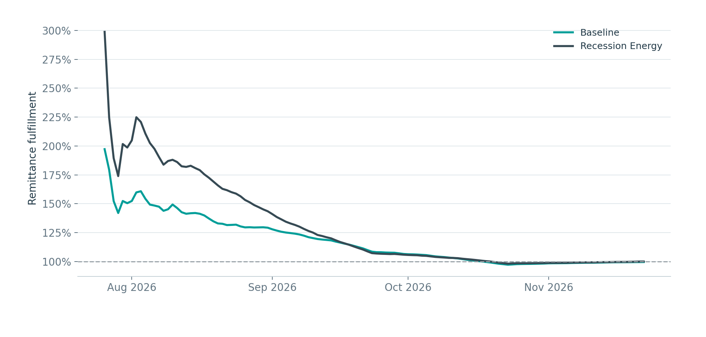
LIFECYCLE
Cumulative remittance converges to plan after early overperformance
The Baseline cohort finishes slightly below 100%; the stress cohort closes at exactly 100%.
Baseline
Starts above plan because early remittance is concentrated relative to expected-to-date, then converges to 99.5% at endpoint.
Recession Energy
The smaller funded cohort converges to 100.0% and carries no endpoint exposure.
Control point
Expected-to-date is reconstructed from canonical R1 monitoring semantics; it does not rely on the deprecated predecessor daily table.
Cumulative actual remittance divided by governed expected-to-date

Slide 31
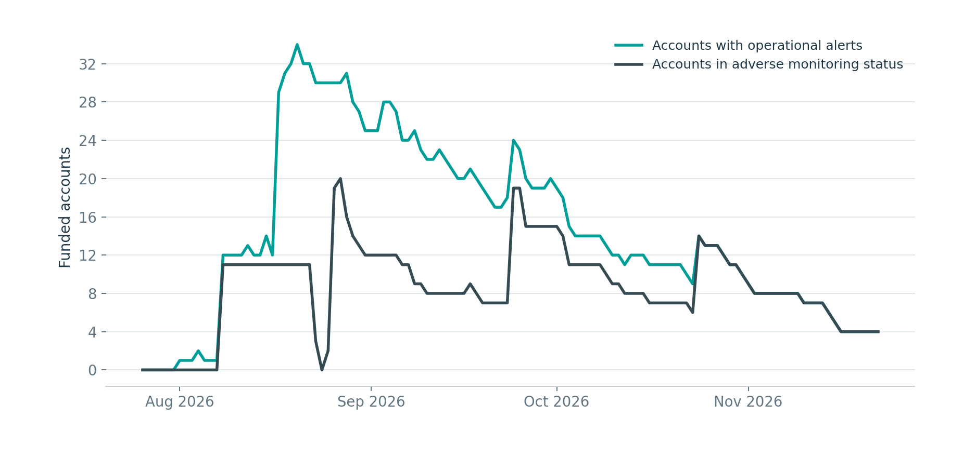
LIFECYCLE
Operational alerts peak before declining to a four-account endpoint population
Alert breadth and adverse status are related but distinct monitoring concepts.
PEAK ALERTED
34
2026-08-20
PEAK ADVERSE
20
2026-08-27
ENDPOINT
4
All severe shortfall
Baseline monitoring breadth and adverse-status counts
Watch and raw alert conditions are not automatically equivalent to servicing action. P04 is intentionally based on governed endpoint states and downstream M2.6-M2.10 results.

Slide 32
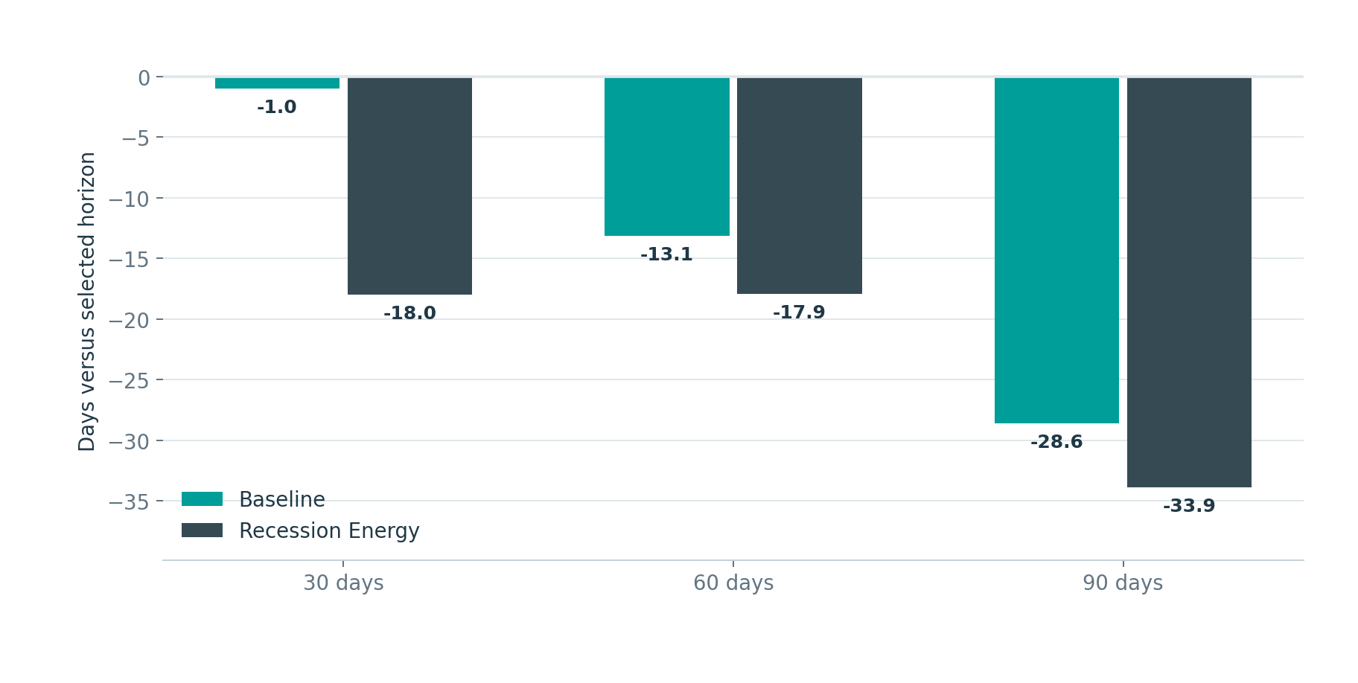
LIFECYCLE
Most paid-off paths finish earlier than their selected horizon
Negative days-versus-plan denotes earlier payoff in the deterministic lifecycle simulation.
BASELINE PAID OFF
STRESS PAID OFF
99 / 103
27 / 27
96.1%
100%
Baseline timing
Mean payoff is 20.9 days earlier than plan; median is 23 days earlier.
Stress timing
Mean payoff is 27.4 days earlier than plan; the payoff distribution remains earlier than plan through the 90th percentile.
Average payoff timing relative to the selected 30/60/90-day horizon

Slide 33
04
Servicing and exceptions
How the four Baseline attention accounts move from monitoring posture through intervention, execution, reconciliation, and certification.

Slide 34
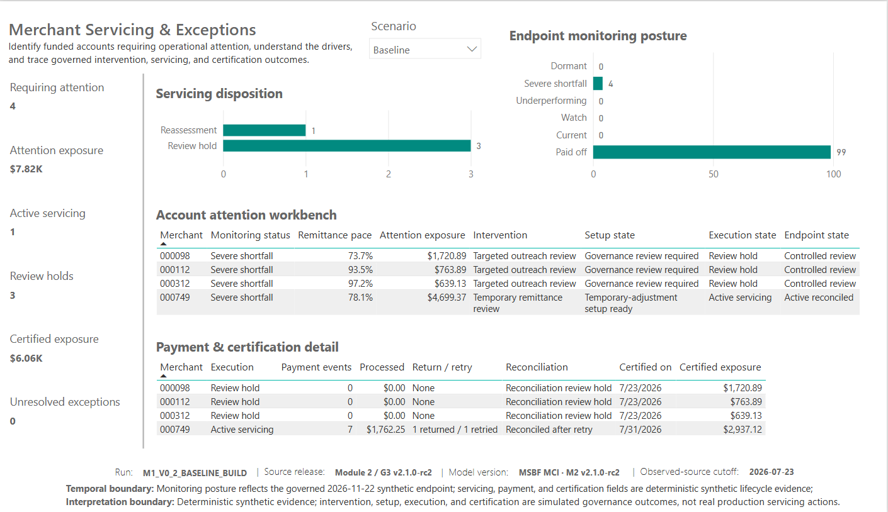
POWER BI EVIDENCE
Baseline servicing and exceptions
Four severe-shortfall accounts require attention; the page traces each through its governed servicing and certification chain.
Power BI P04 - Baseline servicing and exceptions

Slide 35
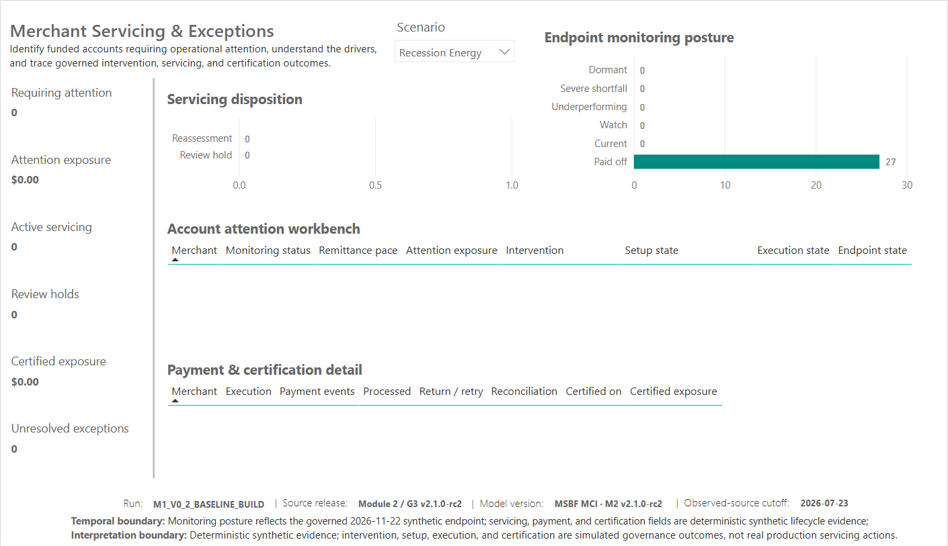
POWER BI EVIDENCE
Recession Energy servicing and exceptions
All 27 stress-funded paths are paid off at endpoint; no servicing or review population remains.
Power BI P04 - Recession Energy servicing and exceptions

Slide 36
SERVICING ARCHITECTURE
The four attention paths split into one active reassessment and three governance review holds
The downstream chain preserves distinct intervention, setup, execution, reconciliation, and endpoint states.
M2.6
INTERVENTION
M2.7
SETUP
M2.8
EXECUTION
M2.9
CERTIFICATION
M2.10
ENDPOINT
1 PATH
Temporary remittance review
1 PATH
Temporary-adjustment setup ready
1 PATH
Active servicing
1 PATH
Reconciled after retry
1 PATH
Active reconciled
3 PATHS
Targeted outreach review
3 PATHS
Governance review required
3 PATHS
Review hold
3 PATHS
Certified review hold
3 PATHS
Controlled review
The total funded-path population remains 130: 126 require no further action, three enter controlled review, and one completes active temporary processing with a resolved retry.

Slide 37
ATTENTION POPULATION
Four Baseline accounts explain all endpoint attention exposure
The workbench isolates exactly three review holds and one active-servicing account.
MERCHANT | INDUSTRY | PACE | ATTENTION EXPOSURE | INTERVENTION | EXECUTION | CERTIFIED EXPOSURE
000098 | Professional Services | 73.7% | $1,720.89 | Targeted outreach review | Review hold | $1,720.89
000112 | Healthcare Services | 93.5% | $763.89 | Targeted outreach review | Review hold | $763.89
000312 | General Retail | 97.2% | $639.13 | Targeted outreach review | Review hold | $639.13
000749 | Professional Services | 78.1% | $4,699.37 | Temporary remittance review | Active servicing | $2,937.12
M2.5 endpoint attention exposure
M2.10 certified exposure
after execution and reconciliation
Exceptions
$7,823.28 before downstream processing.
$6,061.03 after $1,762.25 processed on merchant 749.
One return and one retry are fully reconciled; unresolved exceptions = 0.

Slide 38
05
Application-level evidence
Representative merchant journeys demonstrate scenario isolation, review reasoning, stress-floor enforcement, and lifecycle traceability.

Slide 39
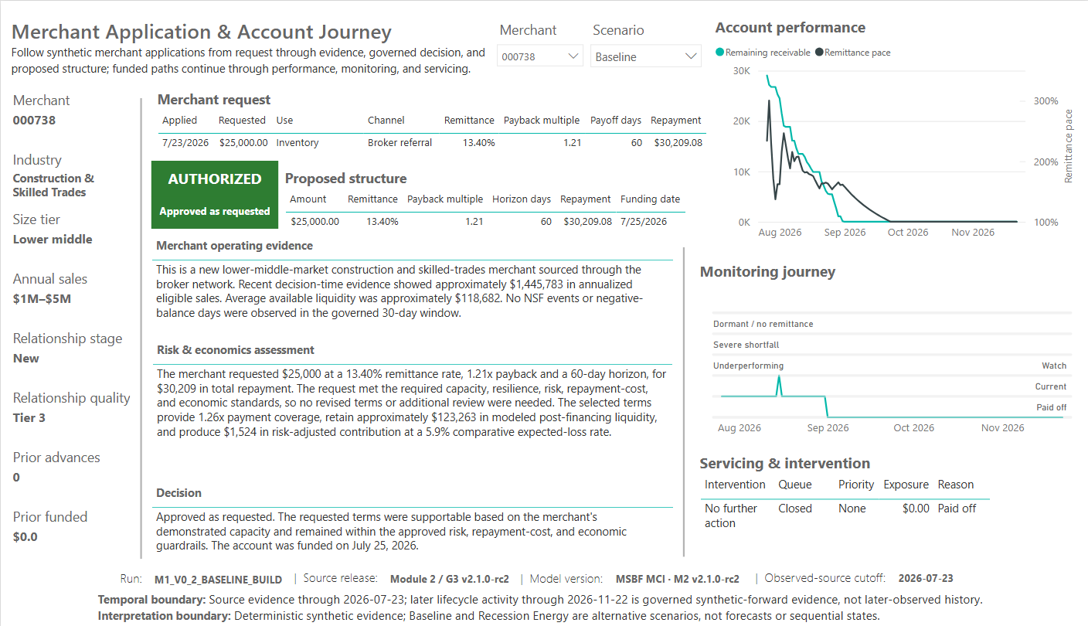
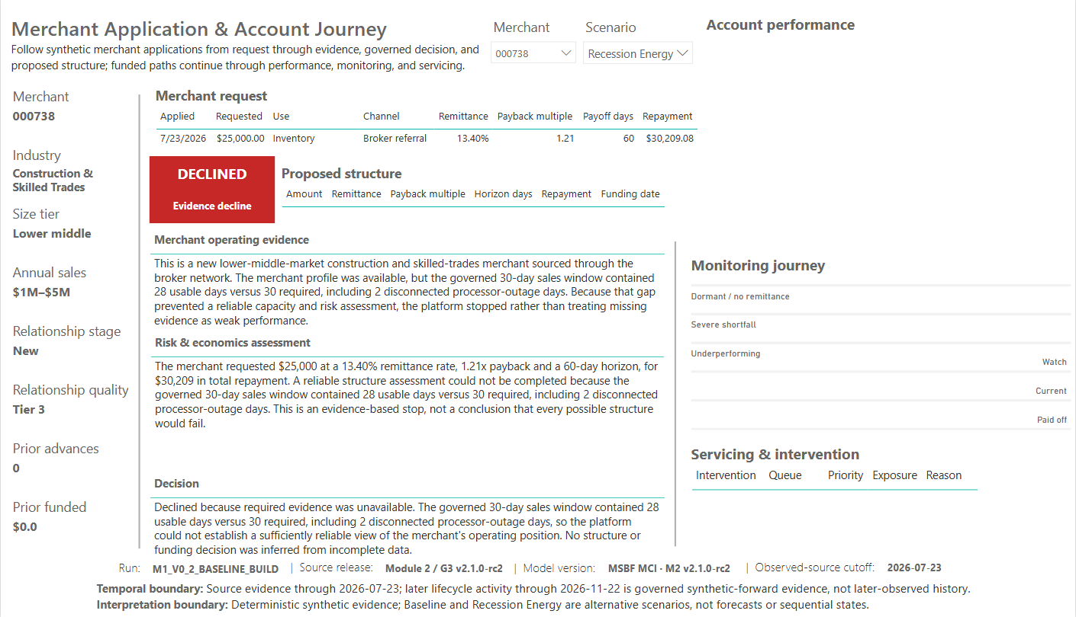
APPLICATION EVIDENCE
Merchant 738 - approval versus evidence decline
The same application is approved and funded in Baseline, but cannot proceed under stress because required evidence availability falls below the threshold.
BASELINE
RECESSION ENERGY
What the pair demonstrates
Baseline: $25,000 approved as requested, funded 2026-07-25, paid off. Stress: 28 usable days versus 30 required, including two disconnected outage days; no structure assessment, funding, monitoring, or servicing is permitted.

Slide 40
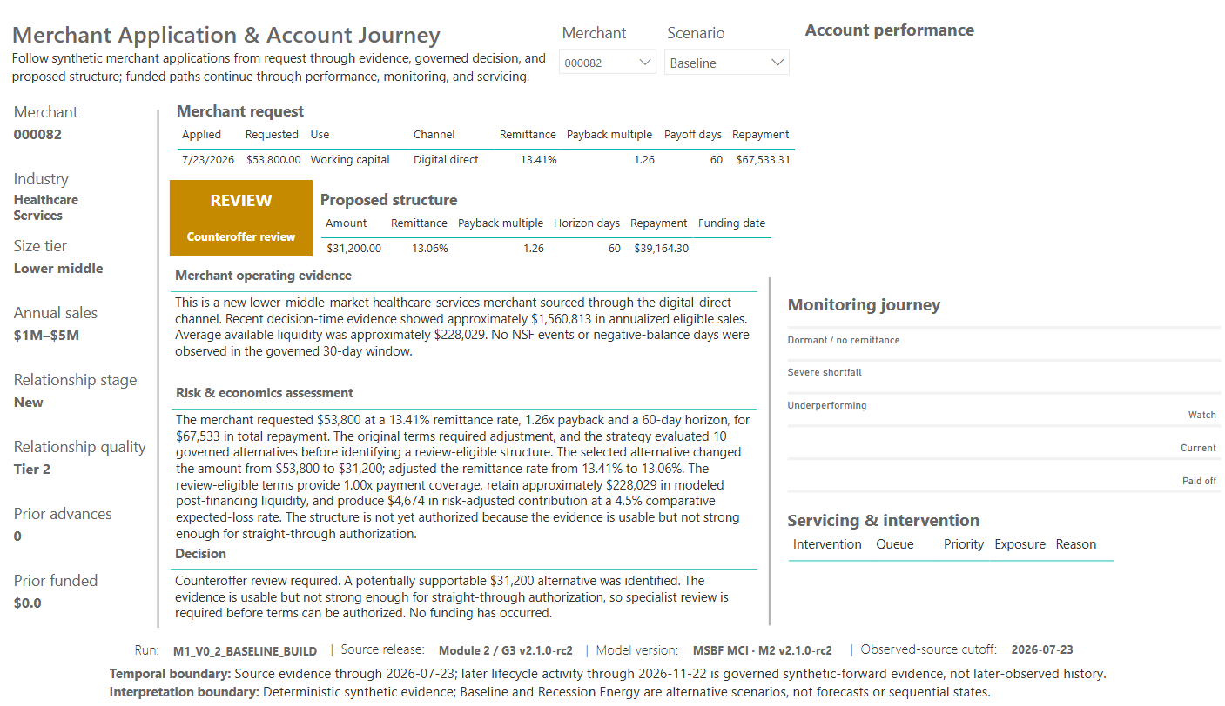
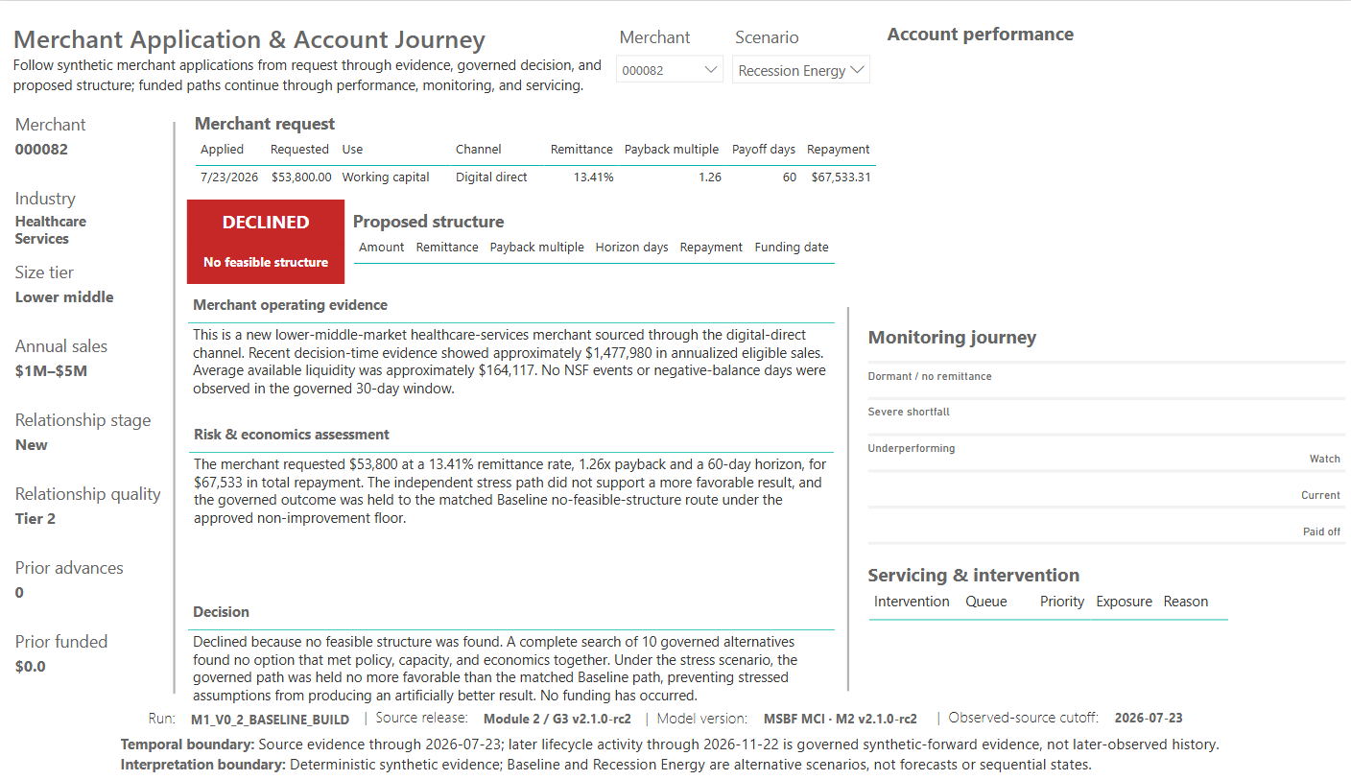
APPLICATION EVIDENCE
Merchant 082 - reviewable alternative becomes no-feasible under stress
The pair shows how a proposed counteroffer can remain review-only in Baseline and then fail the governed stress floor.
BASELINE
RECESSION ENERGY
What the pair demonstrates
Baseline: $53,800 request, $31,200 review-eligible alternative, but evidence is not strong enough for straight-through authorization. Stress: complete search of 10 alternatives; no eligible path survives the matched Baseline non-improvement floor.

Slide 41
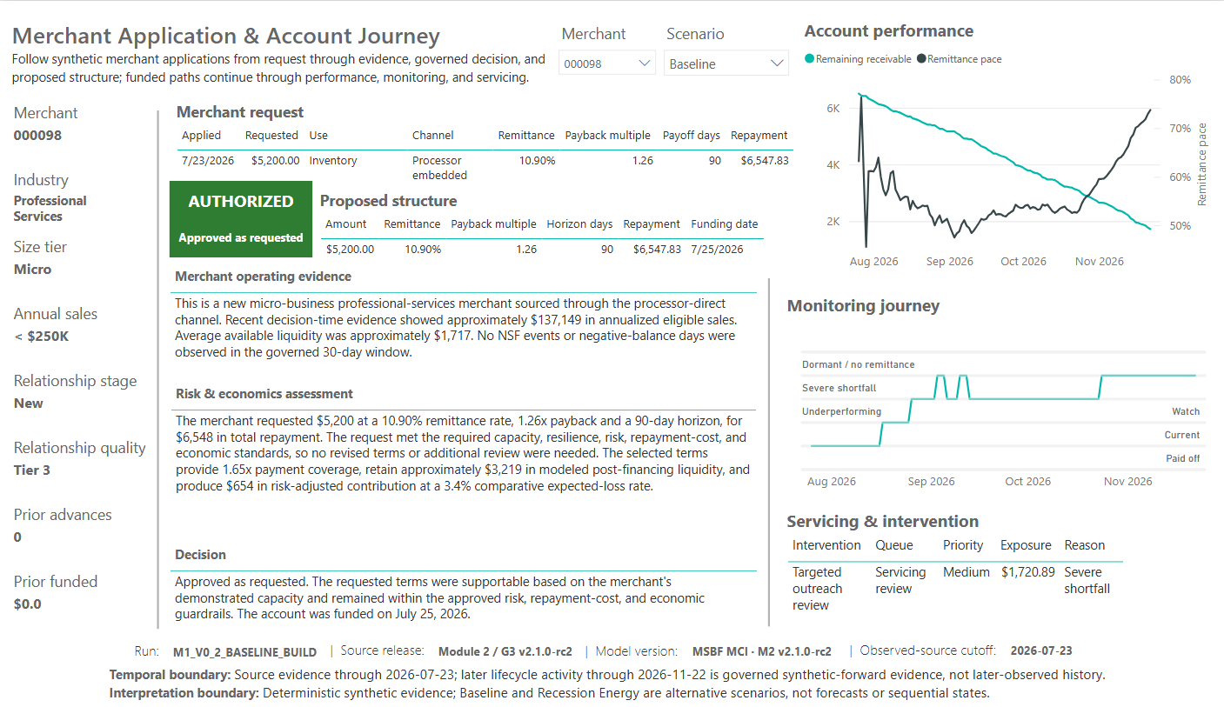

APPLICATION EVIDENCE
Merchant 098 - stress access preserved through a smaller counteroffer
A stressed path can remain authorized, but only through a controlled structure change that respects capacity and economics.
BASELINE
RECESSION ENERGY
What the pair demonstrates
Baseline approves the request as submitted. Under Recession Energy, the $5,200 request is reduced to $2,500 after seven governed alternatives; the path is funded, runs through monitoring, and pays off with no further action.

Slide 42
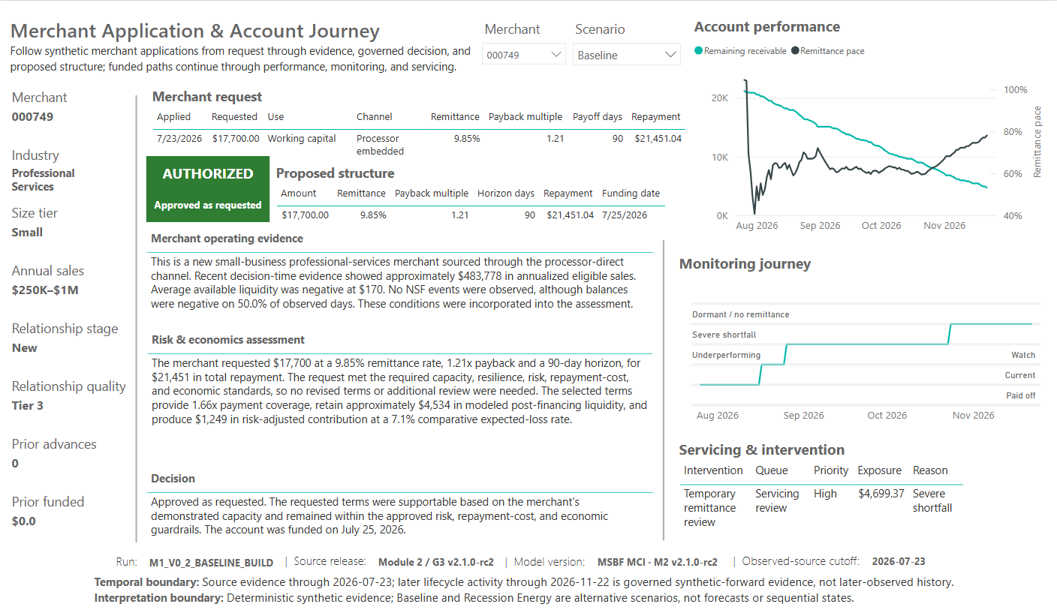
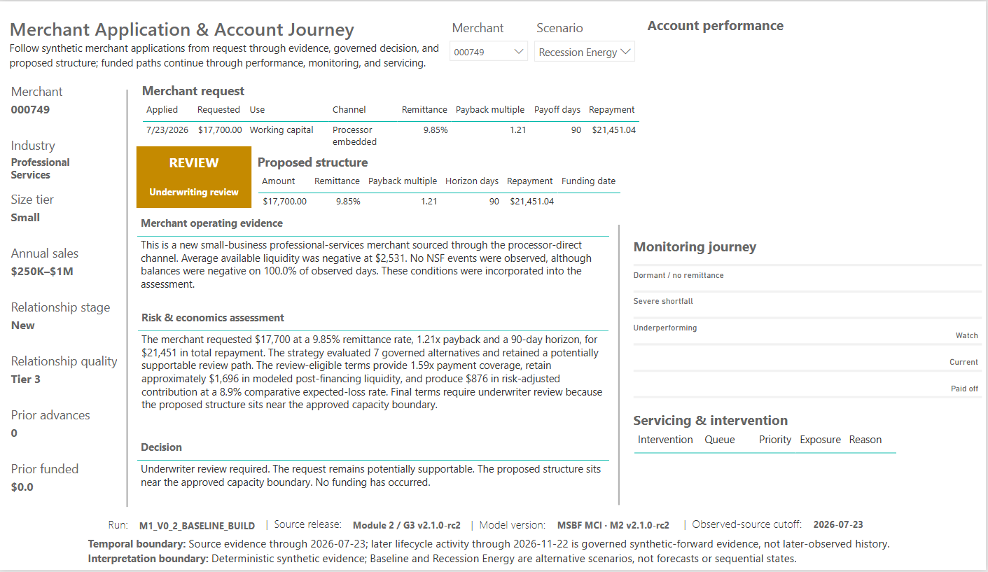
APPLICATION EVIDENCE
Merchant 749 - approval, active servicing, and stress review
The merchant demonstrates both the richest funded-account servicing path and a distinct non-funded stress review outcome.
BASELINE
RECESSION ENERGY
What the pair demonstrates
Baseline: $17,700 approved and funded; later severe shortfall triggers temporary-remittance review, seven payment events, one return, one retry, and $2,937.12 certified exposure after reconciliation. Stress: capacity/resilience remains review-only and no funding occurs.

Slide 43
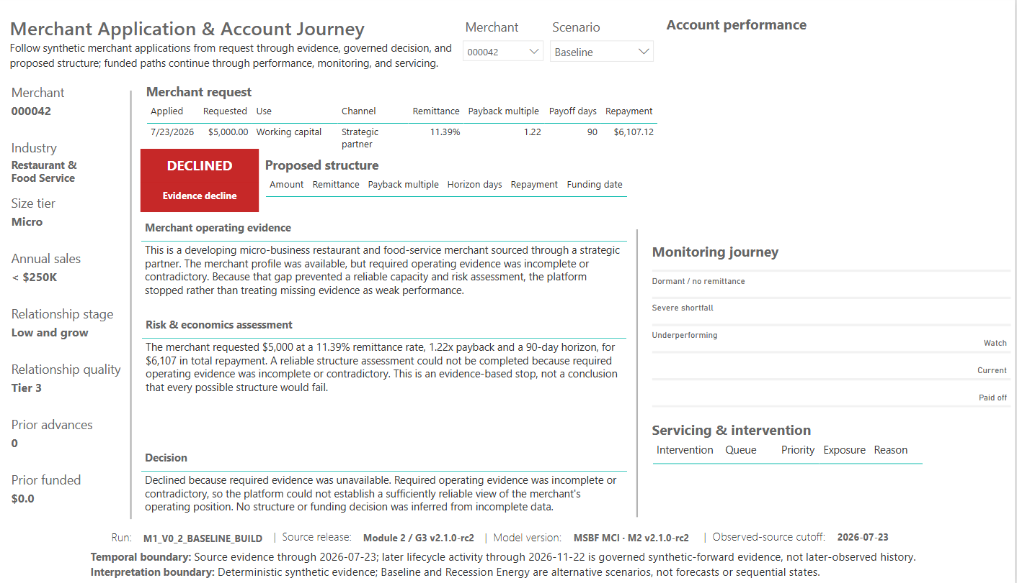
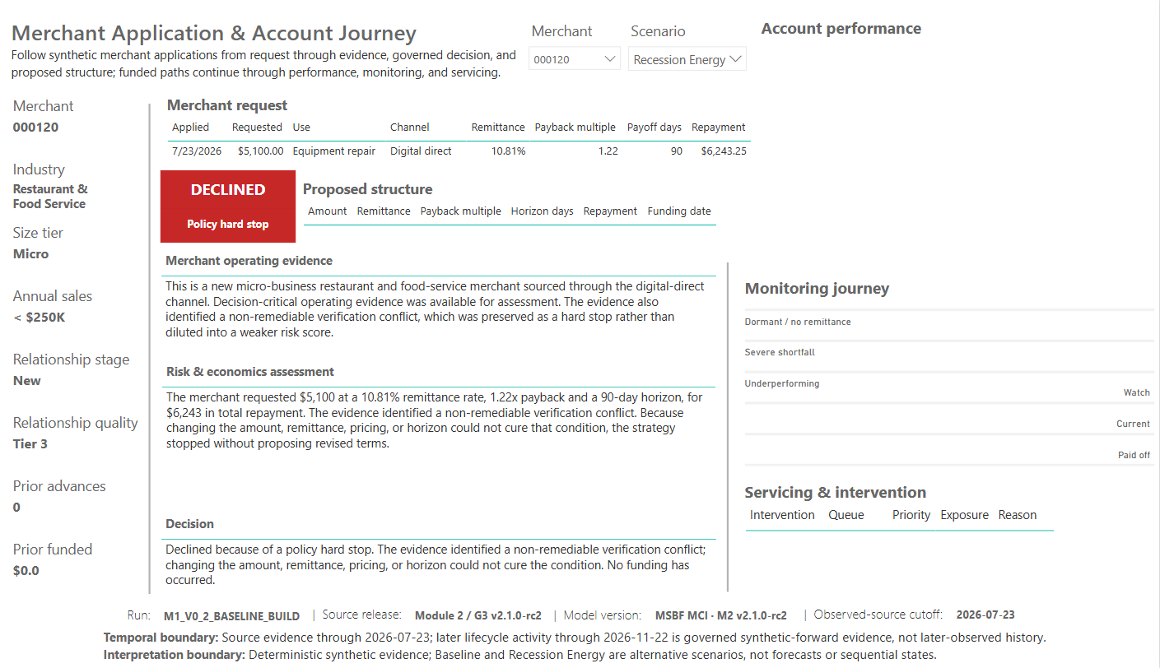
APPLICATION EVIDENCE
Evidence and policy boundaries remain distinguishable
The architecture preserves whether a path is declined because evidence is unusable or because a non-remediable policy condition controls.
EVIDENCE DECLINE
POLICY HARD STOP
Merchant 042
Merchant 120
Required operating evidence is incomplete or contradictory; risk/economics assessment is withheld rather than treating missing evidence as weak performance.
Decision-critical evidence is available, but a non-remediable verification conflict creates a policy hard stop that cannot be cured by revised terms.

Slide 44
06
Assurance and conclusions
What the evidence proves, the controls that support it, and the management implications of the initial cohort.

Slide 45
ASSURANCE
The Power BI conclusions reconcile to complete, exact-key successor populations
QA validates narrative semantics, monitoring coverage, scenario isolation, servicing stage equality, and endpoint reconciliation.
Narrative paths
Daily monitoring rows
P03 operational failures
1,500
15,600
0
All PASS
130 paths x 120 days
Exact reconciliation
Keys per M2.6-M2.10 stage
Intervention distribution
G3-v2 certification controls
130 / 130
126 / 3 / 1
70 / 70
Set-consistent
Closed / outreach / temporary
PASS
Scenario isolation
Reconciliation
Merchant 738 proves the funded Baseline lifecycle does not leak into Recession Energy. Non-funded paths remain blank downstream.
Certification and exposure variances are zero. The sole return/retry exception is resolved; unresolved exceptions remain zero.
R17: IA-D-R17-PBI-001 = ACCEPT. Owner-confirmed persistence/nonregression is CLOSED (PASS_WITH_OBSERVATIONS); no recapture is required. IA-PBI-PUB-HANDOFF-001 authorizes handoff only. Controlled publication and hosted-asset verification remain.

Slide 46
MANAGEMENT IMPLICATIONS
The initial cohort demonstrates a governed credit-intelligence product - not merely a collection of visuals
The strongest findings connect strategy design, risk control, lifecycle evidence, and operational traceability.
1
Access is deliberately selective
Baseline authorizes 13.7% and supports 40.0%; stress authorizes 3.6% and supports 10.7%.
2
Evidence quality is decisive
Stress evidence declines rise from 43 to 191, making availability and continuity as important as modeled economics.
3
Structure search creates controlled alternatives
300 Baseline and 80 stress paths remain supportable through requested terms or bounded remediation.
4
The stress floor prevents artificial upside
All stress authorizations are retained Baseline authorizations; none appear only under stress.
5
Concentration and resilience differ by segment
Processor Embedded and Relationship dominate Baseline; Strategic Partner and Transportation show stronger stress-dollar retention.
6
Lifecycle performance is mostly clean
126 of 130 funded scenario paths close stable; four Baseline accounts require controlled attention.
7
Servicing is traceable and reconciled
The one active path and three review holds remain exact-key linked through intervention, execution, certification, and endpoint state.
The analytical product is strongest when read as one continuum: application evidence -> governed decision -> proposed structure -> funded lifecycle -> monitoring -> intervention -> certification.

Slide 47
COHORT FACT SHEET
Initial 750-merchant cohort - key numbers at a glance
A compact reference for executive and validation use.
COHORT | BASELINE | RECESSION ENERGY | INTERPRETATION
Decision paths | 750 | 750 | Same fixed merchants under alternative scenarios
Authorized paths | 103 | 27 | Approve as requested + authorized counteroffers
Reviewable paths | 197 | 53 | Counteroffer review + underwriting review
Supportable paths | 300 (40.0%) | 80 (10.7%) | Authorized + governed review
Funded amount | $1,385,300 | $344,200 | Physical funded-lifecycle population only
Comparative expected-loss rate | 9.4% | 11.4% | Selected funded cohort; not CECL
Risk-adjusted contribution | $147,981 | $30,032 | Comparative modeled economics
Endpoint paid off | 99 / 103 | 27 / 27 | Deterministic synthetic lifecycle
Endpoint attention | 4 accounts / $7,823 | 0 accounts / $0 | Adverse monitoring states
Certified exposure | $6,061 | $0 | After execution/reconciliation
Unresolved exceptions | 0 | 0 | M2.10 endpoint

Slide 48
FORWARD VIEW
What the current cohort overview enables next
P01-P04 are complete and frozen for the rc2 publication candidate; P05/P06 remain excluded from the client-facing release.
Execute the authorized publication handoff
Use the cohort analytically
Preserve boundaries
- Power BI audit: IA-D-R17-PBI-001 = ACCEPT
- Handoff: IA-PBI-PUB-HANDOFF-001 = AUTHORIZED
- Complete the separate final cohort-report review
- Execute controlled GitHub publication / public supersession
- Download hosted assets; verify filename, size, SHA-256 and Windows-native clean extraction
- Preserve the accepted Power BI bytes and R7 registers
- Examine concentration and resilience by industry and source
- Evaluate review workload and supportable-path composition
- Preserve scenario-isolated merchant case studies for stakeholder communication
- Design and validate a future decision-strategy challenger separately; current M2.11 profiles do not demonstrate high-level decision migration
- Keep deterministic synthetic labeling explicit
- Do not reinterpret comparative expected loss as CECL
- Do not treat servicing simulations as production actions
- Do not collapse evidence, policy, no-feasible, and review outcomes into one decline category
This detailed cohort report is a read-ahead for the current P01-P04 publication candidate. A shorter executive extract is a separate, nonblocking follow-on.

Slide 49
07
Appendix
Detailed segment tables, metric definitions, and evidence/package records.

Slide 50
APPENDIX
Acquisition-source detail
Presentation-rounded acquisition-source results reconciled to cohort totals. Stress = Recession Energy.
SOURCE | SCENARIO | APPS | FUNDED | AMOUNT | SUPPORT | EL | END EXP
Broker or Lead | Baseline | 90 | 9 | $137.1K | 38.9% | 11.5% | $0
Broker or Lead | Stress | 90 | 2 | $19.0K | 11.1% | 13.7% | $0
Organic | Baseline | 25 | 4 | $39.5K | 28.0% | 8.4% | $639
Organic | Stress | 25 | 0 | $0 | 4.0% | N/A | $0
Owned | Baseline | 35 | 6 | $64.6K | 31.4% | 16.2% | $0
Owned | Stress | 35 | 1 | $5.0K | 11.4% | 21.3% | $0
Paid | Baseline | 90 | 7 | $85.7K | 40.0% | 7.3% | $0
Paid | Stress | 90 | 1 | $9.5K | 12.2% | 7.2% | $0
Processor Embedded | Baseline | 255 | 36 | $466.4K | 42.4% | 10.7% | $7.18K
Processor Embedded | Stress | 255 | 7 | $99.9K | 11.4% | 11.7% | $0
Relationship | Baseline | 135 | 25 | $417.6K | 41.5% | 6.9% | $0
Relationship | Stress | 135 | 8 | $93.3K | 11.9% | 8.6% | $0
Strategic Partner | Baseline | 120 | 16 | $174.4K | 39.2% | 9.6% | $0
Strategic Partner | Stress | 120 | 8 | $117.5K | 7.5% | 13.7% | $0
Normalized source-family crosswalk: slide 6. Segment expected-loss rates describe scenario-specific selected funded cohorts. A lower aggregate rate under stress may reflect selection/composition, not matched-path improvement; the path-level stress non-improvement floor remains controlling.

Slide 51
APPENDIX
Industry detail
Presentation-rounded industry results reconciled to cohort totals. Stress = Recession Energy.
INDUSTRY | SCENARIO | APPS | FUNDED | AMOUNT | SUPPORT | EL | RAC
Construction | Baseline | 98 | 11 | $162.0K | 28.6% | 14.4% | $11.2K
E-Commerce | Baseline | 68 | 11 | $101.5K | 47.1% | 10.0% | $10.5K
Energy | Baseline | 60 | 6 | $77.8K | 31.7% | 14.2% | $8.9K
General Retail | Baseline | 120 | 7 | $213.6K | 39.2% | 7.1% | $29.2K
Healthcare | Baseline | 82 | 15 | $124.0K | 43.9% | 6.2% | $13.2K
Professional | Baseline | 112 | 30 | $314.8K | 58.0% | 7.3% | $31.9K
Restaurant | Baseline | 120 | 6 | $54.2K | 37.5% | 8.4% | $7.1K
Transportation | Baseline | 90 | 17 | $337.4K | 31.1% | 11.1% | $35.9K
Construction | Stress | 98 | 1 | $10.9K | 4.1% | 10.8% | $0.8K
E-Commerce | Stress | 68 | 3 | $37.3K | 16.2% | 13.0% | $2.6K
Energy | Stress | 60 | 2 | $17.4K | 5.0% | 21.6% | $2.0K
General Retail | Stress | 120 | 1 | $5.5K | 7.5% | 10.0% | $0.9K
Healthcare | Stress | 82 | 4 | $48.8K | 12.2% | 8.7% | $5.1K
Professional | Stress | 112 | 8 | $67.1K | 21.4% | 8.2% | $5.7K
Restaurant | Stress | 120 | 1 | $17.7K | 9.2% | 9.9% | $1.8K
Transportation | Stress | 90 | 7 | $139.5K | 8.9% | 14.5% | $11.1K
Segment expected-loss rates describe scenario-specific selected funded cohorts. A lower aggregate rate under stress may reflect selection/composition, not matched-path improvement; the path-level stress non-improvement floor remains controlling.

Slide 52
APPENDIX
Metric and boundary definitions
Interpretation rules used throughout the deck.
TERM | CONTROLLED INTERPRETATION
Authorized paths | Approve-as-requested plus authorized counteroffers.
Reviewable paths | Counteroffer-review plus manual-underwriting-review paths; no funding is implied.
Supportable paths | Authorized + reviewable paths. This is not an approval rate.
Comparative expected-loss rate | Selected funded cohort expected loss divided by path-weighted EAD; not a CECL estimate.
Risk-adjusted contribution | Source-owned comparative modeled contribution after risk adjustment; not audited profit.
Attention exposure | Endpoint remaining receivable on Underperforming, Severe Shortfall, or Dormant / No Remittance paths.
Certified exposure | M2.9/M2.10 reconciled ending exposure after synthetic processing and certification.
Baseline / Recession Energy | Alternative governed scenarios for the same application population; neither is a forecast or sequential state.
Observed-source cutoff | Decision-time source evidence is fixed at 2026-07-23.
Synthetic-forward lifecycle | Funding, monitoring, servicing, and payoff after the cutoff are deterministic synthetic evidence through 2026-11-22.
Segment expected-loss rates describe scenario-specific selected funded cohorts. A lower aggregate rate under stress may reflect selection/composition, not matched-path improvement; the path-level stress non-improvement floor remains controlling.

Slide 53
APPENDIX
Evidence register and current project identity
The deck is traceable to organized owner evidence and the final Power BI publication candidate.
Owner-evidence presentation folder
Current Power BI identity
94 clean PNG captures
- P01 Command Center: 32
- P02 Cohort Lifecycle: 32
- P03 Application Journey: 28
- P04 Servicing & Exceptions: 2
Separate owner evidence retains QA, tooltip, accessibility, and interaction captures.
File: MSBF_Merchant_Credit_Intelligence_M2_v2.1.0-rc2.pbix
Size: 27,635,305 bytes
SHA-256: ca46e8551860836a0cf4ff9239c42fcf8df02f1705596b9f8ca1bd047b5294e4
Model label: MSBF MCI - M2 v2.1.0-rc2
R17 acceptance and publication boundary
Evidence hierarchy
IA-D-R17-PBI-001 = ACCEPT closes R16. IA-PBI-PUB-HANDOFF-001 = AUTHORIZED permits direct publication handoff. The R3 PBIX DataModel is unchanged; owner no-recapture signoff is accepted. Persistence/nonregression is closed with observations. GitHub publication and public supersession are not executed by this audit.
1. Accepted R26 facts and R17 audit/handoff authority
2. Accepted final PBIX model and installed DAX
3. Power BI full-page and segment captures
4. Narrative, monitoring, servicing, and QA captures
5. This deck's derived tables and charts
The private review carrier contains physical sources, byte sizes/SHA-256, row counts/grains, deterministic derivation logic, source-to-slide/claim maps, output-image identities, and reproduction results. It is not a public-release asset.

