Slide 1
Survival Strategy Framework
From time-to-event data to governed intervention evidence
Separate persona discovery from CoxPH risk modeling.
Validate discrimination with stratified K-fold out-of-sample scoring.
Select a model-derived top-quartile target cohort.
Apply control, favorable, and adverse scenarios to the same governed IDs.
Rebuild interactions and squared terms before re-scoring.
Archive calibration, PH review, scenario controls, and stakeholder evidence.
Public demonstration data | Illustrative scenarios | Not a production retention forecast

Slide 2
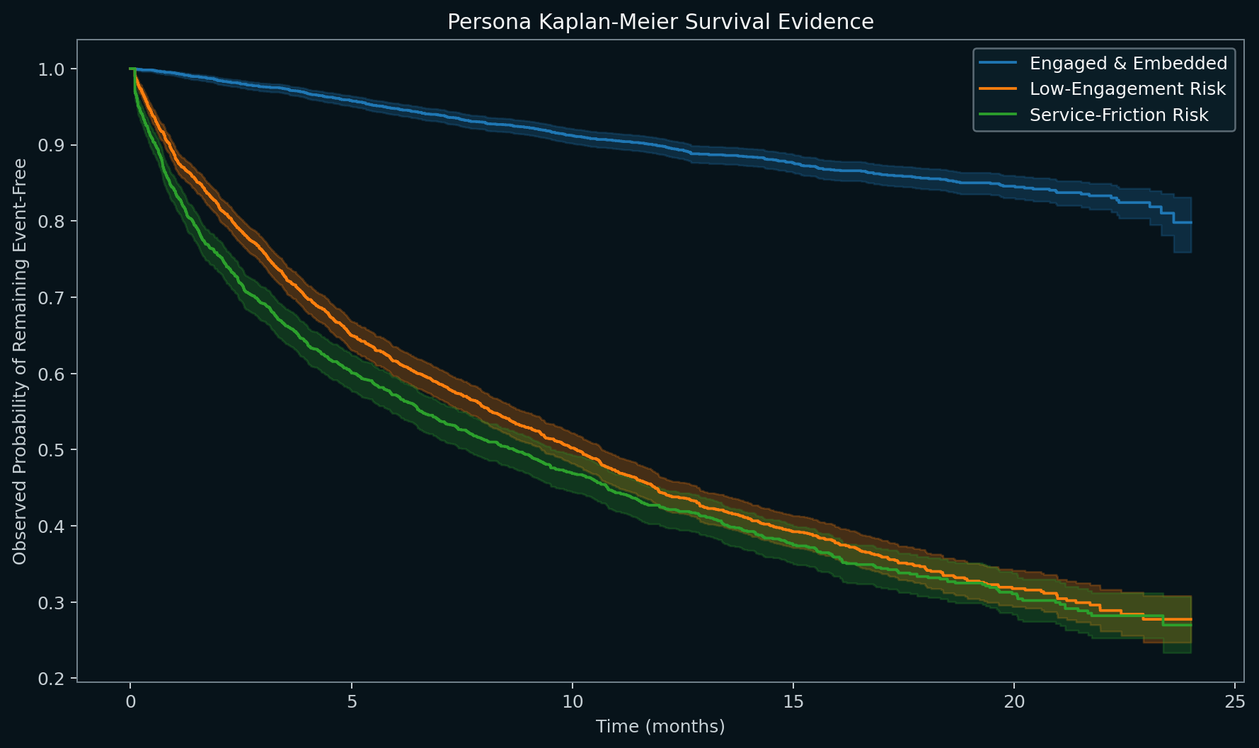
Persona Lifecycle Evidence
Observed Kaplan-Meier curves; personas are descriptive segments, not CoxPH model inputs.
Public demonstration data | Illustrative scenarios | Not a production retention forecast

Slide 3
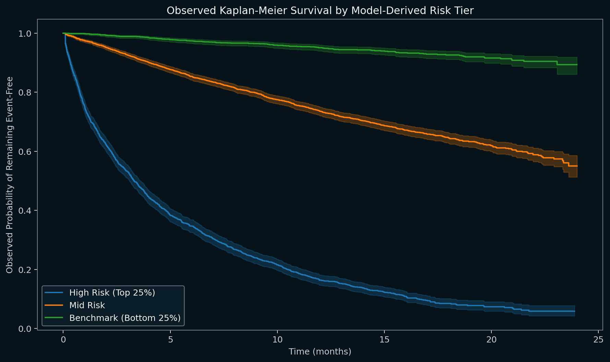
Model-Derived Risk Tiers
Observed Kaplan-Meier evidence across baseline partial-hazard tiers.
Public demonstration data | Illustrative scenarios | Not a production retention forecast

Slide 4
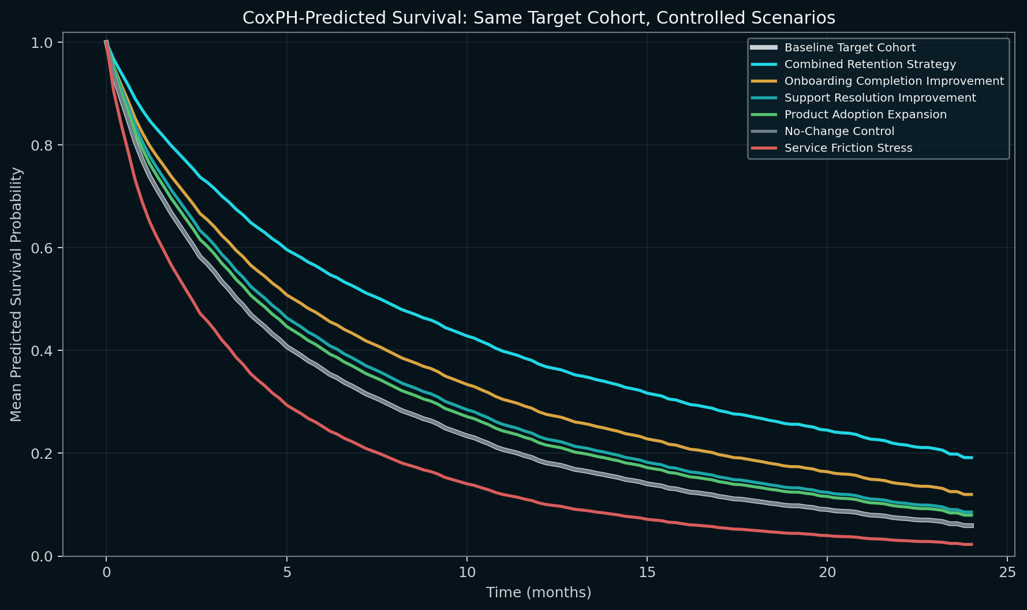
Same-Cohort Predicted Survival
CoxPH-predicted survival for identical target IDs under control, favorable, and stress scenarios.
Public demonstration data | Illustrative scenarios | Not a production retention forecast

Slide 5
Scenario Comparison
Modeled sensitivity at 12 months; survival uplift shown in percentage points
Scenario | Type | Hazard Reduction | Survival Uplift | Direction | Rank
Combined Retention Strategy | IMPROVEMENT | 52.9% | 18.8 pp | IMPROVED | 1
Onboarding Completion Improvement | IMPROVEMENT | 28.0% | 9.5 pp | IMPROVED | 2
Support Resolution Improvement | IMPROVEMENT | 25.7% | 4.7 pp | IMPROVED | 3
Product Adoption Expansion | IMPROVEMENT | 11.8% | 3.5 pp | IMPROVED | 4
No-Change Control | CONTROL | 0.0% | 0.0 pp | NEUTRAL | 5
Service Friction Stress | STRESS | -72.9% | -8.2 pp | ADVERSE | 6
Public demonstration data | Illustrative scenarios | Not a production retention forecast

Slide 6
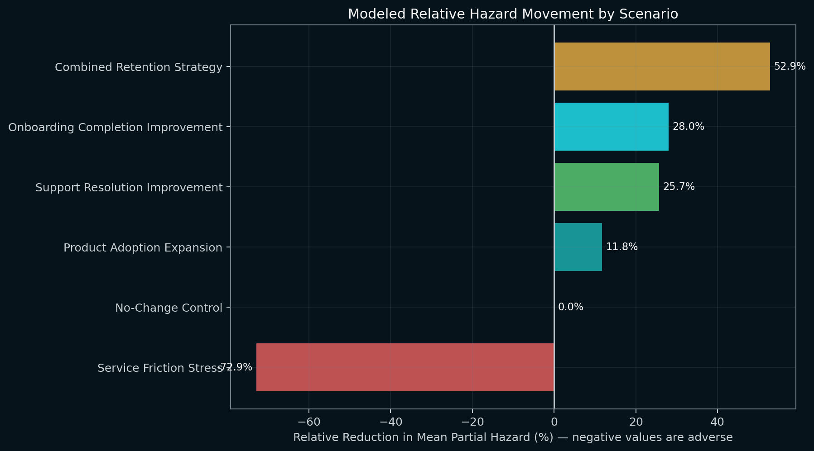
Relative Hazard Movement
Positive values indicate modeled hazard reduction; negative values indicate adverse stress movement.
Public demonstration data | Illustrative scenarios | Not a production retention forecast

Slide 7
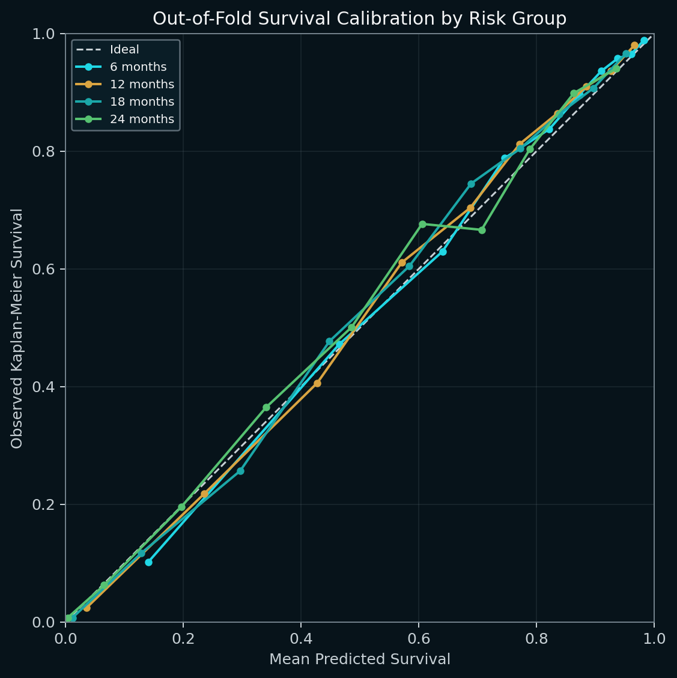
Model Validation Snapshot
Out-of-fold discrimination, calibration, and proportional-hazards review
0.827
Apparent concordance
0.827
5-fold CV mean
0.119
Integrated Brier score
PASS_WITH_REVIEW
PH diagnostic status
Public demonstration data | Illustrative scenarios | Not a production retention forecast

Slide 8
Executive Interpretation
Evidence, review status, and boundaries
7,500
Synthetic records
1,875
Target-cohort records
52.9%
Best modeled hazard reduction
18.8 pp
Survival uplift at 12 months
PASS_WITH_REVIEW
Run acceptance
The Survival Strategy Framework - Synthetic Retention Demo run analyzed 7,500 records with an observed event rate of 39.52%. The regularized CoxPH model produced an apparent development-sample concordance index of 0.827; deterministic 5-fold validation produced a mean concordance of 0.827 (SD 0.007). The baseline high risk (top 25%) rule selected 1,875 records for same-cohort sensitivity testing. Among the illustrative improvement scenarios, 'Combined Retention Strategy' produced the largest modeled movement for the same 1,875-record target cohort: mean partial hazard declined by 52.86%, and modeled survival at 12 months increased by 18.79 percentage points. The run concluded PASS_WITH_REVIEW; proportional-hazards evidence was classified PASS_WITH_REVIEW. These outputs are model-based sensitivity evidence from demonstration data, not causal treatment effects, production retention forecasts, or realized financial outcomes.
Modeled sensitivity — not causal treatment effect.
Synthetic demonstration data — no PII.
No booked revenue, realized ROI, or production forecast is claimed.
Production use requires domain calibration, monitoring, and model-risk approval.
Public demonstration data | Illustrative scenarios | Not a production retention forecast

