Slide 1
Modeling adaptation

Slide 2
Under a Brownian motion model, character state evolves in a purely stochastic manner, with rate σ:
dX(t) = σ dB(t)
Expected change in phenotype
Rate of
stochastic evolution
Random normal
variable
Phylogenetic covariance arises because the expected covariance in character state / phenotype is a function of how recently two species have diverged from one another.

Slide 5
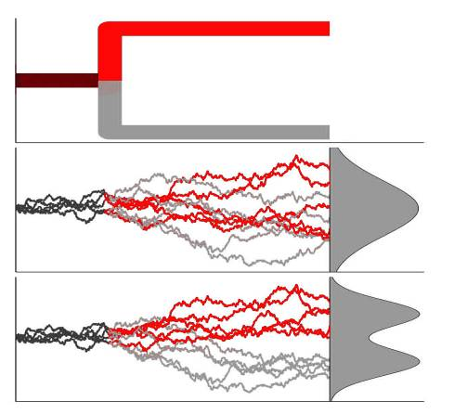
The Hansen model
Species 1
At the completion of speciation, species 1 and 2 are presumed to evolve independently.
Species 2
Under an OU model with a single optimum, expectation is that the two do not diverge in mean character value.
θ
Under an OU model with a separate optimum for each branch, character means diverge. Brownian motion is an OU model with α (selection strength) = 0.
θ₁
θ₂
From Butler and King 2004, Am. Nat. 164: 283–295

Slide 7
An Ornstein-Uhlenbeck process is a Brownian motion process with an added pull or attraction toward a subtree-specific optimum / equilibrium. This is what we expect to see under stabilizing or directional selection, with a breakdown in phylogenetic autocorrelation across the tree.

Slide 8
Ornstein-Uhlenbeck models are essentially the Brownian motion model with an additional deterministic term that models a pull toward an optimum or equilibrium value, θ, with rate α:
Rate of evolution toward equilibrium
Distance from
the equilibrium
dX(t) = σ dB(t)
+ α [θ – X(t)] dt
Expected change in phenotype
Rate of
stochastic evolution
Random normal
variable
These models are also referred to as “rubber-band” models. An Ornstein-Uhlenbeck process will lead to character transitions if different subtrees are in different trait equilibria / optima.
Notes:
Explain more graphically what the parameters mean. Sigma represents how jagged the walk is, e.g. dX(t) is the change in chromosome number in an infinitesimal time. Alpha is the strenght of the rubber band. Theta is the phenotype value that for some reason the group is being driven towards.

Slide 9
While under Brownian motion, we expect apparent transitions only due to drift or when one subtree samples from an extreme starting point…

Slide 10
…a trait evolving according to a multiple-optimum Ornstein-Uhlenbeck process will drive toward subtree-specific character state distributions.

Slide 11
What pieces do we need to build the categorical O-U model?
A parameter that scales covariance matrix C, reflecting how adaptation erodes phylogenetic signal (α)
A parameter for the rate of evolution (σ²)
A parameter for the root state (β₀, which is analagous to last week’s â), as well as one for each of the K optima corresponding to K selective regimes (β_{K}).

Slide 12
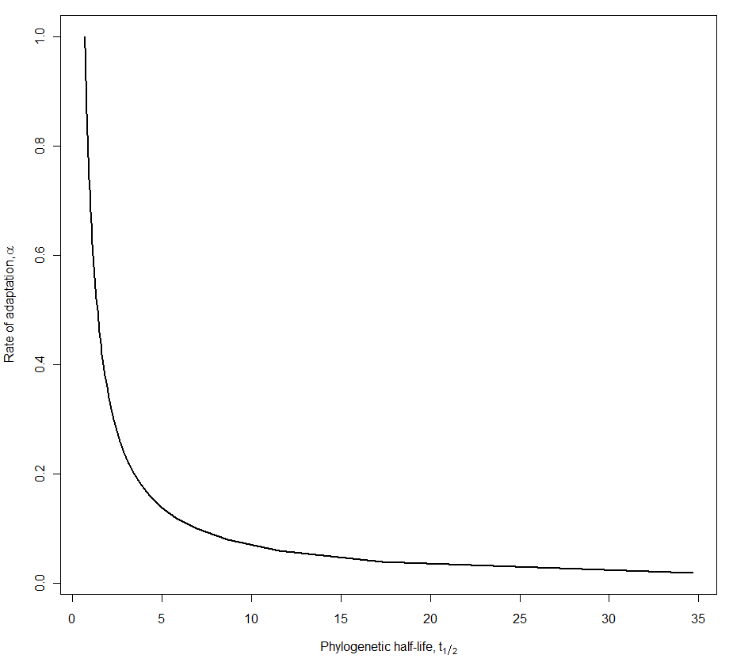
α = ln(2) / t_{½}

Slide 13
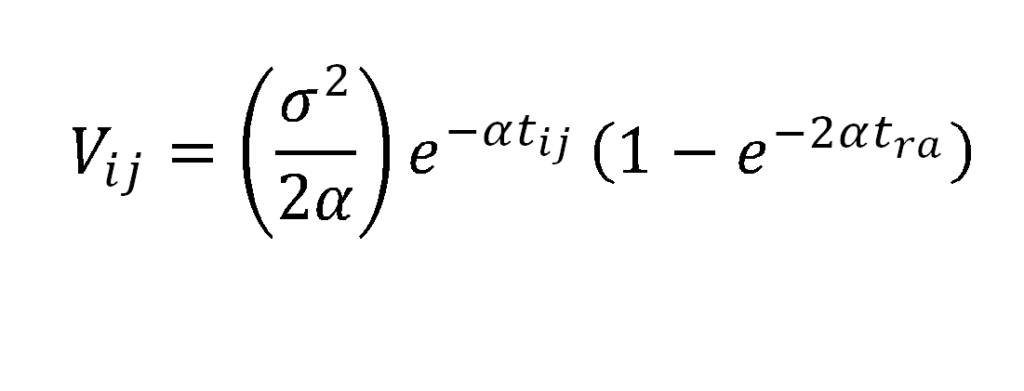
Rate of adaptation
Phylogenetic distance between tips
Distance from root to mrca of tips
V_{ij} → 0 as α → ∞
V_{ij} → t_{ra} as α → 0

Slide 14
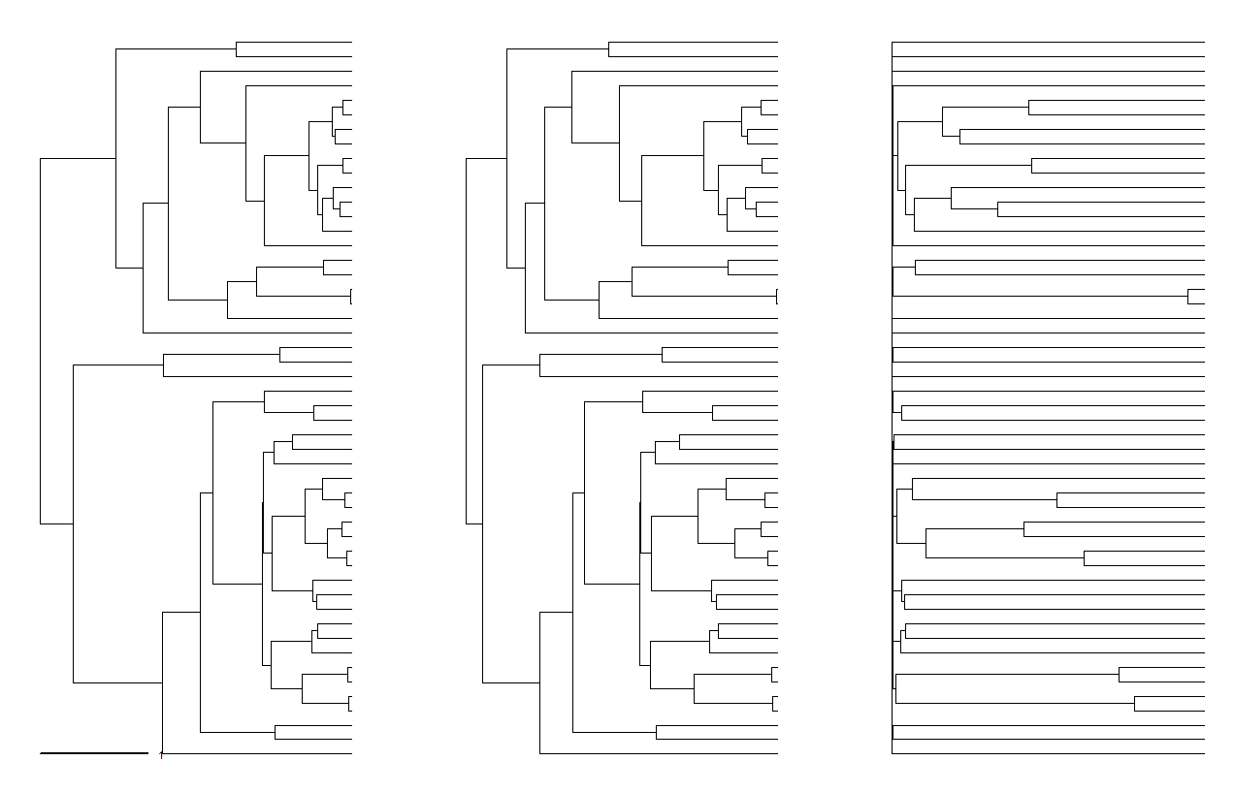
Original tree: branch lengths proportional to time
O-U tree
α = 0.25, t_{½} = 1.4
O-U tree
α = 5.0, t_{½} = 0.14

Slide 15
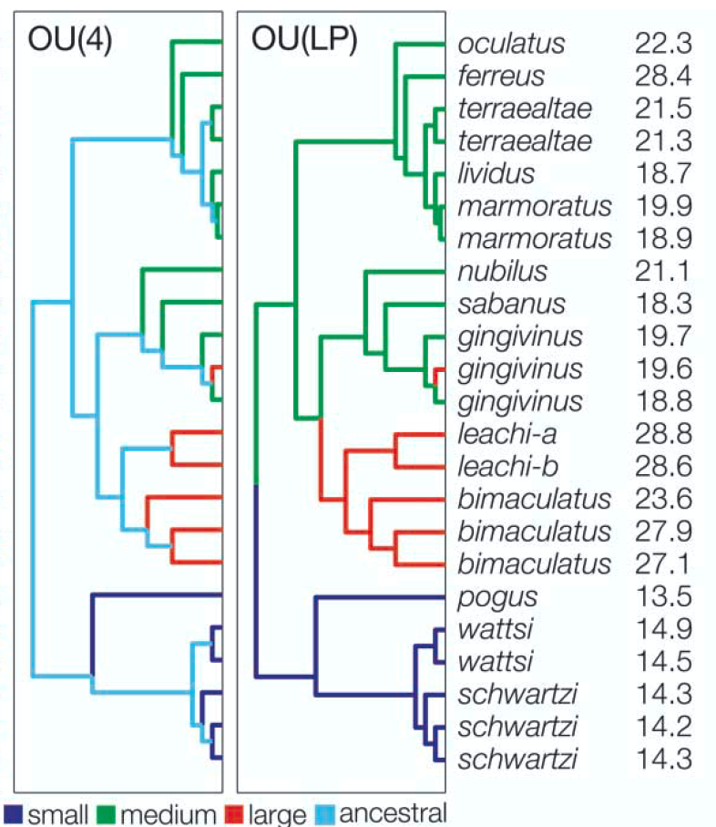
Alpha only scales the effect of adaptation on phylogenetic structure. To get expected values at the tips – we need both expected values and variances at the tips to fit a model of trait evolution – we need to understand how the selective regimes affect trait values at the tips.
The mechanism for doing this works by regressing the observed values on the times spent in each selective regime, weighted by the time spent in each regime and downweighted by the time elapsed since leaving that regime.

Slide 16
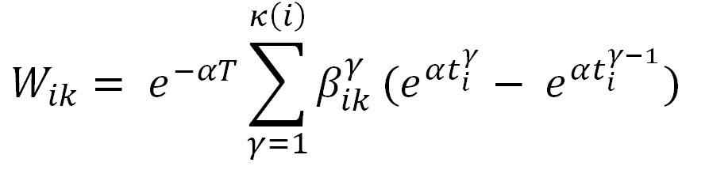
N = 23, K = 4
N = 23, K = 3
W₁₀ | W₁₁ | W₁₂ | … | W_{1k}
W₂₀ | W₂₁ | W₂₂ | … | W_{2k}
W₃₀ | W₃₁ | W₃₂ | … | W_{3k}
. | . | . | … | .
. | . | . | … | .
. | . | . | … | .
W_{i0} | W_{i1} | W_{i2} | … | W_{ik}
Notes:
Note that W_{i0} is just e^-alpha*T, which reduces to 0 as alpha -> infinity, and 1 as alpha -> 0. The latter is exactly the vector we would use to estimate the intercept in a GLS regression, or, equivalently, the phylogenetic root state. Our ability to estimate the root erodes rapidly in the OU model, and consequently this parameter is simply not estimated in many OU analyses.

Slide 17
We have learned the GLS estimator for the phylogenetic mean (in the univariate case) and regression coefficients (multivariate case):
â = (1’ C⁻¹ 1)⁻¹ (1’ C⁻¹ X)
β_{PHY} = (X’ C⁻¹ X) ⁻¹ X’ C⁻¹ y
Because the OU model is a weighted regression, we also use GLS to find the evolutionary optima:
θ = (W’ C⁻¹ W) W’ C⁻¹ X

Slide 18
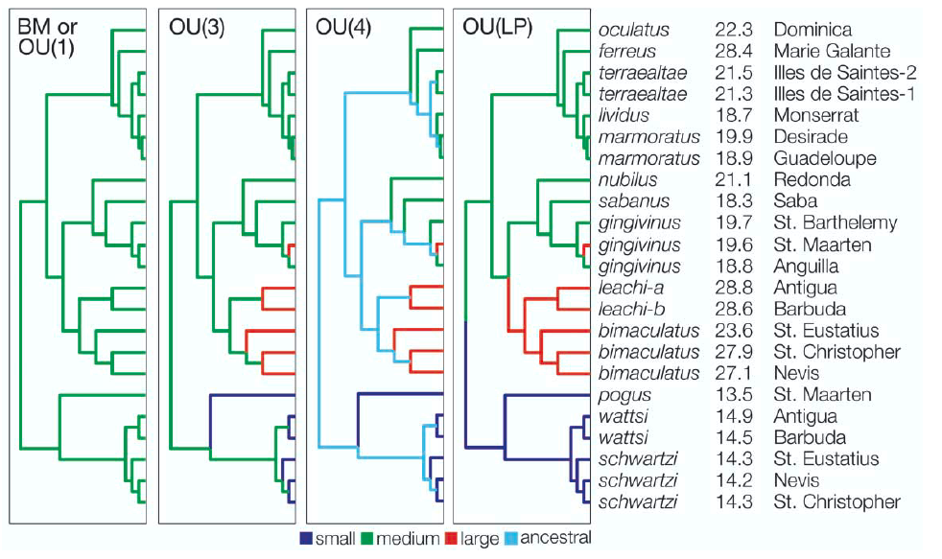

Slide 19
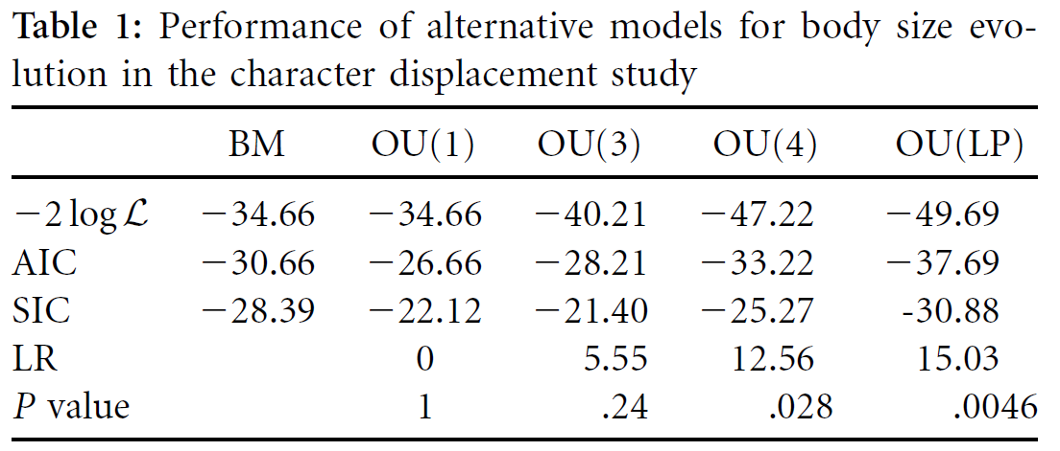
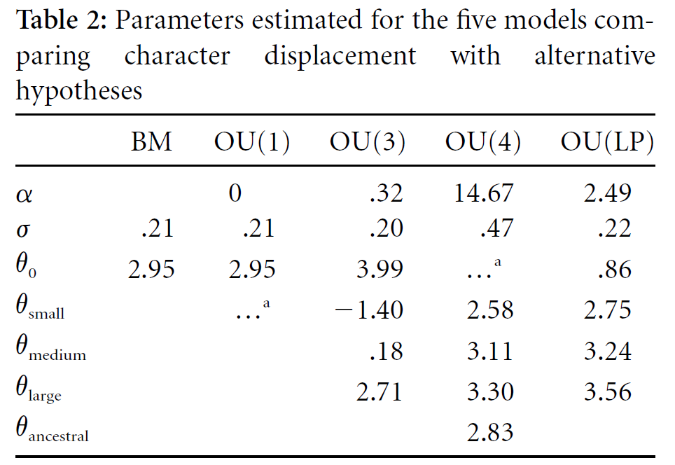

Slide 20
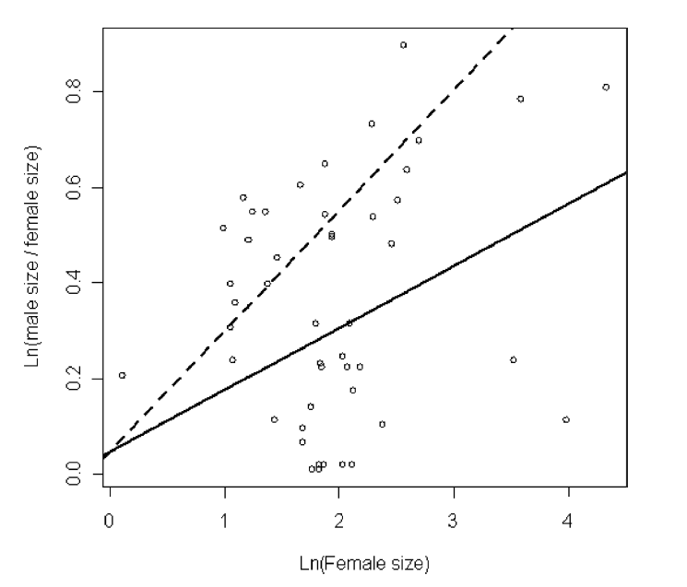
β_{OPT} = β_{PHY} / (1 – (1 – e^{-αt})/ αt)
β_{PHY} = (X’ C⁻¹ X) ⁻¹ X’ C⁻¹ y
Hansen TF, Pienaar J, Orzack SH. 2008. A Comparative Method for Studying Adaptation to a Randomly Evolving Environment. Evolution 62(8): 1965-1977.
Notes:
Last week we left off with the problem of estimating the correlation between an environmental predictor and a trait that we blv evolves in response to it.

