Slide 1
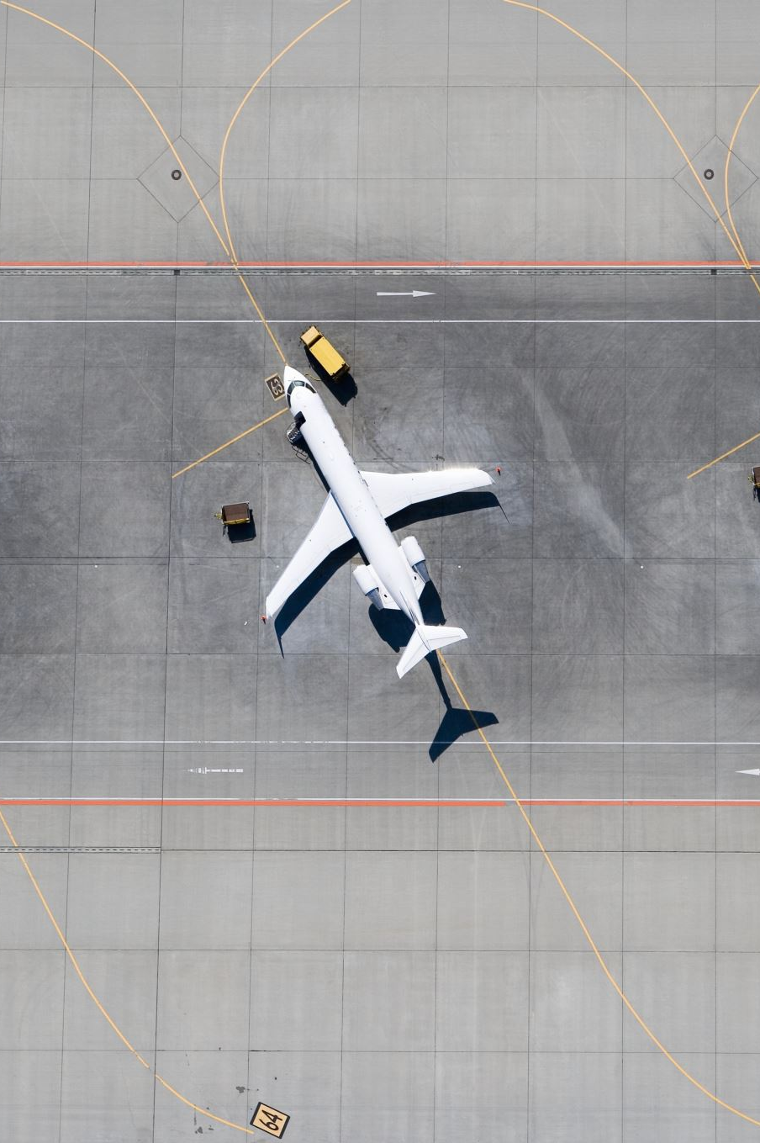
LineOps AI
The GPT-powered co-pilot for Aviation Professionals

Slide 2
The Problem
- Engineers flip through 500-page manuals during turnarounds
- MEL/OI and fault isolation workflows waste time
- Tools are outdated and not mobile-friendly
- Fault triage is reactive, not predictive

Slide 3
The Solution
LineOps AI is a web/mobile app powered by GPT:
- Voice, ATA, or free-text search
- Fault recognition & PIREP suggestions
- Works offline; secure & compliant

Slide 4
Market Opportunity
- 300,000+ licensed engineers globally
- Expandable to pilots, MROs, dispatchers
- Long-term TAM: $100M+ in ARR

Slide 5
New Business Model
- $5/month for first 10,000 users
- $10/month thereafter
- Enterprise licensing for airlines and MROs
- API integration for EFB/MRO systems
- Freemium tier for training institutions

Slide 6
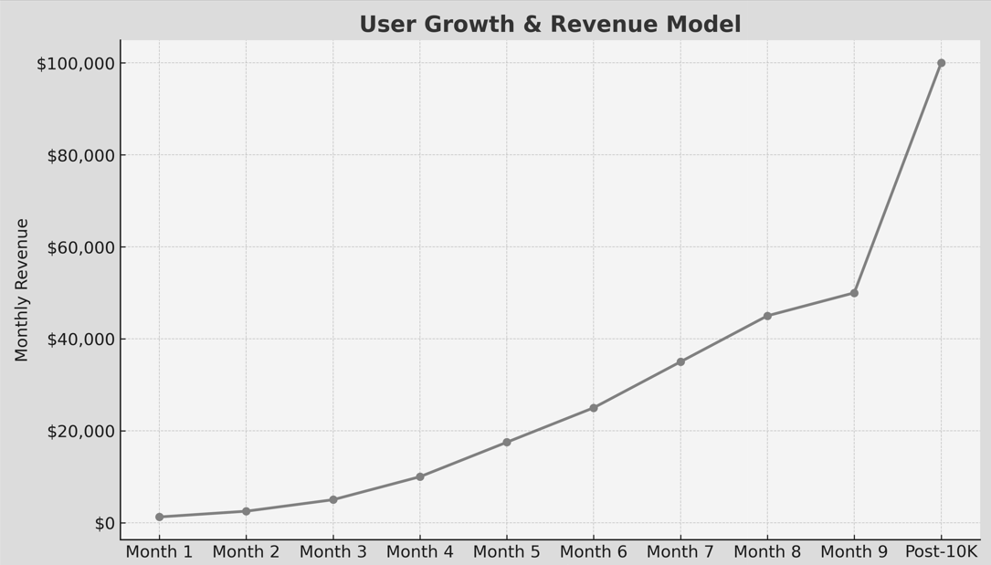
User Growth & Revenue Model
Month 1: 250 users → $1,250
Month 2: 500 users → $2,500
Month 3: 1,000 users → $5,000
Month 4: 2,000 users → $10,000
Month 5: 3,500 users → $17,500
Month 6: 5,000 users → $25,000
Month 7: 7,000 users → $35,000
Month 8: 9,000 users → $45,000
Month 9: 10,000 users → $50,000
Post-10K: $10/user = $100,000/month

Slide 7
Updated Financial Projections
- Year 1: $500K (10,000 users @ blended pricing)
- Year 2: $1.5M–$2M (25,000 users)
- Year 3: $4M–$6M (airline/MRO licensing + 50K users)

Slide 8
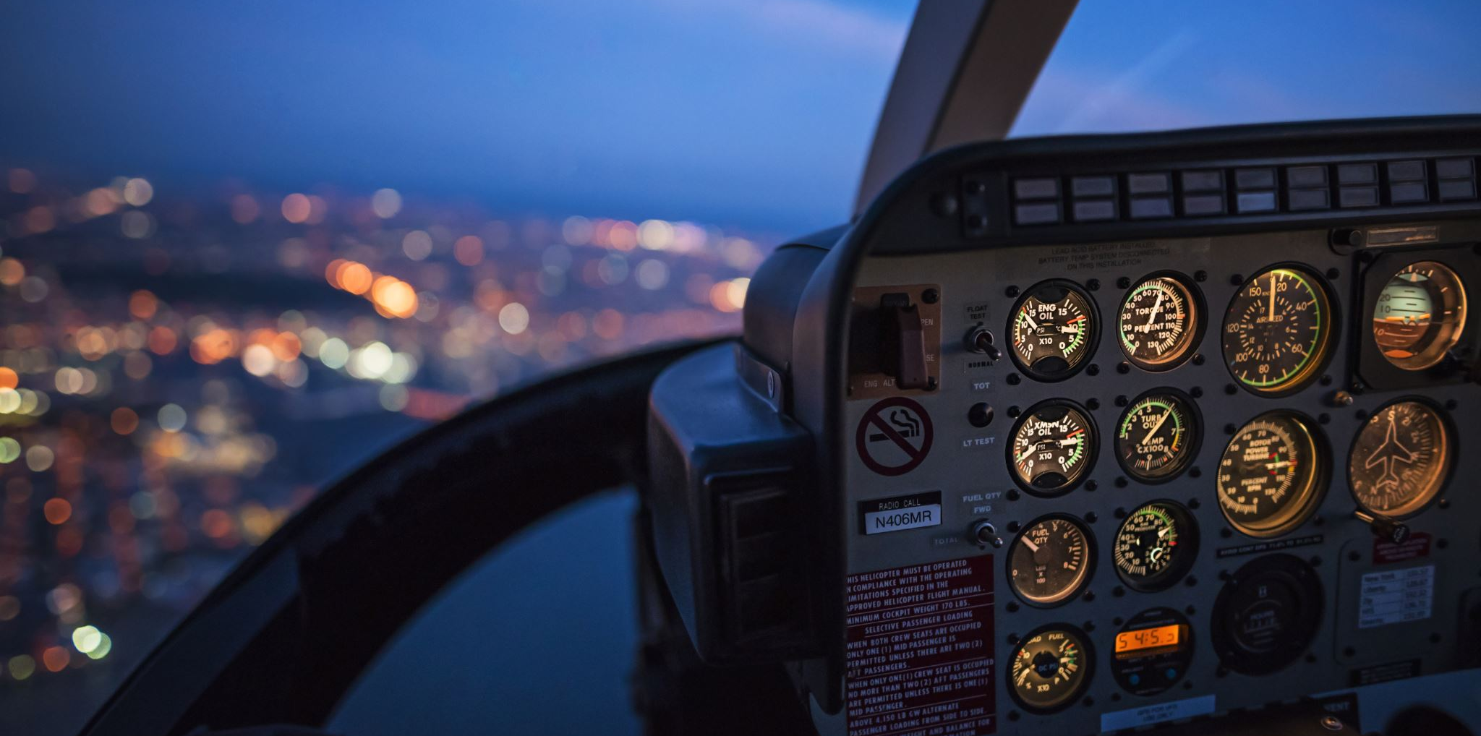
Go-to-Market Strategy
MVP: Engineers, Pilots, Cabin Crew – Aviation Professionals
Channels: LinkedIn, WhatsApp, influencers
Partners: Aviation schools, unions
MRO events and expos

Slide 9

Team & Vision
Aviators + data specialists
Deep MRO and regulatory experience
Mission: Empower aviation professionals with intelligent tools to streamline decision-making, enhance safety, and redefine operational efficiency.

Slide 10
Join Us
We're building the co-pilot aviation professionals deserve.
Looking for:
- Strategic investors with a passion for aviation and AI
- Beta partners: MROs, airlines, training institutions
- Collaborators in AI, aerospace data, and ops tooling
Together, let's redefine the future of aviation work.

