Slide 1
Formal Verification
Andrew Javier
CMPE 200/CMPE 240

Slide 2
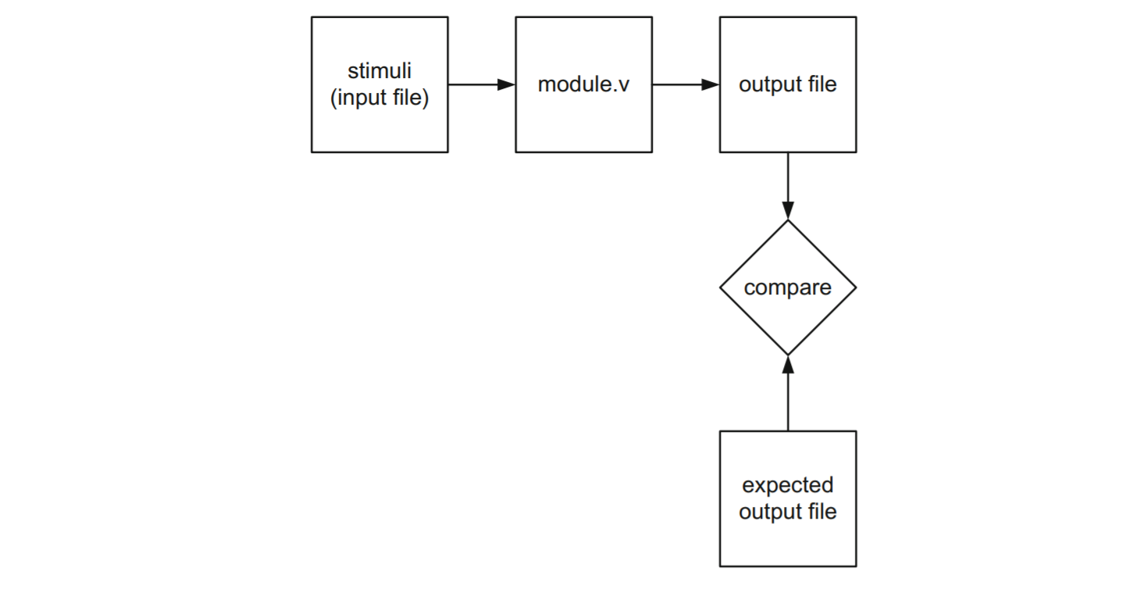

Slide 3
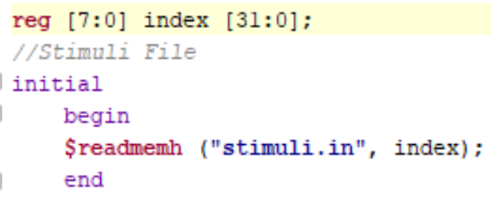
Stimuli
Required:
Memory
A text file
Import file into project
Use $readmemh to retrieve the data from the file

Slide 4
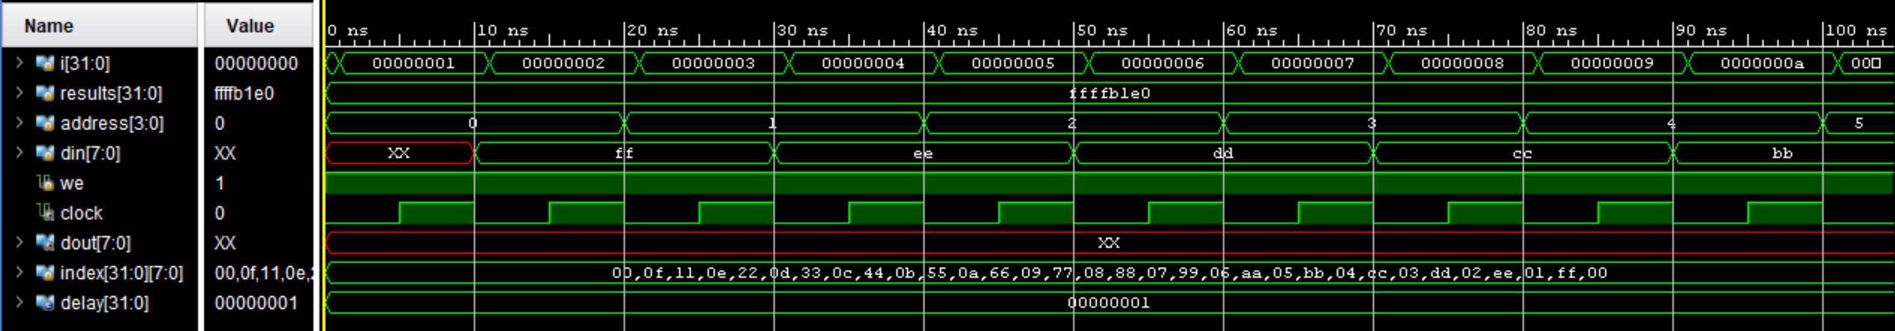
Using the data
Use the memory like an array
Contents stored in order on the file
First element is index [0]
nth element is index [n-1]
In simulations, all data is shown in order (Big Endian or Little Endian based on declaration)

Slide 5
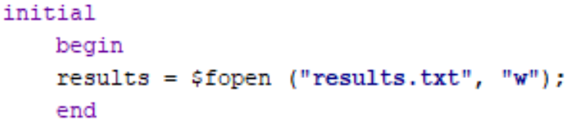
Writing to a file
Use $fopen
“w” represents writing to a file

Slide 6
Accessing the File
If you have the file set up in your project, it won’t write there.
Files are stored in the simulation folder
Root Project Folder > name.sim > sim_1 > behav

Slide 7
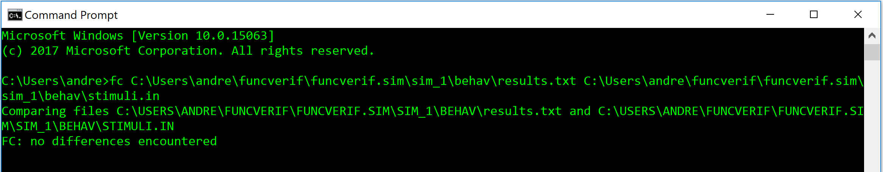
Compare
Create a file based on how information would be written if it was correct
Use C++, Notepad++, etc. to compare
fc on Windows Command Prompt

