Slide 1


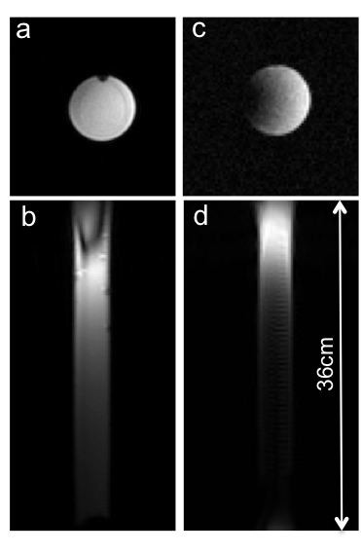
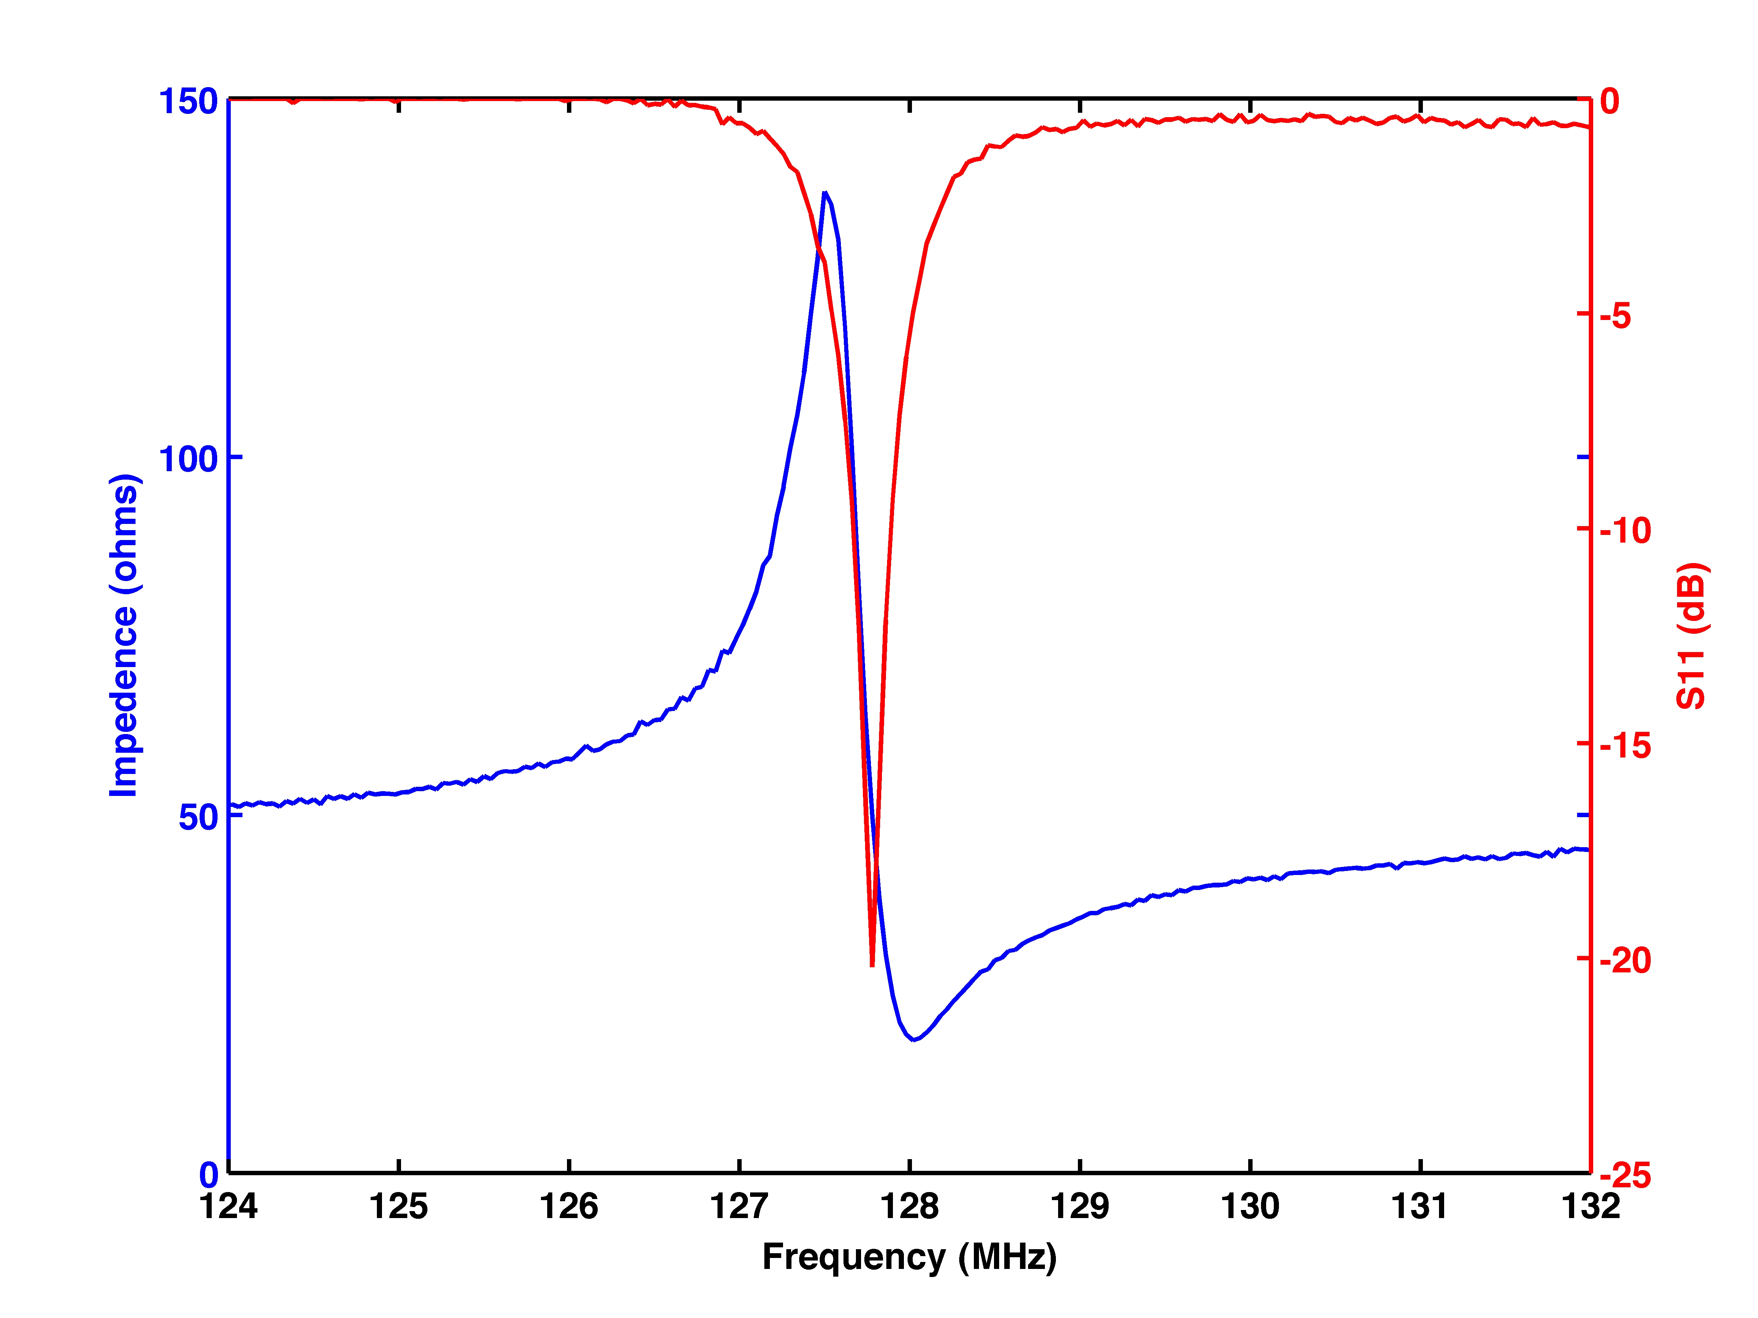
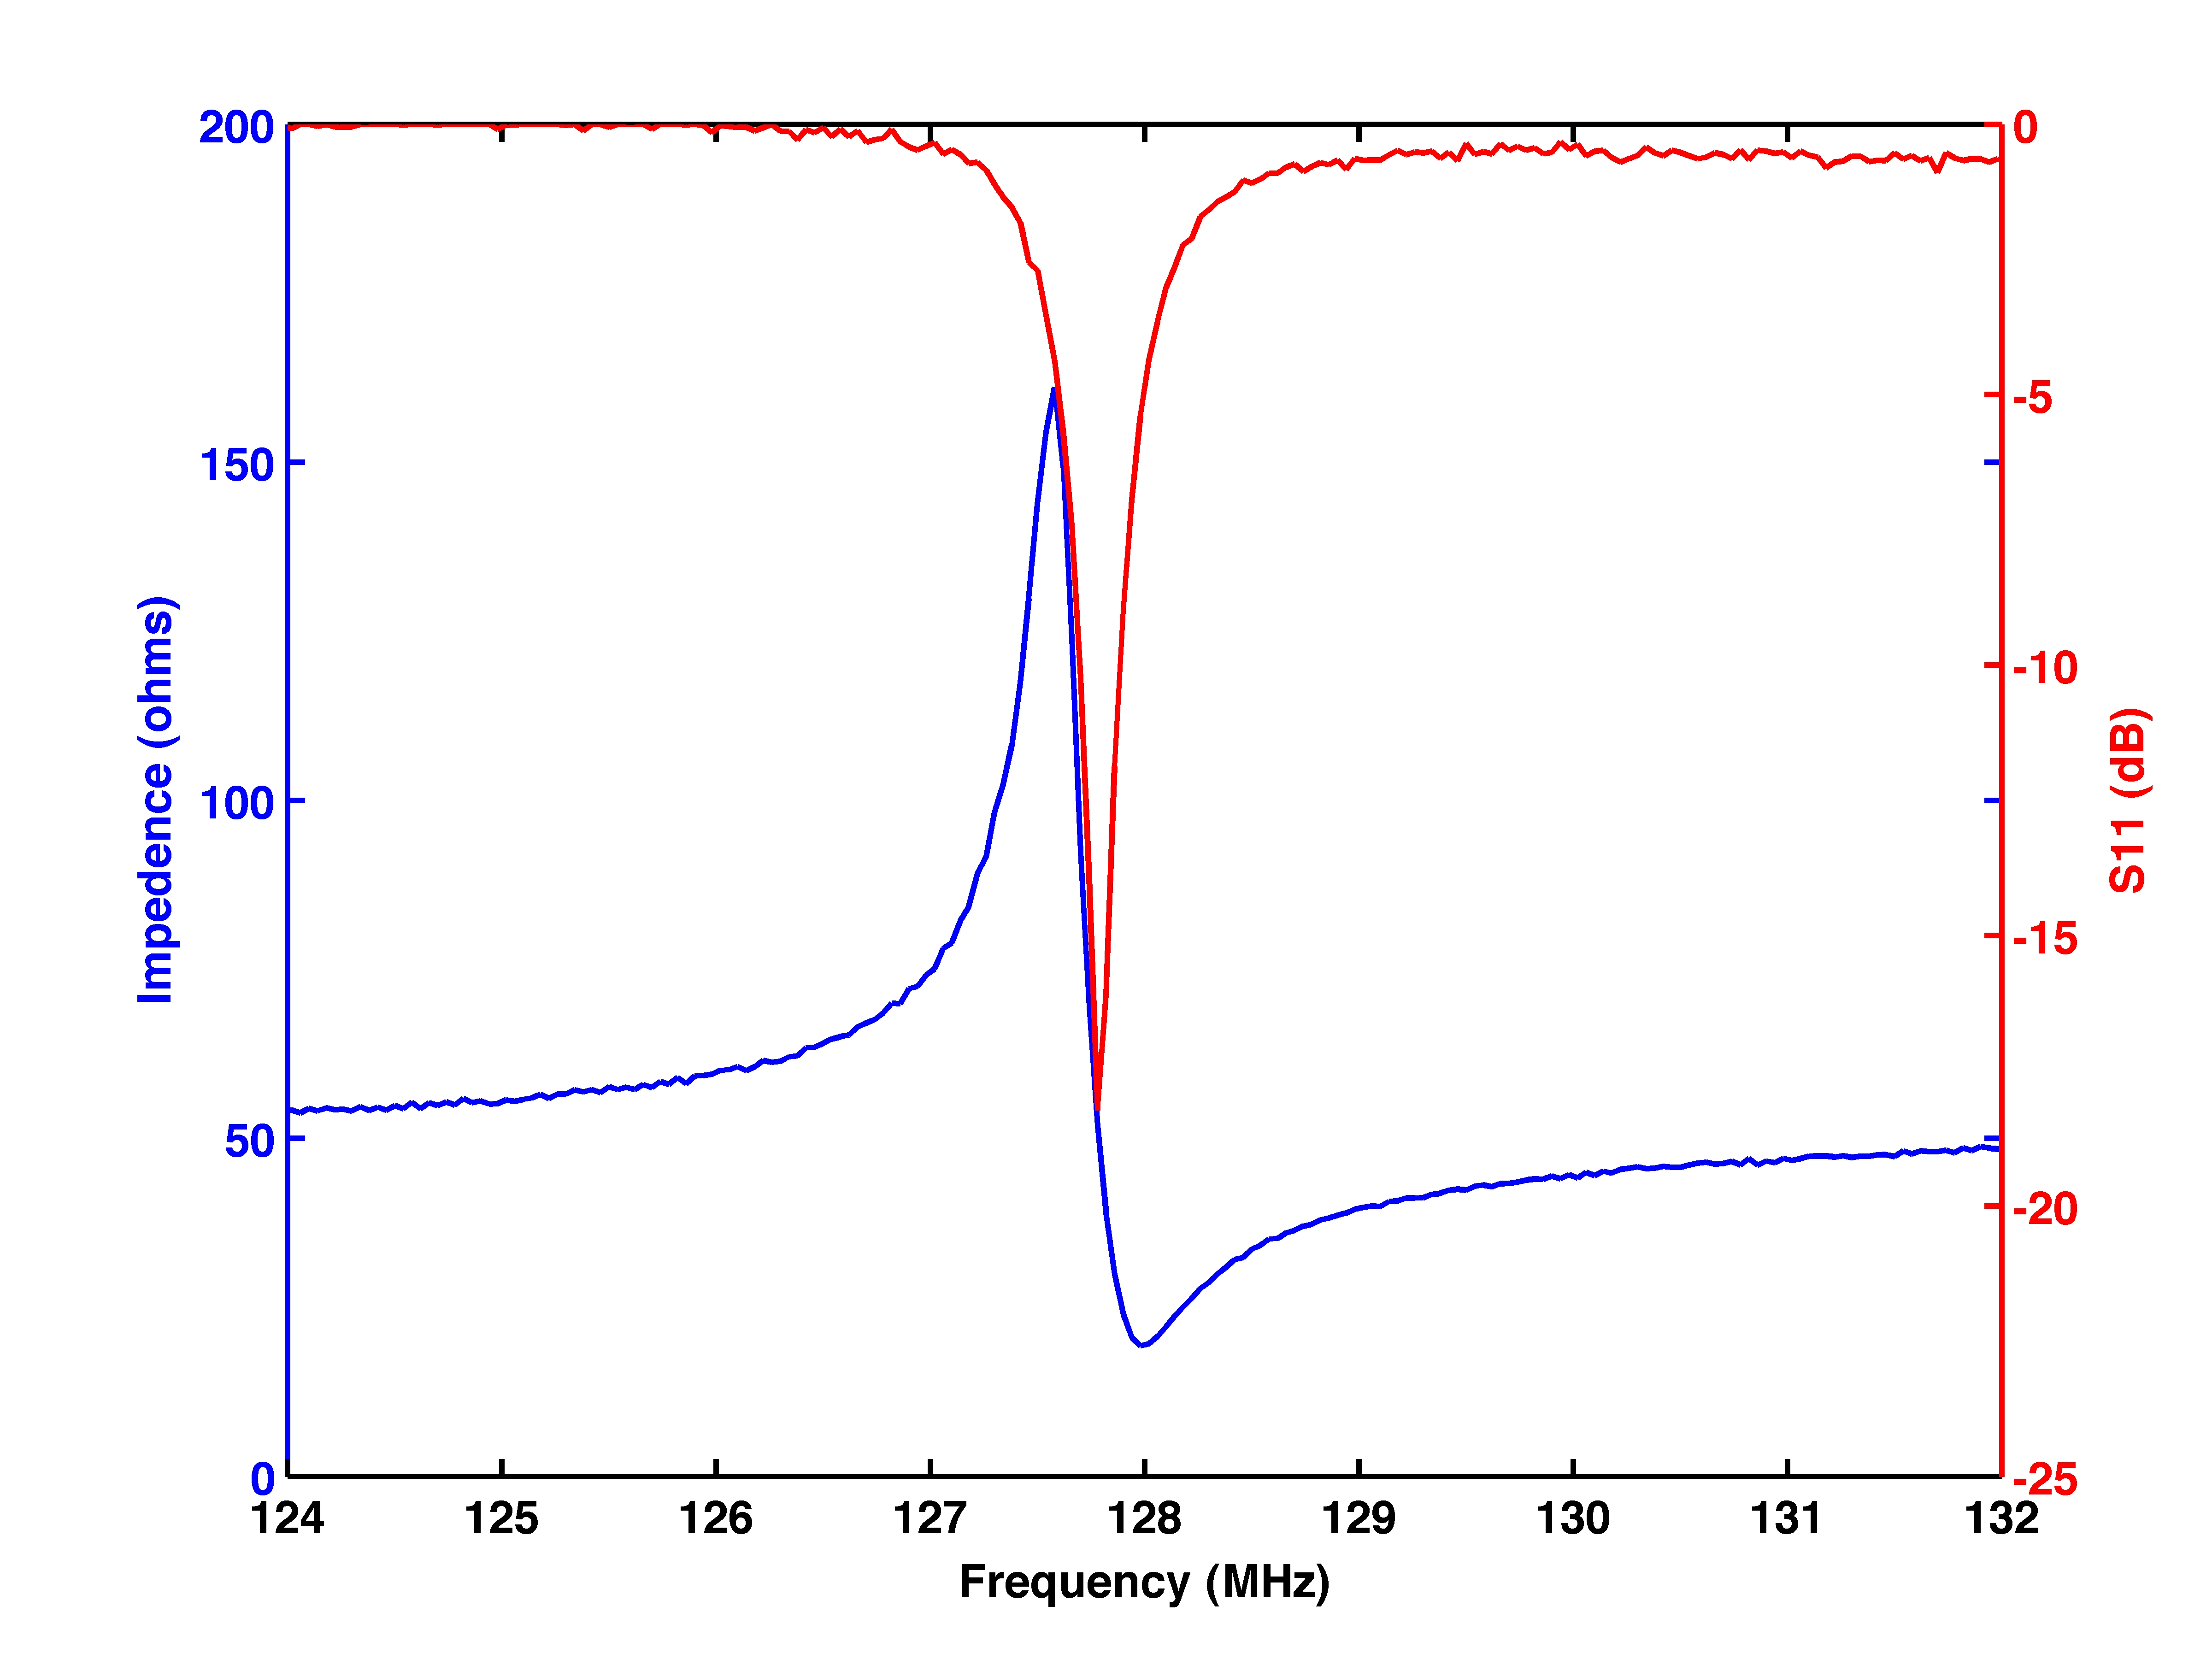
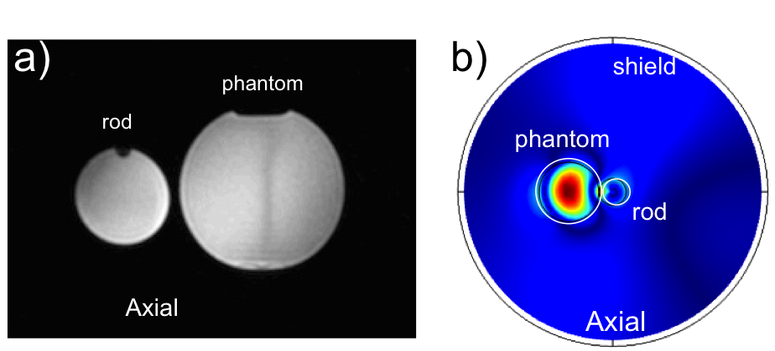
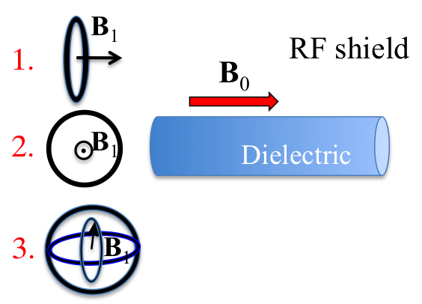


Circularly Polarized Coil
for Traveling Wave MRI
N.B. Konyer¹, A. A. Tonyushkin^{2,3}, A.J.M. Kiruluta^{2,3}, M.D. Noseworthy^{1,4}
¹Imaging Research Centre, St. Joseph’s Healthcare, Hamilton, Ontario, Canada
²Department of Radiology, Massachusetts General Hospital, Harvard Medical School, Boston, MA, USA
³Department of Physics, Harvard University, Cambridge, MA, USA
⁴Department of Electrical and Computer Engineering, McMaster University, Hamilton, Ontario, Canada
Introduction
Since its realization, most traveling wave (TW) imaging has been done in 7T preclinical MR scanners [1,2]. The typical excitation method for such a system is a patch antenna, which is a practical choice for the ultra high field with sufficient bore size (D~λ_{cr}). However, for systems with a small bore diameter-to-critical-wavelength ratio (λ_{cr}), the patch antenna approach, if possible at all, is not the best choice. Previously we have shown that TW excitation can be done with the loop-coil probes and a dielectric insert both at low [3] and ultra high field [4] MRI systems. The main problem with such probes, however, is the relatively low SNR due to linear polarization of the B₁ field.
Here we present a novel loop-coil probe concept allowing propagation of a circular polarized B₁ field. Unlike patch antennas, such probes can be used in systems with low bore diameter-to-critical-wavelength ratio, and can directly couple the TW mode to a dielectric waveguide or other load. We analyze the performance of this coil using an unmodified GE (Waukesha, WI, USA) Discovery 750 3T clinical system.
Figure 2 : MRI images of the tube filled with saline: (a) axial and (b) sagittal slices taken with circular polarized coils; (c) axial and (d) sagittal slices taken with linear polarized coil. Axial images were acquired at a distance of 30cm from the T/R coils.
Coil 1
Coil 2
Figure 1: (top) Schematic of 15cm diameter quadrature loop coils. Typical return loss plots (bottom, red curves) for the two orthogonal coils with minimum at -20dB and -18dB.
Materials and Methods
In our previous experiments [3], we utilized a parallel loop-coil probe [5], where its B₁ field was parallel to the B₀ field (insert 1). Alternatively, we used an orthogonal loop-coil with B₁ orthogonal to B₀ (insert 2). Neither of these probes allow for a circular polarized B₁ field. Our new probe consists of two loop-coils (diameter = 15cm) placed orthogonal to each other (insert 3), and positioned such that each B₁ field is orthogonal to B₀.
The loop-coils were mounted on an acrylic frame to ensure that they remain orthogonal, and hence completely decoupled. Isolation between the loops was measured to be -18dB. The loops were driven in quadrature using a quadrature hybrid splitter connected to the coil inputs. The quadrature hybrid divides the transmit signal in two, introduces a 90º phase shift between the divided signal to drive the two coils. The received MR signal also passes through the quadrature hybrid which serves to recombine the MR signal into a single line. A balun is present at each coil input to minimize currents flowing on the cable shields. The connection between the quadrature hybrid and scanner is accomplished using an interface board with a low-impedance preamplifier and coil-ID functionality. The coils were loaded with the dielectric rod inside the magnet bore and carefully tuned to 127.8 MHz, 50Ω impedance matched, with a typical return loss of less than -20dB for each loop-coil (Fig. 1b). In-bore tuning was accomplished using an MRI-compatible vector impedance analyzer (VIA Echo MRI, AEA technologies, Carlsbad, CA, USA).
Figure 3: MRI axial image with quadrature coils a) and simulations of B1 field map b) of a dielectric rod and a bottle phantom placed next to it and 20 cm away from the coils.
Figure 4: Sketch of experimental setup used to characterize the quadrature loop coils.
Results
We obtained images of the dielectric rod and compared it with a single loop-coil placed orthogonal to the guide edge (Figure 2). Data were acquired using a standard GRE pulse sequence: TR=100ms, TE=18.5ms, flip angle=45⁰, (128x128) matrix, FoV=240mm, slice=10mm, bandwidth=2.1kHz, 8 nex, 1:46 scan time, distance from coil to isocentre was 30cm.
To quantify coil performance, we measured the SNR in a 1-litre bottle of 0.9% saline imaged with both the quadrature (Figure 3a) and linear coils using an axial image on a slice 30cm from the edge of the coils. The SNR was 26.6 for the quadrature coils and 16.8 for the linear coil. Image uniformity was also greatly improved with the use of the quadrature coil.
Further examples of images, including biological samples, obtained with this coil are shown on poster 2798.
Conclusions
We have designed and evaluated a novel quadrature loop coil for TW excitation, which allows for a circular polarized B₁ field excitation. With a dielectric rod insert, the TW concept can be applied to clinical field strength (3T) MRI with the potential application of accessing hard to reach areas, as well as for dealing with B₁ field inhomogeneity issues at 3T. We have demonstrated a much higher SNR with the new coils than with the previously available linear polarized coils. The efficiency improvement at low field MRI also offers the opportunity to adapt far-field imaging concepts [7] to clinical applications. The coils are also suitable to replace a patch antenna TW excitation at ultra-high fields.
References
Brunner D.O. et al., Nature 2009, 457:994-999
Brunner D.O. et al., MRM 2011, 66:290-300
Tonyushkin A. Konyer N.B. et al., Proc. ISMRM 2012, 2698
Tonyushkin A. et al., Proc. ISMRM 2012, 2693
Webb A.G. et al., MRM 2010, 63:297-302
Tonyushkin A. and Kiruluta A.J.M, Proc. ISMRM 2011
Kiruluta A.J.M., JMR 2006, 182:308-314
For more information contact: nkonyer@stjoes.ca

