Slide 1
Course Number: ACCT6273
Course Title: Identifying Strategic Implications in Accounting Data
ID: Jason Yoshimura and Ryan Ohm
Instructor: Marjorie Platt and Julie Hertenstein
Media Title: Lille Tissages Class Discussion Question 6
Multi-media file name: NEU_MBA_ACCT6273_w02_m02
Activity Purpose:
Notes:
Developer Information
-----------------------------------------------
Activity Description: This area should provide a brief description of the activities contained within this media piece
Navigation: This section should provide a brief breakdown of the navigation types contained within this multi-media piece.

Slide 2
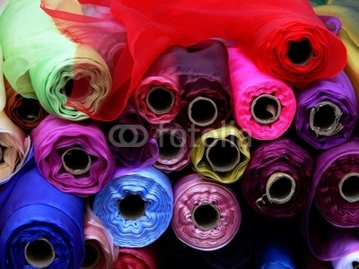
Screen #: 1.
Summary: cover slide
14563635
Lille Tissage
Begin
Navigation Notes: click begin to start activity
Notes:
Developer Information
Type: Click-on

Slide 3

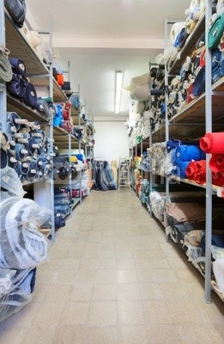
Screen #: 2.
Summary:
36292536, #44943954
What variable cost should be used for the competitors? Think about what you know about the competitors’ costs compared to Lille Tissages’ costs, and pick a variable cost for the competitors that you think might be reasonable (we will just use one variable cost for the competitors, regardless of volume). Only numbers between FF6.80 and FF10.00 can be accepted.
Variable Cost for Competitors:
FF____ per meter
Next
Navigation Notes: student will enter information in the provided area.. Only numbers between FF6.80 and FF10.00 can be accepted. Students click next to get to the next screen
Notes:
Developer Information
Type: Click-on
Voiceover: What variable cost should be used for the competitors? Think about what you know about the competitors’ costs compared to Lille Tissages’ costs, and pick a variable cost for the competitors that you think might be reasonable (we will just use one variable cost for the competitors, regardless of volume). Only numbers between FF6.80 and FF10.00 can be accepted.
Enter this information in the space provided.

Slide 4
Screen #: 3.
Summary:
36292536, #44943954
Using the variable cost you have estimated below are the competitors contributions per meter at prices of FF 15 and FF 20.
Variable Cost for Competitors:
FF____ per meter
Next
Navigation Notes: The number the student enters for the Variable Cost for Competitors is carried into the table for Competitors’ VC/meter in both columns. Competitors’ Price is given as FF 15.00 and FF 20.00 (as seen above). Contribution/meter is calculated as the difference between the two rows above. In this example the middle row would have 7.00 in both columns.
Notes:
Developer Information
Type: Click-on
Voiceover: Using the variable cost you have estimated, here are the competitors contributions per meter at prices of FF 15 and FF 20.

Slide 5
Screen #: 4.
Summary:
36292536, #44943954
What volume do you estimate for the competitors if Lille Tissages is at FF 20, and the competitors are at FF 15? Look back at what you thought was a reasonable volume for Lille Tissages in this situation, and the volume for the competitors will be the difference between Lille Tissages’ volume and 700,000.
Volume for competitors (FF 20 v. FF 15): ________ meters
What volume do you estimate for the competitors if Lille Tissages is at FF 20, and the competitors are at FF 20? Again, look at your earlier assumptions for Lille Tissages’ volume in this situation.
Volume for competitors (FF 20 v. FF 20): ________ meters
Back
Next
Navigation Notes: The answers from this slide will be included in the table on the following slide. Any number can be accepted – (the model numbers on the next slide are 625,000 and 525,000, respectively.). Next moves to screen 5 and back brings students back to screen 3
Notes:
Developer Information
Type: Click-on
Voiceover:
What volume do you estimate for the competitors if Lille Tissages is at FF 20, and the competitors are at FF 15? Look back at what you thought was a reasonable volume for Lille Tissages in this situation, and the volume for the competitors will be the difference between Lille Tissages’ volume and 700,000.
Input your answer in the top space provided.
Then consider what you estimate for the competitors if Lille Tissages is at FF 20, and the competitors are at FF 20? Again, look at your earlier assumptions for Lille Tissages’ volume in this situation.
Input your answer in the bottom space provided

Slide 6
Screen #: 5.
Summary:
36292536, #44943954
Total contribution can be estimated as follows:
Where do the competitors want to be? Where do they get a higher contribution, and, hence, higher profits?
Download
Finish
Navigation Notes: Competitors’ VC/meter is from Screen 2 (example above is assuming they enter in 7). Contribution/meter is the difference of the two rows above.
Competitor’s Volume is from Screen 4.
Total Contribution is Contribution/meter *Competitors Volume.
The student should be able to download as a PDF.
Notes:
Developer Information
Type: Click-on
Voiceover:
Total contribution estimates are depicted in the table shown. As you analyze the results, consider the following: Where do the competitors want to be? Where do they get a higher contribution, and, hence, higher profits?
Click the download button to retrieve a copy of table.

