Slide 1
Course Number: PM512
Course Title: Principles in Epidemiology
ID: Justin Lamberson
Instructor: Roberta McKean-Cowdin
Media Title: Validity and Reliability of Tests
Multi-media file name: PM512-w12-m01.pptx
Date: 3/22/13
Activity Purpose:
Hybrid activity getting students to apply equations they are learning.
Notes:
Developer Information
-----------------------------------------------
Activity Description: Hybrid activity getting students to apply equations they are learning.
Navigation: 1 hub, click on, fill in (x3), presentations (X5)
1

Slide 2

Screen #: 1.1.
Summary: Alexander Raths #36759360
Diagnostic Tests
Screening Tests
Used for persons in whom disease is suspected, due to symptoms, physical findings, or laboratory findings.
Diagnostic Tests can be:
Invasive,
dangerous,
expensive,
not feasible on large groups of people,
time consuming
used for identifying early signs of a disease in people with no signs or symptoms of the disease.
usually separates an asymptomatic population into:
  those who almost certainly do not have the disease and
  those who may have it.
Follow screen with a diagnostic workup to determine whether those who screened positive in fact have the disease before treatment is started.
Versus
Navigation Notes:
Notes:
Developer Information
Type: Presentation
Voiceover: In today’s presentation, we are going to discuss the validity and reliability of screening tests.
Screening tests are used to identify people in early stages of disease, who are not yet symptomatic. Screening tests are used to separate the population into those who might have the disease and those who are very unlikely to have the disease. Typically, those who test positive based on the screening test will be retested using a diagnostic test.
A diagnostic test is a more definitive test that is usually done in people who are suspected to have the disease due to symptoms, physical findings, or laboratory screening results.
Diagnostic tests are usually not done on an asymptomatic population because they are often expensive, they may be invasive, and there may be physical risks associated with taking them.
2

Slide 3

Screen #: 2.1
Summary: Click on hub amadeusz #43371612
Validity Test
Reliability Test
Relation between Validity and Reliability
Navigation Notes: This is a click on hub activity. Validity test launches slide 4. Reliability test launches slide 21, Relation launches slide 25.
Notes:
Developer Information
Type: Click-on
3

Slide 4
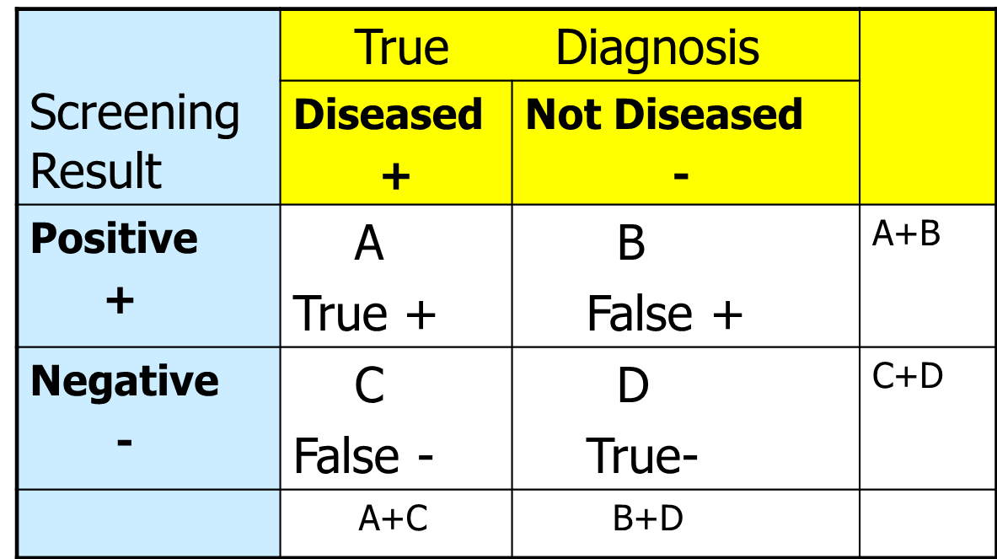
Screen #: 3.1
Summary: sequential click and reveal activity.
Validity
Navigation Notes: this slide will have the instructions pop up at the beginning. When Instructions are closed a question popup will come up. First question is on the next slide. User will need to click on the white boxes with text. They will need to select two items in sequence to fill in an equation. Feedback will be provided for correct and incorrect answers.
Animation Notes: Look of this slide can be improved at developers discretion.
Notes:
Developer Information
Type: Click-on
Instructions Pop-Up: Validity is a measure of accuracy in relation to the truth. A special 4-fold table is used to evaluate the indices of validity. The screening test results, positive or negative, are displayed along the left side (rows) and the person’s “true” disease status based on the diagnostic gold-standard test is indicated at the top (columns). The people who correctly screen positive or correctly screen negative are shown in cells A and D. The people who falsely screen positive or falsely screen negative are shown in cells B and C. We use this table to evaluate the clinical usefulness of a test by comparing the results of the screening test under evaluation with those derived from a definitive diagnostic procedure (“gold standard”).
You will determine how to calculate the sensitivity, the specificity, the predictive value positive, and the predictive value negative of the test.
4

Slide 5
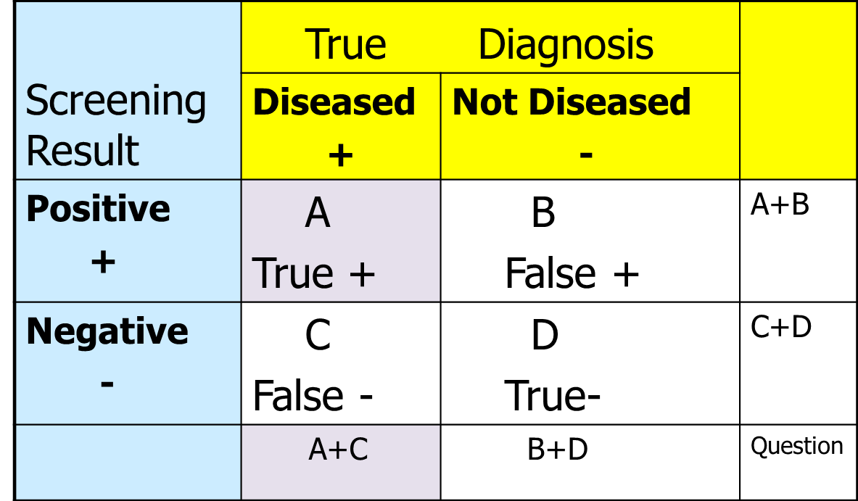
Screen #: 3.1a
Summary: sequential click and reveal activity.
Navigation Notes: this slide will have the question pop up at the beginning. When question is closed user will need to click on the white boxes with text. They will need to select two items in sequence to fill in an equation. Feedback will be provided for correct and incorrect answers. Question button opens up current question again. Purple items are correct answers, order of selection is select A first and then A+C. Question on next slide comes up after correct popup is closed.
Animation Notes: Look of this slide can be improved at developers discretion.
Notes:
Developer Information
Type: Click-on
Question Pop-Up: Sensitivity
Sensitivity is the proportion of persons with disease who test positive using the screening test. It determines the test’s ability to correctly identify individuals who truly have the disease. In other words, it is the proportion or probability that a person will test positive if they truly have the disease.
Use this information to select the cells from the table that are used to calculate sensitivity: ____ / _____
Note: Select the numerator first and then the denominator.
Correct: Well done. You’ve taken all the people who were accurately tested as positive (in other words, the true positives) and divided it by all the people who have the disease.
Incorrect: Try again, your selection does not measure the sensitivity of the test. Remember to select your numerator first.
5

Slide 6
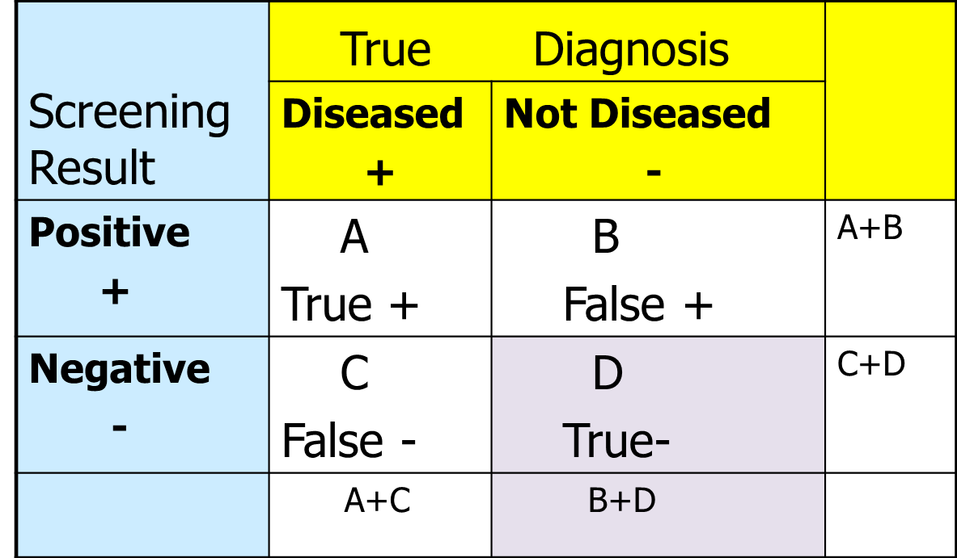
Screen #: 3.1b
Summary: sequential click and reveal activity.
Navigation Notes: this slide will have the question pop up at the beginning. When question is closed user will need to click on the white boxes with text. They will need to select two items in sequence to fill in an equation. Feedback will be provided for correct and incorrect answers. Question button opens up current question again. Purple items are correct answers, order of selection is select D first and then B+D. Question on next slide comes up after correct popup is closed.
Animation Notes: Look of this slide can be improved at developers discretion.
Notes:
Developer Information
Type: Click-on
Question Pop-Up: Specificity
Specificity is the proportion of persons without the disease (true negatives) who test negative. It helps determine the test’s ability to correctly identify individuals who truly do not have disease. It gives us the probability the test will be negative if a subject truly does not have the disease.
Use this information to select the cells of the table that are used to calculate specificity: ____ / _____
Note: Select the numerator first and then the denominator.
Correct: Well done. You’ve taken all the people who were accurately tested negative and divided it by all the people who do not have the disease.
Incorrect: Try again, your selection does not measure the specificity of the test. Remember to select your numerator first.
6

Slide 7
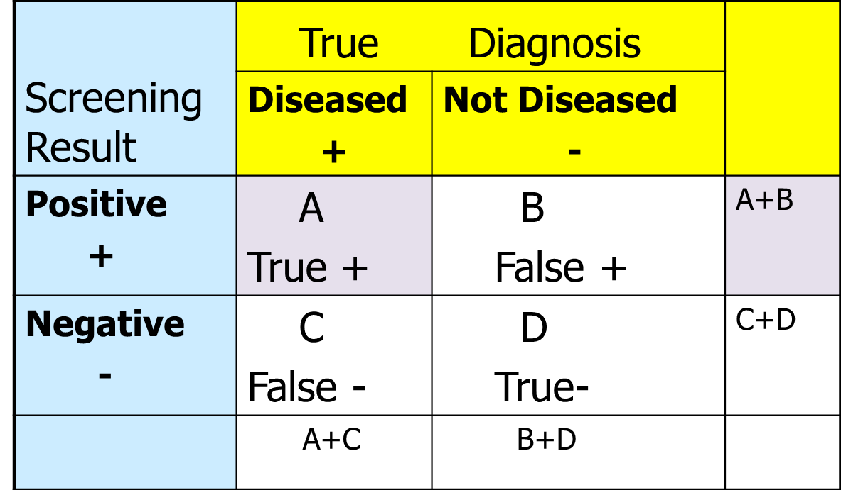
Screen #: 3.1c
Summary: sequential click and reveal activity.
Navigation Notes: this slide will have the question pop up at the beginning. When question is closed user will need to click on the white boxes with text. They will need to select two items in sequence to fill in an equation. Feedback will be provided for correct and incorrect answers. Question button opens up current question again. Purple items are correct answers, order of selection is select A first and then A+B. Question on next slide comes up after correct popup is closed.
Animation Notes: Look of this slide can be improved at developers discretion.
Notes:
Developer Information
Type: Click-on
Question Pop-Up: Predictive Value Positive (PVP)
Predictive value positive is the predictive value of a positive test. It gives us the proportion of persons testing positive who truly have the disease. This is also described as the test ‘yield.’ It is used to answer the question, “now that a person has tested positive, what is the probability that he or she truly has the disease?”
Use this information to select the elements on the chart that will make up the equation that will determine PVP: ____ / _____
Note: Select the numerator first and then the denominator.
Correct: Well done. You’ve taken all the people who were accurately tested positive and divided it by all the people who tested positive.
Incorrect: Try again, your selection does not measure PVP. Remember to select your numerator first.
7

Slide 8
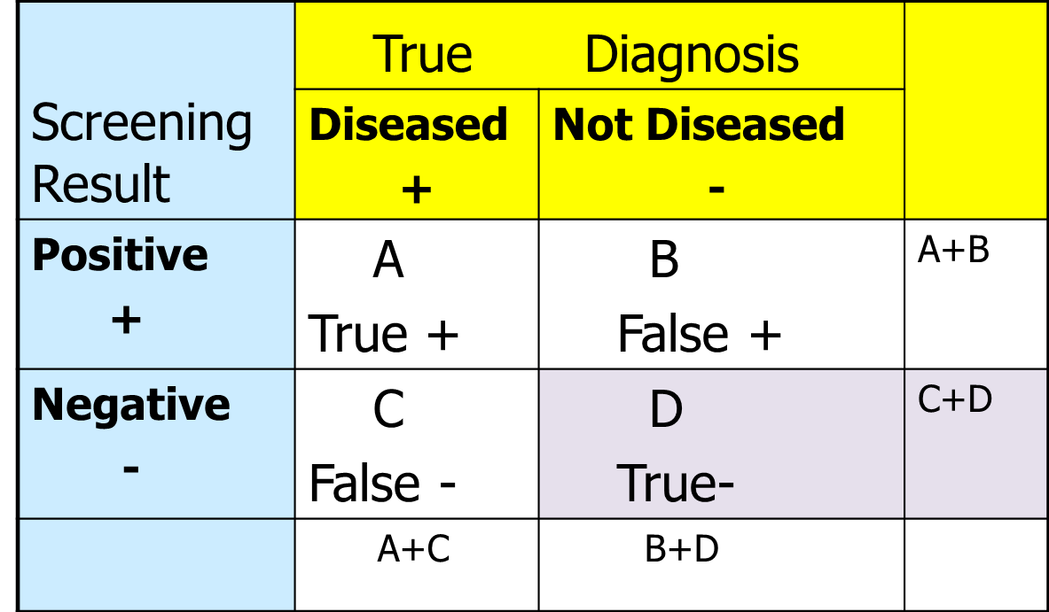
Screen #: 3.1d
Summary: sequential click and reveal activity.
Navigation Notes: this slide will have the question pop up at the beginning. When question is closed user will need to click on the white boxes with text. They will need to select two items in sequence to fill in an equation. Feedback will be provided for correct and incorrect answers. Question button opens up current question again. Purple items are correct answers, order of selection is select D first and then C+D. Question on next slide comes up after correct popup is closed.
Animation Notes: Look of this slide can be improved at developers discretion.
Notes:
Developer Information
Type: Click-on
Question Pop-Up: Predictive Value Negative (PVN)
Predictive value negative is the predictive value of a negative test. It gives us the proportion of persons testing negative who truly do not have the disease.
Use this information to select the cells of the table that are used to calculate PVN: ____ / _____
Note: Select the numerator first and then the denominator.
Correct: Well done. You’ve taken all the people who were accurately tested negative and divided it by all the people who tested negative.
Incorrect: Try again, your selection does not measure PVN. Remember to select your numerator first.
8

Slide 9
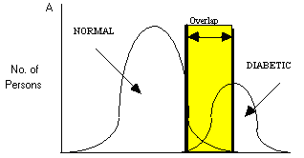
Screen #: 4.1
Summary: Presentation
Blood Glucose Levels
Sensitivity
Specificity
Animation Notes: Start off the slide without showing the yellow area. Show yellow area when VO says “highlighted portion”. When VO says “left side” animate the left wall of the yellow area to move back and forth a few pixels. Same with the right wall when the VO says “right side”. Move the left wall of the yellow area to the left when the VO says “as the cut point is lowered”. Move it only a few pixels. As this moves animate the sensitivity scroller to move up and the specificity scroller to move down proportionally.
Notes:
Developer Information
Type: Presentation
Voiceover: Many screening tests produce results on a continuous scale. For example blood pressure for hypertension or blood glucose levels for diabetes. Sensitivity and specificity depend upon classifying test results as “normal” or “abnormal” based on whether they exceed some specified “cut point”.
In this graph you can see the distribution of blood glucose levels for normal or healthy individuals on the left and for diabetic individuals on the right. The highlighted portion represents overlap between glucose values for healthy or normal individuals and those who are diabetic. Whether you select a low or high blood glucose value to separate normal from diabetic people using the screening test, you will misclassify some individuals because of the overlap of glucose values between the 2 populations. Using the lower blood glucose cut point (the line on the left), some normal or healthy people will be classified as diabetic. Using the higher blood gluose cut point (the line on the right) you will classify some diabetic patients as normal.
To select a cut point, compare the distribution of values in healthy and diseased groups. Usually the two distributions will overlap, so no single value perfectly separates the two groups. The sensitivity and specificity of the test depend on the cut point and the degree of overlap in values between the 2 groups. As the cut point is lowered, more diseased individuals will test positive (assuming high values represent disease), so the sensitivity will increase. However, more non-diseased individuals will also test positive, so, the specificity will simultaneously decrease.
9

Slide 10
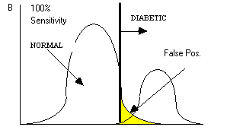
Screen #: 4.2
Summary: Presentation
No. of Persons
Blood Glucose Levels
Animation Notes: Have the “diabetic line” start at the valley between the two curves. Move it left so it arrives at it’s current position in the image when the VO says “All diabetic people”. Animate the lines and terms for the “Normal and False Pos. to appear when VO says “”you will call some “.
Notes:
Developer Information
Type: Presentation
Voiceover: Now if you set the cut point low for calling someone “diabetic” then you will identify ALL the diabetic people correctly, but you will call some people diabetic who are normal. These are our false positives. Our test is 100% sensitive, because all person with diabetes are to the right of our cut point, but our specificity is much lower so we’ve identified a large number of false positives.
10

Slide 11
Screen #: 4.3
Summary: Presentation
Blood Glucose Levels
Animation Notes: At start of VO do not display yellow portion, only show the overlapping curves underneath. When Vo says “cut point” draw attention to the left line of the “overlap area” as the left line appears. When VO says “overlap” have the term overlap and the rest of the yellow area fill in.
Notes:
Developer Information
Type: Presentation
Voiceover: It is important to note that the sensitivity and specificity of a test are independent of the prevalence of undetected disease in the population being tested. Sensitivity and specificity depend upon the cut point used to classify individuals as diseased or non-diseased and the extent of overlap between the distribution of values for normal and diseased persons.
11

Slide 12
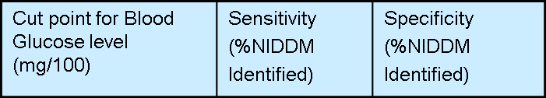


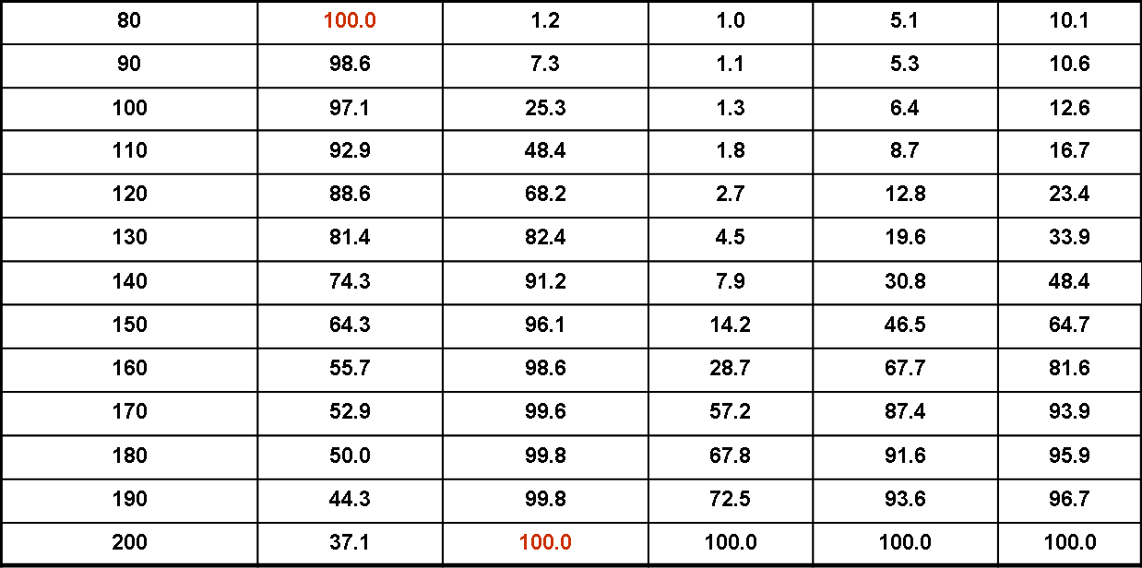
Screen #: 4.4
Summary: Presentation
Animation Notes: When VO says “different prevalence rates” highlight the red 1%, 5%, and 10% in sequence. When VO says “sensitivity is at its highest” highlight the red 100 in the row of 80. When VO says “specificity is highest” highlight the red 100 in the row of 200.
Notes:
Developer Information
Type: Presentation
Voiceover: Here is another way to look at this information. This chart shows the sensitivity, specificity, and predictive value positives of a 2-hour postprandial blood glucose assuming different cut points for blood glucose to diagnosis diabetes and different prevalence rates of diabetes in the population to be screened. Notice that our sensitivity is at its highest when we set the blood glucose cut point low. We are able to capture all cases of diabetes, however we’re also going to have a fair number of false positives. Our specificity is highest when we set the glucose cut point very high and therefore we don’t identify any healthy people as diabetic. However, when our definition of diabetes is very specific (in other words the glucose cutpoint is high) we will miss diagnosing some cases of diabetes. Finally, notice that predictive value positive increases as specificity increases and as prevalence increases.
12

Slide 13
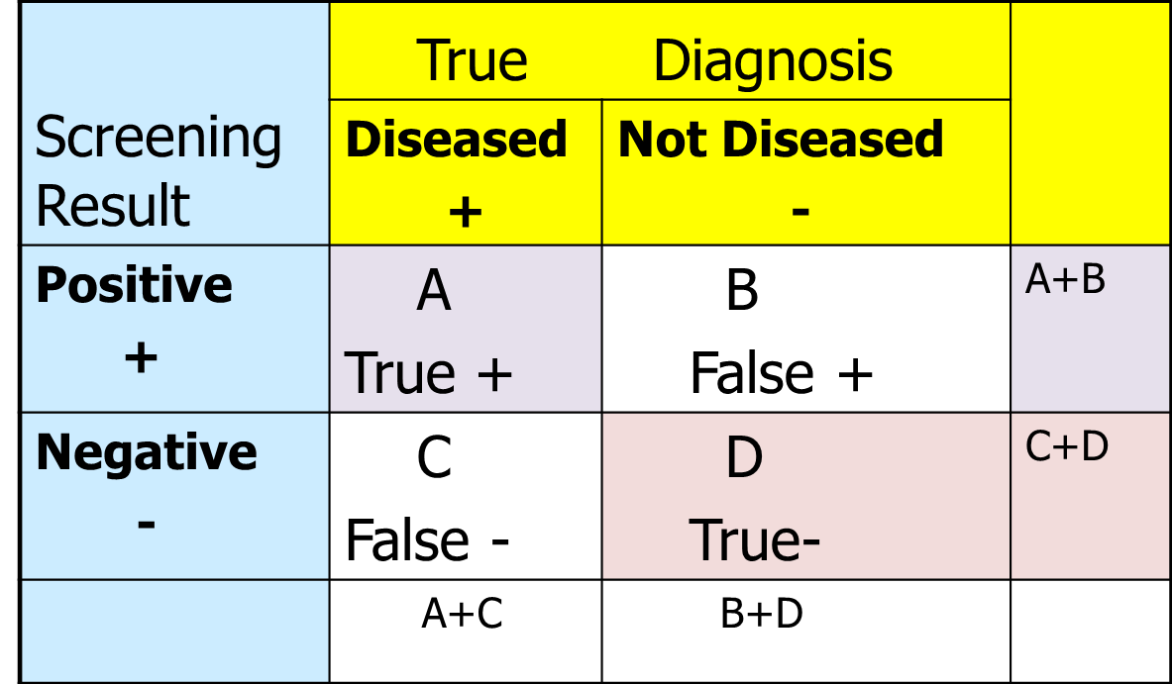
Screen #: 4.5
Summary: Presentation
= 30
= 25
= 55
= 20
= 100
= 120
= 50
= 125
Animation Notes: When VO says “prevalence of the target disease increases” have the number for A go up. Also adjust the A+B and A+C numbers as well Also increase the number in C at a slower rate. So if A is increasing by 5, have C increase by 2 or 3. Then also adjust the C+D and A+C areas as well. When VO says Predictive Value Positive, highlight the purple cells. When the VO says Predictive Value Negative highlight the red squares.
Notes:
Developer Information
Type: Presentation
Voiceover: Predictive values, however, depend heavily on the prevalence of undetected disease in the population being screened. So as the prevalence of the target disease increases, the Predictive Value Positive (PVP) will increase. Also as prevalence increases, the Predictive Value Negative (PVN) will decrease, but not as dramatically as predicitve value positive.
13

Slide 14


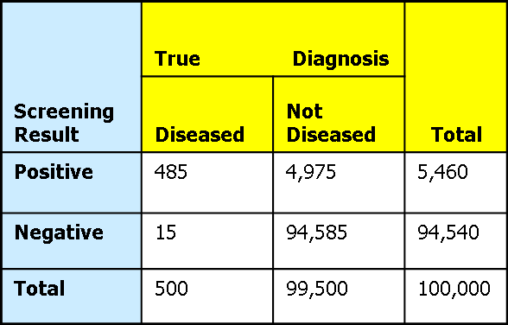
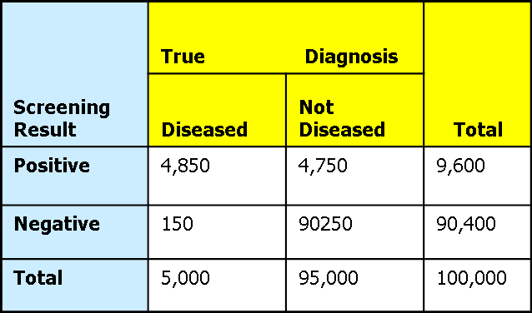
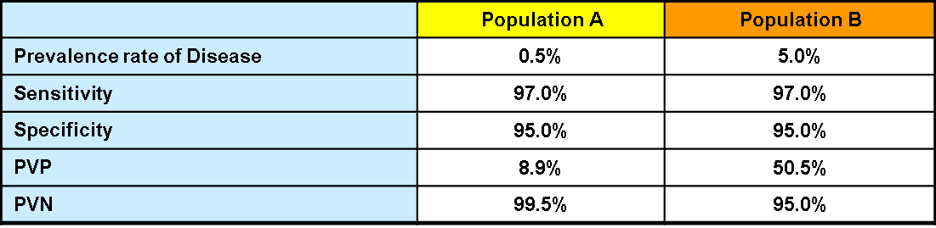
Screen #: 5.1a
Summary: Interactive fill-in slide.
Instructions
Navigation Notes: Students will be calculating Sensitivity, specificity, PVP, PVN. Have those areas on the bottom chart empty, they will be fill in areas. The answers shown are the correct answers. Instructions will be shown at beginning of slide and will be accessible through a button on the side. Finally, Sensitivity, Specificity, PVP, and PVN are all buttons that open a popup indicated in the notes. User cannot advance until all correct answers are filled in.
Animation Notes: Media developer may use their discretion to improve the look of this slide.
Notes:
Developer Information
Type: Fill-in
Instructions: Here is some example information that you can use to calculate the sensitivity, specificity, PVP, and PVN. Fill in the values in the chart provided. If you need to refresh your memory on the equation to use, simply click on the item you are trying to calculate for. So if you needed to see the equation for sensitivity, you can click on sensitivity. Enter your answers as percentages; include one decimal place. You will not be able to advance in the presentation until you fill in all the correct values.
Sensitivity: Sensitivity is the proportion of persons with disease who test positive. You would take those who have tested positive and truly have the disease (true positives) and then divide that by the total number of people who truly have the disease.
Specificity: Specificity is the proportion of persons without the disease who test negative. You would take those who have tested negative and truly do not have the disease (true negatives) and then divide that number by the total number of people who are not diseased.
PVP: Predictive value positive is the predictive value of a positive test. You would take those who tested positive who truly have the disease (true positives) and then divide that number by the total number of people who screen tested positive.
PVN: Predictive value negative is the predictive value of a negative test. You would take those who tested negative who truly did not have the disease (true negatives) and then divide that number by the total number of people who screen tested negative.
14

Slide 15


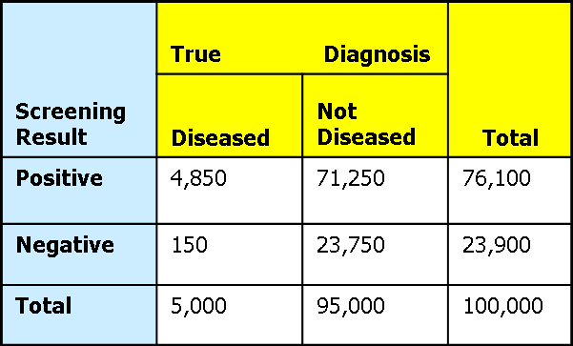
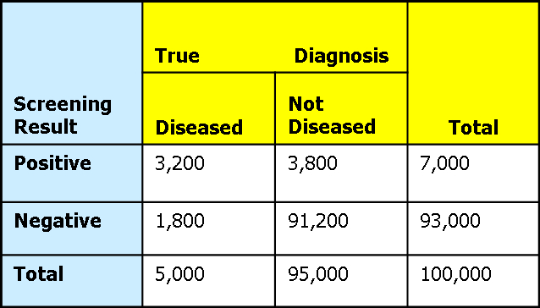

Screen #: 5.1b
Summary: Interactive fill-in slide.
Instructions
Navigation Notes: Students will be calculating Sensitivity, specificity, PVP, PVN. Have those areas on the bottom chart empty, they will be fill in areas. The answers shown are the correct answers. Instructions will be shown at beginning of slide and will be accessible through a button on the side. Finally, Sensitivity, Specificity, PVP, and PVN are all buttons that open a popup indicated in the notes. User cannot advance until all correct answers are filled in. Feedback is shown when all answers are correct.
Animation Notes: Media developer may use their discretion to improve the look of this slide.
Notes:
Developer Information
Type: Fill-in
Instructions: Here is another set of example information that you can use to calculate the sensitivity, specificity, PVP, and PVN. Fill in the values in the chart provided. If you need to refresh your memory on the equation to use, simply click on the item you are trying to calculate for. So if you needed to see the equation for sensitivity, you can click on sensitivity. Enter your answers as percentages; include one decimal place. You will not be able to advance in the presentation until you fill in all the correct values.
Note that this data is comparing a test with a low specificity and high specificity. Take special notice of how each parameter you are measuring is affected by specificity.
Sensitivity: Sensitivity is the proportion of persons with disease who test positive. You would take those who have tested positive and truly have the disease (true positive) and then divide that by the total number of people who truly have the disease.
Specificity: Specificity is the proportion of persons without the disease who test negative. You would take those who have tested negative and truly do not have the disease (true negatives) and then divide that number by the total number of people who are not diseased.
PVP: Predictive value positive is the predictive value of a positive test. You would take those who tested positive who truly have the disease (true positive) and then divide that number by the total number of people who tested positive.
PVN: Predictive value negative is the predictive value of a negative test. You would take those who tested negative who truly did not have the disease (true negative) and then divide that number by the total number of people who tested negative.
Feedback: Well done. Specificity does not affect prevalence, in this example prevalence was the same for both at 5%. Sensitivity was higher for the test that had a lower specificity and lower for the test that had higher specificity. PVP, when prevalence is constant, went higher as specificity went higher. PVN remained relatively the same.
15

Slide 16
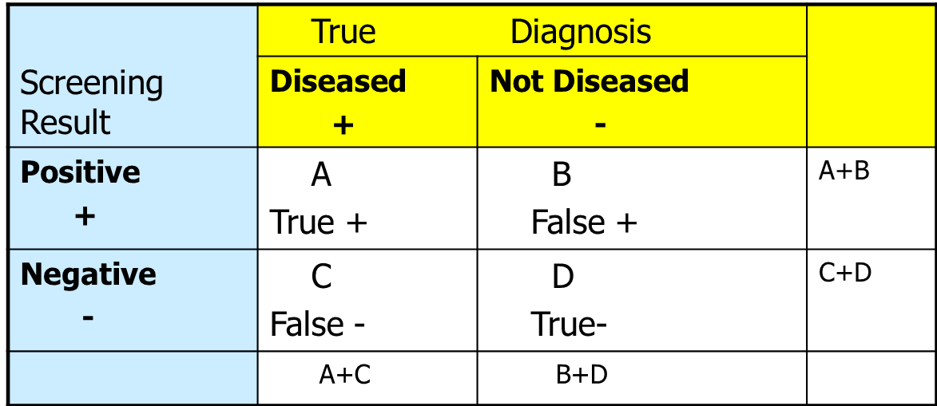
Screen #: 6.1
Summary: Presentation
Validity: Determinants of Predictive Values
PVP increases when prevalence of undetected disease increases.
= 30
= 25
= 55
= 20
= 100
= 120
= 50
= 125
Animation Notes: When VO says “Predictive value positive increases” have the number for A go up. Also adjust the A+B and A+C numbers . When VO says “PVP also increases”, decrease the number in B. Also adjust the A+B and B+D numbers.
Notes:
Developer Information
Type: Presentation
Voiceover: Predictive value positive increases when the prevalence of undetected disease increases. This causes an increase in cell A, which are the true positives. The PVP also increases as the specificity of the screening test increases. This causes a decrease in the false positives in cell B.
16

Slide 17
Screen #: 6.2
Summary: Presentation
Validity: Determinants of Predictive Values
Sensitivity and specificity in rare diseases.
= 10
= 15
= 25
= 5
= 100
= 105
= 15
= 110
Animation Notes: When VO says “This means that specificity has” highlight cell B.
Notes:
Developer Information
Type: Presentation
Voiceover: PVP would also increase slightly if the sensitivity could be increased without decreasing the specificity, but usually an increase in the sensitivity of a screening test involves changing the cut point in a direction that will decrease the specificity. For a rare disease, this will tend to increase the B cell proportionally more than the A cell, resulting in an overall decrease in PVP. For a rare disease there are fewer people in the diseased column; most people in the population will be not diseased. This means that specificity has a big impact on cell B when disease is rare. In those situations, cell B tends to dominate the equation.
17

Slide 18
Screen #: 6.3
Summary: Presentation
Validity: Determinants of Predictive Values
Predictive Value Negative decreases (slightly) when the PVP increases.
= 10
= 15
= 25
= 5
= 100
= 105
= 15
= 110
Animation Notes: When VO says “This is because there” highlight cell D.
Notes:
Developer Information
Type: Presentation
Voiceover: The final determinant of predictive values is that Predictive Value Negative decreases slightly when Predictive Value Positive increases. The magnitude of the change is much less than the corresponding change in PVP, as long as the disease is reasonably rare. This is because there will almost always be a large number of true negatives in the population, which forms both the numerator and most of the denominator of the PVN.
18

Slide 19
Screen #: 6.4
Summary: Presentation
Validity: Two Stage Testing
1. Net sensitivity = Sensitivity[Test 1] x Sensitivity[Test 2]
2. Net specificity = Specificity[Test 1] +
Specificity[Test 2] (1 - Specificity[Test 1])
Notes:
Developer Information
Type: Presentation
Voiceover: Now lets look at indices of validity for two stage testing. Two stage testing usually involves using a more expensive or more invasive test only after an initial less expensive, less invasive, or less uncomfortable test results in a positive. From these two tests we can then determine net sensitivity and net specificity.
19

Slide 20

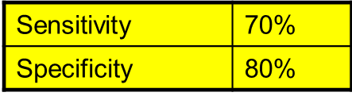
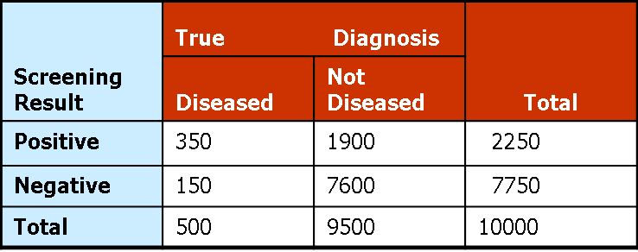

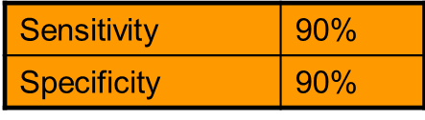
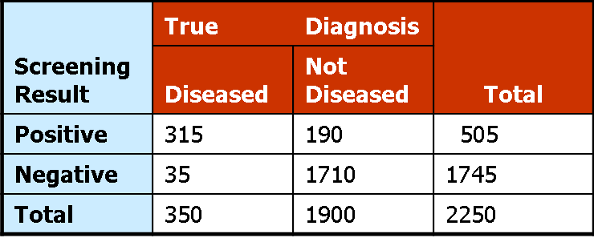
Screen #: 7.1
Summary: This is a fill in slide.
Net sensitivity =
Sensitivity [Test 1] x Sensitivity [Test 2]
= ________
Net sensitivity =.70 X .90 = .63
Also… 315/500 =.63
Net specificity =
Specificity [Test 1] + Specificity [Test 2] (1 – Specificity [Test 1] )
= ________
Net specificity = .80 +.90(1-.80) =.98
Also… (7600 + 1710)/9500 =.98
Navigation Notes: blank places are fill in areas. They must get the answer show in the margin. Top answer is .63 and bottom answer is .98. Answers must be correct to continue. Allow students to return to slide 3 if after completion of this activity. Highlight answer in red if wrong. If after second try still wrong, populate correct answer.
Notes:
Developer Information
Type: fill in
Instructions: Determine the Net Sensitivity and Net Specificity of these tests using the formulas provided. Write your answers in the space provided. Report sensitivity and specificity as a percent rounded to the nearest whole number (no decimal place). Answers must be correct to continue.
20

Slide 21
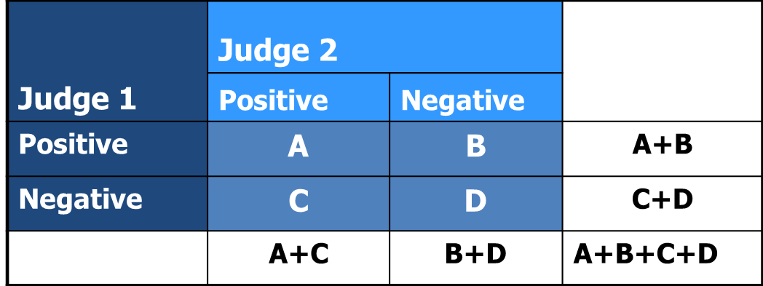
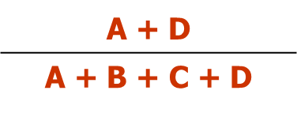
Screen #: 8.1
Summary: Presentation
Reliability of Tests
Overall percent agreement =
(% observed agreement)
Notes:
Developer Information
Type: Presentation
Voiceover: Now lets look at the reliability of a test. Reliability is a measure of repeatability. It can be evaluated by testing and retesting. When we repeat this test, it is important to ask, do we get the same answer every time? Reliability can be determined when the same person is taking a measurement at different times, or 2 different people are taking the same measurement. Interjudge reliability is an indicator of how reliable answers are from 2 different judges.
We can evaluate reliability for a simple dichotomous outcome using a 2 by 2 table. The calls of judge 1 (positive or negative) are described in the rows and the calls of judge 2 are described in the columns. Cells A and D indicate where there was agreement between the judges, while cells Band C indicate whether they disagreed. To determine the overall percentage of agreement, you would take the sum of cells A and D and then divide that by the total number of calls, which is the sum of A, B, C, and D. Pefect agreement would be 1, or 100% and 0 would be perfect disagreement.
21

Slide 22
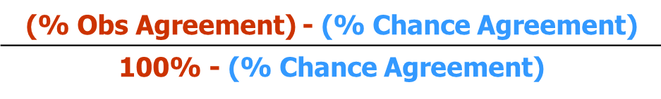
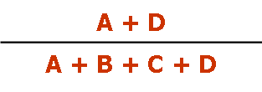
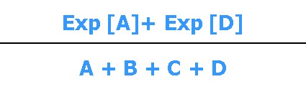
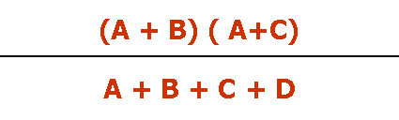
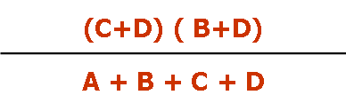
Screen #: 8.2
Summary: Presentation
Reliability of Tests: Kappa Statistic
Kappa =
Kappa statistic: Percent agreement beyond chance
% observed agreement =
% chance agreement =
Exp [A]=
Exp [D]=
Notes:
Developer Information
Type: Presentation
Voiceover: One problem with using the overall percent agreement is that we would expect the judges to agree some of the time just based on chance. A measure of reliability that accounts for chance agreement is the Kappa statistic. The kappa statistic is a measure of reliability for categorical responses that describes the percent of agreement beyond chance.
We can see from the Kappa formula that we use the formula for the percent observed agreement that we learned on the previous slide and subtract the percent agreement due to chance. We divide this value by the differenc between perfect agreement (or 100%) and the percent agreement due to chance.
The calculation of percent agreement due to chance is the number of positive calls and the number of negative calls we expect the 2 judges to agree on by chance, divided by the total number of calls. The number of expected positive calls is the total number of positive calls made by judge 1 (A+B) multiplied by the number of positive calls made by judge 2 (A+C) divided by the total number of calls. The number of expected negative calls is the total number of negative calls made by judge 1 (B+D) multiplied by the number of negative calls made by judge 2 (C+D) divided by the total number of calls.
22

Slide 23
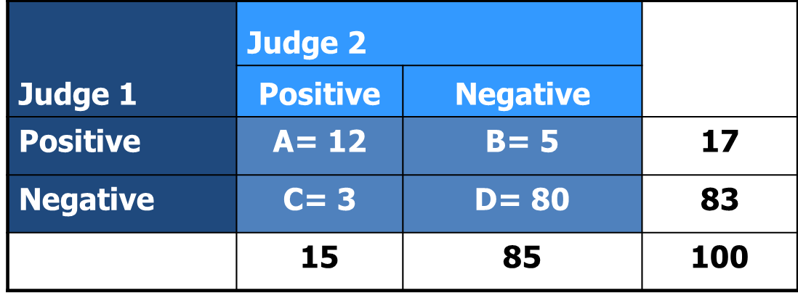
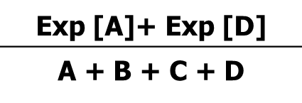
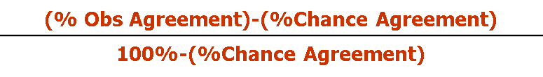
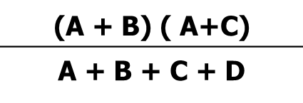
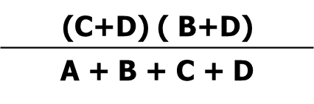
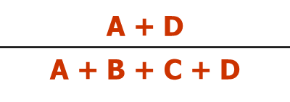
Screen #: 9.1
Summary: Click on and fill in screen.
Kappa =
Percent chance agreement =
Exp [A]=
Exp [D]=
Overall percent agreement = ____
Percent chance agreement = ____
Kappa = ____ (enter answer as 2 decimal value (e.g. 0.50)
Interpretation of Kappa
Navigation Notes: Kappa term launches popup with the equation on the upper left side of the screen. Blank for Kappa is a fill in. Correct answer is below. Overall percent agreement is a button that launches the equation on the lower left side. Blank line is a fill in, correct answer is below. Percent change agreement is a button that shows all equations on the right side in a popup. Fill in area must enter the correct answer which is below. Interpretation of Kappa launches a popup that is shown on slide 24. At conclusion of activity provide means to return to slide 3.
Animation Notes: Developer may improve the look of this slide at their discretion.
Overall percent agreement or = Percent observed agreement
Notes:
Developer Information
Type: Click-on, Fill-in
Kappa Answer: .70
Overall percent agreement Answer: 92%
Percent chance agreement: 73.1%
23

Slide 24
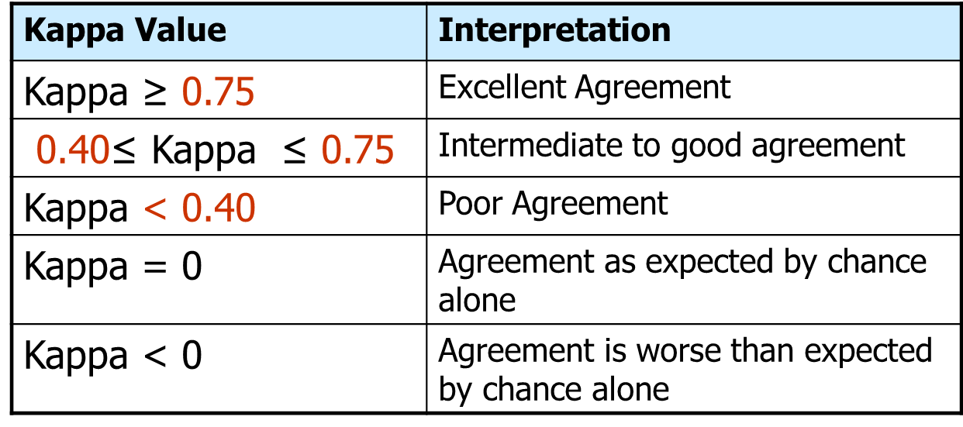
Screen #: 9.1a
Summary: This slide shows the popup of one of the buttons from slide 23.
Interjudge Reliability
Overall percent agreement = ____
Percent chance agreement = ____
Kappa = ____
Interpretation of Kappa
Navigation Notes: Kappa term launches popup with the equation on the left side of the screen. Blank for Kappa is a fill in. Correct answer is below.
Animation Notes: This space should include specific effects or instructions regarding animations. If you have no special requests, remove this from the slide.
Notes:
Developer Information
Type: Popup
24

Slide 25
Screen #: 10.1
Summary: Presentation
Relation between Validity and Reliability
Valid and Reliable
Valid but not Reliable
Reliable but not Valid
Neither Valid nor Reliable
1. Ideal tests are both valid and reliable.
2. Tests with high validity but low reliability are useful for measuring group values but not for measuring values for a given individual.
3. Tests with high reliability but low validity are repeatable for a given individual but the resulting value is not predictive of the intended value.
4. Tests with both low validity and low reliability are essentially useless.
Navigation Notes: Allow user to return to slide 3 at the conclusion.
Animation Notes: Highlight the red Valid and reliable when VO says “the ideal test”. Keep highlighted until next one is highlighted. Red valid but not reliable is highlighted when VO says “Tests with a high validity but low”. Keep highlighted until next one is highlighted. Red Reliable but not valid is highlighted when VO says “Tests with high reliability but low validity”. Keep highlighted until next one is highlighted. Highlight red neither valid nor reliable when VO says “Finally”.
Notes:
Developer Information
Type: Presentation
Voiceover: A given test may be both valid and reliable, valid but unreliable, reliable but not valid, and neither valid nor reliable. The ideal test is, of course, valid and reliable. Tests with a high validity but low reliability are useful for measuring group values, but not for measuring values for a given individual. An example of this would be plasma insulin-like growth factor values that may change for a single person by day, time of day, or fasting status. Tests with high reliability but low validity are repeatable for a given individual, but the resulting value is not predictive of the intended value. An example of this would be a genetic marker in place of plasma measures of insulin-like growth factor which is reliable, but it is not a good precictor of circulating IGF levels. Finally, tests that have low validity and low reliability are essentially useless.
25

