Slide 1
Predicting Heart Disease
Utilizing Supervised Machine Learning to Predict Patient Diagnosis
Notes:
andrew

Slide 2
Objective
The purpose of our project was to create machine learning models to analyze and predict the diagnosis of heart disease in patients using labeled data.
Notes:
Andrew
Create a ML model that could expedite diagnosis of heart disease in patients in order to
Reduce waiting times for diagnosis and by extension provide a rapid treatment response, reducing pain, heart damage and costs

Slide 3
The Data (1.0)
After investigating several datasets we selected the current CSV based on the large number of columns and rows in the data set, the ideal mix of categorical and numerical health data points and the inclusion of a diagnosis of heart disease for each patient.
Data source: Kaggle- Cardiovascular Disease Prediction DataSet
Original data was sourced using health-related telephone surveys for U.S. residents which asked general questions about overall health, doctor visits, demographic info, diet, exercise, and presence of pre-existing conditions.
Notes:
Noe

Slide 4
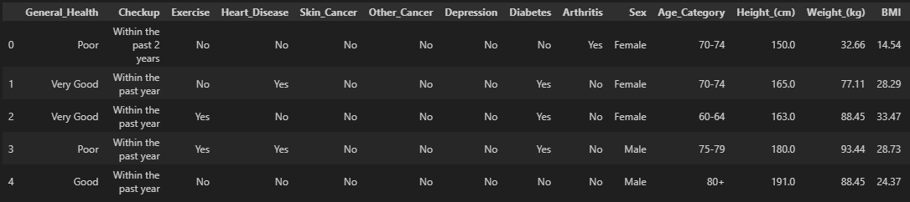
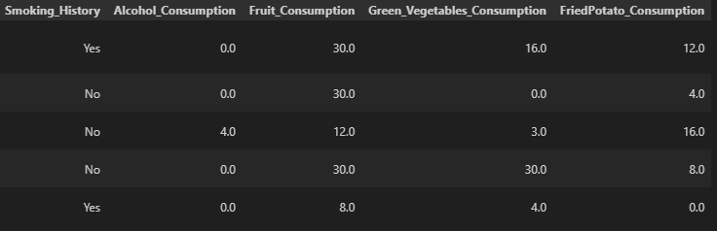
The Data (1.1)
How did we convert/clean our data?
Checked for any missing values in the data.
Encoded categorical data into numerical values.
Mapped outliers in the data to upper and lower bounds.
Aggregated count and mean values of the data.
*For our models we used a smaller dataset that returned equal Yes/No values for current or past history of Heart Disease.
Notes:
Noe

Slide 5
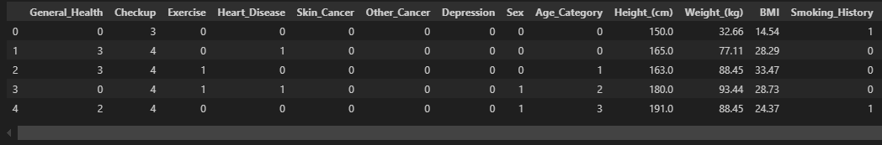
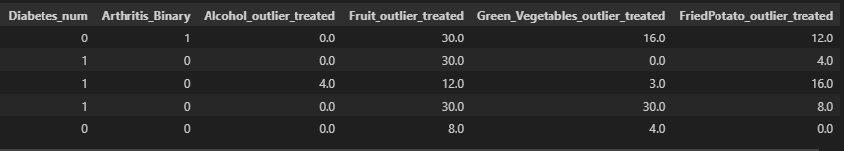
The Data (1.2)
Cleaned data set with encoded and outlier treated values.
Notes:
Noe

Slide 6
Machine Learning
Random Forest
Decision Tree
Logistic Regression
Models Used to Predict Diagnosis
Notes:
Andrew
Wanted to create a benchmark model (RF) to judge against two other potential options to see which model performed the best and which model would be ideal under real world circumstances

Slide 7
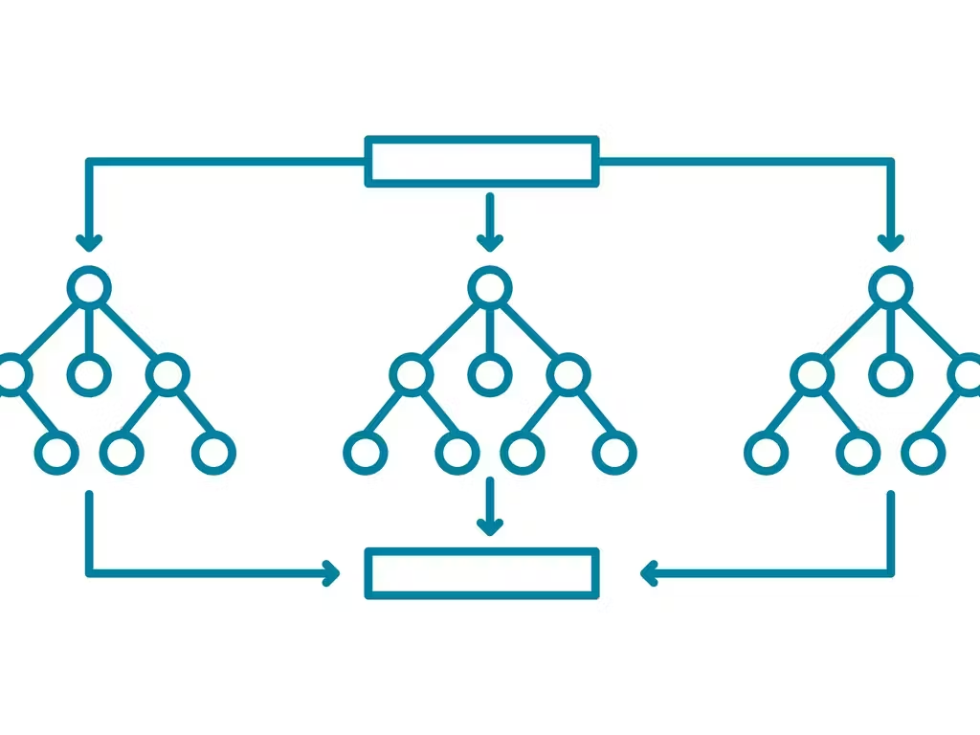
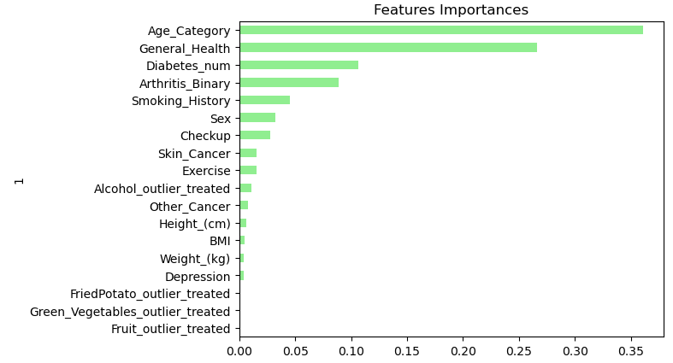
Random Forest
Ideal Applications
Ideal for interpreting large datasets
Overfitting Resistant
Can weight each segments of the dataset based on their effect on its predictions
Drawbacks
Reduced interpretability
Computationally demanding
Accuracy Score:
Entire Dataset: 91%
Balanced Data Set: 74%
Notes:
Andrew
What is a random forest:
Collection of decision decision trees each of which is randomly trained on different segments of the data and each make their own prediction, these predictions are then averaged together to create an overall prediction
Ideal for handling large data sets
Ranked features based on importance
Resistant to overfitting due to random sampling of data

Slide 8
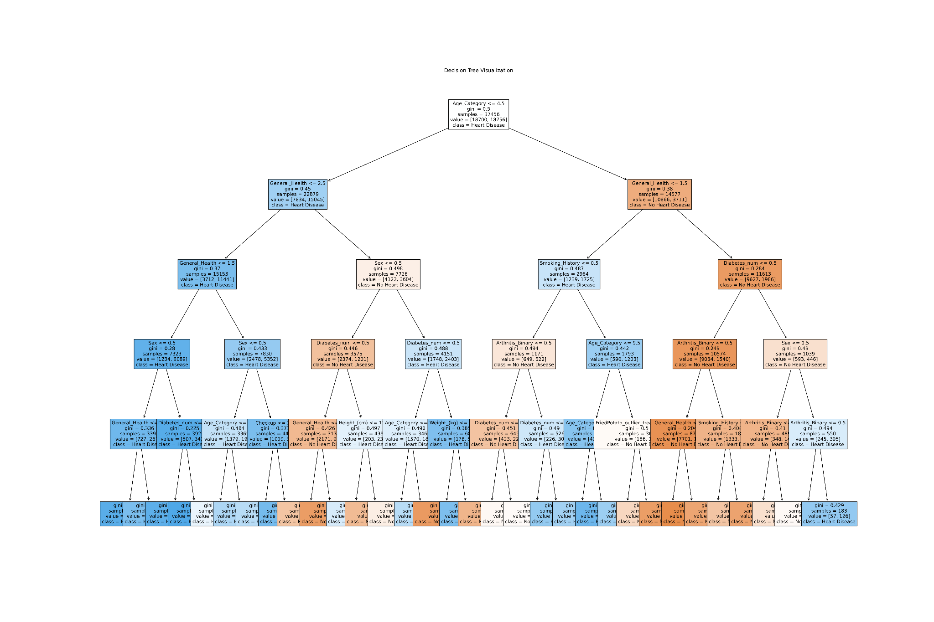
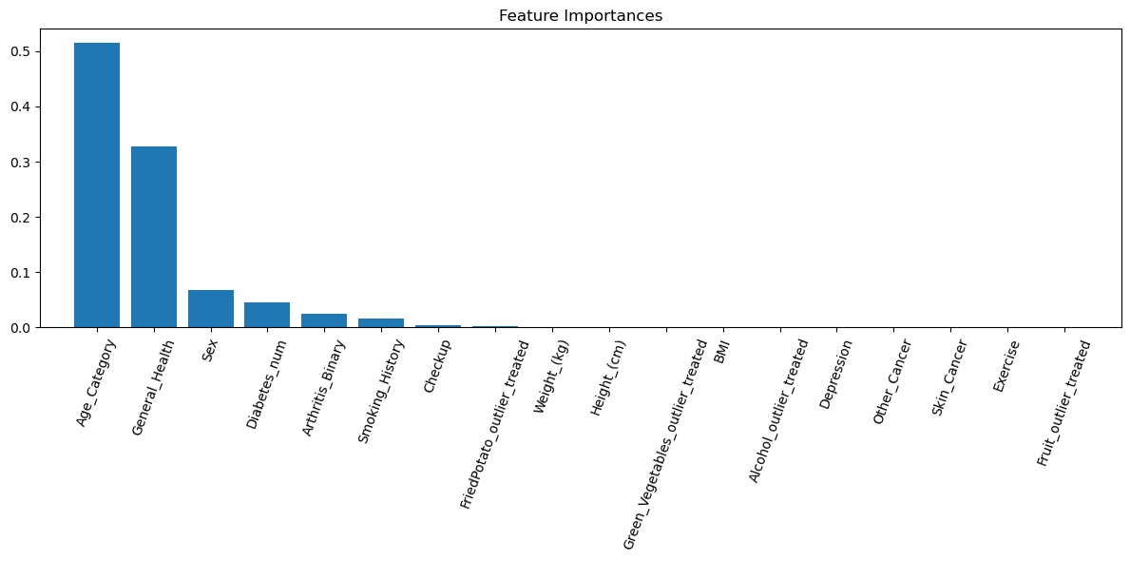
Decision Tree
Decision Tree Model is a classification model, classifies data into distinct categories based on input features,
Pros: easy to interpret, ability to show feature importance in a data set, don’t require scaling and are not sensitive to outliers..
Cons: overfitting, limited in prediction accuracy, poor when handling imbalance data.
Target: Heart Disease
Prediction Accuracy: 74%
Notes:
Noe

Slide 9
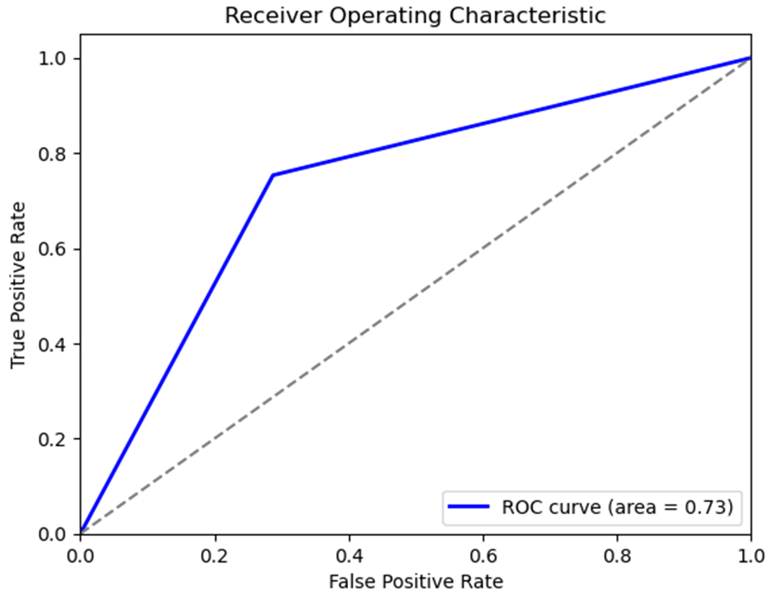
Logistic Regression
Used for binary classification prediction.
Produces a probability score that indicates the probability of the positive class (yes, true, 1, etc)
Cannot describe complex relationships between variables
Target variable:
Heart Disease
Features:
General_Health
Checkup
Age_Category
Smoking_History
Diabetes_num
Arthritis_Binary
Accuracy: 73%
Notes:
Paul

Slide 10
Conclusion

Slide 11
Ideal Model Choice and Future Steps
Which model provided the most accurate and reliable results? (Random Forest)
Effective for both classification and regression tasks.
Suitable for problems with complex patterns and large datasets.
Used when high accuracy is required and interpretability is less of a concern.
How could this be deployed in the real world at a hospital or clinic? What would the advantage be?
These models could be used to expedite diagnosis of heart disease, catching the condition much early and preventing crucial damage from occurring as well as saving money and pain for patients and providers
Which model provided the most accurate and reliable results? (Random Forest)
Pros
Cons
Ideal model for use of predicting heart disease.
Across all three models the prevailing features that seem to predict heart disease are:
Age, General Health
BMI, weight
Notes:
Paul

Slide 12
Questions?

