Slide 1
Project 3 Data Engineering
Jomo Parke
Paul Magarill
Andrew Gilbert
Notes:
jomo

Slide 2
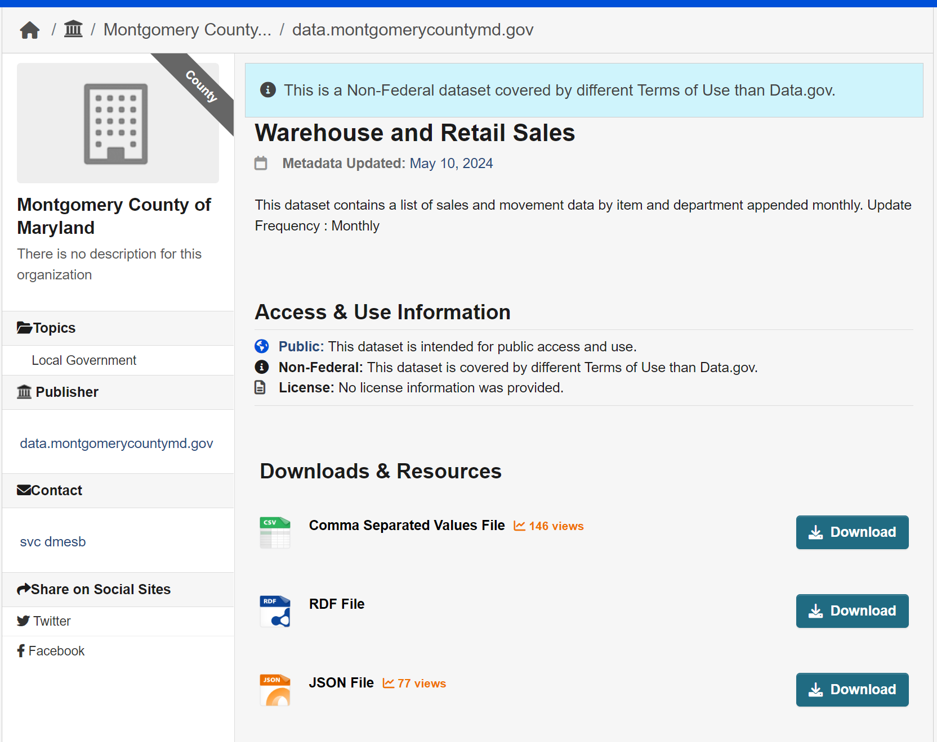
Data Source and Objective
Data Source: Data.gov Montgomery County of Maryland (Updated Monthly)
Create a Database
Could clean, organize and present data in a visually understandable manner
Policy makers and business owners decisions
Notes:
Jomo
Look for annual/monthly/seasonal trends (beverage types, sales)?
Yearly bar chart with most popular types in sequential order
Determining the overall trend of alcohol sales over the course of the dataset?
Use sales data
Which suppliers make the most sales? ()
Scatter/line plot with linear regression of liquor types (calculates overall)

Slide 3
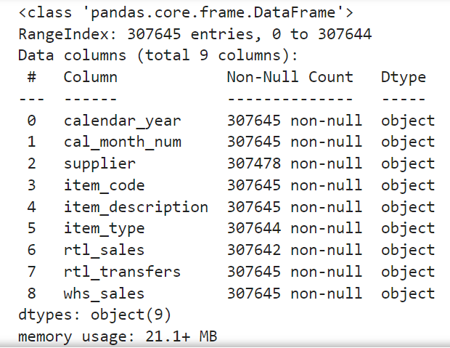
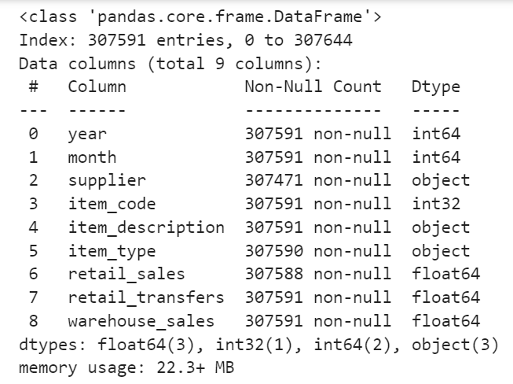
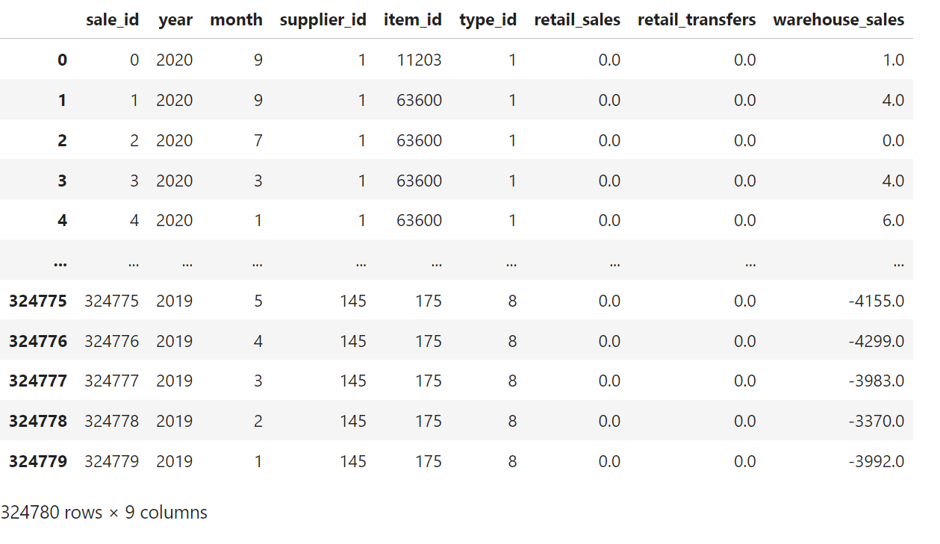
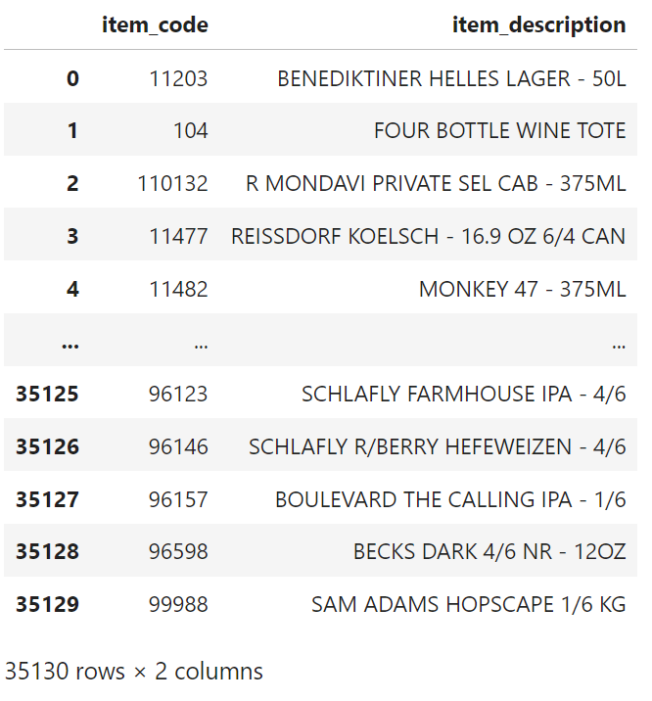
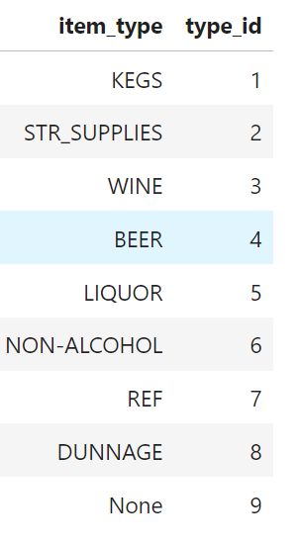
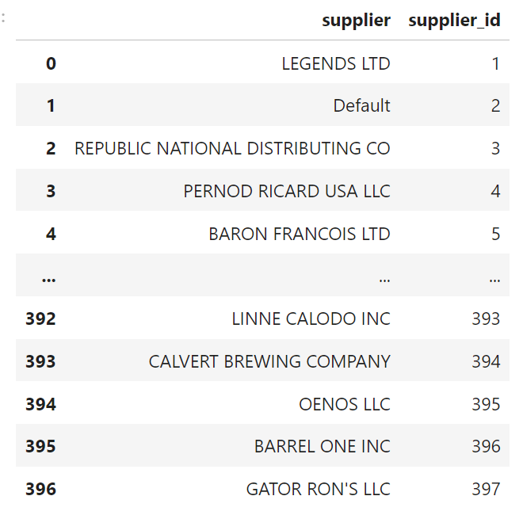
How did we transform it
Notes:
andrew

Slide 4
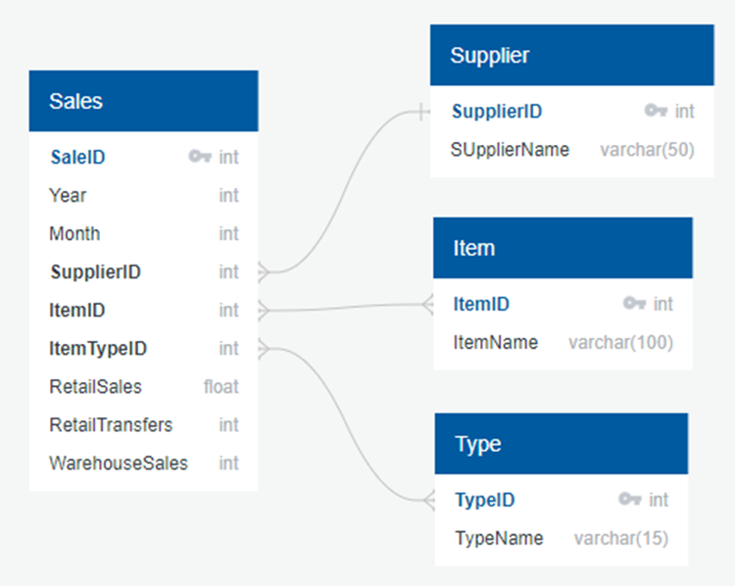
Database description
Primary table: Sales
Connection types:
Each sales is from only one supplier, but can include multiple items and types
Every supplier, item, and type can be involved in multiple sales
UOM: per case
Notes:
paul

Slide 5
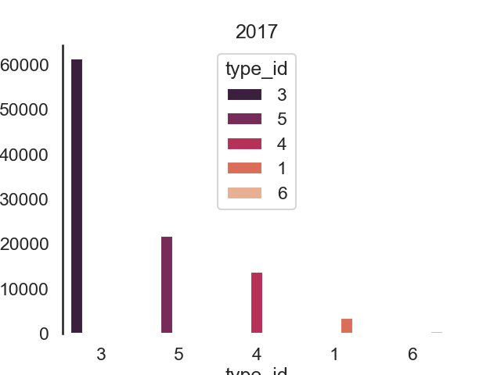
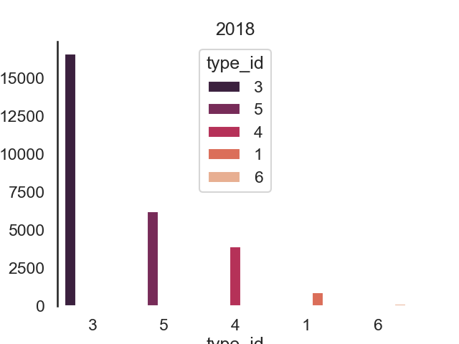
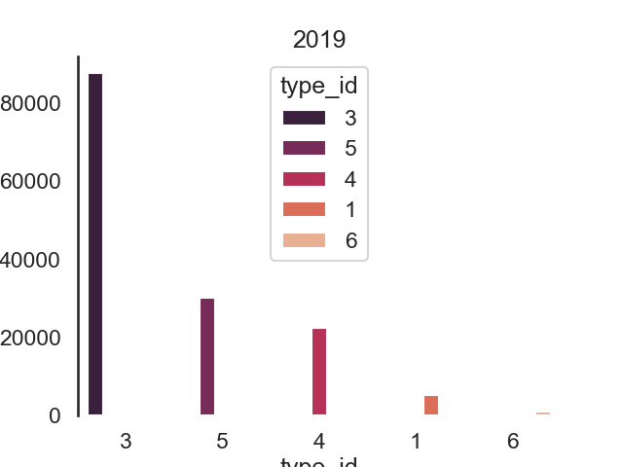
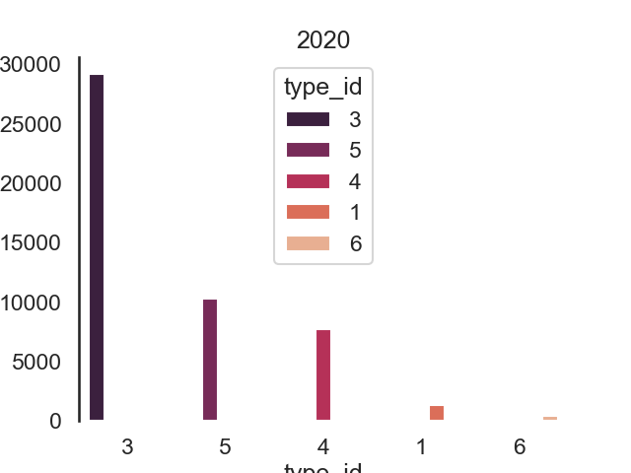
How will future users use this
SqlAlchemy code allows for querying data split into specific groupings that can then be put into dataframes
Seaborn library used to create visual interpretations of the data processed
Notes:
andrew

