Slide 1
Importing the Needed Libraries
Pandas (pd): python library for data manipulation and analysis.
Numpy (np): Library for scientific computing in Python, offers more efficient arrays, mathematical functions and linear algebra operations
Seaborn (sns): used with matplotlib for creating statistical graphics, aesthetically pleasing.
Matplotlib.pyplot (plt): library for creating visualizations in python.

Slide 2
Data Importation
Since we are using a csv file , we have to convert it to an object recognized by python, pandas library.
HouseDF = pd.read_csv(‘location/data.csv’)

Slide 3
Data Information
Checking the number of columns, data types and non-nall values in each column. (df.info)
Calculating various statistics ( mean,std,median..) for numerical columns.

Slide 4
Exploratory Data Analysis for House Price Prediction
Creating visualizations that explores the relationships between pairs of numerical columns in our DataFrame.
This visualization helps us identify potential relationships between the numerical features in our data.

Slide 5
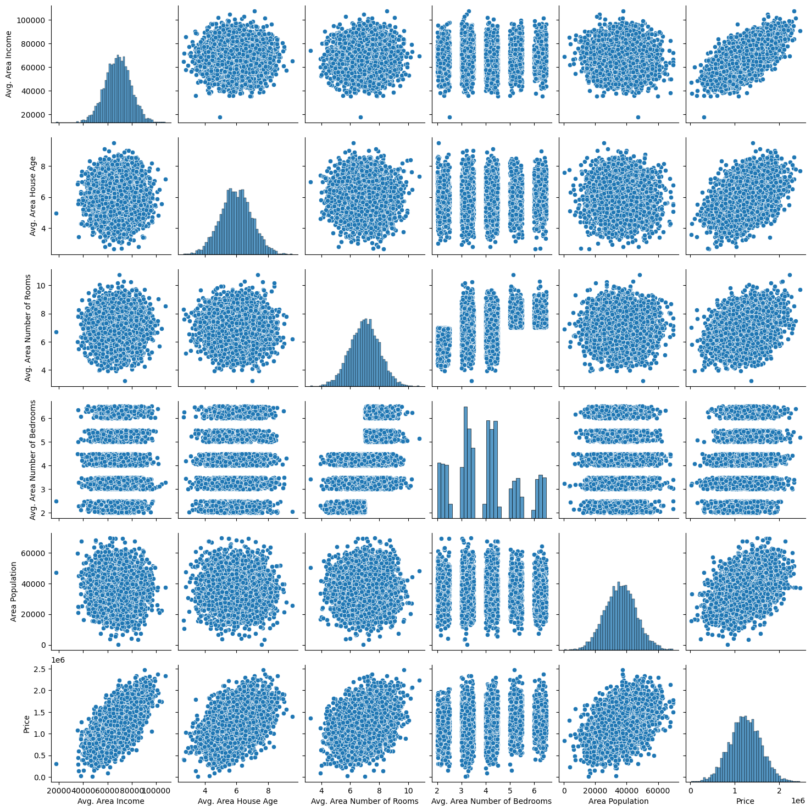

Slide 6
Extracting Price Column
Creating distribution plot using the price column to create a visualization that shows the distribution of house prices.

Slide 7
