Slide 1
Importing the Needed Libraries
Pandas (pd): python library for data manipulation and analysis.
Numpy (np): Library for scientific computing in Python, offers more efficient arrays, mathematical functions and linear algebra operations
Seaborn (sns): used with matplotlib for creating statistical graphics, aesthetically pleasing.
Matplotlib.pyplot (plt): library for creating visualizations in python.

Slide 2
Data Importation
Since we are using a csv file , we have to convert it to an object recognized by python, pandas library.
HouseDF = pd.read_csv(‘location/data.csv’)

Slide 3
Data Information
Checking the number of columns, data types and non-nall values in each column. (df.info)
Calculating various statistics ( mean,std,median..) for numerical columns.

Slide 4
Exploratory Data Analysis for House Price Prediction
Creating visualizations that explores the relationships between pairs of numerical columns in our DataFrame.
This visualization helps us identify potential relationships between the numerical features in our data.

Slide 5
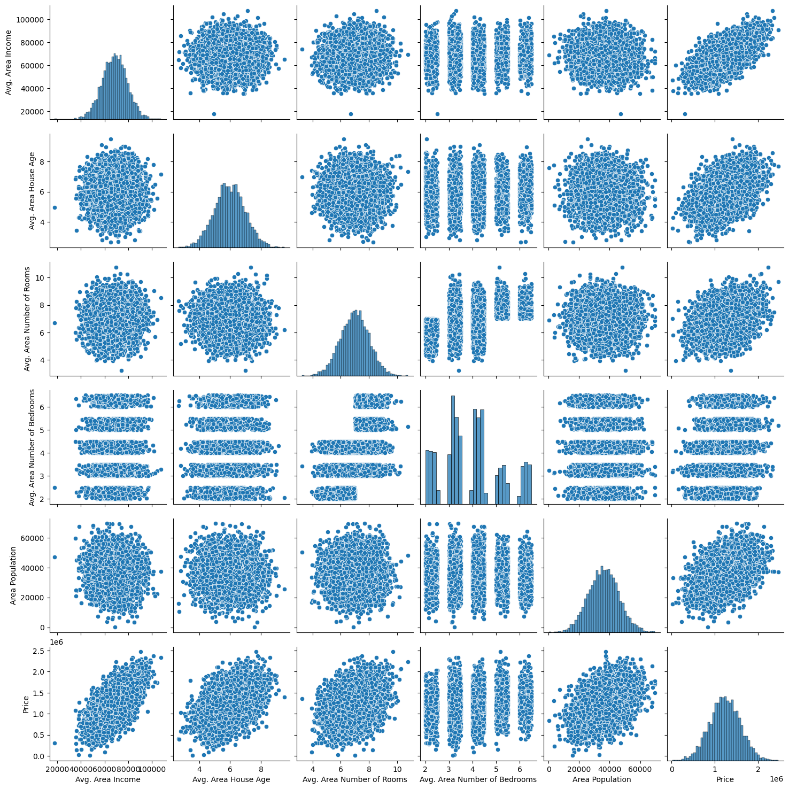

Slide 6
Extracting Price Column
Creating distribution plot using the price column to create a visualization that shows the distribution of house prices.

Slide 7
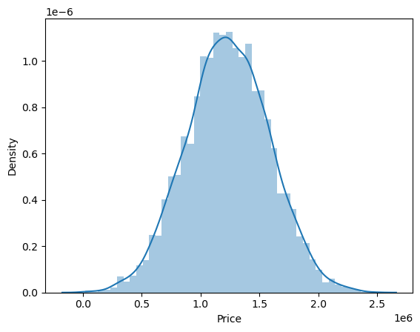

Slide 8
Correlation Matrix - shows the correlation coefficient between each pair of numerical columns in the DataFrame.
Strong positive correlation - values closer to 1
Strong negative correlations - values closer to -1
Heatmap Visualization - Creating a heatmap from the correlation matrix. This heatmap uses color intensity and a color gradient to represent the correlation values.

Slide 9
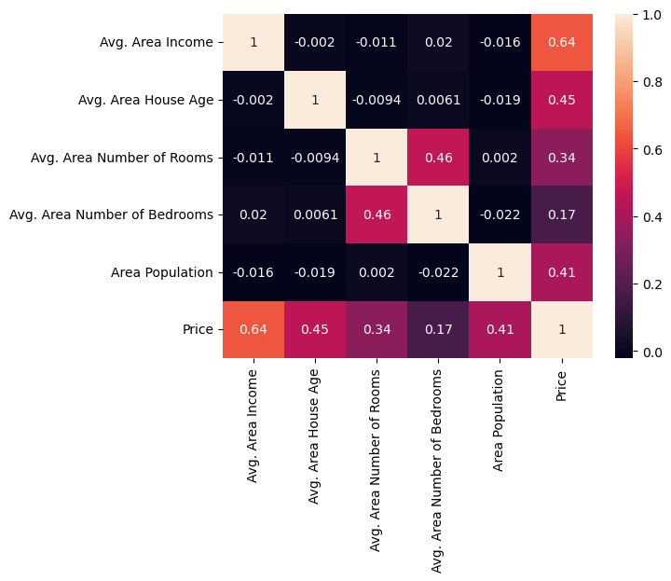

Slide 10
TRAINING LINEAR REGRESSION MODEL
X: This is the feature we use in comparison.
y: This is the target variable (house prices).
The training set will be used to fit the model, and the testing set will be used to evaluate how well the model generalizes to unseen data.
Splitting data into training and testing sets is crucial to avoid overfitting, which occurs when a model performs well on the training data but poorly on unseen data.

Slide 11
Creating model
lm = LinearRegression()
.fit(X_train, y_train) – this is used to train the model .

