Slide 1
Welcome!!

Slide 2

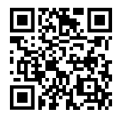
Andrew Taylor
EUC Architect & Microsoft MVP
IntuneBackup.com

Slide 3

Agenda
01
What is IntuneBackup?
02
Backing Up
03
Restoring
04
Deploying Apps
05
Deploying a baseline
06
What’s Planned?
07
How you can help
08
AMA

Slide 4
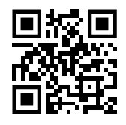
What is IntuneBackup?

Slide 5
History
IntuneBackup Launch
Baseline Deployment
Initial Script
Backup/Restore Script
App Deployment
Log Viewer
Script to copy profiles between tenants, not silent (and slow)
PHP/MySQL front-end Runbook Back-end Re-written PS Script to support automation
Multi-tenant deployment GitLab Support Baseline deployment
Added log viewer. Local Date/Time Display Connection Testing
Backup to GitHub & DevOps GUI Driven V3 performance
Added Ability to deploy Winget apps

Slide 6
Why do I need it?
Never test in prod
Regular backups with timestamps
App Deployment
Have a dev tenant and move policies across
Deploy Winget apps with auto update via Remediations
Users may not report issues straight away
Backup just in case
MSP Management
Baseline deployment
Even after testing in prod, the audit logs aren’t great
Build a policy once, deploy to multiple tenants
Deploy baseline security policies with one click
User error
Disaster Recovery
Total Control
Someone edits or deletes the wrong policy, what do you do?
Quickly re-create most of your tenant (no apps or group memberships)
You own the app reg and the files created

Slide 7
Backing Up

Slide 8
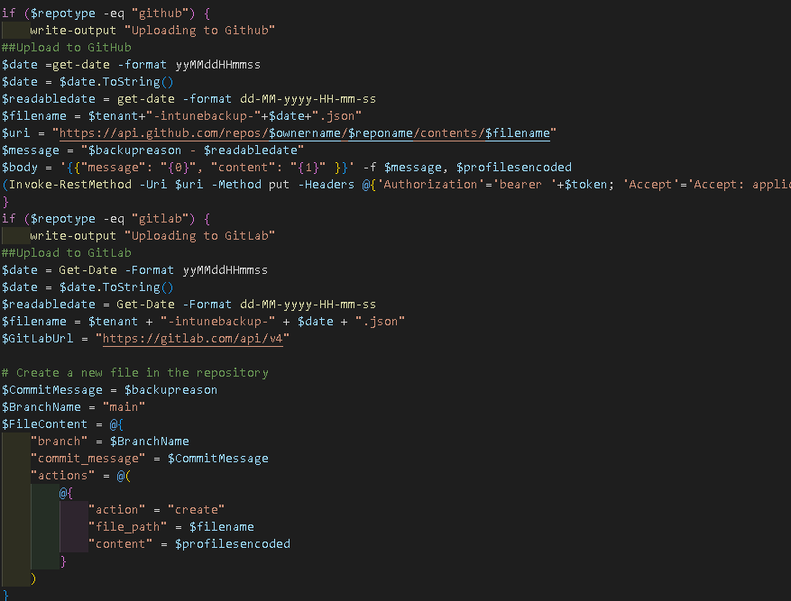
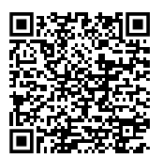
Backing Up
Runs script with parameters in the webhook to trigger a backup and select everything
Also grabs assignments (converting)
Pagination support
Lists what each item is in array
Exports array to Git repo of choice in single page JSON file

Slide 9
Restoring

Slide 10
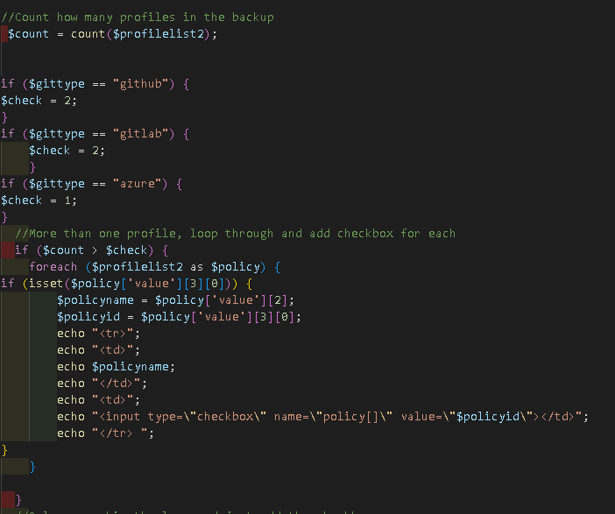
Restoring – Part 1 – Web UI
After Selecting Tenant, it accesses your Git Repo via API and token to find backups
Grabs the file content from Git
Loops through the policies, displaying the name in the drop-down, but passing the ID
This then sends the Webhook request with tenant details and the selected policy IDs
For multi-tenant, it sends multiple requests

Slide 11
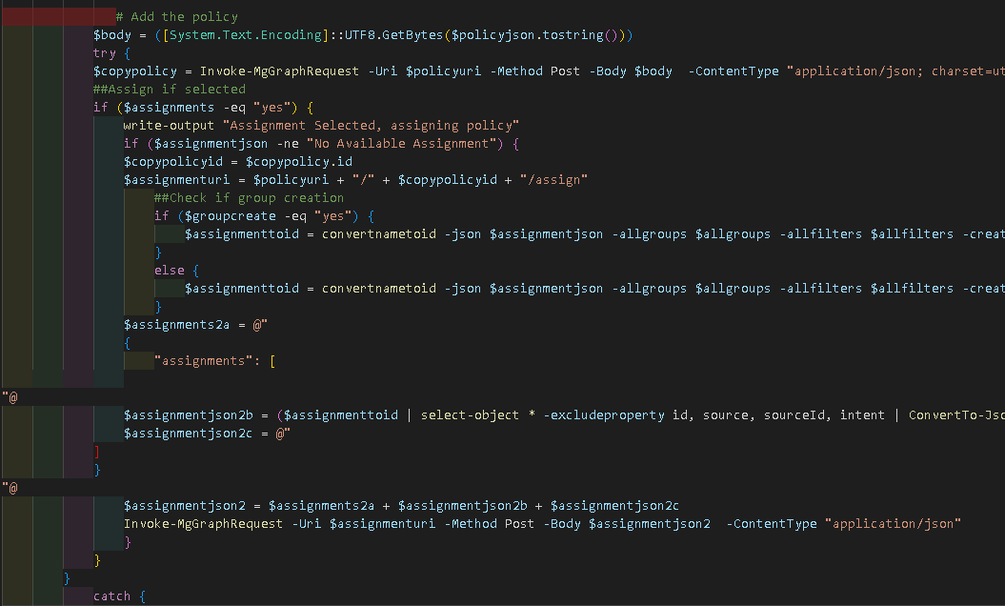
Restoring – Part 2 – Azure Runbook
Loops through policies to send relevant Graph requests
Additional config for CA policies
Admin templates – more tricky again
If Assignment selected, convert Group or Filter name to the ID in destination tenant (or create the group if it doesn’t exist), then send command to assign

Slide 12
Deploying Apps

Slide 13
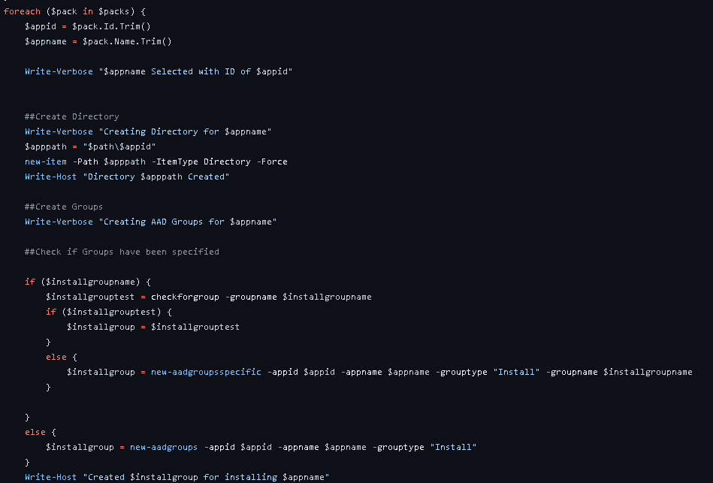
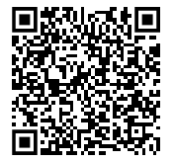
Deploying Apps
Grabs a CSV export of all apps listed in Winget
Displays in searchable drop-down
Triggers Azure Automation Runbook running in hybrid mode
Deploys app, assigns app, creates remediations to update
https://github.com/andrew-s-taylor/public/blob/main/Powershell%20Scripts/Intune/deploy-winget-win32-multiple.ps1

Slide 14
Deploying a Baseline

Slide 15
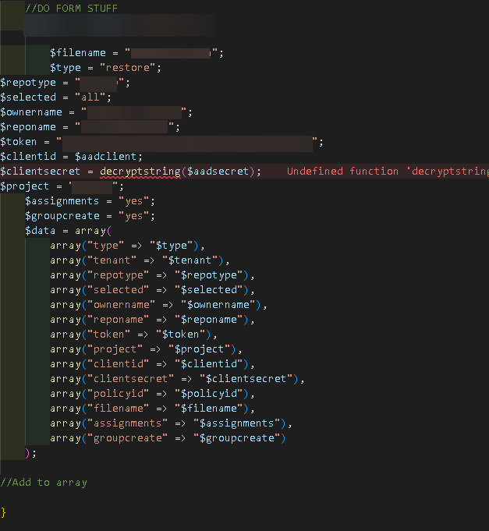
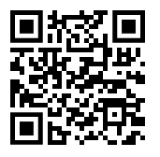
Deploying Baseline
Useful for greenfield tenant
Deploys a limited security baseline
https://intunebackup.com/policies.pdf
Can deploy to multiple tenants
Uses same functionality as backup/restore only grabbing a pre-configured JSON file

Slide 16
What’s Planned?

Slide 17
What is currently planned?
App Deployment
Template Creation
Drift Monitoring
Inclusion of Available assignment alongside required
Creation of baseline templates
Between Live Tenant and Last Backup
Comparison
Bitbucket Support
Between Tenants

Slide 18
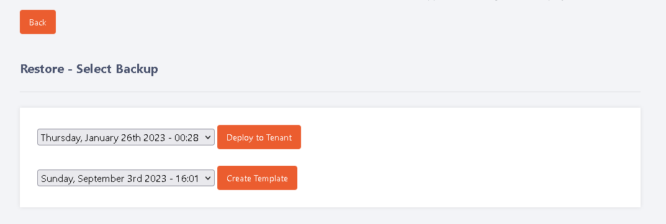
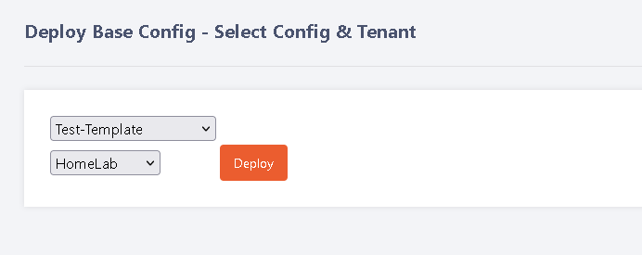
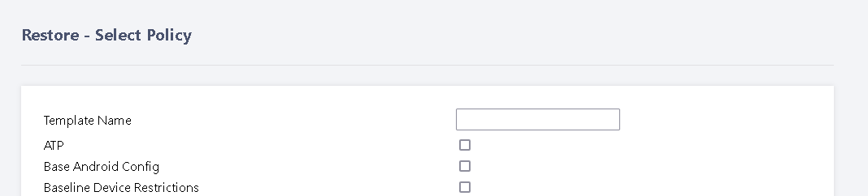
Exclusive Preview

Slide 19
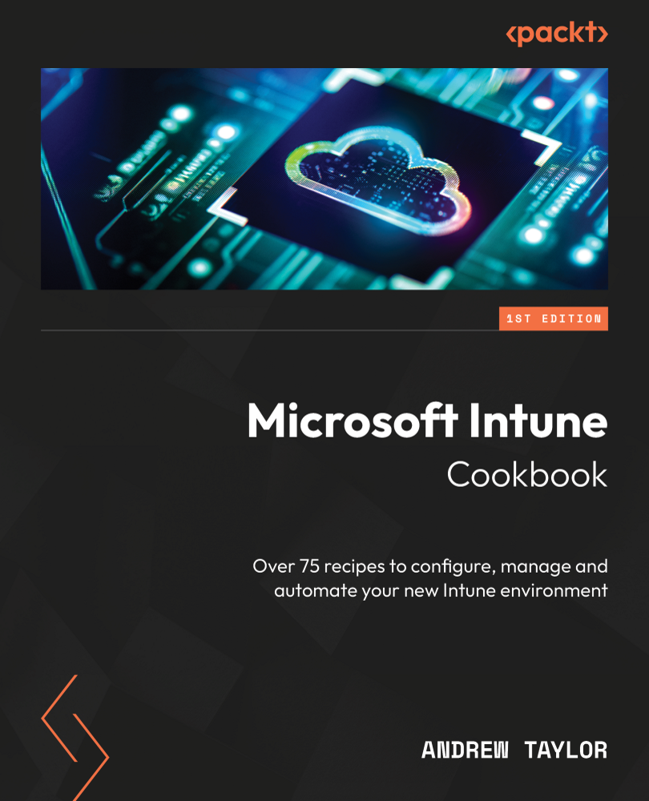
Exclusive Preview-2

Slide 20
How you can help

Slide 21
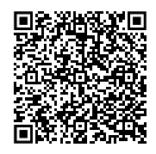
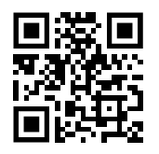
Your Input
Feedback Requests Form
Link for Me

Slide 22
AMA

Slide 23
Self Hosted
Use code PARIS50 for 50% off

Slide 24
Thank you!!

