Slide 1
Data Structures
810:052
Dr. Schafer

Slide 2

Getting to know you
Pull out a sheet of notebook paper and fold it in half the “long” way .
Using one of the markers I will pass around, write your “first name and last initial” (or the name you would like to be called).
While I come around and take your “mug shot” please begin to complete the info sheet that I will pass out.

Slide 3
What would be on my info sheet?
Name : Dr. Ben Schafer
Hometown : Ames originally.
Class : This is my 13th year at UNI (5 as a student)
Previous programming experience? : Way too many to list, Java and Perl are the ones I have used the most although Python is quickly moving to #1
Why are you TEACHING this class? : I truly enjoy teaching the introductory classes
Other things about me you should know :
  My handwriting can be messy
  My voice can get loud
  I am teaching with two different languages this semester

Slide 4
Getting Started
I will hand you a syllabus.
Please make sure you read it by Wednesday and come prepared to ask questions.
But a few issues I want to highlight today..

Slide 5
Important times and places
Formal office hours
  MWF 11-11:50 (ITTC 316)
  Th 10:00-noon (ITTC 316)
  Having said that, I follow an open door policy and am around the office from 8:30-5:00 most days
Time and Place:
  MWF 10:00-10:50 AM, ITTC 322
  T 10:00-11:50 AM, Wright 339 [this is a change from the printed course schedule]

Slide 6
Rooms you should know!
ITTC 322 – Lectures
ITTC 305 – The departmental office
ITTC 316 – My office
ITTC 335 – Small general purpose lab
Wright 339 – Labs on Tuesday. Open-lab other days of the week.
Wright 112 – Open-lab most days of the week
Wright 206 – CNS tech support

Slide 7
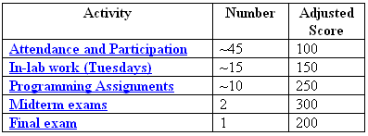
Grading

Slide 8
Scholastic Conduct
I take scholastic conduct SERIOUSLY!
You are responsible for being familiar with the university’s Academic Ethics Policies (http://www.uni.edu/pres/policies/301.shtml) and my comments on scholastic conduct in my course.
General rule
  Discussing assignments is normally acceptable.
  Copying code or answers is not.
First and foremost, your final submission for any assignment should be your own individual, original work unless otherwise specified.

Slide 9
No Distractions!
Cell phones
Computers and PDAs

Slide 10
Guidelines for Success in this Course
Prepare for lecture! Read the text selections before the start of lecture and complete any class prep assignment.
Be on time. Class sessions and lab will both start promptly at 10:00. I will collect assignments at that time and will often start with important announcements.
Try things from the book. Although I may sometimes use the book's activities in lectures or labs, you will gain more if you try them yourself on your time and at your pace. Most of the code used in the text is available online. Grab the code and play with it yourself!

Slide 11
Guidelines for Success in this Course
Write code on your own! Think of simple problems on your own (or from the text) and solve them. If you wonder "what if," TRY IT!
Make use of the office hours early! Don't wait until late in the term to seek help.
If you spend more than 15 minutes staring at the computer stuck on something, ask for help! I am frequently in my office, and there are TAs available in the lab several hours a week.
Be specific in your questions when possible. Rather than asking for an explanation of a large or general topic, be prepared with specific questions or specific examples that raised your questions.

Slide 12
Guidelines for Success in this Course
Make sure that your code runs in the lab. This is especially important for those who complete portions of their work at home. Verify that code that runs on another machine actually runs in the lab so there are no surprises at grading time.
Remember, programming takes practice.

Slide 13
Vocabulary
Data?
Data Types?
Abstract Data Types?
Data Structures?

Slide 14
Vocabulary
Data
  “Information that has been put into a form a computer can use” (Dale and Walker)
  Can mean the “stuff” but to a certain extent, the 1s and 0s itself
  Although we will use plenty of data, it’s not really the point of the course

Slide 15
Vocabulary
Data
Data Types
  “Type” is a category of objects sharing common characteristics
  So a “Data Type” provides an interpretation of the data
    What do I do with all these 1s and 0s ?
    What kind of values are possible?
    What kind of operations are possible?

Slide 16
Basic Data Types
For each of the following, what data type would you use to store information for one student
  Age
  GPA
  Hometown
  Middle Initial
  Name
  Today’s attendance score
  Do they have an advisor hold

Slide 17
Basic Data Types
For each of the following, what data type would you use to store information for one student
  Age - integer
  GPA – floating point number (float)
  Hometown - string
  Middle Initial – character
  Name - string
  Today’s attendance score – integer (or maybe a float)
  Do they have an advisor hold – boolean

Slide 18
Basic Data Types
Most languages start with a basic 4 types of data at the primitive level.
  Integers (numbers without fractional parts)
  Floating point numbers (numbers with fractional parts)
  A single character
  Booleans (True and false values)

Slide 19
Vocabulary
Data
Data Types
Abstract Data Types
  Mostly, just a “semantic” difference between this and a simple Data Type
  Abstract = conceptual, not concrete
  In other words, an ADT “is a logical (conceptual) description of the domain and operations for a piece of data without regard to how it will be implemented

Slide 20
Vocabulary
Data
Data Types
Abstract Data Types
  Mostly, just a “semantic” difference between this and a simple Data Type
  Abstract = conceptual, not concrete
  In other words, an ADT “is a logical (conceptual) description of the domain and operations for a piece of data without regard to how it will be implemented”

Slide 21
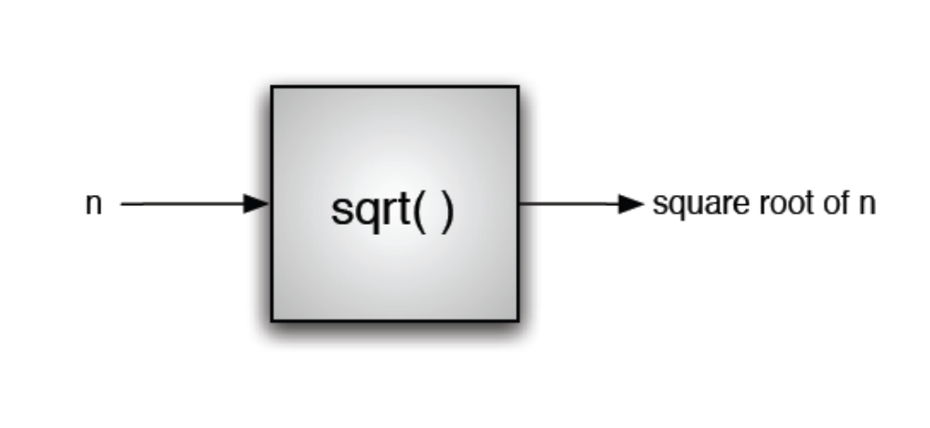
Procedural Abstraction

Slide 22
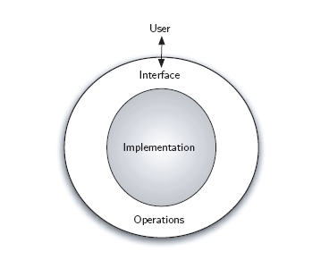
Data Abstraction

Slide 23
ADTs
What type of data would you use if you wanted to store each of the following
  First come first serve record of who gets to borrow the study guide for an exam
  A record of who gets to use the one computer hooked up to the printer (I have priority over everyone, the TA has priority over you)
  A record of the web pages I would see if I pressed the back button on my web browser
  Info on who is to the left and the right of each player at a poker table
  A record of everybody who has ever visited my office, in alphabetical order
  An address book of every student in this class and their email address

Slide 24
ADTs
What type of data would you use if you wanted to store each of the following
  First come first serve record of who gets to borrow the study guide for an exam – FIFO Queue
  A record of who gets to use the one computer hooked up to the printer (I have priority over everyone, the TA has priority over you) – Priority Queue
  A record of the web pages I would see if I pressed the back button on my web browser – Stack
  Info on who is to the left and the right of each player at a poker table – Doubly linked list (DLL)
  A record of everybody who has ever visited my office, in alphabetical order – Binary Search Tree (or DLL or …)
  An address book of every student in this class and their email address - HashMap

Slide 25
Vocabulary
Data
Data Types
Abstract Data Types
Data Structures

Slide 26
Why study data structures?
First of all, you just need to know them…
  Which data structures are available (in general and within a different language or its libraries)?
  You need to be able to consider which data structure to choose for which type of problem
    Appropriateness
    Time/memory tradeoffs

Slide 27
Why study data structures?
But more importantly, you need to have a base understanding of the different ways in which a given structure can be implemented
  You may encounter a language that doesn’t contain a feature you want (DIY!)
  The same structure in different languages may have very different implementations
  Actual implementation may have time/memory ramifications

Slide 28
“Actual implementation may have time/memory ramifications”
Another significant portion of this course is the introduction to the concepts of algorithms and algorithm analysis.
  How does this algorithm perform with 10 items? 100 items? 1000 items?
  A poorly written algorithm may make a problem that seems fine in testing impossible under real world situations

Slide 29
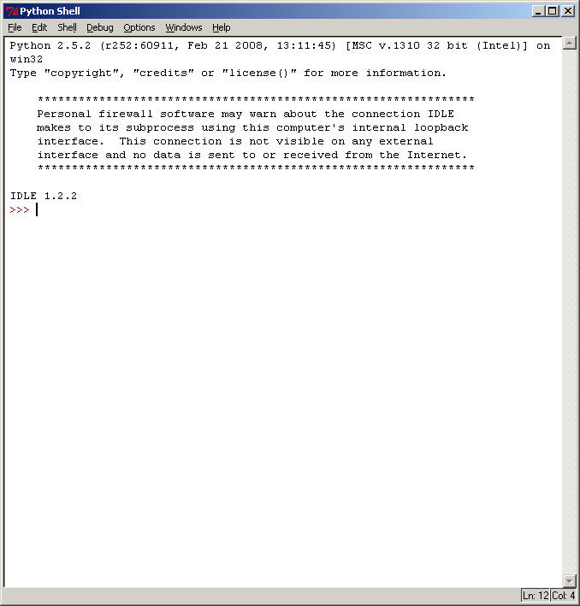
IDLE

Slide 30
Suggestions
Download and install python (version 2.5.2 is what is in the labs) on your home machine.
  www.python.org
Obtain a copy of the python quick reference guide (~60 pages)
  rgruet.free.fr

