Slide 1
Data Structures
810:052
Our first data structure

Slide 2
Other announcements
Lab1 grade and grade code mailed to you
  Spelling/naming matters
  Test your own code (both the easy and the hard)
  Read directions
Seminar today
Picnic on Sunday
CS Club on Thursday

Slide 3
Lab yesterday
We wrote a Pixel class and a demo module together.
I also posted a Student class and a demo module
  Discussion
      The implicit use of class methods
  Questions?

Slide 4
Questions??
Lists
  Range
  Iteration
  Strings as lists
Tuples
Dictionary

Slide 5
Our first “traditional” data structure
Imagine you are keeping track of the webpages cached in your web browser
  What kinds of things do you keep track of?
  How do you interact with that “collection” of data?

Slide 6
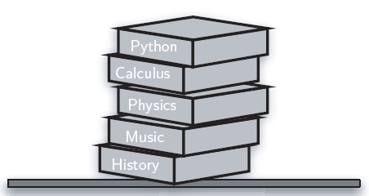
Introducing the stack

Slide 7
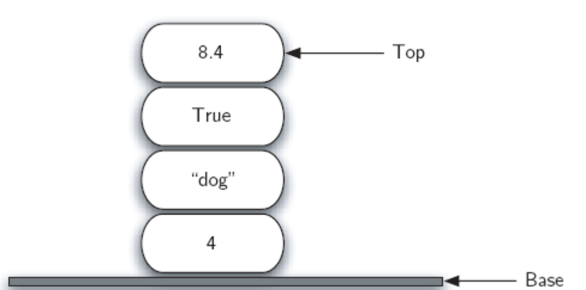
Introducing the stack

Slide 8
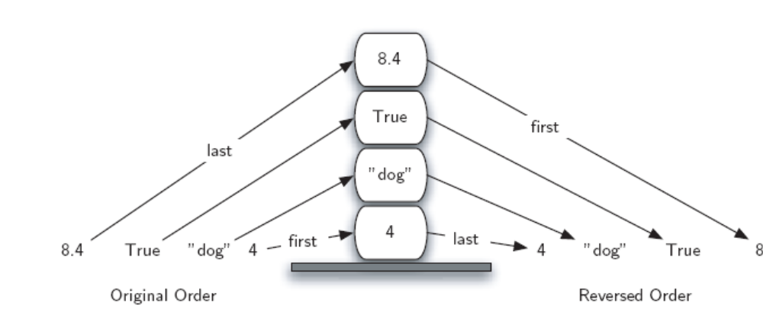
Introducing the stack

Slide 9
The Stack ADT
Stack()
  Creates anew stack that is empty.
  It needs no parameters and returns an empty stack
push(item)
  Adds a new item to the top of the stack.
  Takes the item as a parameter and returns nothing (most of the time)
pop()
  Removes the top item from the stack. This modifies the stack.
  It needs no parameters and returns the item.
peek()
  Returns the top item from the stack without actually modifying the stack
  It needs no parameters and returns the item.
isEmpty()
  Tests to see whether the stack is empty.
  Needs no parameters and returns a boolean
size()
  Returns the number of items on the stack.
  It needs no parameters and returns an integer

