Slide 1
Data Structures
810:052
Implementing a Stack

Slide 2
A couple of issues from Lab02
Follow the naming conventions
TEST YOUR OWN CODE!
__str__ returns a String. It does not print
__add__ returns the sum. It does not print

Slide 3
The Stack ADT
Stack()
  Creates anew stack that is empty.
  It needs no parameters and returns an empty stack
push(item)
  Adds a new item to the top of the stack.
  Takes the item as a parameter and returns nothing (most of the time)
pop()
  Removes the top item from the stack. This modifies the stack.
  It needs no parameters and returns the item.
peek()
  Returns the top item from the stack without actually modifying the stack
  It needs no parameters and returns the item.
isEmpty()
  Tests to see whether the stack is empty.
  Needs no parameters and returns a boolean
size()
  Returns the number of items on the stack.
  It needs no parameters and returns an integer

Slide 4
Implementing a Stack in Python
Together in class we wrote two different implementations of a stack corresponding to Listing 2.1 and 2.2 in your textbook.
See the class website to see what we actually wrote

Slide 5
Implementing a Stack with an Array
Not all languages have lists. Instead, many have an array
  An array is a fixed length sequence of data whose access is made entirely through an index.

Slide 6
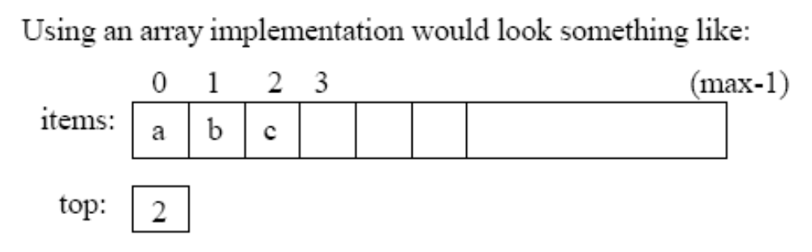
Implementing a Stack with an Array
While this diagram suggests storing the top, I prefer
the situation where you store the nextAvailableSlot

Slide 7
Building an “array” implementation with Python
At construction time, build a list of a certain size and fill it with dummy values
Keep track of this max size
Keep track of where the next value goes (nextAvailableSlot)
Before you push, make sure there is a slot for it.

