Slide 1
Introduction to Trees

Slide 2
Before we start
Questions about the next PA?
Finishing up the OrderedList from last time

Slide 3
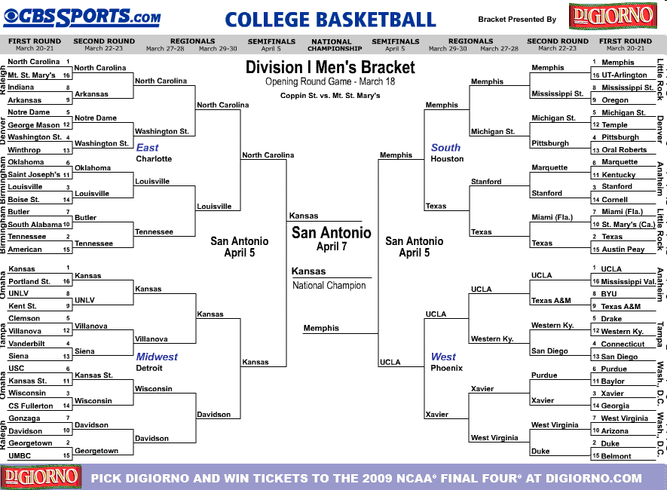
Tournament Brackets

Slide 4
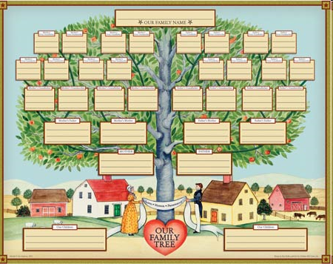
Family Tree

Slide 5
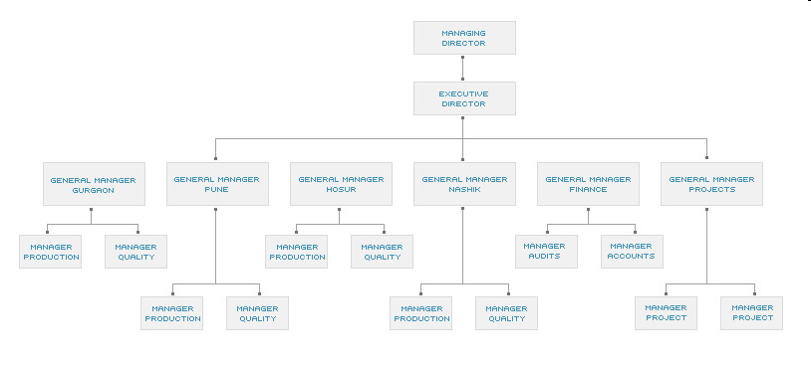
Corporate Hierarchy

Slide 6
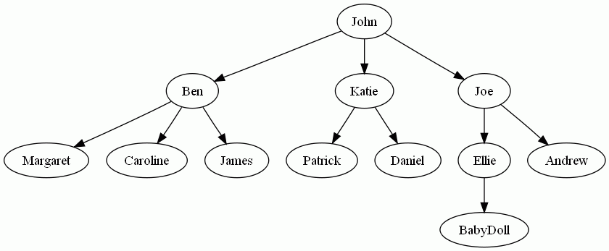
A Family Tree in a more
“computer science”-like format

Slide 7
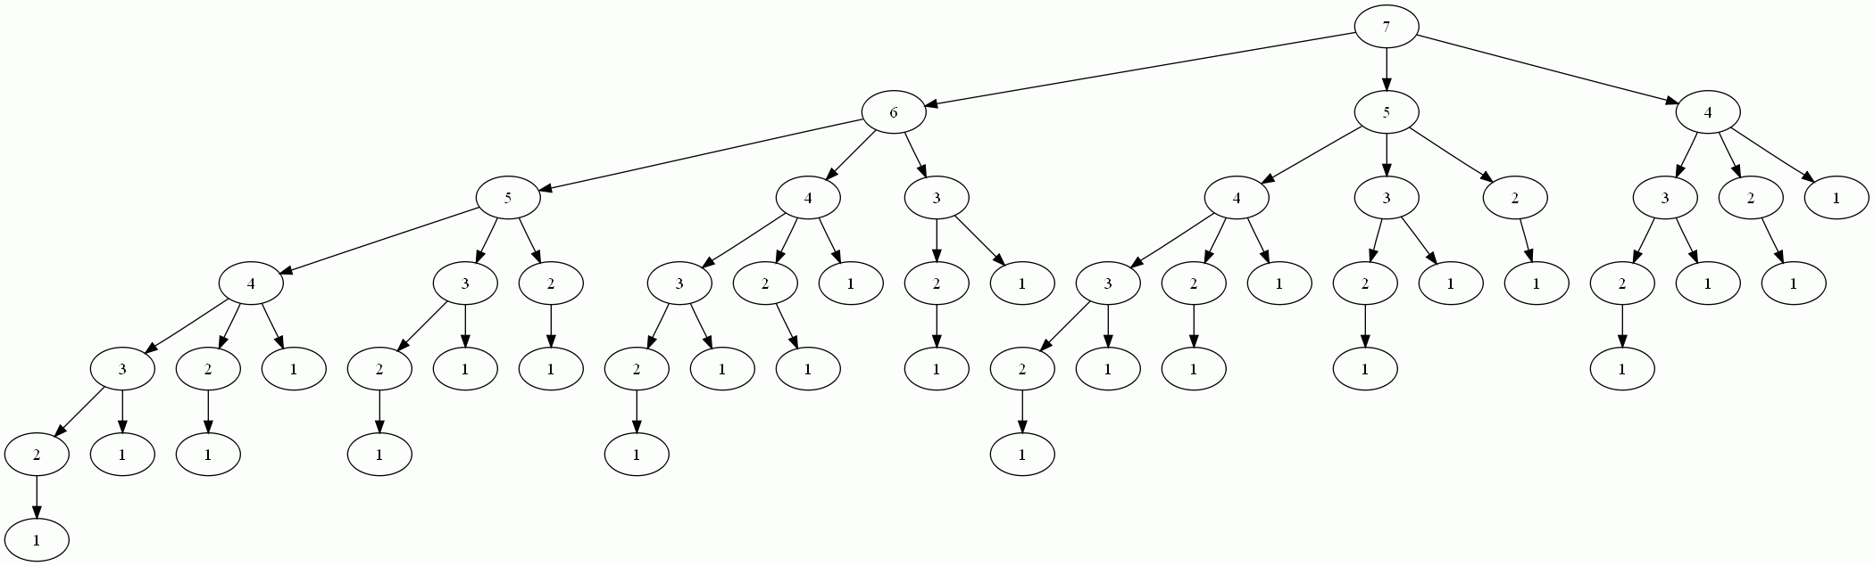
A search space tree for a variant of nim

Slide 8
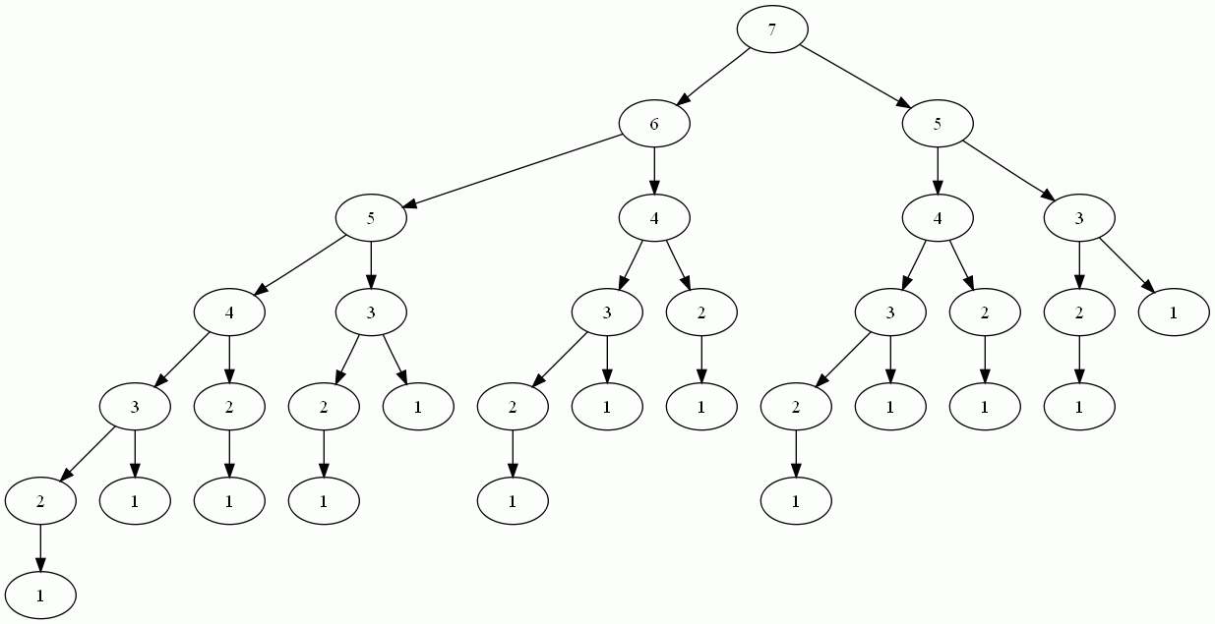
A search space tree for another variant of nim

Slide 9
Tree Vocabulary
Node – A fundamental part of a tree. It is where multiple edges come together. It consists of a name (sometimes “key”) and some optional, additional data.
Edge – A connection between exactly two nodes. This creates a “parent/child” relationship

Slide 10
Tree Vocabulary
Child – A node with an incoming edge from some other node is called the child of that node.
Parent – A node with an outgoing edge to some other node is called the parent of that node.
Root node– All (non-empty) trees have exactly one root. It is the only node without an incoming edge (without a parent). Traditionally at the top of the tree.
Leaf – A node that has no outgoing edges (without any children). Traditionally at the bottom of the tree
Observations:
  Any non-root node has exactly one parent
  Any non-leaf node has at least one child

Slide 11
Tree Vocabulary
Path – An ordered list of nodes (which are connected by edges) from the root to a particular node.
Depth – (aka level) The number of edges followed to get from the root to a particular node.
Height – The maximum level of any node

