Slide 1
AVL Trees

Slide 2
First, Lab 11
Reading code is difficult…
  Having said that, you HAVE to be able to work your way through other people’s code
The problem appeared to be in the situation where you delete the root node with one or more children
  We were focusing on one child only

Slide 3
The problem
There are calls to self.parent in delete_key() but this value doesn’t exist for the root node.
if self.leftChild:
if self == self.parent.leftChild:
self.parent.leftChild = self.leftChild
else:
self.parent.rightChild = self.leftChild
else:
if self == self.parent.leftChild:
self.parent.leftChild = self.rightChild
else:
self.parent.rightChild = self.rightChild

Slide 4
The Solution
Have the root node “take over” the value of the child moving into it’s place:
If self.parent != None:
if self.leftChild:
if self == self.parent.leftChild:
self.parent.leftChild = self.leftChild
else:
self.parent.rightChild = self.leftChild
else:
if self == self.parent.leftChild:
self.parent.leftChild = self.rightChild
else:
self.parent.rightChild = self.rightChild

Slide 5
The Solution
Have the root node “take over” the value of the child moving into it’s place:
else:
if self.leftChild:
self.key=self.leftChild.key
self.payload=self.leftChild.payload
self.rightChild=self.leftChild.rightChild
self.leftChild=self.leftChild.leftChild
else:
self.key=self.rightChild.key
self.payload=self.rightChild.payload
self.leftChild=self.rightChild.leftChild
self.leftChild=self.rightChild.rightChild

Slide 6
What about the two child case?
else: # replace self with successor
succ = self.findSuccessor()
succ.spliceOut()
if self == self.parent.leftChild:
self.parent.leftChild = succ
else:
self.parent.rightChild = succ
succ.leftChild = self.leftChild
succ.rightChild = self.rightChild

Slide 7
What about the two child case?
else: # cleaner version
succ = self.findSuccessor()
succ.spliceOut()
self.key = succ.key
self.payload = succ.payload

Slide 8
Moving on
What is the Big-Oh analysis for operations of a Binary Tree?
  Insertions
  Deletions
  Search

Slide 9
The concept of an AVL Tree
An AVL Tree (named after G.M. Adelson-Velsky and E.M. Landis who first published the structure in 1962) is a special type of Binary Search Tree that is height balanced
  In the context of AVL trees, height balanced means that for every node, the height of it’s left and right subtrees differ by at most one

Slide 10
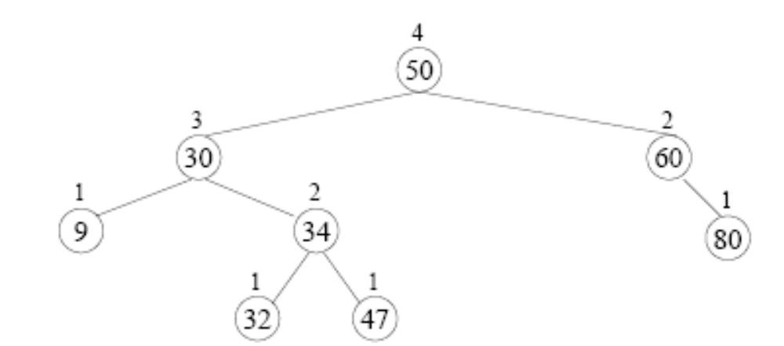
The concept of an AVL Tree
For example, this would be a valid AVL tree

Slide 11
The concept of an AVL Tree
This is sufficient to guarantee that an AVL tree with n nodes has a height of no worse than O (log n)
Therefore, insertions, deletions, and search are also, at worse, O (log n)

Slide 12
The concept of an AVL Tree
For each node in this tree, determine it’s “balance factor” (EQ, TL, or TR)

Slide 13
The concept of an AVL Tree
What would happen if I inserted a node with a key of 90?
Identify the node “closest” to this new node that no longer satisfies the height balanced property.
How could we “fix” the tree? [Hint, the node identified above is often called the pivot node]

Slide 14
Inserting a node in an AVL tree
Insert as “normal” by using recursion to identify where the node is inserted as a new leaf
As the recursion “unwinds” as you come back from the put calls, adjust the balance factor of the nodes on the search path (requires modifying the recursive call to return True/False based on whether the subtree got taller)
As the recursion unwinds if we encounter a pivot node (as in the previous slide) we perform one or two “rotations” to restore the AVL tree’s height balanced property.

Slide 15
The different cases
It turns out there are four cases we need to consider when we unwind from “put” in an AVL tree. These are in fact mirror images of two cases
  Right-Right case
  Right-Left case
  Left-Left case
  Left-Right case

Slide 16
Right-Right case
For example, consider the previous insertion of 90. The pivot node (60) was already TR prior to inserting this node:

Slide 17
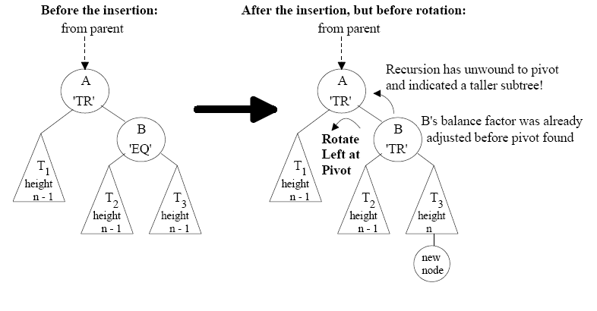
Right-Right case
But that was a specific example, let’s consider the generic example, where the pivot node has a prior balance factor of TR and we make it worse by adding to the far right:

Slide 18
Right-Right case
Notice that the pivot point (A) now is “TR” to an extreme (a factor of two).
It is TR, and the node to it’s right is TR, so we have a Right-Right situation

Slide 19
Right-Right case
We can fix this by doing a “rotate left”

Slide 20
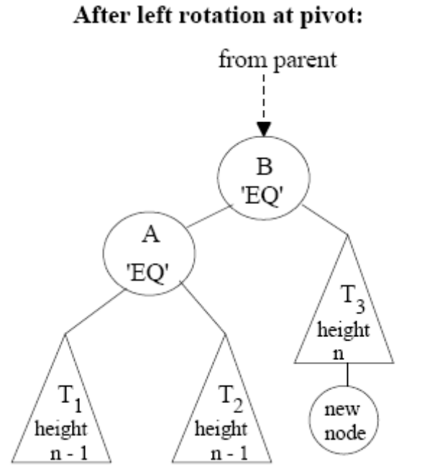
Right-Right case
We can fix this by doing a “rotate left”

Slide 21
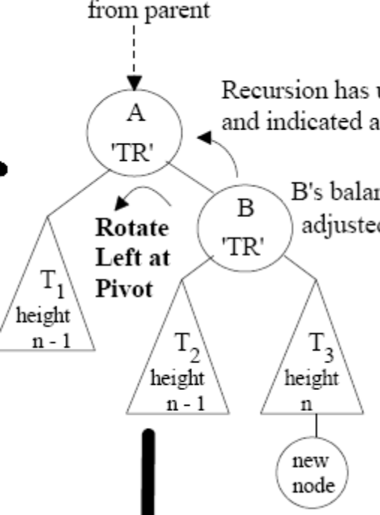
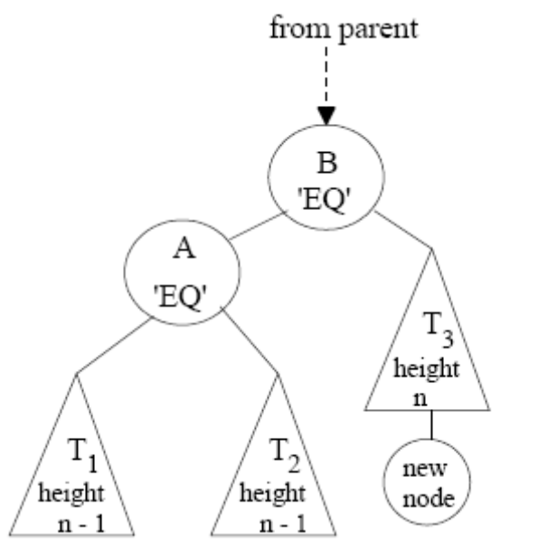
What would the “code” look like?
Assuming you know pivot what would the code look like to accomplish rotateLeft()

Slide 22
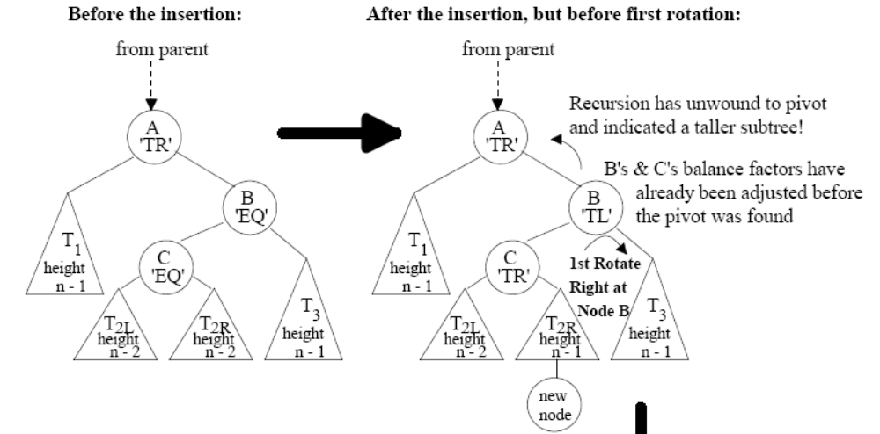
Right-Left case
Let’s consider a different situation:

Slide 23
Right-Left case
Notice that pivot node (A) is now TR to a factor of two. Notice that the node to it’s right is TL (but only to a factor of 1). This is a Right-Left Case.

Slide 24
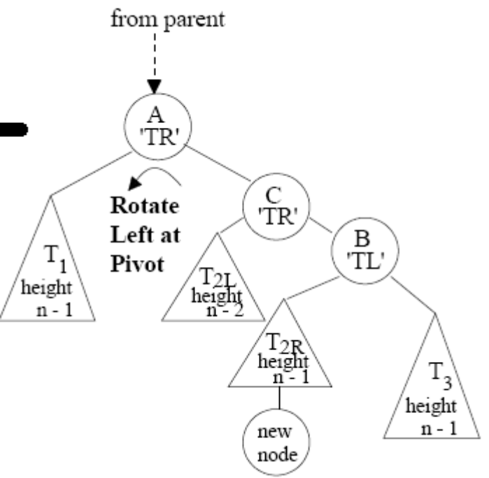
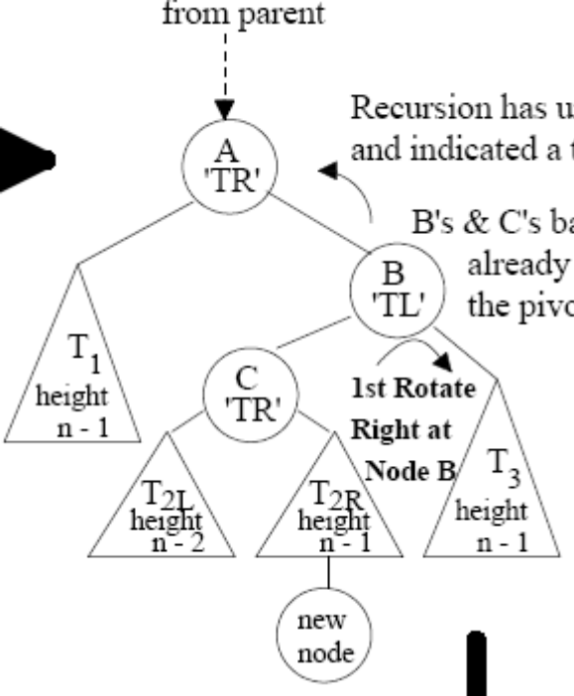
Right-Left case
We can fix this but it requires TWO rotations.
First, we rotate the TL child of the pivot node to the right

Slide 25
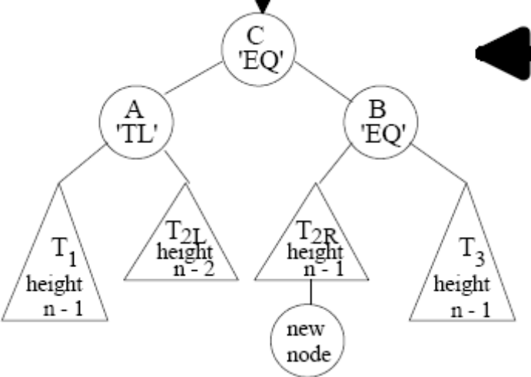
Right-Left case
We can fix this but it requires TWO rotations.
Second, we rotate the TR pivot node to the left

Slide 26
The other two cases
It turns out that the other two cases:
  Left-Left case
  Left-Right case
  Are just mirror versions of the previous cases

