Slide 1
AVL Trees

Slide 2
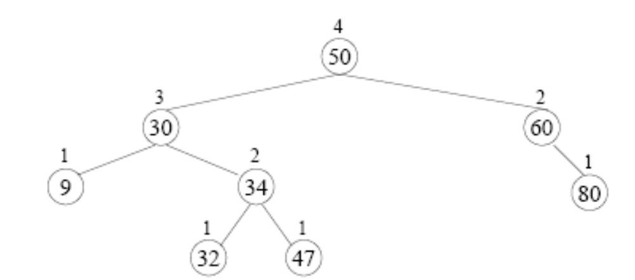
Review - The concept of an AVL Tree
In the context of AVL trees, height balanced means that for every node, the height of it’s left and right subtrees differ by at most one

Slide 3
Review - The concept of an AVL Tree
Each node knows it’s “balance factor” (EQ (0), TL(-1), or TR(1))

Slide 4
Review - Inserting a node in an AVL tree
Insert as “normal” by using recursion to identify where the node is inserted as a new leaf
As the recursion “unwinds” as you come back from the put calls, adjust the balance factor of the nodes on the search path (requires modifying the recursive call to return True/False based on whether the subtree got taller)
As the recursion unwinds if we encounter a pivot node (as in the previous slide) we perform one or two “rotations” to restore the AVL tree’s height balanced property.

Slide 5
The different cases
It turns out there are four cases we need to consider when we unwind from “put” in an AVL tree. These are in fact mirror images of two cases
  Right-Right case
  Right-Left case
  Left-Left case
  Left-Right case

Slide 6
Right-Right case
For example, consider the previous insertion of 90. The pivot node (60) was already TR prior to inserting this node:

Slide 7
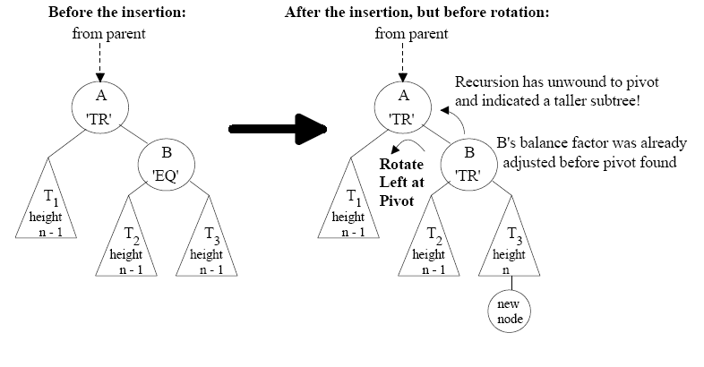
Right-Right case
But that was a specific example, let’s consider the generic example, where the pivot node has a prior balance factor of TR and we make it worse by adding to the far right:

Slide 8
Right-Right case
Notice that the pivot point (A) now is “TR” to an extreme (a factor of two).
It is TR, and the node to it’s right is TR, so we have a Right-Right situation

Slide 9
Right-Right case
We can fix this by doing a “rotate left”

Slide 10
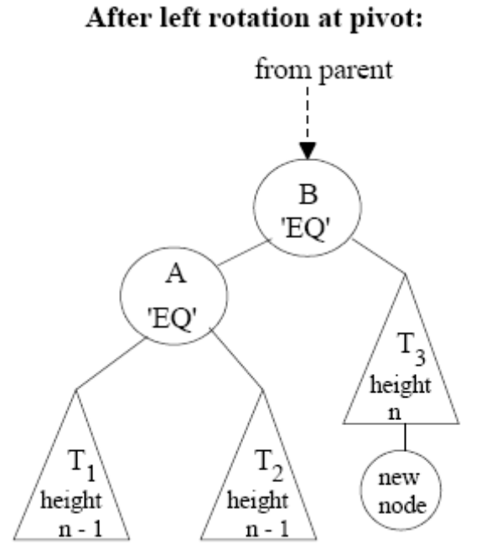
Right-Right case
We can fix this by doing a “rotate left”

Slide 11
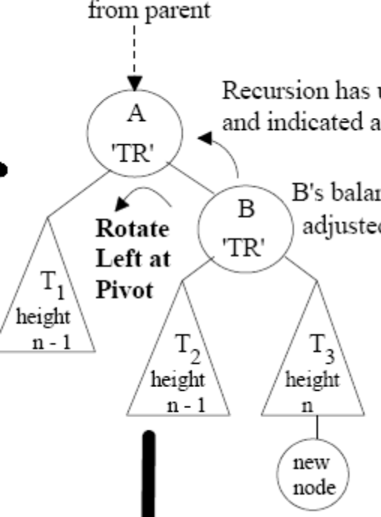
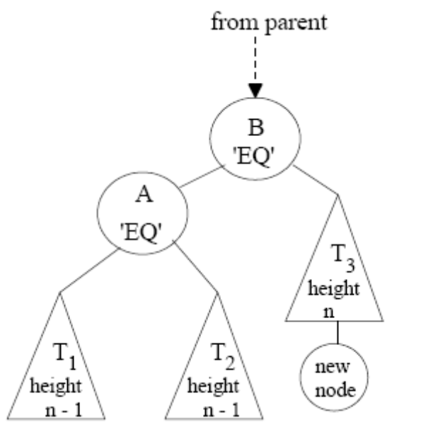
What would the “code” look like?
Assuming you know pivot what would the code look like to accomplish rotateLeft()

Slide 12
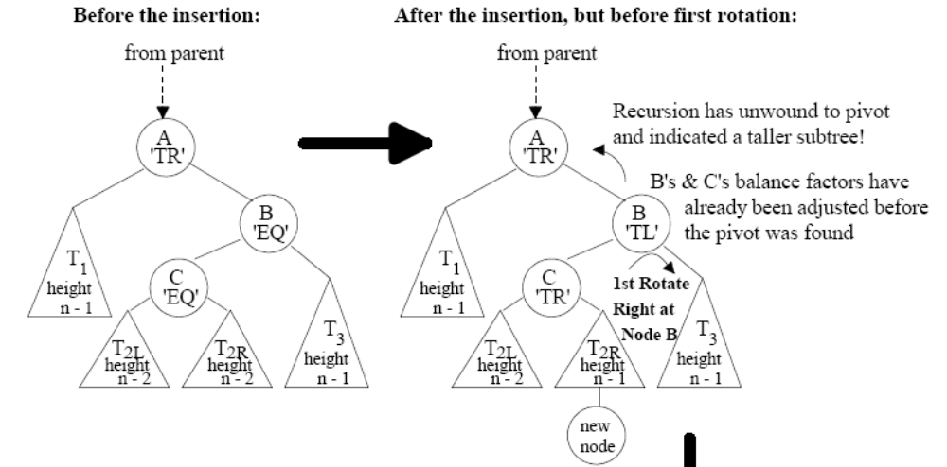
Right-Left case
Let’s consider a different situation:

Slide 13
Right-Left case
Notice that pivot node (A) is now TR to a factor of two. Notice that the node to it’s right is TL (but only to a factor of 1). This is a Right-Left Case.

Slide 14
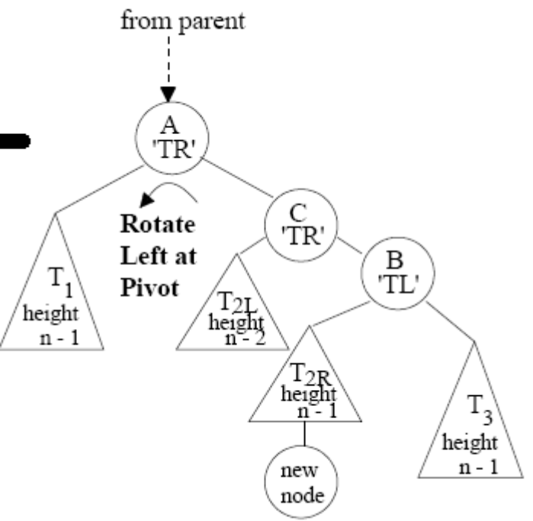
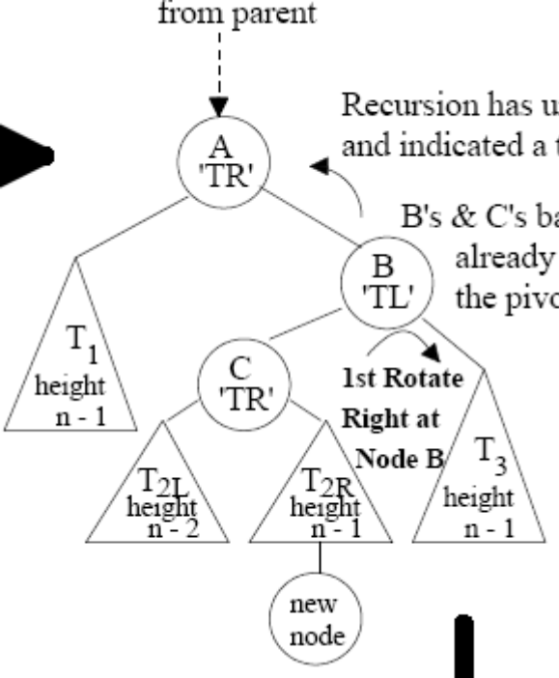
Right-Left case
We can fix this but it requires TWO rotations.
First, we rotate the TL child of the pivot node to the right

Slide 15
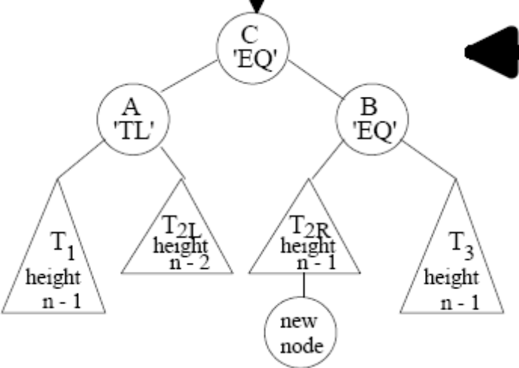
Right-Left case
We can fix this but it requires TWO rotations.
Second, we rotate the TR pivot node to the left

Slide 16
The other two cases
It turns out that the other two cases:
  Left-Left case
  Left-Right case
  Are just mirror versions of the previous cases

