Slide 1
Introduction to Graphs

Slide 2
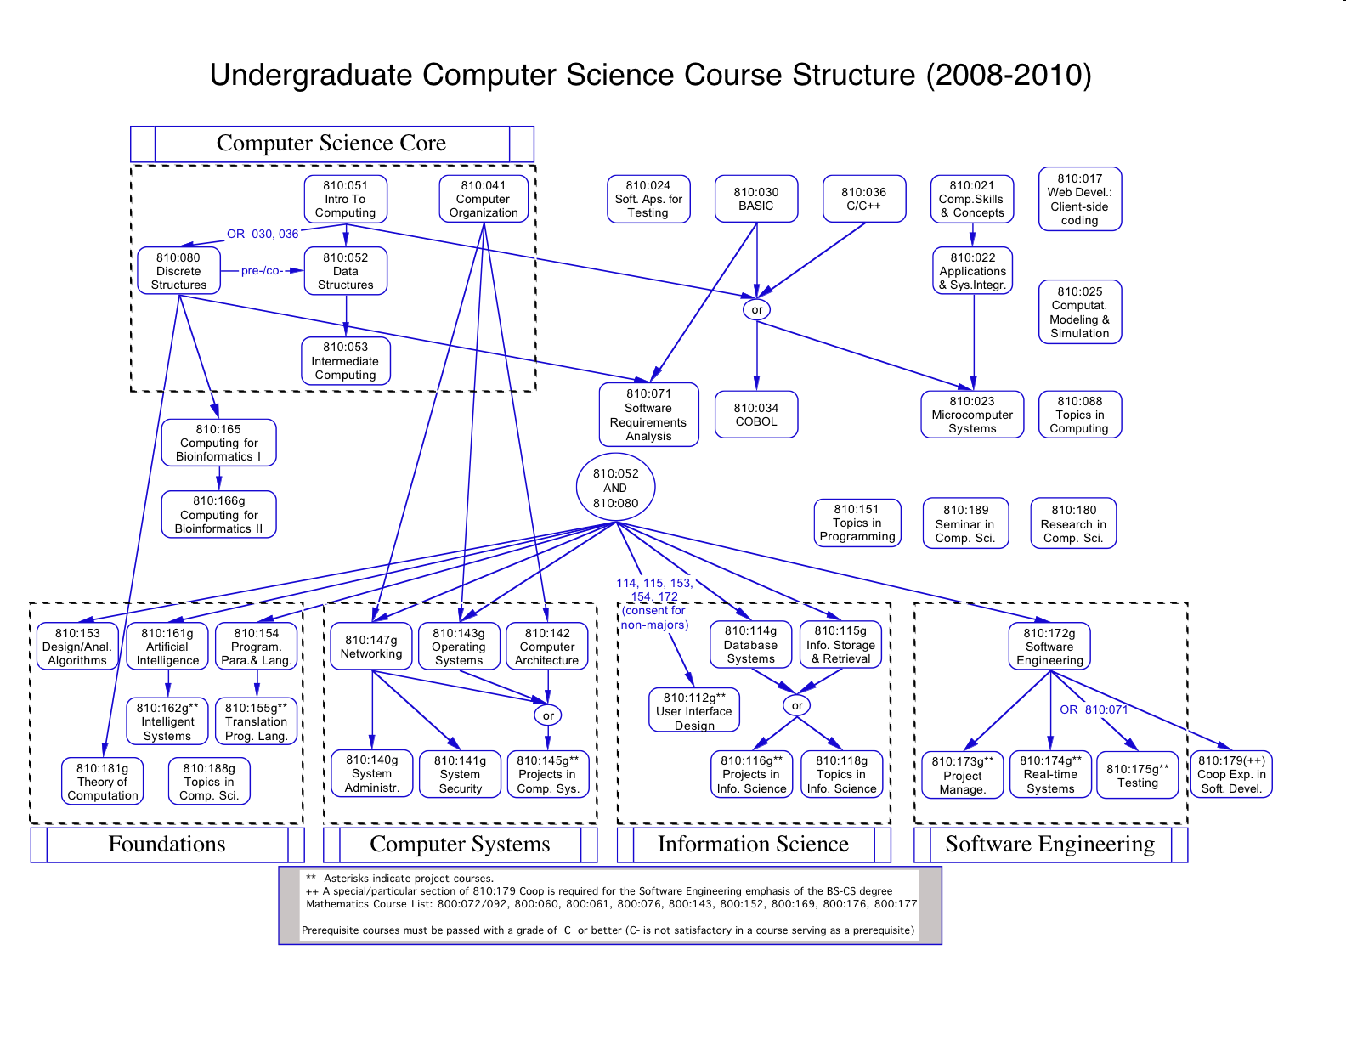

Slide 3


Slide 4
Vocabulary
Vertex
  A node on a graph
Edge
  A connection between two vertices to show there is a relationship between those vertices.
  Edges may be one way or two way.
Weight
  Indicate the cost to go along that edge
  Not required. If absent, the weights are considered equal

Slide 5
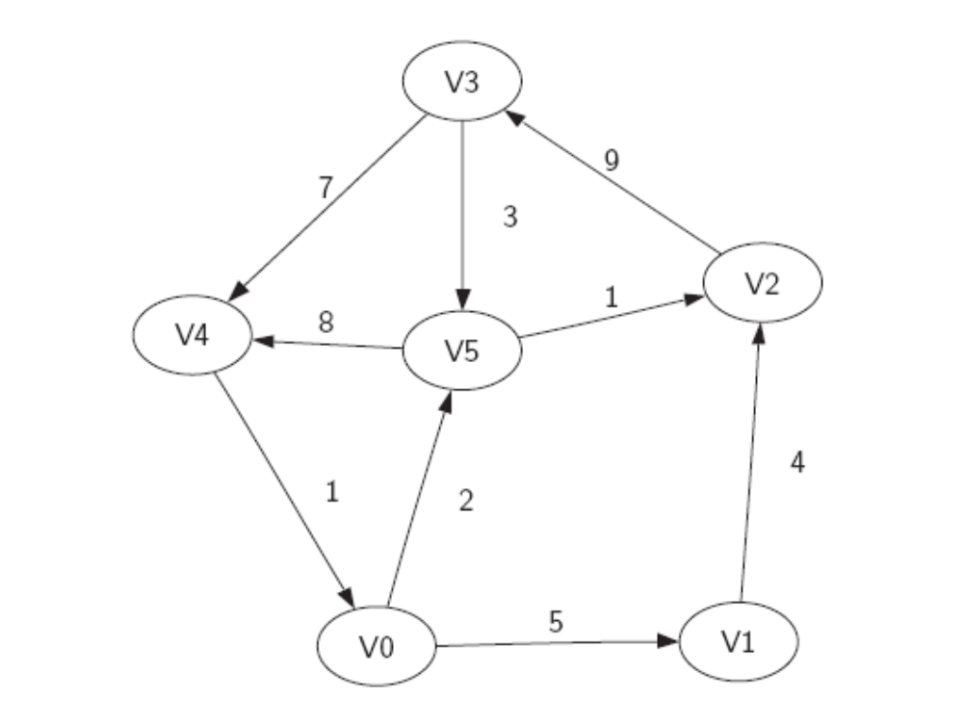

Slide 6
Mathematical Definition
A graph G is defined as
  G = (V,E)
where V is the set of vertices and E is a set of edges.
An edge, e ε E is defined as a tuple (v1,v2,w) where v1,v2 ε V and w is the weight associated with the edge

Slide 7
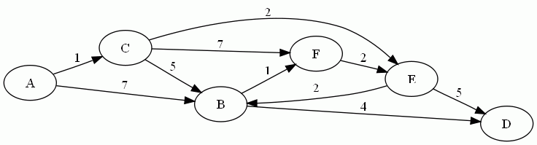
Write the mathematical description of the following set, S1.

Slide 8
Additional Vocabulary
Path
  A sequence of vertices that are connected by edges. (Although we normally define a path by the edges travelled).
  Contains both an unweighted path length (the number of edges) and a weighted path length (the sum of the weights of those edges)
Cycle
  A path that starts and ends at the same vertex.
  We can define acyclic graphs and directed acyclic graphs

Slide 9
Interface to a graph structure
Graph()
addVertex()
addEdge()
getVertex()
getVertices()

Slide 10
Representation
What might you do to store a graph?

Slide 11
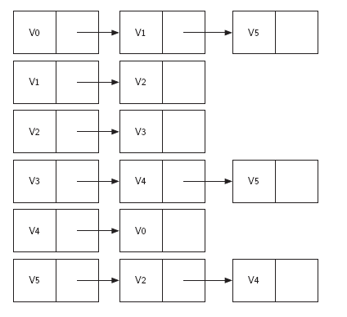
Representation
An Adjacency List

Slide 12
Representation
What is the adjacency list for

Slide 13
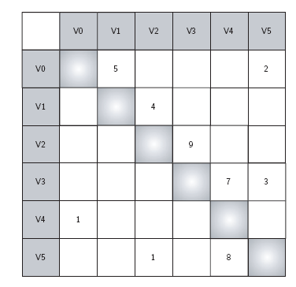
Representation
An Adjacency Matrix

Slide 14
Representation
What is the adjacency matrix for

