Slide 1
Implementing Graphs
Using Graphs

Slide 2
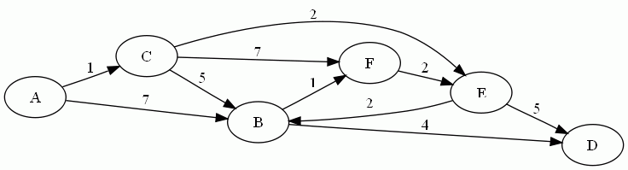
Last time we introduced graphs

Slide 3
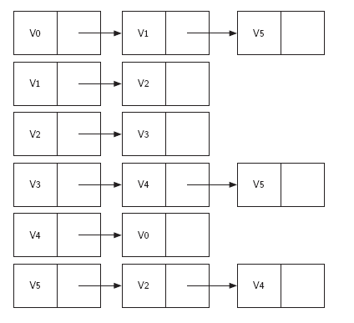
Representation
An Adjacency List

Slide 4
Interface to a graph structure
Graph()
addVertex()
addEdge()
getVertex()
getVertices()
So what kinds of things do we need to keep track of?
Where?

Slide 5
Minimum Vertex class
class Vertex:
def __init__(self,num):
self.id = num
self.adj = []
self.cost = {}
def addNeighbor(self,nbr,cost=0):
self.adj.append(nbr)
self.cost[nbr] = cost
def __str__(self):
return str(self.id) + "\n"
def getCost(self,nbr):
return self.cost[nbr]
def setCost(self,nbr,cost):
self.cost[nbr] = cost
def getAdj(self):
return self.adj
def getId(self):
return self.id

Slide 6
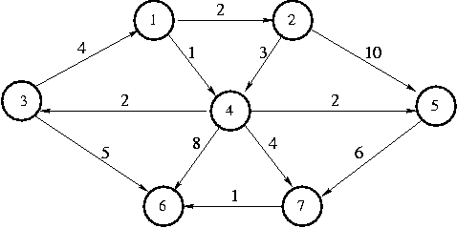
Building a graph or two
What sequence of commands would build the graph we looked at in yesterday’s lab?

Slide 7
Yeah, I don’t want to build that by hand again
PA07
  Write code that, given a text file containing a graph description, can build the Graph() represented by that description
  Write cdoe that, given a Graph() can write a text file containing a description of that file

Slide 8

Using graphs - searching
Suppose I wanted to move from Arad to Bucharest. How might I do it?

Slide 9
Searching
It’s “easy” to see the solution when you see the graph, but consider what the graph ADT sees:
(Arad,Zerind, 75), (Arad,Sibiu,140), (Arad,Timisoara,118), (Zerind,Oradea,71), (Oradea,Sibiu,151),(Sibiu,Fagaras,99), (Sibiu,Rimnicu,80), (Timisoara,Lugoj,111), ….

Slide 10
Two kinds of search
Breadth-First Search (BFS)
  You consider all vertices reachable in a path of length N before considering any vertices reachable in a path of length N+1
Depth-First Search (DFS)
  You follow a single edge from v1 to vn. You then recursively follow the edges from vn to vm, vk, etc before considering alternate edges from v1.
Both of these are hard to see from descriptions, but easy to see when you consider examples.

