Slide 1
Design Patterns

Slide 2
What is a pattern?
A pattern is a solution to a reoccurring problem in a context
Context - Situation in which the pattern applies
Problem - Goal in the given context referencing the constraints imposed by the context
Solution - Describes a general way to achieve the goal and the set of constraints

Slide 3
Benefits of Design patterns
Reuse solutions, not code
Benefit by learning from the experience of others.
You do not have to reinvent solutions for commonly recurring problems
Establish Common Terminology
Communication and teamwork require a common base of vocabulary and a common viewpoint of the problem.
Design patterns provide a common point of reference during the analysis and design phase of a project.
Higher Level perspective
Focus on the problem and on the process of design and object orientation. This frees you from the tyranny of dealing with the details too early.

Slide 4
Object-oriented Design patterns principles
Design to interfaces
Write interface classes and then produce implementation classes
Abstract classes satisfy this requirement
Encapsulate what varies
Separate code that stays the same to code that varies
Types should be closed for modification but open for extension
Maximize re-use
Designing code with change in mind can lead to quicker releases and fewer bugs

Slide 5
Inheritance vs composition
Inheritance was seen as a powerful tool in early days of OO
Over time it has been found to be far less useful, systems built using large inheritance hierarchies have proven to be fragile.
A single change in a common base class can have far reaching effects.
Composition can deliver many of the benefits of inheritance such as code re-use.

Slide 6
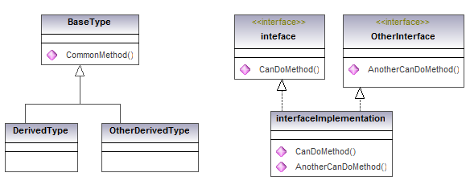
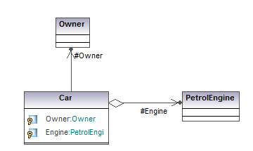
Class Diagrams, Relationships
Inheritance: Is-kind-of
Interface: Can Do
Association: one object holds a reference to another
Composition: the item being reference is actually residing in the parent object
Notes:
There are effectively two forms of inheritance is-kind-of and Can Do. Kind of style behaviour is stating that a class may very well inherit behaviour from the base class since it is a similar kind of entity, where as Can Do implies the object is capable of doing something probably in its own unique way.
There is often a lot of confusion over what is the difference between Association, Aggregation and Composition...
Association is simply one object holds a reference to another...
Aggregation is a more stronger association where by when the object holding the reference is disposed any aggregated objects are also disposed. In the example above it would seem reasonable if the car was crushed the engine would also cease to exist...where as we would not typically expect the owner to have the same life time model as the car.
Finally Composition is seen to be even stronger form of Aggregation...often this is used to represent relationships such that the item being reference is actually residing in the parent object...In the case of .NET we could consider a value type...In practice there is little to be gained by representing this level of relationship in the design.
Further confusion is introduced by the use of the term composition in design pattern speak encapsulating all forms of association...

Slide 7
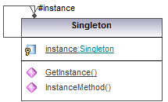
Singleton pattern
Objects that have a single instance.
lobal point of access to the object
Lazy initialization
Thread safe

Slide 8
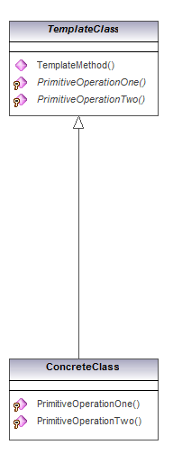
Template method pattern
Template method defines the skeleton of an algorithm in an operation, deferring some steps to subclasses.
It lets subclasses redefine certain steps of an algorithm without changing the algorithm's structure.

Slide 9
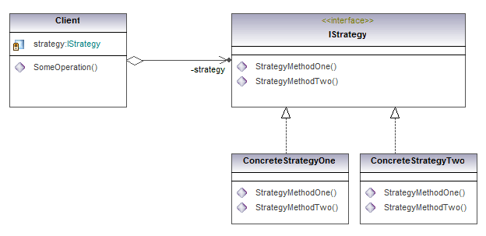
strategy pattern
Template method used abstract methods and inheritance to call different behavior
Alternatively supply implementation behavior at run time using composition

Slide 10
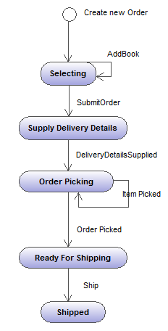
State machine
Objects can behave differently over time. The State Machine pattern satisfies the need for state awareness.
An Order type is created to represent an order as it passes through the business process. The ordering process goes through a series of steps triggered by events.
Select items
Set delivery details
Items are selected
Order is shipped
The Order type is responsible for ensuring the business process is followed.

Slide 11
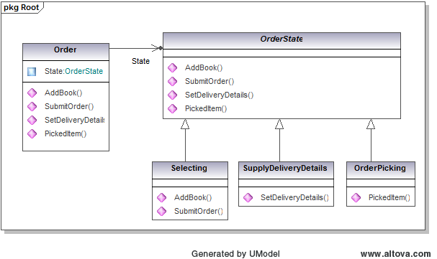
State pattern
Localize the behavior of each state so that changes to one state don’t effect another.
Implement each state as its own nested class.
Have the Order object delegate behavior to the current state object.

Slide 12
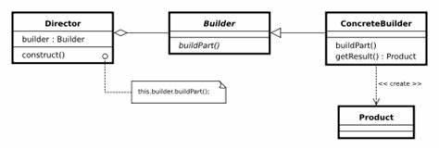
builder pattern
Builders allow the construction of a complex object over a series of steps
Builder hides the complexity of the construction
Complex object representation is independent of method of construction
Construction methods typically return self to allow natural method chaining
Build method returns complex object

Slide 13
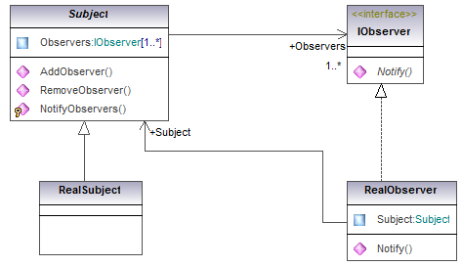
observer pattern
Patterns for creating events, event notification, and event handling.
Observer is the event client, which implements a handler.
Subject is the object or target. This is the event server responsible for notifying the client objects. In addition, there could be no observers.

Slide 14
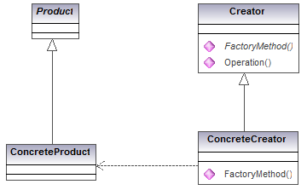
Factory method pattern
Define an interface for creating an object, but let subclasses decide which class to instantiate.
Factory Method lets a class defer instantiation to subclasses

Slide 15
Other useful patterns
There are many other widely used GOF patterns
Command - a behavioral design pattern in which an object is used to encapsulate all information needed to perform an action or trigger an event at a later time.
Façade - hides the complexities of the system and provides an interface to the client using which the client can access the system.
Adapter - a structural design pattern that allows objects with incompatible interfaces to collaborate.
Decorator - a structural design pattern that lets you attach new behaviors to objects by placing these objects inside special wrapper objects that contain the behaviors.
Proxy - a structural design pattern that lets you provide a substitute or placeholder for another object.
Many more…
Design-Patterns-GoF

