Slide 1
Pre-demo
Nodes
cd /Users/stanleytsang/corda-git/tokenTemplate/cordapp-template-kotlin
./gradlew clean deployNodes
./build/nodes/runnodes
start SettleStock buyer: Citi Bank, seller: JP Morgan, symbol: AV, executedQty: 1000, executedPrice: 1
start SettleStock buyer: Citi Bank, seller: JP Morgan, symbol: 66570, executedQty: 10, executedPrice: 60000
UI (javaFx)
cd /Users/stanleytsang/corda-git/DigitalExchange2/out/artifacts/DigitalExchange2
java -jar ./DigitalExchange2.jar localhost:10006 E
java -jar ./DigitalExchange2.jar localhost:10009 I
java -jar ./DigitalExchange2.jar localhost:10015 P
java -jar ./DigitalExchange2.jar localhost:10012 P

Slide 2
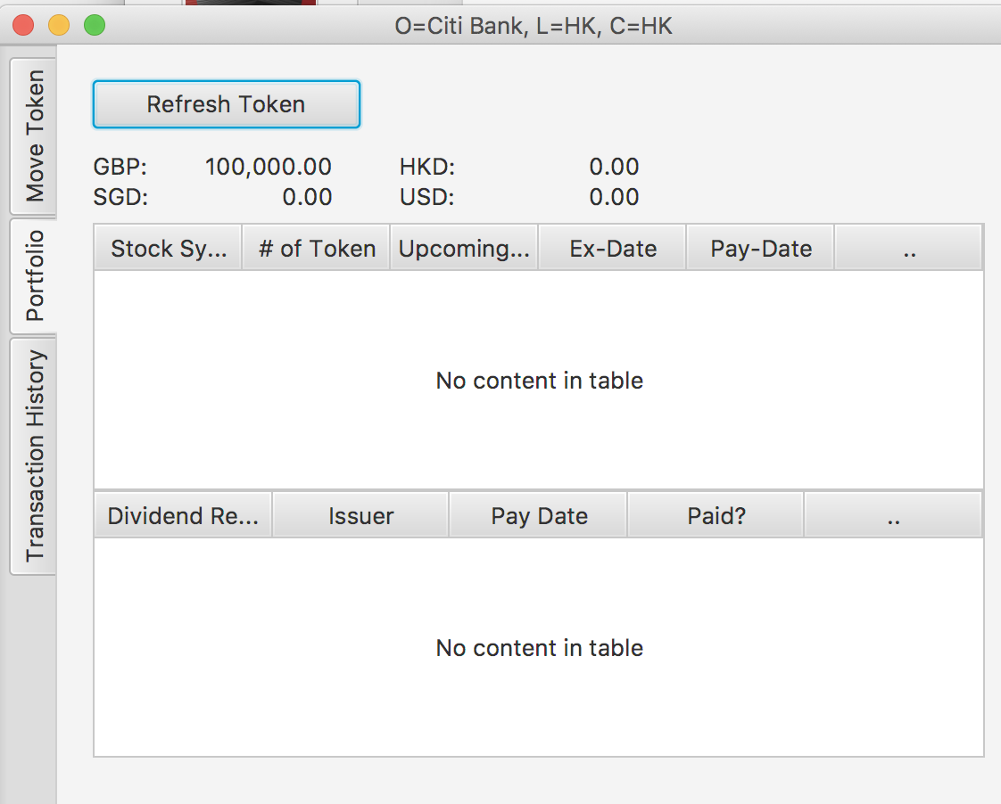

Stock Exchange - Demo Scenario
Exchange
Issue Fiat token to investors for trading stock
Trigger instant settlement flow when 2 orders get matched
Issuer
Issue stock tokens
Dividend
Announce dividend
Issue “dividend receivable” to stock holders on ex-date
Pay stock holders the dividend on pay-date
CITI Bank & JP Morgan (dealer-brokers, institutional investors..)
Buy/Sell stock tokens
*”dividend receivable” is the right to get dividend payment on pay-date
*stock holder entitle to get the “dividend receivable” if hold just before the ex-date
* stock holder get fiat token by redeeming “dividend receivable” on pay-date
RPC
RPC
Exchange
Issuer
Notary
Citi Bank
JP Morgan
RPC
RPC

Slide 3
Post-trade Settlement Demo

Slide 4
Demo - Post-trade Settlement for Securities
Fiat (Cash) & Securities Tokenization
Moving Tokens
Instant Settlement (DvP)

Slide 5
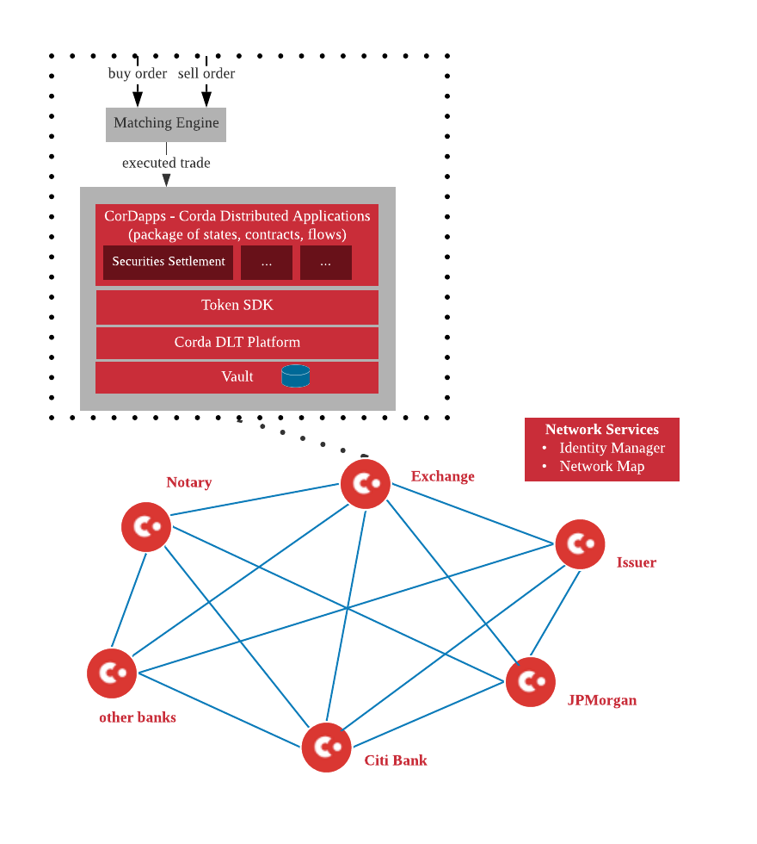
Architecture & Demo Scenario
Exchange
Issue Fiat token to investors upon receiving collateral from them
Start instant settlement when 2 orders get matched
Issuer
Issue stock tokens (primary market)
Corporate Actions
Announce dividend
Issue “dividend receivable” to stock holders on ex-date
Pay stock holders the dividend on pay-date
CITI Bank & JP Morgan (dealer-brokers, prop trading..)
Buy/Sell stock tokens
*”dividend receivable” is the right to get dividend payment on pay-date
*stock holder entitle to get the “dividend receivable” if hold just before the ex-date
* stock holder get fiat token by redeeming “dividend receivable” on pay-date

Slide 6

Issue Fiat Token (Exchange as the Fiat Token Issuer)
Transaction
INPUT STATE
OUTPUT STATE
Fiat Token
Bank accounts
CitiBank: $30k
Exchange: $0
Token Type: HKD
Amount: 30,000
Issued By: Exchange
Held by: CitiBank
IssueTokenCommand
Bank balance transfer… leads to… fiat token creation on Corda
val hkdTokenType = FiatCurrency.getInstance(“HKD”)
subFlow(IssueTokens(listOf(30,000 of hkdtokenType issuedBy ourIdentity heldBy citiBank)))
//Token SDK provides generic subFlows to issue/move/redeem any type of tokens

Slide 7
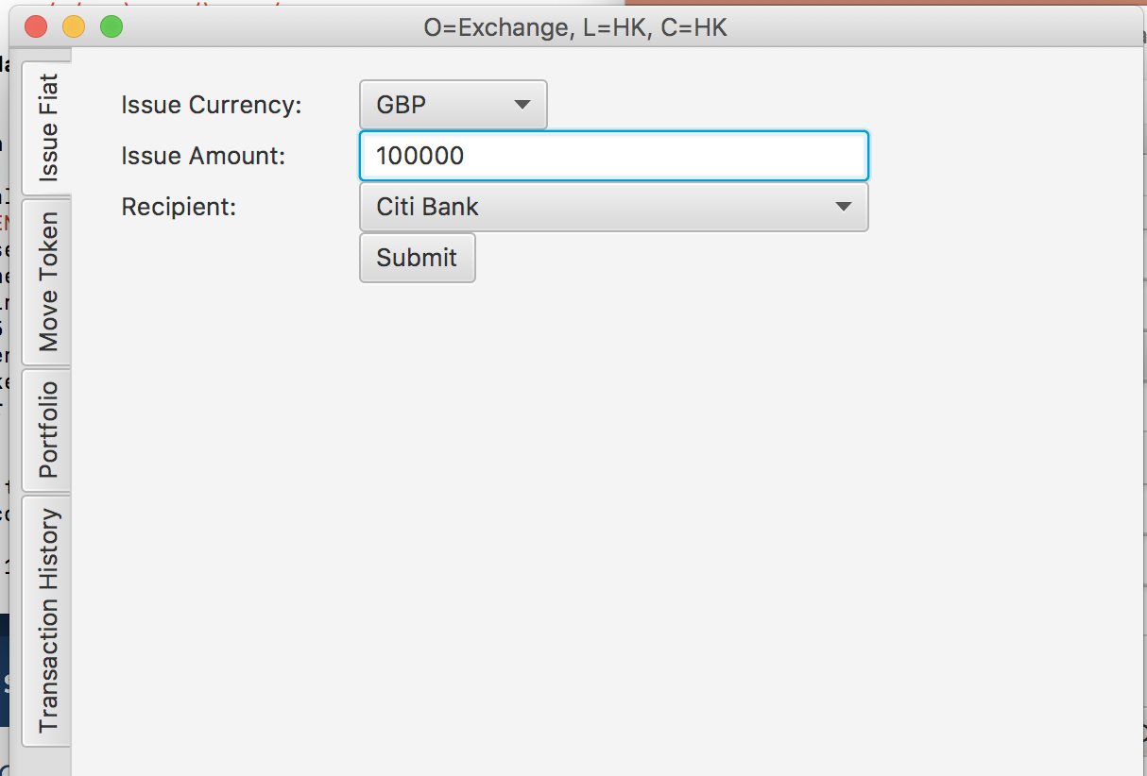
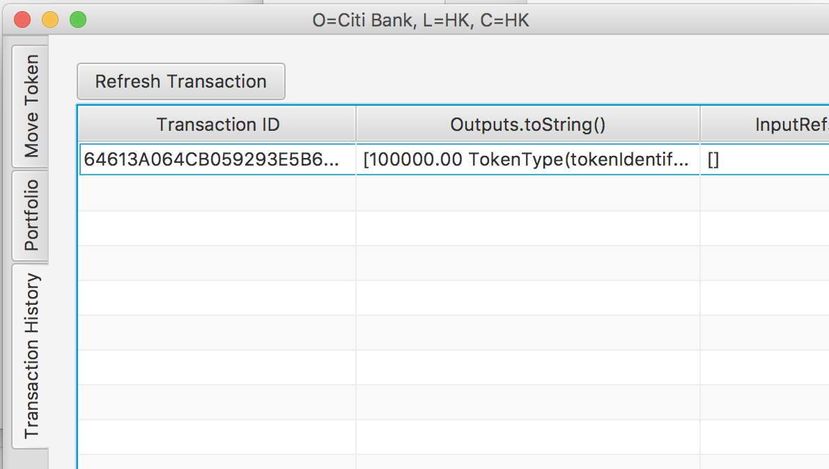
Demo - Issue Fiat Token
Participants deposit money into Exchange’s bank account, Exchange then issues them the same value of fiat token for buying stock, paying dividend..
Participants can withdraw the money by redeeming the fiat token
Example:
Exchange issues 2Million KRW tokens to Citi bank
Citi bank can see the tokens in the portfolio page
Only Exchange & Citi bank can see the transaction

Slide 8
Issue Stock Token
OUTPUT STATE
Stock: EvolvableTokenType
INPUT STATE
symbol: AV
name: Aviva Insurance Inc
currency: HKD
dividend:
maintainers: Issuer
CreateEvolvableTokens
//Create stock token type instance for AV
val av = Stock(symbol= “AV”, name= “Aviva”, currency = “HKD", maintainers = listOf(ourIdentity))
subFlow(CreateEvolvableTokens(lg.withNotary(getPreferredNotary(serviceHub)),listOf(exchange))
OUTPUT STATE
FungibleToken
INPUT STATE
Token Type: av.toPointer()
Amount: 3,000,000
Issued By: Issuer
Held by: issuer
IssueToken
//Issue stock token for AV
subFlow(IssueTokens(listOf(3,000,000 of av.toPointer() issuedBy ourIdentity heldBy ourIdentity)))

Slide 9
Move Tokens
INPUT STATE
OUTPUT STATE
FungibleToken
FungibleToken
Token Type: av.toPointer()
Amount: 3,000
Issued By: Issuer
Held by: Issuer
Token Type: av.toPointer()
Amount: 3,000
Issued By: Issuer
Held by: JPMorgan
HISTORIC
moveTokenCommand
//Initiating flow (JP Morgan)
subFlow(MoveFungibleTokensFlow(listOf(PartyAndAmount(citiBank, 3,000 of av.toPointer())), listOf(citiBankSession)))
//Responding flow (Citi bank)
subFlow(MoveTokensFlowHandler(initatorSession))

Slide 10
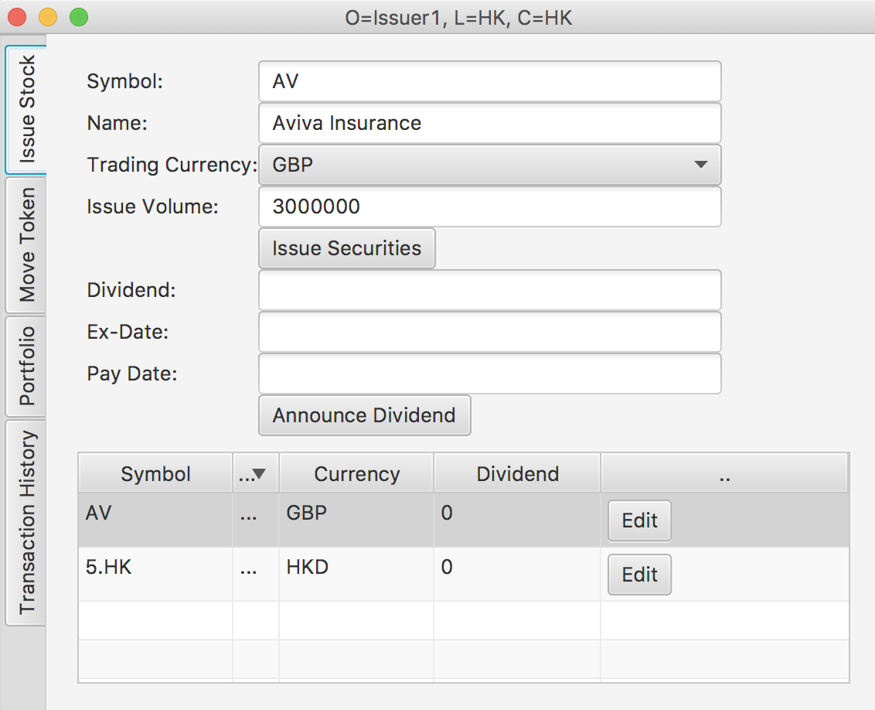
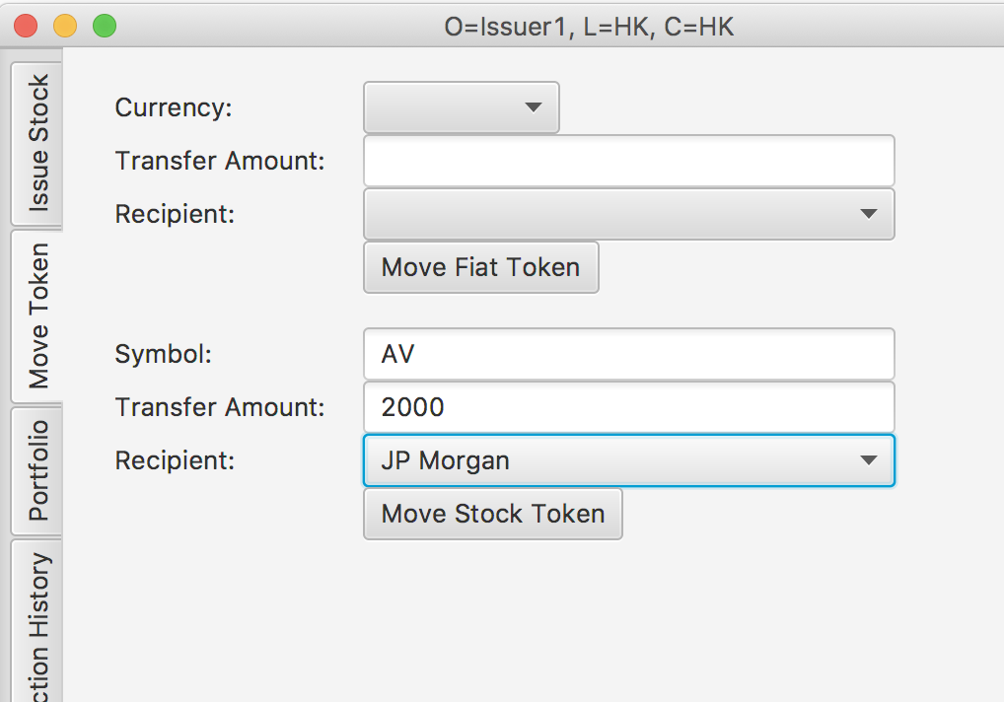
Demo: Issue/Move Stock Token
IPO: Issuer issue stock tokens and then move to participants
Example:
Issuer issues totally 3M stock tokens for Aviva
Move 2000 tokens to JP Morgan

Slide 11
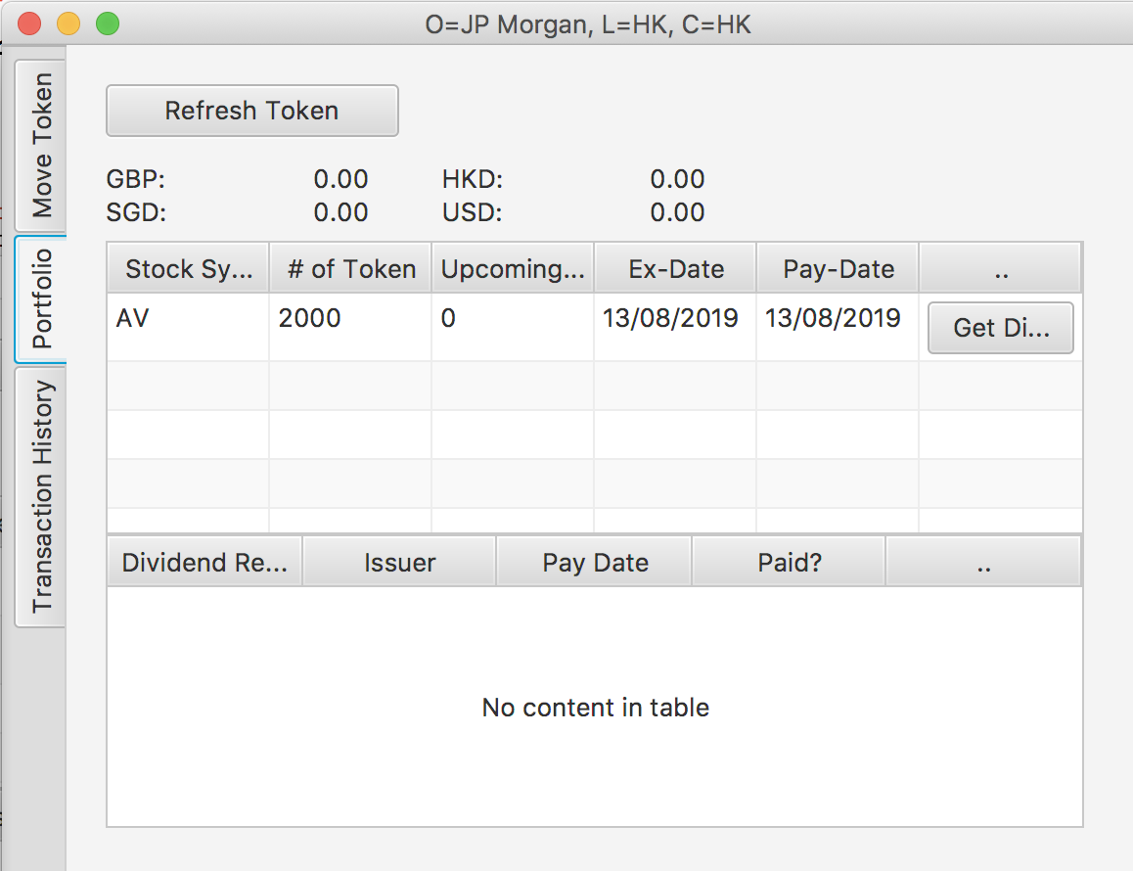
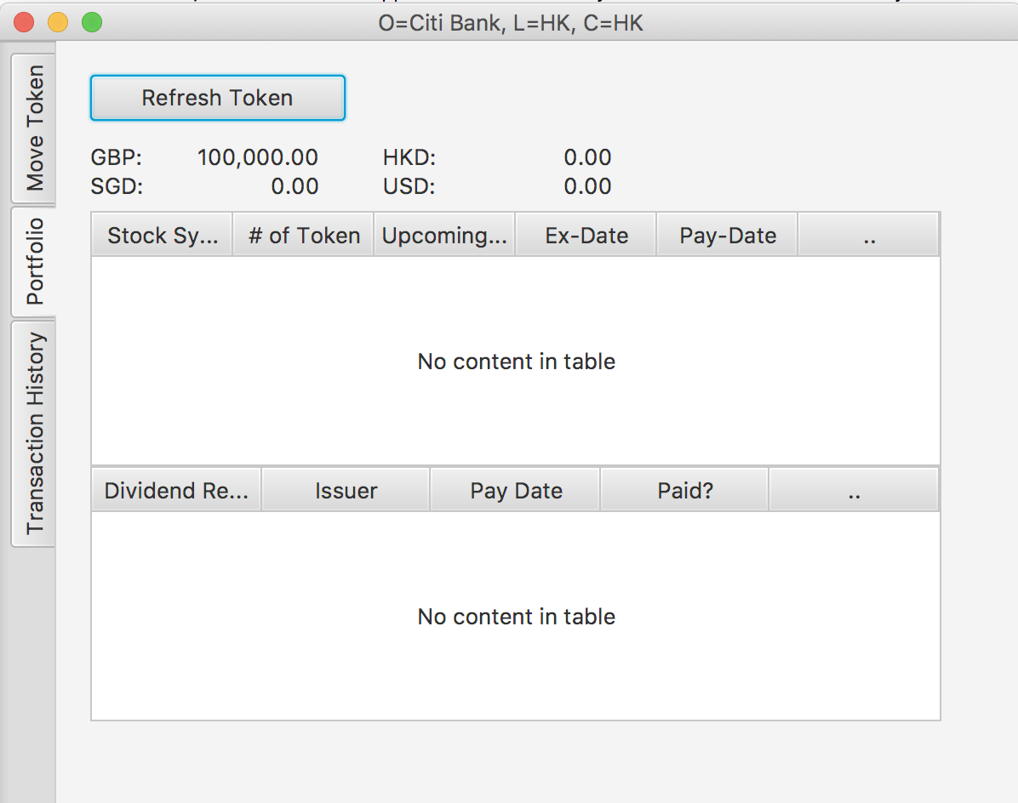
Demo: Portfolio
Participants can check the portfolio for both fiat and stock token

Slide 12
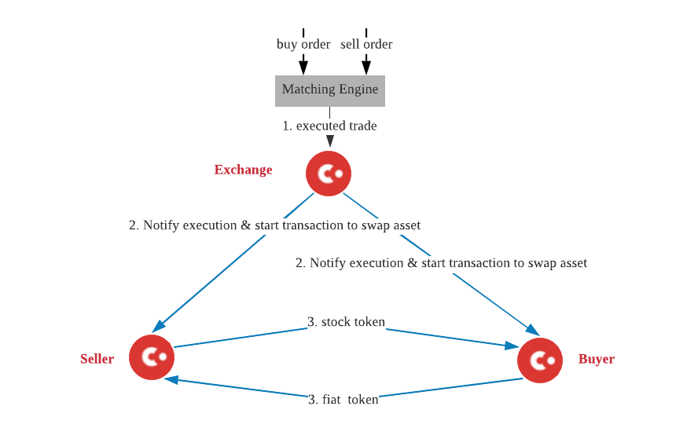
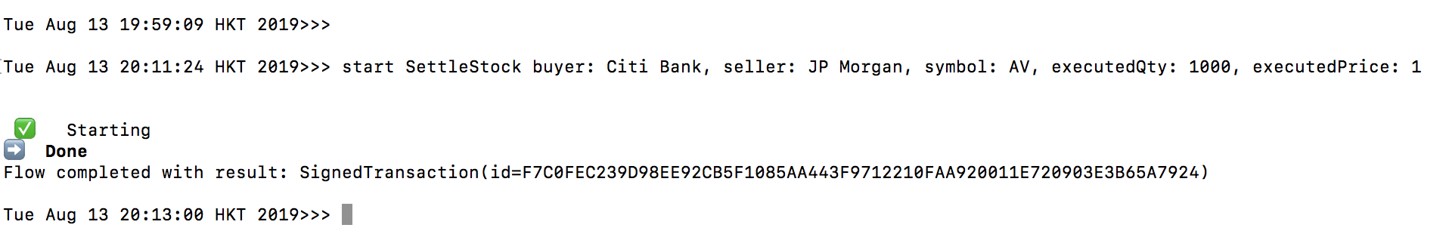
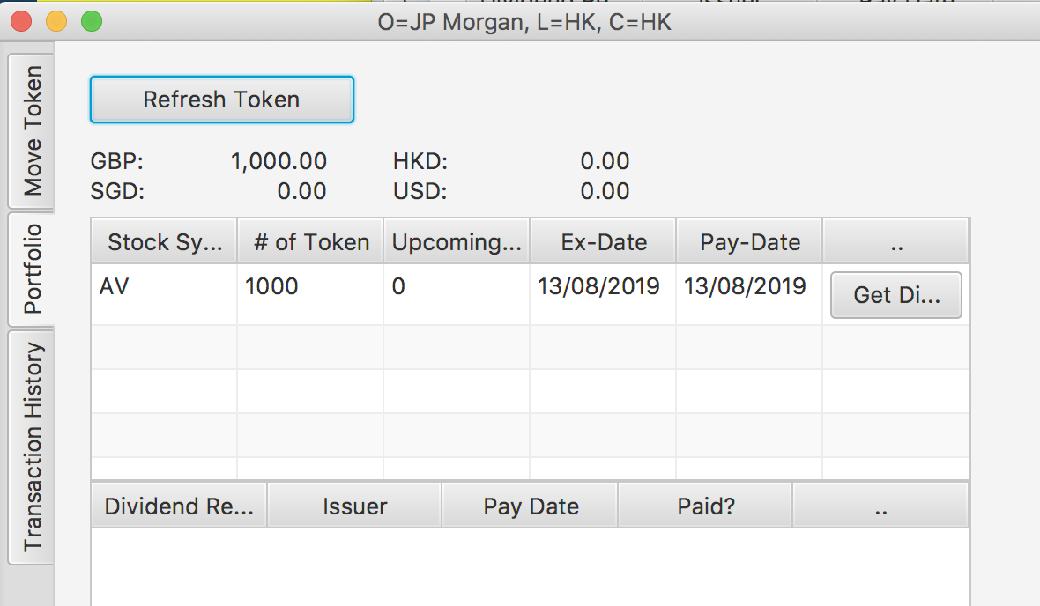
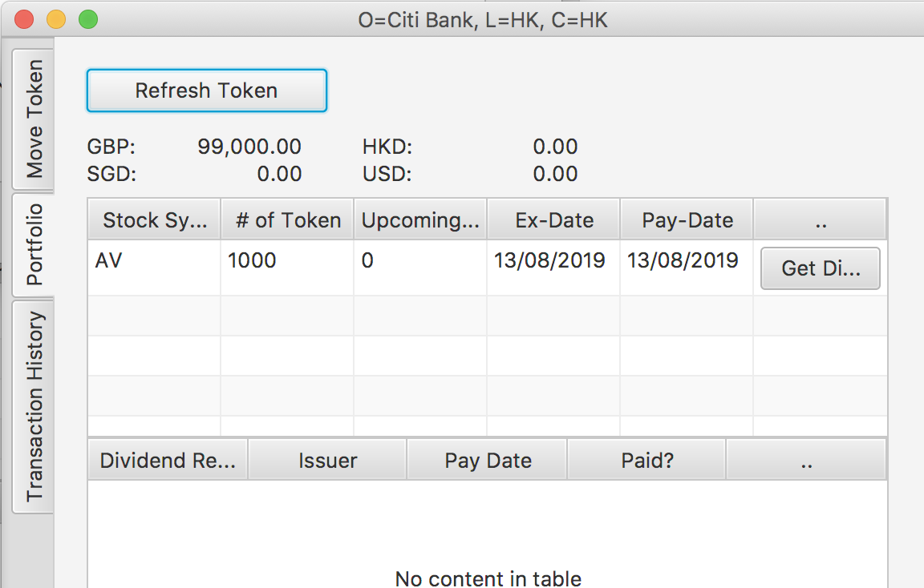
Demo: Instant Settlement
JP & Citi send orders to exchange’s matching engine.
Once matched, the executed trade is sent to the exchange’s Corda node to start the settlement flow
Example:
In the demo, trigger settlement flow from node shell manually
start SettleStock buyer: Citi Bank, seller: JP Morgan, symbol: AV, executedQty: 1000, executedPrice: 1

Slide 13
Instant Settlement Flow – swap between fiat & stock tokens
Buyer (Citi)
Exchange
Seller (JP)
Send buy order
Send sell order
Matching
Engine
Order matched
ExecutionNotification
settleStockFlow
TokenSelection().generateMove
1. inputFiatToken: StateAndRef<FungibleToken>
2. outFiatToken: FungibleToken
ExecutionNotification
TokenSelection().generateMove
Cordapp
1. inputStockToken: StateAndRef<FungibleToke>
2. outStockToken: FungibleToken
CollectSignaturesFlow
SignTransactionFlow
SignTransactionFlow
Responder Signatures
FinalityFlow

Slide 14
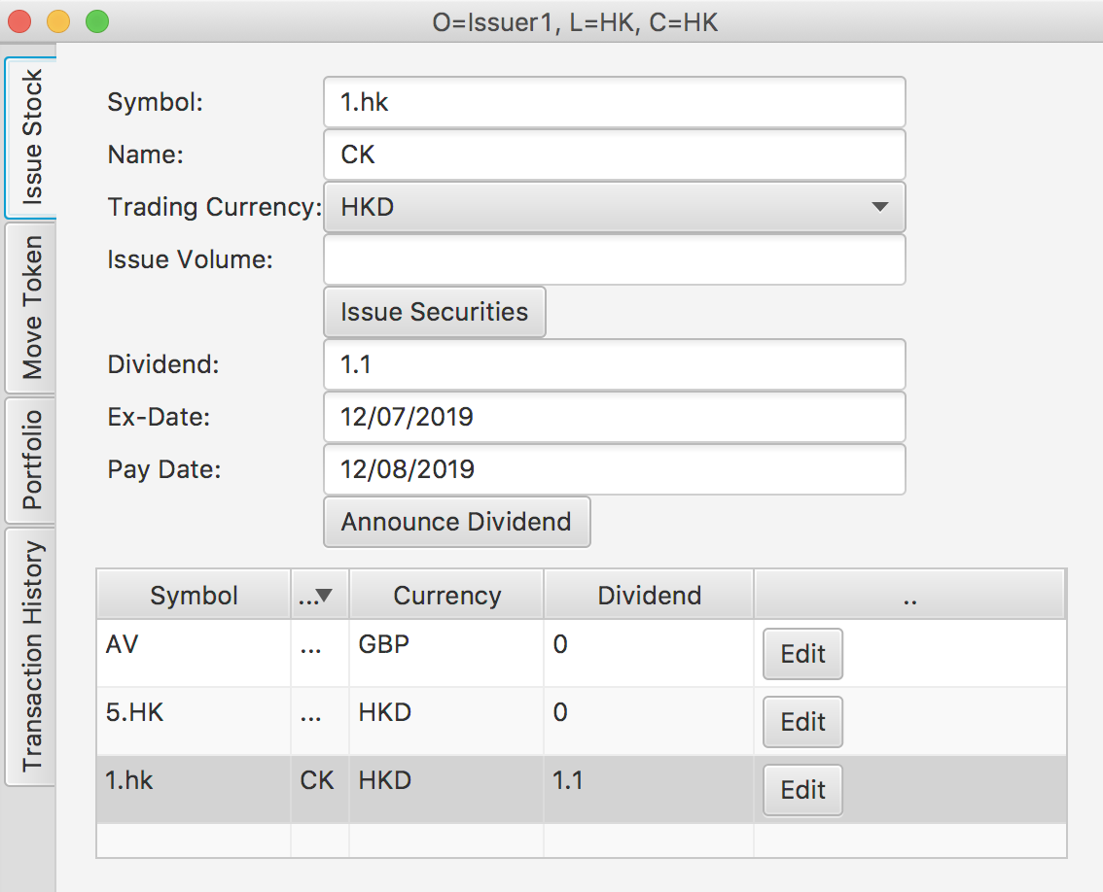
Announce Dividend
Issuer announce dividend and should input:
dividend per token
Ex-Date (entitle to get the dividend receivable if hold just before the ex-date)
Pay-Date (get payment by redeeming dividend receivable on Pay-date)

Slide 15
Request Dividend Receivable on Ex-Date
Stock: EvolvableTokenType
symbol: AV
name: Aviva Insurance
currency: GBP
dividend: 0.1
Ex-date: 13/09/2019
Pay-date: 13/10/2019
DividendReceivable
issuer: issuer
holder: JP Morgan
payDate: 13/10/2019
dividendAmount: 300
isPay: false
FungibleToken
Token Type: aviva.toPointer()
Amount: 3,000
Issued By: Issuer
Held by: JP Morgan
createDividendReceivable
[signers: Issuer, JPMorgan]
FungibleToken
Token Type: aviva.toPointer()
Amount: 3,000
Issued By: Issuer
Held by: JP Morgan
Notes:
How to prevent double spend?

Slide 16
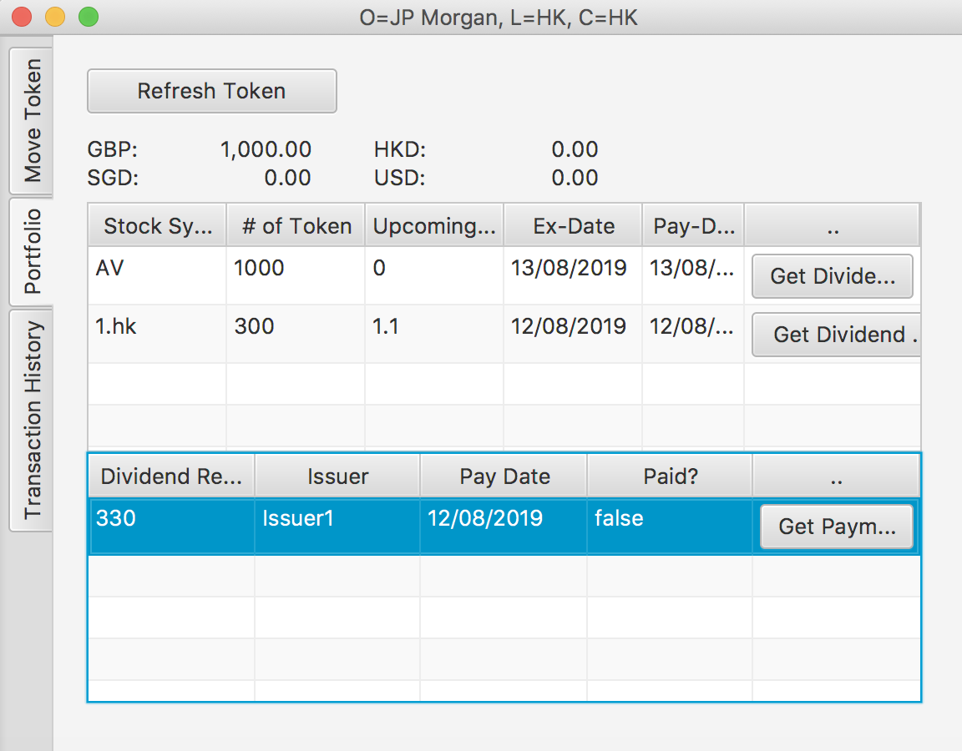
Demo: Request Dividend Receivable on Ex-Date
On Ex-date, the Dividend Receivable should be automatically generated by running cron-job. For demo purpose, the token holder click “Get Dividend Receivable” to get it.
Dividend Receivable is a obligation which the issuer should pay the holder on pay date

Slide 17
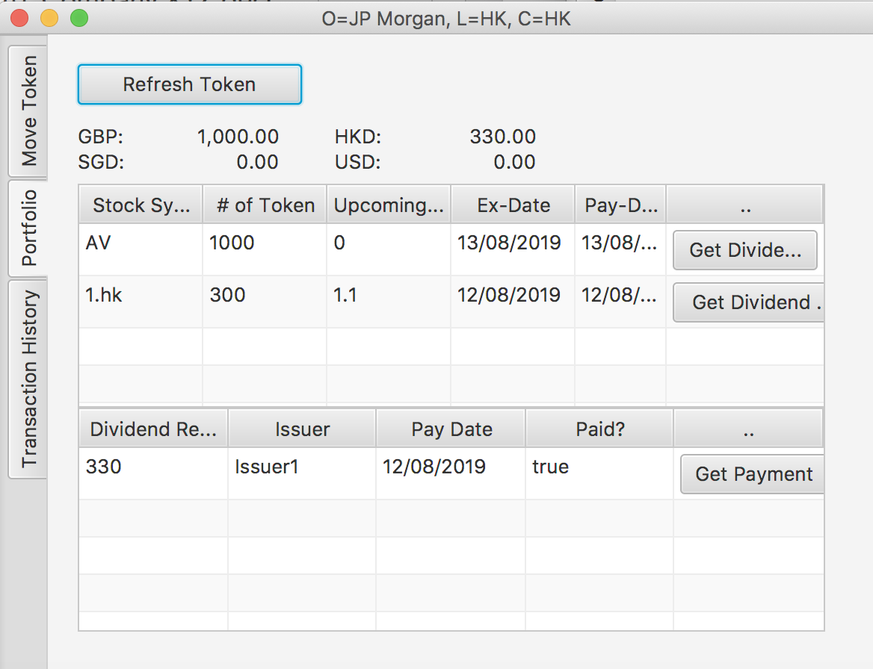
Demo: Request payment on pay date
On pay-date, the DVP (dividend receivable vs payment) is triggered by running cron-job. For demo purpose, the token holder click “Get payment” to trigger it.
Example:
Holder click “Get Payment”
The Dividend Receivable become “paid”
The HKD token is increased by the dividend amount

