Slide 1
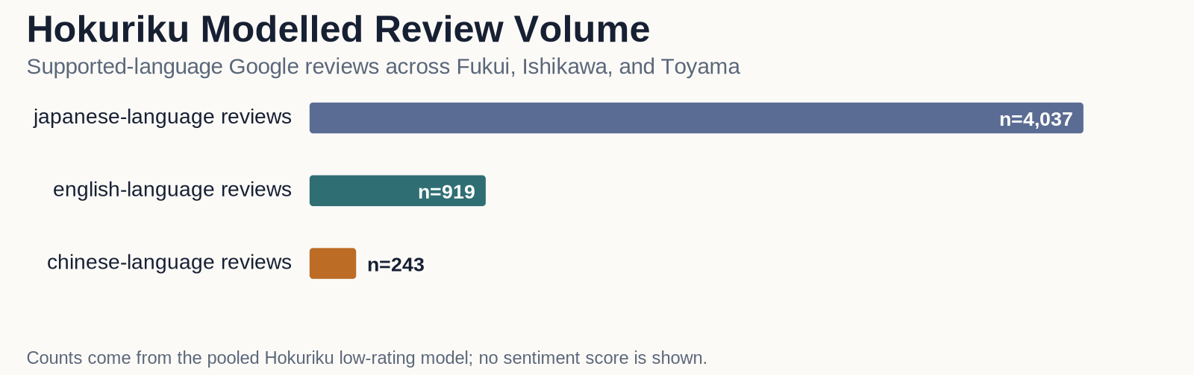
II. METHODS
The data
データ
Tagged reviews
タグ付き口コミ
6,036 Google reviews
Google口コミ 6,036件
Japanese 4,037 · English 919 · Chinese 243 (modeled)
日本語 4,037 ・ 英語 919 ・ 中国語 243(モデル対象)
Other-language 797 · too-short 40 (not modeled)
その他言語 797 ・ 短すぎ 40(モデル対象外)
Sites by prefecture
県別スポット数
Fukui 28 · Ishikawa 28 · Toyama 24
福井 28 ・ 石川 28 ・ 富山 24
Language means the review language, not the writer's nationality.
「言語」は口コミの言語であり、書いた人の国籍ではない。
The rating model uses Japanese, English, and Chinese-language Google reviews.
評価モデルでは、日本語・英語・中国語のGoogle口コミを使用。
We publish only counts and summaries. Raw review text stays inside the project.
公開するのは件数と要約のみ。口コミの原文はプロジェクト内に保管する。
3 / 12
Notes:
Lynn (45 sec): Our dataset is 6,036 Google reviews from 80 sites in Fukui, Ishikawa, and Toyama. The rating model uses 4,037 Japanese, 919 English, and 243 Chinese-language reviews. 'Language' is the language of the text, not the reviewer's nationality. We only publish aggregate counts; raw text never leaves the project. [For Q&A: a further 797 reviews were other languages and 40 were undetected or too short; a separate set of 200 Xiaohongshu posts is shown later.]

Slide 2
II. METHODS
Turning review text into signals
口コミを手がかりに変える
1. Tag each review with the 18 topics it mentions, using human-checked keyword lists.
1. 人が確認したキーワードを使い、各口コミが触れた18の話題に印をつける。
2. Call a review "low-rated" if it gave 3 stars or fewer: 851 of 5,199 reviews.
2. 3つ星以下を「低評価」とする：5,199件中851件。
3. For each problem topic, ask: do reviews that mention it get low ratings more often?
3. 各問題の話題について、それに触れた口コミは低評価が多いかを調べる。
• The Google star rating is the shared yardstick. We do not compare sentiment-tool scores between languages.
共通のものさしはGoogleの星評価。感情ツールの点数は言語間で比較しない。
5,199
reviews modelled
モデル対象の口コミ
851
were low-rated
低評価だった
4 / 12
Notes:
Andrew (50 sec): We tag each review with the 18 topics it mentions, using keyword lists a person reviewed. A low rating means 3 stars or fewer: 851 of 5,199 reviews. For each problem topic we ask whether mentioning it goes with a low rating more often. The Google star rating is our common outcome, so we never compare sentiment scores across different languages.

Slide 3
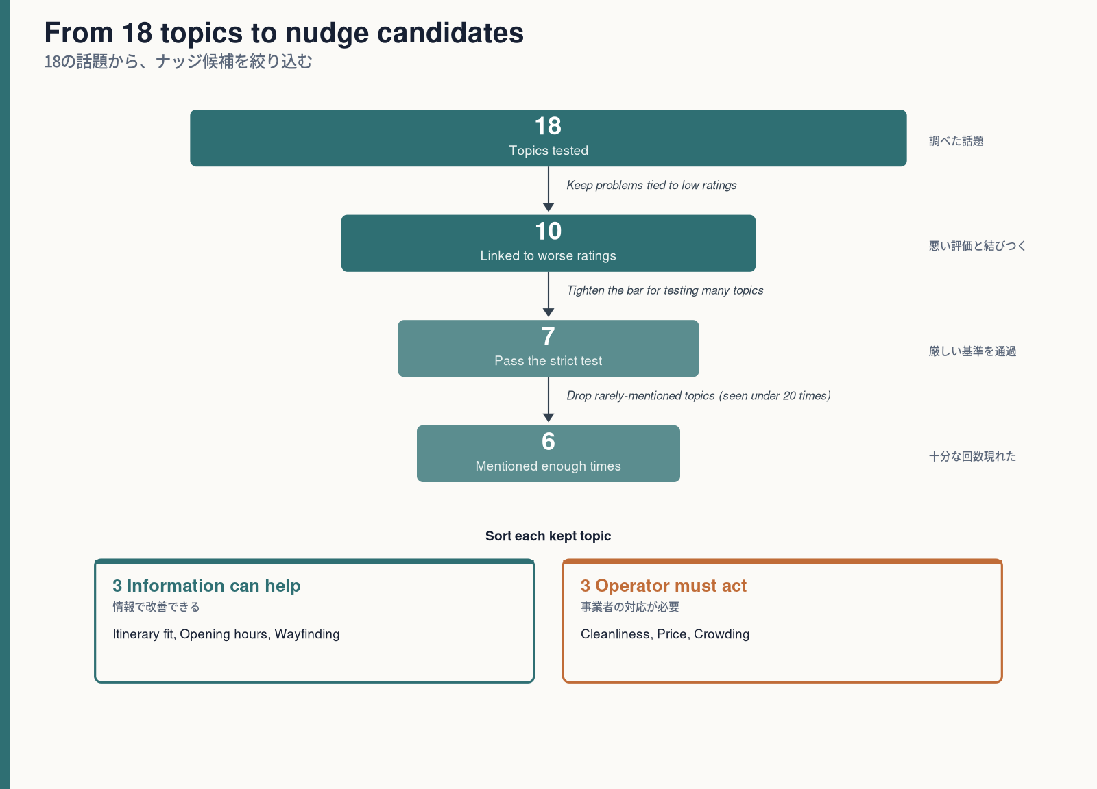
II. METHODS
How we tested it
どう調べたか
• For each of the 18 topics we fit a multiple logistic regression: does mentioning the problem predict a low rating, after adjusting for review length, language, and prefecture?
18の話題ごとに多重ロジスティック回帰を行う:口コミの長さ・言語・県をそろえた上で、その問題への言及が低評価を予測するか？
• Each model returns an adjusted odds ratio with a 95% confidence interval - how strongly the topic is tied to a low rating.
各モデルは、調整済みオッズ比と95%信頼区間を返す:その話題が低評価とどれだけ強く結びつくか。
• Because we test many topics, we correct for multiple comparisons (false-discovery rate) so chance findings do not slip through.
多くの話題を検定するため、多重比較の補正(偽発見率・FDR)を行い、偶然の結果を除く。
• A topic is kept only if it is statistically significant, points to worse ratings, and appears at least 20 times.
統計的に有意で、悪い評価の方向で、20回以上現れた話題だけを残す。
• We then sort each kept topic into "information can help" or "the operator must act."
残った話題を「情報で改善できる」か「事業者の対応が必要」かに振り分ける。
This ranks where to run the next experiment. It does not prove that any nudge works.
これは「次にどこで実験するか」の順位づけ。ナッジの効果を証明するものではない。
5 / 12
Notes:
Andrew (60 sec): For each of the 18 topics we fit a separate multiple logistic regression, asking whether mentioning the problem predicts a low rating after adjusting for review length, language, and prefecture. Each model gives an adjusted odds ratio with a 95 percent confidence interval. Because we test many topics, we correct for multiple comparisons using the false-discovery rate. A topic is kept only if it is statistically significant, points to worse ratings, and is seen at least 20 times. We then label each survivor as something information can help or something the operator must fix.
--- FULL METHOD (for Q&A / examiners; do NOT read aloud) ---
Model: Firth bias-reduced (penalized) logistic regression, one per aspect; outcome = low rating (3 stars or fewer); adjusted for text length, review language, and prefecture. Firth was chosen because several aspects were rarely mentioned, which makes ordinary logistic regression unstable. Output: an adjusted odds ratio with a 95% confidence interval and a p-value for each model (18 primary models, 47 across all segments). Multiple testing: Benjamini-Hochberg FDR. Ranking gate: FDR-significant AND a harmful association (odds ratio > 1) AND at least 20 pooled mentions. Sanity check: for 4 selected aspects, Firth and standard-logit estimates agreed closely (maximum |delta log OR| = 0.013); smallest model p = 1.2×10⁻⁹. Caveat: POI-level clustering is not modeled in the Firth estimates, so row-level uncertainty may be understated; this is exploratory ranking, not a causal claim. Full table and CIs are in Seminar-Speaker-Script-and-QA.docx.

