Slide 1
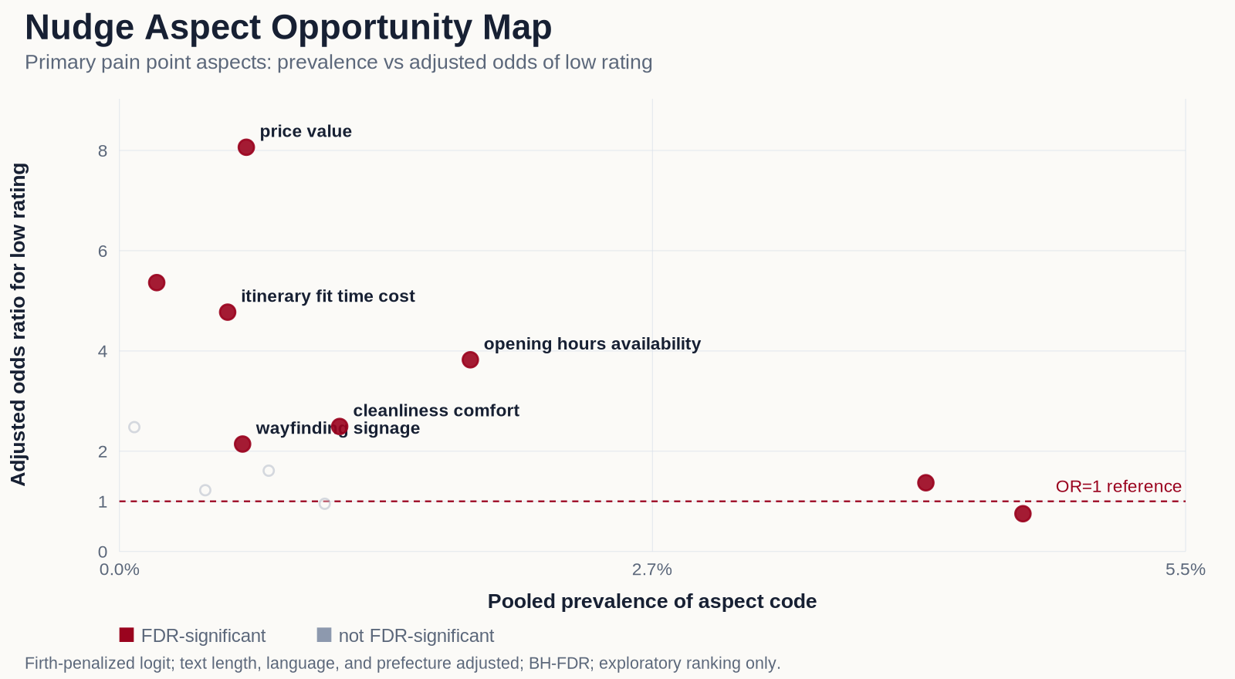
III. RESULTS
Which problems predict low ratings
どの不満が低評価を予測するか
Pain point 不満点 | Seen in 出現率 | Adjusted OR (95% CI) 調整OR(95%CI) | BH-FDR p BH-FDR p | Nudge-able ナッジ可能
Opening hours / availability 開館時間・営業状況 | 1.8% | 3.82 (2.51–5.83) | 2.2×10⁻⁸ | Yes はい
Itinerary fit / time-cost 行程適合・所要時間 | 0.6% | 4.77 (2.27–10.02) | < .001 | Yes はい
Wayfinding / signage 道案内・表示 | 0.6% | 2.14 (0.99–4.63) | .049 | Yes はい
In plain terms: a review that mentions opening hours is about 3.8x more likely to be low-rated. Itinerary problems: about 4.8x. Wayfinding: about 2.1x (borderline — its range just touches 1).
平たく言えば：開館時間に触れた口コミは低評価が約3.8倍になりやすい。行程の問題は約4.8倍、道案内は約2.1倍(境界的—範囲がちょうど1に接する)。
Adjusted OR = odds ratio after accounting for review length, language, and prefecture. Higher means more linked to low ratings. Price (OR 8.06) and cleanliness (OR 2.49) matter too, but need an operator fix.
調整OR=口コミの長さ・言語・県をそろえた後のオッズ比。大きいほど低評価と強く関連。価格(OR 8.06)や清潔さ(OR 2.49)も関連するが、事業者の対応が必要。
6 / 12
Notes:
Andrew (55 sec): Three nudge-able pain points are significant after FDR correction. The odds ratios are 3.82 for opening hours, 4.77 for itinerary fit, and 2.14 for wayfinding. In plain terms that is about 3.8, 4.8, and 2.1 times the odds of a low rating when the problem is mentioned. Wayfinding is borderline: its 95% interval (0.99 to 4.63) just includes 1. Price (OR 8.06) and cleanliness (OR 2.49) are also linked but require operator action, not information.

Slide 2
III. RESULTS
A separate idea from Chinese posts
中国語の投稿から得た、別の手がかり
What the Chinese posts hint at
中国語の投稿が示唆すること
(weaker evidence)
(弱い根拠)
200 Chinese-language Fukui posts from Xiaohongshu. There is no star rating here, so this is a hint, not a test.
福井に関する中国語の投稿200件(小紅書)。星評価がないため、これは「検証」ではなく「手がかり」。
Sentiment was read with SnowNLP (a Chinese-text sentiment tool), interpreted only within this source.
感情はSnowNLP(中国語テキストの感情分析ツール)で判定し、このソース内だけで解釈する。
Signals worth testing
検証する価値のあるシグナル
Dinosaur / museum: 42 of 43 posts positive (97.7%), versus 76.4% without the tag (p = .011).
恐竜・博物館：43件中42件がポジティブ(97.7%)。タグなしは76.4%(p = .011)。
Scenic nature: 62 of 67 positive (92.5%), versus 75.2% (p = .016).
自然景観：67件中62件がポジティブ(92.5%)。タグなしは75.2%(p = .016)。
Candidate nudge: test a Chinese-language discovery card featuring dinosaurs / museums and scenery. Hint only — one platform, a secondary sentiment tool, no rating model, no causal claim.
候補ナッジ：恐竜・博物館と自然景観を前面に出した中国語の発見カードを検証する。手がかりに限定—単一プラットフォーム、副次的な感情ツール、星評価モデルなし、因果主張なし。
8 / 12
Notes:
Lynn (55 sec): Separately, we looked at 200 Chinese-language posts about Fukui from Xiaohongshu. These have no star rating, so we treat them as a hint, not a test. Posts tagged with dinosaurs or museums were positive 97.7% of the time, versus 76.4% without the tag (p = .011 after BH-FDR). Scenic-nature posts were 92.5% positive versus 75.2% (p = .016). This suggests a Chinese-language discovery card to A/B test next. It is hypothesis-generating only: one platform, a secondary sentiment tool, no causal claim.

Slide 3
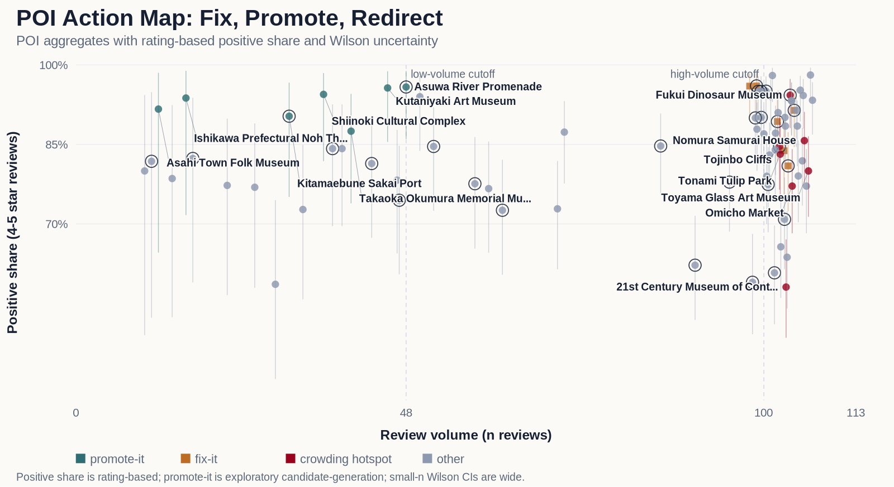
III. RESULTS
Where to act: fix-it and promote-it sites
どこで動くか：改善型と推奨型のスポット
10
Fix-it sites
改善型
7
Promote-it sites
推奨型
7
Crowding hotspots
混雑ホット
• Fix-it sites show strong pain points; promote-it sites have a high share of 4-5 star reviews (10 fix-it, 6 in Fukui; 7 promote-it, 2 in Fukui; 7 crowding hotspots).
改善型は不満点が強いスポット、推奨型は4〜5つ星の割合が高いスポット(改善型10・うち福井6、推奨型7・うち福井2、混雑ホット7)。
• More reviews mean more trust: under 48 reviews is thin, over 100 is solid.
口コミが多いほど信頼できる：48件未満は少数、100件超は多数。
• Top Fukui promote-it: Kitamaebune Sakai Port 90.3% positive (95% range 75.1%-96.7%); then Asuwa River Promenade 95.8% (86.0%-98.8%).
福井の推奨型トップ：Kitamaebune Sakai Port 90.3%(95%範囲 75.1%〜96.7%)、次に Asuwa River Promenade 95.8%(86.0%〜98.8%)。
9 / 12
Notes:
Lynn (55 sec): We sort sites into three groups. Fix-it sites (10, 6 in Fukui) have strong pain points. Promote-it sites (7, 2 in Fukui) have a high share of 4-5 star reviews. We also flag 7 crowding hotspots. We trust sites with more reviews: under 48 is thin, over 100 is solid. Shares use Wilson 95% confidence intervals. The top Fukui promote-it site is Kitamaebune Sakai Port at 90.3% positive (Wilson 95% CI 75.1% to 96.7%), then Asuwa River Promenade at 95.8%.

Slide 4
III. RESULTS
Rank common nudges by impact, then ease
共通ナッジをインパクト、次に実装容易性で順位づける
Each idea has reviewed support from English, Japanese, and Chinese-language reviews. Evidence types stay separate.
各施策には英語・日本語・中国語のレビュー済み根拠がある。エビデンス種別は統合しない。
Rank 順位 | Common solution 共通施策 | Why it ranks here 順位の理由 | Next-semester test 来学期の実験
1 | Multilingual visit-readiness card 多言語の来訪準備カード | Impact: High · Build: Easy. All 3 groups show planning pain points; the rating model put hours and itinerary fit through the strict test. インパクト:High ・ 実装:Easy。3群すべてに計画上の不満点があり、評価モデルでは営業時間と旅程適合が厳しい基準を通過。 | A/B test one card with hours, duration, transfers, booking, and backups. 営業時間、所要時間、乗換、予約、代替案をまとめたカードをA/Bテスト。
2 | Localized discovery and itinerary card ローカライズした発見・旅程カード | Impact: High · Build: Moderate. All 3 groups show pull evidence; the Chinese posts dinosaur and scenic topics pass the strict test. インパクト:High ・ 実装:Moderate。3群すべてに魅力の根拠があり、中国語投稿の恐竜と景観は厳しい基準を通過。 | A/B test localized attraction cards with nearby itinerary bundles. 周辺旅程を組み合わせた言語別の観光地カードをA/Bテスト。
3 | Off-peak and alternative-site prompt オフピーク・代替地プロンプト | Impact: High · Build: Harder. All 3 groups show crowding evidence; its low-rating link passes the strict test but is borderline (CI includes 1). インパクト:High ・ 実装:Harder。3群すべてに混雑の根拠があり、低評価との関連は厳しい基準を通過するが境界的(信頼区間が1を含む)。 | A/B test quieter-time and nearby-substitute prompts. 空いている時間帯と近隣代替地の提示をA/Bテスト。
This is an opportunity ranking, not proof of effectiveness. Higher impact ranks first; easier to build breaks ties.
これは機会の順位づけで、効果の証明ではない。インパクトが高い順、同点なら作りやすさで決める。
10 / 12
Notes:
Andrew (55 sec): We rank the cross-language solutions by impact first, then by how easy they are to build. Priority one is the multilingual visit-readiness card: all three languages flag planning problems, and the opening-hours and itinerary signals passed the strict test. Priority two is the localized discovery card, supported by the Chinese dinosaur and scenery signals. Priority three, off-peak prompts, shows crowding in all three languages; its link to low ratings passes the strict test but is borderline, and it ranks lower mainly because it is the hardest to build. This is an opportunity ranking, not proof of effectiveness.

Slide 5
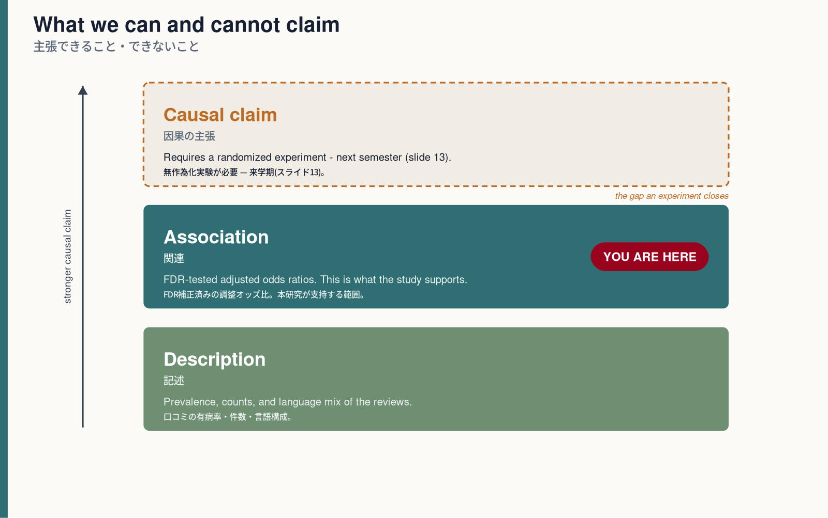
IV. DISCUSSION
What this can and cannot claim
主張できること・できないこと
• This is exploratory: it points to experiments to run, not proof of cause and effect.
これは探索的：実験の候補を示すもので、因果関係の証明ではない。
• The opportunity scores rank what to test next. They do not measure how well a fix works.
機会スコアは「次に何を試すか」の順位づけ。効果の大きさを測るものではない。
• We treat each review on its own, so the model may be slightly overconfident — another reason we call this a ranking, not proof.
各口コミを個別に扱うため、モデルはやや自信過剰かもしれない—だからこそ順位づけであり、証明ではない。
• Language groups describe the review's language, not the writer's nationality.
言語グループは口コミの言語であり、執筆者の国籍ではない。
11 / 12
Notes:
Andrew (50 sec): We are clear about the limits. This study is exploratory and hypothesis-generating, not causal. The opportunity scores rank what to test next; they do not estimate how well an intervention works. We model each review on its own, so because reviews cluster within sites, the row-level estimates may understate uncertainty — which is exactly why we present a ranking rather than a proof. And language groups describe the review language, not the reviewer's nationality. The evidence ladder shows where we sit: above description, at association, below a causal claim.

