Slide 1
i
inqi
inqi.monkeycode.io
QWEN CLOUD GLOBAL AI HACKATHON · AUTOPILOT AGENT TRACK
One report.
AI agents on it.
Customer inquiry → vendor discovery → real email outreach → negotiated replies → ranked quotes. Unattended.
Inquiry
→
Discover
→
Outreach
→
Negotiate
→
Report
Notes:
inqi is the track brief's first example, built for real: customer inquiries to quotes, end to end, unattended.

Slide 2






WHAT IT DOES
The whole sourcing loop, unattended
Intake — web or plain email
Email your request to intake@inqi-postmark-reply.monkeycode.io. inqi acknowledges with a live link; strangers get a polite decline with a reason (credit-gated — nobody spends our tokens anonymously).
Pre-research + optional questionnaire
Compliance gates the request; if the agent judges it needs more information, it reaches out with a short questionnaire — otherwise it proceeds straight to research.
Breadth discovery with specificity
Qwen forms queries and mines real provider pages, telling specific providers apart from aggregators and directories — search specifics inform the hunt but never fake target progress.
Outreach under a persona
Emails shortlisted businesses — region-matched per-report persona, DKIM-signed, per-thread reply routing back into the agent.
Multistage reply loop
Knowledge flows customer prompt → enrichment → questionnaire → synthesis → negotiation. The agent never invents commitments, yet carries every conversation to a decision point.
An extension for other agents
inqi is designed as an extension of other agents on real-world tasks: if your personal assistant has email access, that's enough to interact — request in, ranked report back, pay on delivery.

Slide 3
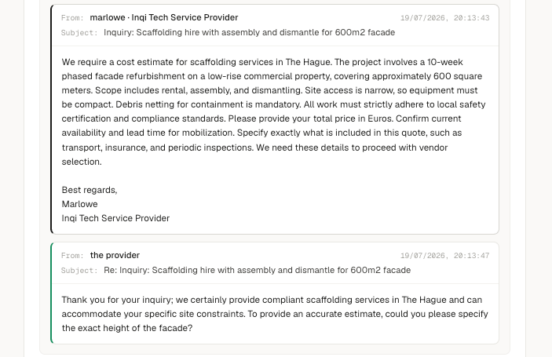


REAL-WORLD PROOF
It negotiated a real price with a real business
Multi-turn, in character
Follow-ups handled across the thread; persona held; price confirmed.
Safe by construction
Compliance gates on prompts and inbound replies; outreach pinned during beta so tests never spam real shops.
Demo mode, honestly framed
For judging, vendor replies are simulated — so judges don't trigger real emails. Production mode is the thread on the left.
In-product view: Marlowe (inqi persona) reaches the vendor — the reply routes straight back into the loop.

Slide 4


PROBLEM VALUE · 25%
Measured unit economics, not estimates
$50–150
≈ $0.50
0 credits
what 2–4 h of a procurement specialist's sourcing time costs, per task
the demo report, all-in — Qwen tokens + searches + emails, metered in-product
cost to the customer when a run fails — pay on delivery
Hundreds of times cheaper than the labor it replaces — and it isn't modeled: every AI call, search and email is usage-recorded with its price; the report's cost view shows how the total is built.
The demo report — fully metered, not estimated: ~1.06M Qwen tokens · ~290 AI calls · ~170 web searches · 30 evidence sources kept · 8 deep-research passes · 3 outreach emails — $0.50 all-in. Lighter consumer runs land well under that.
Who needs it: construction & industrial procurement (materials, machinery, plant hire) · SMB purchasing · competitor analytics · concierge services · marketplaces onboarding supply. Two intake channels businesses already use: the web — and their own inbox.

Slide 5



INNOVATION & AI CREATIVITY · 30%
Sophisticated use of Qwen Cloud
qwen3.6-plus, tier system wired
Multistage reply loop
One model runs breadth, depth, reply loop and synthesis today — and each phase resolves its model from config, so stronger or cheaper Qwen models slot into any phase with a flag flip. Depth-grade output in one pass keeps a heavy industrial report around half a dollar.
Evaluate the vendor's email (answer? counter-question? risk?), then respond — never inventing commitments, yet carrying the conversation to a decision point.
Optional questionnaire, LLM-gated
Specificity classification
The agent judges whether clarification is needed; if so it reaches out with a short questionnaire — otherwise it proceeds. Unattended runs resolve with "decide for me" semantics.
Provider page vs aggregator, judged per hit — search specifics inform the hunt but can never fake target progress. Proven out via live A/B runs.
Self-improving workflows (genes)
Per-report personas
Tunables ride each report as versioned "genes" — e.g. v7 raises breadthCap 8→10 and adds an outreach wave. Cassette-scored, then auto-approved if it beats the incumbent (next slide).
A Rotterdam excavator hire is carried end-to-end by a Dutch-region voice; a Lisbon photographer search by "Mariana V." Pinned 1:1 — the fleet never reads as one bot.

Slide 6
INNOVATION · THE SELF-UPDATE LOOP
The workflow updates itself
RUN
MEASURE
PROPOSE
REHEARSE
PUBLISH
reports execute on the active workflow version
→
usage ledger + outcome scoring, per report
→
new "genes": discovery caps, wave plans, models
→
golden cassettes score it against the incumbent
→
validated graph, versioned, live — no deploy
⟲
AUTO-APPROVE — designed in: a proposed version that beats the incumbent on rehearsal scores publishes itself — the loop closes without a human, and the next report runs on the improved workflow.
Every stage exists today — versioned graphs, tunable genes, cassette rehearsal, the publish gate. The workflow isn't code someone edits: it's a genome the system iterates.

Slide 7


TECHNICAL DEPTH · 30%
Production-ready over toy demos
DB-versioned state machines — built for dynamic updating
The pipeline is data, not code: new graph versions publish live, no redeploy — proposed by operators or, with auto-approve, by the system itself. Replayable and recoverable.
550+
All on Alibaba Cloud, Qwen everywhere
backend tests, incl. regressions written from live failures
One ECS instance runs the whole product — Caddy TLS, React SPA, NestJS API, Postgres, pg-boss, SearXNG/Serper — with Qwen Cloud (DashScope) for every model call and Postmark for mail.
Crash-safe autonomy
4
pg-boss queue, leases + reaper recovery for stuck runs, optimistic transitions, idempotent settlement, outbox events → realtime UI.
versioned workflow graphs driving the pipeline
Money handled like money
Append-only credit ledger with balance == Σ(ledger) invariant. Pay-on-delivery, audited grants, concurrency-safe request approve/reject.
Deliverability engineering
1 ECS
Two DKIM-signed sender identities (system vs persona outreach) · RFC threading headers · per-thread reply routing into the webhook · bounce + suppression handling · decline cool-downs. Replies land in the agent, not a mailbox.
runs the entire product — measured, meterable, portable
Autonomy with brakes
Compliance gates score the prompt, questionnaire free-text and every inbound reply · credit-gated intake with reasoned declines · plus-alias signups blocked (grant farming) · suspension enforced mid-flight.

Slide 8
OPERABILITY & TRANSPARENCY
An agent you can operate — and audit
Live board
Run controls
Cost transparency
every report's pipeline in realtime; drill into inquiries, threads, dossiers
pause · resume · cancel any report mid-flight
every AI call, search and email usage-recorded with its price — the cost view shows how each total is built
Credit requests
Workflow versions
Users & audit
customers ask; operators approve (editable amount) or reject; approval emails the customer
the pipeline as data: inspect any version, diff against active, publish live — diagrams render sub-workflow hand-offs
directory, suspension, and a full audit trail of operator actions

Slide 9
CHALLENGES
What fought back — and what it taught us
Tuning an autopilot is a moving target
Moving between models, safely
Change a model or a parameter and quality — or cost — regresses silently. Golden cassettes replay recorded real runs; rehearsal drivers score each candidate config before publish. Regression testing that embraces LLM non-determinism.
Every model swap shifts tone, JSON discipline and cost. We migrate by rehearsal: record real runs as golden cassettes, replay them against the candidate Qwen model, compare quality and spend — then flip a config flag. No big-bang migrations.
Lesson: production agent work is 20% prompting, 80% systems engineering — plus a harness that respects non-determinism.

Slide 10
FUTURE VISION
From last-mile inquiries to full orchestration
NOW
T+1
T+2
Last-mile inquiries
High-level orchestration
Topic research reports
One concrete request, owned end-to-end: discover real vendors, negotiate by email, deliver a ranked report with quoted prices.
Shipping today — this is the demo.
One goal decomposed into many inqi reports running in parallel, then synthesized into a single plan + budget.
Wedding = Venue + Photographer + Catering + Florist + Music
Construction = Architect + Design + Materials + Machinery + Permits
The same engine — discover, verify, negotiate, synthesize — pointed at open-ended topics: market scans, competitor watch, standing reports that refresh themselves.
Procurement is the beachhead; researched decisions are the product.
→
→
Each stage rides the machinery that already exists: self-updating versioned workflows, report genes, golden-cassette rehearsal, agent-to-agent email intake.

Slide 11
i
inqi
Try it during judging.
Sign up and the system grants 10 credits automatically — run your own report, watch the agents work, and read the cost ledger when it lands.
Live product
inqi.monkeycode.io — Alibaba Cloud ECS, Qwen Cloud models
Repository
github.com/andrew-vogulkin/inqi — 550+ tests, docs, workflow diagrams
Demo video
intake email → live pipeline → vendor thread → ranked report → cost view
One report. AI agents on it.

