Slide 1
Hyperparameter Optimization Using CANDLE on Biowulf
Andrew Weisman High Performance Computing Analyst
January 19, 2021

Slide 2
Agenda
Introduction to Hyperparameter Optimization
Overview of CANDLE
Walk-through: Running a grid search using CANDLE from scratch
Notes:
Note slides are online and talk being recorded, so just listen
Happy to take questions during, just put them in the chat

Slide 3
Introduction to Hyperparameter Optimization
Part I
Please fill out the survey: https://bit.ly/CANDLE_Workshop_Jan21

Slide 4
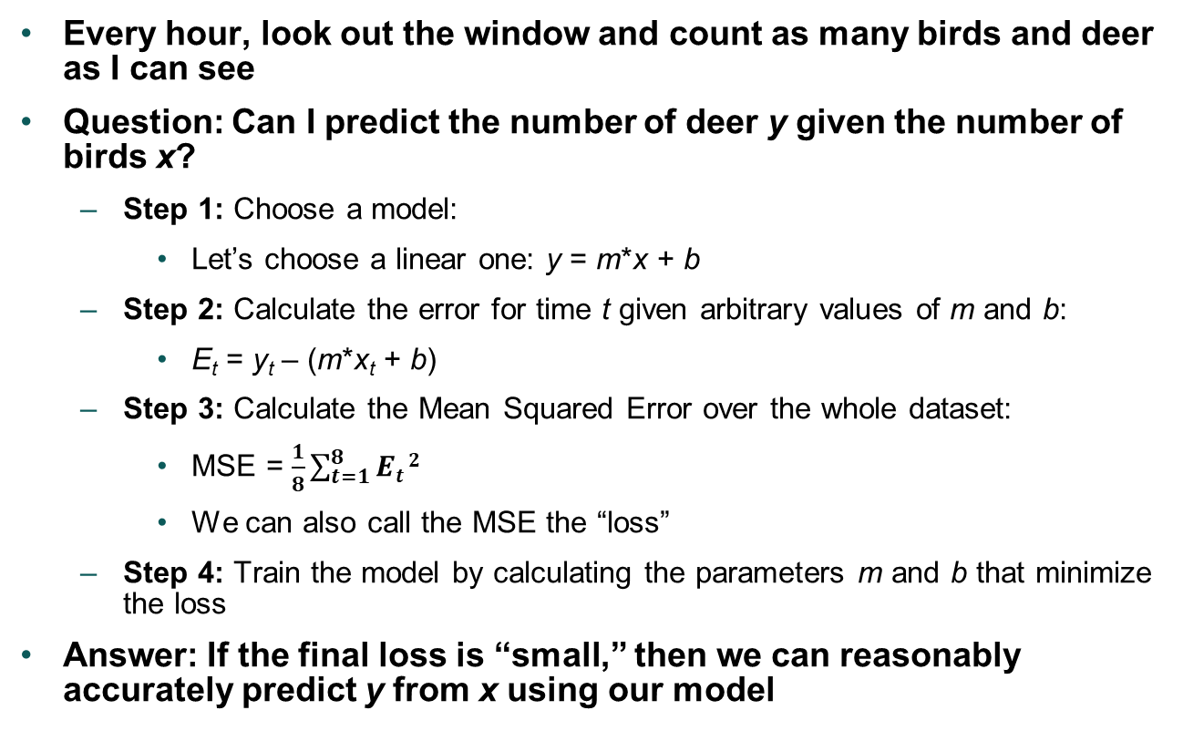
Prediction using a linear model
Every hour, look out the window and count as many birds and deer as I can see
Question: Can I predict the number of deer y given the number of birds x?
Step 1: Choose a model:
Let’s choose a linear one: y = m*x + b
Step 2: Calculate the error for time t given arbitrary values of m and b:
E_{t} = y_{t} – (m*x_{t} + b)
Step 3: Calculate the Mean Squared Error over the whole dataset:
MSE = $\frac{1}{8}\sum_{t=1}^{8}{Et}2$
We can also call the MSE the “loss”
Step 4: Train the model by calculating the parameters m and b that minimize the loss
Answer: If the final loss is “small,” then we can reasonably accurately predict y from x using our model
Time (t) | Number of birds (x) | Number of deer (y)
9:30 AM | 5 | 3
10:30 AM | 2 | 2
11:30 AM | 1 | 0
⁞ | ⁞ | ⁞
4:30 PM | 2 | 1

Slide 5
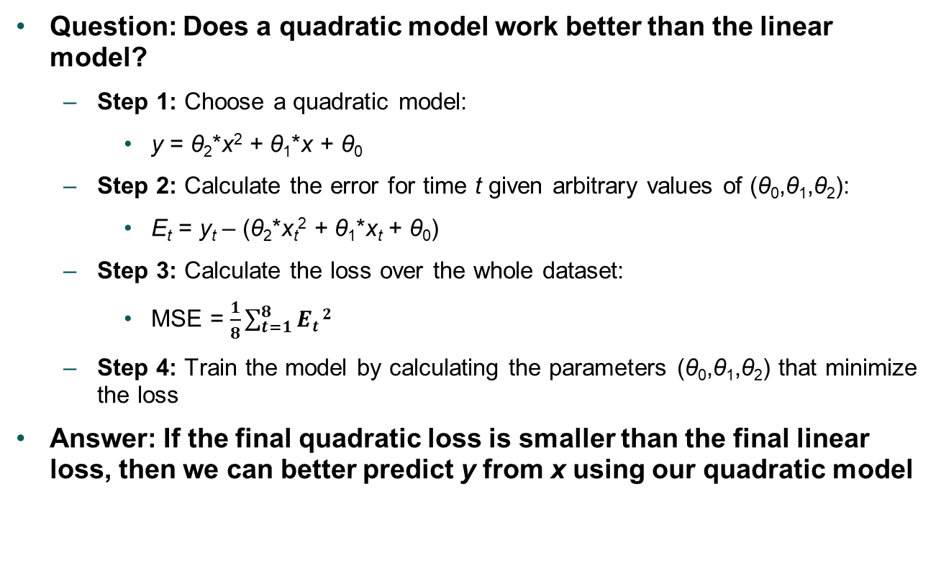
Prediction using a quadratic model
Question: Does a quadratic model work better than the linear model?
Step 1: Choose a quadratic model:
y = θ₂*x² + θ₁*x + θ₀
Step 2: Calculate the error for time t given arbitrary values of (θ₀,θ₁,θ₂):
E_{t} = y_{t} – (θ₂*x_{t}² + θ₁*x_{t} + θ₀)
Step 3: Calculate the loss over the whole dataset:
MSE = $\frac{1}{8}\sum_{t=1}^{8}{Et}2$
Step 4: Train the model by calculating the parameters (θ₀,θ₁,θ₂) that minimize the loss
Answer: If the final quadratic loss is smaller than the final linear loss, then we can better predict y from x using our quadratic model
Time (t) | Number of birds (x) | Number of deer (y)
9:30 AM | 5 | 3
10:30 AM | 2 | 2
11:30 AM | 1 | 0
⁞ | ⁞ | ⁞
4:30 PM | 2 | 1

Slide 6
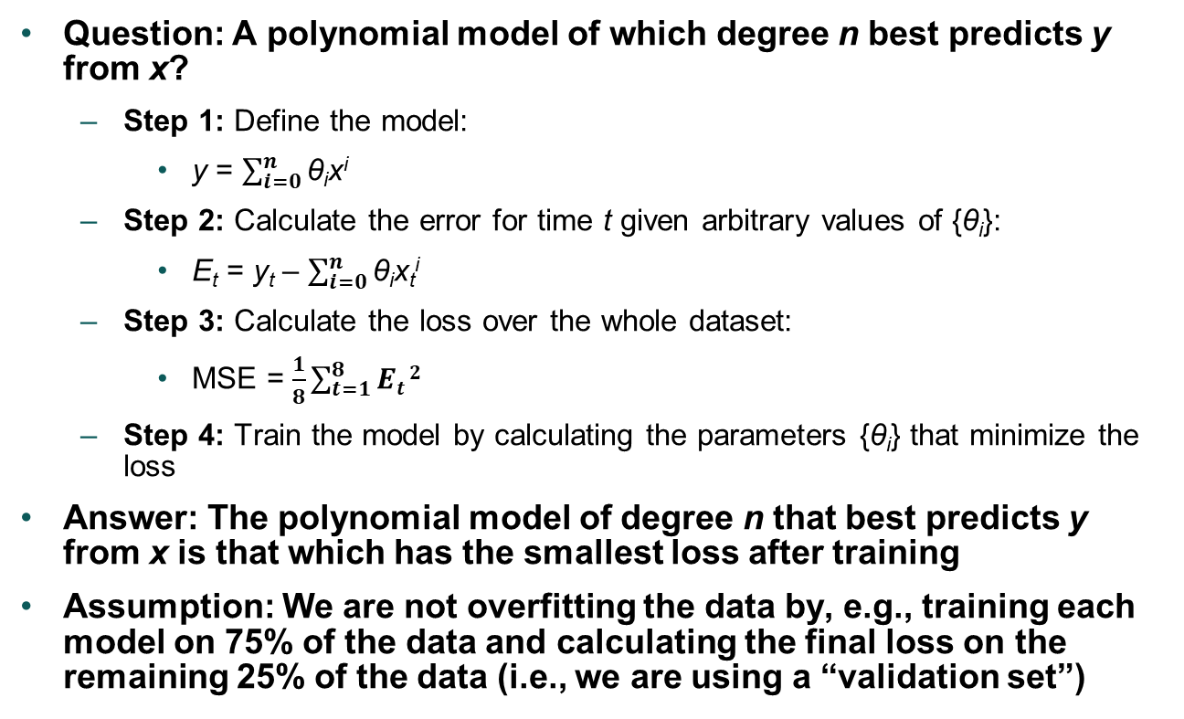
Prediction using a polynomial model of degree n
Question: A polynomial model of which degree n best predicts y from x?
Step 1: Define the model:
y = $\sum_{i=0}^{n}{\text{θ}\text{i}\text{x}\text{i}}$
Step 2: Calculate the error for time t given arbitrary values of {θ_{i}}:
E_{t} = y_{t} – $\sum_{i=0}^{n}{\text{θ}\text{i}\text{x}\text{t}\text{i}}$
Step 3: Calculate the loss over the whole dataset:
MSE = $\frac{1}{8}\sum_{t=1}^{8}{Et}2$
Step 4: Train the model by calculating the parameters {θ_{i}} that minimize the loss
Answer: The polynomial model of degree n that best predicts y from x is that which has the smallest loss after training
Assumption: We are not overfitting the data by, e.g., training each model on 75% of the data and calculating the final loss on the remaining 25% of the data (i.e., we are using a “validation set”)
Time (t) | Number of birds (x) | Number of deer (y)
9:30 AM | 5 | 3
10:30 AM | 2 | 2
11:30 AM | 1 | 0
⁞ | ⁞ | ⁞
4:30 PM | 2 | 1

Slide 7
Let’s take stock of what we have
The general model we are using is polynomial
We can define a specific type of polynomial model by choosing a fixed value of n:
n=1 refers to a linear model (one non-trivial term in the model)
n=2 refers to a quadratic model (two non-trivial terms in the model)
etc.
In other words, the model is specified by the value of n
n is called a “hyperparameter” of the model
For each model (i.e., for each possible value of n), we train the model by calculating the weights/parameters (the {θ_{i}}) that minimize the loss
We declare the “best” model as that having the smallest loss
In other words, we have optimized the hyperparameter n
We have just performed hyperparameter optimization (HPO)
Note: Hyperparameters are fixed during the training process, whereas weights/parameters are changing during the training process
nterms (n) | Validation loss
1 | 3
2 | 0.5
3 | 1.5
⁞ | ⁞
10 | 2.5

Slide 8
Types of HPO: grid search vs. Bayesian search
In both cases, we are “searching” for the “best” hyperparameter (HP), which is that which minimizes a measure of loss
We have performed a “grid search,” in which the minimization metric (i.e., the validation loss) is calculated for every possible value of n (in this case, for n=1,2,…,10)
Grid search is easy enough when the space of possible HP values is small and the training process is fast
However, if we define a larger HP space (say, n could be anywhere from 1 to 100), or if the training process is slow, then performing a full grid search takes significant time and computational resources
A “Bayesian search” would be more efficient:
Sample the HP space a few times, performing training for, say, n = 1, 25, 50, 75, 100
If, say, smaller values of n lead to lower loss, then we would resample the HP space more densely for smaller n and more sparsely for larger n
In this way, we could determine the optimum value of n without having sampled the full HP space and performing training for every value, saving precious time and resources
The point is we are not naïvely sampling the full HP space, but rather more elegantly sampling the HP space by incorporating knowledge of prior results into the sampling process itself
nterms (n) | Validation loss
1 | 3
2 | 0.5
3 | 1.5
⁞ | ⁞
10 | 2.5

Slide 9
Machine/deep learning commonalities
Nearly all machine/deep learning models have hyperparameters that can (and should!) be optimized:
Polynomial: number of terms in the polynomial expression
Random forest: number of decision trees, maximum number of levels in each tree
Neural network: number of hidden layers, type of activation function
General model: number of training epochs, learning rate, batch size
A measure of loss can always be defined
This allows you to assess different values of HPs within a model type
This is true for both supervised and unsupervised learning
Bottom line: You can always improve your machine or deep learning models by performing HPO because there are always HPs that can be tweaked

Slide 10
Overview of CANDLE
Part II
Please fill out the survey: https://bit.ly/CANDLE_Workshop_Jan21

Slide 11
Introduction to CANDLE
CANDLE is a software platform for performing common machine/deep learning tasks at scale
CANcer Distributed Learning Environment
Developed jointly by the Department of Energy and the National Cancer Institute
Aims to support all computational needs of the JDACS4C pilot projects
What we end up with is a powerful open-source software package for performing machine-learning-related tasks on High Performance Computing systems
Non-specific to cancer
Continuously updated and improved
Broken up into “workflows” such as hyperparameter optimization (HPO), uncertainty quantification, weight-sharing, etc.
We have enabled, tested, and supported the HPO functionality of CANDLE on NIH’s Biowulf supercomputer
Two of the most popular methods for performing HPO: grid search and Bayesian search
Actively supported on Biowulf by Frederick National Lab’s Strategic and Data Science Initiatives team
Notes:
This is not Biowulf-specific, currently enabled on Summit as well

Slide 12
Why you should perform HPO using CANDLE on Biowulf
HPO is key to finding the best model for your needs
CANDLE makes performing HPO as easy as possible
Minimal modification to your model
Minimal setup process
CANDLE is smart
Load balancing – minimal resource downtime
Intelligent hyperparameter selection when using the bayesian workflow
More computational power is easily employed due to CANDLE’s integration with Biowulf’s resources
Machine/deep learning models can be written in Python, R, or bash
All you need is a Biowulf account; it is ready for you to use right now!

Slide 13
How to run a sample CANDLE job on Biowulf
Log in to Biowulf and enter a directory on the /data partition (e.g., /data/$USER/candle)
Load the CANDLE module: module load candle
Import a sample CANDLE job: candle import-template <grid|bayesian|r|bash>
Submit the job to Biowulf: candle submit-job <TEMPLATE-NAME>_example.in
Inspect the results: candle aggregate-results $(pwd)/last-candle-job

Slide 14
Summary: How to perform HPO on your own model using CANDLE
Ensure your model already works on Biowulf
Adapt your model to work with CANDLE
Define the hyperparameters in your model using a dictionary (or data.frame) named candle_params
Assign a metric of model performance to a variable named candle_value_to_return
Create a CANDLE input file
This is easiest done by modifying one of the template input files that can be imported using candle import-template <grid|bayesian|r|bash>
Confirm that your CANDLE-adapted model and input file settings run using CANDLE without running a full workflow
Submit the full CANDLE job to Biowulf
Inspect the results using, e.g., candle aggregate-results <RESULTS-DIR>

Slide 15
(1) Ensure your model already works on Biowulf
Acquire a model:
Internet/GitHub
Textbook, journal article, or software documentation
You already have one
Request an interactive node on Biowulf using, e.g.: sinteractive --gres=gpu:k80:1 --mem=20G
Run the model using, e.g.: python my_model_script.py Rscript my_model_script.R
See the Biowulf user guide for more information on running scripts on Biowulf
Notes:
If your model does not work outside of CANDLE, you cannot expect it to work using CANDLE!

Slide 16
(2) Adapt your model to work with CANDLE
Define the hyperparameters in your model by the candle_params dictionary (Python) or data.frame (R), e.g.:
Python example
tree_depth = 4
nhidden_layers = 5
tree_depth = candle_params[‘decision_tree_depth’]
nhidden_layers = candle_params[‘nhidden_layers’]
R example
tree_depth <- 4
nhidden_layers <- 5
tree_depth <- candle_params[[“decision_tree_depth”]]
nhidden_layers <- candle_params[[“nhidden_layers”]]

Slide 17
(2) Adapt your model to work with CANDLE ctd.
Assign a minimization metric of model performance to the candle_value_to_return variable, e.g.:
Python example
score = model.evaluate(x_test, y_test)
candle_value_to_return = score[0]
R example
candle_value_to_return <- my_validation_loss
Notes:
or Keras history object if using Python+Keras

Slide 18
(3) Create a CANDLE input file
This is a single text file containing all the settings you need for your CANDLE job
The easiest way to create an input file is to modify one of the templates, which can be imported using candle import-template <grid|bayesian|r|bash>
The input file contains three sections:
&control: General job settings
&default_model: Default values of whatever settings are defined using the candle_params dictionary in the adapted model script from Step (2)
&param_space: Specification of the space of the hyperparameter values to sample during the CANDLE workflow
See the CANDLE documentation for details on the possible keywords
&control
model_script="$(pwd)/mnist_mlp.py"
workflow="grid"
nworkers=2
worker_type="k80"
walltime="00:20:00"
run_workflow=1
/
&default_model
epochs=20
batch_size=128
activation='relu'
optimizer='rmsprop'
num_filters=32
/
&param_space
{"id": "hpset_01", "epochs": 15, "activation": "tanh"}
{"id": "hpset_02", "epochs": 30, "activation": "tanh"}
{"id": "hpset_03", "epochs": 15, "activation": "relu"}
{"id": "hpset_04", "epochs": 30, "activation": "relu"}
{"id": "hpset_05", "epochs": 10, "batch_size": 128}
{"id": "hpset_06", "epochs": 10, "batch_size": 256}
/

Slide 19
(3) Create a CANDLE input file ctd.
For a grid search, instead of creating the &param_space section by hand, you can create one automatically using: candle generate-grid <PYTHON-LIST-1> \ <PYTHON-LIST-2> ...
For example: candle generate-grid \ "['nlayers',np.arange(5,15,2)]“ \ "['dir',['x','y','z’]]”
The resulting output in hyperparameter_grid.txt in the candle_generated_files will look like
Then copy-paste these settings into the &param_space section
As the example shows, you can access Python’s NumPy library through np
{"id": "hpset_00001", "nlayers": 5, "dir": "x"}
{"id": "hpset_00002", "nlayers": 5, "dir": "y"}
{"id": "hpset_00003", "nlayers": 5, "dir": "z"}
{"id": "hpset_00004", "nlayers": 7, "dir": "x"}
{"id": "hpset_00005", "nlayers": 7, "dir": "y"}
{"id": "hpset_00006", "nlayers": 7, "dir": "z"}
{"id": "hpset_00007", "nlayers": 9, "dir": "x"}
{"id": "hpset_00008", "nlayers": 9, "dir": "y"}
{"id": "hpset_00009", "nlayers": 9, "dir": "z"}
{"id": "hpset_00010", "nlayers": 11, "dir": "x"}
{"id": "hpset_00011", "nlayers": 11, "dir": "y"}
{"id": "hpset_00012", "nlayers": 11, "dir": "z"}
{"id": "hpset_00013", "nlayers": 13, "dir": "x"}
{"id": "hpset_00014", "nlayers": 13, "dir": "y"}
{"id": "hpset_00015", "nlayers": 13, "dir": "z"}

Slide 20
(3) Create a CANDLE input file ctd.
To run a Bayesian search, change the workflow setting to bayesian
Change the &param_space section of the input file to something like:
&param_space
makeDiscreteParam("batch_size", values = c(16, 32))
makeIntegerParam("epochs", lower = 2, upper = 5)
makeDiscreteParam("optimizer", values = c("adam", "sgd", "rmsprop", "adagrad"))
makeNumericParam("drop", lower = 0, upper = 0.9)
makeNumericParam("learning_rate", lower = 0.00001, upper = 0.1)
/

Slide 21
(4) Confirm that your CANDLE-adapted model and input file settings run using CANDLE without running a full workflow
To do this, run the model once using the default set of hyperparameters set in the &default_model section of the input file:
Allocate an interactive node, e.g.: sinteractive --gres=gpu:k80:1 --mem=20G
Set the run_workflow keyword to 0 in &control section of the input file
Run CANDLE using: candle submit-job <INPUT-FILE>
As long as the last message before the prompt is returned is Input file submitted successfully and the output in the new file subprocess_out_and_err.txt looks reasonable, you can be almost guaranteed that running an actual CANDLE workflow will work as well!

Slide 22
(5) Submit the full CANDLE job to Biowulf
Set the run_workflow keyword to 1 in &control section of the input file
Run CANDLE using, again: candle submit-job <INPUT-FILE>
You will know you have submitted the CANDLE job successfully to Biowulf if you see, at the end of the output to the screen: JOB_ID=<YOUR-SLURM-JOB-ID> Input file submitted successfully
You can monitor the status of the job using, e.g.: watch squeue -u <YOUR-BIOWULF-USERNAME>

Slide 23
(6) Inspect the results of the CANDLE job – manual inspection
Once the job is complete, enter the directory last-candle-job, which is a symbolic link
Ensure the content of the file output.txt looks reasonable, and in particular that it ends with something like: MPIEXEC TIME: 263.763 EXIT CODE: 0 COMPLETE: 2021-01-14 18:56:51
Then enter the run directory, which contains one subdirectory per hyperparameter set run on the model
Skim through the output of each run of the model using, e.g., less */subprocess_out_and_err.txt
In each hyperparameter subdirectory, there should be a file called result.txt containing the value of the minimization metric you defined in step (2) (candle_value_to_return)

Slide 24
(6) Inspect the results of the CANDLE job – automated inspection
Alternatively, once the job is complete, collect all the minimization metrics and values of the hyperparameters into a a single file using: candle aggregate-results $(pwd)/last-candle-job
This will create a file called candle_results.csv in the candle_generated_files directory that contains the metrics (in increasing order) and their corresponding hyperparameter values, e.g.: result,dirname,id,mincorr,maxcorr,number_cv,extfolds 000.796,hpset_00001,hpset_00001,0.200000,0.80,2,5 000.796,hpset_00004,hpset_00004,0.200000,0.80,5,5 000.837,hpset_00002,hpset_00002,0.200000,0.80,3,5 000.878,hpset_00003,hpset_00003,0.200000,0.80,4,5 000.905,hpset_00007,hpset_00007,0.200000,0.80,8,5 000.964,hpset_00005,hpset_00005,0.200000,0.80,6,5 000.964,hpset_00006,hpset_00006,0.200000,0.80,7,5 001.000,hpset_00008,hpset_00008,0.200000,0.80,9,5
This file can, e.g., be imported into Excel to for more careful observation and analysis such as Pearson correlation

Slide 25
Walk-through: Running a grid search using CANDLE from scratch
Part III
Please fill out the survey: https://bit.ly/CANDLE_Workshop_Jan21

Slide 26
Introduction to the model
An autoencoder is a type of unsupervised deep learning algorithm
It reduces the dimensionality of the inputs and then reconstructs them, calling the error in the reconstruction process the “reconstruction loss”; this is the loss we want to minimize
A variational autoencoder (VAE) is a type of autoencoder that is better capable of “generating” new samples (it is a “generative” model) by defining a continuous latent space
It is pretty cutting-edge
PyTorch is a deep learning library written in Python and developed by Facebook
It is a popular alternative to the Python deep learning library TensorFlow/Keras developed by Google
We will optimize some hyperparameters of a PyTorch-based VAE using CANDLE on Biowulf, with the usual goal of finding the hyperparameters that minimize the reconstruction loss

Slide 27
(1) Ensure the model already works on Biowulf
Create and enter a working directory on Biowulf’s data partition: mkdir /data/$USER/vae_with_pytorch cd /data/$USER/vae_with_pytorch
Clone PyTorch’s “examples” repository from GitHub and enter the directory for the VAE example: git clone https://github.com/pytorch/examples.git repo cd repo/vae
Test the example: sinteractive --gres=gpu:k80:1 --mem=20G module load python python main.py
Notes:
Note how easy it is to run DL on Biowulf
Note this has nothing to do with CANDLE

Slide 28
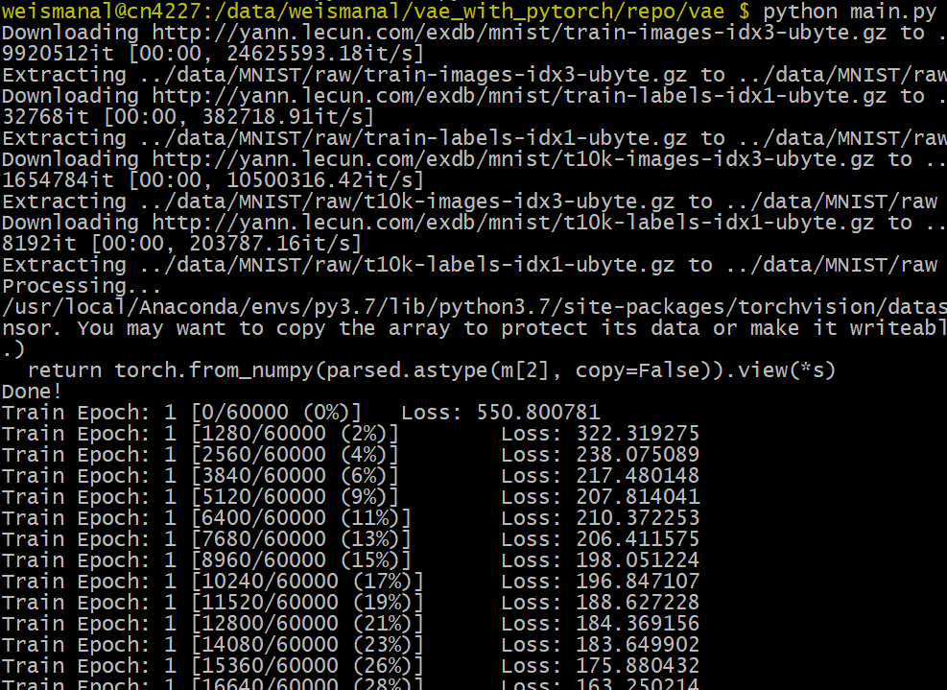
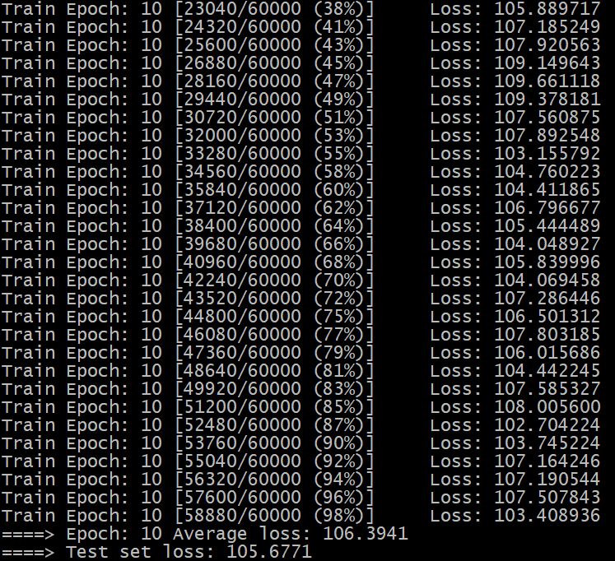
(1) Ensure the model already works on a Biowulf compute node ctd.
Output to screen (after a couple minutes):

Slide 29
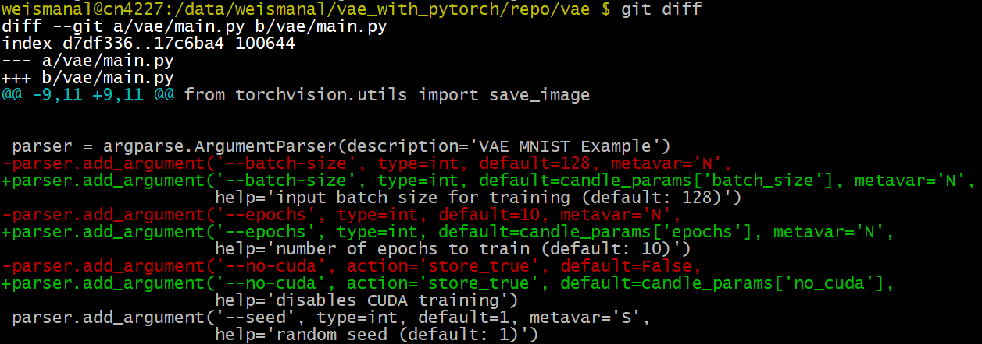
(2) Adapt the model to work with CANDLE
Define the hyperparameters in main.py using the candle_params dictionary:

Slide 30
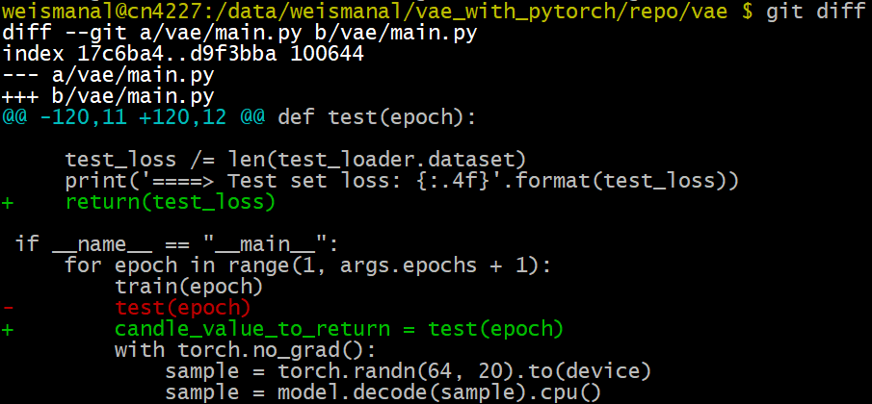
(2) Adapt the model to work with CANDLE ctd.
Assign a minimization metric of model performance to the candle_value_to_return variable in main.py:

Slide 31
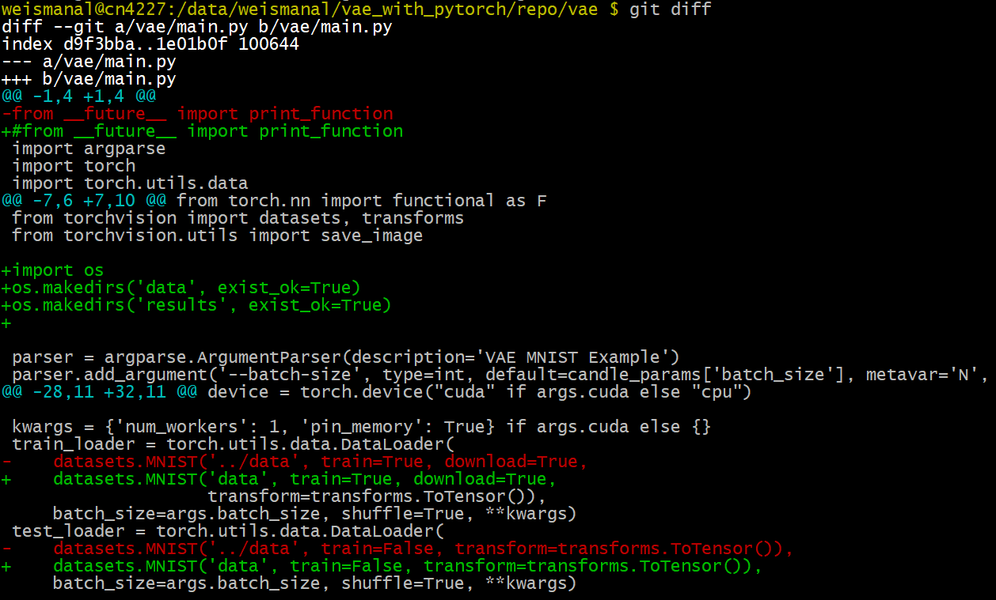
(2) Adapt the model to work with CANDLE ctd.
Make some additional minor changes due to how this model script was written
Note: We quickly discovered the need for these changes by performing Step (4) (running CANDLE without running a full workflow)

Slide 32
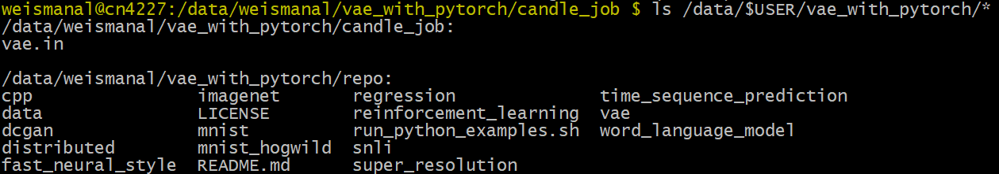
(3) Create a CANDLE input file
Import the grid search template: mkdir /data/$USER/vae_with_pytorch/candle_job cd /data/$USER/vae_with_pytorch/candle_job module purge module load candle candle import-template grid rm mnist_mlp.py mv grid_example.in vae.in ls /data/$USER/vae_with_pytorch/*

Slide 33
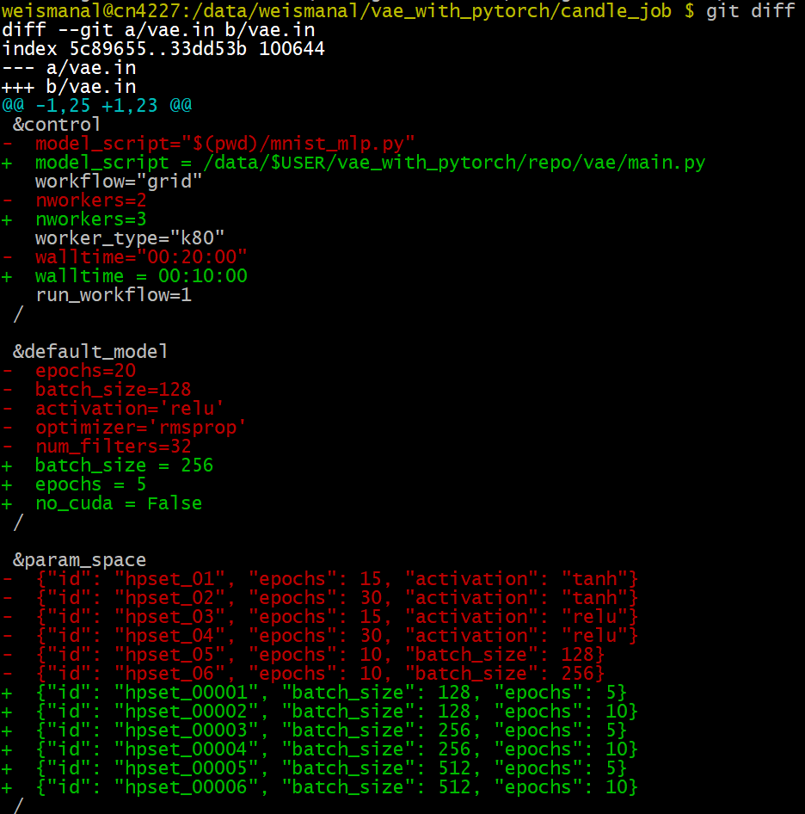
(3) Create a CANDLE input file ctd.
Modify the input file from the grid search template
Note that even though we don’t vary no_cuda in the &param_space section, CANDLE knows what value to use since it is defined in the &default_model section

Slide 34
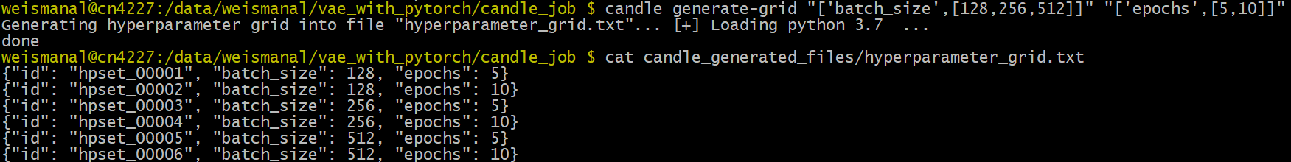
(3) Create a CANDLE input file ctd.
Note that we generated the &param_space section using: candle generate-grid "['batch_size',[128,256,512]]" \ "['epochs',[5,10]]"

Slide 35
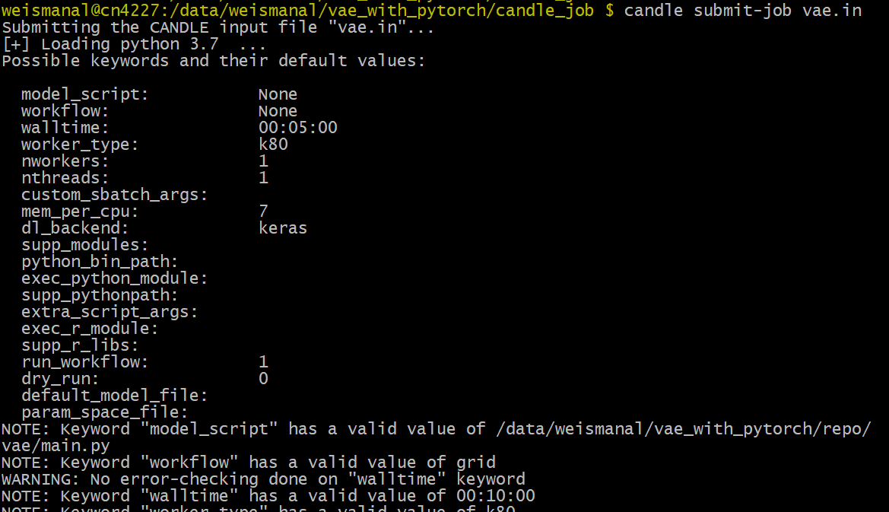
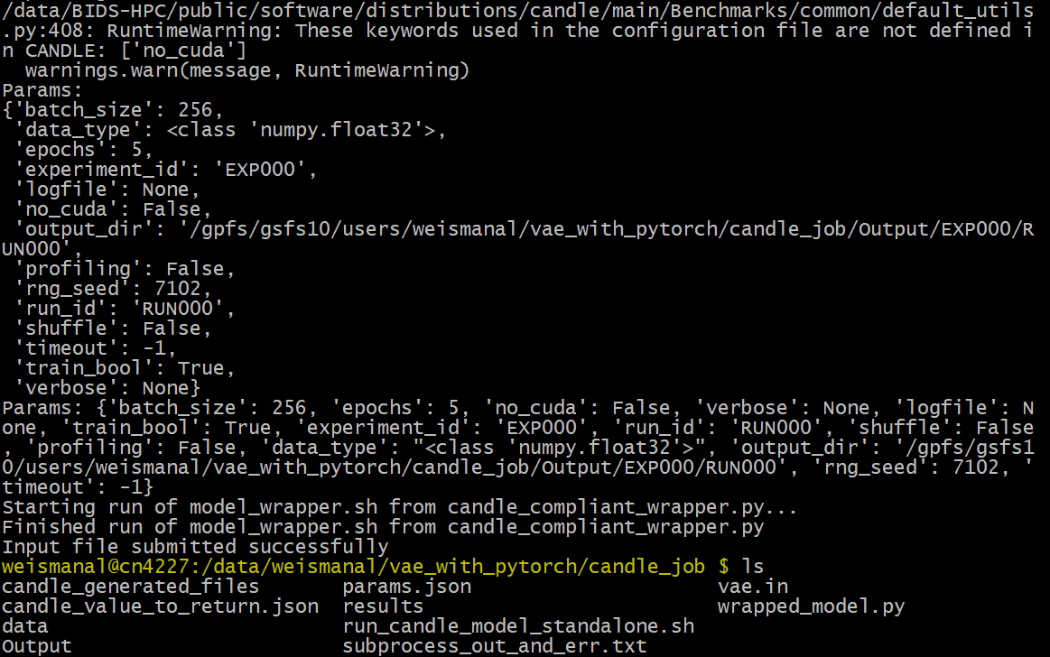
(4) Run the model using CANDLE without running a workflow
Set run_workflow=0 and run from an interactive node: candle submit-job vae.in:

Slide 36
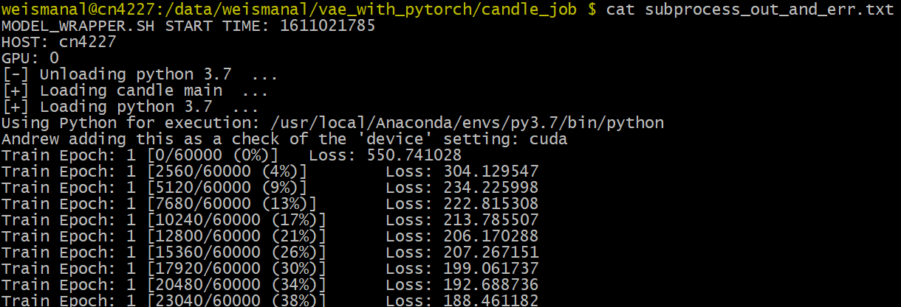
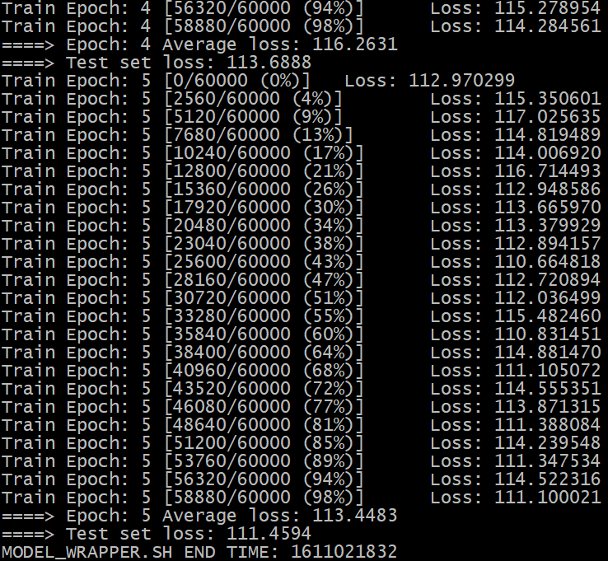
(4) Run the model using CANDLE without running a workflow ctd.
Review the contents of subprocess_out_and_err.txt:
Everything looks reasonable; and we can be reasonably confident that the full CANDLE job will work as expected!

Slide 37
(5) Submit the full CANDLE job
Clean up the working directory: mkdir no_workflow mv * no_workflow/ cp no_workflow/vae.in .
Set run_workflow=1 and run candle submit-job vae.in

Slide 38
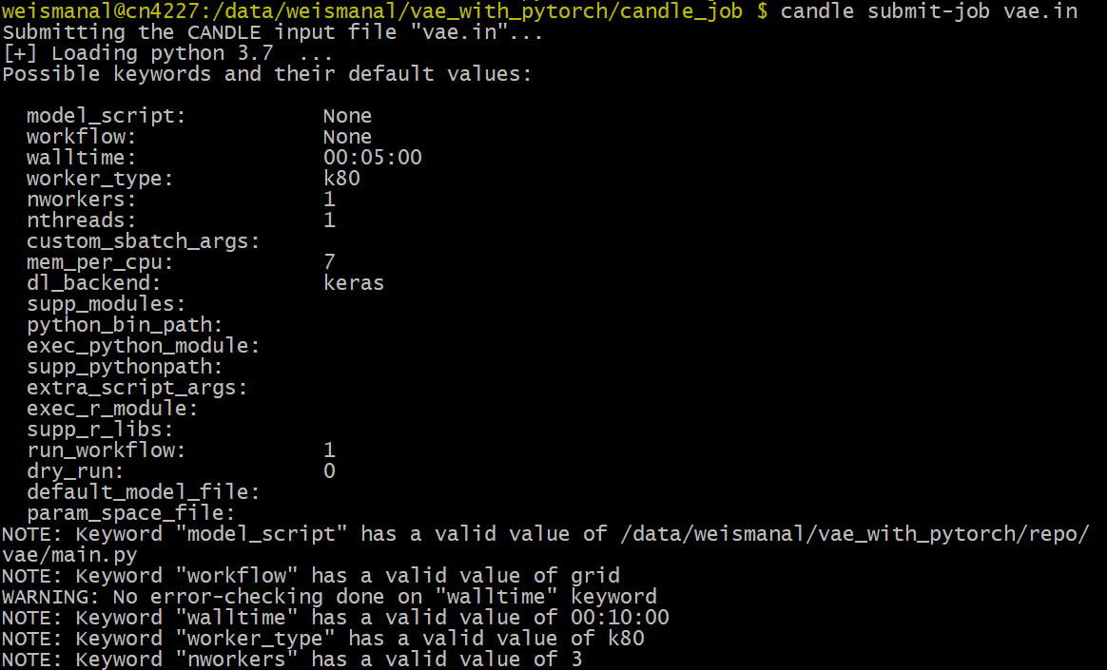
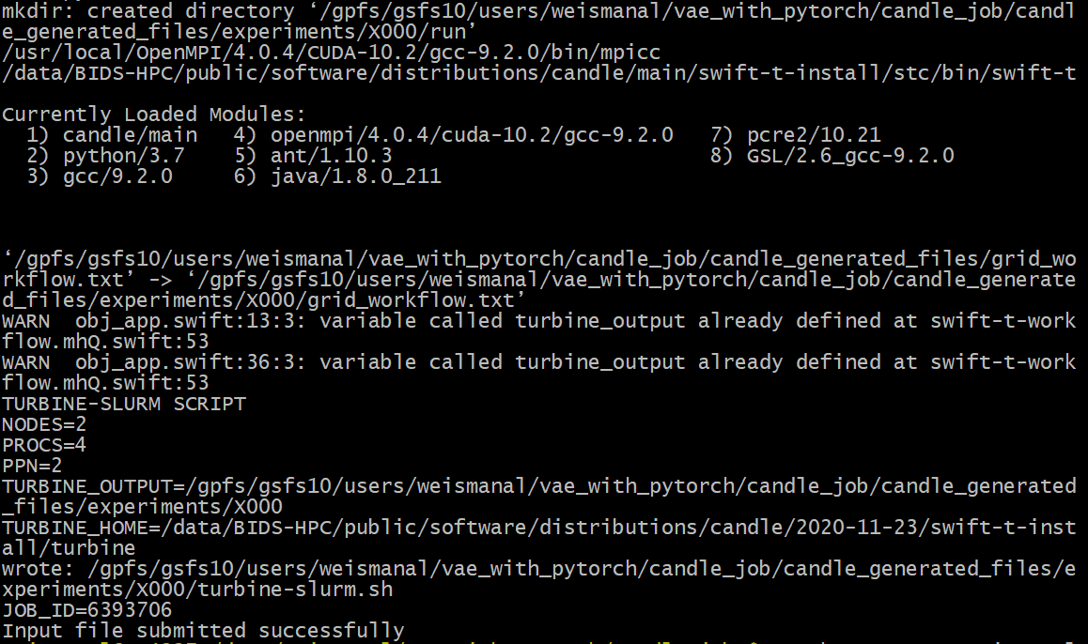
(5) Submit the full CANDLE job ctd.
Output to the screen:

Slide 39
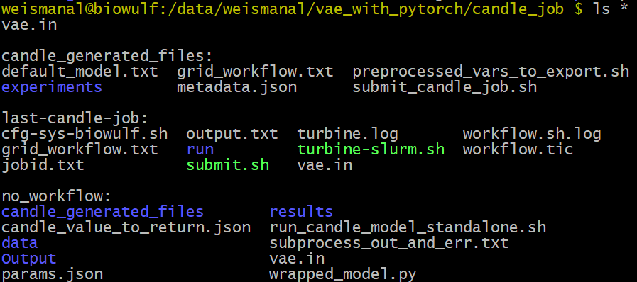
(6) Inspect the job results
After the job completes, observe the final directory structure:
last-candle-job is an always-updated symbolic link

Slide 40
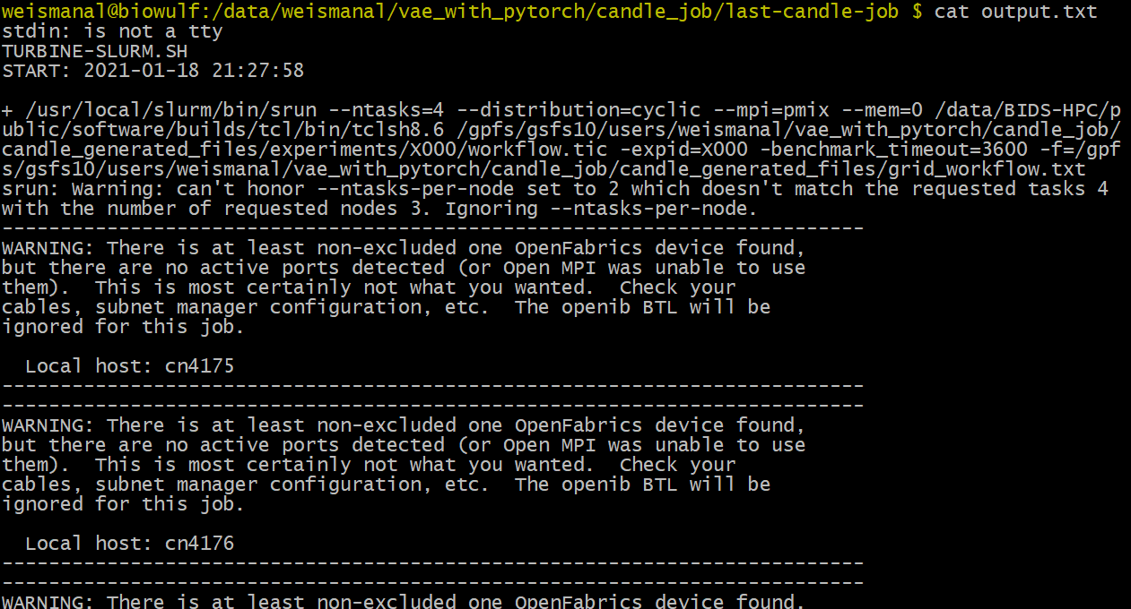
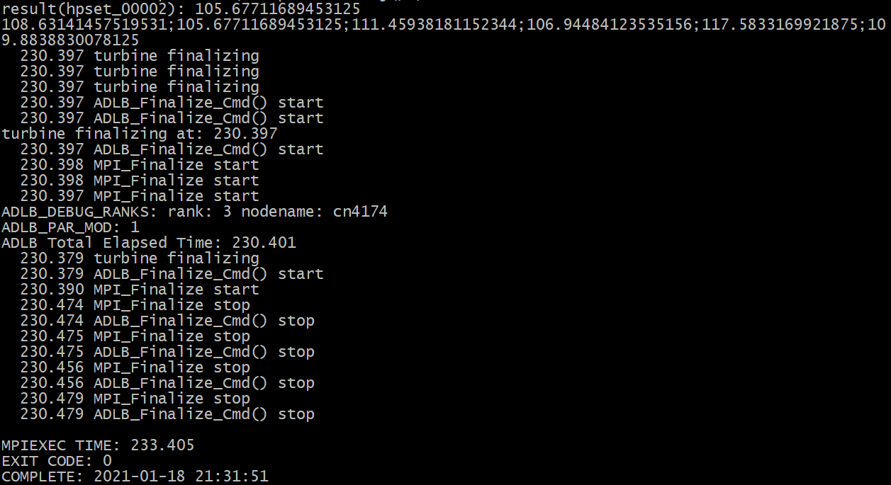
(6) Inspect the job results ctd.
Enter last-candle-job directory and observe the contents of output.txt:

Slide 41
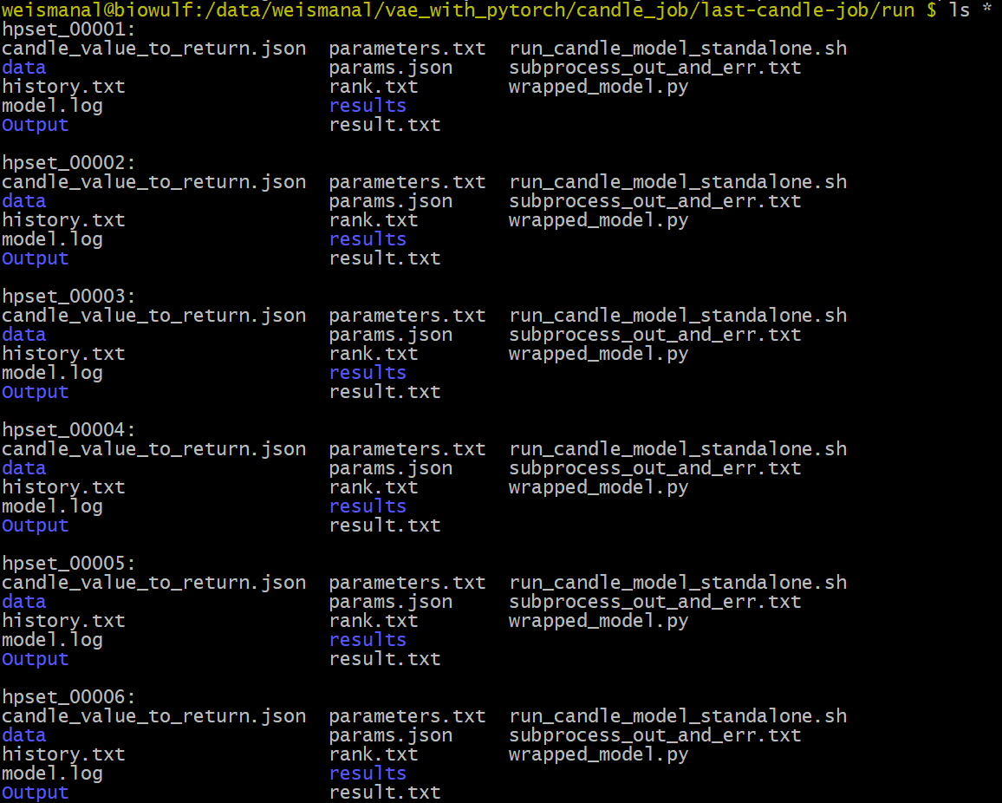
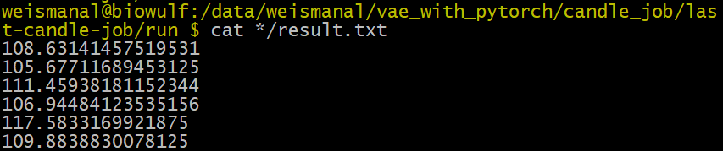
(6) Inspect the job results ctd.
Enter run directory and observe the directory structure
See the final reconstruction loss on the test set for each hyperparameter set:

Slide 42
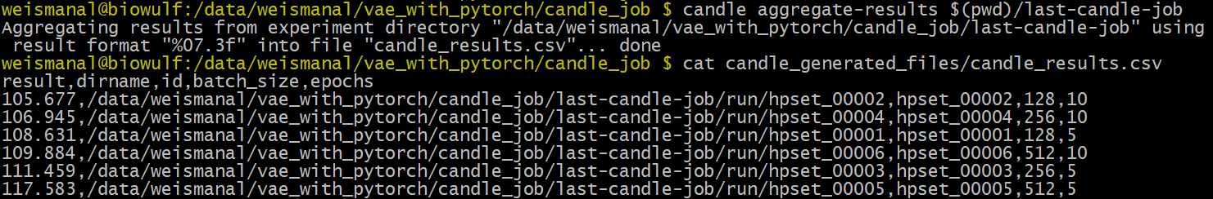
(6) Inspect the job results ctd.
Enter the submission directory again and generate and observe the aggregated results:
These results, which are sorted by increasing test loss, preliminarily show that a combination of low batch size and high number of epochs results in lower test loss

Slide 43
Wrap-up
Appreciation:
SDSI team: George Zaki, Ravi Ravichandran, Lynn Borkon, Petrina Hollingsworth
DOE teams: Argonne, Los Alamos, Oak Ridge National Labs
Biowulf staff: Tim Miller, Wolfgang Resch, Susan Chacko
IT support: Michael Rinaldi, Jose Aragon
Links:
Presentation survey: https://bit.ly/CANDLE_Workshop_Jan21
CANDLE on Biowulf documentation
Biowulf user guide
This very talk
My contact info: andrew.weisman@nih.gov
Questions?

Slide 44
Presentation Title
Presenter Title, Affiliation
Date 1, 2018

Slide 45
Secondary Slide Title
Bullet point
Bullet point
Bullet point

Slide 46
Presenter
Section Title

