Slide 1
Employee Attrition
An Analysis of Factors Leading to Employee Turnover
Andrew Yule, DDS Analytics

Slide 2
Introduction
Goals:
Top factors contributing to attrition
Identify interesting trends
Predict attrition and employee salary

Slide 3
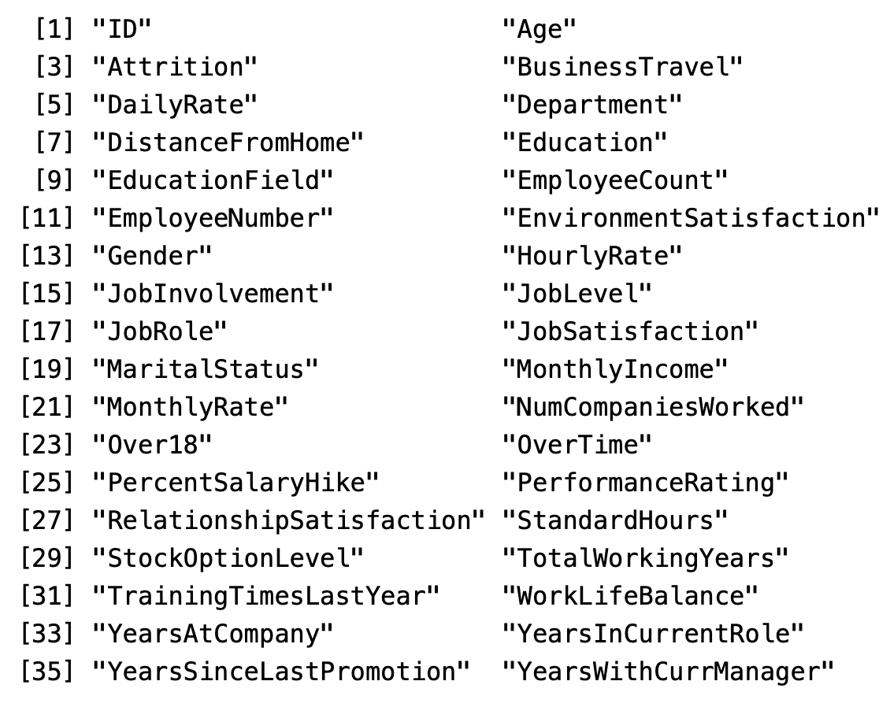
Data Summary
870 observations
36 variables available
30 variables used in analysis

Slide 4
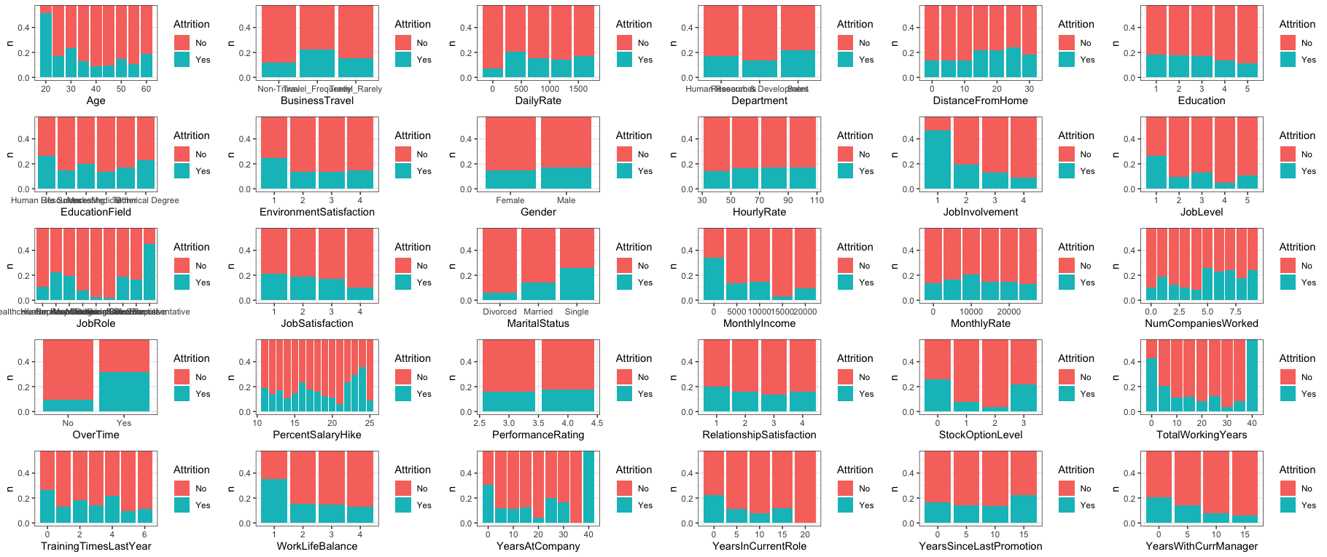
Key Variables Effecting Employee Attrition

Slide 5
Key Variables Effecting Employee Attrition

Slide 6
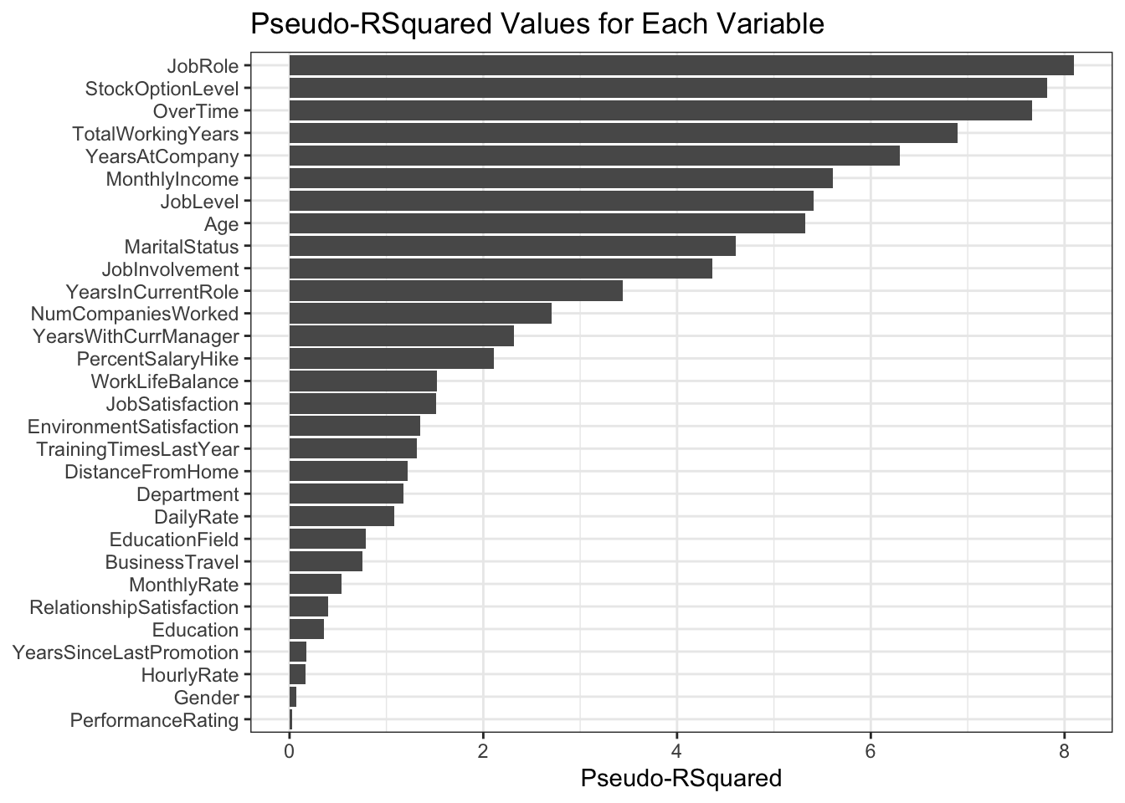
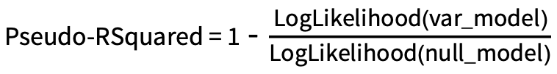
Top 3 Factors Effecting Employee Attrition
Log Likelihood used to estimate Pseudo-RSquared
Null model based on overall attrition across the entire data set (16%)
Variables Log Likelihood compared against null model
Key Factors:
Job Role
Stock Option Level
Over Time

Slide 7
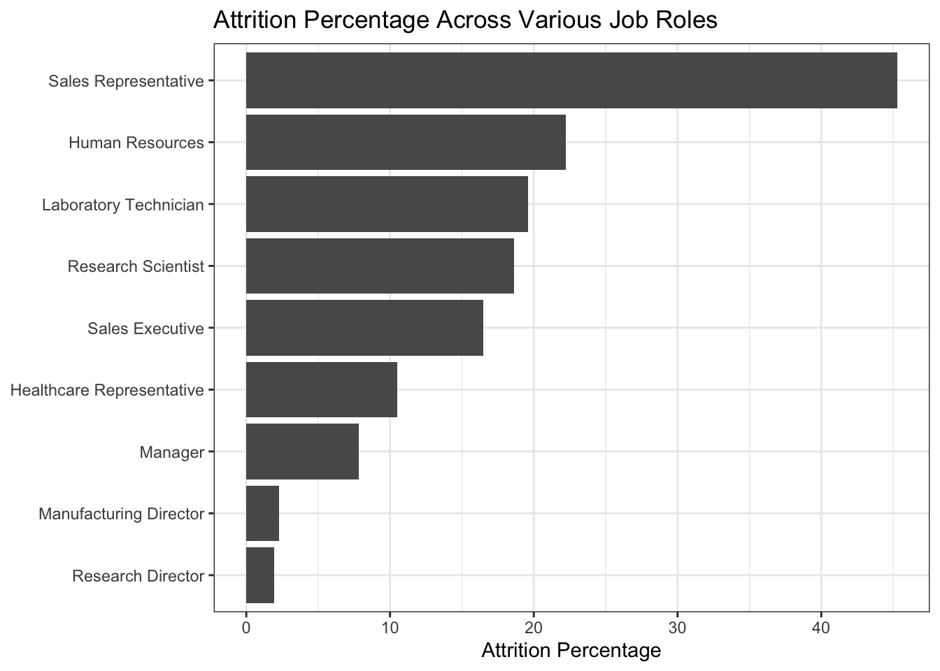
Interesting Job Role Specifics
Sales roles are likely to have the highest attrition
Options to decreasing attrition:
↑ stock options
↓ over time
↑ monthly income

Slide 8
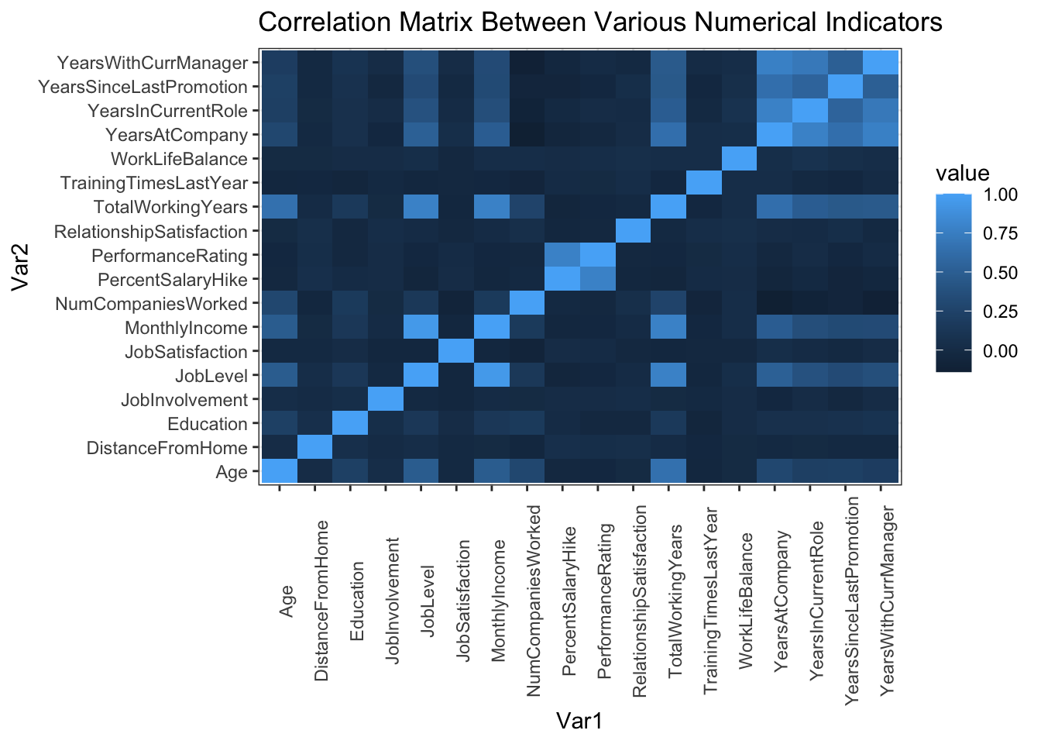
Notable Trends
No strong correlations between work life balance and other variables
Work life balance may be something highly determined by the individual and not workplace factors

Slide 9
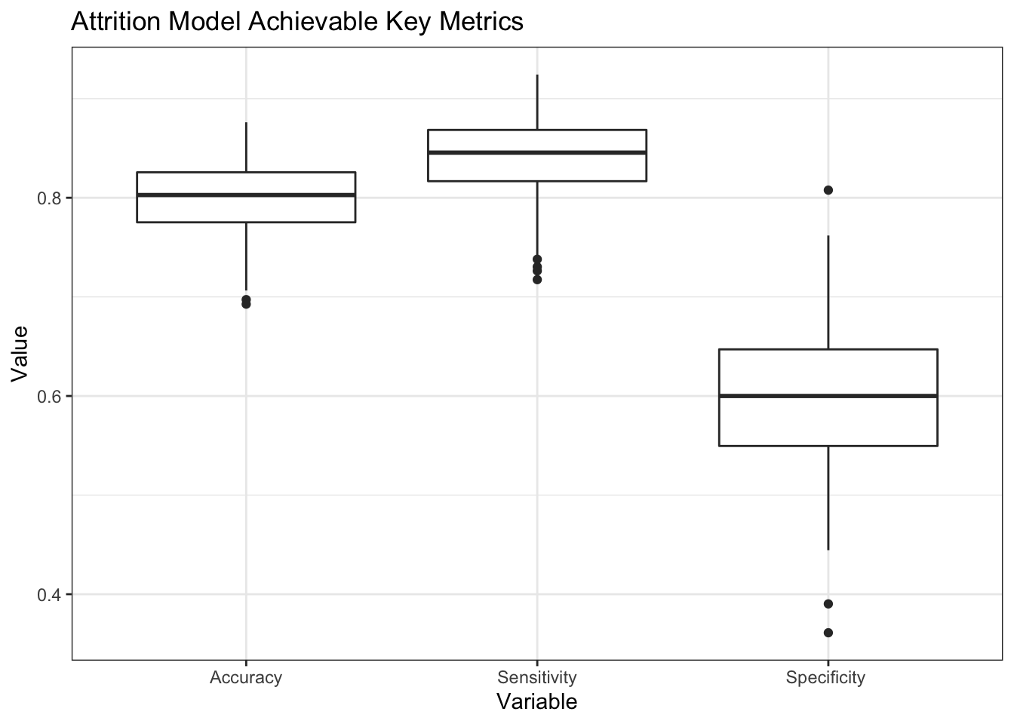
Predicting Attrition
Naïve-Bayes model constructed with 16 of the 30 variables analyzed
Achievable metrics:
Accuracy – 80%
Sensitivity – 84%
Specificity – 61%

Slide 10
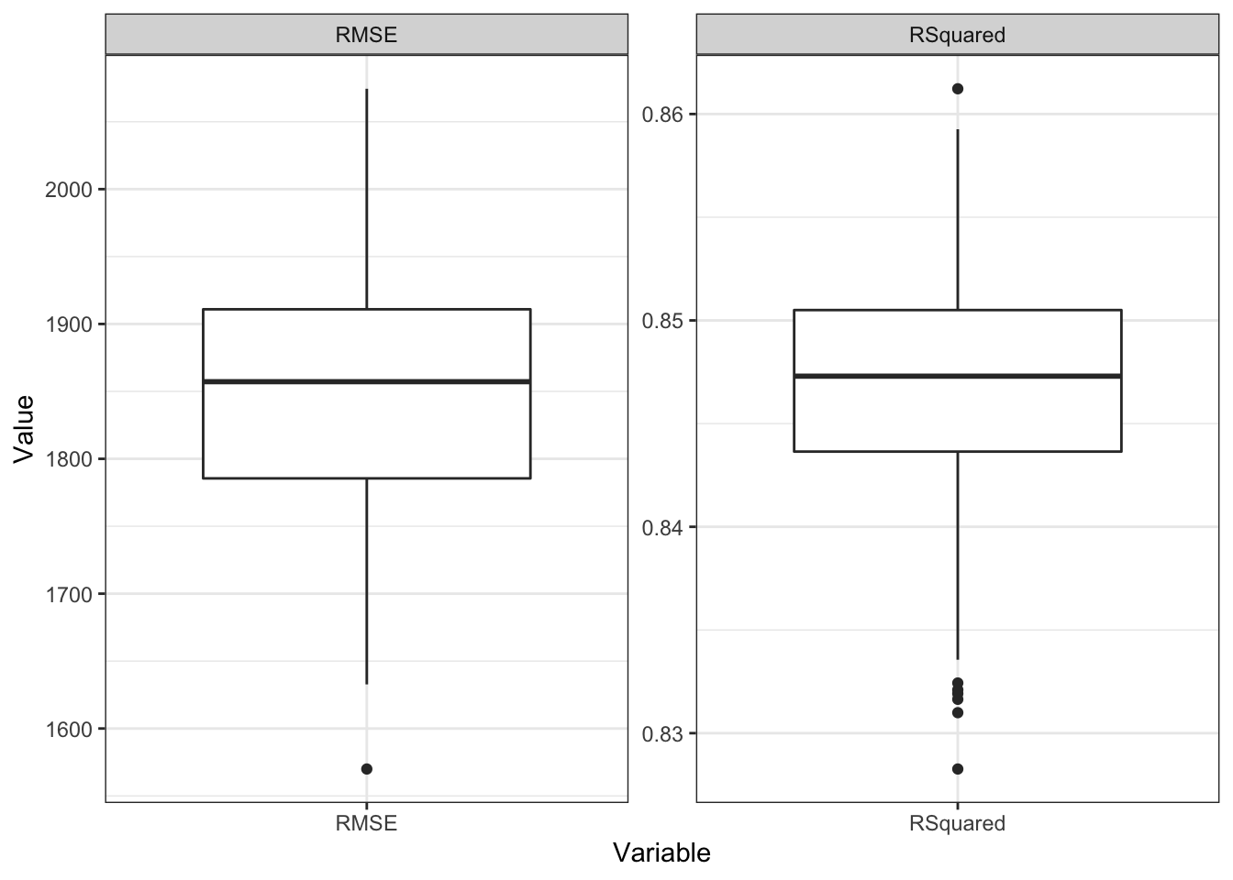
Predicting Salary
Linear Regression model constructed based on Age, Job Role, Years at Company, and Stock Options
Achievable metrics:
R² – 0.85
RMSE – $1,850

Slide 11
Key Takeaways
Focusing on certain job roles like sales is the most important to prevent attrition
Of the top 6 factors effecting employee attrition that can be controlled, providing stock options, decreasing overtime, and increasing salary are the best ways to retain employees
Attrition and salary can be predicted by simple models with relatively good accuracy. More complicated models such as gradient boosted trees or neural networks can be developed if needed and are expected to improve prediction capability

Slide 12
Thank You

