Slide 1
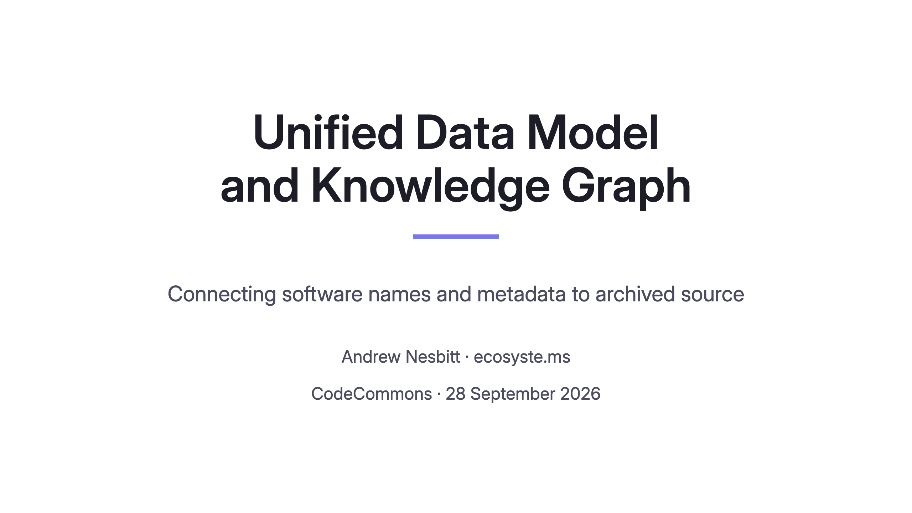
Notes:
0:00
On screen before speaking starts.

Slide 2
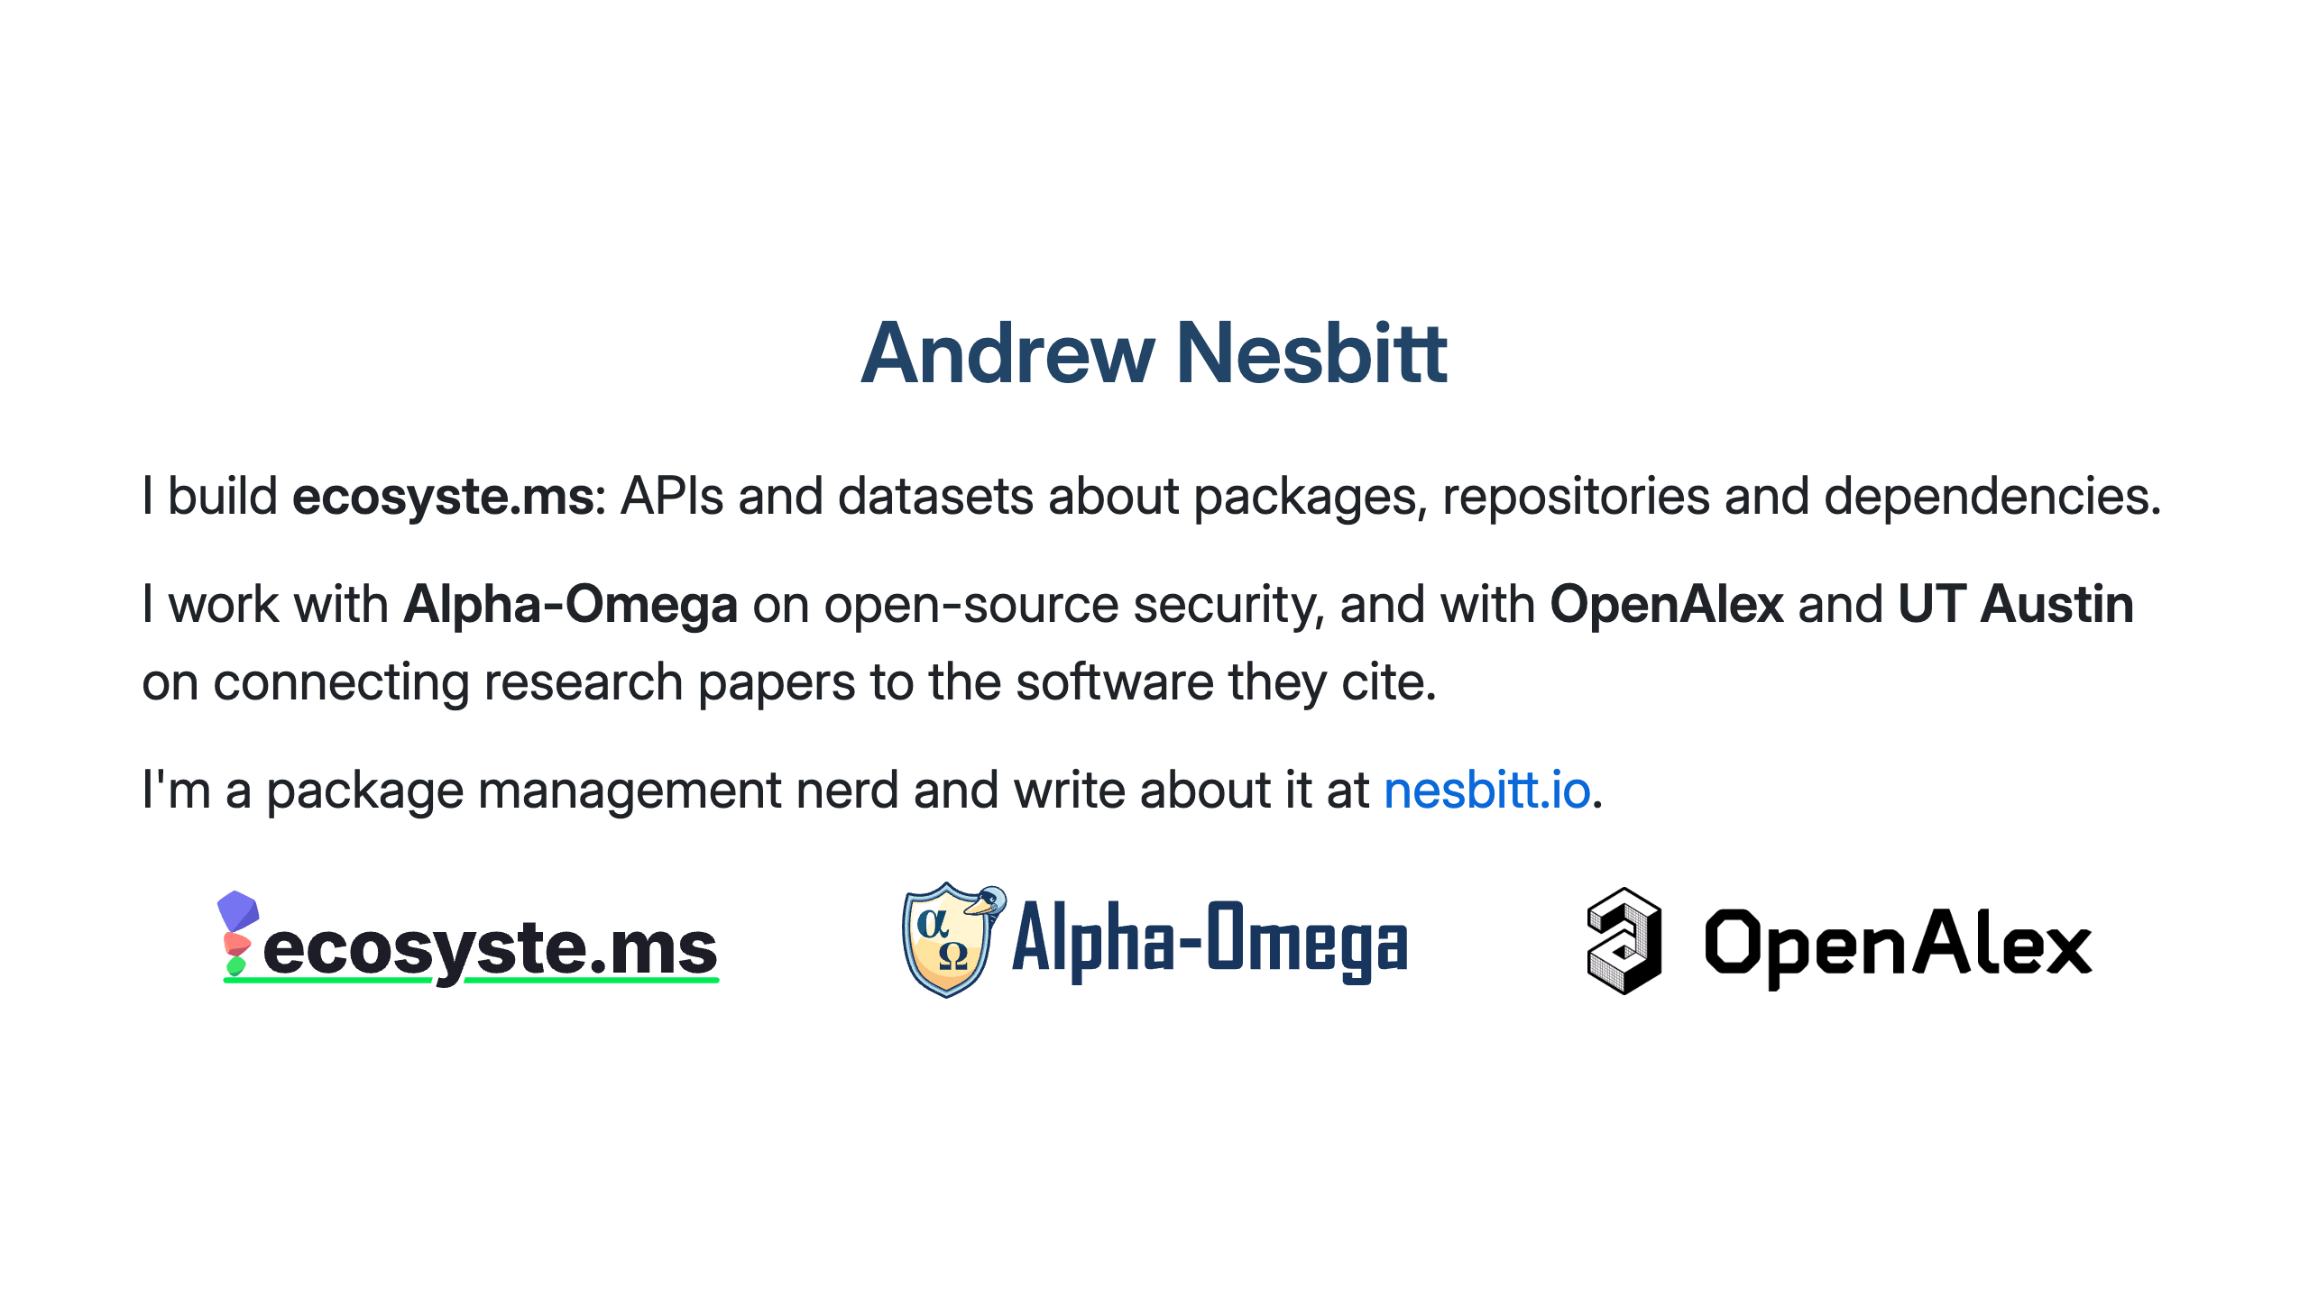
Notes:
0:45
- ecosyste.ms
- Alpha-Omega security work
- OpenAlex/UT Austin research-software grant

Slide 3
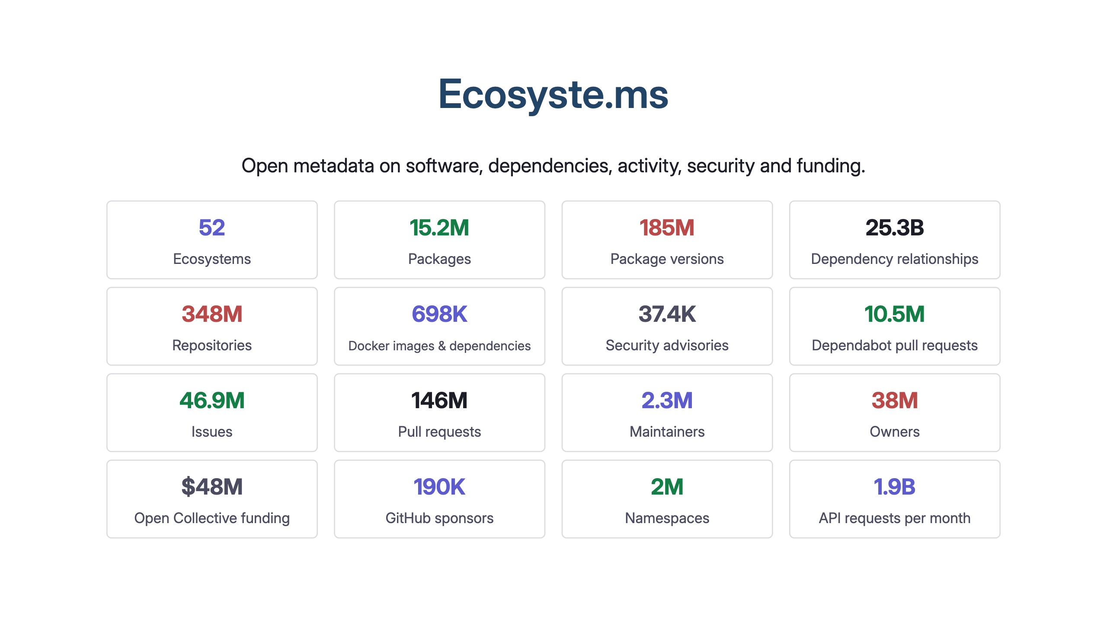
Notes:
0:45
Repository URLs and package IDs join these datasets.
Counts overlap; don't add them. Sponsor counts aren't funding amounts.

Slide 4
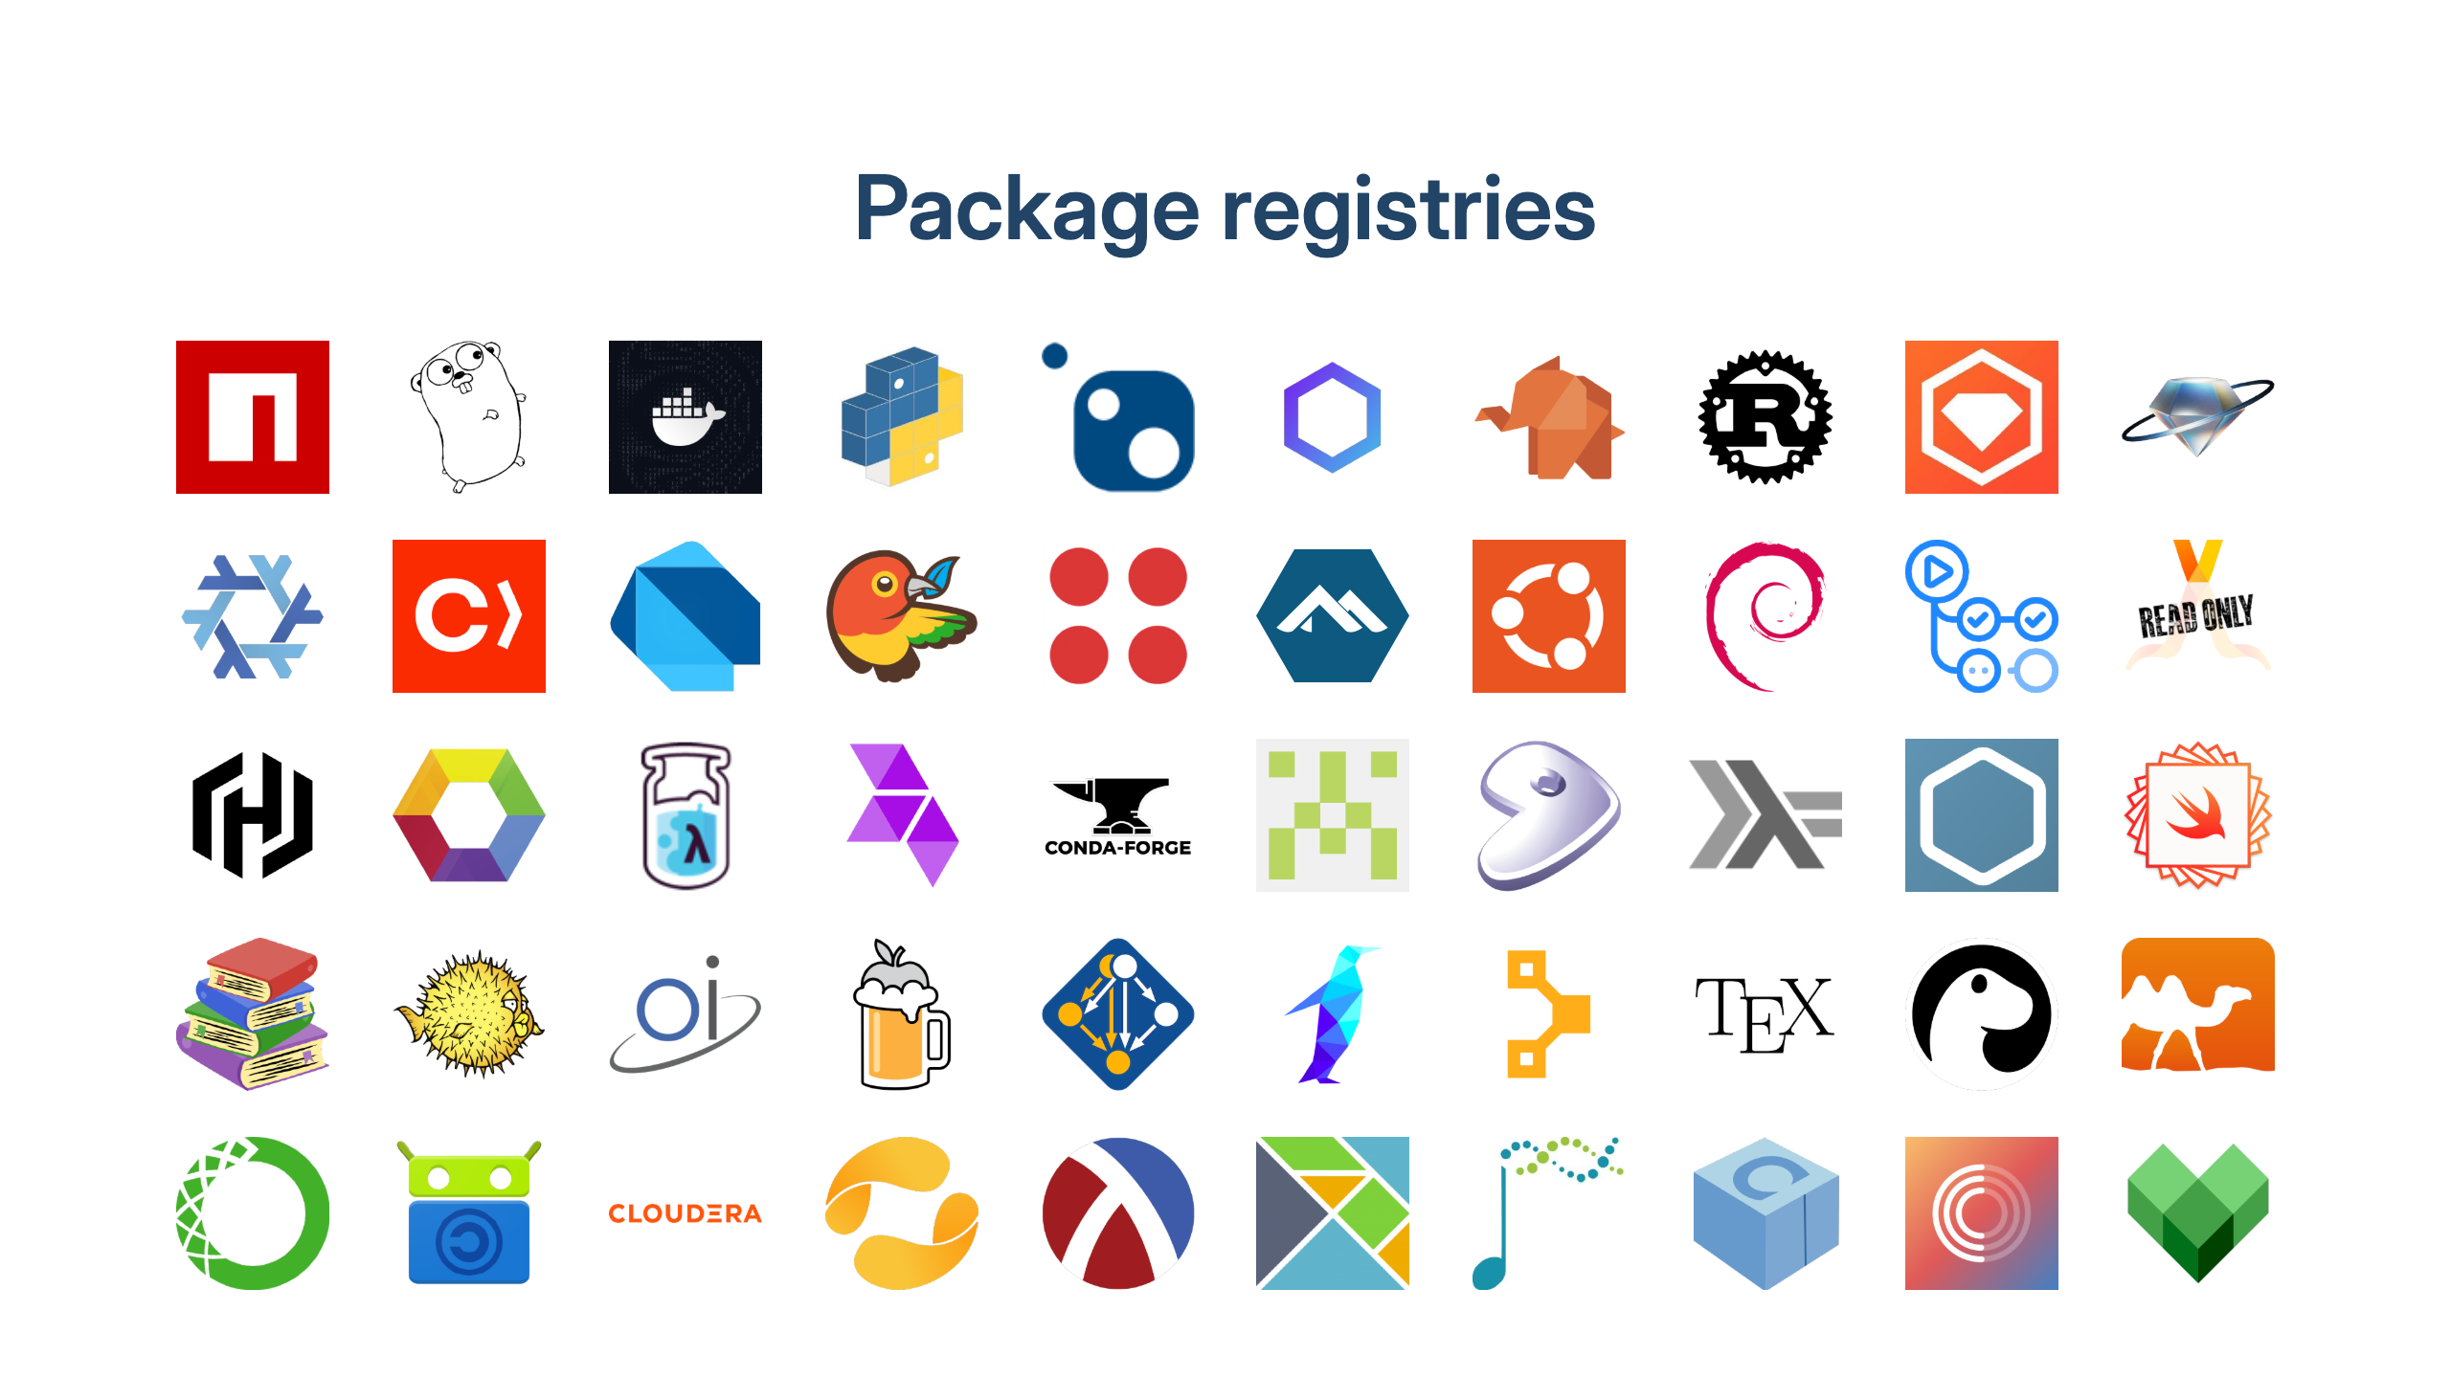
Notes:
0:30
Each registry has its own naming and version rules.
Several distribution releases share an avatar; image count differs from registry count.

Slide 5
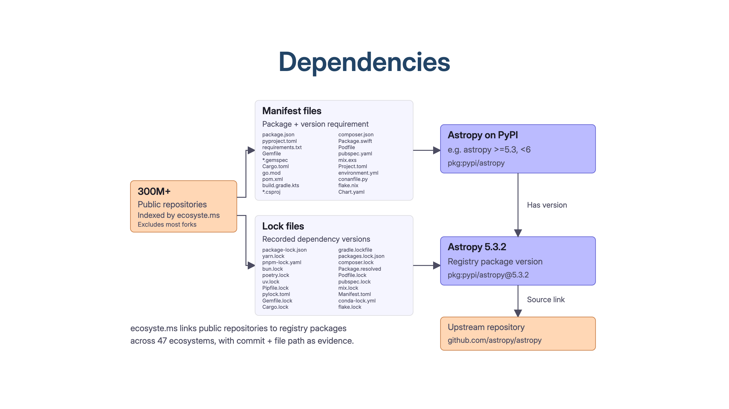
Notes:
1:00
25B+ dependency links recorded.
Keep commit + file path so each relationship can be checked against archived source.
SWH's documented API doesn't expose a resolved package dependency graph.

Slide 6
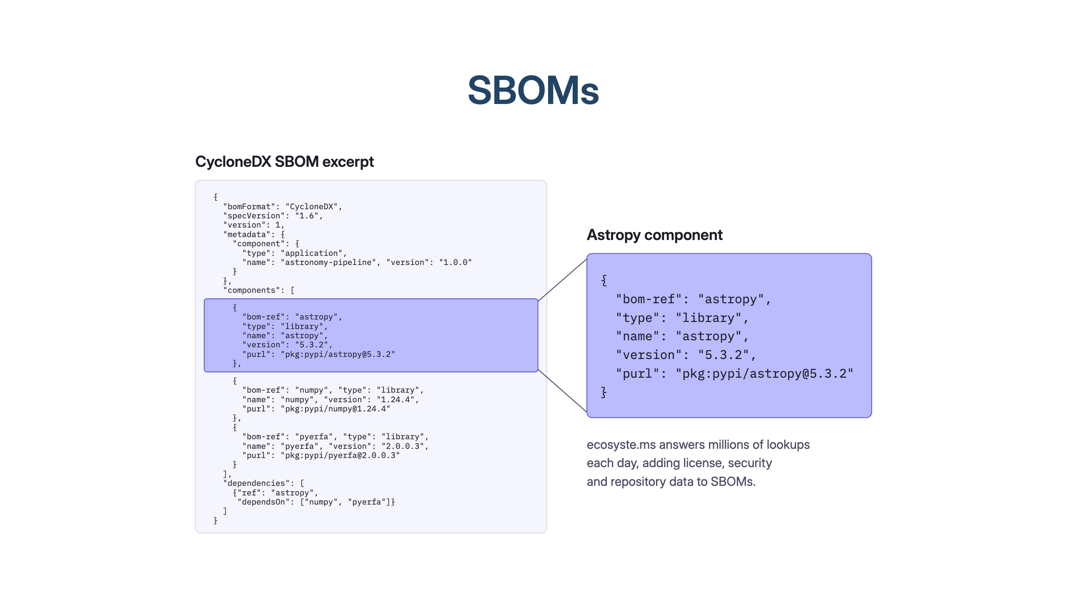
Notes:
1:00
Astropy: community-developed astronomy software.
Enrichment starts with a purl; the missing step is tracing it to archived source.

Slide 7
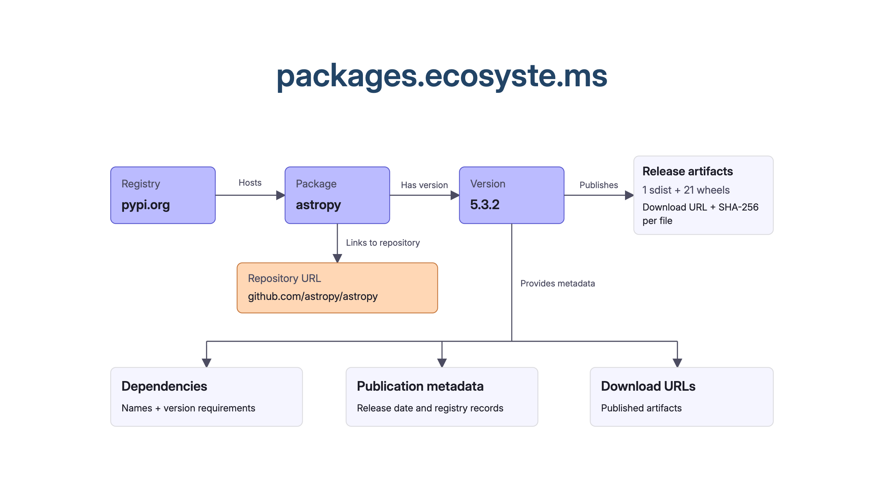
Notes:
3:00
Adapter per registry; feeds + forge events + sweeps keep records current.
One Rails service per concern, own Postgres, HTTP between them.
Shared upstream helps connect registries. Check version mappings and downstream backports.

Slide 8
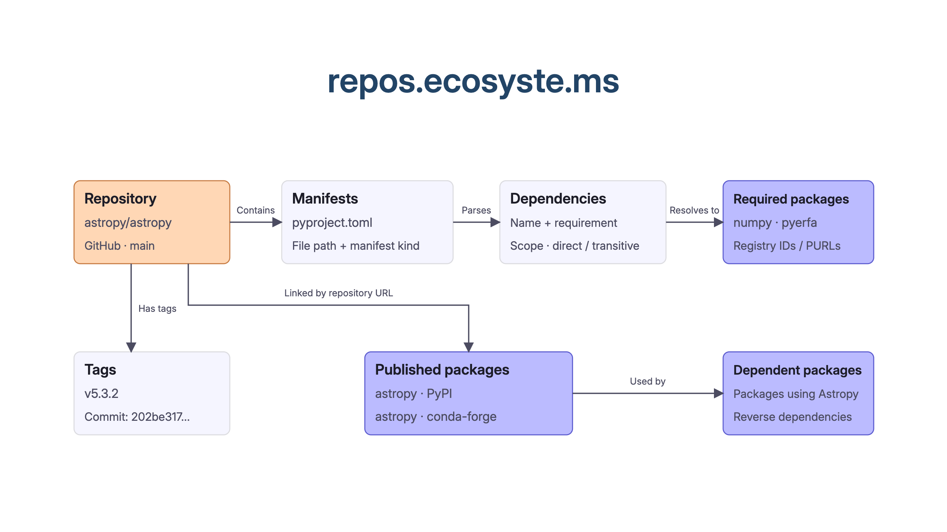
Notes:
2:00
Default-branch manifests don't establish a release's dependencies; parse the tag separately.
One repository can publish several packages with different dependency sets.

Slide 9
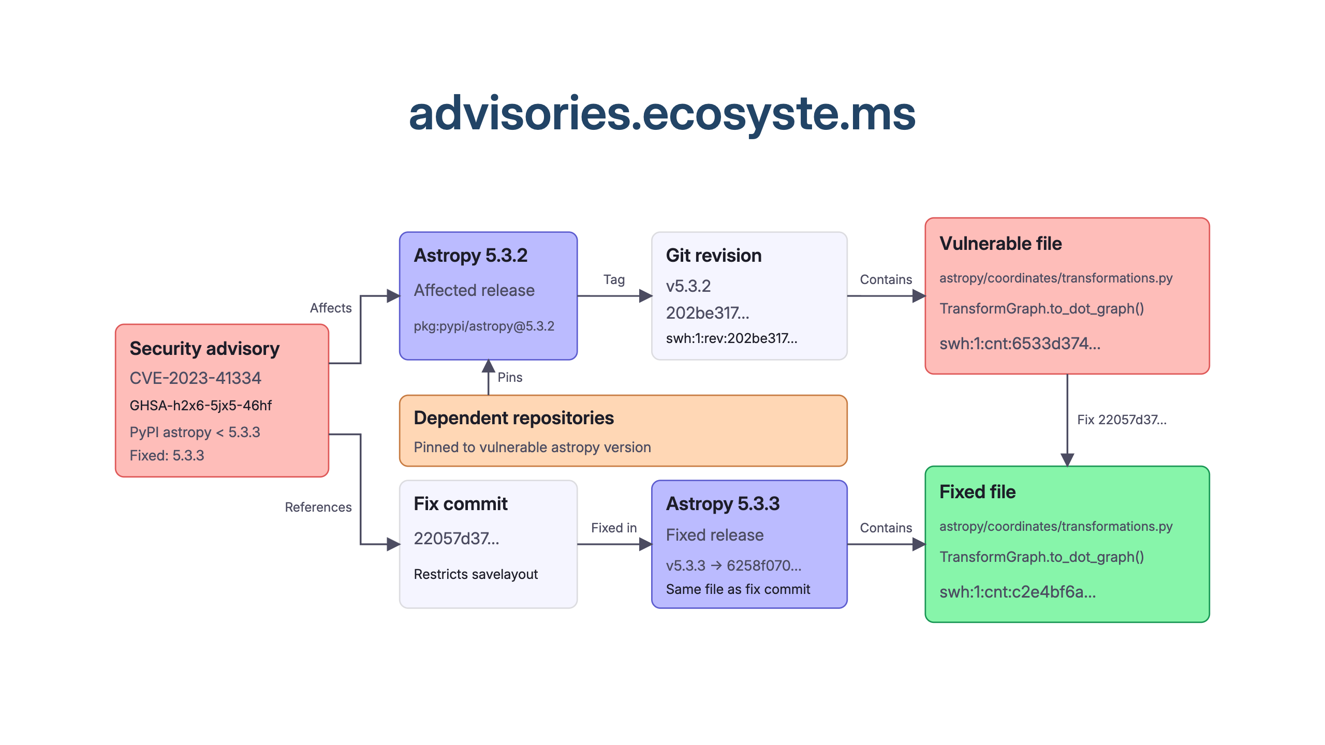
Notes:
2:00
Verified before/after file bytes connect the fix to these releases.
A pin indicates potential exposure; exploitability depends on use.
Content SWHIDs calculated locally; archive presence still needs checking.

Slide 10
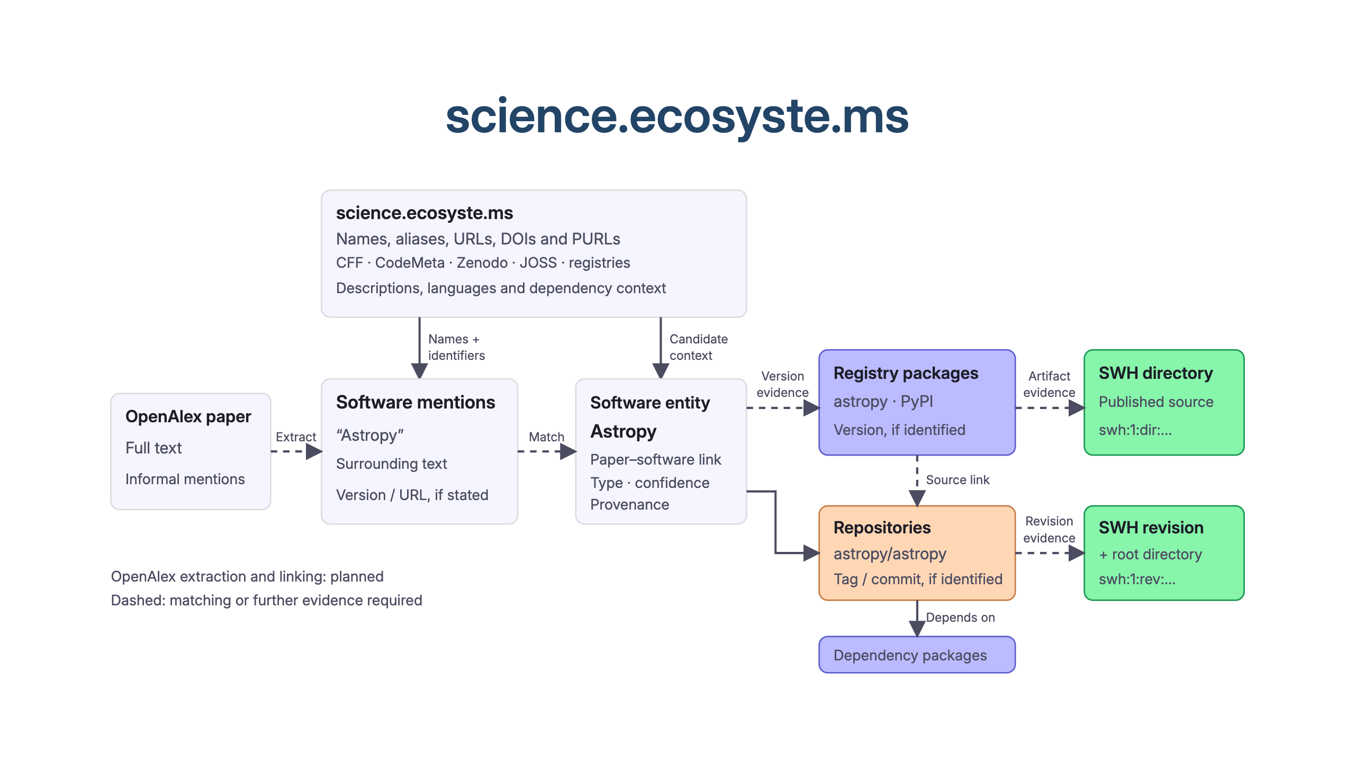
Notes:
2:00
A software-paper citation alone doesn't establish software use.
Science's current SWH scans cover default-branch checkouts; they can't establish which version a paper used.
These links could support software credit and adoption metrics.

Slide 11
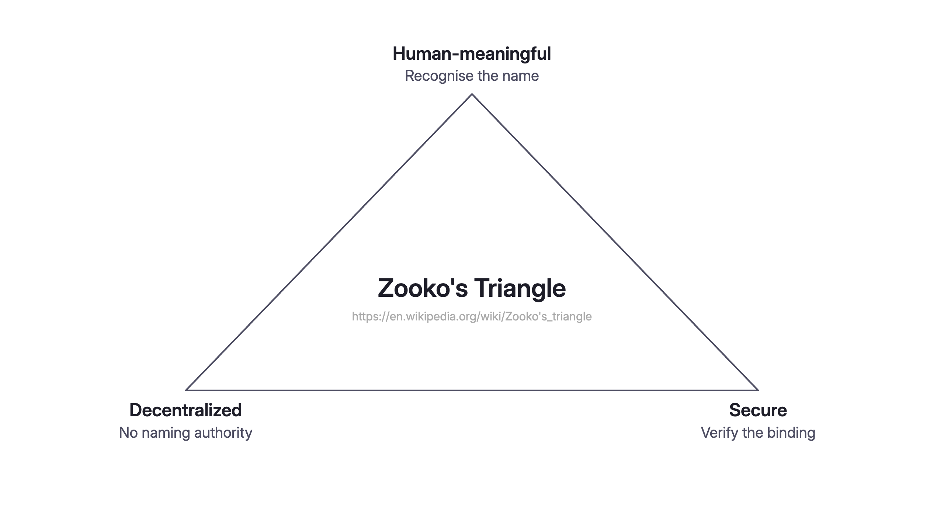
Notes:
1:00
Naming is hard; Zooko Wilcox-O'Hearn, 2001. Pick two.
Classic examples: DNS names, content hashes, petnames.
Package management hits this daily.

Slide 12
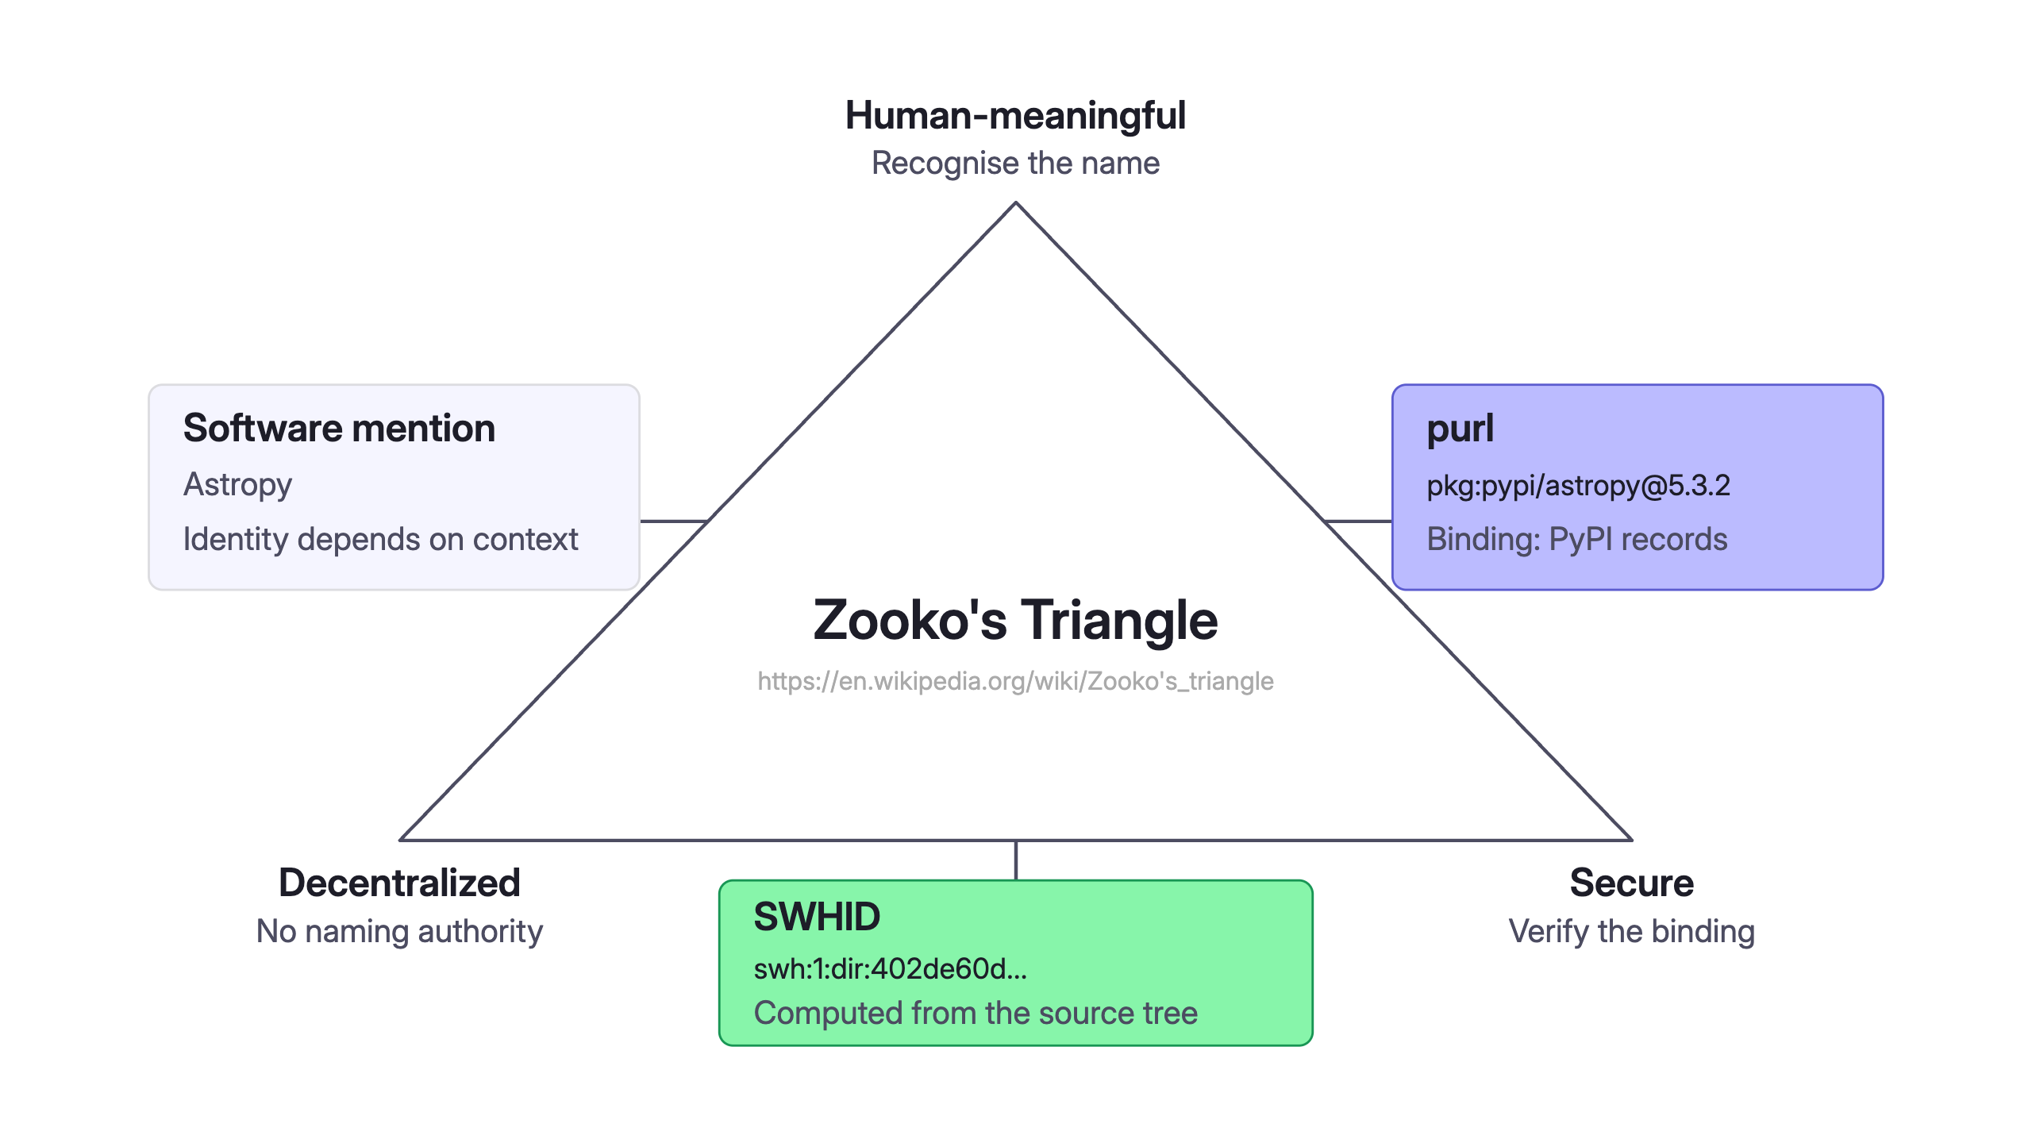
Notes:
1:00
A mention is meaningful but unverifiable,
a purl is meaningful and verifiable but only via the registry's authority,
a SWHID is verifiable and authority-free but means nothing to a human,
and the graph exists so you can walk between the three.

Slide 13
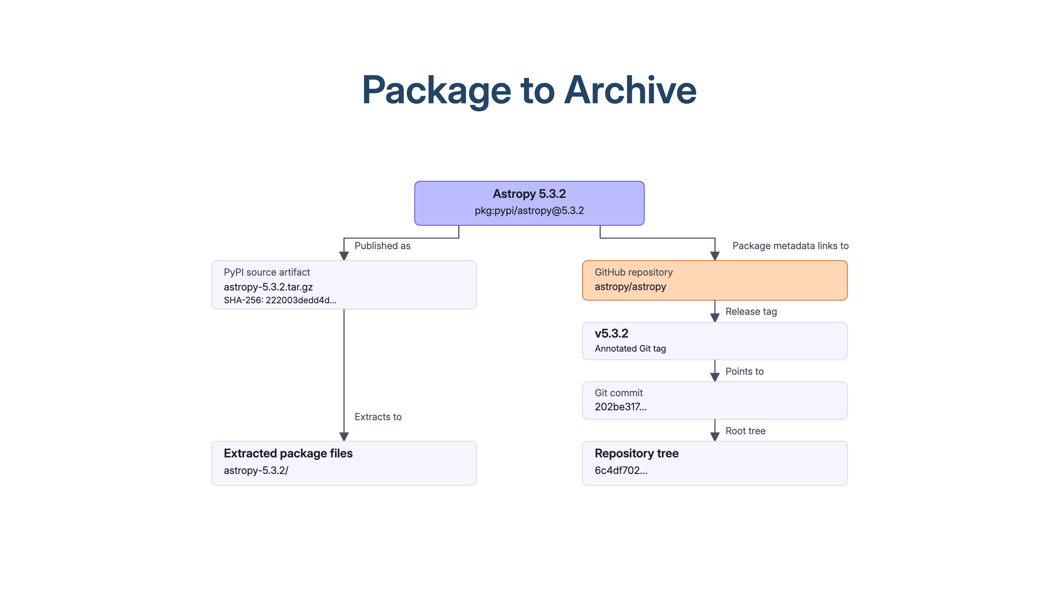
Notes:
2:00
Repository URLs can be wrong; tags are conventions. Verify both.
Packaging can add or omit files, so the published tree can differ from Git.

Slide 14
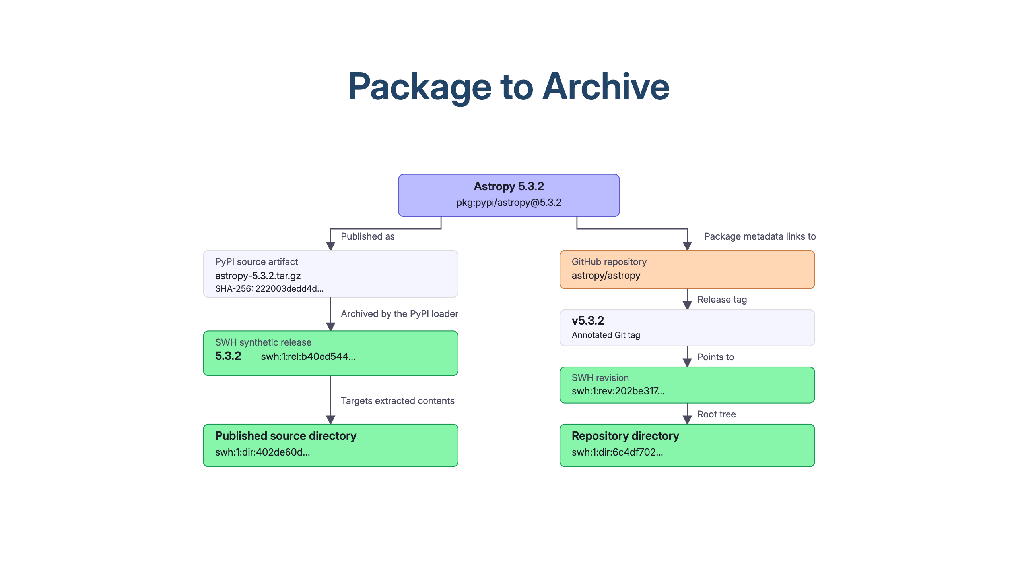
Notes:
2:30
The directories still differ after removing the archive's wrapper folder.
Return both with evidence so callers can choose. Wheels remain a separate preservation question.

Slide 15
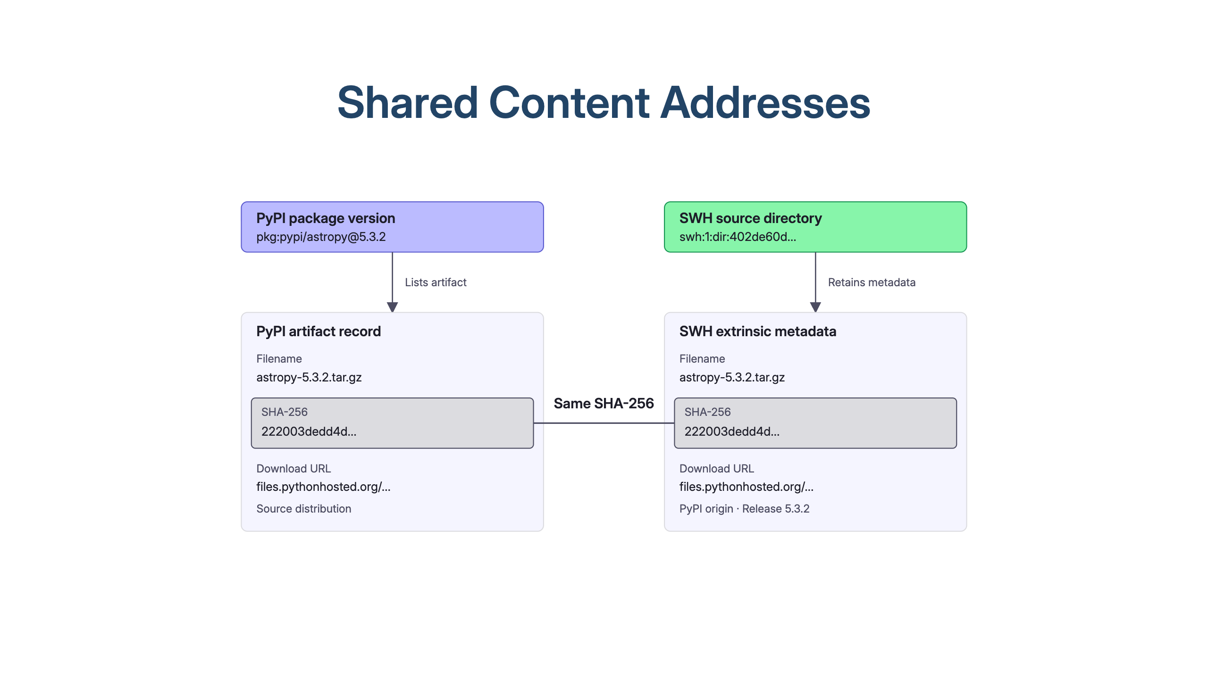
Notes:
2:00
SWH retains authority + fetcher + discovery date; ecosyste.ms indexes by purl.
CodeCommons ask: make this join queryable from the package side.

Slide 16
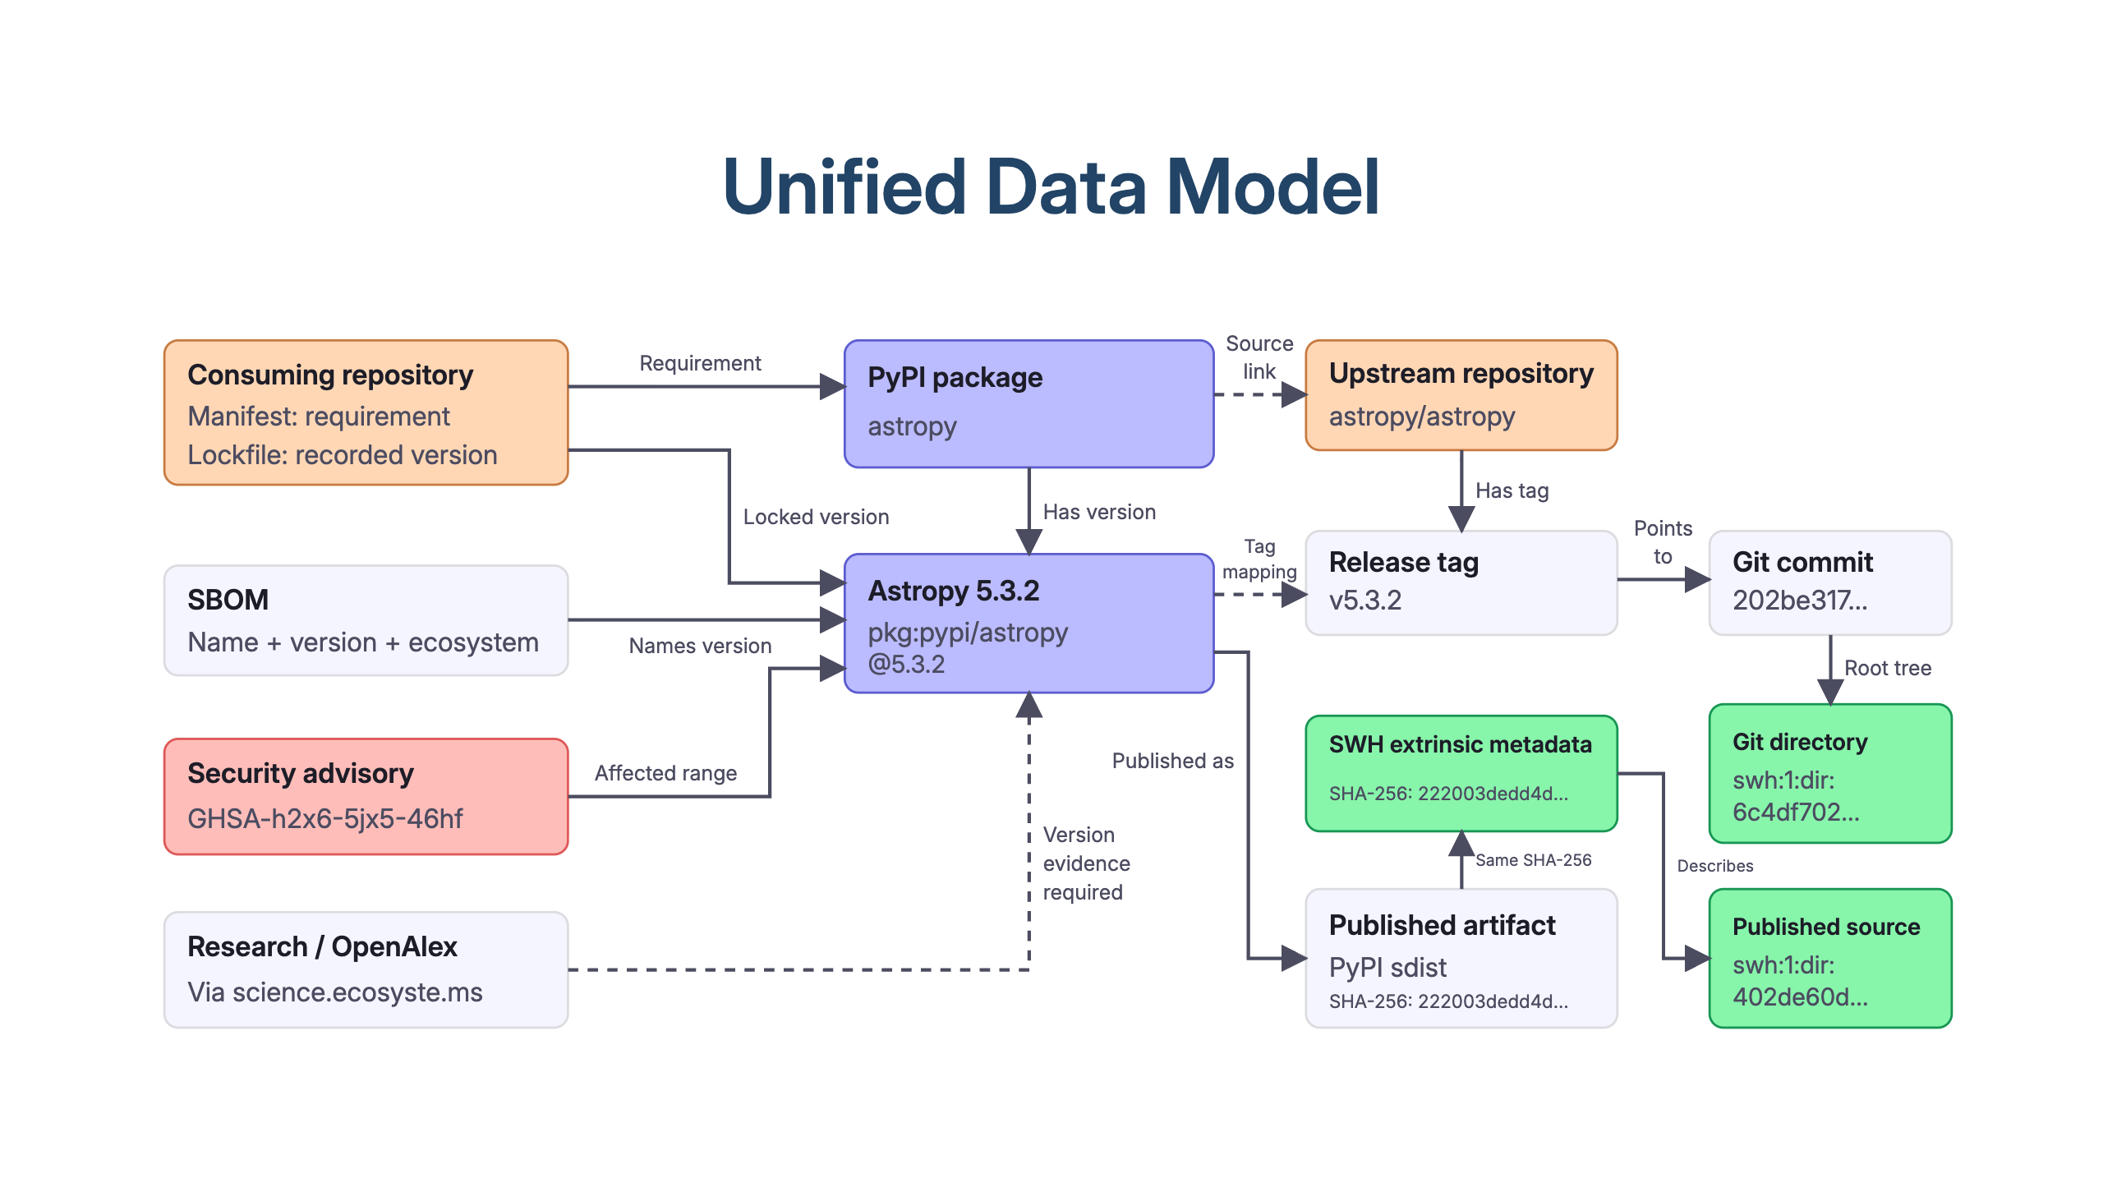
Notes:
1:30
Each relationship needs its source and date; bindings change.
CodeCommons could maintain these mappings and expose verifiable paths to archived source.

Slide 17
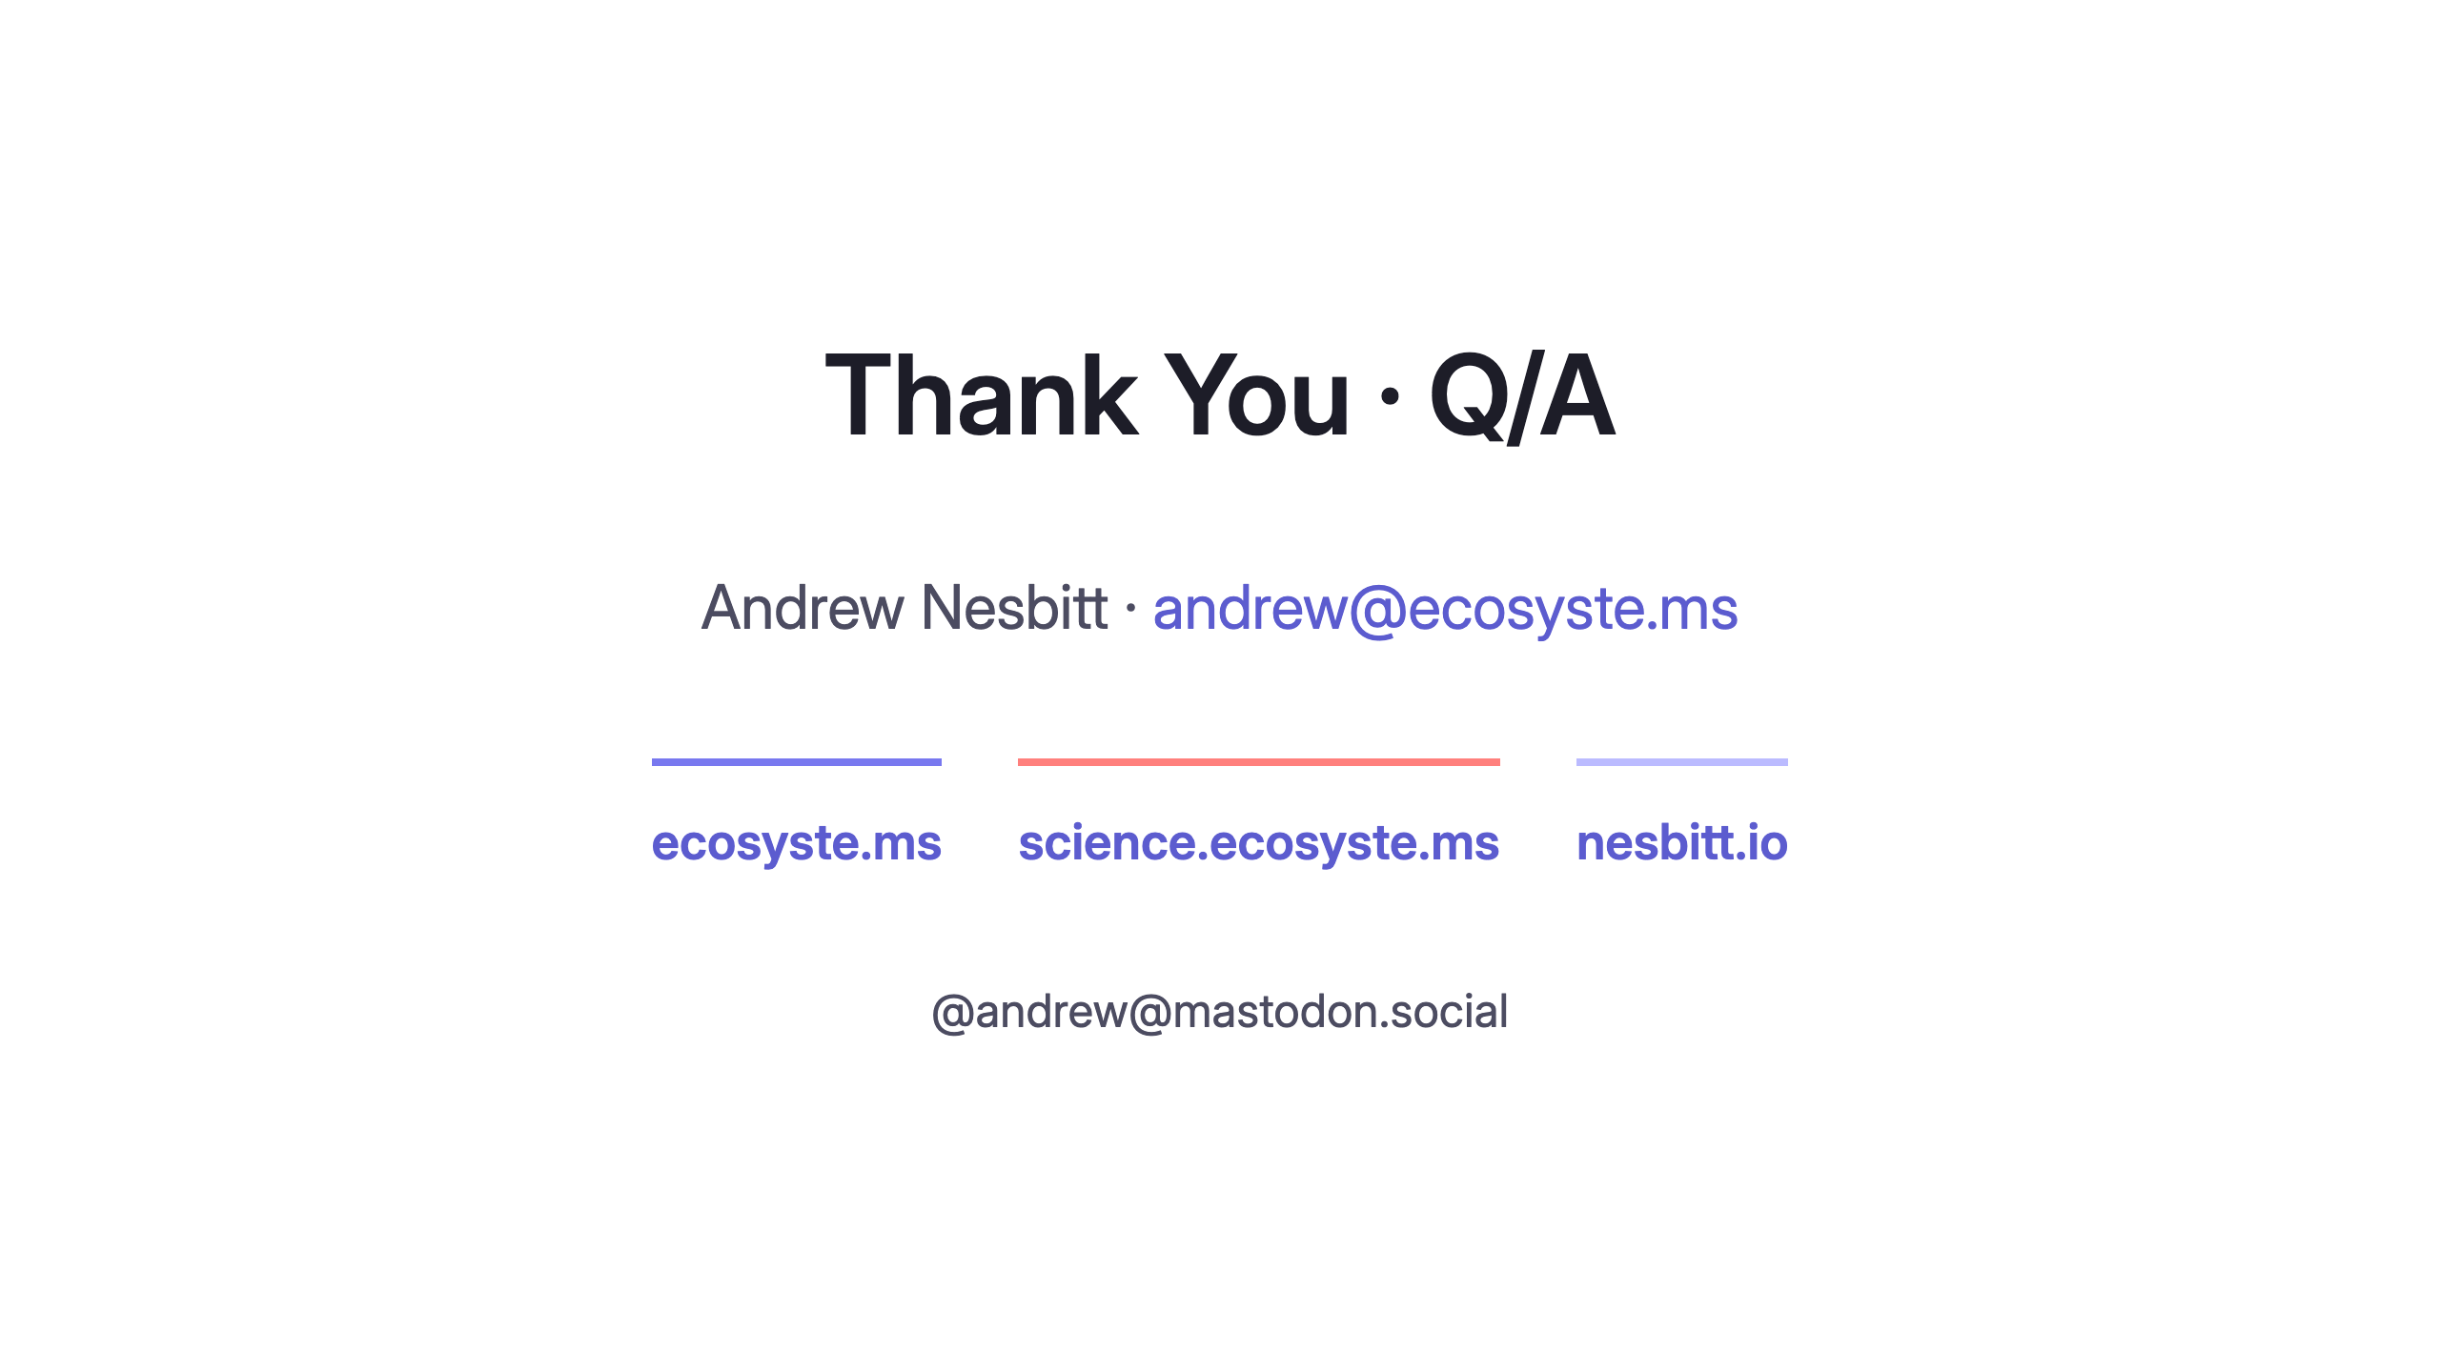
Notes:
0:00
Left on screen during the ~10 minutes of questions.
Likely first question is "how does ecosyste.ms actually work under the hood":
one Rails service per concern, own Postgres, HTTP between them,
adapter per registry, everything joined on repository_url.

