Slide 1
Data Science HW3
Department of Computer Science
National Tsing Hua University (NTHU)
Hsinchu, Taiwan
Due Date: 2023/05/12 (FRI) 23:59
TA : 蔡珮瑜 資電館743
Email: lobsterlab.cs.nthu@gmail.com

Slide 2
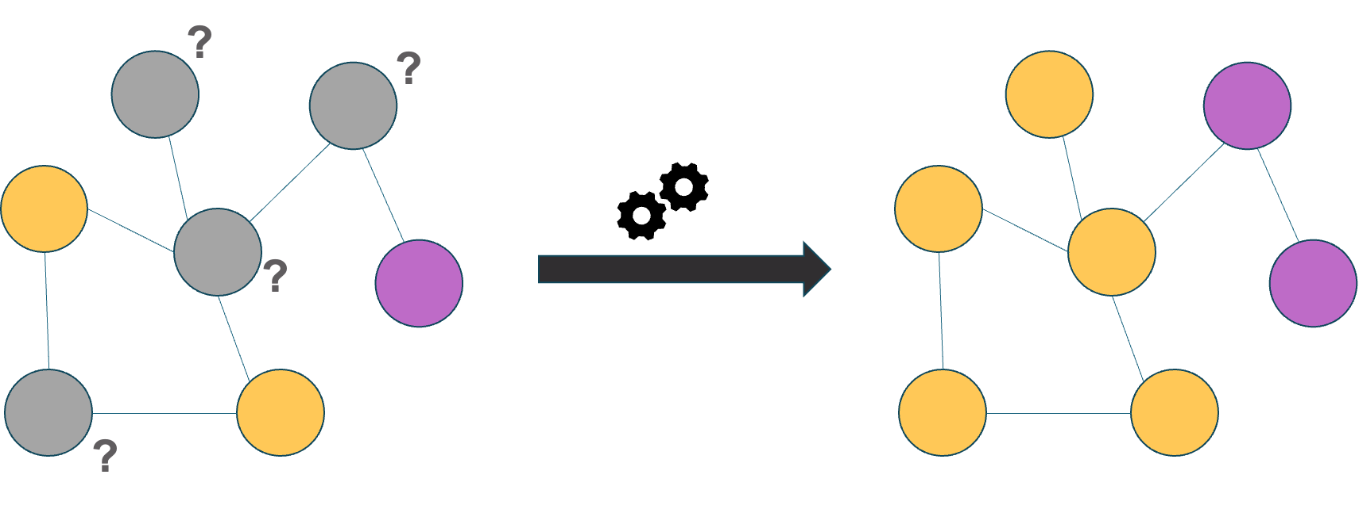
HW3 Node classification
Build a node classification model
Given an unknown graph dataset
Train your model using the training nodes
Predict the labels of the testing nodes.

Slide 3
HW3 is hosted on Kaggle
HW 3 Kaggle link
https://www.kaggle.com/t/d1097b49b16014572e81c3bafd7e3bb9
Deadline: 2023/05/12 (FRI) 23:59
Fill your Kaggle name in the google form
We will use the result on Kaggle to score this homework
You also need to hand in your code on eeclass.
The instructions for submitting files will be described in later pages.
Do not directly copy any source on the internet.

Slide 4
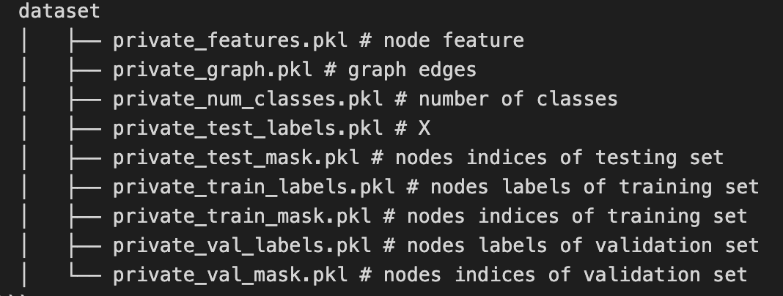
Dataset description
A modified graph data
Each node has a predefined feature.
Dataset file name description

Slide 5
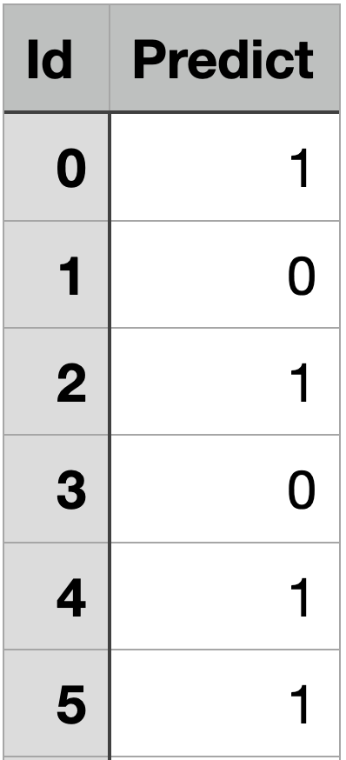
Output format
For each testing instance, there is a unique id
Output your prediction to csv file with the following format and submit to Kaggle
Remember to write the first line ‘Id,Predict’
Output csv file example:

Slide 6
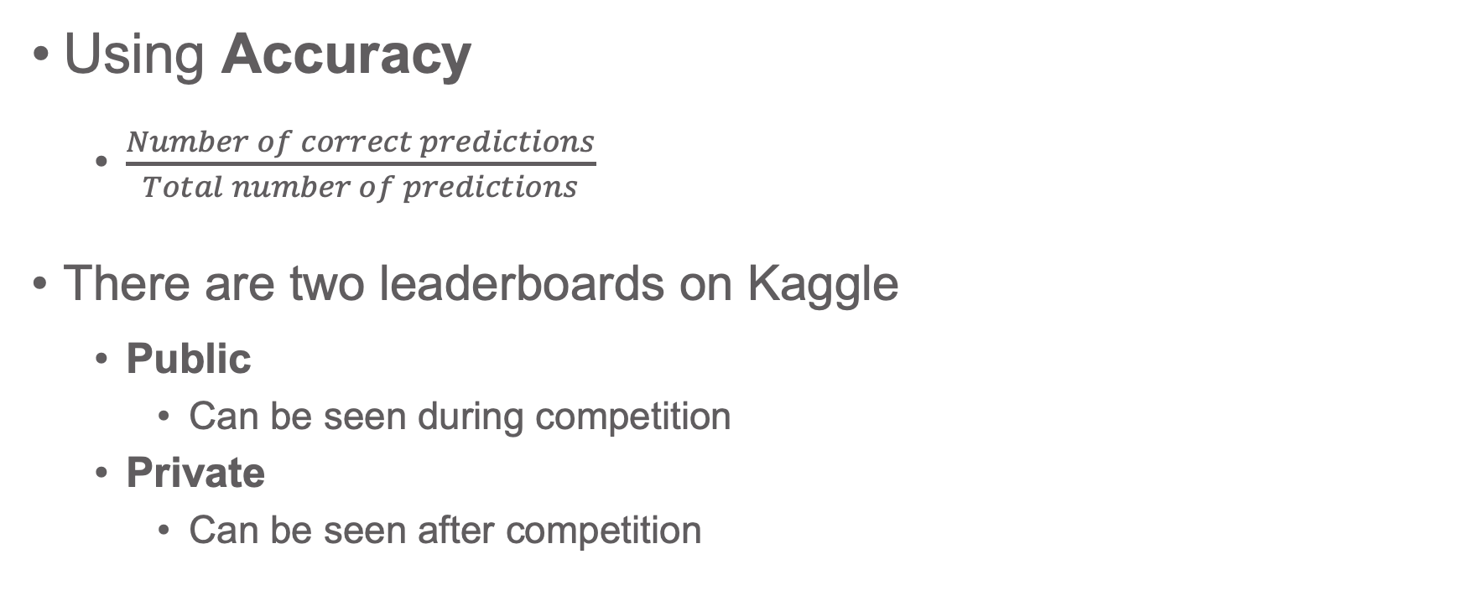
Evaluation
Using Accuracy
$\frac{Number of correct predictions}{Total number of predictions}$
There are two leaderboards on Kaggle
Public
Can be seen during competition
Private
Can be seen after competition

Slide 7
Public and Private leaderboard
Public (Can be seen during competition)
50% testing data
For reference
Private (Can be seen after competition)
the other 50%
Use this result for final scoring
50%
Public score
Testing
data
50%
Private score

Slide 8
Scoring
 | Public | Private* | Your HW3 Score
Baseline 0 | 0.750 | 0.740 | 0
Baseline 60 | 0.814 | 0.786 | 60
Baseline 70 | 0.834 | 0.806 | 70
Baseline 80 | 0.838 | 0.822 | 80
Baseline 88 | 0.850 | 0.840 | Top 20% : 100 20%~80%: 92 Others: 88
You will get 0, if your private score is between baseline 0 and baseline 60
You will get 60, if your private score is between baseline 60 and baseline 70
You will get 70, if your private score is between baseline 70 and baseline 80
And so on
* The private score of each baseline may be adjusted based on the results of classmates.

Slide 9
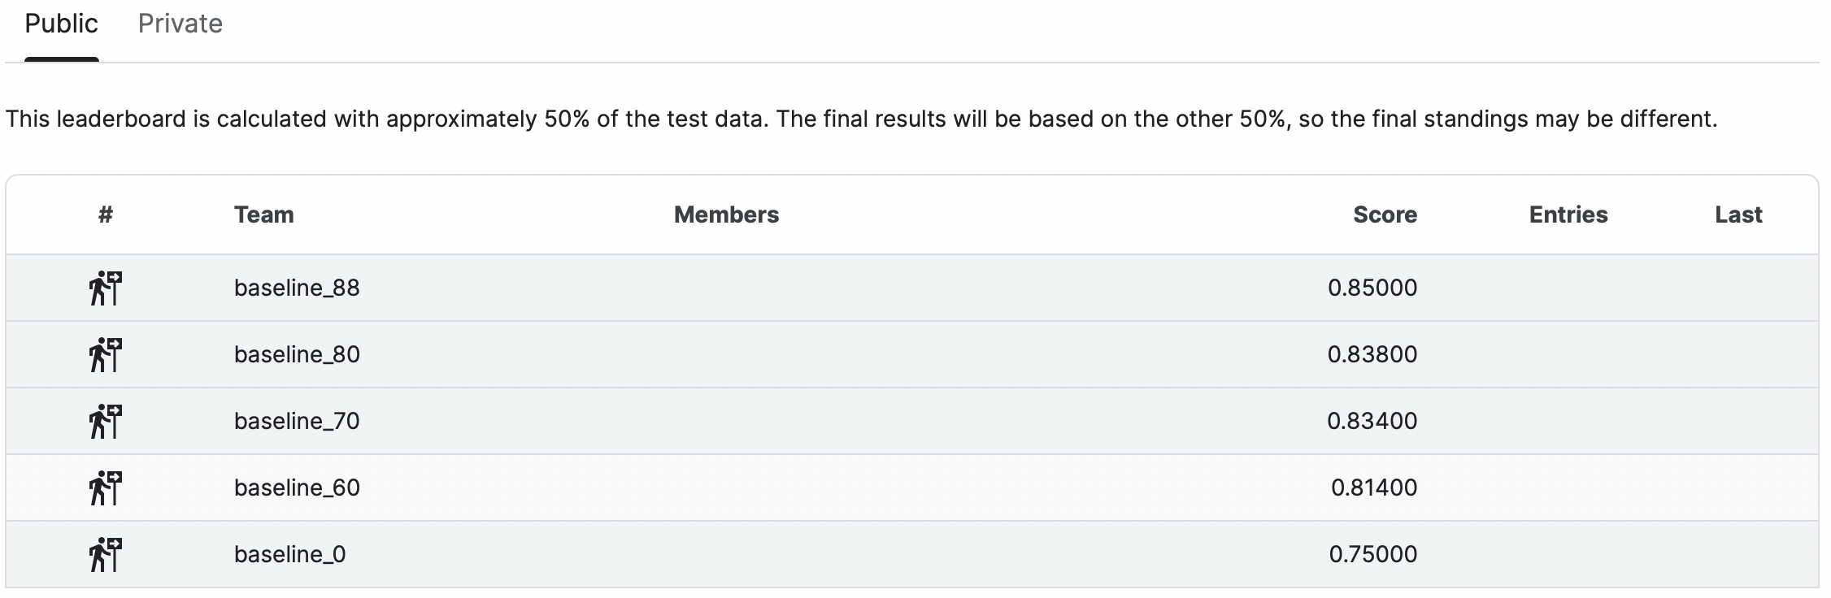
Scoring
Baseline scores
There are benchmarks on the leaderboard for reference

Slide 10
Other rules
You can submit 20 times per day
You can choose 5 predictions for final scoring
Kaggle will use the best one to be your result
We will publish private leaderboard one time on eeclass 3 days before the deadline of this homework.
This won’t affect your final score, just for you to check your status.

Slide 11
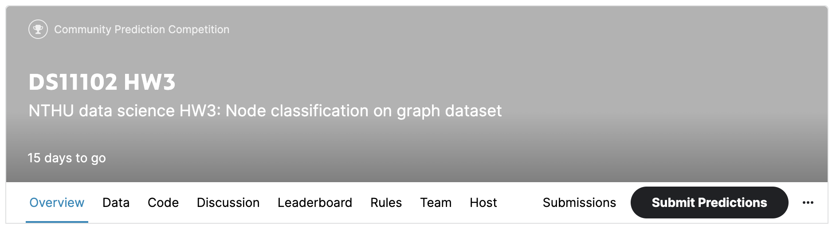
How to submit
Click ‘Submit Predictions’ button on the navigation bar

Slide 12
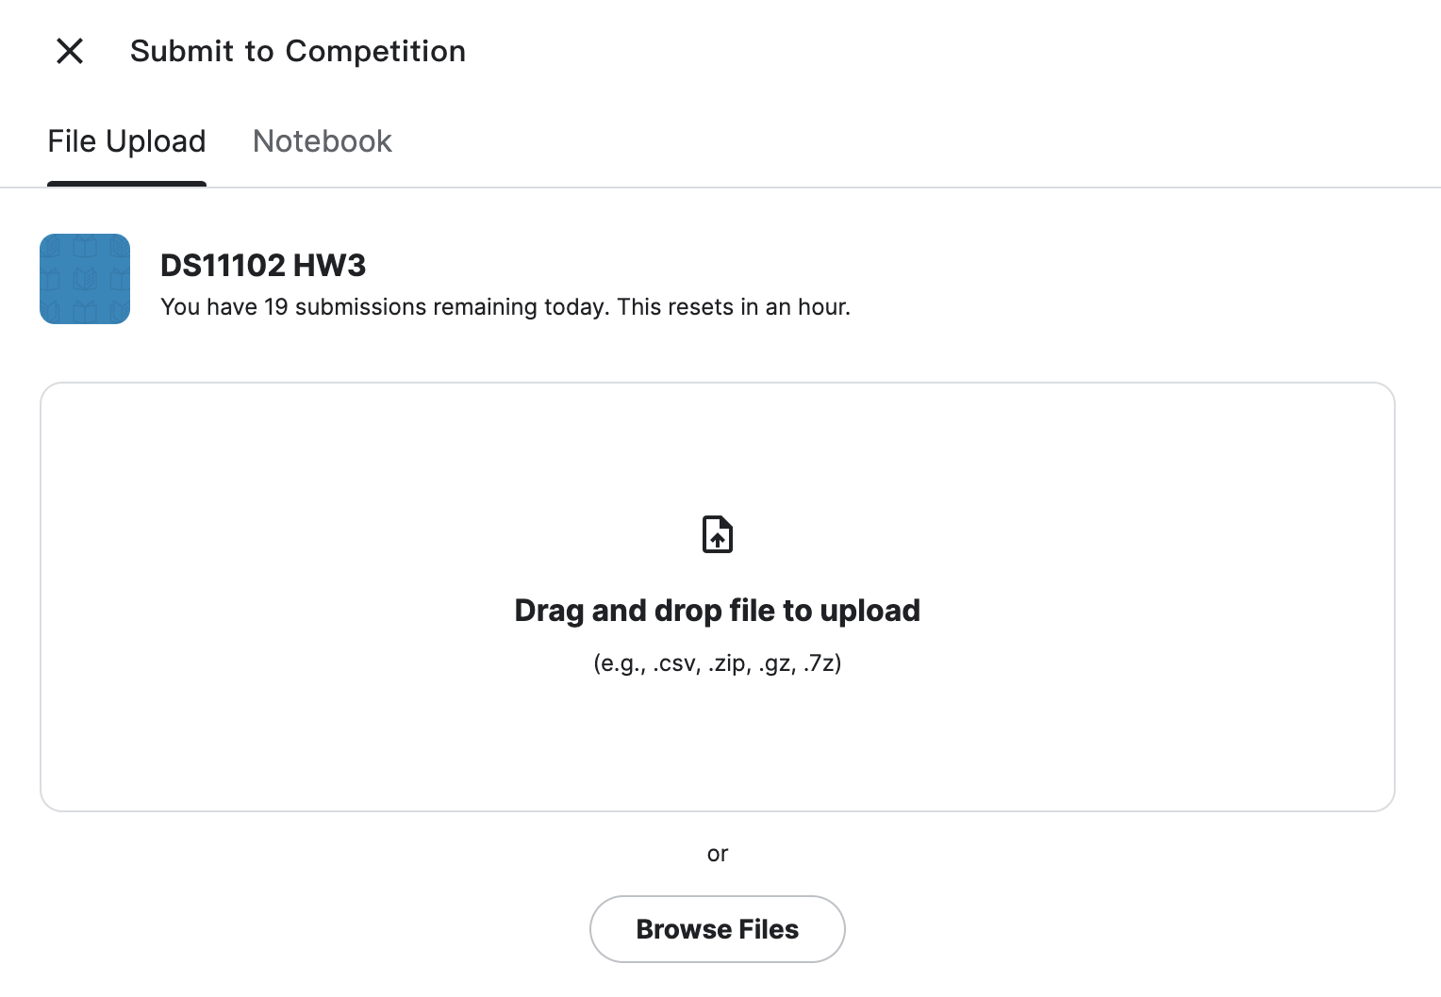
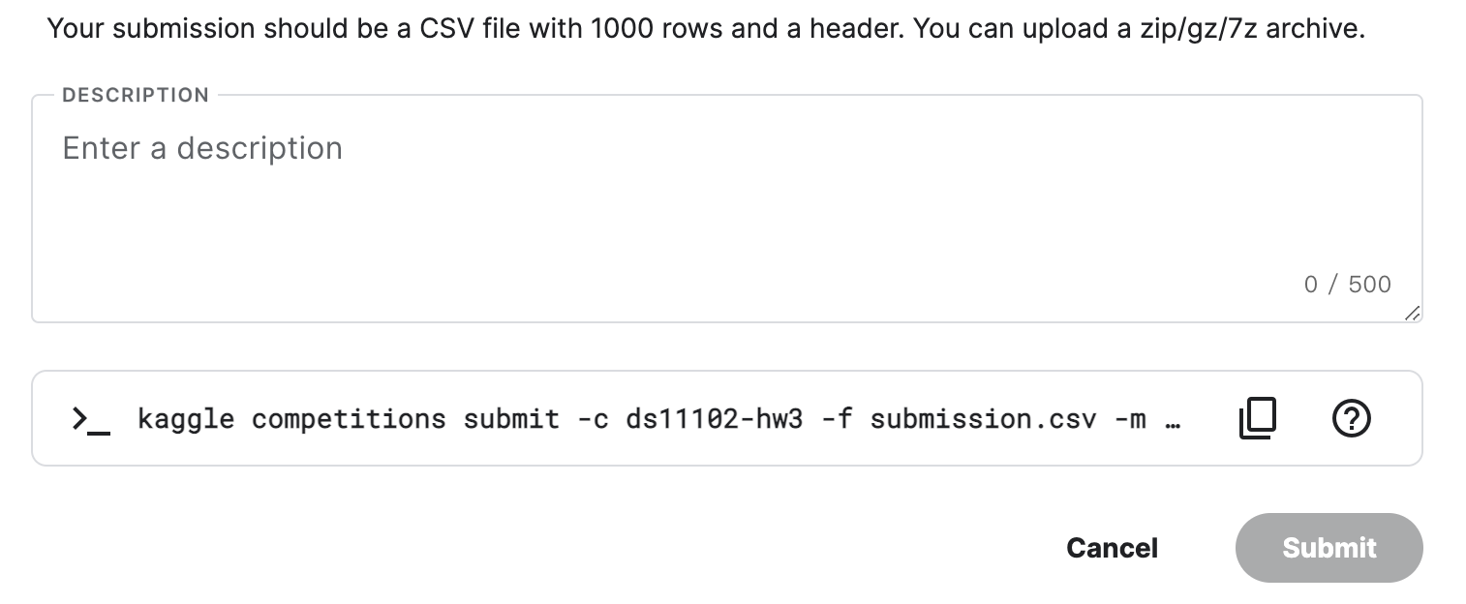
How to submit
You can write some description
about the answer csv file
Upload your answer csv file here
Click to submit

Slide 13
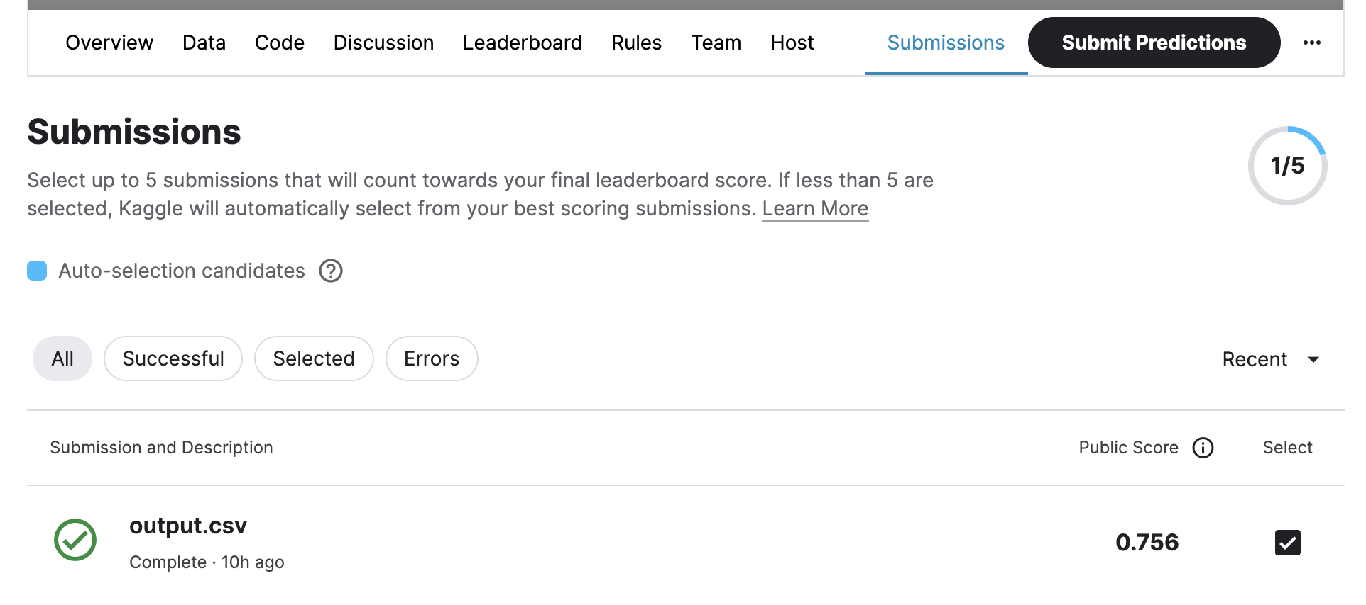
Choose predictions for final scoring
You can see all your submissions in ‘Submissions’
Remember to choose 5 predictions before the deadline

Slide 14
Sample code description
Baseline 0 method

Slide 15

Sample code
Load data based on provided dataset name.
No need to modify this file.
Define the details of model.
Train and evaluate the model.
Export the submission csv file.

Slide 16
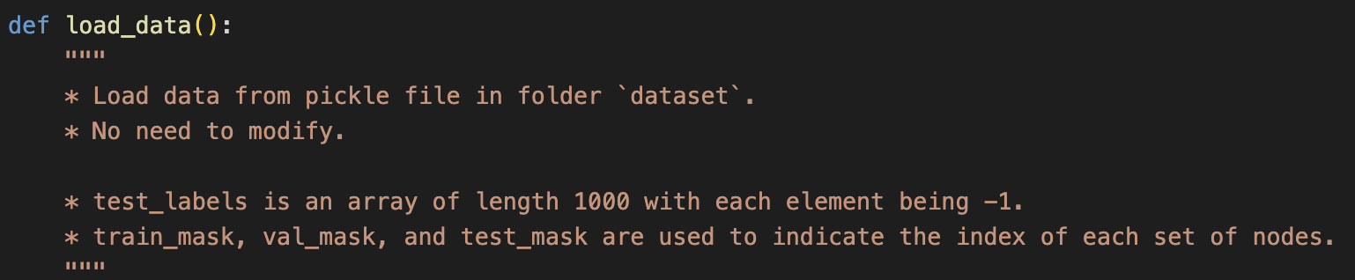
data_loader.py

Slide 17
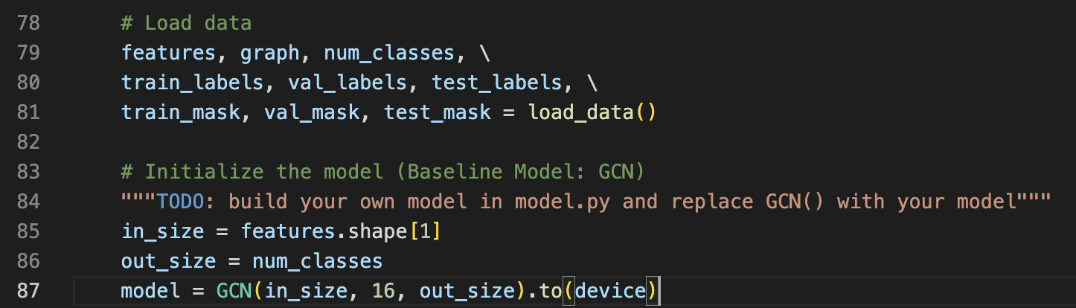
train.py

Slide 18
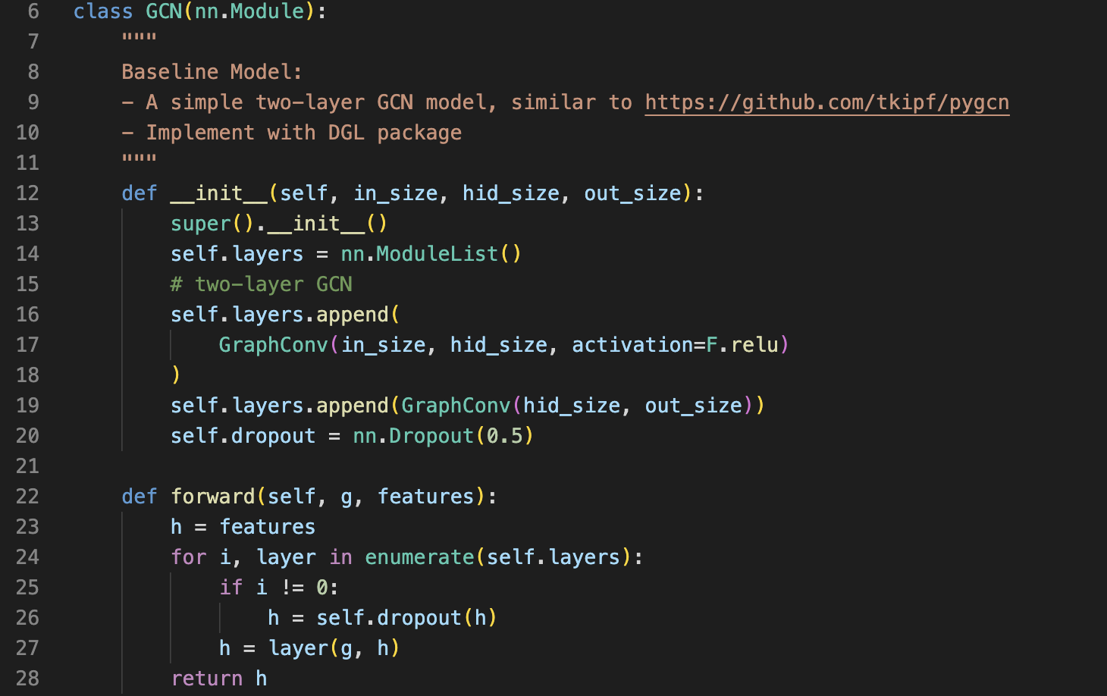
model.py

Slide 19
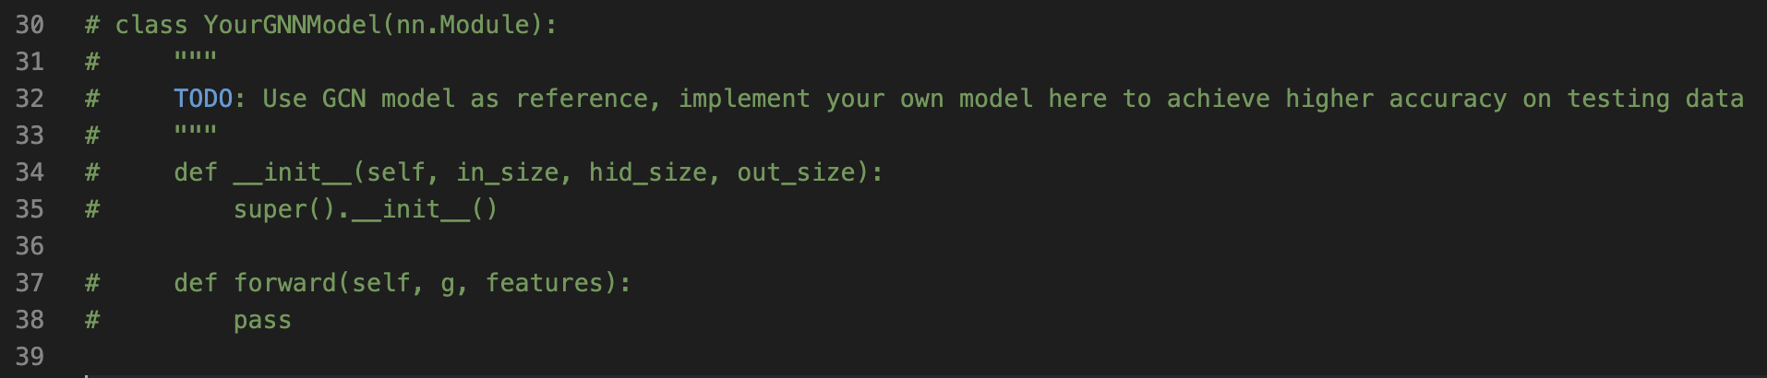
model.py

Slide 20
How to run
Run:
python3 train.py \
--epochs {num of epochs} \
--es_iters {num of iters to trigger early stopping}\
--use-gpu
Example:

Slide 21
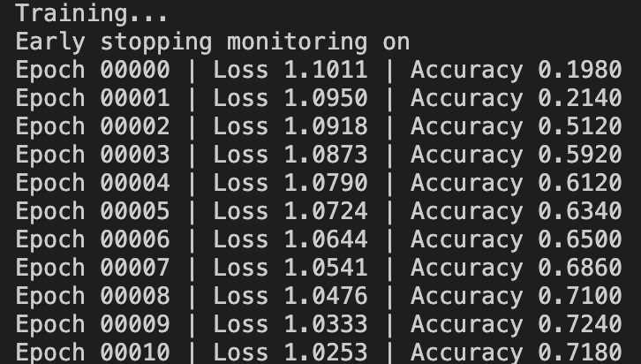
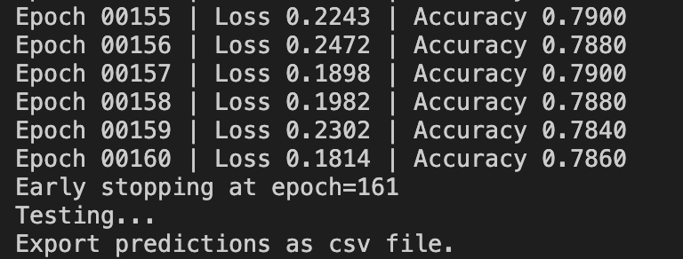
Once you successfully run the sample code…
……
* Please remember to upload your output csv file to Kaggle for scoring.

Slide 22
HW3 Conclusion
Submit your code to eeclass before deadline
All your python scripts file which is able to read dataset, train your model, export a prediction csv file
a README.md file
describe how to run your code
The predictions must be derived from a machine learning or deep learning model.
Evaluate your model performance on Kaggle.
Submit your model prediction file
We will use the result on Kaggle to score this homework.

Slide 23
For Your Reference
DGL: https://docs.dgl.ai/index.htm
State-of-the-Art
GAT: https://arxiv.org/pdf/1710.10903v3.pdf
SSP: https://arxiv.org/pdf/2008.09624v1.pdf
GRACE: https://arxiv.org/abs/2006.04131v2
State-of-the-art on Node Classification : https://paperswithcode.com/task/node-classification

