Slide 1
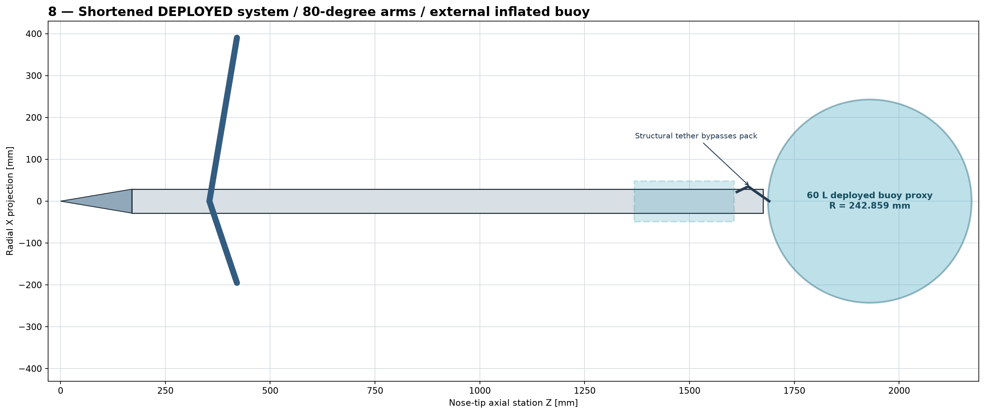
EXECUTIVE RELEASE STATUS | 26 AUGUST 2026
STINGRAY digital product definition
The mechanism is digitally coherent. The inflation architecture is not releaseable.
NOT RELEASED FOR FABRICATION OR FIELD USE
Frozen configuration: 1,675.4 mm rigid body | 355 mm arm pivot | external 60 L buoy pack
Evidence: Release Index; Non-Release Exception Report
1

Slide 2
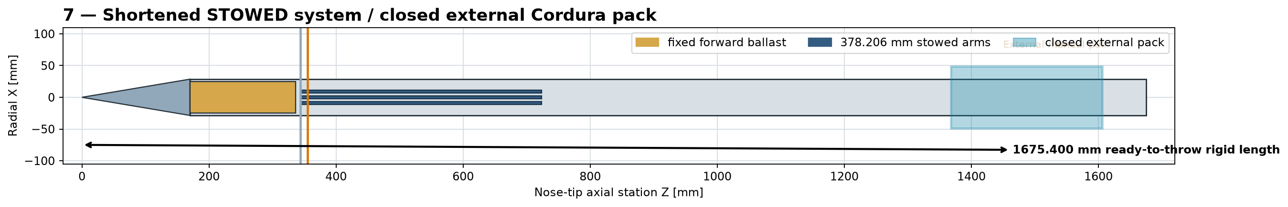
STINGRAY DIGITAL PRODUCT DEFINITION
A compact body deploys arms and an external recovery buoy
The system is intended to remain compact before use, deploy three arms, open an aft softgoods pack, and transfer recovery load through a dedicated tether path.
STOWED - 1,675.4 mm rigid length
DEPLOYED - 80 degree arms, open pack
Evidence: Technical Analysis Report sections 5-6; CAD views 07-08
2

Slide 3
STINGRAY DIGITAL PRODUCT DEFINITION
Operation is a five-step chain - and every link must work
1
2
3
4
5
STOWED
TRIGGER
DEPLOY
OPEN
RECOVER
>
>
>
>
Arms retained; pack closed
Water bobbin or manual pull
Crosshead moves; three arms rotate
Cordura flaps peel; buoy unfolds
Buoy inflates; tether carries load
The chain stops at step 5: the selected cartridge cannot supply the modeled buoy volume.
Evidence: Technical Analysis Report sections 2, 7-8; Pressure Topology
3

Slide 4
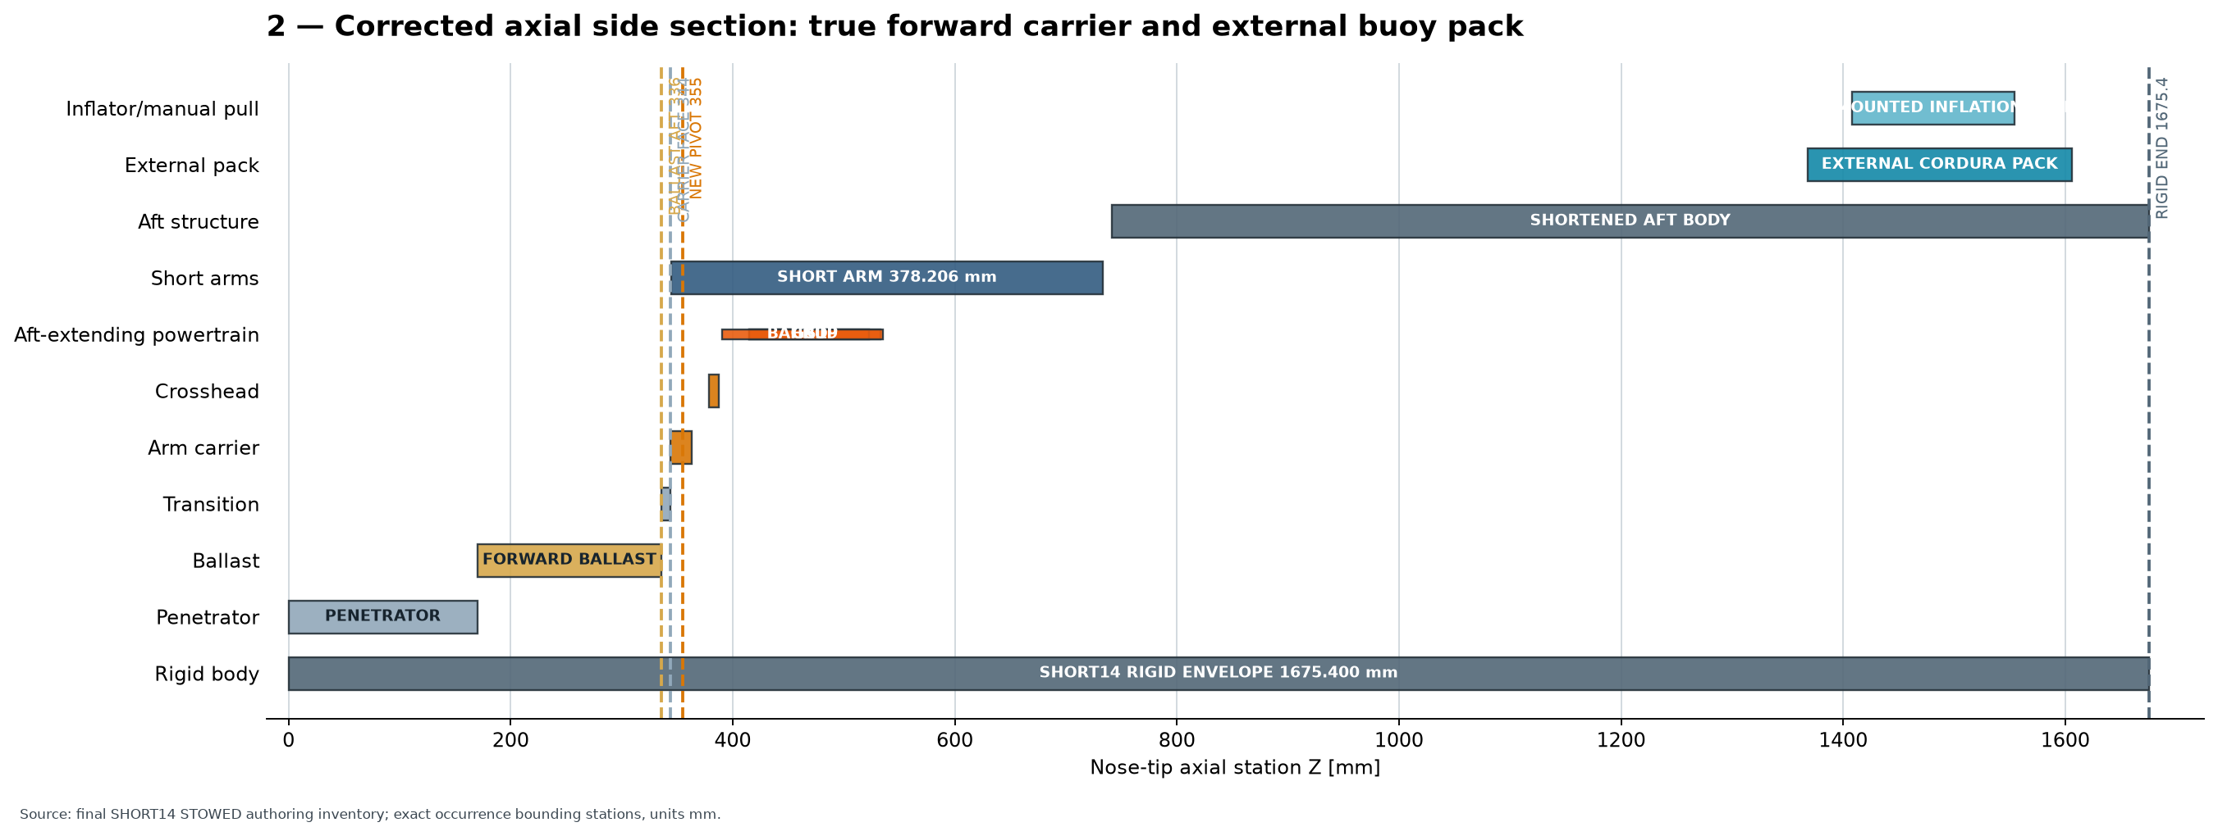
STINGRAY DIGITAL PRODUCT DEFINITION
Three subsystems share one continuous mechanical load path
FORWARD BODY
Penetrator and ballast establish the nose-side structural datum.
ARM POWERTRAIN
Gas springs, dampers, common crosshead, links, and stops rotate three arms.
AFT RECOVERY
Closed/open softgoods, inflator, buoy harness, hardpoint, and HMPE tether.
Evidence: Component Design-Basis Matrix; Source Package 05 design report
4

Slide 5
STINGRAY DIGITAL PRODUCT DEFINITION
The frozen digital assembly is complete enough to audit rigorously
Every claim below is tied to the frozen AP242 masters and their authoring inventories.
180
92
81
697,167
named occurrences in each endpoint state
unique part definitions
modeled arm positions from 0 to 80 degrees
full-motion exact pair rows
ZERO unauthorized rigid overlaps | ZERO blocked Booleans | ZERO track/fit-register errors
Mass: 10.583 kg | reserve to 18.14 kg limit: 7.557 kg | rigid length: 1,675.4 mm
Evidence: Endpoint Validation Summary; Full Motion Exact Boolean Summary; Mass/CG/Inertia Report
5

Slide 6
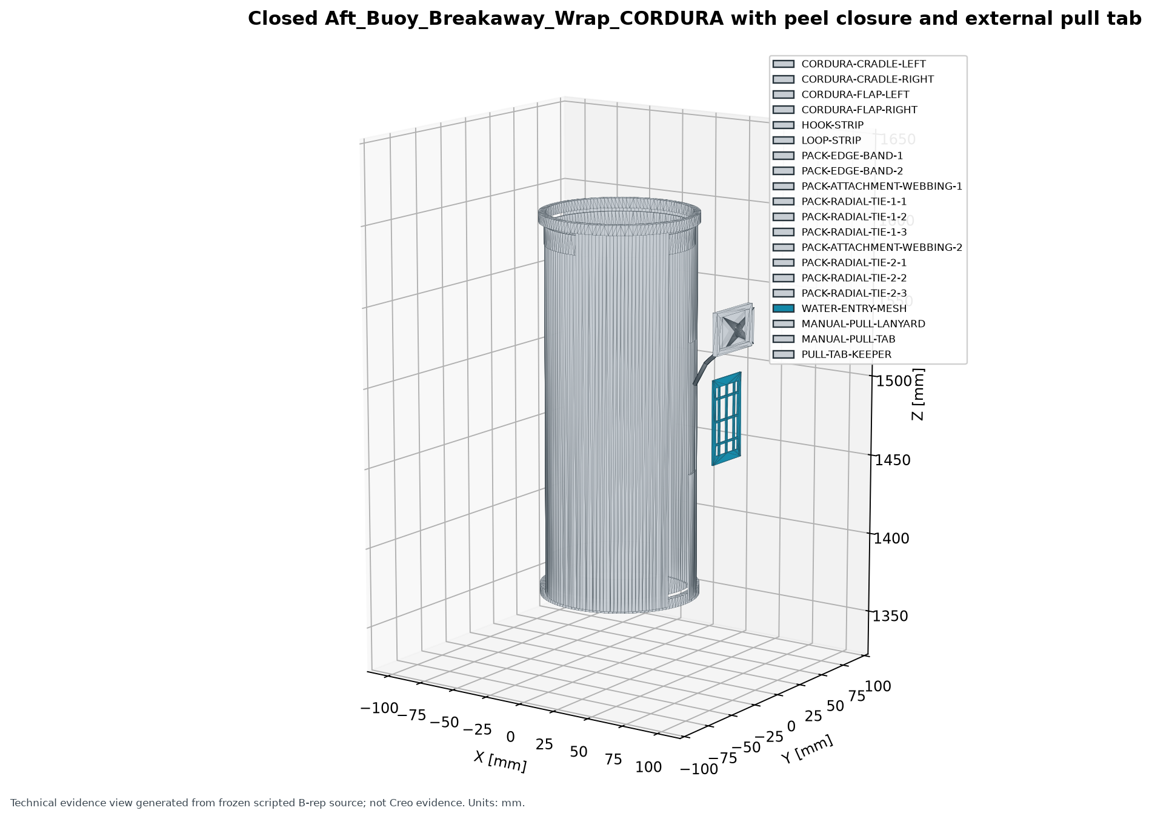
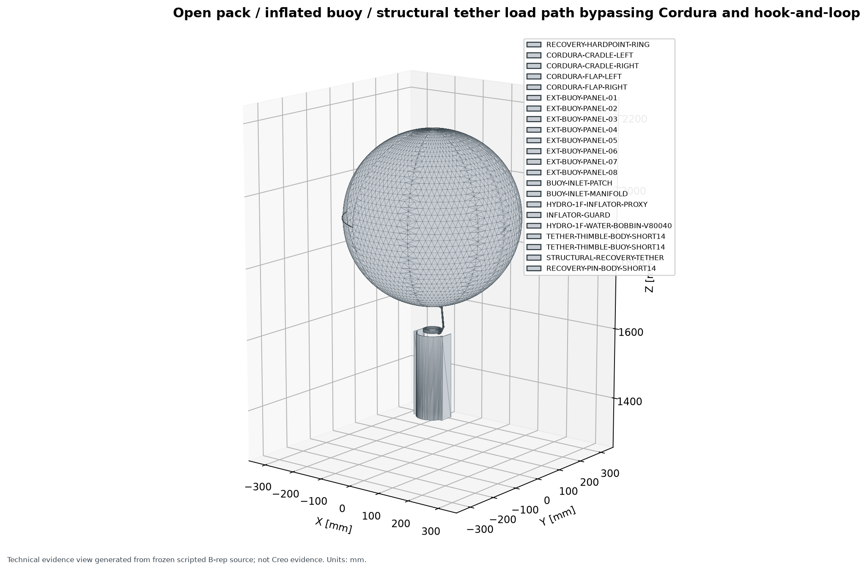
STINGRAY DIGITAL PRODUCT DEFINITION
The open DEPLOYED pack is controlling intent, not a cleanup defect
STOWED - separate panels form the closed pack.
DEPLOYED - flaps remain attached; tether bypasses Cordura and hook-and-loop.
Evidence: Screenshot Closure Report images 10-11; CAD views 09 and 12
6

Slide 7
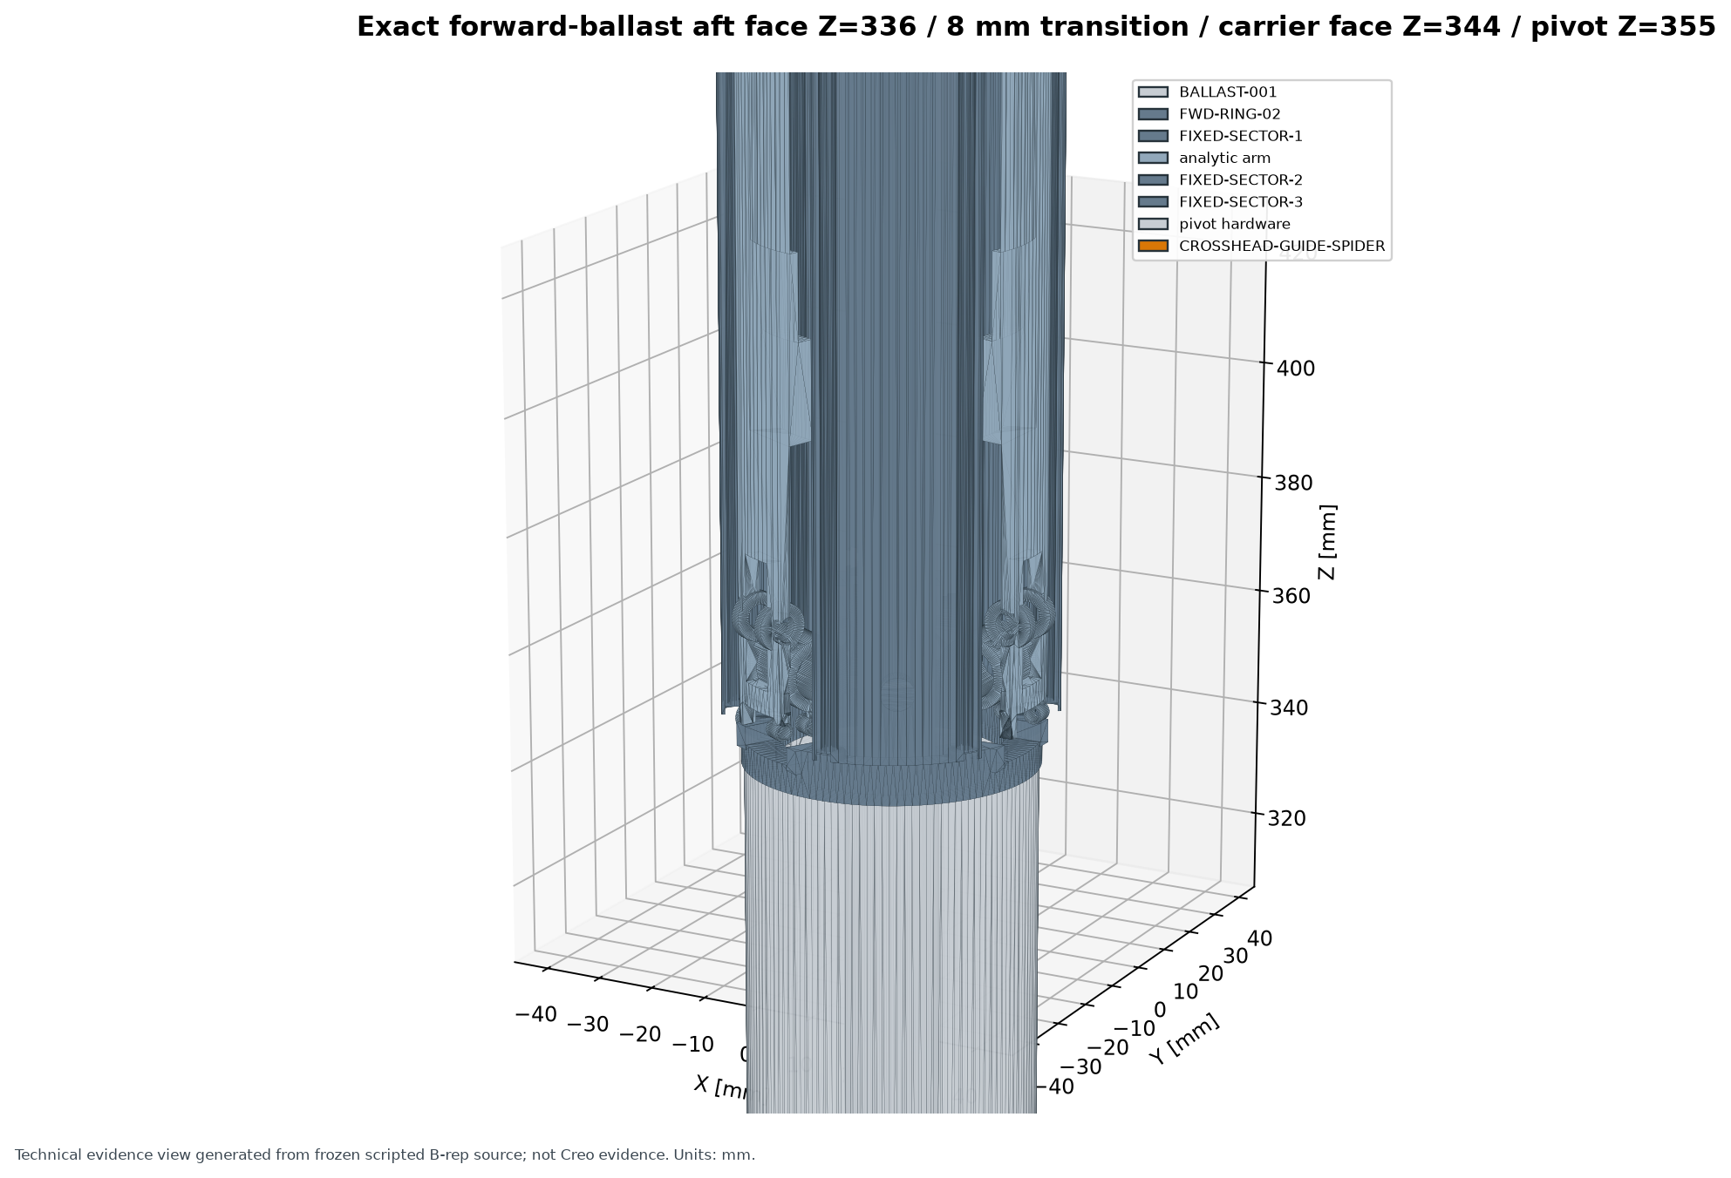
STINGRAY DIGITAL PRODUCT DEFINITION
Digital mechanism motion passed every modeled position
0-80°
15.055
one-degree audit coverage
mm crosshead travel
- 43,035 rows in the five-angle gate
- 697,167 rows in the full sweep
- closure residual: 2.49e-14 mm
- no invalid or unclassified rigid interference
Digital PASS does not prove deployment time, loads,
fatigue, or physical lock capacity.
Evidence: Technical Analysis Report section 5; validation/full_motion
7

Slide 8
CONTROLLING RELEASE FAILURE
The selected 12 g cartridge can supply only about 11% of the modeled buoy
An optimistic ideal-gas calculation already proves the mismatch. Real delivery would be lower because of cooling, residual gas, pressure drop, leakage, and required buoy pressure.
Selected cartridge at 20 C
6.56 L
Modeled buoy nominal volume
60.0 L
FAIL: ideal lower-bound CO2 mass is 109.8 g, before real losses and overpressure.
Evidence: Technical Analysis Report section 2; Stored Gas Independent Calculation
8

Slide 9
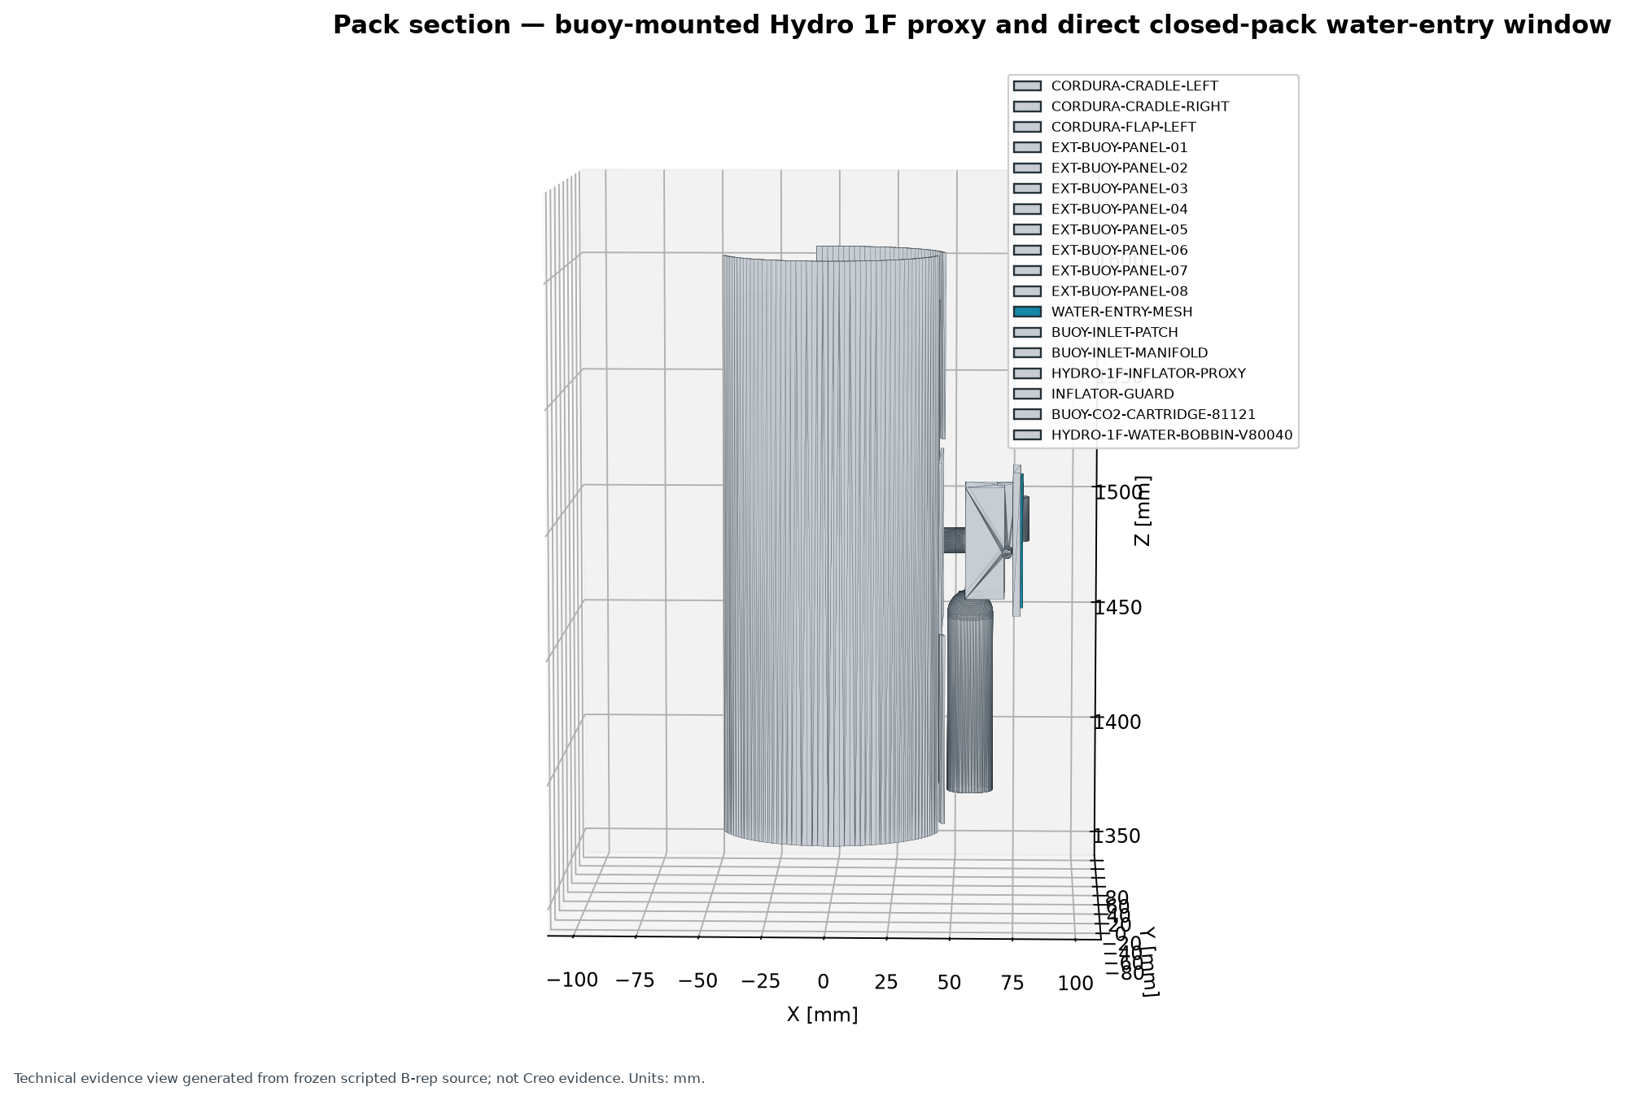
STINGRAY DIGITAL PRODUCT DEFINITION
The pressure path is compact, but its exact installed interfaces are unresolved
KNOWN
Leland 81121: 12 g CO2, 3/8-24 puncture cartridge
KNOWN
Hydro 1F family uses V80040 water-sensitive bobbin
OPEN
Exact Hydro suffix and matching thread configuration
OPEN
Vendor-exact geometry, flow curve, patch interface, leak result
Topology: cartridge -> Hydro 1F family inflator -> custom 60 L buoy patch. No separate hose, tube, regulator, gauge, or pneumatic cylinder remains in this configuration.
Evidence: Pressure Topology; Port-to-Port Table; Pressure Ratings Matrix
9

Slide 10
STINGRAY DIGITAL PRODUCT DEFINITION
The current configuration is custom-heavy and not fabrication-ready
79 MAKE
13 BUY
123
custom definitions requiring released manufacturing control
catalog or supplier-derived definitions
AP242/BREP/render state definitions delivered
Fabrication remains prohibited because the package does not contain approved dimensioned drawings, GD&T, tolerance stacks, process capability, torque/locking data, or validated tool access.
COTS-first objective
No complete, orderable commercial inflation module has passed geometry, interface, gas-capacity, and application gates.
NO PURCHASE OR FABRICATION AUTHORIZED
Evidence: Full BOM; Make/Buy Trade Study; Manufactured-Part Drawing Register
10

Slide 11
STINGRAY DIGITAL PRODUCT DEFINITION
Release now depends on physical evidence and an architecture correction
1
Correct inflation architecture
Minimum physical test families
Select a complete cartridge/inflator/buoy combination that passes capacity and rated-interface gates.
- inflation architecture and cold/hot delivery
- wet pack opening and extraction
- buoy proof, burst, leak, lift, and stability
- arm/lock/hardpoint/tether structural proof
- dynamic deployment and handling/drop
- fatigue, wear, corrosion, UV, humidity, storage
- realistic assembly, service, reset, and inspection
2
Define loads and release drawings
Control mission, impact, proof, life, tolerance, torque, material, finish, and inspection requirements.
3
Qualify the physical product
Wet opening, inflation, leak, proof/burst, buoyancy/stability, dynamic, fatigue, corrosion, and assembly trials.
Evidence: Risk Register/FMEA; Physical Verification Plan
11

Slide 12
STINGRAY DIGITAL PRODUCT DEFINITION
Digital pass; production release fails
DIGITAL PASS
RELEASE FAIL
- clean procedural build
- 180 occurrences per state
- hierarchy, occurrence identities, transforms, and valid solids preserved on reimport
- nominal envelope and mass properties
- endpoint exact-Boolean audit
- five-angle audit
- full 0-80 degree one-degree sweep
- 12 g / 60 L gas-capacity mismatch
- inflator suffix, exact geometry, ratings, and leak/flow unknown
- proxy and developmental softgood envelopes
- required load/strength/tolerance analyses incomplete
- manufacturing drawings and work instructions absent
- physical qualification absent
- AP242 bytes not reproducible across identical builds
- root assembly naming nonconformance remains open
- required screenshots and newer attachment placeholders absent
Evidence: Objective Release Gate Table; Non-Release Exception Report
12

Slide 13
DECISION
Do not release this configuration
Next gate
Bring back one complete, orderable, source-supported inflation module and a controlled 60 L requirement. If none passes, stop with a measured architecture decision.
Use the frozen digital package as a controlled engineering baseline. Correct the inflation architecture first; then define loads, complete manufacturing definition, qualify the physical product, and rerun independent review.
AUTHORIZATION: ENGINEERING REVIEW ONLY
Digital baseline retained:
- STOWED / DEPLOYED AP242
- 92 unique parts
- 123 state definitions
- full 81-position audit
No fabrication. No purchase. No qualification acceptance. No field use. No merge to main.
Evidence: Release Index; Make/Buy Trade Study; Physical Verification Plan
13

