Slide 2
Microservices with Azure Service Fabric Building and Running Services at Scale
Matt Snider
#AzureServiceFabric

Slide 3
Microservices vs. Monoliths

Slide 4

Monolithic application approach
Microservices application approach
A monolithic application has most of its functionality within a few processes that are componentized with libraries.
Scales by cloning the app on multiple servers/VMs/Containers
App 1
App 1
App 2
A microservice application separates functionality into separate smaller services.
Scales out by deploying each service independently creating instances of these services across servers/VMs/containers

Slide 5
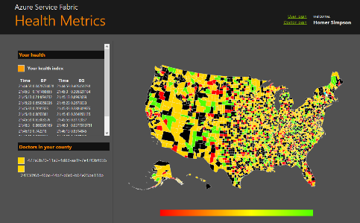

State in Monolithic approach
State in Microservices approach
Single monolithic database
Tiers of specific technologies
Graph of interconnected microservices
State typically scoped to the microservice
Variety of technologies used
Remote Storage for cold data
stateless presentation services
stateless services
stateful services
stateless services with
separate stores

Slide 6
What Is Azure Service Fabric?

Slide 7
Microsoft Azure Service Fabric A platform for reliable, hyperscale, microservice-based applications
Microservices
High Availability
Data Partitioning
Service Fabric
Health Monitoring
Code Orchestration & Lifecycle Management
Hybrid Operations
Self-healing
Simple programming models
High Density
Rolling Upgrades
Low Latency
Placement Constraints
Replication & Failover
Stateful Services
Fast Startup & Shutdown
Resource Management
Hyper-Scale
Automated Rollback
Azure
Private cloud
Other clouds

Slide 8
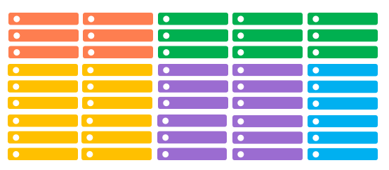
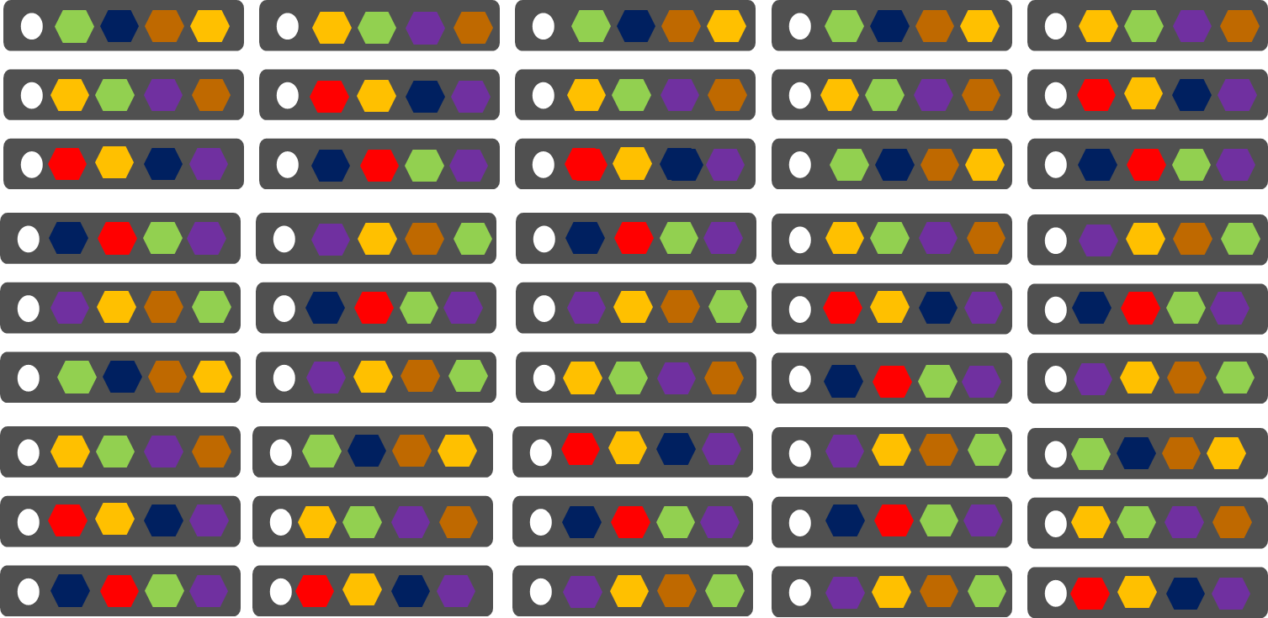
Comparing Azure Cloud Services vs. Azure Service Fabric
Azure Cloud Services
(Web and Worker Roles)
Azure Service Fabric
(Stateless, stateful or Actor services)
1 role instance per VM
Uneven utilization
Low density
Slow deployment & upgrade (bound to VM)
Slow scaling and failure recovery
Limited fault tolerance
Many microservices per VM
Even Utilization (by default, customizable)
High density (customizable)
Fast deployment & upgrade
Fast scaling of independent microservices
Tunable fast fault tolerance

Slide 9
Cluster
Set of OS instances (real or virtual) stitched together to form a pool of resources
Cluster can scale to 1000s of machines, is self repairing, and scales-up or down
Acts as environment-independent abstraction layer
Windows OS
Windows OS
Windows OS
Fabric
Node
Fabric
Node
Fabric
Node
Windows OS
Windows OS
Windows OS
Fabric
Node
Fabric
Node
Fabric
Node

Slide 10
Service type
Services types are composed of code/config/data packages
Code packages define an entry point (dll or exe)
Config packages define service specific config information
Data packages define static resources (eg. images)
Packages can be independently versioned
<ServiceManifest Name="QueueService" Version="1.0">
<ServiceTypes>
<StatefulServiceType ServiceTypeName="QueueServiceType" HasPersistedState="true" />
</ServiceTypes>
<CodePackage Name="Code" Version="1.0">
<EntryPoint>
<ExeHost>
<Program>ServiceHost.exe</Program>
</ExeHost>
</EntryPoint>
</CodePackage>
<ConfigPackage Name="Config" Version="1.0" />
<DataPackage Name="Data" Version="1.0" />
</ServiceManifest>
Service Type 1
Code
Config
Data

Slide 11
Application type
Declarative template for creating an application
Based on a set of service types
Used for packaging, deployment, and versioning
Application Type A
Service Type 1
Service Type 2
Service Type 3
Code
Config
Data
Code
Config
Data
Code
Config
Data

Slide 12
Updates Since //Build 2015
Now In Public Preview
Create Clusters via ARM & Portal
Hosted Clusters in Azure
Many Performance, Density, & Scale Improvements
Many API Improvements
New Previews
Linux Support
Java Support
Docker & Windows Containers
On Premises Clusters

Slide 13
Microservices with Azure Service Fabric

Slide 14
Service Fabric Microservices
App1
App2
App Type Packages
Service Fabric Cluster VMs

Slide 15
Handling Machine Failures
#FAIL
App1
App2
App Type Packages
Service Fabric Cluster VMs

Slide 16
Stateful Microservices - Replication
Primary
Secondary
Replication
Service Fabric Cluster VMs

Slide 17
Service Fabric Programming Models
Guest Executables
Bring any exe
Any language
Any programming model
Packaged as Application
Gets versioning, upgrade, monitoring, health, etc.
Reliable Services
Stateless & stateful services
Concurrent, granular state changes
Use of the Reliable Collections
Transactions across collections
Full platform integration
Reliable Actors
Stateless & stateful actor objects
Simplified programming model
Single Threaded model
Great for scaled out compute and state

Slide 18
Programming models: Reliable Services
Reliable collections make it easy to build stateful services
An evolution of .NET collections - for the cloud
ReliableDictionary<T1,T2> and ReliableQueue<T>
Collections
Single machine
Single-threaded
Concurrent Collections
Single machine
Multi-threaded
Reliable Collections
Multi-machine
Replicated (HA)
Persistence (durable)
Asynchronous
Transactional

Slide 19
Transactionally Modifying Reliable Data
protected override async Task RunAsync(CancellationToken cancellationToke)
{
var requestQueue = await this.StateManager.GetOrAddAsync<IReliableQueue<CustomerRecord>>(“requests");
var locationDictionary = await this.StateManager.GetOrAddAsync<IReliableDictionary<Guid, LocationInfo>>(“locs");
var personDictionary = await this.StateManager.GetOrAddAsync<IReliableDictionary<Guid, Person>>(“ppl");
var customerListDictionary = await this.StateManager.GetOrAddAsync<IReliableDictionary<Guid, object>>(“customers");
while (true)
{
cancellationToke.ThrowIfCancellationRequested();
Guid customerId = Guid.NewGuid();
using (var tx = this.StateManager.CreateTransaction())
{
var customerRequestResult = await requestQueue.TryDequeueAsync(tx);
await customerListDictionary.AddAsync(tx, customerId, new object());
await personDictionary.AddAsync(tx, customerId, customerRequestResult.Value.person);
await locationDictionary.AddAsync(tx, customerId, customerRequestResult.Value.locInfo);
await tx.CommitAsync();
}
}
}
Everything happens or nothing happens!

Slide 20
Programming models: Reliable Actors
Independent units of compute and state
Large number of them executing in parallel
Communicates using asynchronous messaging
Single threaded execution
Automatically created and dehydrated as necessary

Slide 21
Running Microservices at Scale

Slide 22
Service partitioning
Services can be partitioned for scale-out.
You can choose your own partitioning scheme.
Service partitions are striped across machines in the cluster.
Replicas automatically scale out & in on cluster changes
Node 1
Node 2
Node 3
Node 4
Node 5
Node 6
S
P2
P1
S
S
S
S
P3
P4
S
S
S

Slide 23
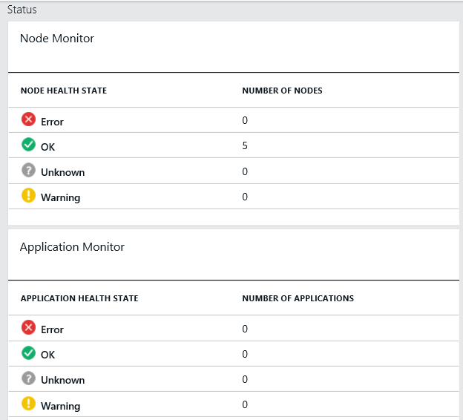
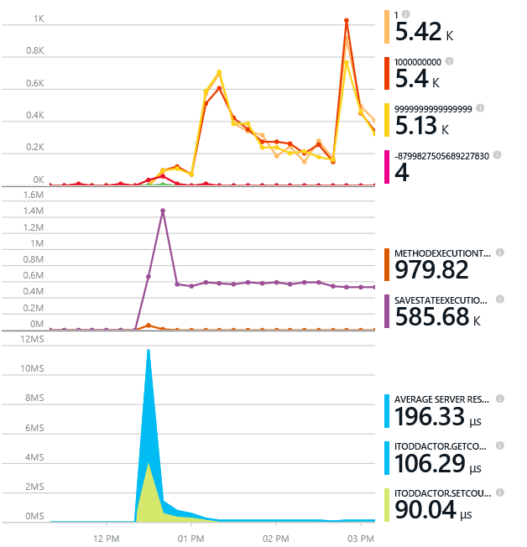
Monitoring your Services
Visibility into how your services are doing when running in production
Health status monitoring
Built-in health status for cluster and services
Flexible and extensible health store for custom app health reporting
Allows continuous monitoring for real-time alerting on problems in production
Performance and stress response
Rich built-in metrics for Actors and Services programming models
Easy to add custom application performance metrics

Slide 24
Diagnostics and Troubleshooting
Detailed System Optics
Repair suggestions. Examples: Slow RunAsync cancellations, RunAsync failures
All important events logged. Examples: App creation, deploy and upgrade records. All Actor method calls.
Custom Application Tracing
ETW == Fast Industry Standard Logging Technology
Works across environments. Same tracing code runs on devbox and also on production clusters on Azure.
Easy to add and system appends all the needed metadata such as node, app, service, and partition.
Choice of Tools
Visual Studio Diagnostics Events Viewer
Windows Event Viewer
Windows Azure Diagnostics + Operational Insights
Easy to plug in your preferred tools: Kibana, Elasticsearch and more

Slide 25
Application Upgrade
Upgrade Domain #1
Upgrade Domain #2
Upgrade Domain #3
App Repository
Windows OS
Windows OS
App A v1
Windows OS
App C v2
App A v1
App C v1
Fabric
Node
App B v2
Fabric
Node
Fabric
Node
App B v2
App C v2
App C v1
App C v1
App C v2
Windows OS
Windows OS
Windows OS
Fabric
Node
App B v2
App C v2
App B v2
App C v1
Fabric
Node
App A v1
App A v1
Fabric
Node

Slide 26
Real Customers and Workloads

Slide 27
Services built with Service Fabric
Skype for Business
Hybrid Ops
Azure Document DB
Billions of transactions/week
Intune
800k+ devices
Azure Core Infrastructure
Event Hubs
20bn events/day
Bing Cortana
500m evals/sec
Azure SQL Database
1.4 million databases
Power BI
More!
IoT

Slide 28
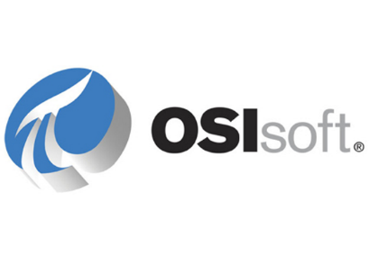
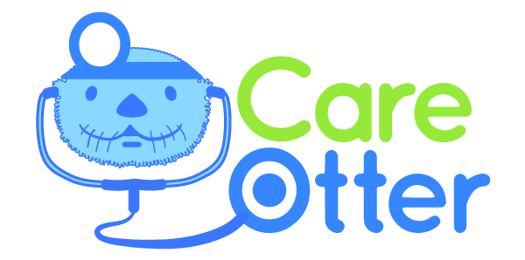







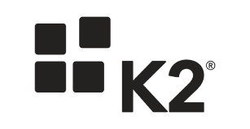


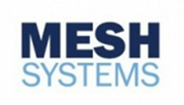



























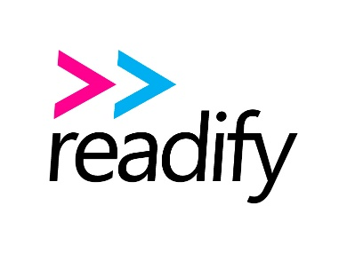












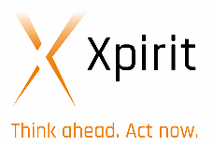





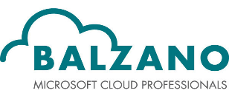




300+ Service Fabric Preview Customers

Slide 29
Conclusion

Slide 30
Takeaways
Microservices enable development and management flexibility
Service Fabric is the platform for building applications with a microservices design approach
Service Fabric is battle tested and provides a rich platform for both development and management of services at scale

Slide 31
Q&A

Slide 32
Call to Action
Code With Service Fabric SDK
http://aka.ms/ServiceFabric
Check out the Sample Code
http://github.com/Azure/ServiceFabric-Samples
Read the Docs
http://aka.ms/ServiceFabricDocs
Try Service Fabric for Free
http://aka.ms/TryServiceFabric

Slide 33
THANKS!

