Slide 1

Detecting Brain tumors in Magnetic Resonance Imaging (MRI)
ML-6202 (Group 5)
Zongzhu Li, Maliha Aziz
Notes:
Image by biorender
Requires permission for re-use

Slide 2
Outlines
The Challenge that needs NN.
Overview of Dataset for Different Types of Brain Tumors
Data Preprocessing
Modeling, Prediction and Evaluation
SVM, KNN and Naïve Bayes
ANN with Parameters Exploratory
CNN
Summary and Discussion

Slide 3
Challenge: Can NN assist a Neuro-oncologist in diagnosing brain tumors?

Slide 4
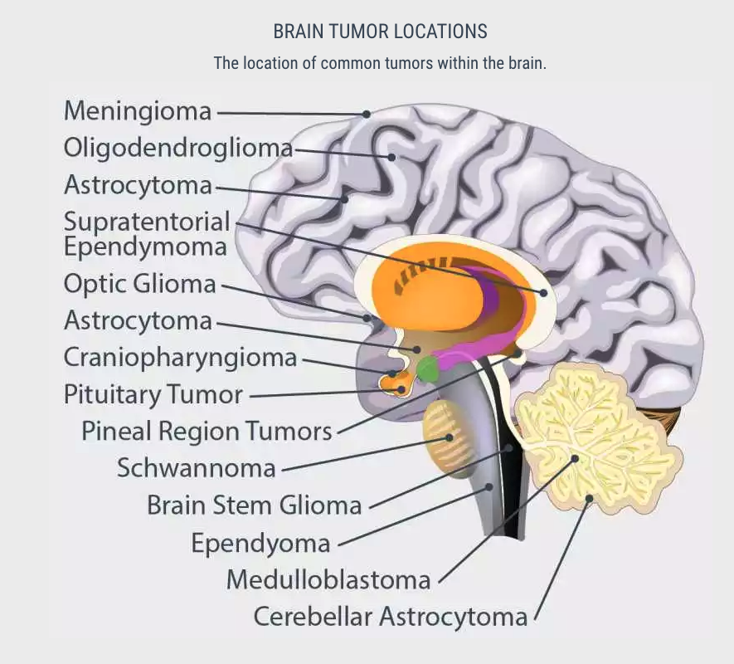
Brain Tumor states
Data source: https://www.kaggle.com/sartajbhuvaji/brain-tumor-classification-mri
Tumor type | Dataset type | N
No Tumor | Training
No Tumor | Test
Glioma | Training
Glioma | Test
Meningioma | Training
Meningioma | Test
Pituitary | Training
Pituitary | Test
Dataset type
Training
Test
Total
Notes:
Image from:
https://miamineurosciencecenter.com/en/conditions/brain-tumors/types/

Slide 5
Challenges in Brain Cancer Treatment
Breaking through the blood-brain barrier
The challenges of surgical removal
The efficiency and accuracy of brain cancer diagnosis by doctors
Application of Machine Learning in Brain Cancer Diagnosis (3)
Increase the efficiency and accuracy of brain cancer diagnosis
Provide cloud diagnosis for people in the developing countries

Slide 6
Data preprocessing

Slide 7
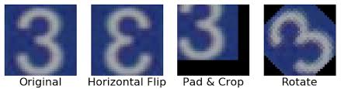
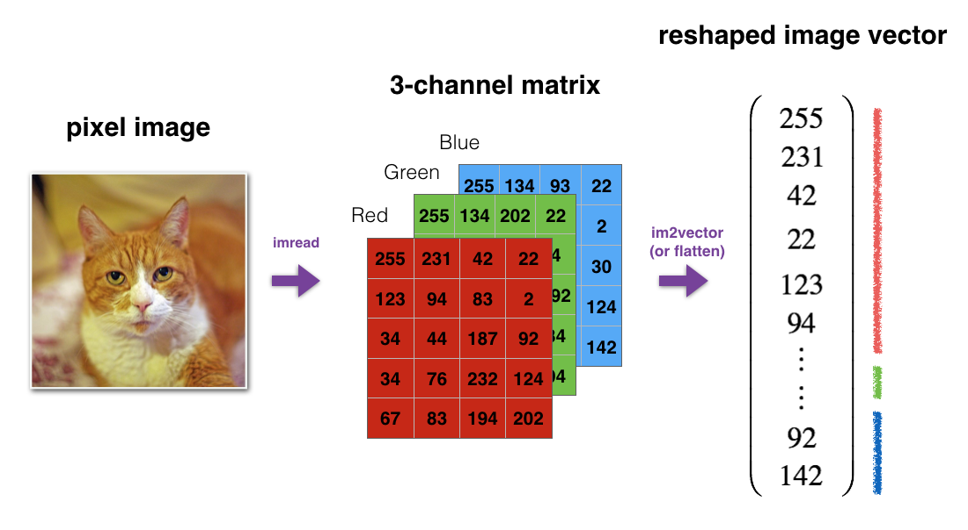
Resize --- (128 X 128)
Transform to array from image
Normalization---(/255.0)
Data Augmentation---(ImageDataGenerator)
rotation_range=20,
width_shift_range=0.2,
height_shift_range=0.2,
zoom_range=0.2,
horizontal_flip=True
Data reshape from 3D to 2D
Notes:
# Image Data Augmentation: Image data augmentation is a technique that can
be used to artificially expand the size of a training dataset by creating modified versions of images in the dataset.
It uses techniques such as flipping, zooming, padding, cropping, etc. # Data augmentation makes the model more robust to slight variations, and hence prevents the model from overfitting.

Slide 8
Modeling, Prediction and Evaluation

Slide 9
Classical models

Slide 10
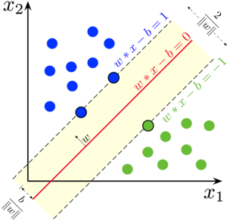
Support Vector Machine (SVM)

Slide 11
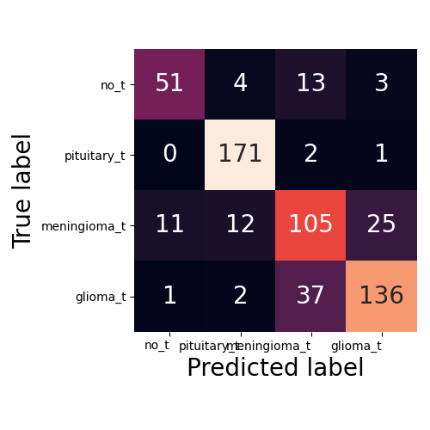
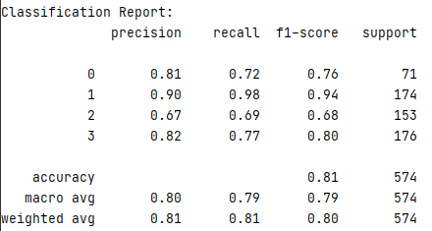
SVM
clf = SVC(kernel="poly")

Slide 12
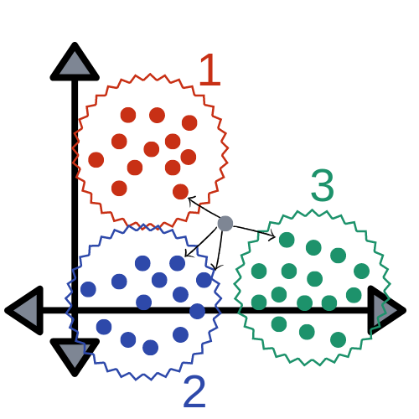
K Nearest Neighbors (KNN)

Slide 13
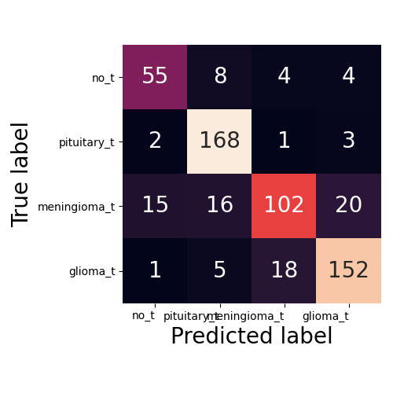
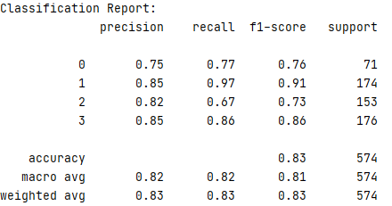
KNN
clf = KNeighborsClassifier(n_neighbors=4)

Slide 14
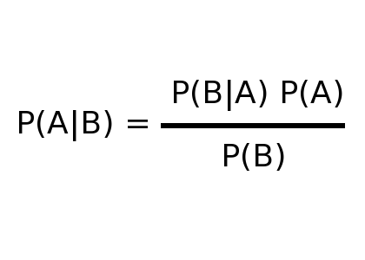
Naïve Bayesian (NB)
NB

Slide 15
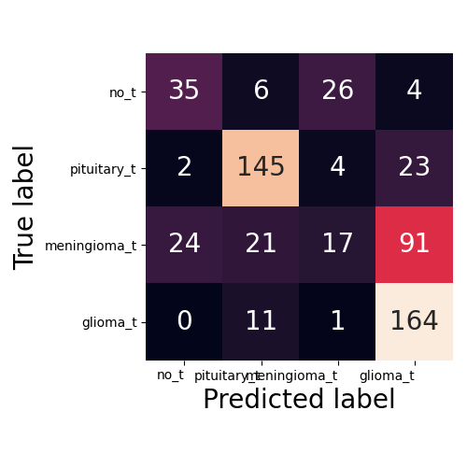
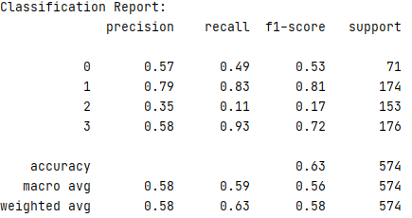
NB
clf = GaussianNB()

Slide 16
Artificial Neural Networks (ANN)

Slide 17
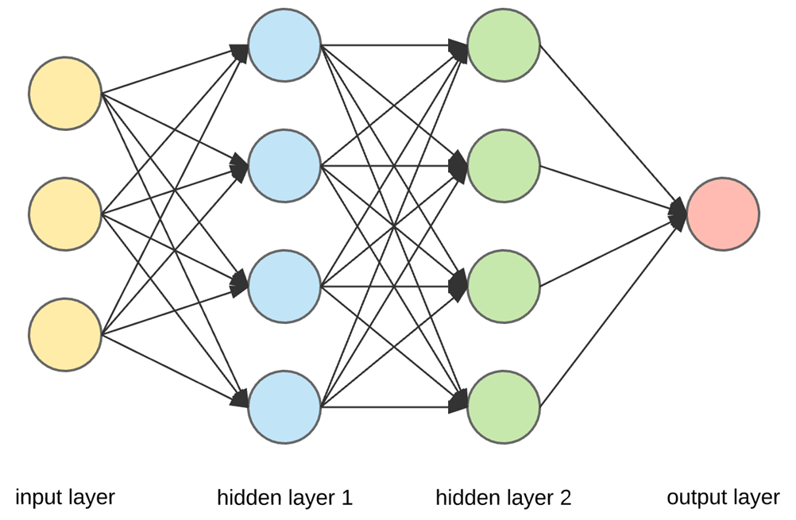

Slide 18
Experiments Design and Results for ANN
ANN | Layers & Nodes | Iteration | Activation | Early-stopping | Solver | Accuracy (%)
01 | (20, 20) | 500 | “sigmoid” | False | Adam | 84.5
02 | (20, 20) | 500 | “relu” | False | Adam | 79.4
03 | (20, 20) | 500 | “sigmoid”, ”relu” | False | Adam | 82.1
04 | (500, 500) | 500 | “sigmoid” | True | Adam | 85.2
05 | (20, 20, 20,20) | 500 | “sigmoid” | False | Adam | 80.8
06 | (20, 20) | 2000 | “sigmoid” | False | Adam | 82.2
07 | (20,20) | 500 | “sigmoid” | False | SGD | 81.2
08 | (20, 20) | 500 | “sigmoid” | False | RMSprop | 84.8
09 | (20, 20) | 500 | “sigmoid” | False | Adagrad | 81.0
10 | (20, 20) | 500 | “sigmoid” | False | Adadelta | 78.6
11 | (20,20) | 500 | “sigmoid” | False | Adamax | 73.3
ANN | (500, 500, 20) | 500 | “sigmoid” | False | RMSprop | 87.5

Slide 19
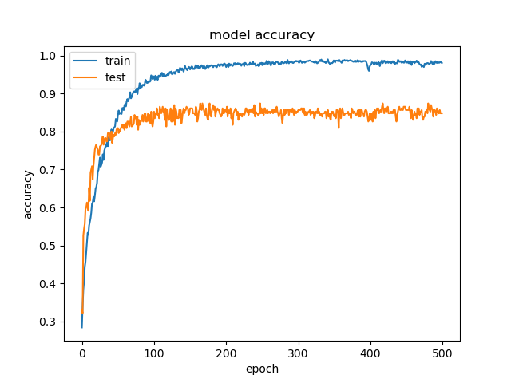
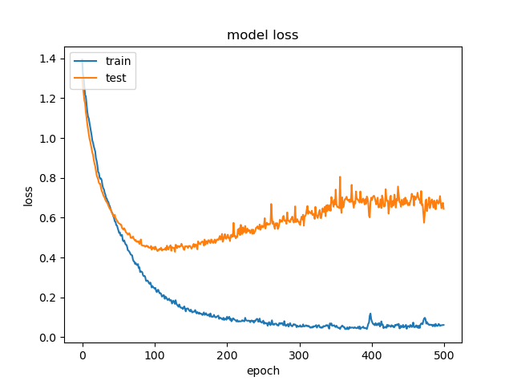
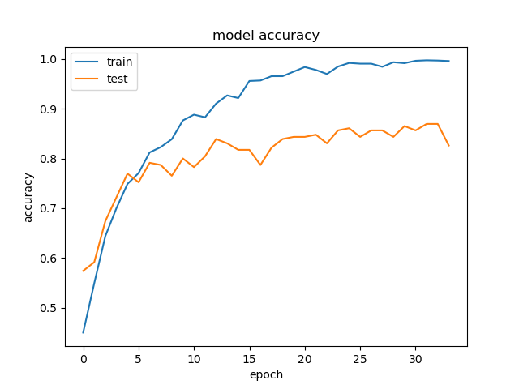
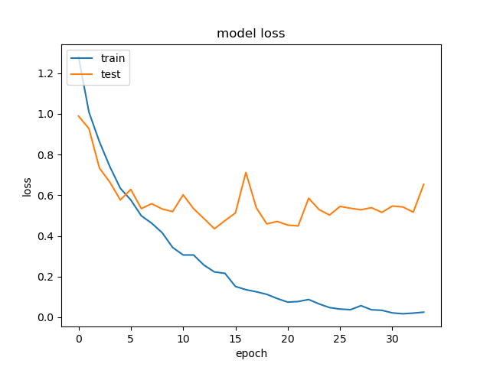
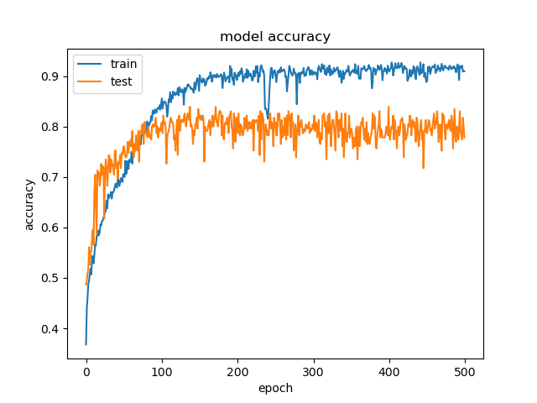
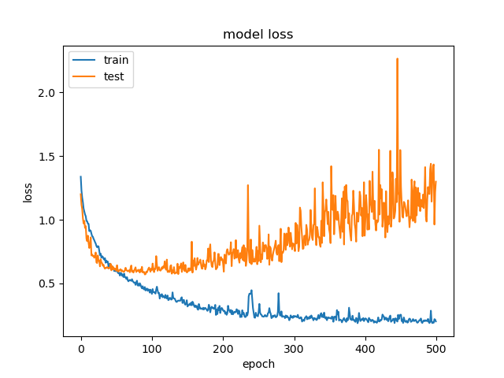
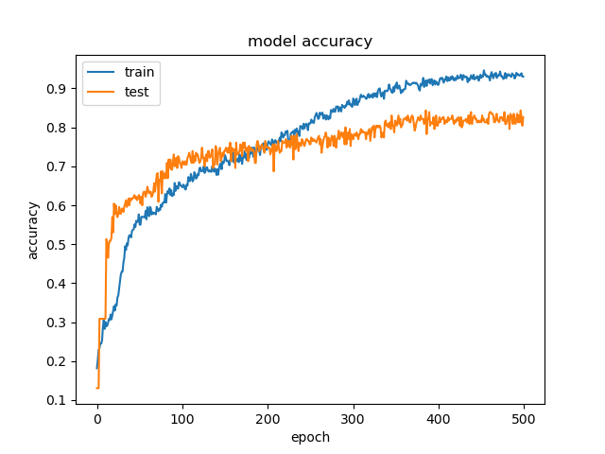
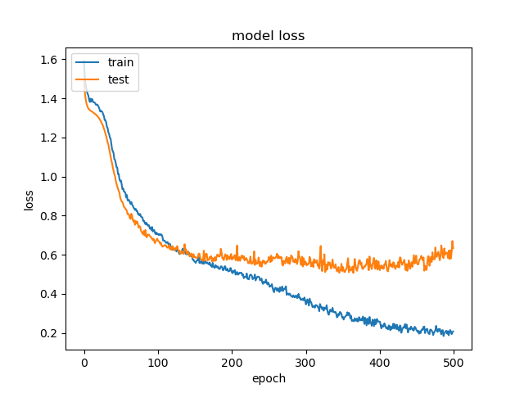
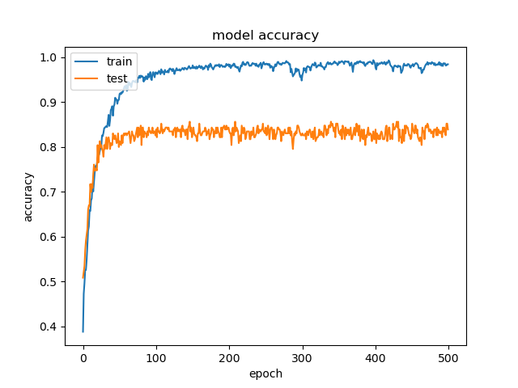
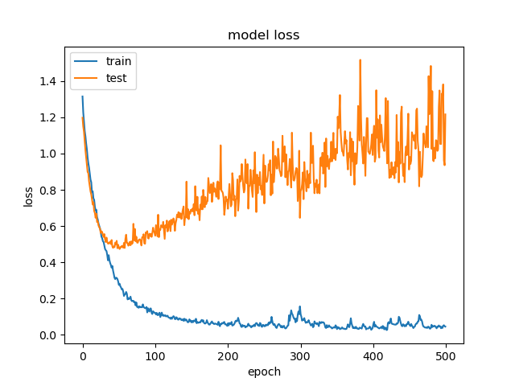
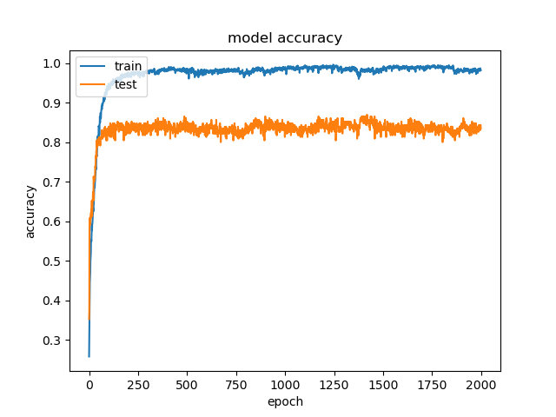
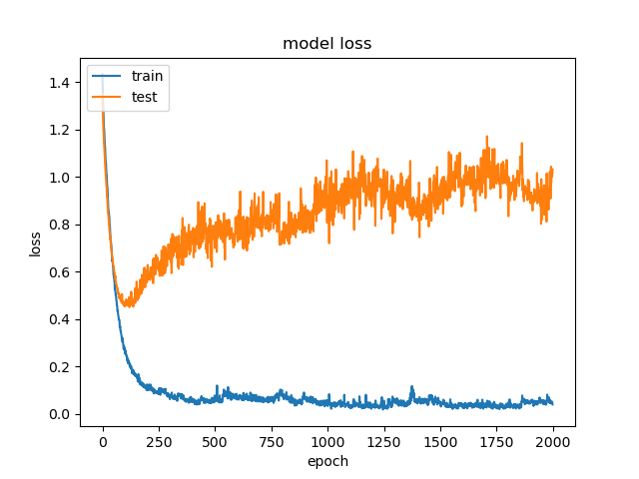
ANN
01
ANN
04
ANN
02
ANN
05
ANN
03
ANN
06

Slide 20
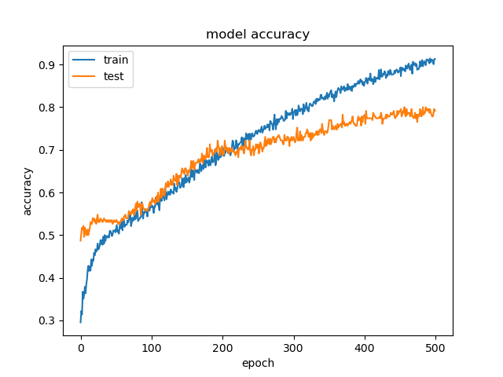
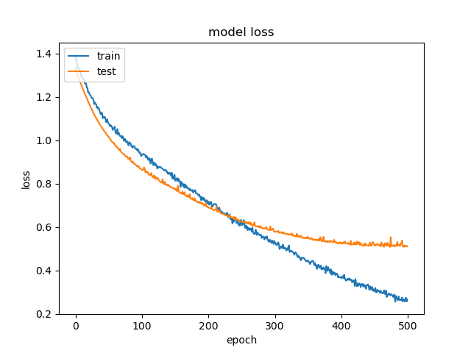
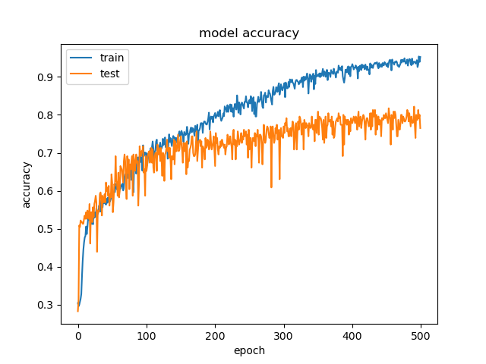
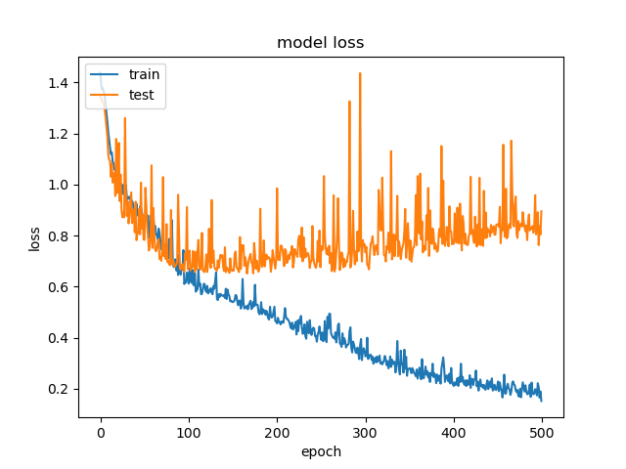
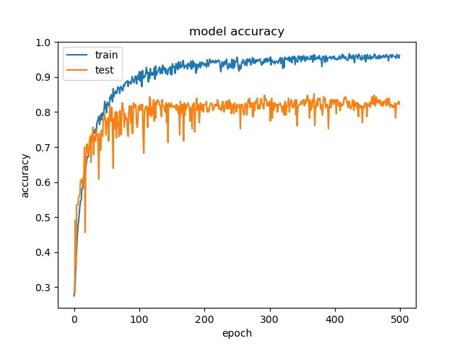
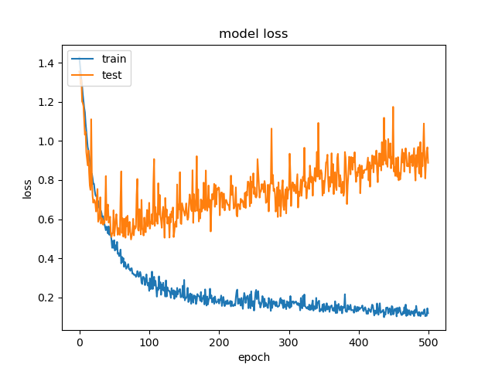
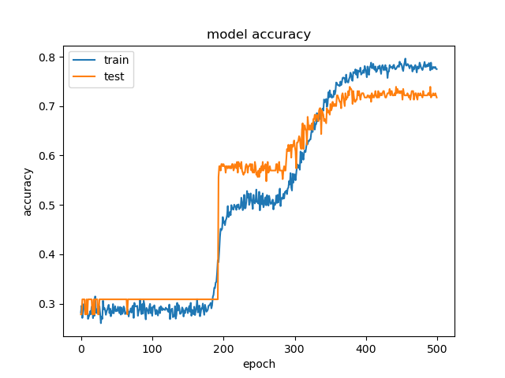
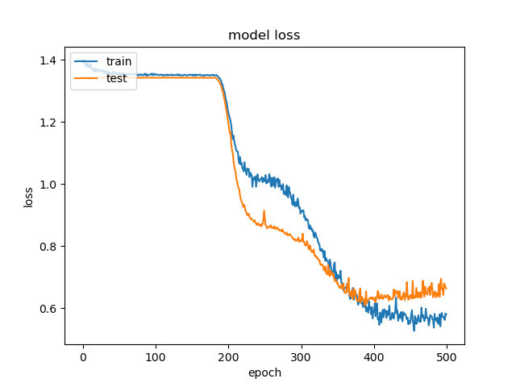
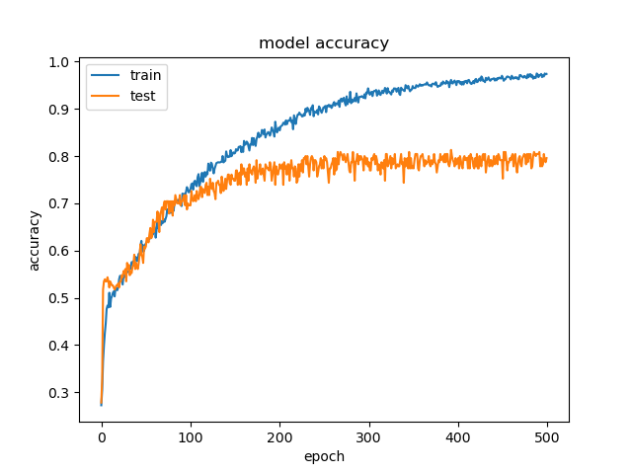
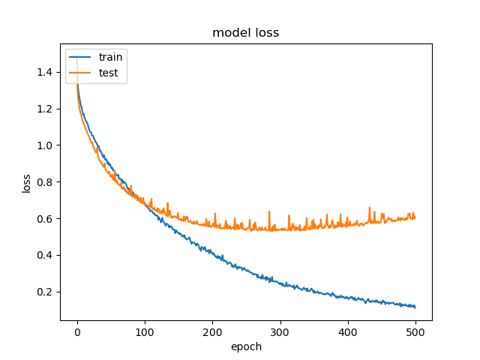
ANN
07
ANN
10
ANN
08
ANN
11
ANN
09

Slide 21
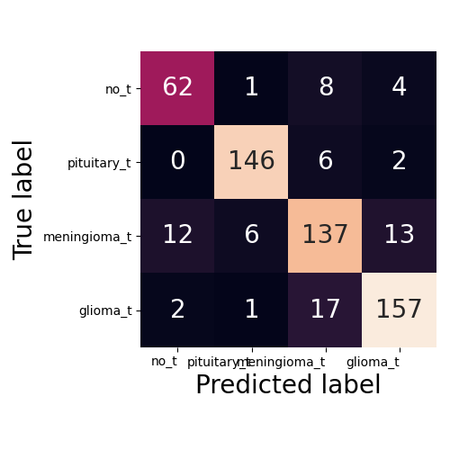
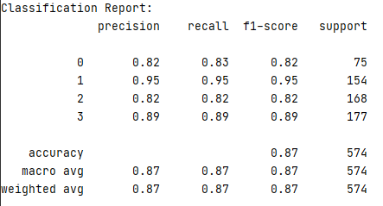
Modeling, Prediction and Evaluation - ANN
Hidden layers and Nodes: (500,500,20)/ Iteration: 500/ Activation: “sigmoid”/ Solver: RMSpro (lr=0.001)

Slide 22
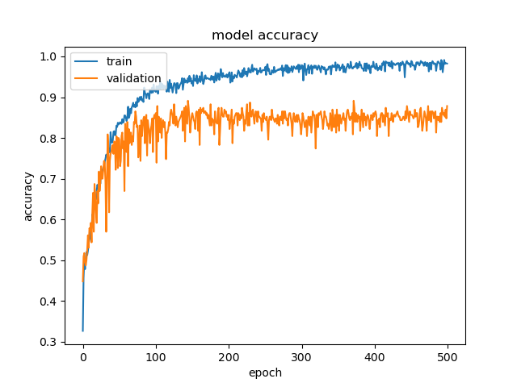
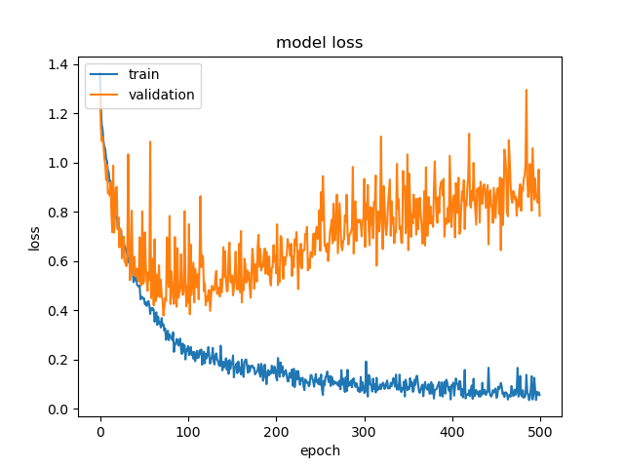
Modeling, Prediction and Evaluation - ANN

Slide 24
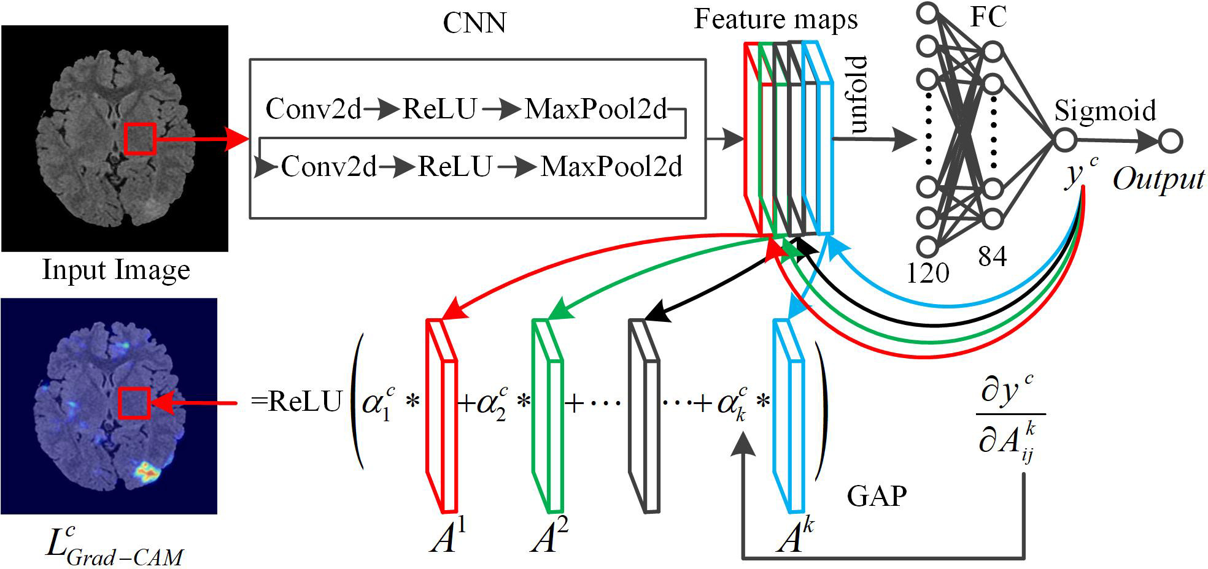
Modeling, Prediction and Evaluation - CNN

Slide 25
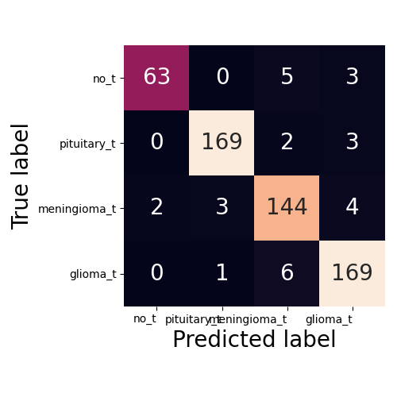
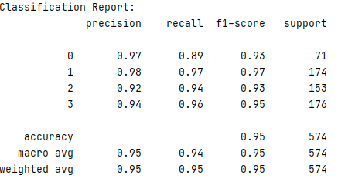
Modeling, Prediction and Evaluation - CNN

Slide 26
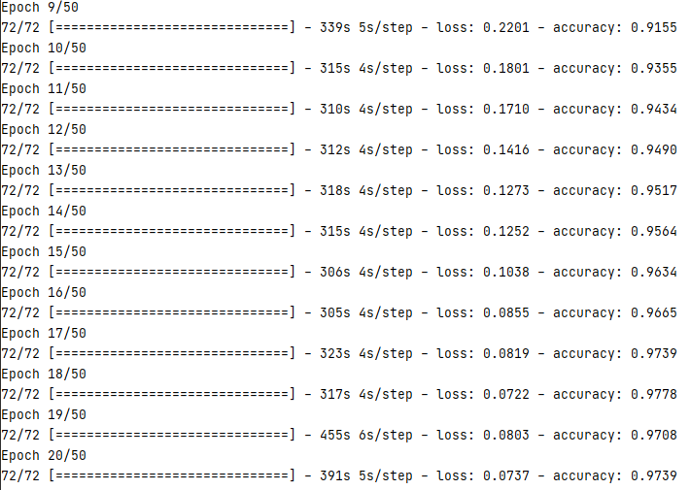
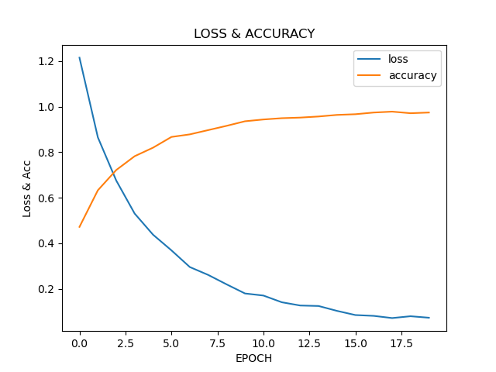
Modeling, Prediction and Evaluation - CNN

Slide 27
Summary and Discussion

Slide 28
References
1. Aldape, K., Brindle, K.M., Chesler, L. et al. Challenges to curing primary brain tumours. Nat Rev Clin Oncol 16, 509–520 (2019). https://doi.org/10.1038/s41571-019-0177-5
2. Cao, H., Erson-Omay, E.Z., Li, X. et al. A quantitative model based on clinically relevant MRI features differentiates lower grade gliomas and glioblastoma. Eur Radiol 30, 3073–3082 (2020). https://doi.org/10.1007/s00330-019-06632-8
3. Nadeem, M. W., Ghamdi, M., Hussain, M., Khan, M. A., Khan, K. M., Almotiri, S. H., & Butt, S. A. (2020). Brain Tumor Analysis Empowered with Deep Learning: A Review, Taxonomy, and Future Challenges. Brain sciences, 10(2), 118. https://doi.org/10.3390/brainsci10020118
4. Hollon, T.C., Pandian, B., Adapa, A.R. et al. Near real-time intraoperative brain tumor diagnosis using stimulated Raman histology and deep neural networks. Nat Med 26, 52–58 (2020). https://doi.org/10.1038/s41591-019-0715-9
5.
6.
7.
8.

