Slide 1
Database Management Systems Lab Project
Presentation by Aditya Pal (16CS01017)

Slide 2
Problem Statement
In the real world, when we want to trade in the stock market, we have to go through a broker who sets up all the processes for us. However, sometimes that becomes inefficient.
This application is an attempt to address that issue, as it emulates a stock-trading platform where you can perform such transactions, without any intermediary at all.
Key features such as advertisements, sending email notifications, prediction of share prices, live update of prices etc. are also included.
Notes:
What if the broker is not responding in a critical time? Can we let the chance of a great transaction slip by us like that? What if the stock market is about or crash or the price of my most invested share is going down way too rapidly? I don’t think it’s a risk we should take.
If approved by the Government of a country, a powerful server is used to handle high loads and sufficient security features are added to the application so that real money can be transacted through it, this can solve the redundancy of going through a broker for the more experienced people, while others could still rely on them. This would also inspire people to be more invested in stock markets and financial trading due to process having become a lot easier, and they would also look much more closely at their own transactions as they are responsible for it. Thus, with the increase in business knowledge and transaction frequency, it can help out the economy quite a lot.

Slide 3
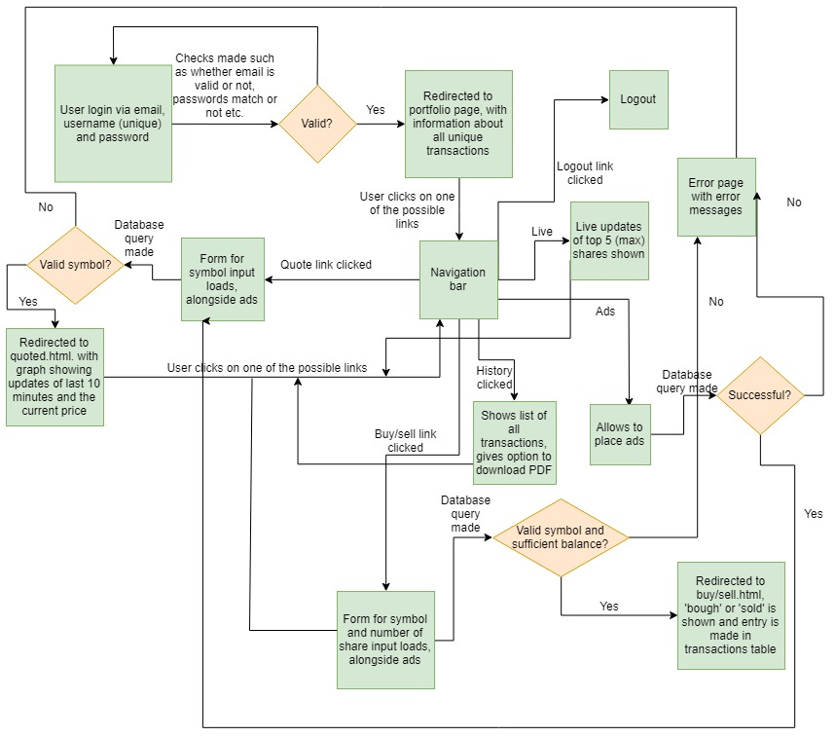
Flow Diagram
Notes:
As it has already been mentioned, the primary code is written in Python. The following flow diagram will better help explain the concepts

Slide 4
symbol | imagesource | alttext | description | link | priority | duration | created
uid | f1 | f2 | f3 | f4 | f5
symbol | price
id | user_id | symbol | shares | price_per_share | created_at
Other Constraints:
priority and duration are integers between 1-10
Username, email fields are unique and hence are candidate keys
Except f1, f2, f3, f4 and f5 all fields are NON-NULL
Schedulers update table 1 and table 3 at intervals of once per hour
id | username | hash | cash | email

Slide 5
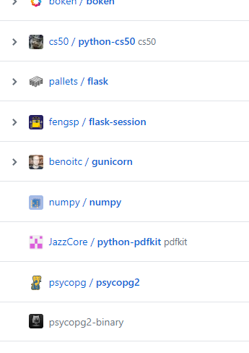
Requirements
The main application is an web-app, which is written in Python and runs on the Flask framework. It uses the SQLite database for data management.
The main libraries used are Flask, Flask-session, numpy and bokeh.
The data needs no special formatting and sanitization is always performed before interaction with the database, ensuring that no SQL injection can take place.
Notes:
Flask is used for backend and also to render the webpages; bokeh is used for visualization of the graphs; numpy is there for matrix calculations and basic linear regression. Other libraries, as shown on the right are used as one-off modules; CS50 to help interact with the database, which in this case is an SQLite instance, pdfkit is used for creating pdf out of html documents, apscheduler for running pieces of the code periodically and so on.

Slide 6
Design, Part 1 (Triggers)
ensureAdSanctity: Used before insert on the ads table. Ensures that the values inserted into the duration and priority field of the advertisement table would be proper integers.
ensureMinBalance: Used before update on users table to ensure that the user has a minimum amount of balance always.
ensureValidEmail: Used before insert into users table to check that the email id is valid.
Notes:
This could also be handled by a CHECK constraint and selecting the domain of the duration to be an integer, but then creating proper error messages would be problematic as it can’t be determined which error caused the insert to fail
We could have also moved this all to application logic, however, and that seems more beneficial in this case as SQLite isn’t that integrated with PL/SQL.

Slide 7
Design, Part 2 (Procedures):
Periodic procedures
Get_ads: Runs every hour to search the database and collects the information about the advertisements submitted till now.
Predict: Deletes the old prediction data and queries alphavantage.co to collect historical data about all unique symbols in the transaction table.
Regress: Runs a linear regression model on the historical data collected from alphavantage.co and stores the predicted price of the share in the database.
Notes:
Get_ads. It also performs other functions such as deleting the advertisements that have outlived their duration period. It also stores them in a file so that multiple queries are not made everytime a page loads and thus makes the process highly optimized, since remote procedure calls/GET requests are even slower than disc I/O.
Predict: Saves all the data in a file called data.json so that regress can make use of it. I have used a model of share price prediction as described in https://www.researchgate.net/publication/259240183_A_Machine_Learning_Model_for_Stock_Market_Prediction, and it has given me pretty accurate results, although that was not the main focus of the project.

Slide 8
Procedures (Continued)
Non-periodic procedures
sendmail: Sends a email
index: Shows the portfolio of stocks
ads: Allows somebody to place an ad on the website.
quote, buy, sell: Allows users to lookup the price of a share, buy a share or sell it, respectively.
addFriend, deleteFriend, messageFriend: Allows users to interact with users designated as friends.
history: Shows list of all transactions.
Live: Shows live updates about the top 5 (max) shares of the user.
Utility methods such as login, logout, change_password etc.
Notes:
Index: Which is a complete listing of all the shares he user has ever bought/sold alongside the predicted prices of shares. Options to buy/sell the shares also exist directly from there.
Friend might be necessary in order to quickly inform somebody of a great deal.
History: Options to download a PDF report of the page exists.
Live: The updates of last 10 minutes, in graphical format are shown. Top is determined in terms of transactions (bought+sold) of a particular share.

Slide 9
Design, Part 3 (SQL):
The SQL involved in this project is minimalistic.
The emphasis was more on a highly efficient relational schema, which is why the SQL statements are mostly insert and update statements, with no complicated triggers/stored procedures clogging up the database.
The unique design feature of statements in this project is its robustness to growth.
Notes:
However, it doesn’t mean it is less important; it signifies that it is used as efficiently as possible and only when necessary.
PL/SQL has obviously not been used since it is not an ORACLE database.
Let’s assume the project grows so much that we need distributed databases and multiple tables to keep track of them all. Even before this application connects to any database, it uses the regional identifier of a person from his location, or guesses/caches it based on the shares he transacts, so it can auto switch databases and cross-query without any intervention from DBMS administrators, if a mapping of zones to transactions is done. The file structure as mentioned in in the files already optimize queries and all relations are in 3NF form, which makes it efficient.

Slide 10
Thank You
Let’s go to the demonstration already, shall we?

