Slide 1
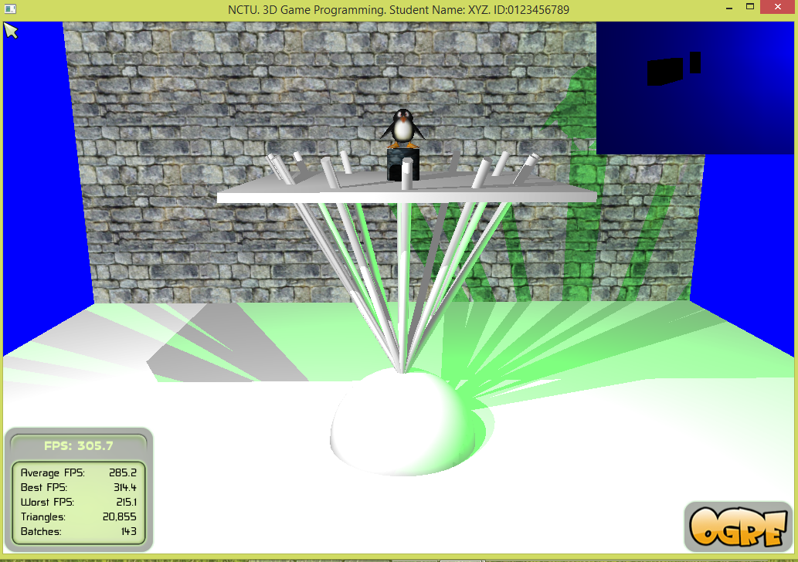
Hierarchy Structure

Slide 2
Submission
Rename the folder to 3DGP_Ex01_StudentID
Zip the folder and upload it to E3

Slide 3
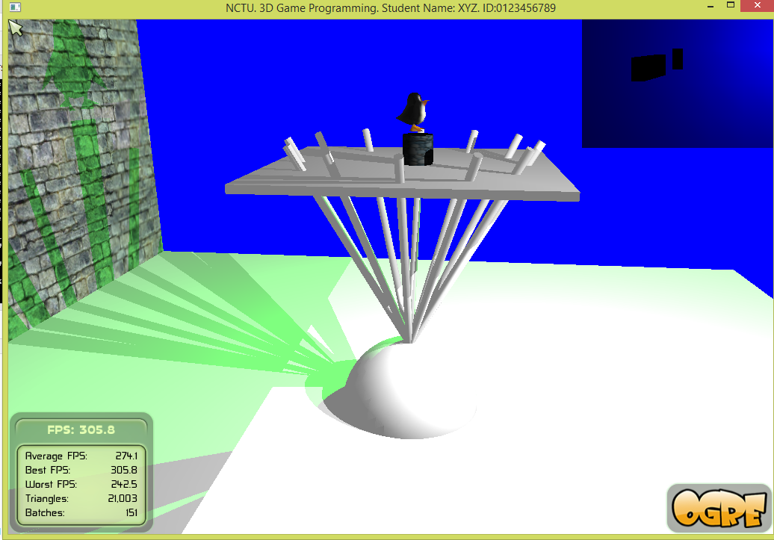
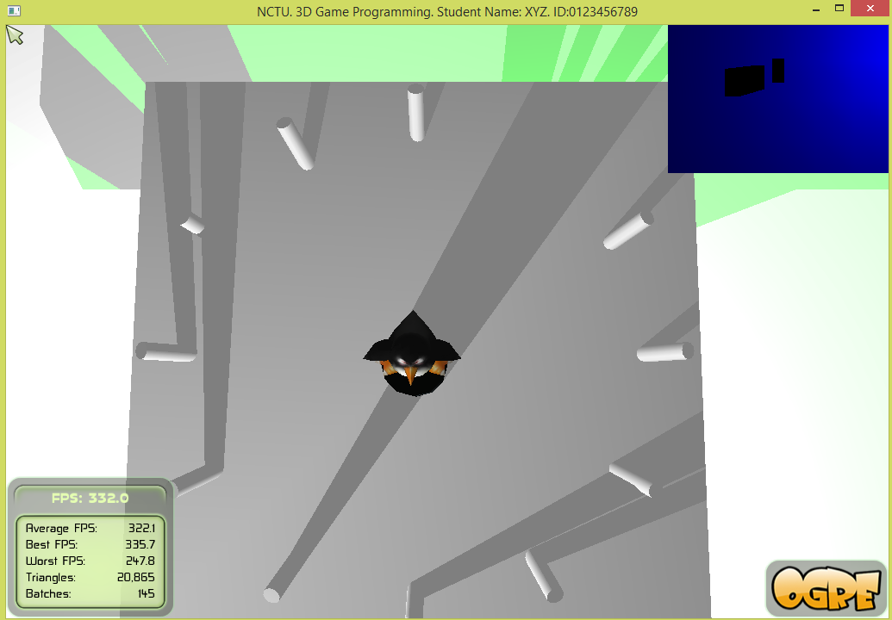
Goal
Build the hierarchical structure
Animate the structure
‘1’
‘2’
‘3’

Slide 4
Tasks
You must use the given template to do this quiz. If not, your score is zero.
Show your student Name and ID on the top bar of the window.
MUST DO or your score is ZERO.
Check
/////////////////////////////
//add your own stuff
/////////////////////////////
Build the hierarchical structure
To create it, modify createHierarchyStructure().
You can add your own methods, data members and so on.

Slide 5
Tasks
You must do something similar to the demo.
1. [10+10%] Press ‘9’, ‘0’ to perform yaw(-a) and yaw(a) to the scene node A, respectively; where a is a positive floating number.
2. [5+5%]Press ‘7’, ‘8’ to perform pitch(-b) and pitch(b) to the scene node C, respectively; where b is a positive floating number.
3. [10%] Limit the rotation of node C inside [-30, 30].
4. [10%] If the same key (‘0’, ‘9’, ‘8’, or ‘7’) are pressed twice, the corresponding action is toggled (i.e., turn on or off based on the current state).
5. [10%] Place the penguin on the upper face of the column C without severe penetration when the penguin is on the upper face.
6. [20%] Animate a penguin up and down in its local frame, i.e., using setPosition. The default mode is TS_LOCAL.
7. [20%] The hierarchical structure is constructed correctly.

Slide 6
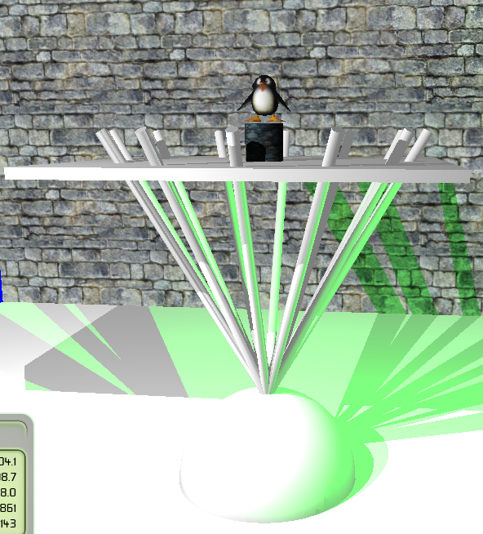
Structure
Penguin moving up and down
scene node C
column.mesh
Node A is the root of the hierarchy. Use node A to create 12 column objects which form a cone structure.
A platform is constructed from a cube mesh.
Place a large column on the top of the platform. Finally, place a penguin on top of the column.
scene node B
Platform. cube.mesh
columns form
a cone structure
scene node A

Slide 7
Enjoy Programming
Show your student Name and ID on the top bar of the window.
MUST DO or your score is ZERO.

Slide 8
How to Build Programs? Do it as usual! But ……
Need the following items
Visual Studio
Platform Toolset: Visual Studio 2010 (v100)
Project Properties
→Configuration Properties
→General
→Platform Toolset
→Select Visual Studio 2010 (vc100)

Slide 9
Hint
Use convertLocalToWorldPosition for a scene node to get world coordinates of a local position.
e.g., localPos = Vector3::ZERO;
globalPos = mPenguinNode->convertLocalToWorldPosition(localPos);

