Slide 1
Space

Slide 2
Note
Our TAs will rebuild your program when they test your program.
You must upload the folder that is self-contained.

Slide 3
Submission
Rename the folder to 3DGP_Ex02_StudentID
Zip the folder and upload it to E3

Slide 4
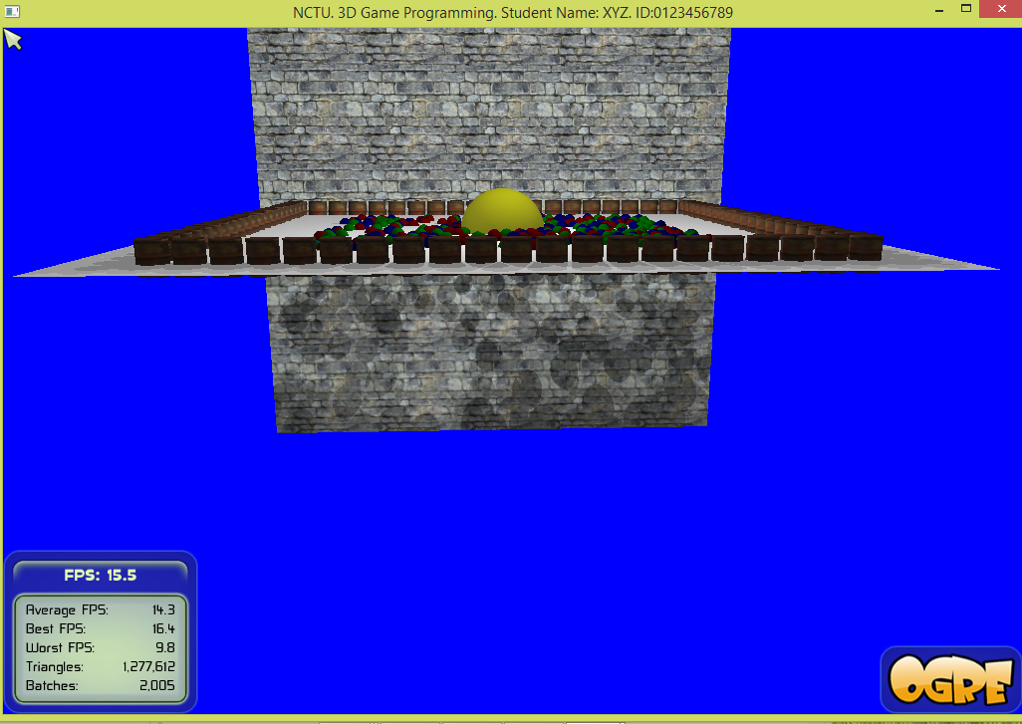
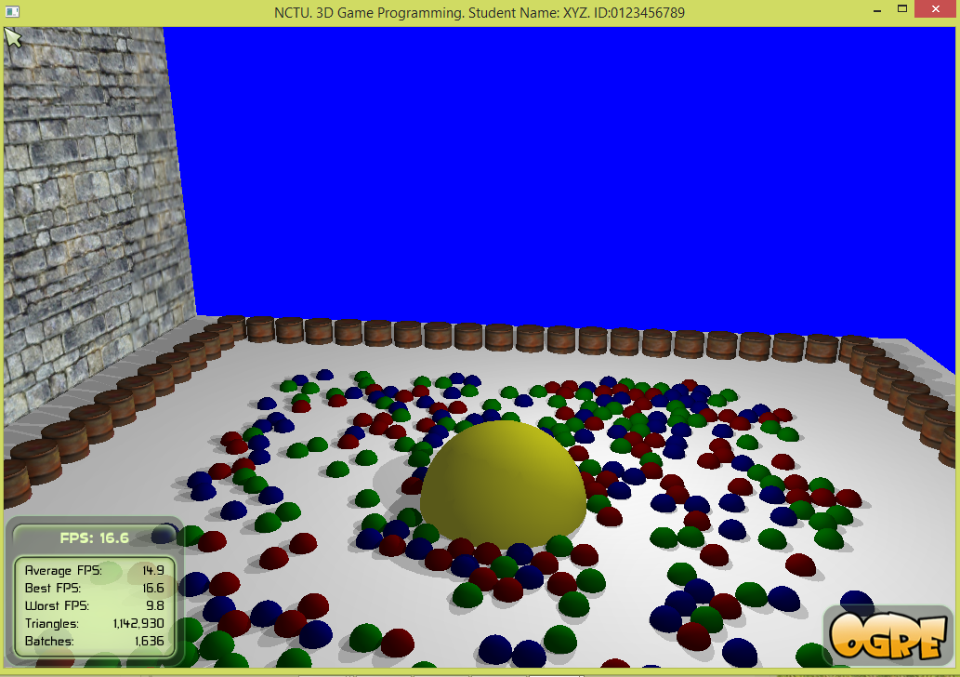
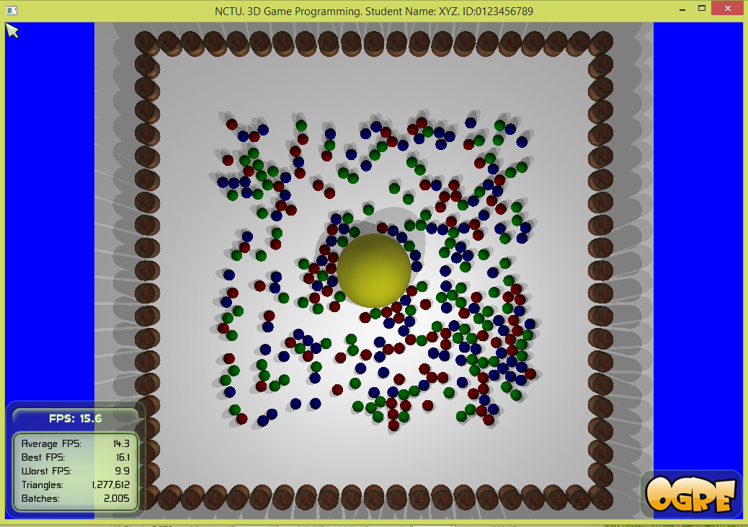
Goal
Build the space with small spheres
Build a wall with barrels
Control a large sphere to move around
‘1’
‘2’
‘3’

Slide 5
Tasks
Show your student Name and ID on the top bar of the window.
MUST DO or your score is ZERO.
Check
/////////////////////////////
//add your own stuff
/////////////////////////////
Build the space. You should use the random number generator.
For example, (rand()%10000.0)/10000.0 returns a floating point number inside [0, 1).

Slide 6
Tasks
You must do something similar to the demo.
[5%] Generate the small spheres inside [-400, 400]x[-400, 400].
[5%] Generate a rectangular wall by barrels
[5%] Randomly assign colors to small spheres: red, green or blue.
[10%] Create a large sphere
[10%] Press ‘u’, ‘j’, ‘h’, and ‘k’: to control the large sphere to move. See demo. The motions of the large sphere and small spheres must be smooth.
[20%] Handle collision between small spheres
[10+10%] Handle collision between the small spheres and the large sphere. The large sphere pushes away small spheres.
[10%] The large sphere must lay inside the region surrounded by barrels.
[10%] Press ‘7’, ‘8’, ‘9’, and ‘0’ to change the number of spheres to 100, 200, 300, 500, respectively.
[3+2%] Press ‘b’ to reset all the spheres.

Slide 7
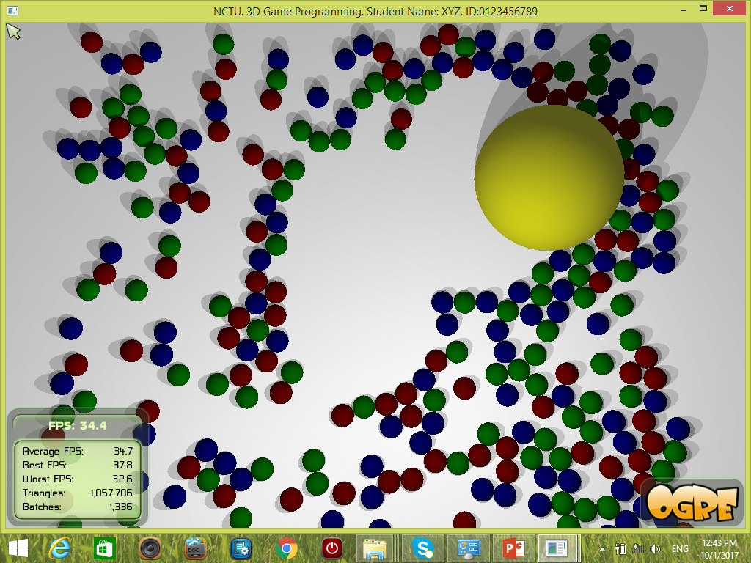
Space

Slide 8
Hints
The hints are not solution. They give you some insights about the problems that you want to handle.

Slide 9
Circle-circle collision handling
The circles move along the direction of the center points.
Make sure to normalize the direction
E.g., Vector3 n = p0 – p1;
If (n.length()!=0.0)
n.normalize();

Slide 10
Some important functions
resolveCollision( SceneNode *nodeA, SceneNode *nodeB,
float rA, float rB, float wA, float wB)
resolveCollisionLargeSphere()
resolveCollisionSmallSpheres()
resolveCollision()
reset()
createSpace()

Slide 11
Barrels
int offset = mNumSpheres;
mNumObstacles = 80;
for (int i = 0; i < mNumObstacles; ++i ) {
int index = i+offset;
genNameUsingIndex("R1", index, name_en);
genNameUsingIndex("S1", index, name_sn);
mEntity[index] = mSceneMgr
->createEntity( name_en, "Barrel.mesh" );
mSceneNode[index] = mSceneMgr
->getRootSceneNode()
->createChildSceneNode(
name_sn);
mSceneNode[index]->scale(10.0, 10., 10.0);
mSceneNode[index]->attachObject(mEntity[index]);
}

Slide 12
First wall
float r_obs = 28.0; // barrel radius
float d_gap = 30.0;
for (int i = 0; i < 20; ++i) {
int index = i+offset;
float x = -600.0+2*d_gap;
float y = 10.0;
float z = -600.0;
x += 2*d_gap*i;
mSceneNode[index]->setPosition(x,y,z);
}

Slide 13
Second wall
offset += 20;
for (int i = 0; i < 20; ++i) {
int index = i+offset;
float x = -600.0;
float y = 10.0;
float z = 600.0;
x += 2*d_gap*i;
mSceneNode[index]->setPosition(x,y,z);
}

Slide 14
View 1
mCameraMan->getCamera()
->setPosition(Vector3(-77.89, 169.11, 1996.70));
mCameraMan->getCamera()
->setDirection(Vector3(0.05, -0.25, -0.97));

Slide 15
View 3
mCameraMan->getCamera()
->setPosition(Vector3(-0.0, 1608.68, 0.0));
mCameraMan->getCamera()->lookAt(0.0, 0.0, -0.01);

Slide 16
Enjoy Programming
Show your student Name and ID on the top bar of the window.
MUST DO or your score is ZERO.

Slide 17
How to Build Programs? Do it as usual! But ……
Need the following items
Visual Studio
Platform Toolset: Visual Studio 2010 (v100)
Project Properties
→Configuration Properties
→General
→Platform Toolset
→Select Visual Studio 2010 (vc100)

