Slide 1
Data Science Final Presentation
eBay eProduct Visual Search Challenge
Andres Ponce
彭思安

Slide 2
Introduction
Visual search is the problem of finding similar images using the semantic contents of an image rather than a text query.

Slide 3


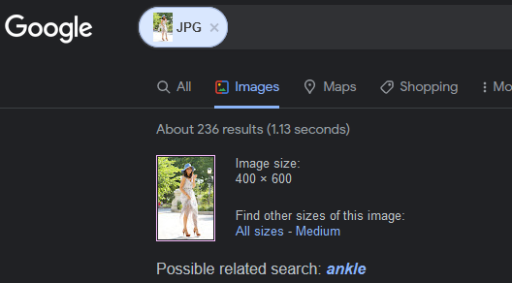
Motivation
Personal inexperience in visual search.
Utility in e-commerce platforms for recommendations, data aggregation, etc…
Using text can lead to poor results

Slide 4
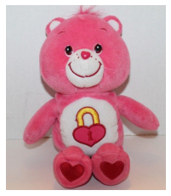
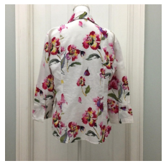
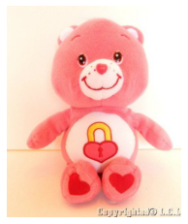

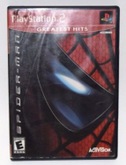
Competition
Given a set of query images, find images of the same products in a large image index set.
Query Image
Index Set

Slide 5
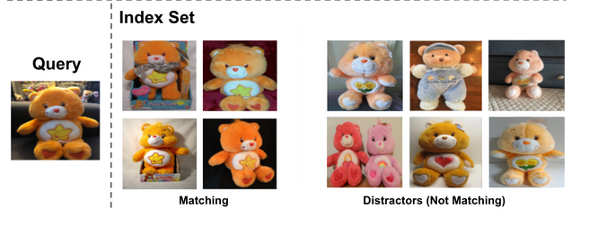
Competition
Training set contains 1.3 million images with hierarchical class labels.
16 meta classes
77 level2 classes
1000 leaf classes
Evaluation set contains 1.1 million image index set and 5,000 query images.
Different images than training.

Slide 6

Approach
General approach
Use a deep network to obtain embedding for a query image $z$.
Deep Hierarchical Classification
Compare $z$ with index set images via some nearest-neighbor procedure.
Locality Sensitive Hashing

Slide 7
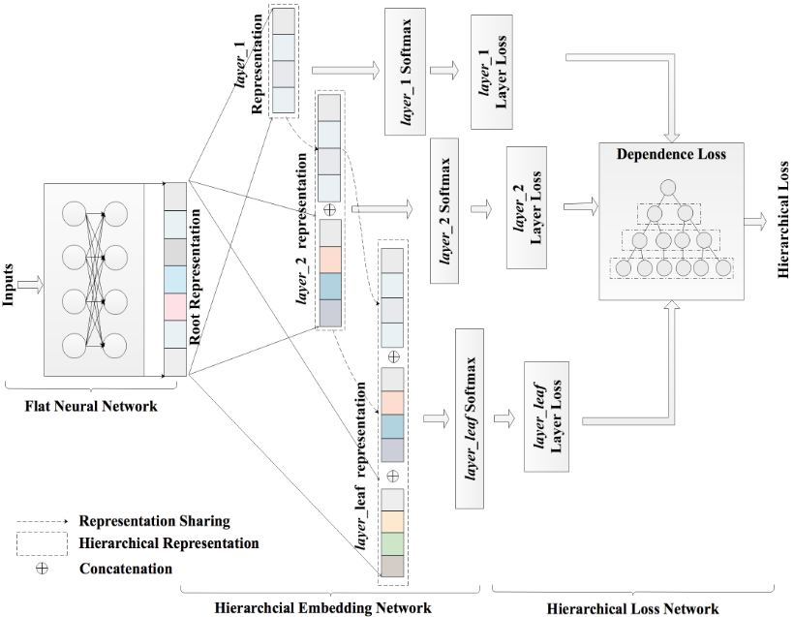
Approach – Deep Hierarchical Classification
Settled on Deep Hierarchical Classification.
Incorporates hierarchical information during training.
Seemed better suited for e-commerce scenario.

Slide 8
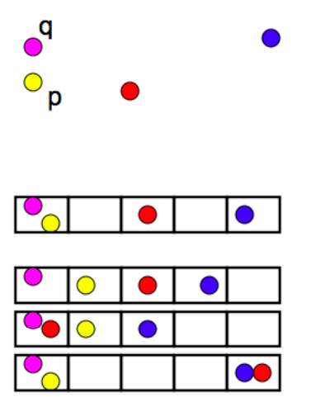
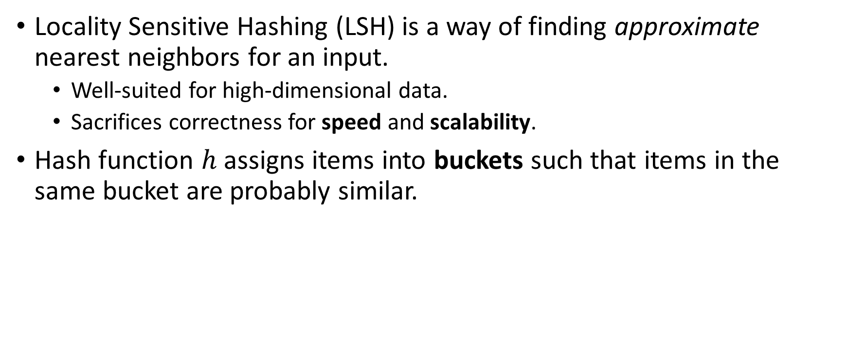
Approach – Locality Sensitive Hashing
Locality Sensitive Hashing (LSH) is a way of finding approximate nearest neighbors for an input.
Well-suited for high-dimensional data.
Sacrifices correctness for speed and scalability.
Hash function $h$ assigns items into buckets such that items in the same bucket are probably similar.

Slide 9
Training & Experiments
We train a ResNet50 to predict meta, level 2, leaf class in training set.
With the trained model, we obtain the embeddings of the index set images and store them in our hash table.
Have many smaller hash tables due to memory constraint.
Adds much delay to inference time.
During evaluation, we query hash table for closest matches to query image embedding.

Slide 10
Results
Quite low – 3% mAR@10
How many images we predicted are correct.
We believe a couple reasons:
DHC might not scale to large datasets.
Hierarchical labels during training might not be as important.
Cutoff for “identical” products hard to determine.

Slide 11
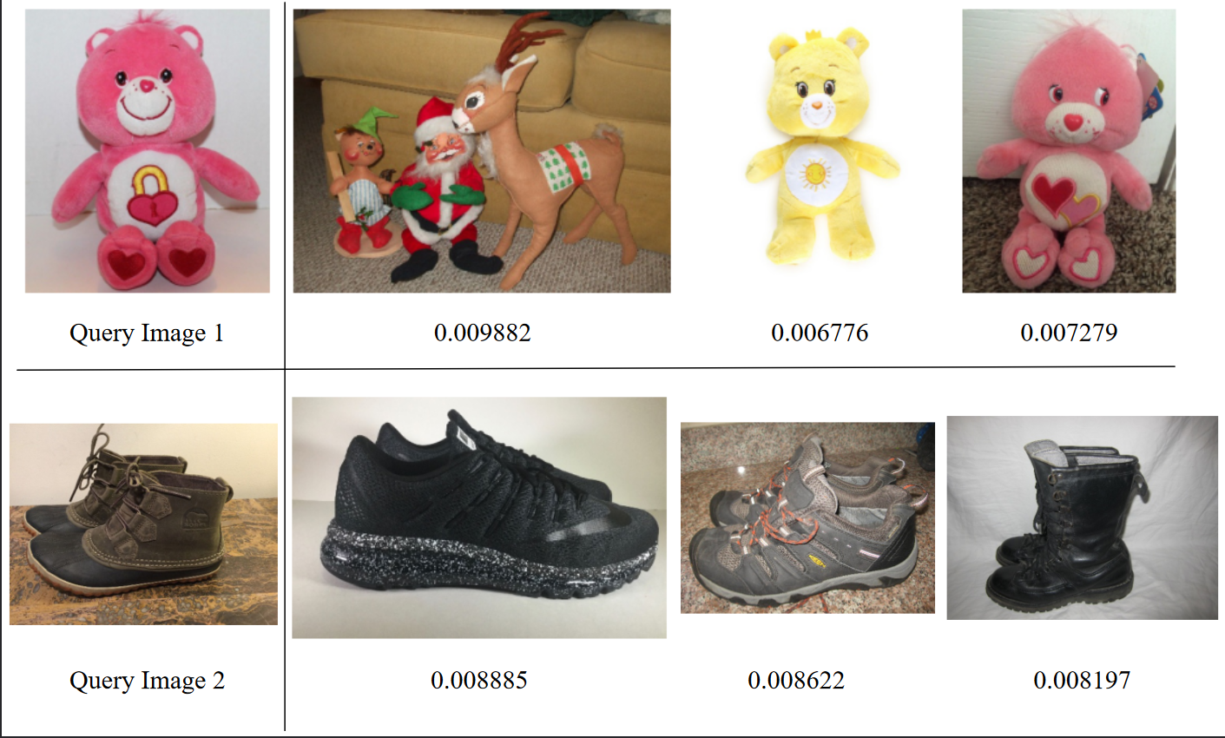
Results
Model works as a general image classifier
Cannot distinguish between fine-grained differences in images.
Sometimes slightly different products have very low distance.

Slide 12
Conclusions
We learned about visual search, its challenges, and utility in e-commerce platforms.
Visual search tougher because of small differences in products.
Searching through large index set resource intensive.

